Slide 1
WXG-4 Visual Disc Rotating Light Instrument(LED Lamp)
Main technical parameters]
Instrument model | WXG-4
Measurement Mode | Optical rotation
Instrument light source(optional) | Sodium Lamp+Color Filter,Wavelength 589nm/LED Lamp, Wavelength 589nm
Measuring range | ±180°
Graduation Plate Grid Value | 1°
Graduation Plate Vernier Reading Value | 0.05°
Magnifying Glass Magnification | 4×
Test Tube Length | 100mm/200mm Ordinary Type
Power Supply | 220V±22V,50Hz±1Hz
Instrument size | 540mm×220mm×380mm
Instrument net weight | 5kg

Slide 2
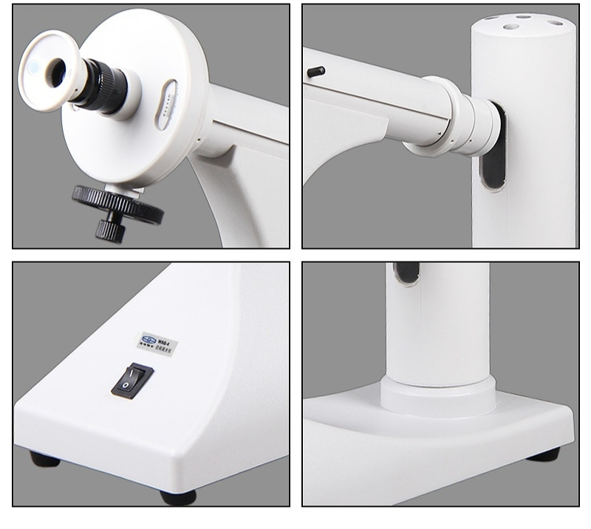

Slide 3
