Slide 1
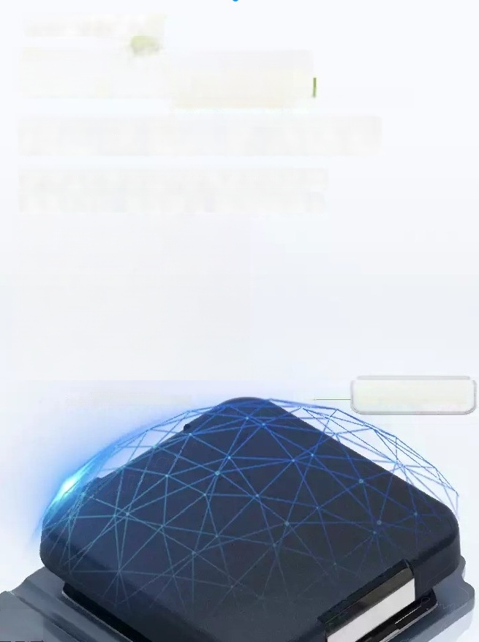
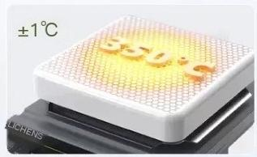

'Temperature servo
Servo temperature controf drive technology
Precision dial,anti-corrosion and scratch resistant
lsostatic pressure graphite surfaceOspecial fluorine anti-corrosion coating;
Aerospace materials,uniform temperature control(limited to ICS MSA HDI)
CNC precision carving O nano ceramic coating Excellent temperature control
LCS-MSA-H,LCS-MSA-HD
teflon coating

Slide 2
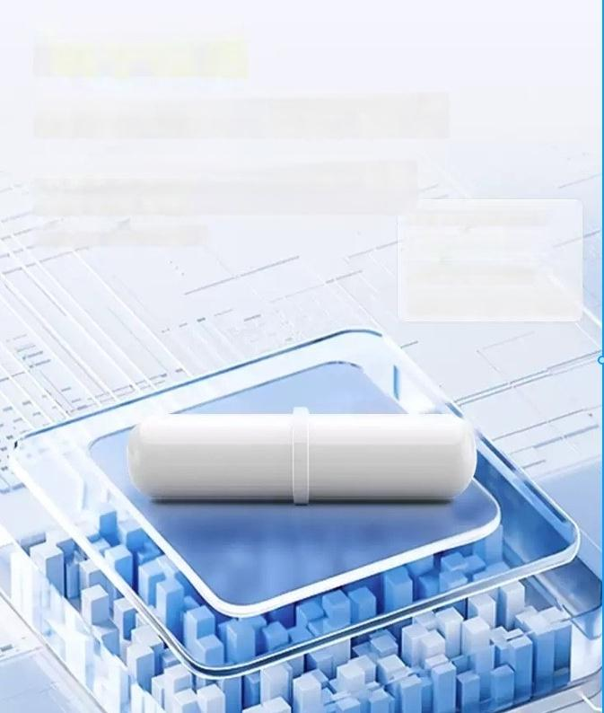
Jumping detection
」
Intelligent monitoring to prevent jumping
Ensure sufficient suction,effectively prevent jumping phenomenon,and achieve significant mixing effect.
*Limit LCS-MS-HDI
Automatic detection during jumping
And stop rotating;
After the mixer returns to its position,
Reduce 100rpm before restarting

Slide 3
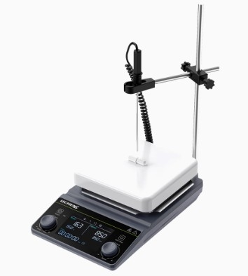

Slide 4
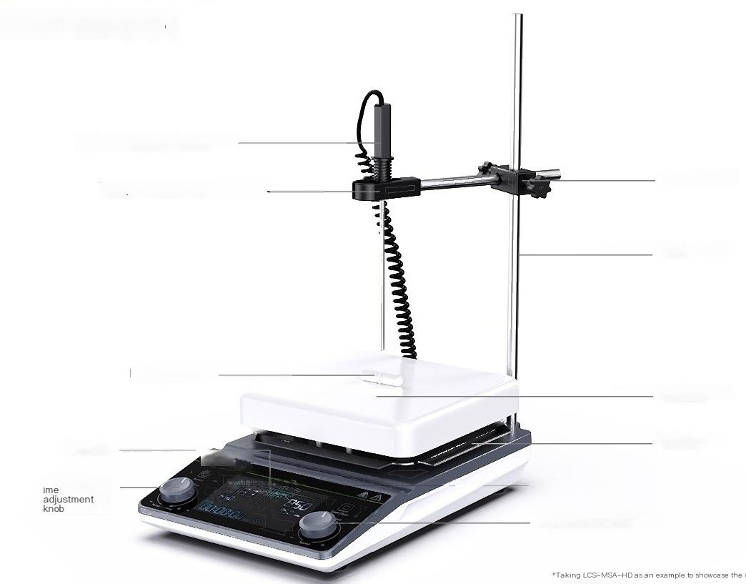
A magnetic stirrer
MSA-HD series
PT1000 temperature sensor
Temperature sensor bracket
Magnetic stirrer
display
Temperature/t
Cross clamp
Vertical pole
Heating plate
Heat shield
Speed adjustment knob

Slide 5
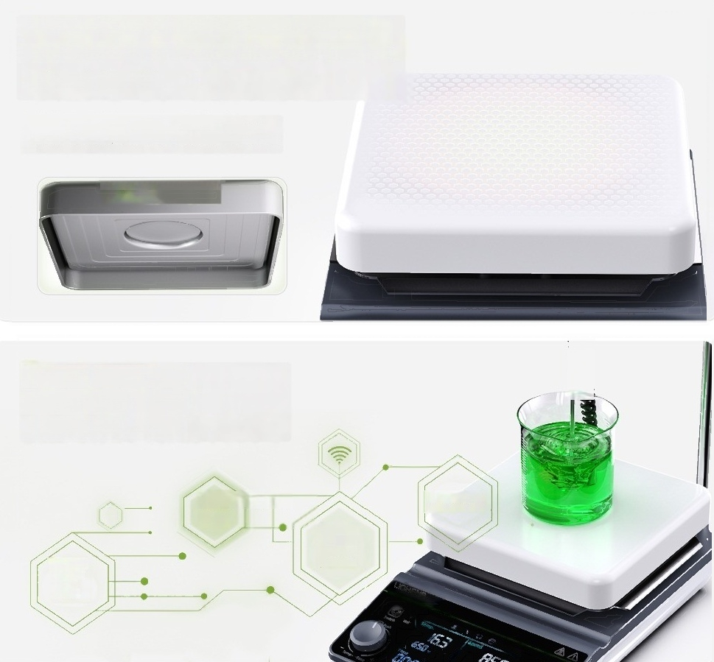
CNC precision aluminum disc+ceramic coating
with uniform thermal conductivity,anti-corrosion
and scratch resistance
Solid fully covered aluminum plate,fast heating,
accurate temperature control,ceramic coating more
nt.
CNC precIsion aluminum disc
Intelligent control
collaboration improves
mixing efficiency
Remote control
corrosion-resistant,scratch resistant and wear-resista
B
Reversible
Parame ter
memor y
Six stage program mable control

Slide 6
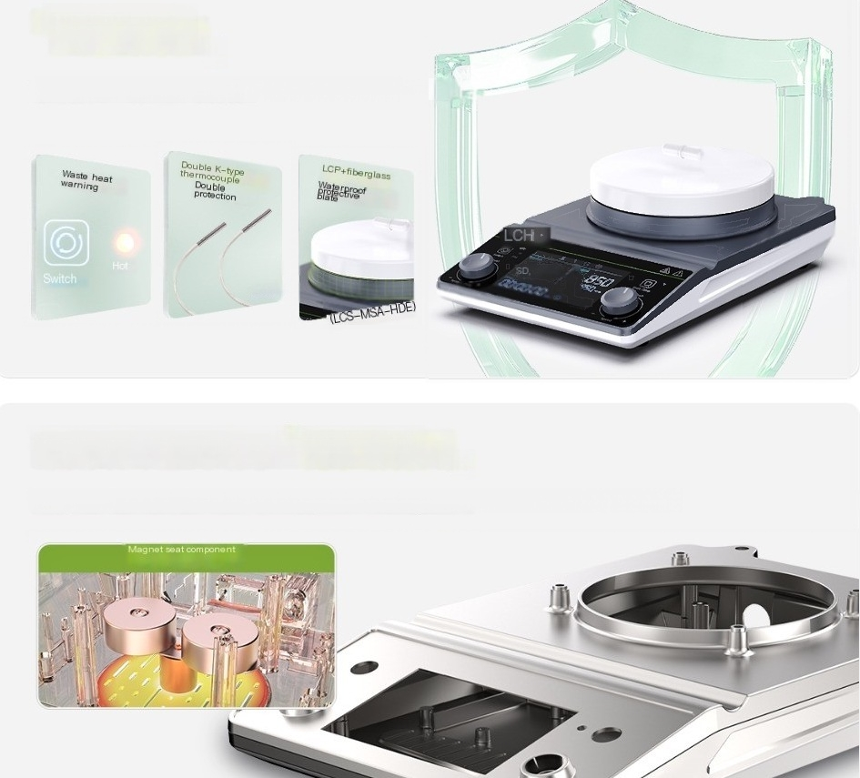
Safety protection
」
Waste heat warning,dual over temperature protection
(Internal)
Magnesium aluminum alloy body is stable and durable
」
Using rare earth(samarium cobalt)magnet seat components(limited to LCS-MSA-HDE)

Slide 7
model | LCS-MSA-D |  | LCS-MSA-H | LCS-MSA-HD | LCS-MSA-HDE
Display mode | LCD display screen not have ^{LCD} ^{display} ^{screen} LCD display screen
Motor type | brushless dc motor |  | brushless dc motor | brushless dc moto | r brushless dc motc
speed range | 50~2000rpm |  | 50~2000rpm | 50~2000rpm | 50~2000rpm
Speed control accu | racy ±10rpm |  | / | ±10rpm | ±2%(unloaded 1500rpm)
Forward and reverse r function | otation have |  | / | have | have
time range | 1~99h59min |  | / | 1~99h59min | 1~99h59min
Temperature | range / |  | RT~350℃ | RT~350℃ | Disk surface:RT-330℃ Sample:RT-200℃
precision | / |  | / | Disk surface:±1℃Solution: RT~100℃,+0.2℃ ;≥100℃,±1% | Disk surface:≤100℃,± 3℃ Solution:50 ℃,±0.5 ℃
Maximum mixing c (H2O) | apacity 20L |  | 20L | 20L | 15L
Workdisk material | lntegrated cast aluminum+ceramic corrosion-resistant coating | CNC precision carving process a carving process aluminum disc+ coating ceramic corrosion-resist |  | luminum disc+CNC precision ceramic corrosion-resistant ant coating | lntegrated cast aluminum+ceramic corrosion-resistant coating
Size of work ar | ea 170X170mm 170X170mm |  |  | 170X170mm | 150mm

Slide 8

_{function} ^{t}r able | / | 6-stage | 6-stage programmable control and skip detection
data interface / | / | RS232 | RS232
AC220V 50Hz 50W | AC220V 50Hz 950W | AC220V 50Hz 950W | AC220V 50Hz 800W
net weight 2.6kg | 3.2kg | 3.2kg | 2.5kg
Product size
290X188X85mm 290X | 188X95mm 290X188X95mm | 308X190X87mm
(LXWXH)
-s
a
e
programmable
rog
a
m
control
control
supply voltage
power

Slide 9



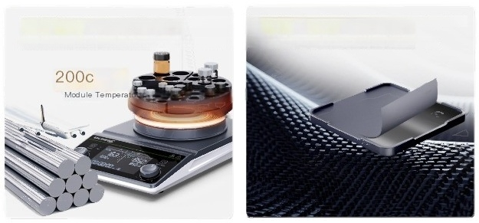
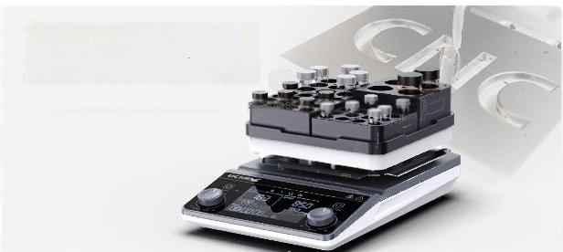
Magnetic stirer heating module (optional accessory)
^{Round} ^{bottom} ^{flask} ^{heating} ^{module} Fan shaped heating module Square heating module
Volume:50-1000ml
Hole diameter:15.2-28.5mm
Hole diameter:12.2-28.5mm
*For more module selection,please contact customer service
Exollent thermal conductivity of aviation aluminum materials Hard "black scale"anti-corrosion and scratch resistant High mechanical strength and excellent thermal conductivity Hard oxide coating,over 200h salt spray test
CNC precision carving of alloy with excellent accuracy and stable nesting
CNC precision carving,excellent precision,

Slide 10

A magnetic stirrer
MSA-HDI series
PT1000 temperature sensor
Temperature sensor bracket
Vertical pole
Magnetic stirrer
Heating plate
Cross clamp
display
Temperature/t ^{i}amd ustment
knob
Heat shield
Speed adjustment knob
UCHENS

Slide 11
mo⁰aI LCS-MSA-HD
Display mode | LCD display screen
Motor type | brushless dc motor
speed range | 50~1500rpm
Speed control acc | uracy Soil 2%(unloaded,1500rpm)
Fonward and rev | erse rotation function ^{have}
ime range | 1~99h59min
Temperature r | ange RT~380℃
precision | Disk surface:≤100℃,±3℃
Maximum mixin | g capacity 20L
Workdisk materi | _{al} sostatic pressure graphite+Teflon anti-corrosion coating
Size of work area | 170x170mm
Magnetic specific | ations and dimensions B-type 10*40mm
function | 6-segment programming,RS232 data interface,skip detection
supply voltage | AC220V 50Hz
power | 950W
net weight | 3.2kg
Product size
290X188X90mm

Slide 12
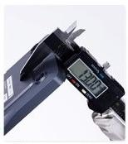
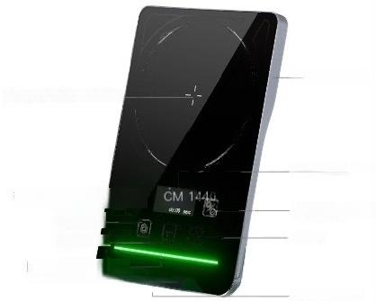
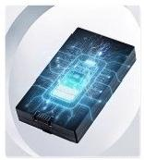
Ultra thin magnetic stirrer
MST series
SNG upinum
OLED LCD screen
B8bton/start Set key
power interface
Tempered glass worktable
Function kev/cn 圈
Reduce k
Hri ^{LCHENS}
13mm ultra-thin body
3-hour portable lithium battery

Slide 13
model | LCS-MST-1P
Display mode | OLED display screen
Maximum mixing capa | city(H,O)L IL
鼎 a n d | C-type 07*20mm(used above 700rpm)+B-type 08*30(used below 700rpr
control mode | Click+swipe
Motor type/driving mode | Magnetic Coils
speed range | 15~1500rpm
time range | Run:1~99min59s,0 normally open Forward and reverse:20-99 secon
Work disk | Matarial:Tempered Size:Medium 100mm
Housing materia | aluminum alloy
supply voltage | Input 110~240V,output 5V2A/lithium battery 50/60HZ
net weight | 0.35kg
Product size(LXWXH) | 169*109*13mm

