Slide 1
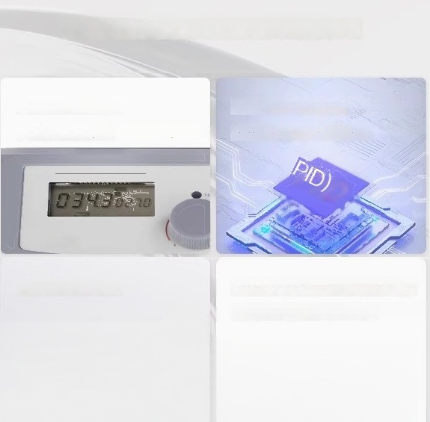
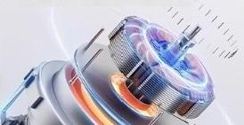
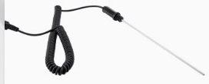
Excellent magnetic stirring performance of DC brushless motor
LCD digital display
Real time temperature and speed
Embedded PID Control
Equipped with over temperature protection(580℃)
IPwwar
box
brushless dc motor
Explosion proof,maintenance free,long lifespan
Can be equipped with PT1000 temperature sensor
Improve temperature control accuracy
to±0.2℃

Slide 2

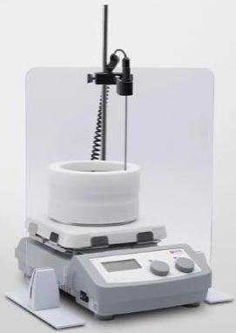
7-inch LCD CNC heated type
Digital display of real-time temperature and rotational speed
Glass ceramic heating panel
Adjust the speed and temperature by tuming the knob.
Over-temperature
protection function
Numerical control speed regulation
Thermalwarning function
The maximum heating temperature is 550℃
Brushless DC motor
Compatiblewith temperature
sensor
"Thessadsplsy modelory,forrekerence ory.The actusl product detaks are stbjectto the pyicalitem

Slide 3
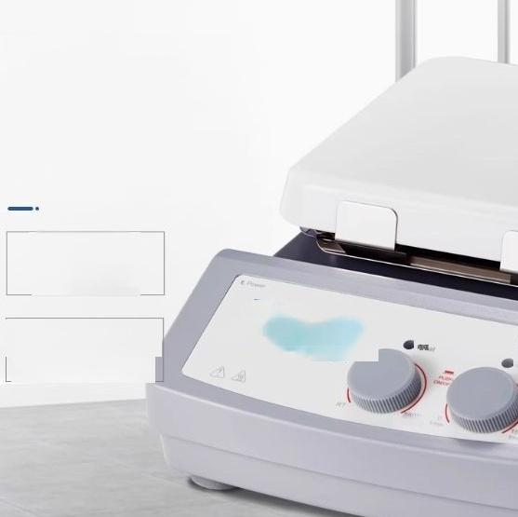
LCD Liquid Crystal Display Screen
Control the heating temperature and rotational speed
Control of rotational speed of brushless DC
motor
Control heating temperature and speed brushless DC motor control speed
High-temperature
residual heat
warningfunction
at 50℃
Glassceramic surface is
resistant to high
temperature and corrosion.

Slide 4
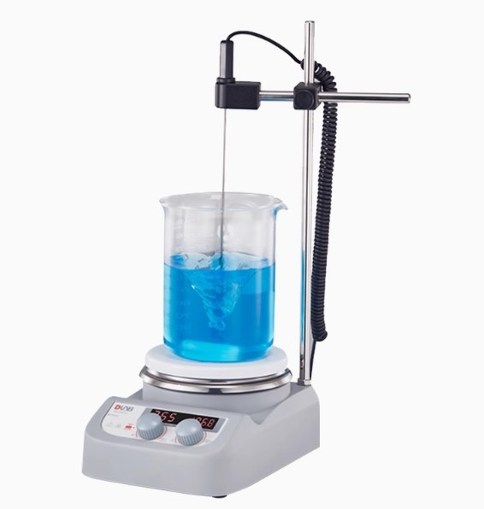

Slide 5

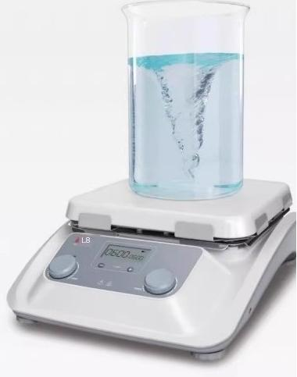
MS10-H500-Pro
10 inch ceramio disc surface
LCD CNC Heating Magnetic Stirrer
Characteristics and
advantages
·Large capacity magneti stiring:With strong stiring foree and a 10 inch oversized disc,the maximum liquid volume that can be stired is 30L
·High performance:The ceramic glass disc surface is resistant to high temperatures and has excellent chemical corosion resistance.
Acourato tmporatun antrol LCDdisplgvu the sot tomporatureand actul nample tomporaturo,and can bo connectod to an oxternal tomporature sonsor PT1000 with a tomperature control acouracy of±072C.
·Wide speed range:100-1500rpm.
Heating temperature:room temperature-500℃
·After shutdown,if the temperature of the working disk exceeds 50℃,the warning light will continue to flash to ensure safe operation.
·Data transmisson:SD cards can also record real-time instrument operation data.
·Timer function:It can set the running time of the instrument

Slide 6

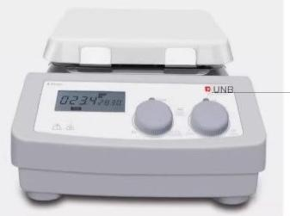
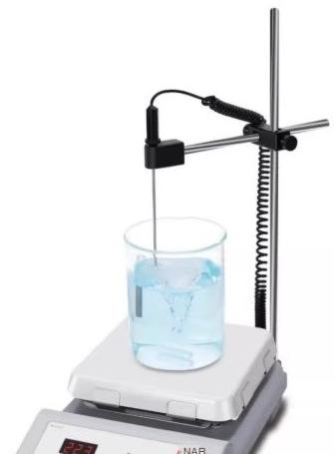
MS7-H550-Pro
7-inch ceramic disc LCD CNC
heating magnetic stirrer
MS7-H550-S
7-inch ceramic disc surface
LED digital heating magnetic stirrer
Characteristics and
advantages
Digital display of real-time temperature and speed,Embedded PID control with over temperature protection function to ensure safe heating
-The maximum heating temperature can reach 550℃
:s ceramic heating panel is corrosion-resistantand easy to
-Extermal PT1000 temperature sensor can be connected to improve temperature contro accuracy to±0.2℃
-Numerical contro speed regulation,maximum speed 1500rpm
·Powerful DC brushless motor
RRBg8nient adjustment of speed and temperature through two-When the residual temperature of the heating panel exoeeds 50℃,even if it is turned off,the screen will flash and displaya high temperature warning
-Remote control and data saving can be achieved by connecting toa computer through the R232 interface.

Slide 7
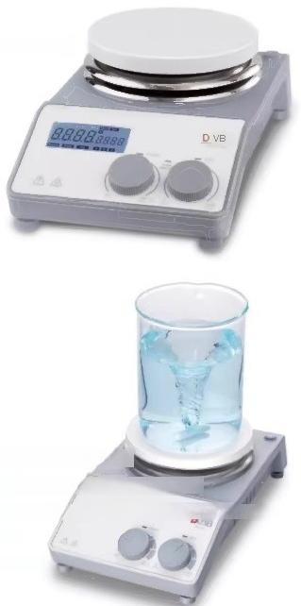
MS-H-PROA
LCD CNC Heating Magnetic Stirrer
Three heating modes can be switched (fast heating,standard heating,and smooth heating)
MS-H-ProT
LCD CNC timed heating magnetic stirrer
MS-H-S
Standard heating type magnetic stirrer
Characteristics and advantages
Configure DC brushless motor,explosion-proofmaintenance free
Digital temperature control,with a maximum temperature of 340℃
The maximum speed can reach 1500rpm
The maximum stiring capacity (H2O)can reach 20L
Flexible timing,ranging from 1 hour to 99 hours and 59 minutes lonly applicable to MS-H-Pro mode
High definition LCD dsplay simultaneously shows actual temperature and speed(MS-H-Pro models alsodytme)
Extermal emperature senaor PT1000 can be used to accurately contol the ample temperature,yih atomperature control acurac 02℃
Stainless steel ceramic coated working disc highly resistant to chemical corrosion
Equipped with remote control function,can connect to a computer and transmit data
·There are multiple attachments that are compatible
·
.
·
·
.
.
.
.
·
·

Slide 8
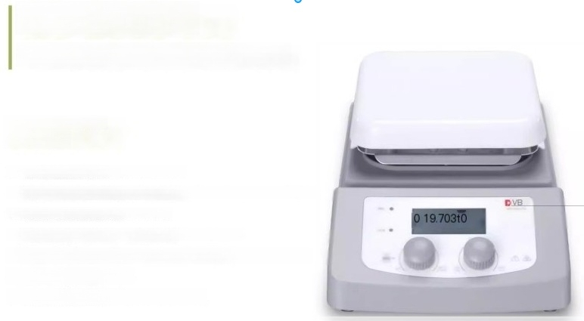
MS-H380-Pro
LCD CNC Heating Magnetic Stirrer
Characteristics and
advantages
·The maximum heating temperature is 380℃
·High definition LCD display screen shows real-time temperature and speed
·Maintenance free brushless DC motor
.Ceramic coated aluminum alloy disc,fast heating speed
·External PT1000 temperature sensor,plug and play,easy to operate
·Maximum speed 1500rpm
.The maximum mixing volume [water]is 5L

Slide 9
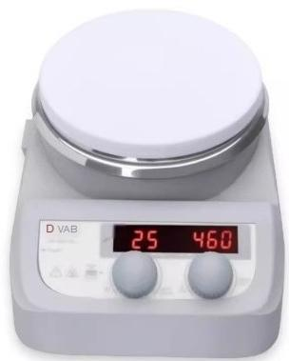
MS-H280-Pro
LED digital display heating type
magnetic stirrer
MS-H280 Pro isa low-temperature magnetic stirer with a maximum heating
temperature of 280 ℃,which can perfectly handle daily small volume liquid
Characteristics and advantages
·Digital temperature control,with a maximum temperature of 280℃;
·Numerical control speed regulation,with a maximum speed of up to 1500rpm;
Stainless steel ceramic coated working disc is highly resistant to chemical corrosion; Extemal temperature sensor PT1000 can be used to accurataly control the
sample temperature,with a temperature control accuracy of±0.2℃
·LED display screen simutaneously displays temperature and speed;
Residual temperature warning When the temperature of the panel exceeds 50
Residual temperature warning: When the temperature of the panel exceeds 50 ℃ after stopping heating (even if the power is turned off), a warning of overheating of the panel temperature will still appear to protect the safety of the operator;
·The maximum mixing volume [water]is 3L

Slide 10
Mainly used in fields such as chemical synthesis, physical and chemical analysis, and biopharmaceuticals.
Characteristics and
advantages
·Four heating plates with independent temperature and speed control, independent display
·LCD display screen simultaneously shows actual temperature and speed
·PID temperature control technology provides real-time and precise control over the heating process, with a maximum temperature of 340 ℃
·DC brushless motor has low noise, high reliability, maintenance free, and good speed control
·External temperature sensor PT1000 can be used to accurately control the sample temperature, with an accuracy of ± 0.2 ℃
·Automatically activate overheat protection at 420 ℃
·Stainless steel ceramic coated working disc highly resistant to chemical corrosion
·There are multiple attachments that are compatible
Technical Paramet | MS-H340-S4
Working Size | 0135mm(5 inches)x4
Disk material | Ceramic coated stainless steel dis
Motor type | brushless dc motor
Number of mixing points | 4
Maximum mixing volume[water] | 10Lx4
Maximum size of agitator [len^{gth]} | 40mm
speed range | 200-1500rpm
Speed display | LCD
TEMPERATURE DISPLAY | LCD
Speed control aocuracy | ±20rpm
Heating temperature range | 25-340℃
Overheat protection | 420℃
Temperature display aocuracy | +0.1℃
External temperature sensor | PT1000(accuracy soil 0.2C)
degrees of protection provided by enclosure | IP21
motor input power | 1.8Wx4
power | 515Wx4
Thermal output power | 500Wx4
power supply | 100-120,60Hz;200-240V,50Hz
Size [length x width x heig^{ht]} | 898x270x128mm
weight | 9.5kg
Environmental temperature and humidity | 5-40℃,80%RH

Slide 11


Technical Paramet | MS-H-S10
Work disk size [length xwidth | 180x450mm
Disk materia | Aluminum disk surface
Motor type | brushless dc motor
Number of mixing points | 10
Maximum mixing volume [water] | 0.4Lx10
Maximum size of the mixer [length] | 40mm
speed range | 0-1100rpm
Speed display | scale
TEMPERATURE DISPLAY | scale
Heating temperature rang | Room temperature-120℃
Overheat protection | 140℃
degrees of protection provided by enclosure | IP21
motor input power | 12W
Motor output power | 4W
power | 490W
Thermal output power | 470W
power supply | 100-120/200-240V.50/60Hz
Size [length x width x height] | 182X622X65mm
weight | 3.2kg
Environmental temperature | and humidity 5-40℃,80%RH
Characteristics and
advantages
·DC brushless motor,maintenance free,capable of long-term continuous operation,strong
power
·Maximum speed 1100rpm
The maximum heating temperature of the work panel is 120
·Aluminum laser engraving surface,anti slip.
corrosion-resistant,wear-resistant,with good
heating uniformity
non-slip
Multiple stirring points
brushless do motor

Slide 12
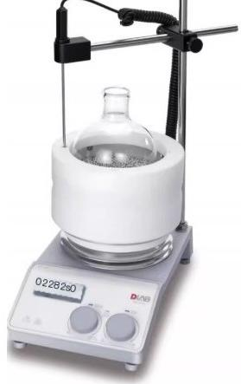
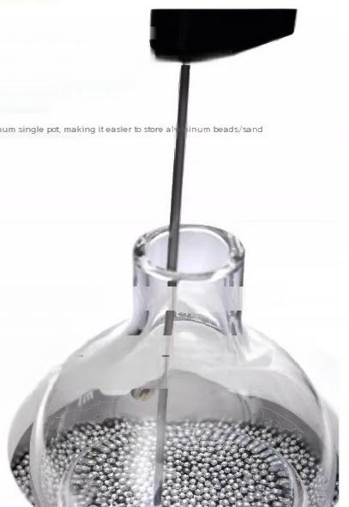
Temperature control tips
The metal sand bath can be used in conjunction with the entire series of magnetic stirrers from Dalong
It is recommended to place the external temperature sensor in the metal sand through
the probe hole and adjust the height to between 1/2and 1/3of the distance from the
top of the metal sand,which can achieve more accurate sample temperature control
effect
·Suggest heating temperature not exceeding 280℃
Configuration
information
-500mL and 1000mL metal sand bath modules are o ional;
·The 1.5mm metal bead is a regular spherical shape with atter fludh
-The 3mm metal sand is irregular in shape,and even if it falls on the tabletop of the test bench,it will not roll
freely,making iteasy to maintain;
Metal sand bath
Characteristics and
advantages
·The metal andis madeof hah-tengthaluminum alo,wihexclent themalconducthiy andave un temeee ane
Flexible combination of containers in various shapes,easy and convenient to operate;
·The module s equiped with extemal pobe holes,which can be fixed without a bracket to achieve pecise mperature conrol extemaly,
Environmentally friendly,non-toxic,smoke free,odorless,and pollution-free;
·High safety,eliminating silicone oil splashing during oil bath
Flammable and explosive safety hazards;
PTFE outer shell can effectively maintain insulation;
·More uniform temperature while avoiding bums to protect personal safety;

Slide 13

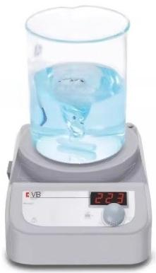
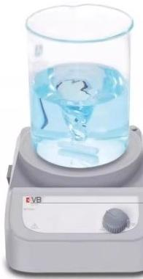
Characteristics and advantages
·Numerical ontro speed
·The maximum mixing capacity
·LED display speed(Ms PA)
regulation,speed range0-1500pm
of water is 3L
Technical Parameter | MS-PA | MS-PB
Work disk size | 0135mm(5 inches) | 0135mm (5 inches)
Disk material | Nylon+GF | Nylon+GF
Motor type | brushless dc motor | brushless dc motor
Number of mixing points | 1
Maximum mixing capacity [H20 | 3L | 3L
Maximum length of agitator | 50mm | 50mm
speed range | 200-1500rpm | 0~1500rpm
Speed display | LED | scale
degrees of protection provided by enclosure | IP42 | IP42
motor input power | 5W | 5W
Motor output power | 3W | 3W
power | 15W | 10W
power supply | 100-120/200-240V,50/60Hz | 100-120/200-240V,50/60Hz
Size [length x width x height] | 150x260x80mm | 150x260x80mm
weight | 1.8kg | 1.8kg
Environmental temperature and humidity | 5-40℃,80%RH | 5-40℃,80%RH

Slide 14
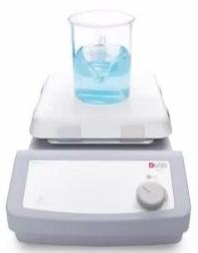
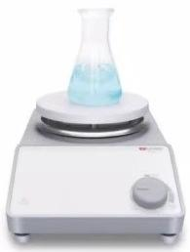
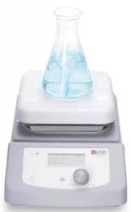
MS-S A magnetic stirrer MS7-S 7-inch square disk magnetio stirrer Speed range 0-1500rpm .The maximum mixing capacity of wateris 10L .Ceramic worktable is highly resistant to chemical corrosion | MS6-Pro LCD CNC magnetic stirrer ·High definition LCD display screen shows real-time rotational speed -Maintenance free brushless DC motor mic coatad aluminum alloy disc surface,corosion-resistantand easy to -Numerical control speed regulation,up to 1500rpm Maximum mixing volume 5L
MS7-S
MS-S
MS6-Pro
—

Slide 15
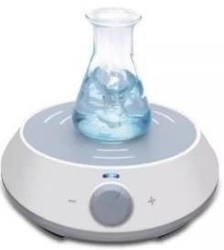
EcoStir
Economic magnetic stirrer
EooStir isa magnetic stirrer specially designed for liquid mixing functions,suitable for fields
such as chemical analysis,biological reagent mixing,routine experiments,liquid processing.
Characteristics and
advantages
·DC brushless motor maintenance free;
·Rare earth magnets enhance stirring force;
·Stepless speed regulation 300-2000rpm;
·UItra quiet,no vibration;
PET coating is highly resistant to chemical corrosion;
-The bracket is suitable for pH sensors or sensors for other purposes

Slide 16
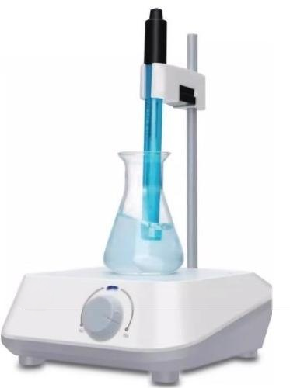
EcoStir
Economic square disk magnetic stirrer
The economical square disk magnetic stirrer is designed to be reliable,with strong sirring and equipped with electrode supports,making itan ideal tool for electroche mical measurement in applications such as water quality and environmental monitor ing.drug and food analysis,liquid culture,ete.It can also be used for home brewing. sobering up,mother and bacterial fermentation,etc.
Characteristics and advantages
.Compact structure,small footprint,can be powered by a 12V power supply for mobile laboratories
·Square work surface,maximum mixing capacity 1.5L
A bracket with clips can fix pH meter electrodes or other sensors
·The standard PET coated panel has good chemical resistance
·Can support users to customize color printing panels
·Maintenance free DC brushless motor
·An economical,reliable,and durable choice

