Slide 1
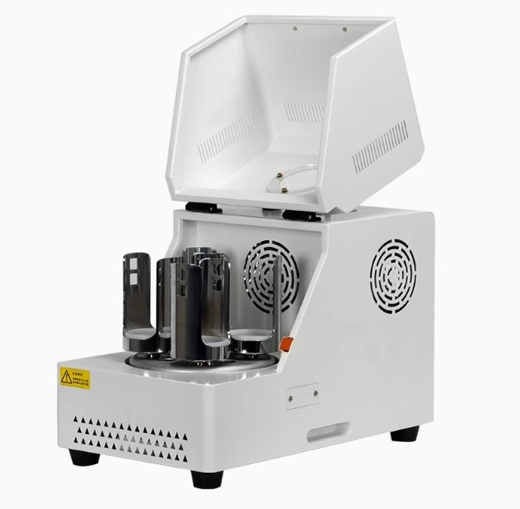

Slide 2






Featured Features
Digital tube display
intelligent control
Equipped with a visual window
Mult sample processing
Timed shutdown
Simple operation

Slide 3
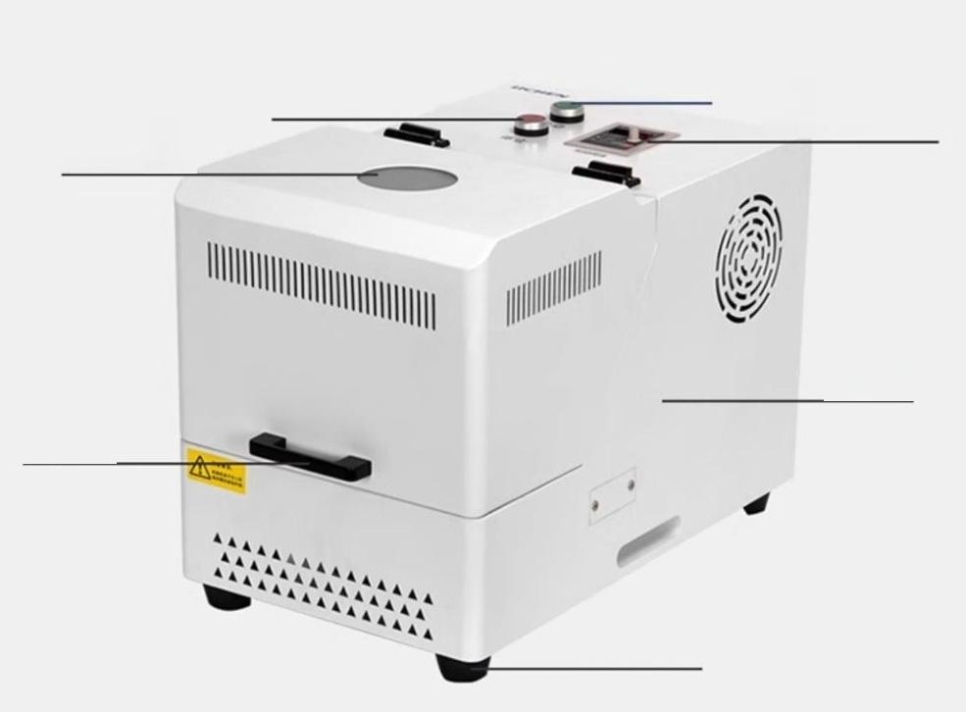
Power
Stop button button
Control Panel
Visible
window
Body of the
aircraft
Pull handle
Foot mat

Slide 4
Model number | Ic-pbm-0.41 | LC-PBM-6L | LC-PBM-12L
Input power supply | 220v/50hz
Rated Power(KW) | 0.75 | 1.5
Rotationalspeed (RPM/min) | 35-435. | 35-335. | 35-290.
Rotation speed (RPM/min) | 70-870. | 70-670. | 70-580.
Total running time(min) | 0-3600.
Display mode | LED digital tube
Display content | Voltage,rotational speed,frequency,current
Sampling particle size (um) | 0.1
Ball mill tank capacity (in mj | 50-100. | 250-1500. | 500-3000.
Ballmilltank station | 4 | 4 | E
Processing capacity (ml) | Undernormalcircumstances,the ratio of ballsto materialsin the ball millshould be asclose to 1:las possible,and the totalvolumeof the balls and materialsshould beno lessthan1/3of the totalvolume of the ball mill,and no more than 2/3of the totalvolume of the ball mill.
Grinding method | Dry grinding/Wet grinding
Net weight(kg) | 33 | 93 | 186
Product dimensions (cm) | 53×30×37 | 77×50×58岁 | 90×60×64
Note:The ball milltankis an optional item.For details,please contact the customer service.

Slide 5
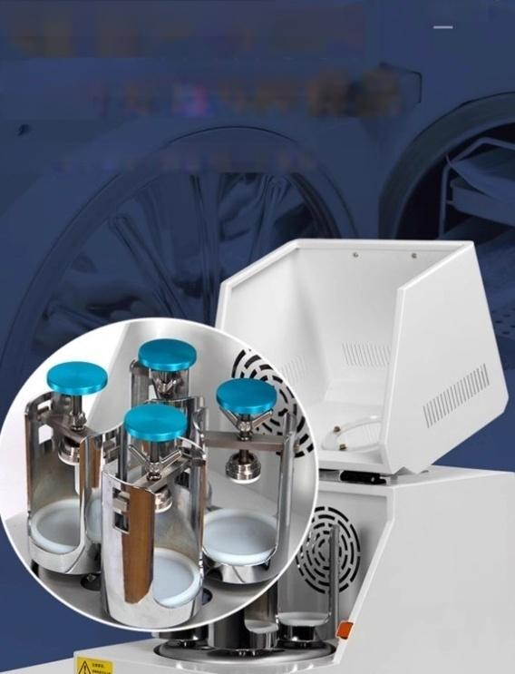

4 cans with high grinding efficiency
Simultaneously process 4 types of samples
There are 4 grinding can holders on the work disk,which is highly efficient

Slide 6
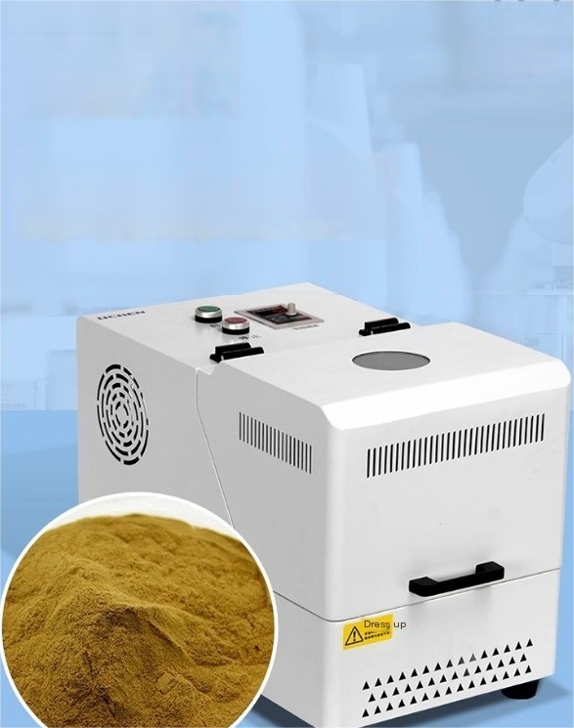
Stable rotation
speed and meticulou
s grinding
The grinding process is carried out in a fuly enclosed ball mill jar to avoid cross contamination and improve grinding efficiency.The minimum particle size of the
ground product can reach 0.1 microns

Slide 7
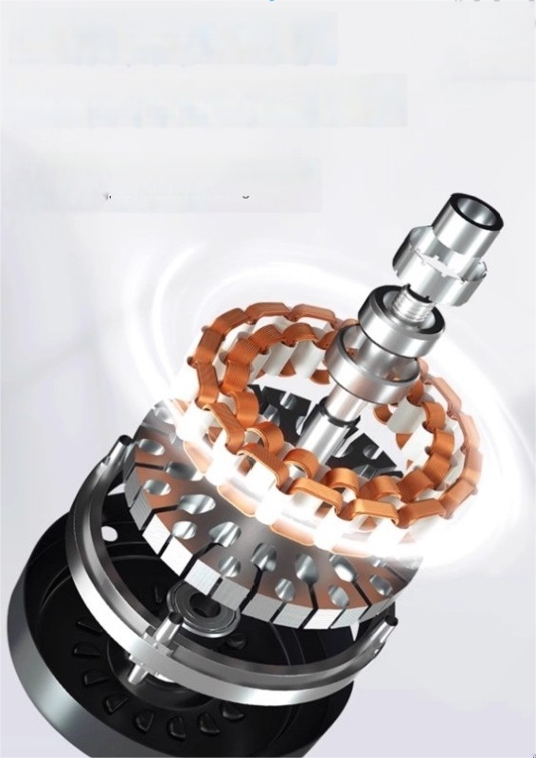
three phase asynchronous Motor
Variable frequency speed regulation has low energy consumption
Adopting three-phase asynchronous motor,
variable frequency speed regulation has low
energy consumption and a wide range of

Slide 8
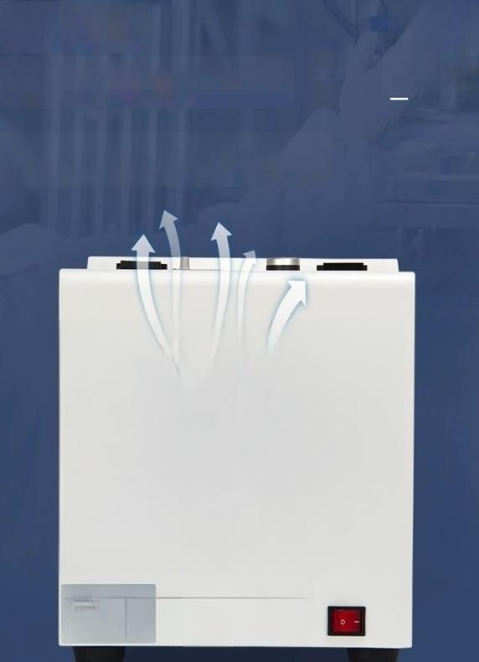

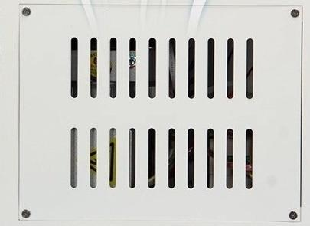


Heat dissipation
hole
Easy to dissipate heat from the
motor
#
Facilitate motor
Motor cooling
The appearance adopts sheet metal spray coating,with heat dissipation holes on the back for easy motor heat dissipation and extended service life
N
P5c
48
aP
Linear ball machine
7
4 Le
怒

Slide 9

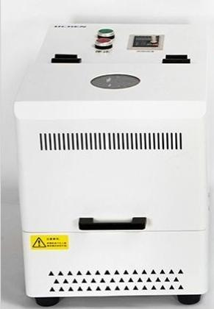

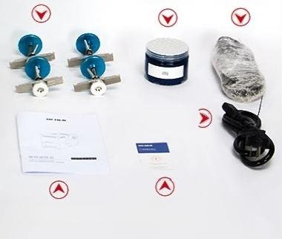
Packinglist display
lc-pbm-0.4l
Host machine
Lubricating
grease
Power cord
Certificate of Conformity, User Manual Warranty Card
Clamping device
Drive belt

