Slide 1
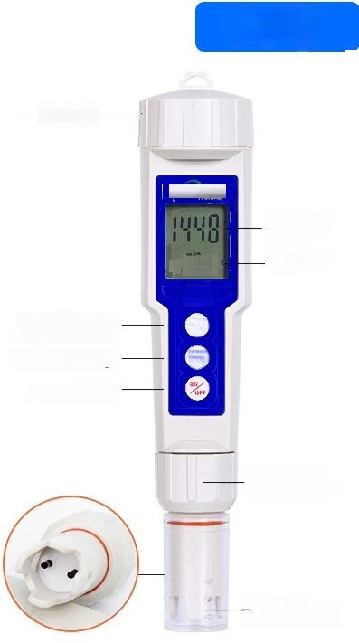
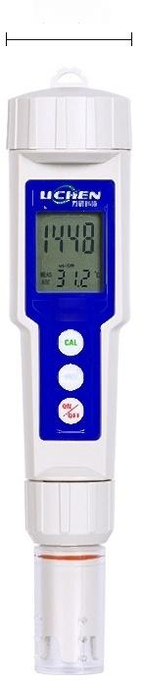
Size
Battery compartment —
3.7cm
CT-2
meter
MOLD
CAL calibration key Data Hold Key ON/OFF key | UCHEN 3 12 CT-2 meter CAL MOLD | Measured value Temperature value
延站
18.7cm
Electrode fixing ring
Electrode
protection cap
Platinum black
^{electrode} *All the above data are measured manually

Slide 2

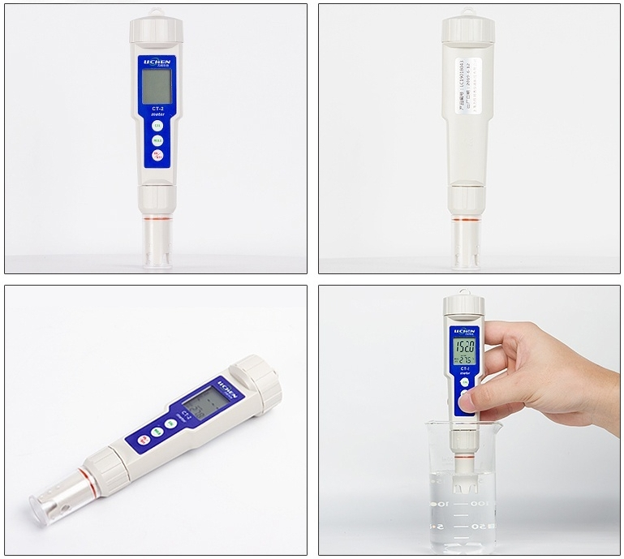
Real shot

Slide 3
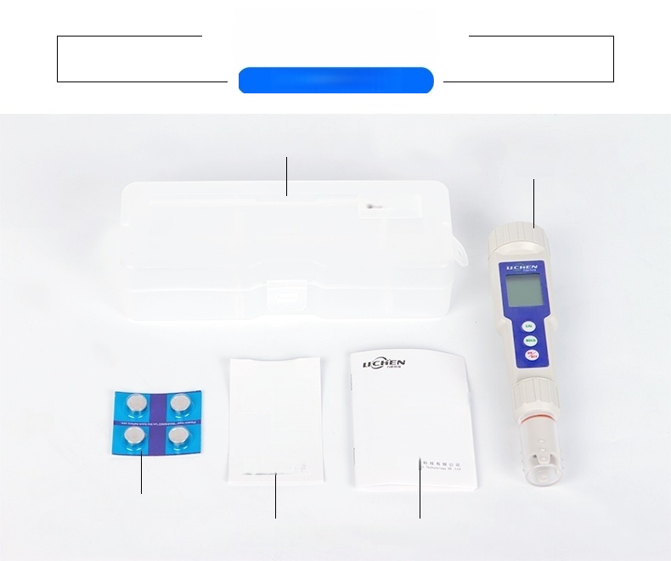

Detailed list
Shelter protective case
Host
na
III1
EA8 再 填 相 注
CT-2
ete
ucK
Product quality
certificate.
本 户 严 热 给 ， 就 原 量 作 曲 胜术要求，釉验治修，准平出厂。
Pen-type conductivity meter/TDS pen
User manual
力 附 西
1
,
9
|
上 0 力 照
Batteries(4 pieces)
Quality certificate User manual

Slide 4
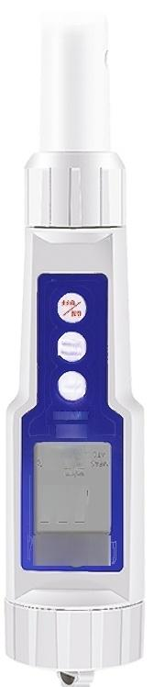
l
moM
IV3
J01eu
Z-10
h02
LE2
NDn

Slide 5

Technical Parameters
Parameter
Model | CT-2 | CT-20 | TDS-1 | TDS-10
Measuring range | 0~2000us/cm | 0~20.00ms/cm | 0~1000ppm | 0~9999ppm
Resolution | lus/cm | 0.01ms/cm | 1ppm
Measurement | ±2%FS |  | ±2%FS
Aecuracy Screen Display | Conductivity+Temperature Dual Display |  | TDS+Temperature Dual Display
Automatic calibration | 84us/cm 1413us/cm | 1413us/cm 12.88ms/cm | 40.38ppm 744.7ppm | 744.7ppm 7447ppm
Working temperature | 0-60℃(32-140°F)
Automatic shutdown | 10 minutes
Battery | 1.5V Battery(LR44)X4 Pcs
Size | φ40×185mm
Weight | 88g

Slide 6


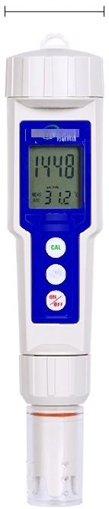
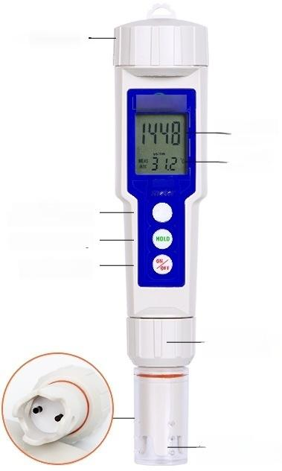
Product specification
3.7cm
UCHEN
CT-2
meter
NOLD
Battery compartment—
uCHEN
Measured value
Temperature value
CT-2
CAL
calibration key
Data Hold Key
ON/OFF key
Electrode
fixing ring
Electrode
protection cap
CAL
8.7cm
Platinum Black
Electrode
(The picture shows CT-2)
*All the above data are measured manually

Slide 7
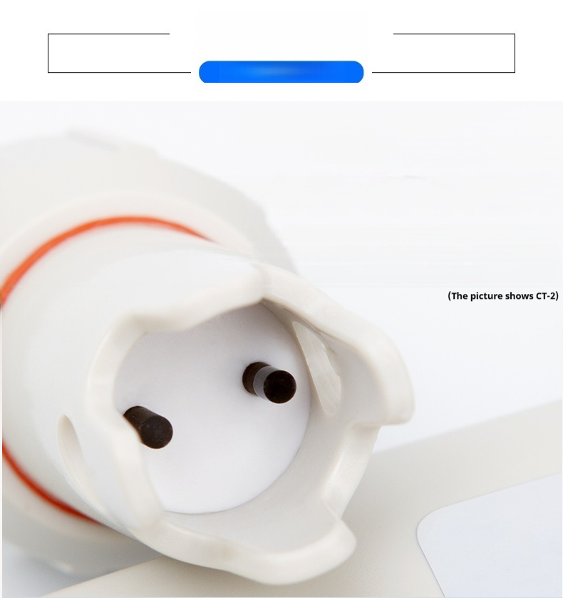
Characteristic
High-efficiency platinum black electrode
Electrode with replaceable design
Platinum surface electroplating treatment,increases activity and surface area
High-sensitivity platinum black electrode,more accurate measurement
Electrodeis replaceable,easier maintenance

Slide 8
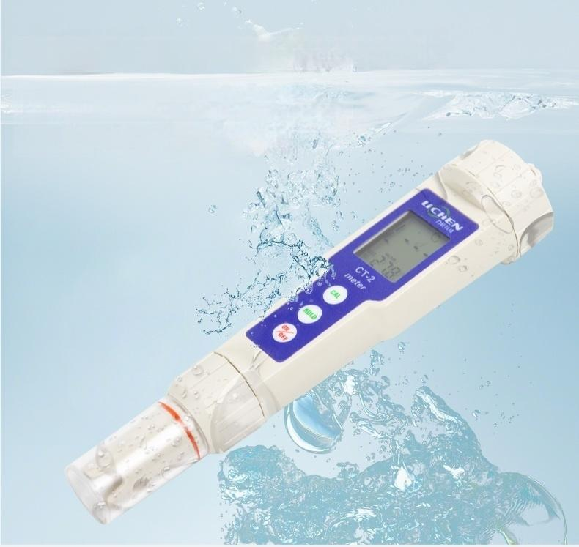
Built-in buoyancy,fully waterproof design
IP67 waterproof level,can be fully submerged
underwater at 5 meters depth,built-in buoyancy design, so that after the conductivity meter falls into the water Can float and be retrieved quickly,no need to worry about falling into
water and losing it

Slide 9
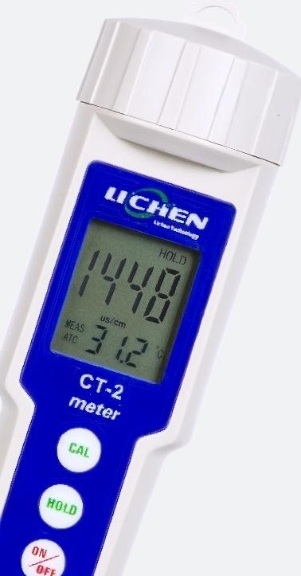
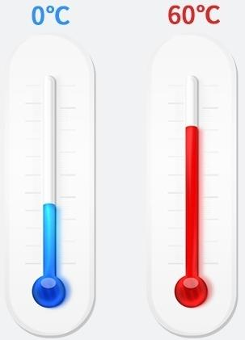
Automatic temperature compensation
Temperature unit conversion
Instrument automatically corrects detection Error caused by temperature,temperature units C/F can be converted freely
Temperature compensation range 0℃ to 60°℃

Slide 10
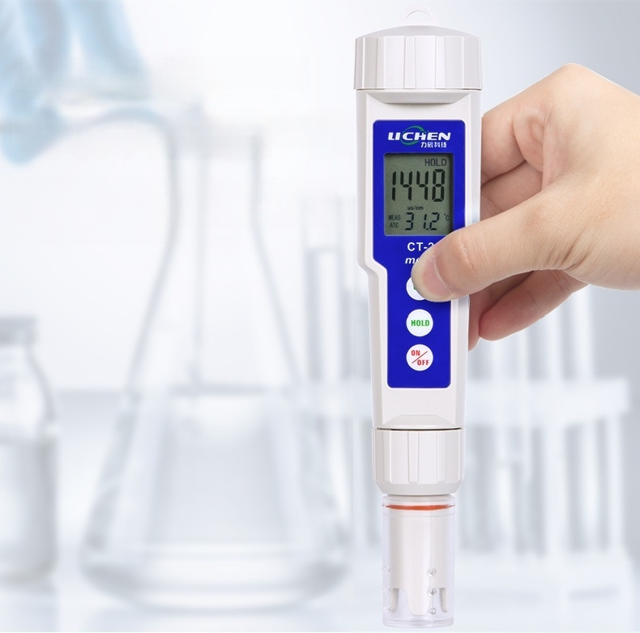
Automatic calibration,
Automatic buffer recognition
The instrument has the function of automatically
identifying the standard buffer solution.It is
simple and efficient to automatically calibrate the
instrument with one key.

Slide 11
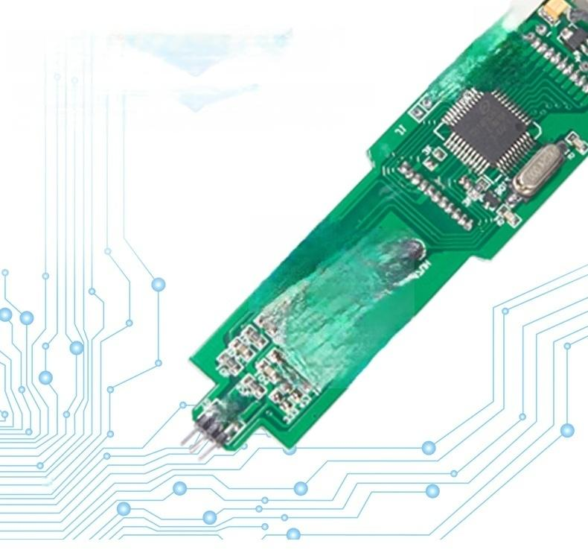
RAM integrated chipset
Dual-channel standard,RAM chipset,high computing speed Capable of sensing nanoamp-level current,accurately measuring conductivity values
FnCT-A_Ur.5
^{rnC1-} m 强重

Slide 12


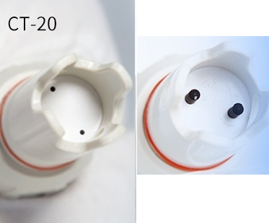
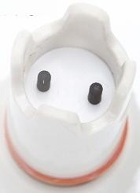
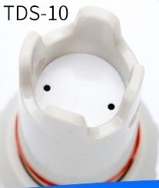
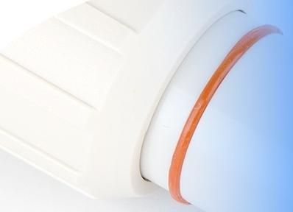
Product details
^{CT-2} Conductivity
Meter Platinum Black Electrode
High Sensitivity Platinum Black Electrode, More Accurate Measurement Surface Plating Treatment,Increases Activity and Surface
TSMC Electrode Can Be Replaced,Easier Maintenance
TDS-1
TDS
Platinum Black Electrode
High-sensitivity platinum black electrode,more
accurate measurement,surface plating
treatment,increased activity and surface area, replaceable electrode for easier maintenance
Sealing ring
Fully Waterproof Rubber Ring Design IP67 Waterproof Level
Sealing Rings on All Connection Parts

Slide 13

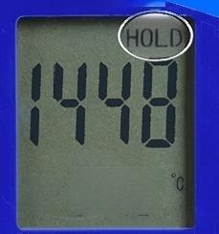
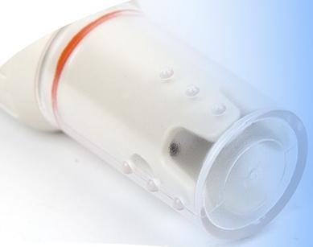
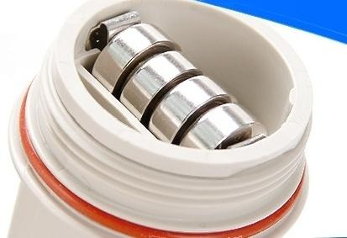
LED LCD
Temperature/conductivity dual digital LED wide-angle LCD display technology,intuitive and clear readings.
Data hold function
Press the"HOLD"button to lock the current data,the "HOLD"symbol willappear on the screen,press the
"HOLD"button again to unlock the mode.
Lichen
us/cm
31.2
MEAS
ATC
Electrode protection cap
Effectively protects platinum black electrodes from damage
Extends electrode service life
Power supply battery,battery | compartment
Removable replacement LR44 button battery extends the device's lifespan

Slide 14
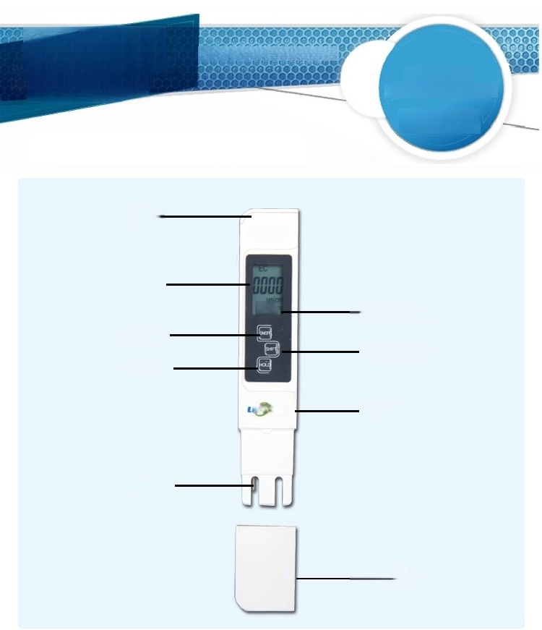
Analytical diagram
PRODUCT FEATURES
VARIOUS
LABORATORIES
CLEAN BENCHES
ONLY CLEAN BENCH
Battery. Cover | TDS&EC eterihoidl
Reading display
 | ²³⁶ —°C/F display
On/Off
TDS&EC switch
Value lock
^{CH} ^{N} Lichen LOGO
Electrodes
Electrode
protective shell
E
n

Slide 15

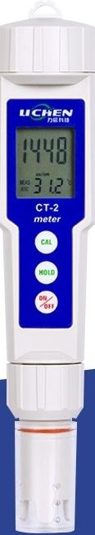
CT-2
Pen-type Conductivity Meter
Measurement Range:0~2000us/cm
Resolution:1us/cm
Auto Calibration:84us/cm
1413us/cm
Screen Display:Conductivity + Temperature Dual Display

Slide 16
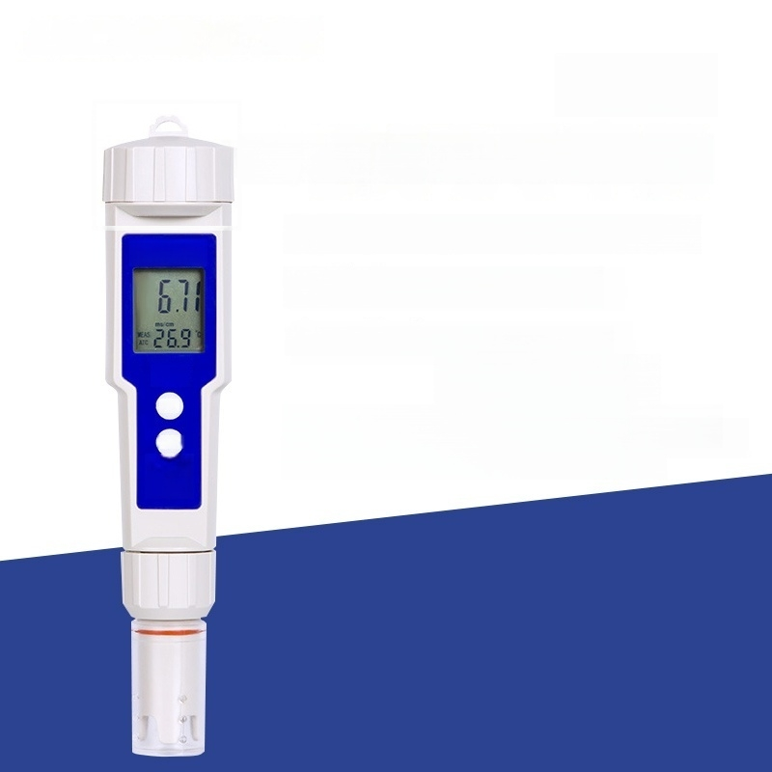

CT-20
Pen-type Conductivity Meter
Measurement range:0~20.00ms/cm
LICHEN
Resolution:0.01ms/cm
Automatic calibration:1413us/cm
12.88ms/cm
Screen Display:Conductivity + Temperature Dual Display
CT-20 meter
CAL
HOLD

Slide 17

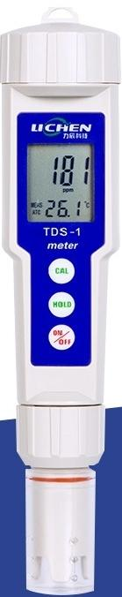
TDS-1
Pen-style TDS pen
Measurement range:0~1000ppm
Resolution:1ppm
Automatic calibration:40.38ppm
744.7ppm
Screen display:TDS+temperature dual display

Slide 18

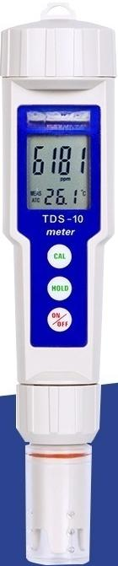
TDS-10
Pen-style TDS pen
Measurement range:0~9999ppm
Resolution:1ppm
Automatic calibration:744.7 ppm
7447ppm
Screen display:TDS+temperature dual display

Slide 19
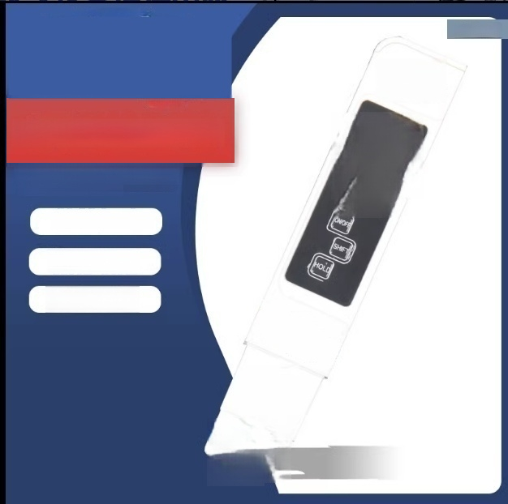

TDS&EC
mferihold
Water quality testing pen
TDS value and conductivity
value dual switch
Platinum-plated probe
Value lock
LCD display
三C
us m⁴
8
/c

