Slide 1
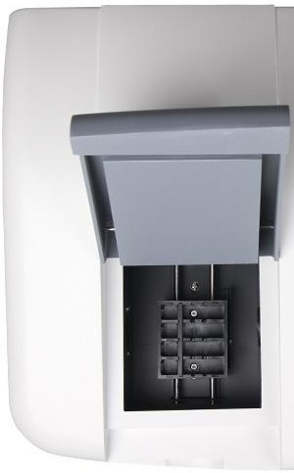

盛DPTOP

Slide 2
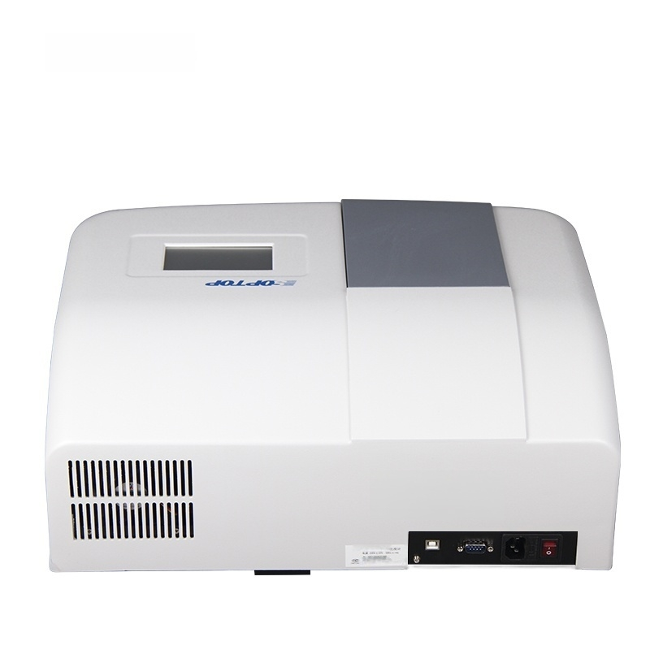

n
4 巷

Slide 3
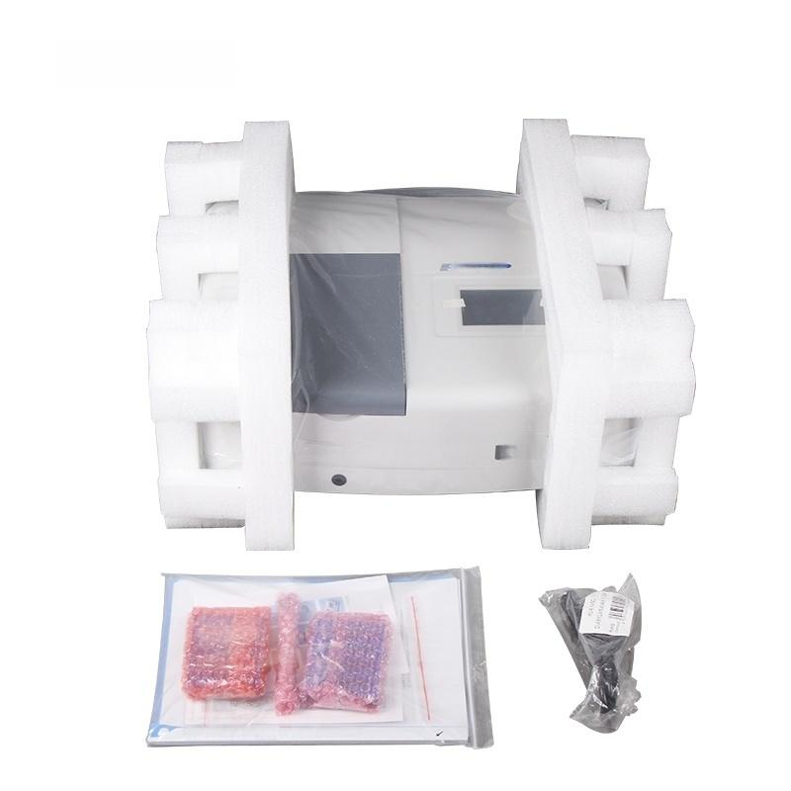
DPToP
r
754
w石早文远或A ^{ow-324A}

Slide 4
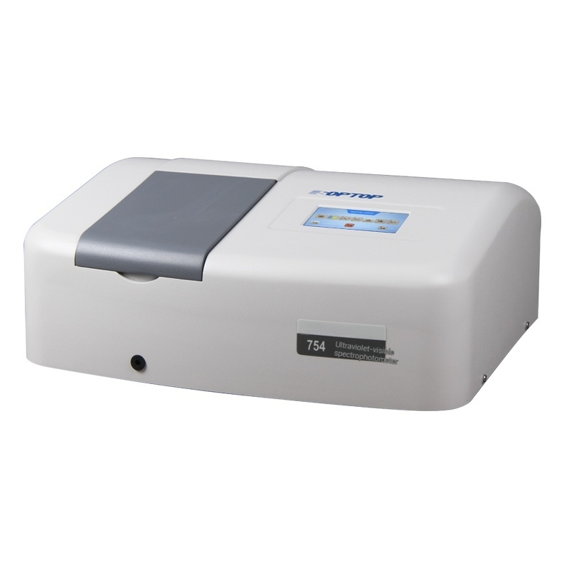

Slide 5
1 Product Features/Functions
C H A R A C T E R I S T 1 C
Features: (1).The monochromator is a C-T type monochromator with a1200-line holographic grating.(2).It automatically switches at 340nm(752),and the switching wavelength can be set(754\756 PC).
Function: 1).Automatic wavelength,quick and accurate wavelength setting and conversion (2).4.3-inch color touch screen with clear display and easy operation(3).Direct reading of concentration,setting of concentration factor and concentration,with a direct reading function,can save 200 records Test records(can save 50 curve parameters 754/756PC/7230G/723PC) (4).USB data interface (5).UV-Solution workstation software,equipped with various testing and scanning functions(723PC/756PC)
P A R A M E T E R

Slide 6
Technical parameters(UV light 752/754/756PC)
Model | 752 | 754 |  | 756PC
Monochromator | CT-type monochromator,1200 lines per
Monitor | millimeter diffraction grating,4.3-inch (480×272)color touchscreen
Spectral bandwdth | 4nm | 4nm |  | 2nm
Wavelength range | 200~1000nm | 190~1000nm(step interval 0.1nm)
Wavelength scanning speed | / | / |  | 200~3000nm/min
Wavelength moving speed | 8000nm/min
Maximum allowable wavelength error | ±2.0nm(automatic calibration upon startup) |  | ±1.0nm(automatic calibration upon startup)
Wavelength repeatability | 1.0nm |  | 0.5nm
Measuring range | T:0~200.0%T,A:-0.301~3.000Abs,C:-9999~9999
Maximum allowable error of transmittance ratio | ±0.5%T
Transmission ratio repeatability | 0.2%T
Stray light | ≤0.5%T | ≤0.3%T |  | ≤0.15%T
100%line noise at wavelength edge | 0.5%T | 0.5%T |  | /
0%line noise at wavelength edge | 0.2%T | 0.2%T |  | /
Baseline linearity | / | / |  | ±0.004A
Baseline drift | / | / |  | ±0.002A/h
Baseline dark noise | / | / |  | ±0.3T
UV-Solution software | / | / |  | Available
Data Interface | USB
Power Supply | 220V±10%50Hz 90w/110V±1060Hz 90W
Instrument net weight | 10.5Kg | 10.5Kg |  | 10.5Kg
Instrument gross weight | 14.5Kg | 14.5Kg |  | 15.0Kg
Instrument size | 470x380×225mm
Package Dimensions | 650×539x370mm

Slide 7
Technical Parameters(Visible Light 7230G/723PC)
Model | 7230G | 723PC
Monochromator | C-T type monochromator,1200 lines holographic grating
Monitor | 4.3-inch(480x272)color touch screen
Spectral bandwidth | 4nm | 2nm
Wavelength range | 325~1100nm(step interval 0.1nm)
Wavelength scanning speed | / | 200~3000nm/min
Wavelength shifting speed | 8000nm/min
Maximum allowable wavelength error | ±1.0nm(automatic calibration upon startup)
Wavelength repeatability | 0.5nm
Measuring range | T:0~200.0%T,A:-0.301~3.000Abs,C:-9999~9999
Maximum allowable transmittance error | ±0.5%T
Transmission ratio repeatability | 0.2%T
Stray light | ≤0.3%T(at 360nm)
100%line noise at wavelength edge | 0.5%T | /
Wavelength edge 0% line noise | 0.2%T | /
Baseline linearity | / | ±0.004A
Baseline drift | / | ±0.002A/h
Baseline dark noise | / | ±0.3T
UV-Solution software | / | Available
Data Interface | USB
Power Supply | 220V±10%50Hz 75W/110V±10%60Hz 75W
Instrument net weight | 10.0Kg | 10.0Kg
Instrument gross weight | 14.0Kg | 14.5Kg
Instrument size | 470x380×225mm
Package Dimensions | 650x539x370mm

Slide 8
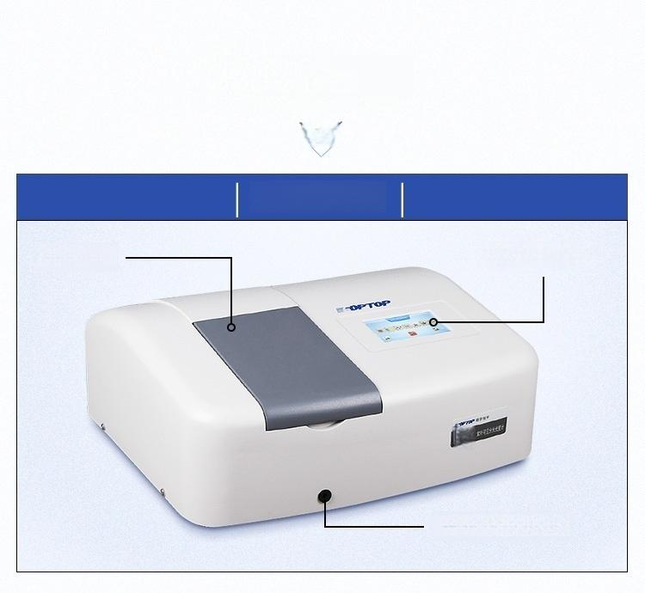

oFunction
Introduction
BRIEF INTRODUCTION
Product front
Sample Room Control Panel
754
Sample pull rack rod

Slide 9
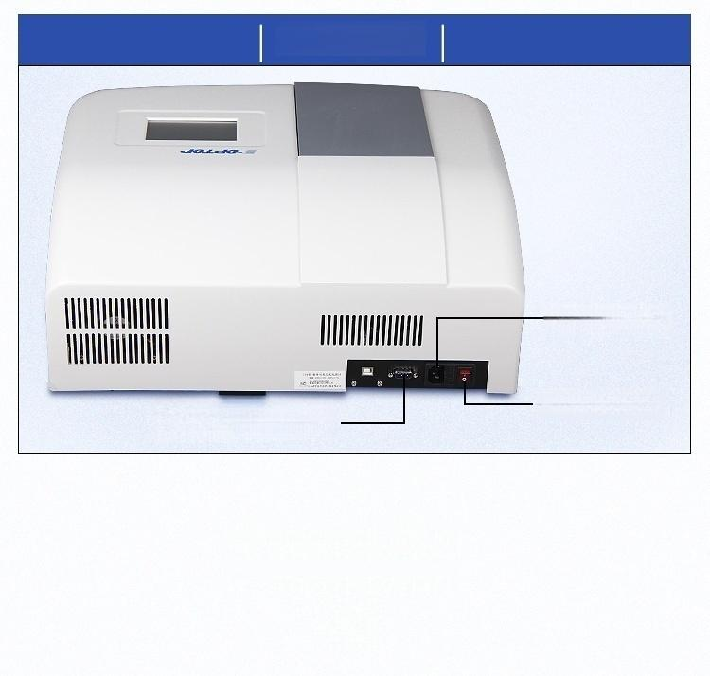
Product back
Power outlet
Power Switch
Data communication
interface
Product Details
P A R A M E T E R

Slide 10

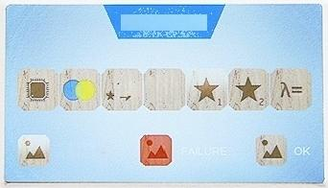
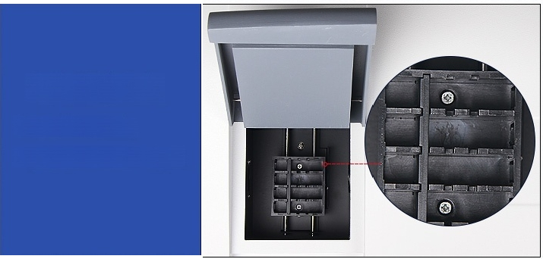
CPTCP
(1).Control Panel
4.3-inch color touch screen with full functions,easy to operate
INITIALIZING
★ λ0
TESTING
(2).Sample Room
Spacious sample room
Optional 10cm colorimetric stand

Slide 11
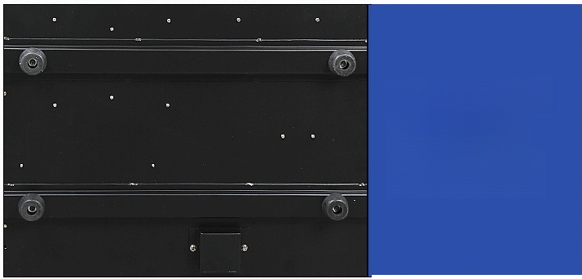
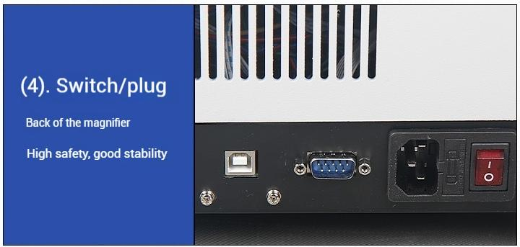
(3).Metal base Metal bottom plate
structure
Optical path should not be offset
Product packaging
P A C K A G E

Slide 12
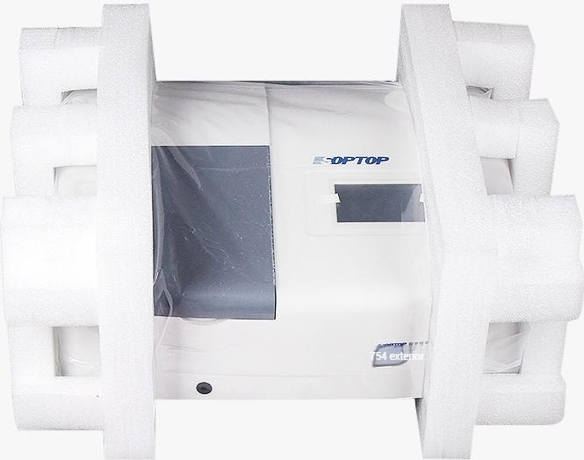
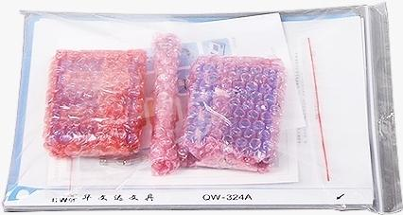
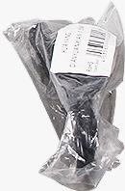
(1).Ultraviolet light included: | (2).Visible light included:
Ultraviolet 752754756PC
Standard configuration 4 glass 1 centimeter
2 quartz 1 centimeter cuvettes
Visible 7230G723PC
Standard configuration 4 glass 1 centimeter

