Slide 1
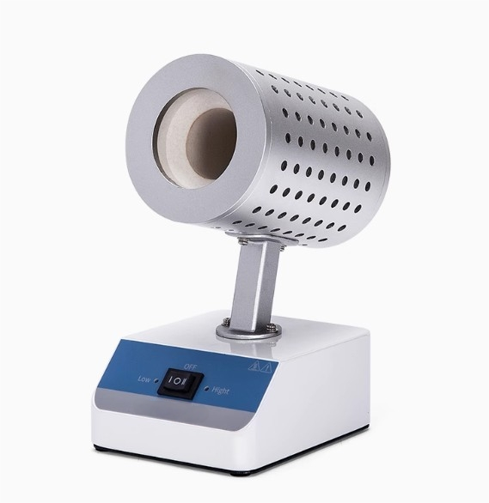

Slide 2
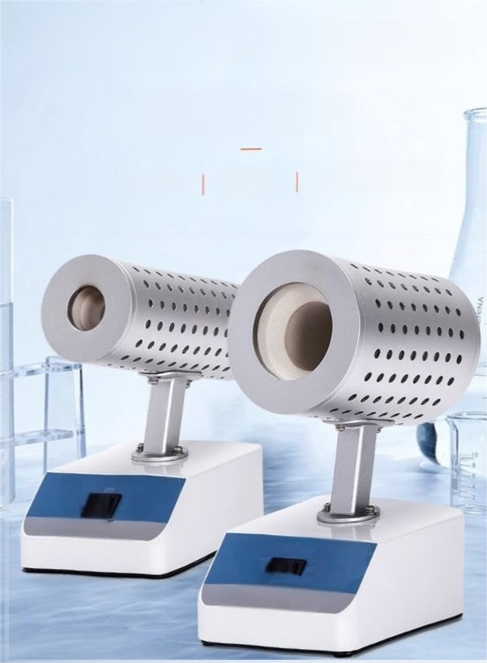
Infrared inoculation ring sterilizer
The operating temperature can reach
over 900℃for rapid sterilization.
Smallin size ^{Lightweight} No open flames

Slide 3




Product features
1 Safe and reliable No open flames,not afraid of wind,no pollution.
2 | The center temperature can reach 900℃(for theJtype). The heating speed is wery fast,and it can replace alcohol lamps.Thesterilization is more thorough
3 | Fast sterilization speed At the highest temperature,sterifization can becompleted in asfast as3seconds.
The heating ringis made ofhigh-quality95ceramic material.
it has a high operating temerature,excellent corrosion resistance and wearresistance
Not prone to cracking,with a long service life;

Slide 4
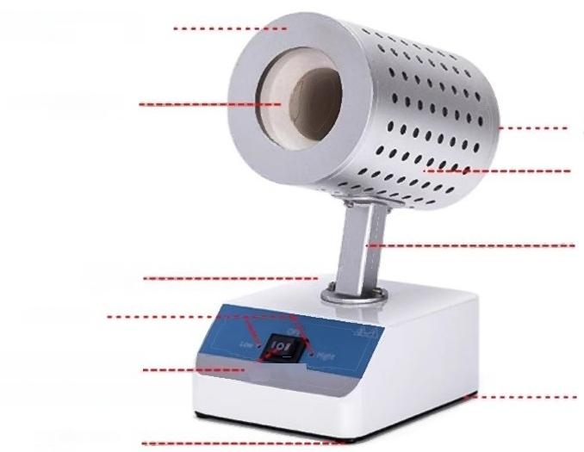
Technical Specifications
Heat the outer cover of the
container
Ceramic heatingelement
Heat the outer cover of the container
Heating external cover
Connecting rod
Bodyof
the aircraft
Indicator light
Two-level temperature.
adjustment switch base plate
Rubber-bottomed
feet

Slide 5
Product model | SN-HM-900 | SN-HM-900L
Power supply | AC220V
Frequency | 50Hz
Power | 150W | 250W
The maximum temperature in the central area | 900℃±50℃ | 820℃±50℃
Low temperature | 350℃±25℃
The outerdiameter of the largestdisinfection item | φ14 mm | φ35 mm
Totallength ofthe heatingzone | 150mm | 100mm
Heating-up time | 12min
Environmentaltemperatue | 5-40℃
Fuse | 250V3A5×20
Dimensions of the shape | 170×140×185mm | 100×140×200mm
Net weight | 0.9kg | 1.1kg

Slide 6
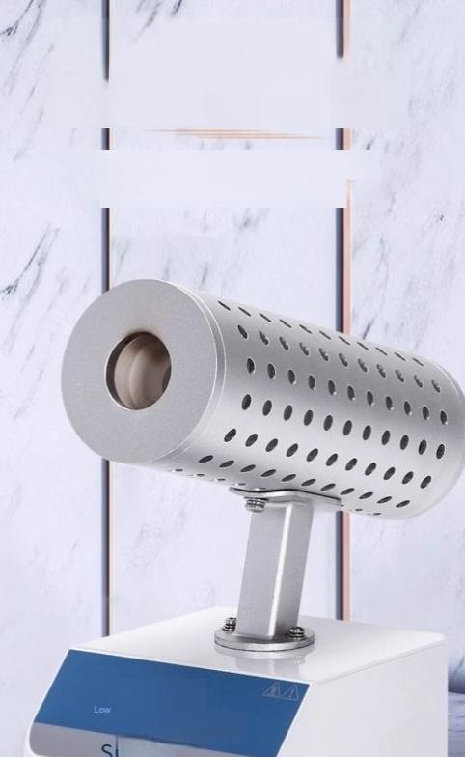
Placed in a suitable location,it has a compact structure and is easy to carry.
Aluminumconnectingrod/heating body outercover, corrosion-resistant,with an exquisite appearanceof
powder-coated sheet metal body,and asturdy structure.
e

Slide 7
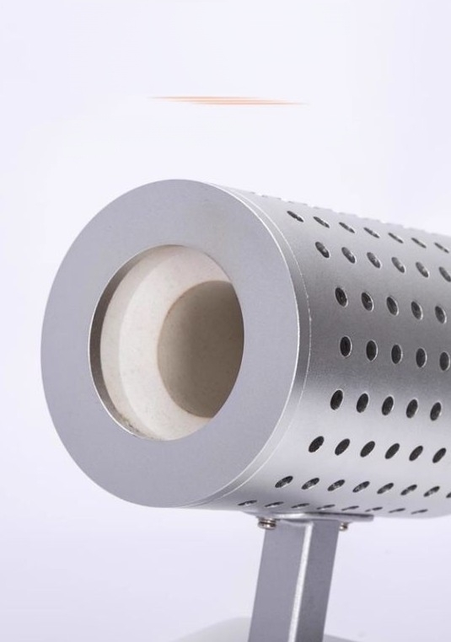
Infrared heating ceramic tube with 95 porcelain material
integrated molding
High heatingtemperature,rapid temperature rise,no open flame,
corrosion-resistant,good wearresistance,not prone to cracking,long service life

Slide 8
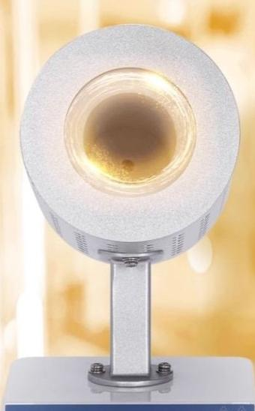
A fastertemperature rise leads to more
thorough sterilization.
Thecentertemperature can reach 900℃(forsmall
diameters).Thesterilization speed is very fast.At the highest temperature,itcan besterilized in aslittle as3seconds.

Slide 9

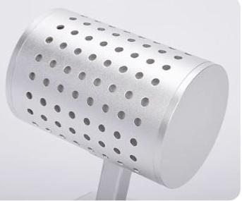
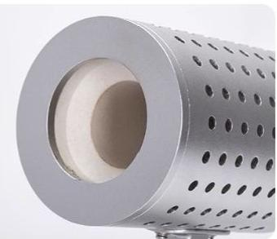
Details presentation
01
/
Heating external cover
Aluminum material,with surface
oxidation treatment forcorrosion
resistance,and a refnedappearance.
02
/
Ceramic heating element
High-quality 95 porcelain material is molded in one piece.It has a high heating temperature,quick heating speed and a long service life.

Slide 10
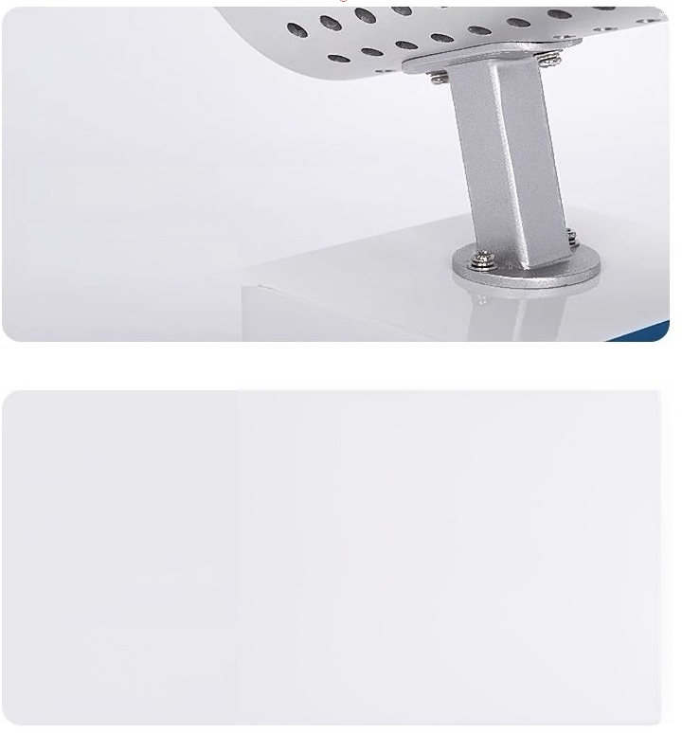
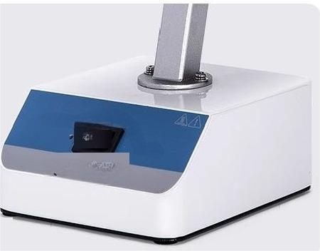
03
/
Aluminum connecting rod
Surface oxidation treatment,with
corrosion-resistant appearance and
exquisite design,and reliable structure.
04
/
Temperature adjustment switch
The settings are for low temperature mode and high temperature mode. The gears are clearly marked and
easy to switch between.

Slide 11
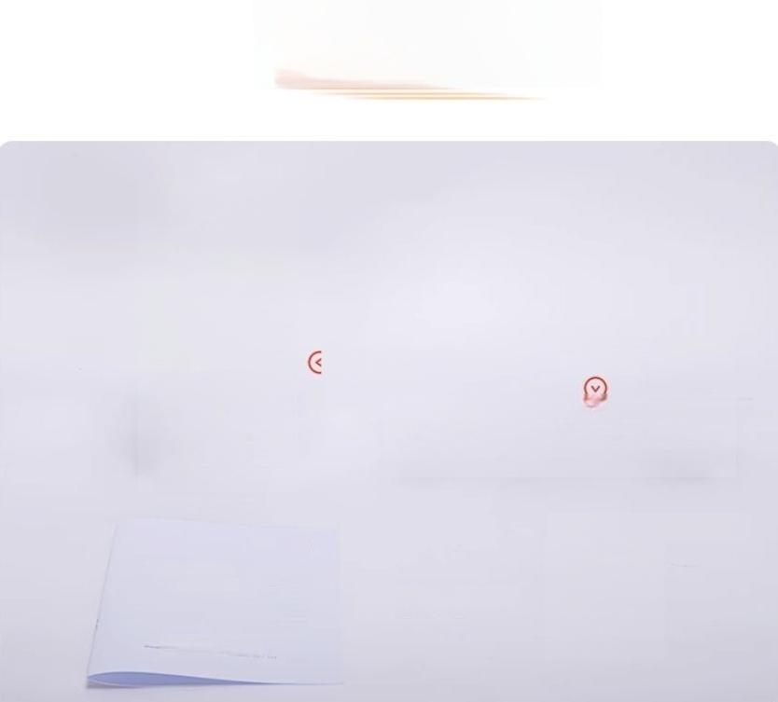
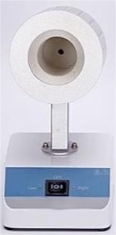



Packing List
Host machine Power cord
Certificate of Conformity
sunne
infaed gpecesedinctien
Ukaginstuciens5
Instruction manual

