Slide 1
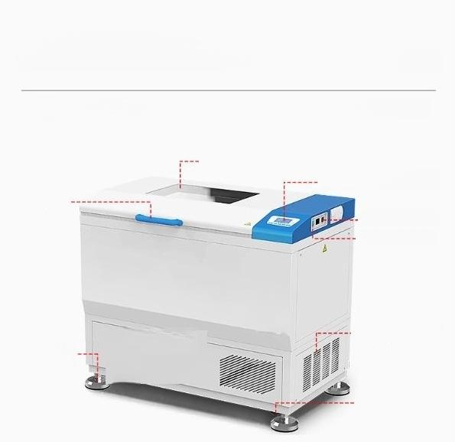
Product details
Models with "C"indicate thermostatic oscillators with cooling function.
Tempered observation window
Liquid crystal display
Lighting switch Power switch
Hands
Supporting leg
Ventilation opening
Roller

Slide 2
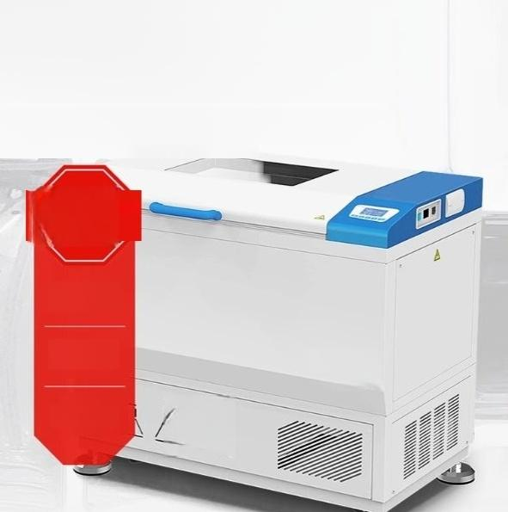
The box dooris opened. Automatically stop running
There isadoorswitch.When the boxdooris opened,the micro-ventilation,heating and The rocking bed automaticallystops,eliminating the drawback ofexcessive temperature
fluctuations.
stop
Blower
Heating | “沙克尔” 孵化器
Vibration | 只

Slide 3
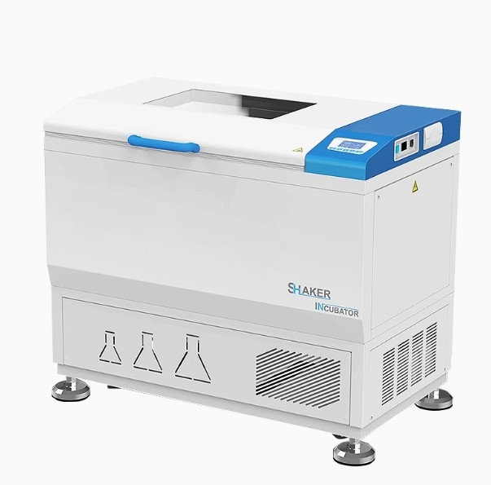

Slide 4








Liquid crystal display Fluoride-free design 304inner liner DC motor
Wind speed adjustable
Temperature Limit Alarm
Timer function Self-diagnosis

Slide 5

Optional Accessories:(The delivery time for optional accessories has been extended by 7 days)
1.Multiple-programmable liquid crystal controller 4.USB flash drive data storage
2.Embedded Printer 5.Humidity Control Function
3.RS485/232 interface and communication software 6.Lighting controlsystem
Note:You can choose either USB flash drive,RS⁴85/232 interface,or printer.
optional
functions

Slide 6

Ultraviolet sterilization
Effectively kill the floating
bacteria in the box
The interior of the box can be disinfected,effectively killing the floating bacteria in the circulating air within the box,thereby effectively preventing contamination during cell culture.

Slide 7

Large screen
Tempered observation window
The large screen tempered observation window,the inner chamber and the vibration platform surface are all made of stainless steel,which is convenient for cleaning.

Slide 8
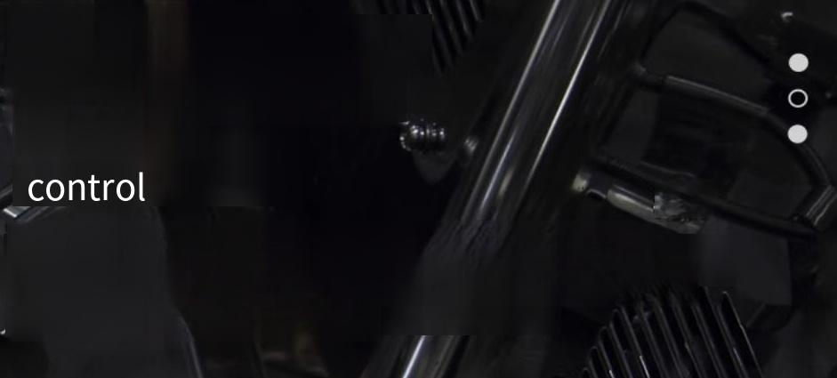
The size of the
circulating wind speed
Automatic
The speed of the circulating fan is automatically controlled, which can prevent the volatilization of samples during the test due to the fan operating too fast.

Slide 9
Brushless DC motor
Long-term continuous operation
Low heat dissipation brushless DC motor,with large starting torque,wide speed regulation range,no maintenance required,and breaking through the defect of being unable to operate continuously for a long time.

