Slide 1
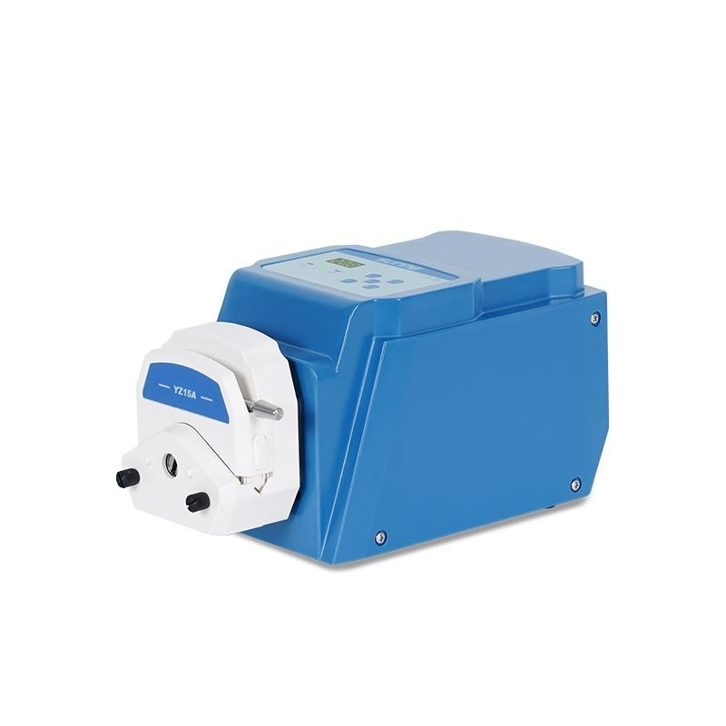

Slide 2
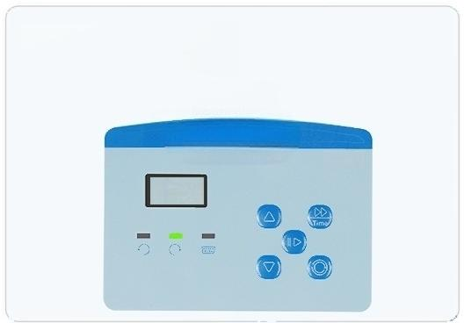
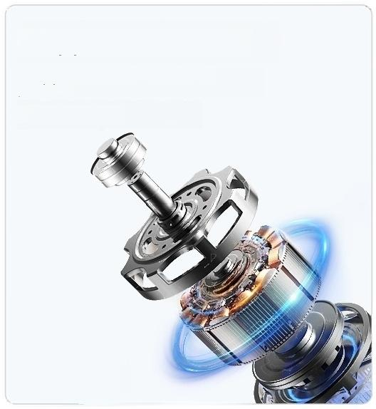
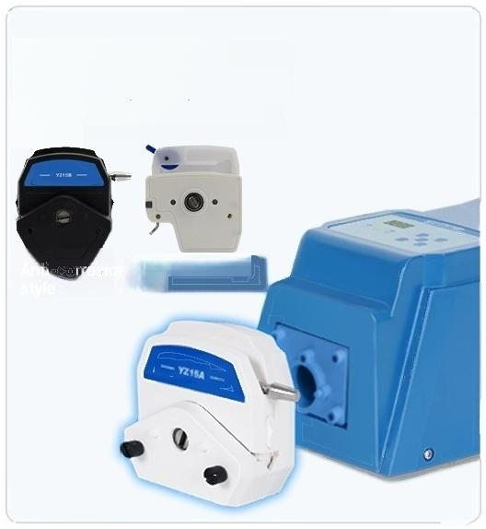
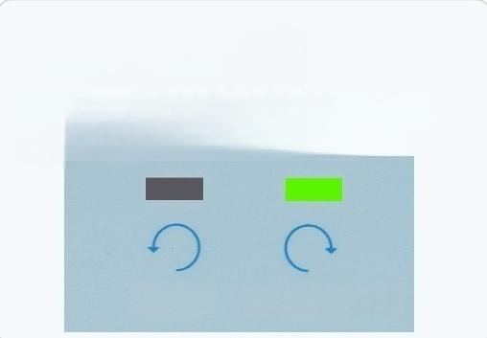
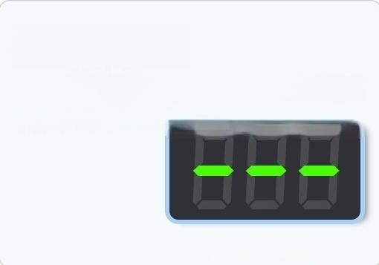

Function analysis grasping advantages
PRODUCT
FEATURES
Digital
Stepper motor drive
128 times finer segmentation,high
precision,
Low vibration,ultra-quiet
LED display
Energy saving and environmental
protection,long lifespan
▲
208
Compatible with
multiple pump heads
Supports various pump head
options
DG Series Pump
Head
Forward and reverse
rotation optional
Adjust forward and reverse rotation using the forward/reverse button
Reverse Forward rotation
One-key deflation
With full speed button,quickly fill and drain the pipeline
Full speed state
External control function
(Optional)
Allow control of the peristaltic pump's speed, start/stop status,and rotation direction via external control interface.

Slide 3
Model | SN-RBT-2YZ15A | SN-RBT-2YZ15BSN-RBT-2YZ25A|SN-RBT-2YZ25B
Display mode | LED 3-digit tube
Adjustable speed range | 0.1~200rpm
Speed resolution | 0.1rpm(speed≤100rpm)11rpm(speed>100rpm)
Timing range | 0.1 seconds to 99 hours
Timing accuracy | ≤20 milliseconds
Timing adjustment method | Manual:stepped adjustmentCommunication: continuous adjustment
Internally controllable function items | Speed,start/stop,forward/reverse,full speed
External control modes | 0-10KHz,0-5V,0-10V,4-20mA,RS485,foot switch
External controllable function items | Start/stop control,direction control,speed control
Standard pump head | 2xYZ15A | 2xYZ15B | 2xYZ25A | 2xYZ25B
Hose specifications | 13#、14#、19#、16#、25#、17#、18# |  | 15#、24#
Flow range | 0.007-825ml/min |  | 0.17-590ml/min
Number of pump head rollers | 3
Working Environment | Temperature 0-40℃,humidity<80%no condensation
Protection rating | IP31
Power supply voltage | AC100V~AC250V 50Hz/60Hz or DC100V~DC275V
Power consumption during standby mode | <15W
Normal load power | <30W
Starting power | <55W
Net Weight | 3KG
Product Size (L×W×H) | 360×142×148mm

Slide 4
Model | SN-RBT- DG61 | SN-RBT- DG101 | SN-RBT- DG62 | SN-RBT- DG102 | SN-RBT- DG63 | SN-RBT- DG103
Display mode | LED 3-digit tube
Adjustable speed range | 0.1～200rpm
Speed resolution | 0.1rpm(rotational speed s 100rpm)11rpm(rotational speed>100rpm)
Timing range | 0.1 seconds to 99 hours
Timing accuracy | ≤20 milliseconds
Timing adjustment method | Manual:step adjustment Communication: continuous adjustment
Internally controllable function items | Speed,start/stop,forward/reverse,fullspeed
External control form | 0-10KHz,0-5V,0-10V,4-20mA,RS485,foot switch
External controllable function items | Start/stop control,direction control,speed control
Standard pump head | DG61 | DG101 | DG62 | DG102 | DG63 | DG103
Hose specifications | _{1×1、2×1、3×1} Wall thickness 0.8~1mm,inner diameter ≤3.17mm
Flow range | 0.0061-75 ml/min | 0.0061-54 ml/min | 0.0061-75 ml/min | 0.0061-54 ml/min | 0.0061-75 ml/min | 0.0061-54 ml/min
Number of pump head rollers | 6 | 10 | 6 | 10 | 6 | 10
Working Environment | Temperature 0-40℃,humidity <80%no condensation
Protection rating | IP31
Power supply voltage | AC100V~AC250V 50Hz/60Hz or DC100V~DC275V
Power consumption during standby mode | <11W
Normal load power | <20W
Starting power | <40W
Net Weight | 2.4KG
Product Size (L×W×H) | 250×142×148mm |  | 260×142×148mm |  | 270×142×148mm

Slide 5
Model | SN-RBT- DG64 | SN-RBT- DG104 | SN-RBT- DG66 | SN-RBT- DG106
Display mode | LED 3-digit tube
Adjustable speed range | 0.1~200rpm
Speed resolution | 0.1rpm(speed≤100rpm)1rpm(speed>100rpm)
Timing range | 0.1 seconds to 99 hours
Timing accuracy | ≤20 milliseconds
Timing adjustment method | Manual:step adjustmentt Communication: continuous adjustment
Internally controllable function items | Speed,start/stop,forward/reverse,full speed
External control form | 0-10KHz,0-5V,0-10V,4-20mA,RS485,foot switch
External controllable function items | Start-stop control,direction control,speed control
Standard pump head | DG64 | DG104 | DG66 | DG106
Hose specifications | 1×1,2×1,3×1 wall thickness 0.8~1mm,inner diameter≤3.17mm
Flow range | 0.0061-75ml/min | 0.0061-54ml/min | 0.0061-75ml/min | 0.0061-54ml/min
Number of pump head rollers | 6 | 10 | 6 | 10
Working Environment | Temperature 0-40℃,humidity<80%no condensation
Protection rating | IP31
Power supply voltage | AC100V~AC250V50Hz/60Hz or DC100V~DC275V
Standby power consumption during stopping | <11W
Normal load power consumption | <20W
Starting power | <40W
Net Weight | 2.4
Product Size (L×W×H) | 280×142×148mm |  | 300×142×148mm

Slide 6

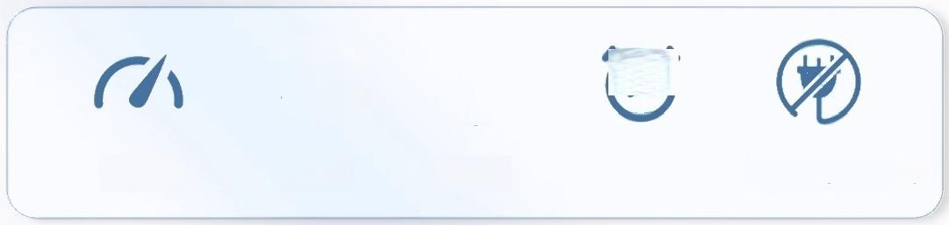
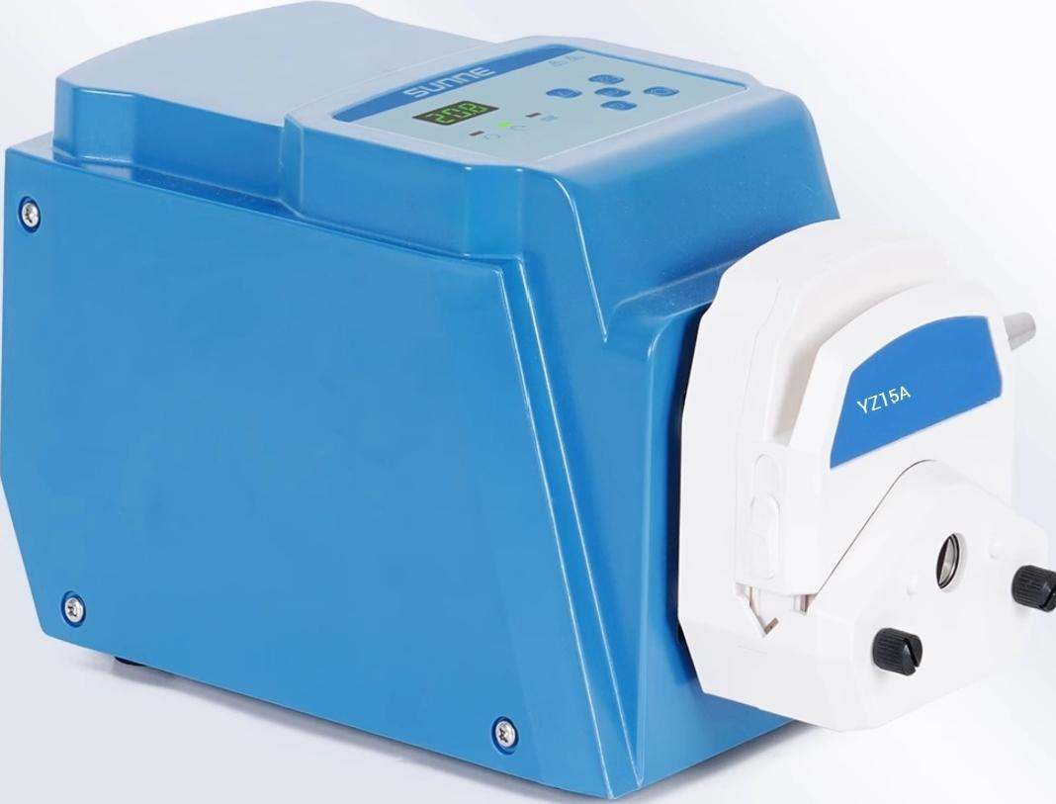
Function integration Easy to operate
Meeting diverse needs
Combines speed regulation,forward and reverse rotation,
timing,power-off memory and other functions,easy to
operate,more convenient to use.
C
Forward rotation Timer Power outage memory
Speed regulation Reverse

Slide 7
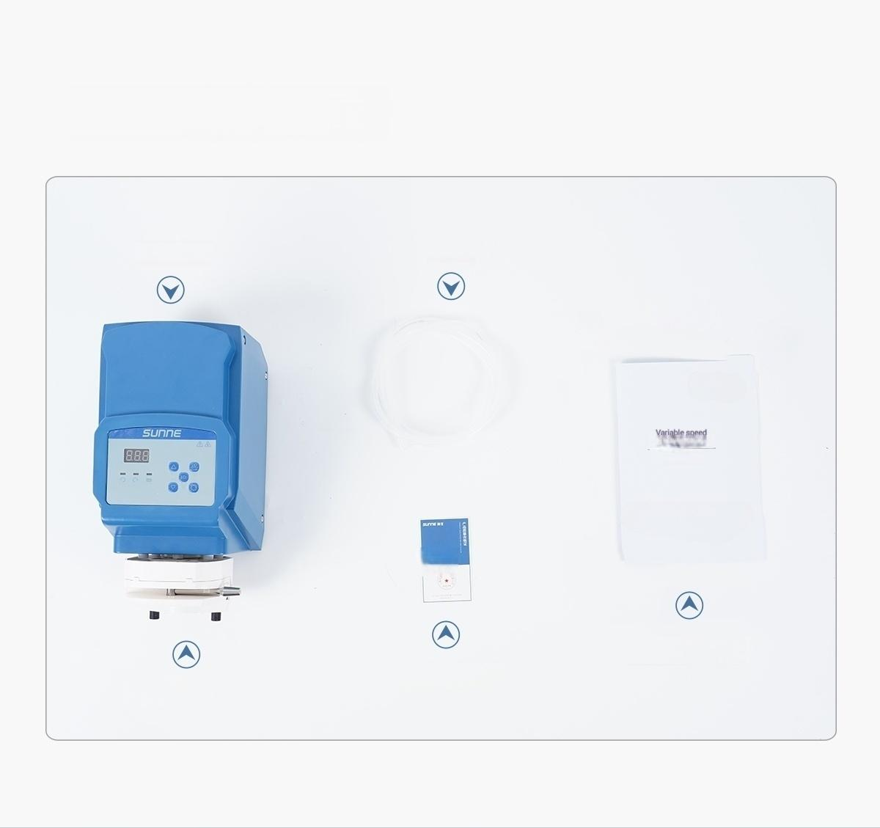
Instrument list display
DETAIL
DISPLAY
Drive motor Soft Tube
end-driven pump
User manual
User manual
Certificate of Quality/Warranty Card
Pump head

Slide 8
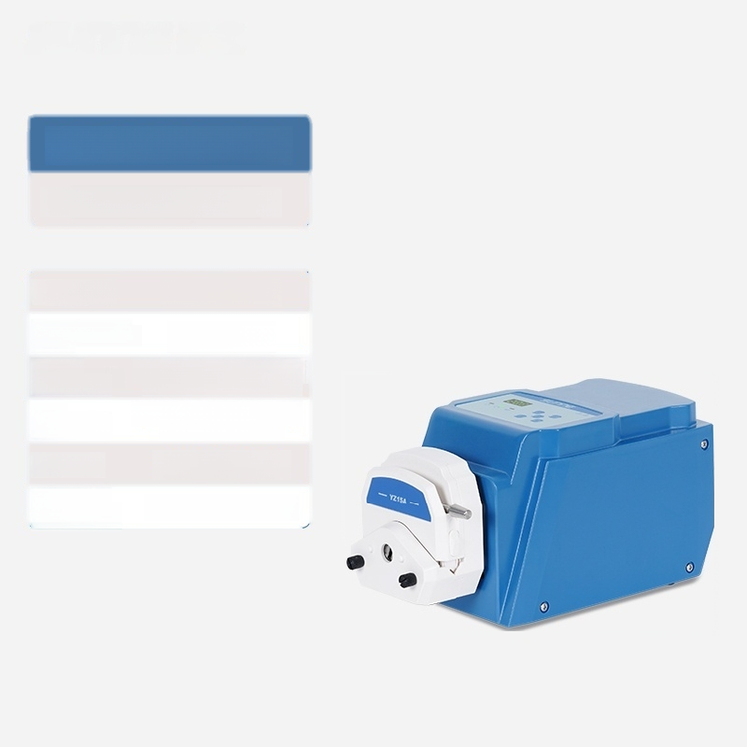
SN-RBT-YZ15A
Variable Speed Peristaltic Pump
Display mode: LED 3-digit tube
Adjustable speed 0.1~200rpm range:
Speed 0.1rpm(speed s 100rpm) resolution: 1rpm(speed>100rpm)
Hose 13#、14#、19#、16#、 ^{specifications:} 25#、17#、18#
Flow range 0.007-825ml/min
Product Size: (L×W×H) | 290×142×148mm

Slide 9

SN-RBT-YZ15B
Variable Speed Peristaltic Pump
Display mode: LED 3-digit tube
Adjustable speed 0.1~200rpm range:
Speed 0.1rpm(speed s 100rpm) resolution: 1rpm(speed>100rpm)
Hose 13#、14#、19#、16#、 ^{specifications:} 25#、17#、18#
Flow range 0.007-825ml/min
Product Size: (L×W×H) | 290×142×148mm

Slide 10

SN-RBT-YZ25A
Variable Speed Peristaltic Pump
Display mode: LED 3-digit tube
Adjustable speed 0.1～200rpm range:
Speed 0.1 rpm(speed s 100 rpm) resolution: 1 rpm(speed>100 rpm)
ifications: ^{15#、24#}
Flow range 0.17-590ml/min
Product Size: (L×W×H) | 290×142×148mm
Hose
spec

Slide 11

SN-RBT-YZ25B
Variable Speed Peristaltic Pump
Display mode:LED 3-digit tube
^{t}:^{able} ^{speed} 0.1~200rpm
Speed 0.1rpm(speeds 100rpm) resolution: 1rpm(speed>100rpm)
^{Hose} 15#、24#
Flow range 0.17-590ml/min
Product Size: (L×W×H) | 290×142×148mm
Ad
us
ra
ge
specifications:

Slide 12

SN-RBT-2YZ15A
Variable Speed Peristaltic Pump
Display mode: LED 3-digit tube
Adjustable speed 0.1~200rpm range:
Speed 0.1rpm(speed s 100rpm) resolution: 1rpm(speed>100rpm)
Hose 13#、14#、19#、16#、 ^{specifications:} 25#、17#、18#
Flow range 0.007-825ml/min
Product Size: (L×W×H) | 360×142×148mm

Slide 13

SN-RBT-2YZ15B
Variable Speed Peristaltic Pump
Display mode: LED 3-digit tube
Adjustable speed 0.1~200rpm range:
Speed 0.1rpm(speed s 100rpm) resolution: 1rpm(speed>100rpm)
Hose 13#、14#、19#、16#、 ^{specifications:} 25#、17#、18#
Flow range 0.007-825ml/min
Product Size: (L×W×H) | 360×142×148mm

Slide 14

SN-RBT-2YZ25A
Variable Speed Peristaltic Pump
Display mode:LED 3-digit tube
^{t}:^{able} ^{speed} 0.1~200rpm
Speed 0.1rpm(speeds 100rpm) resolution: 1rpm(speed>100rpm)
^{Hose} 15#、24#
Flow range 0.17-590ml/min
Product Size: (L×W×H) | 360×142×148mm
Ad
us
ra
ge
specifications:

Slide 15

SN-RBT-2YZ25B
Variable Speed Peristaltic Pump
Display mode:LED 3-digit tube
^{t}:^{able} ^{speed} 0.1~200rpm
Speed 0.1rpm(speeds 100rpm) resolution: 1rpm(speed>100rpm)
ifications: ^{15#、24#}
Flow range 0.17-590ml/min
Product Size: (L×W×H) | 360×142×148mm
Ad
us
ra
ge
Hose
spec

Slide 16

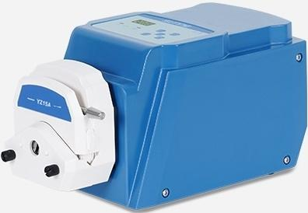
SN-RBT-DG61
Variable Speed Peristaltic Pump
Display mode:LED 3-digit tube
^{Adjustable} ^{speed} 0.1～200rpm range:
Speed resolution: | 0.1rpm(speeds 100rpm) 1 rpm(rotational speed greater than
Hose specifications:wallthickness 0.8~1mm,inner diameter ≤3.17mm
Flow range 0.0061-75ml/min
Product Size: (L×W×H) |  | 250×142×148mm
00 rpm)

Slide 17

SN-RBT-DG101
Variable Speed Peristaltic Pump
Display mode:LED 3-digit tube
^{Adjustable} ^{speed} 0.1～200rpm range:
Speed resolution: | 0.1rpm(speeds 100rpm) 1 rpm(rotational speed greater than
Hose specifications:wallthickness 0.8~1mm,inner diameter ≤3.17mm
Flow range 0.0061-54ml/min
Product Size: (L×W×H) |  | 250×142×148mm
l0o rpm)

Slide 18

SN-RBT-DG62
Variable Speed Peristaltic Pump
Display mode:LED 3-digit tube
^{Adjustable} ^{speed} 0.1～200rpm range:
Speed resolution: | 0.1rpm(speeds 100rpm) 1 rpm(rotational speed greater than
Hose specifications:wallthickness 0.8~1mm,inner diameter ≤3.17mm
Flow range 0.0061-75ml/min
Product Size: (L×W×H) |  | 260×142×148mm
l0o rpm)

Slide 19

SN-RBT-DG102
Variable Speed Peristaltic Pump
Display mode:LED 3-digit tube
^{Adjustable} ^{speed} 0.1～200rpm range:
Speed resolution: | 0.1rpm(speeds 100rpm) 1 rpm(rotational speed greater than
Hose specifications:wallthickness 0.8~1mm,inner diameter ≤3.17mm
Flow range 0.0061-54ml/min
Product Size: (L×W×H) |  | 260×142×148mm
l0o rpm)

Slide 20

SN-RBT-DG63
Variable Speed Peristaltic Pump
Display mode:LED 3-digit tube
^{Adjustable} ^{speed} 0.1～200rpm range:
Speed resolution: | 0.1rpm(speeds 100rpm) 1 rpm(rotational speed greater than
Hose specifications:wallthickness 0.8~1mm,inner diameter ≤3.17mm
Flow range 0.0061-75ml/min
Product Size: (L×W×H) |  | 270×142×148mm
l0o rpm)

Slide 21

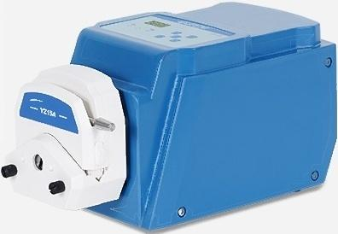
SN-RBT-DG103
Variable Speed Peristaltic Pump
Display mode:LED 3-digit tube
^{Adjustable} ^{speed} 0.1～200rpm range:
Speed resolution: | 0.1rpm(speeds 100rpm) 1 rpm(rotational speed greater than
Hose specifications:wall thickness 0.8~1mm,inner diameter ≤3.17mm
Flow range 0.0061-54ml/min
Product Size: (L×W×H) |  | 270×142×148mm
l0o rpm)

Slide 22

SN-RBT-DG64
Variable Speed Peristaltic Pump
Display mode:LED 3-digit tube
^{t}:^{able} ^{speed} 0.1~200rpm
Speed resolution: | 0.1rpm(speeds 100rpm) 1rpm(speed>100rpm)
Hose specifications:wallthickness 0.8~1mm,inner diameter s3.17mm
Flow range 0.0061-75ml/min
Product Size: (L×W×H) |  | 280×142×148mm
Ad
us
ra
ge

Slide 23

SN-RBT-DG104
Variable Speed Peristaltic Pump
Display mode:LED 3-digit tube
^{Adjustable} ^{speed} 0.1～200rpm range:
Speed resolution: | 0.1rpm(speeds 100rpm) 1 rpm(rotational speed greater than
Hose specifications:wallthickness 0.8~1mm,inner diameter ≤3.17mm
Flow range 0.0061-54ml/min
Product Size: (L×W×H) |  | 280×142×148mm
l0o rpm)

Slide 24

SN-RBT-DG66
Variable Speed Peristaltic Pump
Display mode:LED 3-digit tube
^{Adjustable} ^{speed} 0.1～200rpm range:
Speed resolution: | 0.1rpm(speeds 100rpm) 1 rpm(rotational speed greater than
Hose specifications:wallthickness 0.8~1mm,inner diameter ≤3.17mm
Flow range 0.0061-75ml/min
Product Size: (L×W×H) |  | 300×142×148mm
l0o rpm)

Slide 25

SN-RBT-DG106
Variable Speed Peristaltic Pump
Display mode:LED 3-digit tube
^{Adjustable} ^{speed} 0.1～200rpm range:
Speed resolution: | 0.1rpm(speeds 100rpm) 1 rpm(rotational speed greater than
Hose specifications:wallthickness 0.8~1mm,inner diameter s3.17mm
Flow range 0.0061-54ml/min
Product Size: (L×W×H) |  | 300×142×148mm
l0o rpm)

