Slide 1
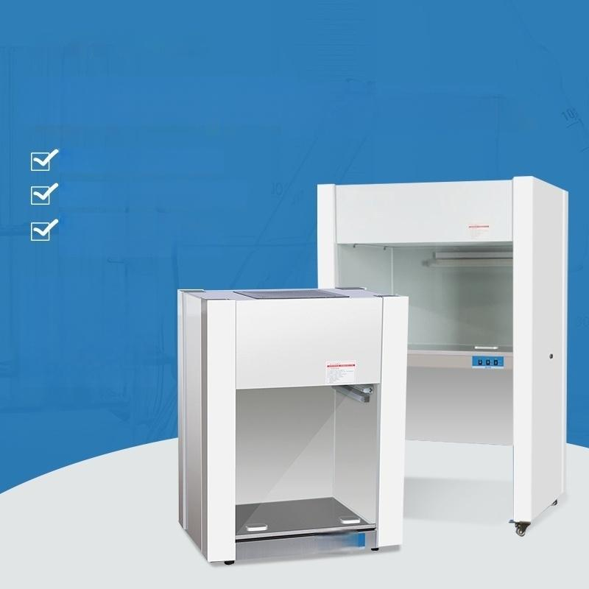
Clean bench
All steel material optional
UV lamp efficient sterilization
Hundred-level
aseptic purification
Table/Floor
(-

Slide 2
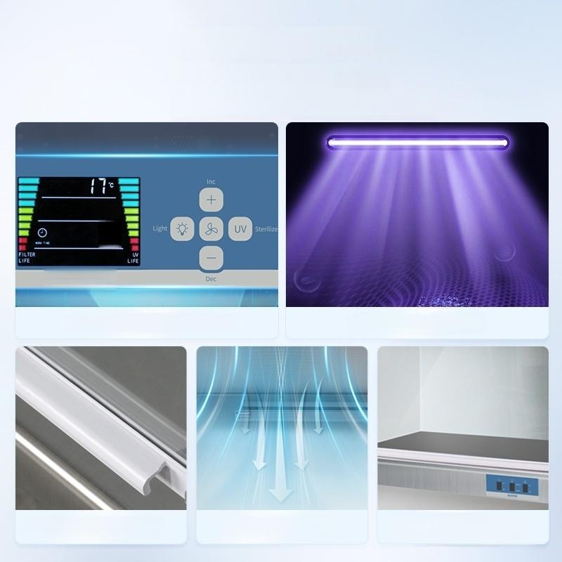
The five core brings
Hundred level
purification experience
0.
Multi-gear speed regulation UV effective sterilization
Constant force spring lift door Air curtain isolation design Stainless steel
enclosed countertop

Slide 3
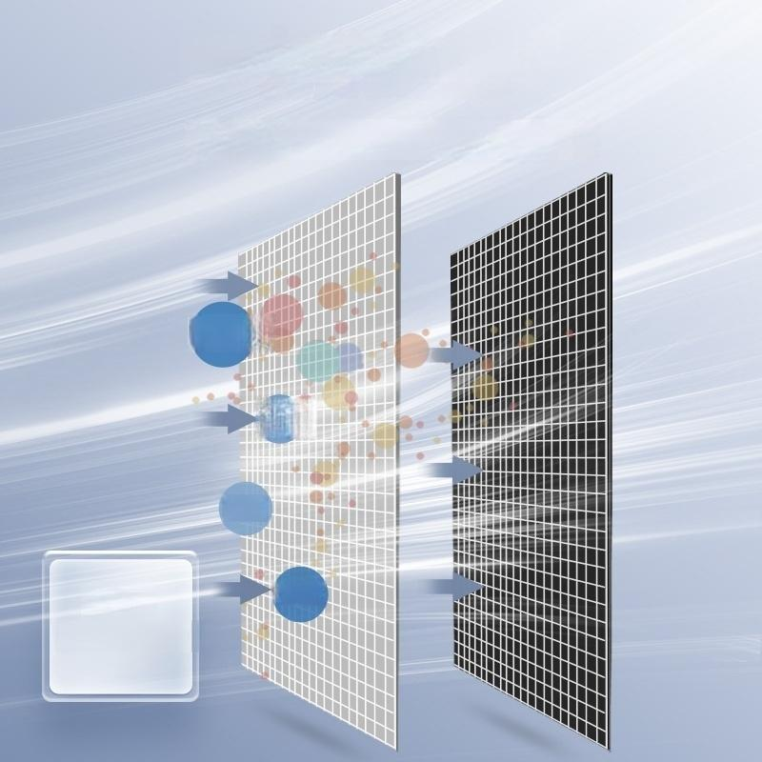
Effective filtration
Using HEPA integrated filter
Bacteriat
Dust
Hair
99%
Sterilization
rate
Partices

Slide 4
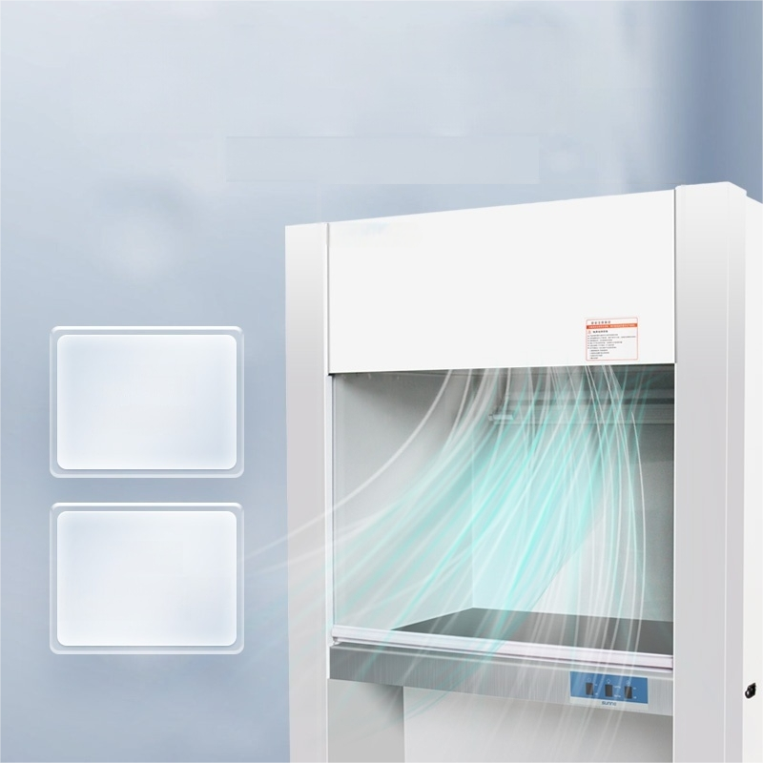
Wide-angle large air volume multi-speed adjustment
2131619 gear optional
0.6m/s Highwind Speed
5min
Provide dust-free
environment

Slide 5
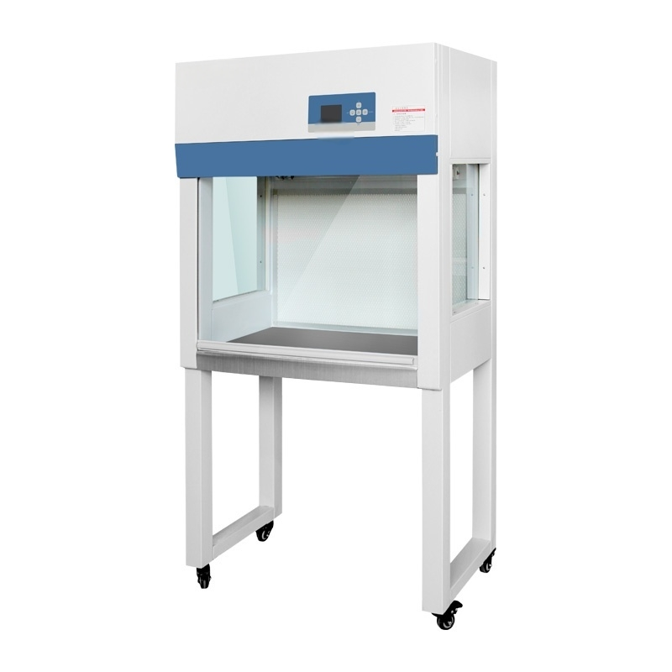

Slide 6
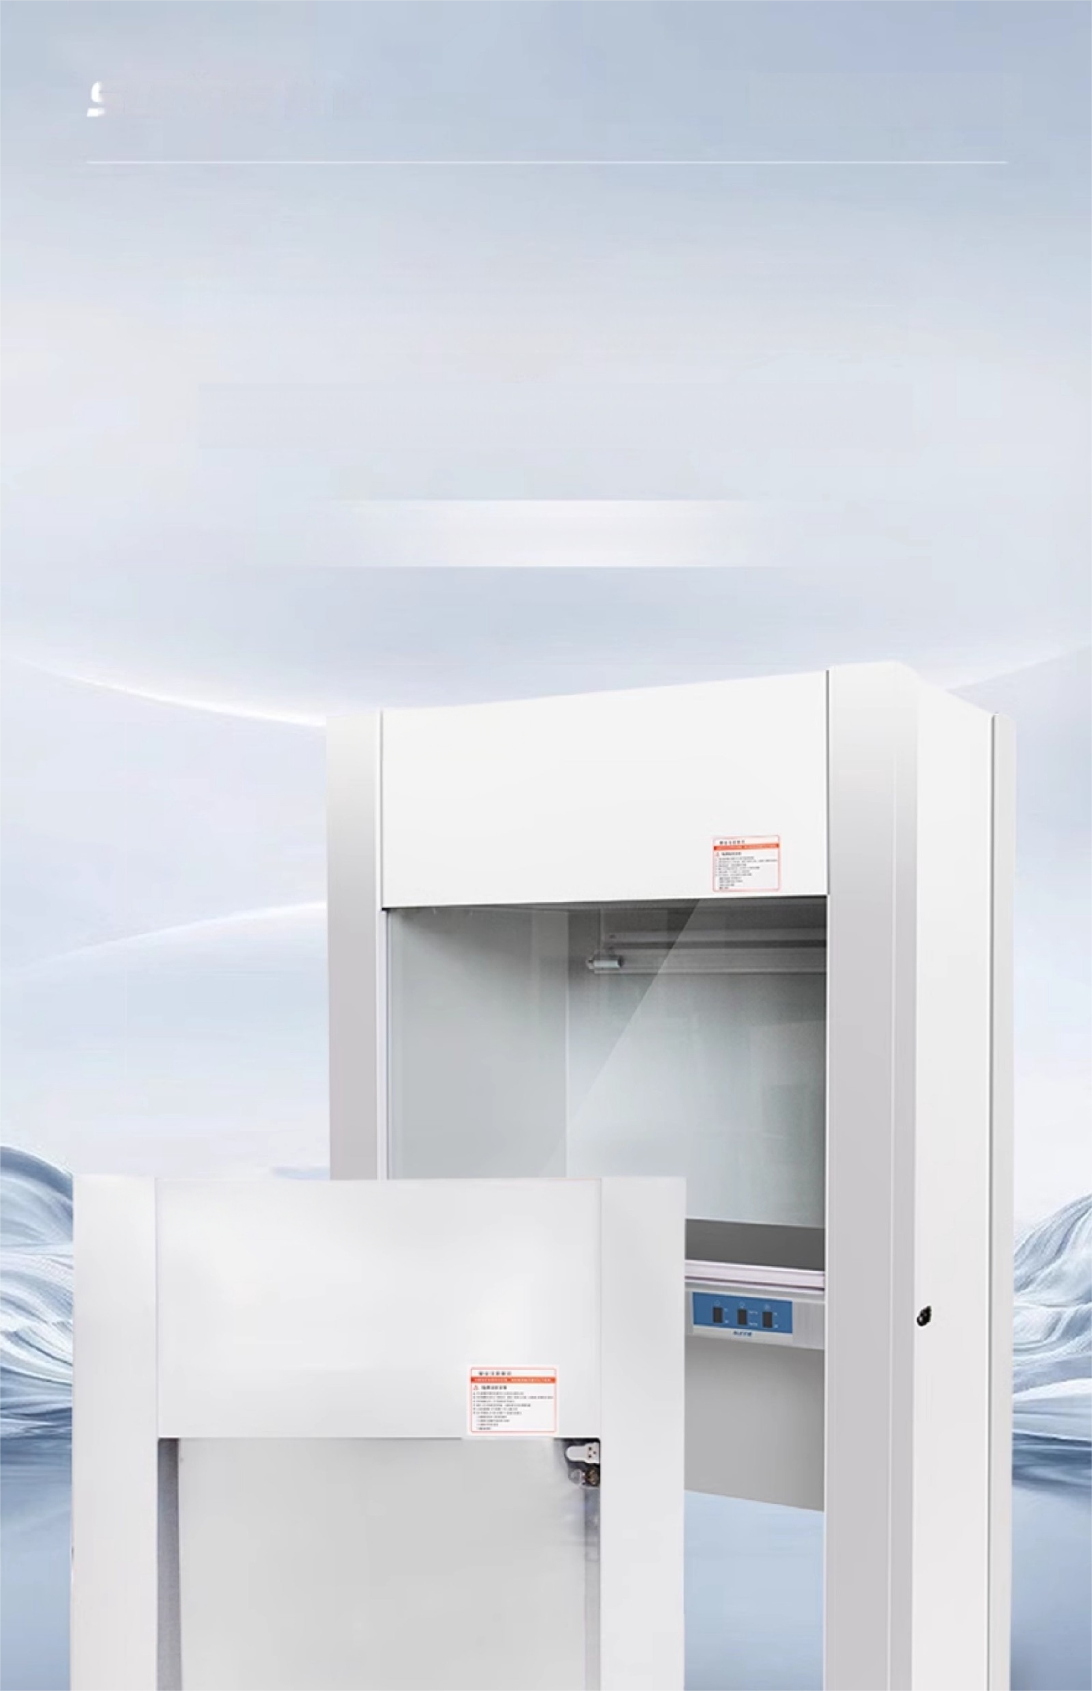
Ultra-clean table
New upgraded clean bench
5min provide dust-free working environment
Effective UV sterilization multi-file control wind speed

Slide 7


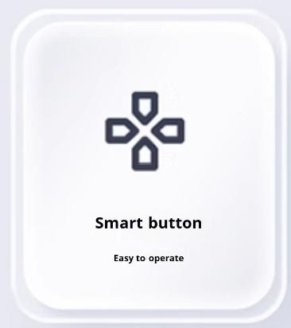
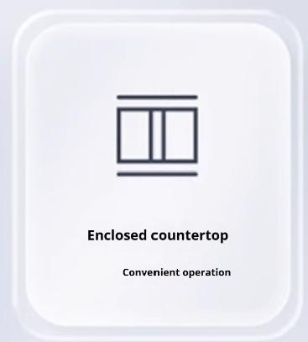
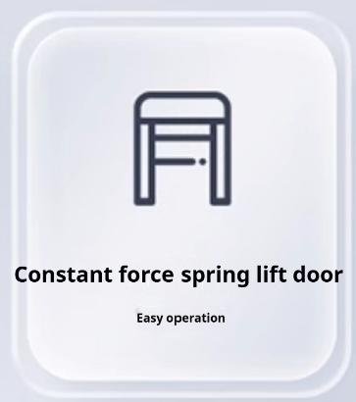
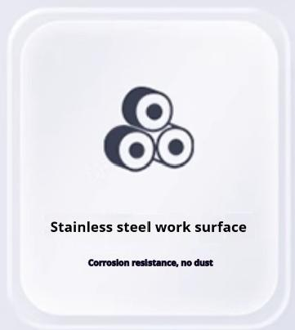
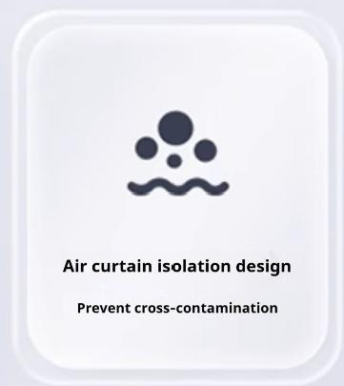
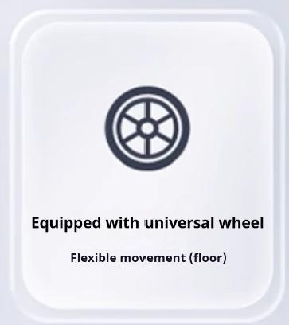
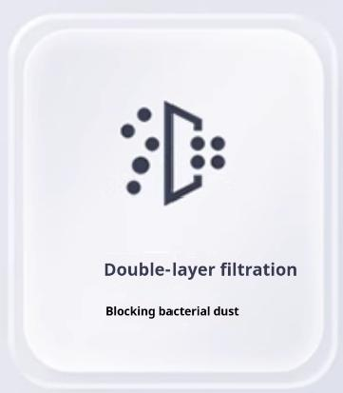
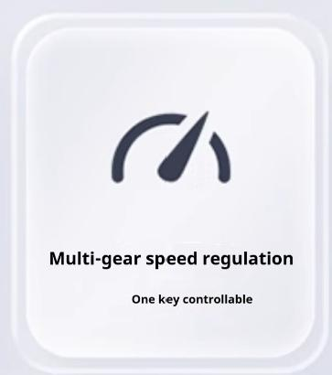
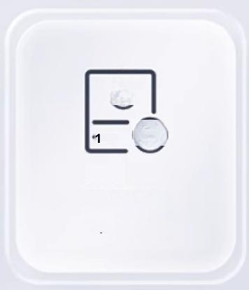
Ultra-clean table
Clean bench C
ultra-clean workbench
Nine characteristics of the quality you want to rest assured
Test
Support for inspection
Except for 650 series

Slide 8



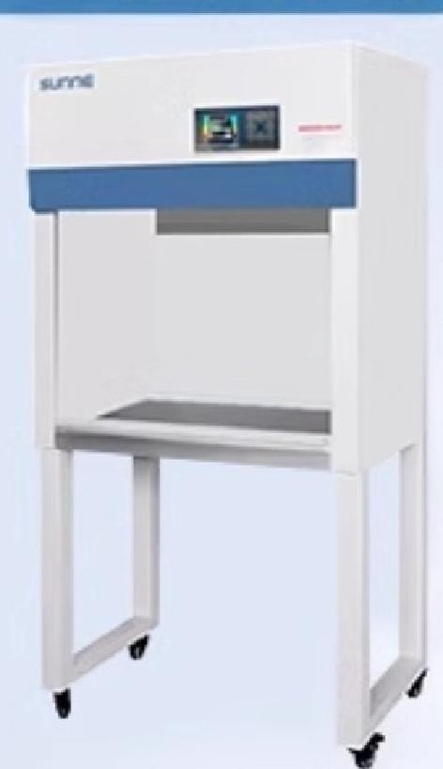
Ultra-clean table
Clean bench
Selection Guide
All-steel workbench
 | Clean bench
 | Single,Double,Double,Double | Single,Double,Double,Double
 | Vertical/horizontal air supply | Vertical/horizontal air supply
 | Some models have | Some models have
 | Except for 650 series | Except for 650 series
 | √
 | Key control | Table type:remote control switch Floor type:LCD instrument
 | Grade 100@≥0.5um | Grade 100 @≥0.5um
 | √ | √
 | × | Partial model support
 | Steel and wood structure | Full steel structure
 | Fast and slow two gears (except economic) | Table type:fast and slow two gears Floor type:three gear adjustment
立 \ 口十↓十

Slide 9
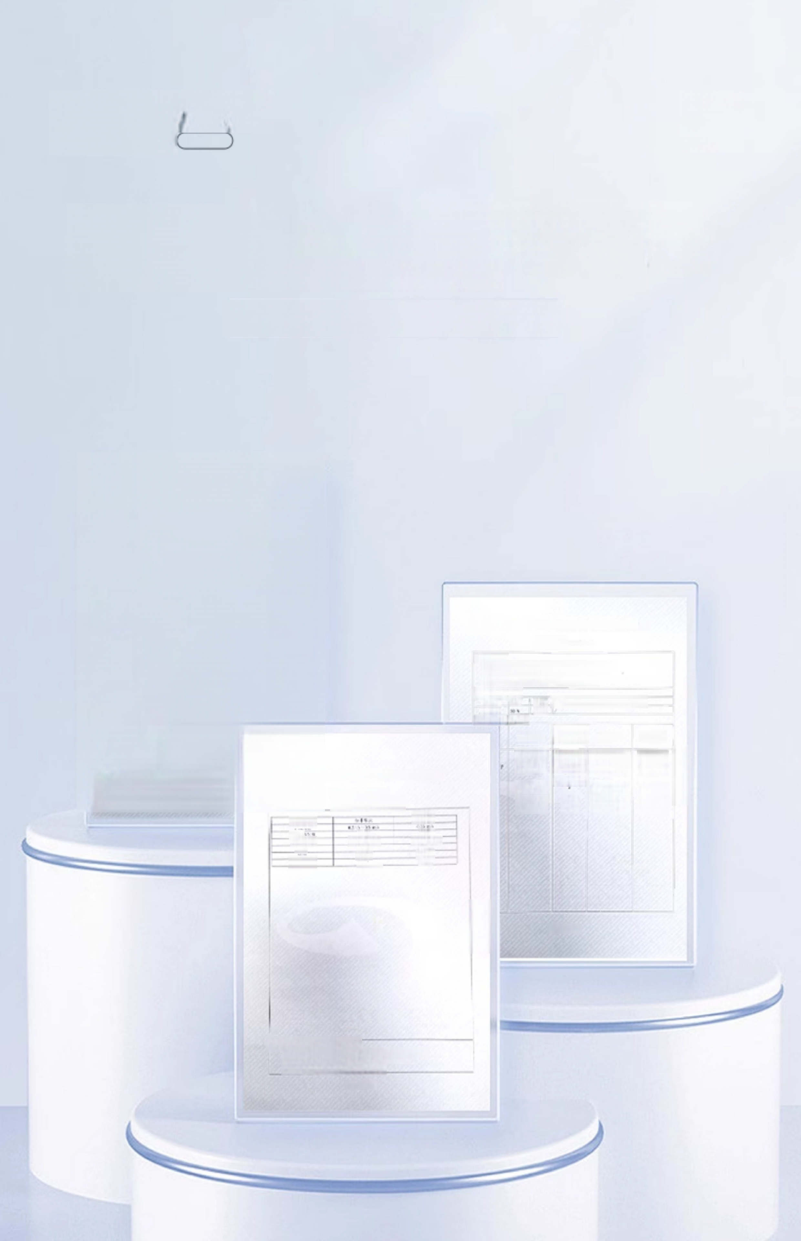





Ultra-clean table
Clean bench
Authoritative Inspection package
quality inspection passed
Give you enough sense of security
Hebei Institute of Metrology Supervision and Testing
Test Certificate
Enquiry No.:0200
Customer Name Service Limited Company
器典器称尼净工介
梨 / 殿 格 wC50
Factory No.15201
The inner rooms on the pass seat are
respectively limited to the company's
trial party 2 net workers.
Hebei Institute of Metrology Supervision and Testing
Number:0
K因世点武棒 5秘量ra 批， 填止里质前希弊 概 觉 检 觉 利 性 查 为 世 本 本 * x r 步 x r s .
FL
画度 |  | Point | 考 重 平 A 点 网 立 两 9 博
时 E t |  | 买绝
w a 8 由 ：
 | ER |  | 这 应生/监大虫 3温 | 9 | E瓶
 | 50 85-c 上 (e |  | 040的 a 时 L | n2 2 200* | P12 11
Shengzhun
唯治员
Ren
2 April 1,20
Renbao 侯抓
II
₄ ⁰ ₍^{重} ^{大} ^{市} ^{主X}
198
Hebei Institute of Metrology Supervision and Testing
证 时， E
3 2 然 熟
₉ (116 搭 b
f4
德
5 自
C
3
118共K
, , 市a,
A报 1 4
L19Y
天P 本 1 0
世
不 姓 ，
4 4 与
严
器
4
头
9 热
t
发

Slide 10
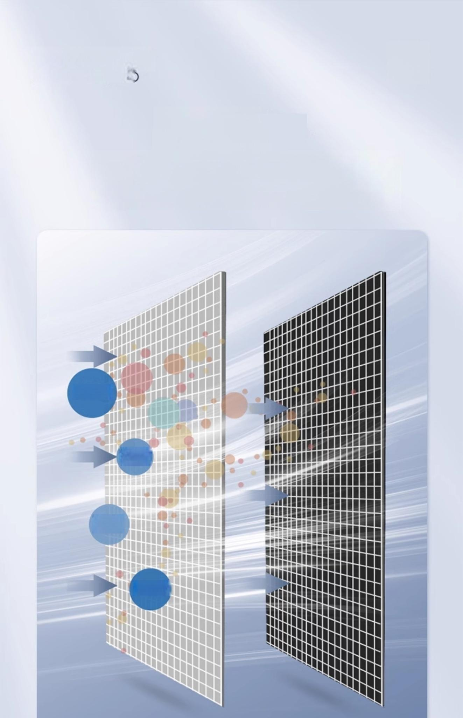

Ultra-clean table Clean bench
From the
inside out
Triple "net"Guardian
Bacteria
Dust
Hair
Particles

Slide 11

01 High-efficiency integrated filter
The first line of defense,effectively blocking dust,bacteria and other pollutants filtered air has been vertical or horizontal airflow output
* National Air Conditioning Equipment Quality Supervision and Inspection Center Report No.:2017H38

Slide 12
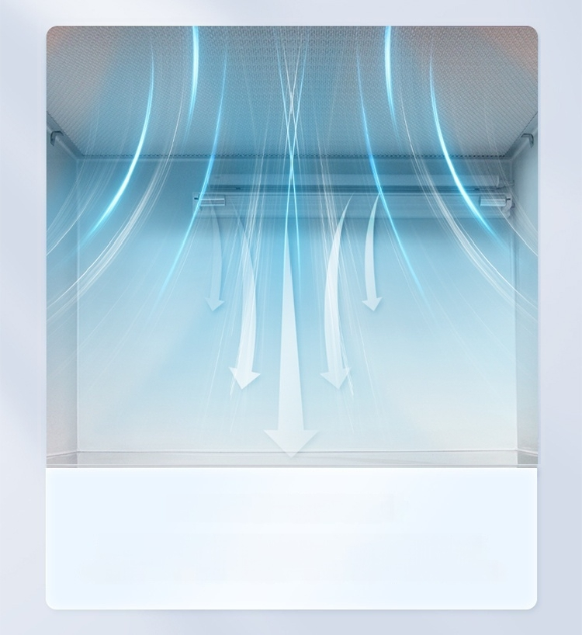
02 Air curtain isolation design
The filtered air is vertically or horizontally output to form a high
ultra-clean air curtain to remove the original natural air in the
ultra-clean area,effectively preventing bacterial cross-contamination

Slide 13
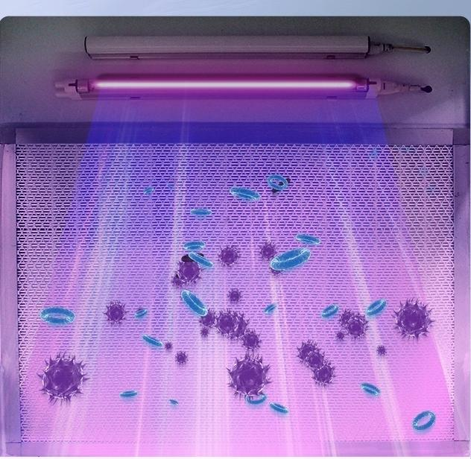



03360 degrees without fear of dead angle effective sterilization
Provide you with a sterile working environment
With anti-ultraviolet lamp damage device,the ultraviolet lamp
and the lighting lamp cannot be turned on at the same time.
Horse
High transmittance
High strength
Long life
Interlock function
Note:SN-C]-1DQSN-CJ-1GQ,table type all-steel 850 series,all-steel 650 series without interlocking function

Slide 14
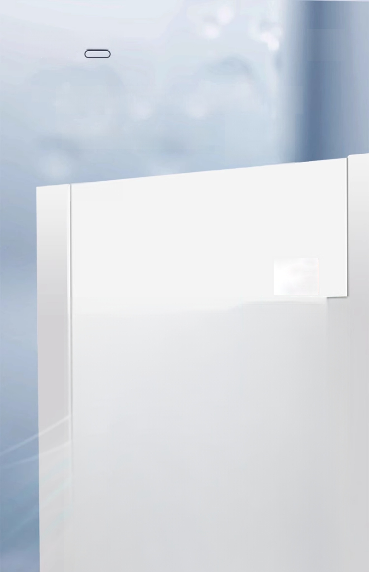


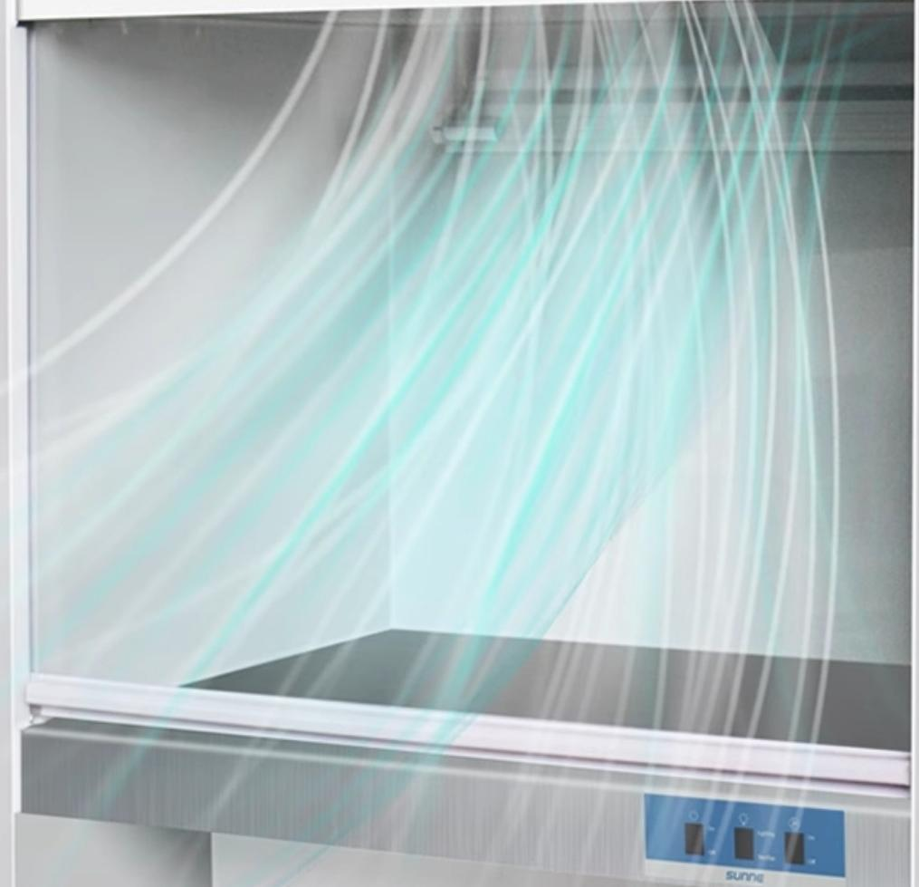
Ultra-clean table
Clean bench
Multi-gear control wind speed
^{All} ^{the} ^{wind} ^{can} ^{reach}
重

Slide 15
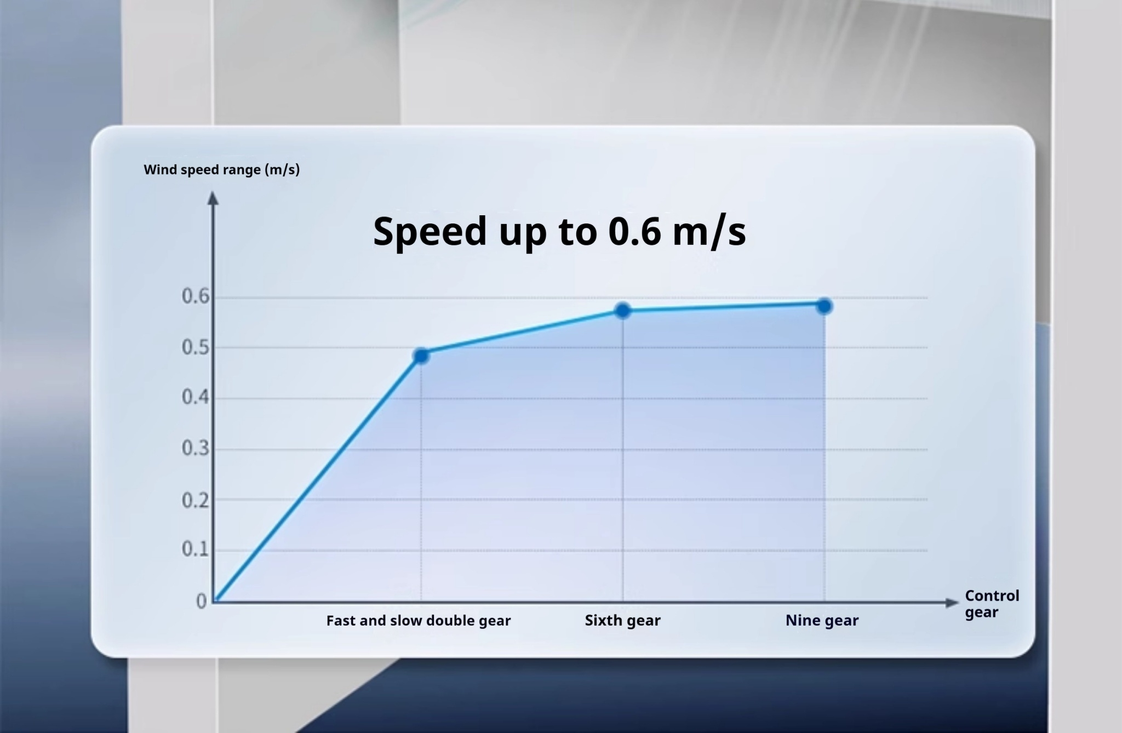

Slide 16
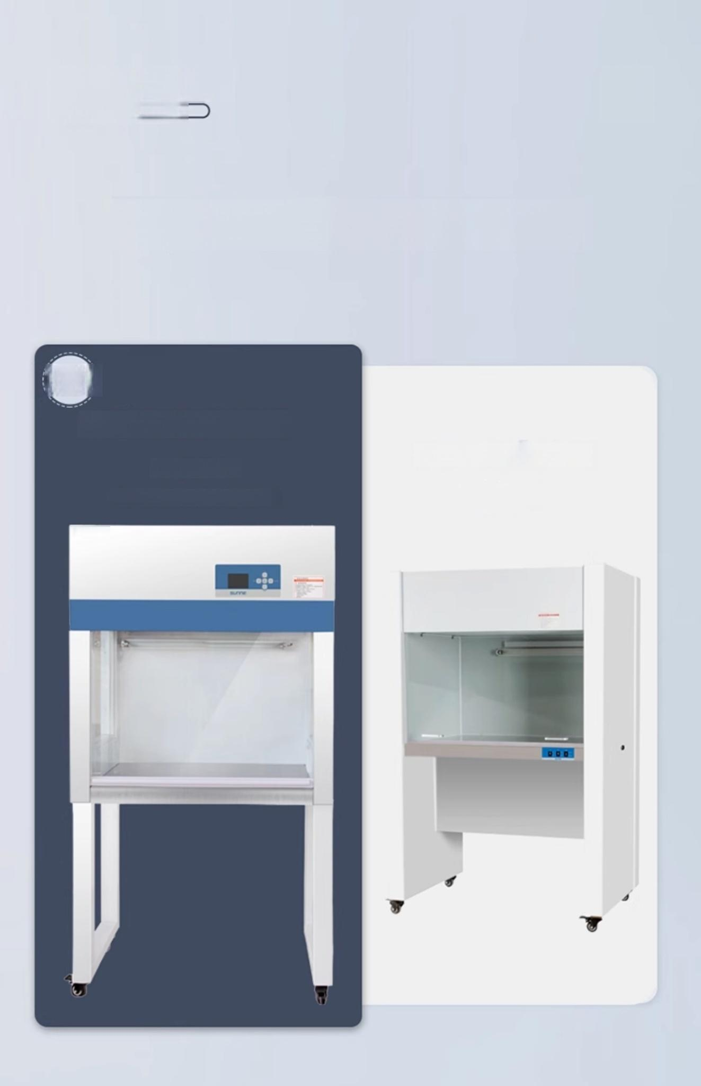

Ultra-clean table
Clean bench C
Enjoy the silky Not easy to fall off
Upgrade
Constant force spring lift door
Easy push and pull
Move up and down with the heart
Hand-pull sliding door
(Old Model)

Slide 17


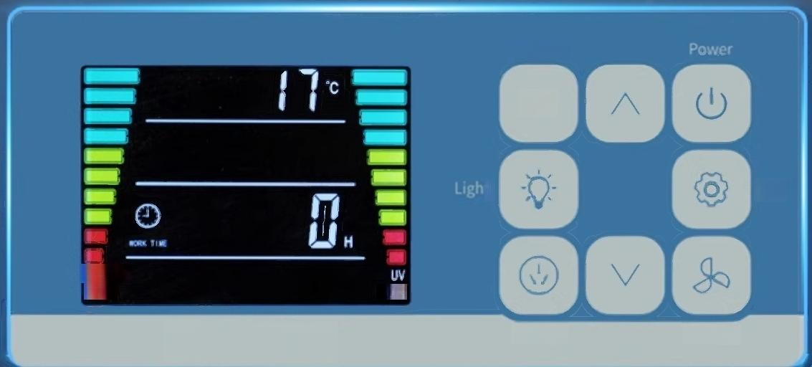
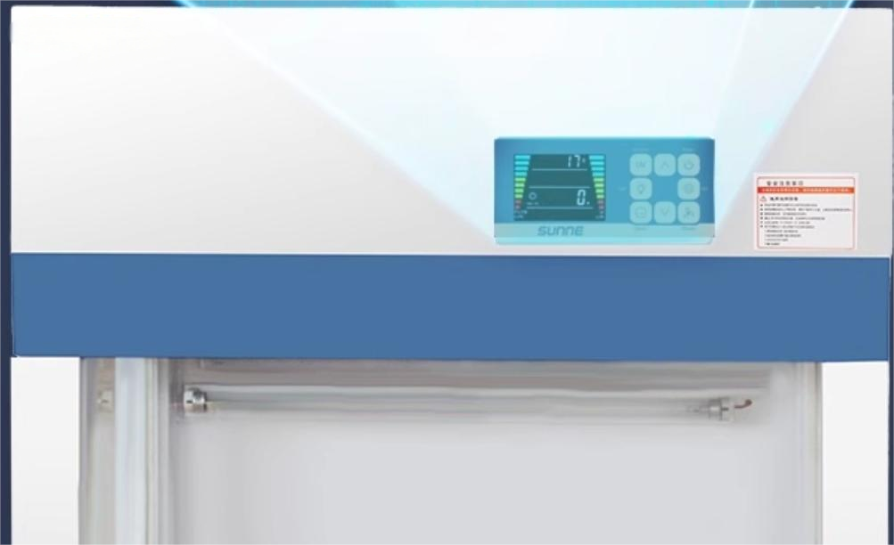
Ultra-clean table
Clean bench
Large screen HD digital display
Smart buttons are easier
Sterilize
UV
t Set
FILTER
LIFE LIFE
Socket
Blower

Slide 18




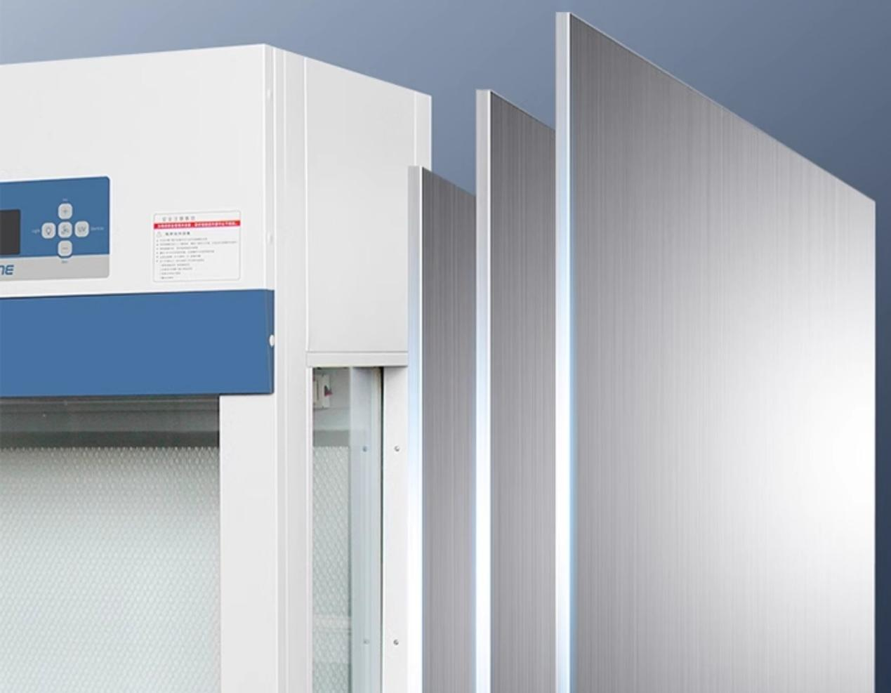
Ultra-clean table Clean bench (
Thickened all-steel
Anti-rust and anti-corrosion
more durable
The shell is made of high-quality steel plate,which is easy to clean.
No rust
Corrosion-resistant
Does not deform

Slide 19
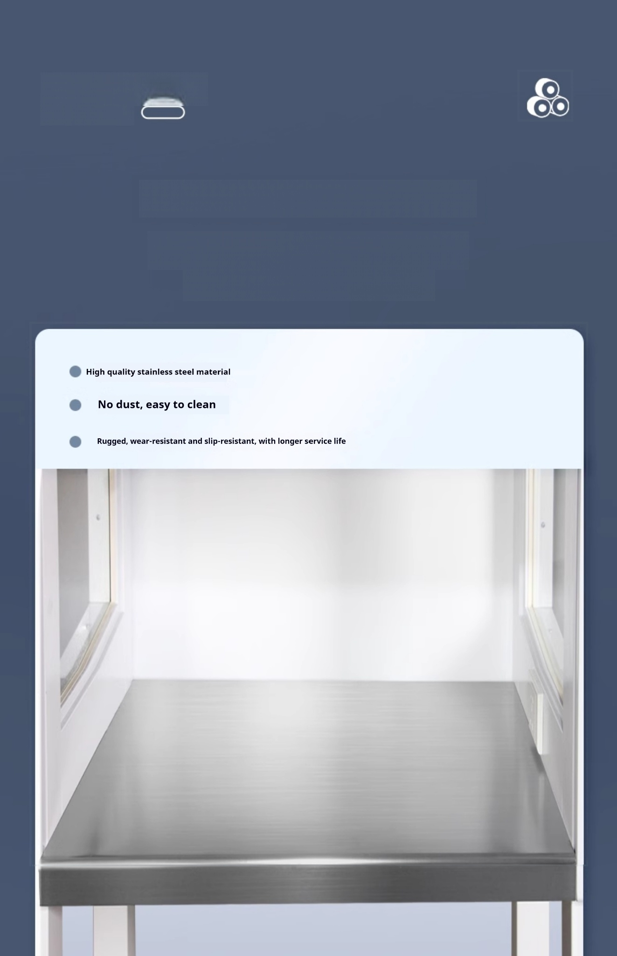
Ultra-clean table
Clean bench
Stainless steel work surface
Corrosion resistance and no dust generation

Slide 20
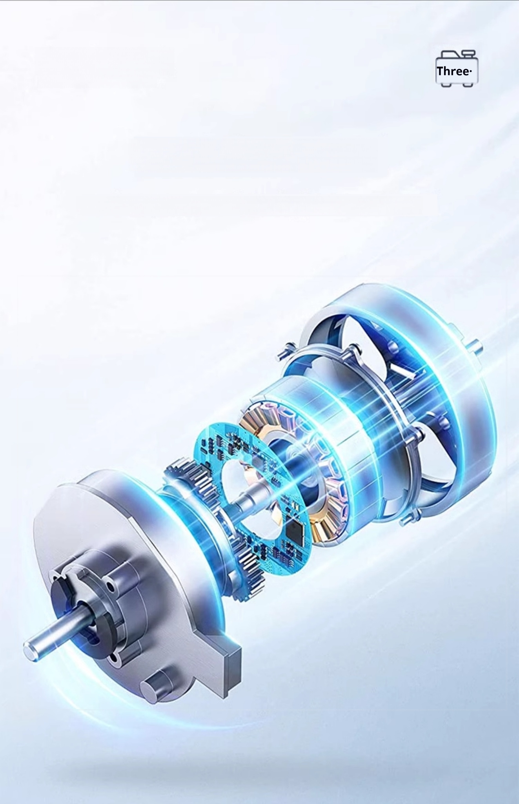
Ultra-clean table
Clean bench
Cite axial flow motor
Power transmission is more powerful and stable,reducing noise output

Slide 21
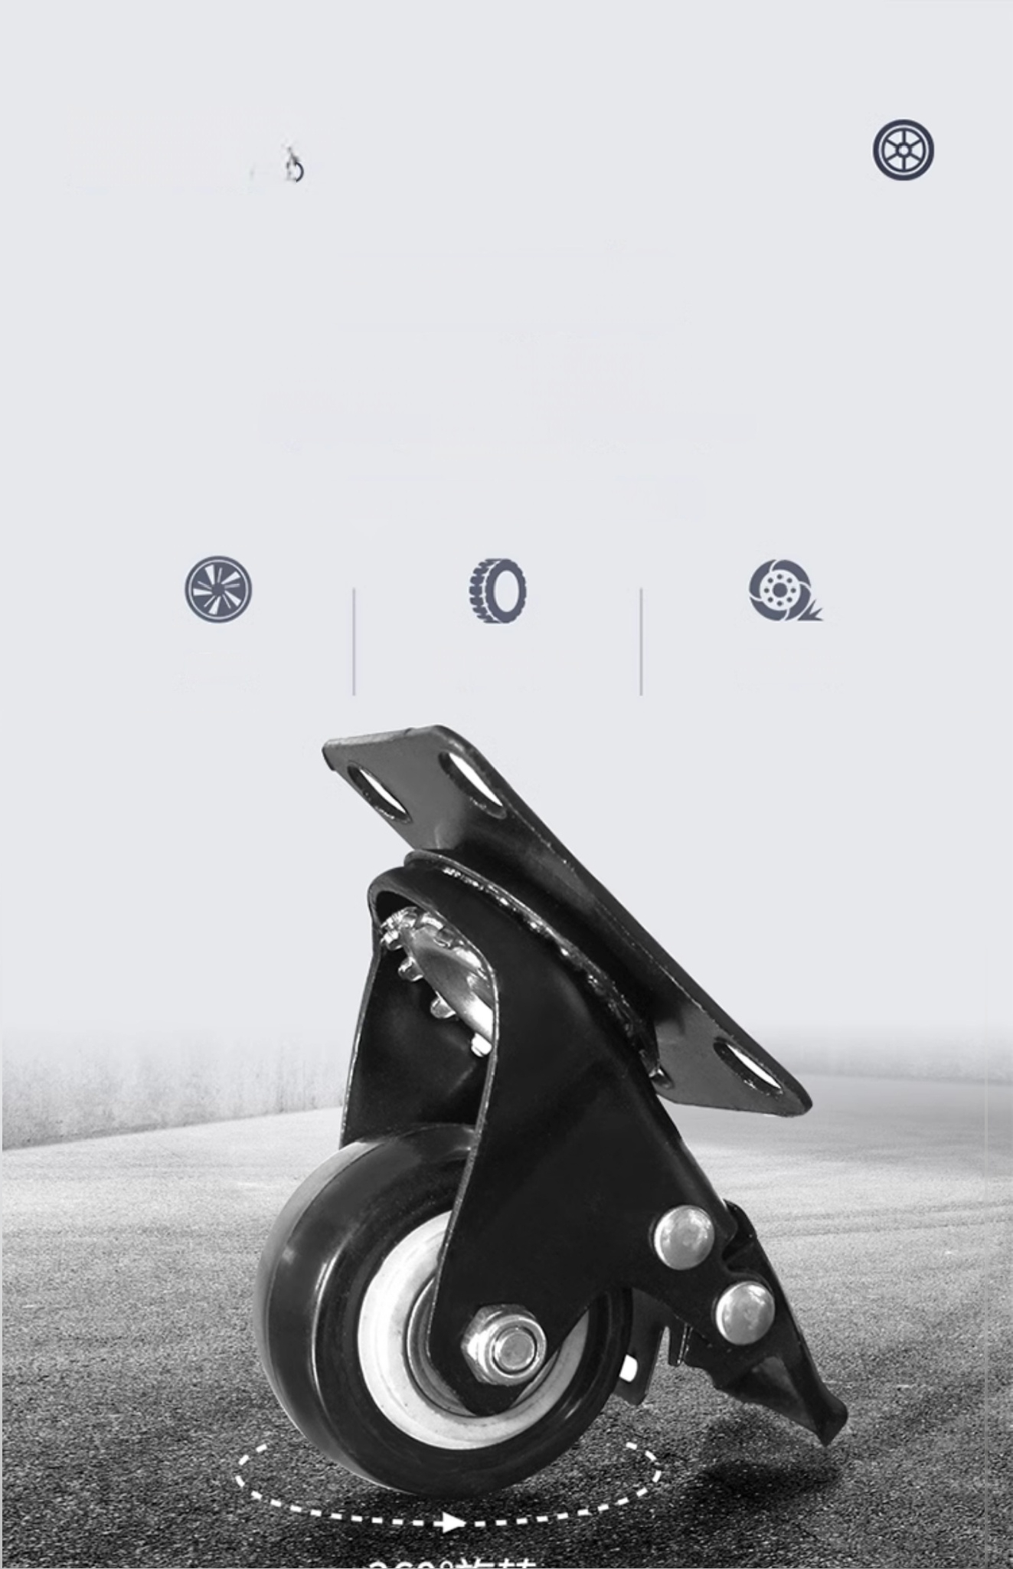
Ultra-clean table
Clean bench
360°double row
Shock-absorbing gimbal pulley
It is no longer difficult to move objects.
Smooth
Wear-resistant Brakeable

Slide 22
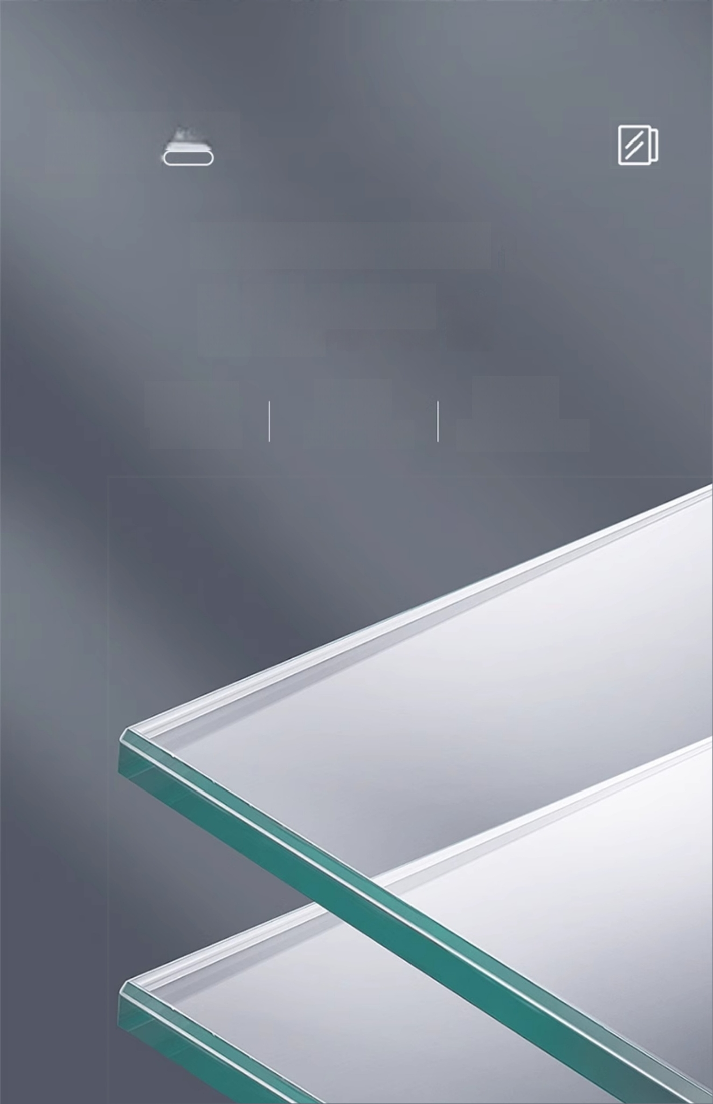
Ultra-clean table
Clean bench
Visualization 4mm
Tempered glass window
4mm
Thickness
CCC
Certification
99%
Transmissivity

Slide 23
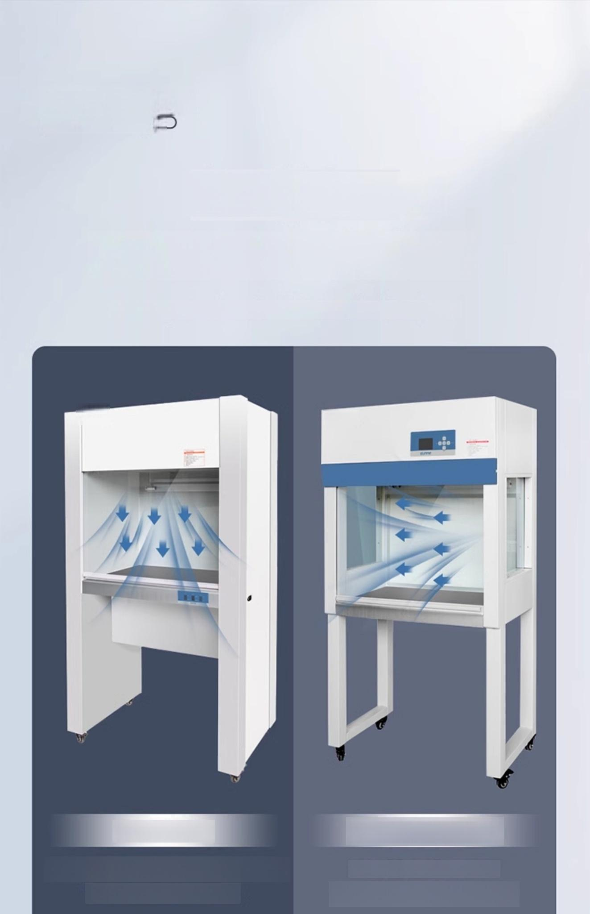

Ultra-clean table
Clean bench C
Vertical/Horizontal
Difference of air supply mode
Two kinds of air supply way sterilization effect is the same
Vertical air supply Horizontal air supply
The filter is at the top of the operating area
Maintain top air circulation
Filter on the back of the operation
Try not to lean against the wall

Slide 24
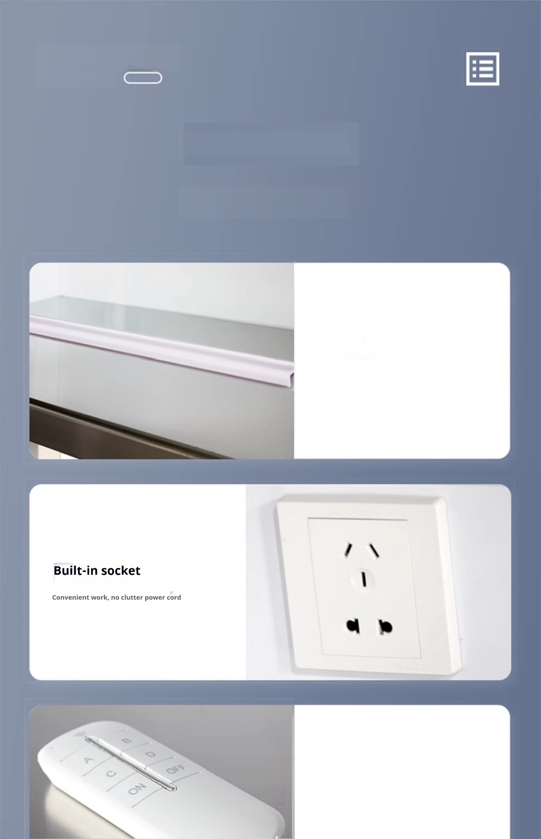
Ultra-clean table
Clean bench
Attention to detail
Quality Assurance
Constant force spring lift door
Easy operation
Equipped with remote control
(Unique to the 650Q|850Q series only)

Slide 25
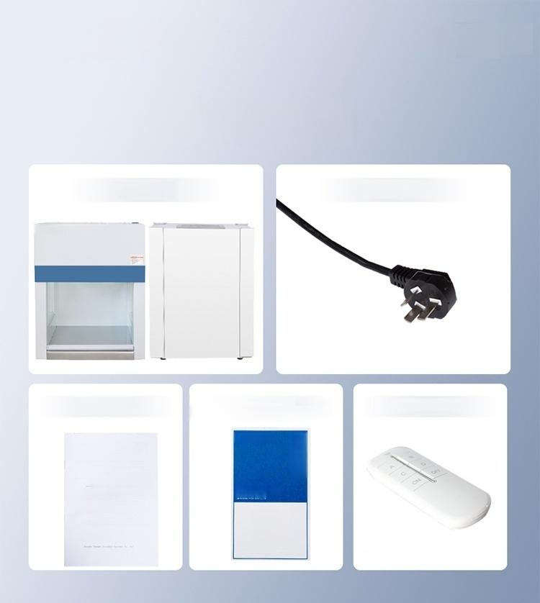

Ultra-clean table Clean bench
Host 1
sunn
A copy of the
instructions
sunne
Clean bench
User manual
1A*
Product
Packing List
1 power cord
Remote Control
Unique to 650Q\850Q series only
One copy of product
certificate warranty card
sunne 当位
1+0
产度量合路
i11
上
an
80%%

Slide 26

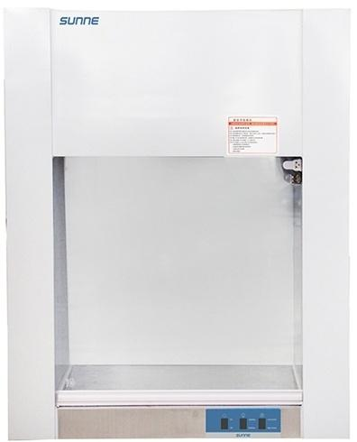


Ultra-clean bench(economic)
SN-VD-650
Air supply mode Applicable number of persons Average wind speed | Vertical air supply Single One-sided 0.2m/s
Wind speed control | First gear
Control method | Key control
Illumination intensity | ≥300Lx
UV lamp power | 8W×1
Constant force spring lift door | √
Stainless steel countertop | √
*This is not
free shipping
Upgraded
Version
Product size:650*450*740mm Work area size:485*400*460mm
Note:the above dimensions are manual measurement,if there is any
error please prevail in kind!

Slide 27

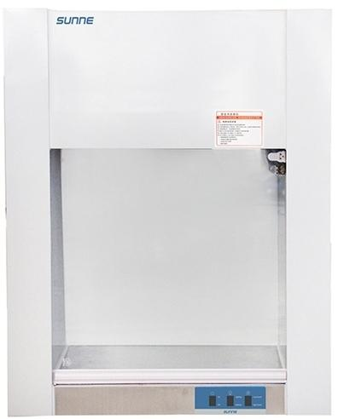


Clean bench (table)
SN-VD-650
Air supply mode Applicable number of persons Average wind speed Wind speed control Control method Illumination intensity UV lamp power Constant force spring lift door Stainless steel countertop | Vertical air supply Single One-sided
 | 0.25m/s
 | Fast and slow two gears
 | Key control
 | ≥300Lx
 | 8W×1
 | √
 | √
Upgraded
Version
Cleanliness:100 @≥0.5um(US Federal 211E)
Product size:650*450*840mm Work area size:485*400*500mm
Note:the above dimensions are manual measurement,if there is any error
please prevail in kind!

Slide 28


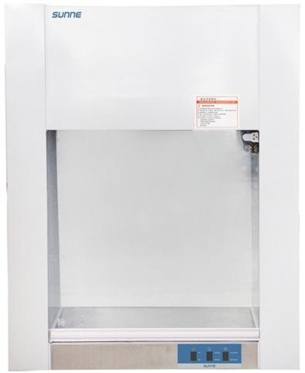


Clean bench(table)
SN-H | D-650
Air supply mode Applicable number of persons Average wind speed | Horizontal air supply Single One-sided 0.25m/s
Wind speed control | Fast and slow two gears
Control method | Key control
Illumination intensity | ≥300Lx
UV lamp power | 8W×1
Constant force spring lift door | √
Stainless steel countertop | √
Upgraded
Version
Cleanliness:100 @≥0.5um(US Federal 212E)
Product size:650*450*840mm Work area size:485*320*540mm
Note:the above dimensions are manual measurement,if there is any error
please prevail in kind!

Slide 29


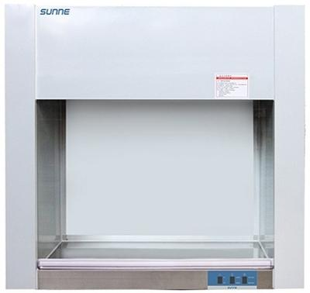


Clean bench(table)
SN-VD-850
Air supply mode Applicable number of persons | Vertical air supply Single One-sided
Average wind speed | 0.35m/s
Wind speed control | Fast and slow two gears
Control method | Key control
Illumination intensity | ≥300Lx
UV lamp power | 8W×1
Constant force spring lift door | √
Stainless steel countertop | √
Support for inspection | √
Upgraded
Version
Cleanliness:100 @≥0.5um(US Federal 213E)
Product size:875*535*870mm Work area size:700*480*510mm
Note:the above dimensions are manual measurement,if there is any error
please prevail in kind!

Slide 30


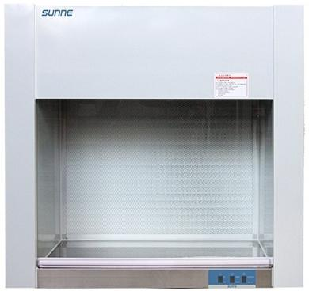


Clean bench(table)
SN-HD-850
Air supply mode | Horizontal air supply
Applicable number of persons Average wind speed Wind speed control Control method Illumination intensity UV lamp power Constant force spring lift door Stainless steel countertop Support for inspection | Single One-sided
 | 0.35m/s
 | Fast and slow two gears
 | Key control
 | ≥300Lx
 | 8W×1
 | √
 | √
 | √
Upgraded
Version
Cleanliness:100 @≥0.5um(US Federal 214E)
Product size:875*535*870mm Work area size:700*400*550mm
Note:the above dimensions are manual measurement,if there is any error
please prevail in kind!

Slide 31


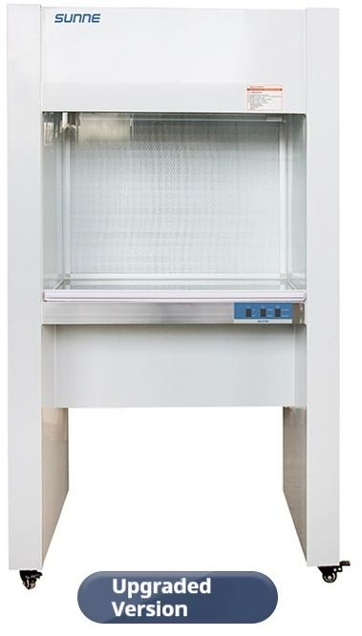

Ultra-clean workbench(floor type)
SN-CJ-1G
Air supply mode Applicable number of persons Average wind speed | Horizontal air supply Single One-sided 0.35m/s
Wind speed control Control method | Fast and slow two gears Key control
Illumination intensity | ≥300Lx
UV lamp power | 20W×1
Constant force spring lift door | √
Stainless steel countertop | √
Support for inspection | √
Cleanliness:100 @≥0.5um(US Federal 215E)
Product size:875*535*1565mm Work area size:700*400*550mm
Note:the above dimensions are manual measurement,if there is any error
please prevail in kind! …… …

Slide 32


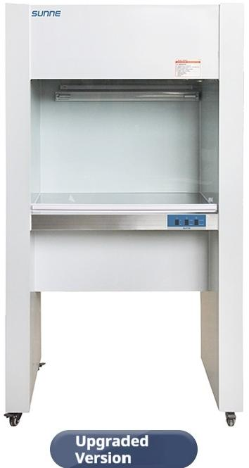

Ultra-clean workbench(floor type)
SN-CJ-1D
Air supply | Vertical air
mode | supply
Applicable number | Single
of persons | One-sided
Average wind speed | 0.35m/s
Wind speed control | Fast and slow two gears
Control method | Key control
Illumination intensity | ≥300Lx
UV lamp power | 20W×1
Constant force spring lift door | √
Stainless steel countertop | √
Support for inspection | √
Cleanliness:100 @≥0.5um(US Federal 216E)
Product size:875*535*1565mm Work area size:700*480*510mm
Note:the above dimensions are manual measurement,if there is any error
please prevail in kind! ……

Slide 33

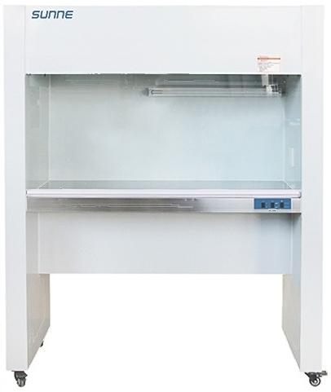


Ultra-clean workbench(floor type)
SN-CJ-2D
Air supply mode Applicable number of persons | Vertical air supply Double single
Average wind speed | 0.35m/s
Wind speed control | Fast and slow two gears
Control method | Key control
Illumination intensity | ≥300Lx
UV lamp power | 30W×1
Constant force spring lift door | √
Stainless steel countertop | √
Built-in socket Support for inspection | √ √
Upgraded
Version
Cleanliness:100@≥0.5um(US Federal 217E)
Product size:1285*535*1580mm Work area size:1110*480*510mm
Note:the above dimensions are manual measurement,if there is any error
please prevail in kind!
-
…

Slide 34

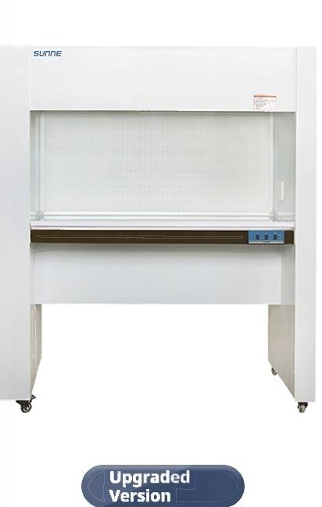

Ultra-clean workbench(floor type)
SN-CJ-2G
Air supply mode Applicable number of persons Average wind speed Wind speed control Control method Illumination intensity UV lamp power Constant force spring lift door Stainless steel countertop Built-in socket Support for inspection | Horizontal air supply Double Single
 | 0.35m/s
 | Fast and slow two gears
 | Key control
 | ≥300Lx
 | 30W×1
 | √
 | √
 | √
 | √
Cleanliness:100 @≥0.5um(US Federal 218E)
Product size:1285*535*1580mm Work area size:1110*400*550mm
Note:the above dimensions are manual measurement,if there is any error
please prevail in kind!
-
…

Slide 35

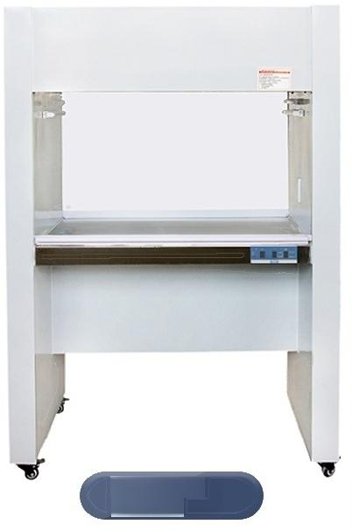

Ultra-clean workbench(floor type)
SN-CJ-1F
Air supply mode Applicable number of persons | Vertical air supply Single double-sided
Average wind speed | 0.35m/s
Wind speed control | Fast and slow two gears
Control method | Key control
Illumination intensity | ≥300Lx
UV lamp power | 8W×2
Constant force spring lift door | √
Stainless steel countertop | √
Built-in socket | √
Support for inspection | √
sunnE
雅
Upgraded
Version
Cleanliness:100 @≥0.5um(US Federal 219E)
Product size:1045*675*1580mm Work area size:870*600*510mm
Note:the above dimensions are manual measurement,if there is any error
please prevail in kind!
- …

Slide 36

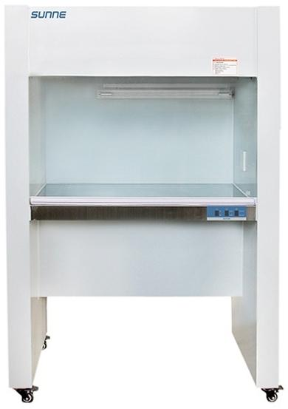


Ultra-clean workbench(floor type)
SN-CJ-1FD
Air supply mode Applicable number of persons Average wind speed Wind speed control Control method Illumination intensity UV lamp power Constant force spring lift door Stainless steel countertop Built-in socket Support for inspection | Vertica air supply
 | Single One-sided
 | 0.35m/s
 | Fast and slow two gears
 | Key control
 | ≥300Lx
 | 20W×1
 | √
 | √
 | √
 | V
Upgraded
Version
Cleanliness:100 @≥0.5um(US Federal 220E)
Product size:1045*655*1580mm Work area size:870*600*510mm
Note:the above dimensions are manual measurement,if there is any error
please prevail in kind!
-
…

Slide 37
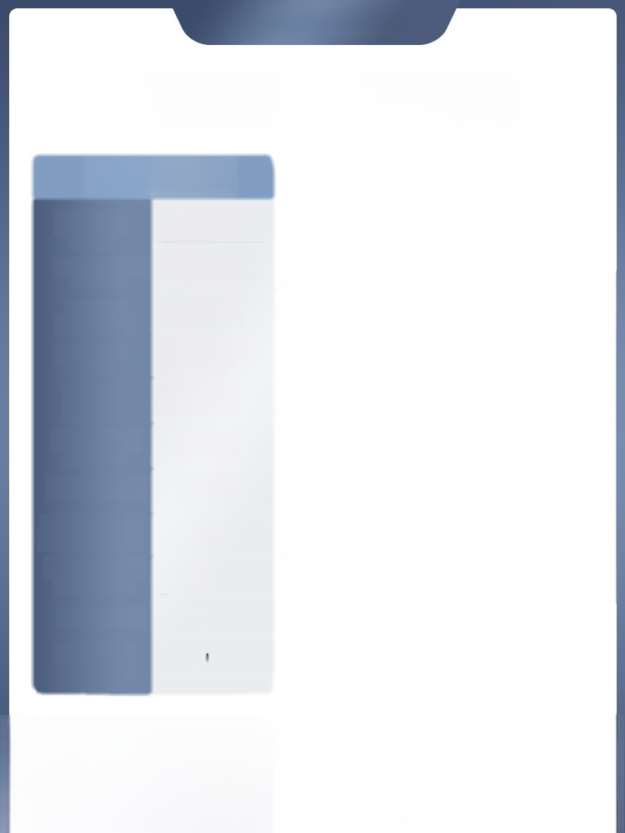
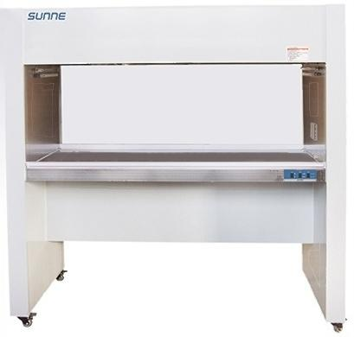


Ultra-clean workbench(floor type)
SN-CJ-2F
Air supply mode Applicable number of persons Average wind speed Wind speed control Control method Illumination intensity UV lamp power Constant force spring lift door Stainless steel countertop Built-in socket Support for inspection | Vertical air supply Double-sided
 | 0.35m/s
 | Fast and slow two gears
 | Key control
 | ≥300Lx
 | 8W×2
 | √
 | √ √
 | √
Upgraded
Version
Cleanliness:100@≥0.5um(US Federal 221E)
Product size:1535*675*1580mm Work area size:1360*600*510mm
Note:the above dimensions are manual measurement,if there is any error
please prevail in kind!
- ……

Slide 38

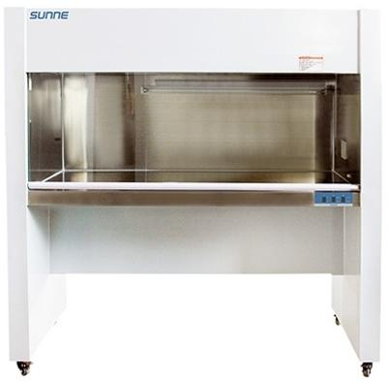


Ultra-clean workbench(floor type)
SN-CJ-2FD
Air supply mode Applicable number of persons | Vertical air supply Double Single
Average wind speed | 0.35m/s
Wind speed control | Fast and slow two gears
Control method | Key control
Illumination intensity | ≥300Lx
UV lamp power | 30W×1
Constant force spring lift door | √
Stainless steel countertop | √
Built-in socket | √
Support for inspection | √
Upgraded
Version
Cleanliness:100@≥0.5um(US Federation 222E)
Product size:1535*655*1580mm Work area size:1360*600*510mm
Note:the above dimensions are manual measurement,if there is any error
please prevail in kind!
-
…

Slide 39

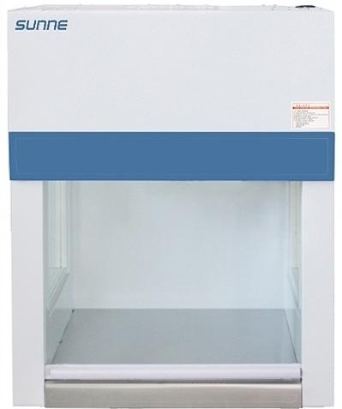


AIl-steel clean table(table type) )
SN-VD-650Q
Air supply mode Applicable number of persons Average wind speed | Vertical air supply Single One-sided 0.25m/s
Wind speed control | Fast and slow two gears
Control method | Remote control switch
Illumination intensity | ≥300Lx
UV lamp power | 8W×1
Constant force spring lift door | √
Stainless steel countertop | √
Upgraded
Version
Cleanliness:100 @≥0.5um(US Federal 223E)
Product size:605*510*835mm Work area size:480*480*460mm
Note:the above dimensions are manual measurement,if there is any error
please prevail in kind!
-
--

Slide 40


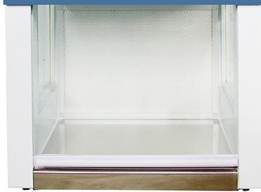


AIl-steel clean table(table type) )
SN-HD-650Q
Air supply mode Applicable number of persons Average wind speed Wind speed control Control method Illumination intensity UV lamp power Constant force spring lift door Stainless steel countertop | Horizontal air supply Single One-sided
 | 0.25m/s
 | Fast and slow two gears
 | Remote control switch
 | ≥300Lx
 | 8W×1
 | √
 | √
SunnE
Upgraded
Version
Cleanliness:100 @≥0.5um(US Federal 224E)
Product size:605*510*835mm Work area size:480*420*460mm
Note:the above dimensions are manual measurement,if there is any error
please prevail in kind!
-
…

Slide 41




All-steel clean table(table type)
SN-VD-850Q
Air supply mode Applicable number of persons Average wind speed | Vertical air supply Single One-sided 0.35m/s
Wind speed control | Fast and slow two gears
Control method | Remote control switch
Illumination intensity | ≥300Lx
UV lamp power | 20W
Constant force spring lift door | √
Stainless steel countertop | √
Support for inspection | √
SUnnE
Cleanliness:100 @≥0.5um(US Federal 225E)
Product size:825*520*930mm Work area size:700*480*540mm
Note:the above dimensions are manual measurement,if there is any error please prevail in kind!

Slide 42




All-steel clean table(table type)
SN-HD-850Q
Air supply mode Applicable number of persons Average wind speed | Horizontal air supply Single One-sided 0.35m/s
Wind speed control | Fast and slow two gears
Control method | Remote control switch
Illumination intensity | ≥300Lx
UV lamp power | 20W
Constant force spring lift door | √
Stainless steel countertop Support for inspection | √ √
sunnE
Cleanliness:100@≥0.5um(US Federal 226E)
Product size:825*520*930mm Work area size:700*420*520mm
Note:the above dimensions are manual measurement,if there is any error
please prevail in kind!

Slide 43



All-steel clean bench(floor type)
SN-CJ-1DQ
Air supply mode Applicable number of persons | Vertical air supply Single One-sided
Average wind speed | 0.35m/s
Wind speed control | Six-speed speed reguiation
Control method | LCD instrument
Illumination intensity | ≥300Lx
UV lamp power | 20W×1
Constant force spring lift door | √
Stainless steel countertop | √
Built-in socket | √
Support for inspection | √
Upgraded
Version
Cleanliness:100 @≥0.5um(US Federal 227E)
Product size:825*520*1570mm Work area size:700*480*540mm
Note:the above dimensions are manual measurement,if there is any error
please prevail in kind!
-

Slide 44



All-steel clean bench(floor type)
SN-CJ | -1GQ
Air supply mode Applicable number of persons Average wind speed Wind speed control Control method Illumination intensity UV lamp power Constant force spring lift door Stainless steel countertop Built-in socket Support for inspection | Horizontal air supply Single One-sided
 | 0.35m/s
 | Six-speed speed reguiation
 | LCD instrument
 | ≥300Lx
 | 20W×1
 | √
 | √
 | √
 | √
Upgraded
Verslon
Cleanliness:100 @≥0.5um(US Federal 228E)
Product size:825*520*1570mm Work area size:700*420*520mm
Note:the above dimensions are manual measurement,if there is any error please prevail in kind!
--

Slide 45




All-steel clean bench(floor type)
SN-CJ-2DQ
Air supply mode Applicable number of persons | Vertical air supply Double Single
Average wind speed | 0.35m/s
Wind speed control | Six-speed speed regulation
Control method | LCD instrument
Illumination intensity | ≥300Lx
UV lamp power | 30W×1
Constant force spring lift door | √
Stainless steel countertop | √
Timed sterilization | √
Built-in socket | √
Support for inspection | √
Upgraded
Version
Cleanliness:100@≥0.5um(US Federal 229E)
Product size:1270*525*1570mm Work area size:1150*480*560mm
Note:the above dimensions are manual measurement,if there is any error
please prevail in kind!
-
…

Slide 46



All-steel clean bench(floor type)
SN-CJ-2GQ
Air supply mode Applicable number of persons Average wind speed | Horizontal air supply Double Single
 | 0.35m/s
Wind speed control Control method Illumination intensity UV lamp power Constant force spring lift door Stainless steel countertop Timed sterilization Built-in socket Support for inspection | Six-speed speed regulation
 | LCD instrument
 | ≥300Lx
 | 30W×1
 | √
 | √
 | √
 | √ √
Upgraded
Version
Cleanliness:100 @≥0.5um(US Federal 210E)
Product size:1270*525*1570mm Work area size:1150*420*520mm
Note:the above dimensions are manual measurement,if there is any error
please prevail in kind!
-
…

Slide 47




All-steel clean bench(floor type)
SN-CJ-1FDQ
Air supply mode Applicable number of persons | Vertical air supply Single One-sided
Average wind speed | 0.35m/s
Wind speed control | Nine speed
Control method | LCD instrument
Illumination intensity | ≥300Lx
UV lamp power | 30W×1
Constant force spring lift door | √
Stainless steel countertop | √
Timed sterilization | √
Built-in socket | √
Support for inspection | √
Cleanliness:100 @≥0.5um(US Federal 212E)
Product size:990*650*1610mm Work area size:870*600*560mm
Note:the above dimensions are manual measurement,if there is any error
please prevail in kind!
- - ---

Slide 48



All-steel clean bench(floor type)
SN-CJ-1FQ
Air supply mode Applicable number of persons Average wind speed Wind speed control Control method Illumination intensity UV lamp power Constant force spring lift door Stainless steel countertop Timed sterilization Built-in socket Support for inspection | Vertical air supply Single double-sided 0.35m/s
 | Nine speed
 | LCD instrument
 | ≥300Lx
 | 20W×1
 | √
 | √
 | √
 | √ √
Cleanliness:100 @≥0.5um(US Federal 211E)
Product size:990*640*1610mm Work area size:870*600*560mm
Note:the above dimensions are manual measurement,if there is any error
please prevail in kind!
-
…

Slide 49




All-steel clean bench(floor type)
SN-CJ-2FDQ
Air supply mode Applicable number of persons Average wind speed Wind speed control Control method Illumination intensity UV lamp power Constant force spring lift door Stainless steel countertop Timed sterilization Built-in socket Support for inspection | Vertical air supply Double Single 0.35m/s
 | Nine speed
 | LCD instrument
 | ≥300Lx
 | 30W×1
 | √
 | √
 | √
 | √ √
Upgraded
Version
Cleanliness:100@≥0.5um(US Federal 214E)
Product size:1483*650*1610mm Work area size:1360*600*540mm
Note:the above dimensions are manual measurement,if there is any error
please prevail in kind!
-… …

Slide 50



All-steel clean bench(floor type)
SN-CJ-2FQ
Air supply mode Applicable number of persons Average wind speed Wind speed control Control method Illumination intensity UV lamp power Constant force spring lift door Stainless steel countertop Timed sterilization Built-in socket Support for inspection | Vertical air supply Double-sided
 | 0.35m/s
 | Nine speed
 | LCD instrument
 | ≥300Lx
 | 30W×1
 | √
 | √
 | √
 | √ √
Cleanliness:100@≥0.5um(US Federal 213E)
Product size:1483*640*1610mm Work area size:1360*600*560mm
Note:the above dimensions are manual measurement,if there is any error
please prevail in kind!
-- …

Slide 51


