Slide 1

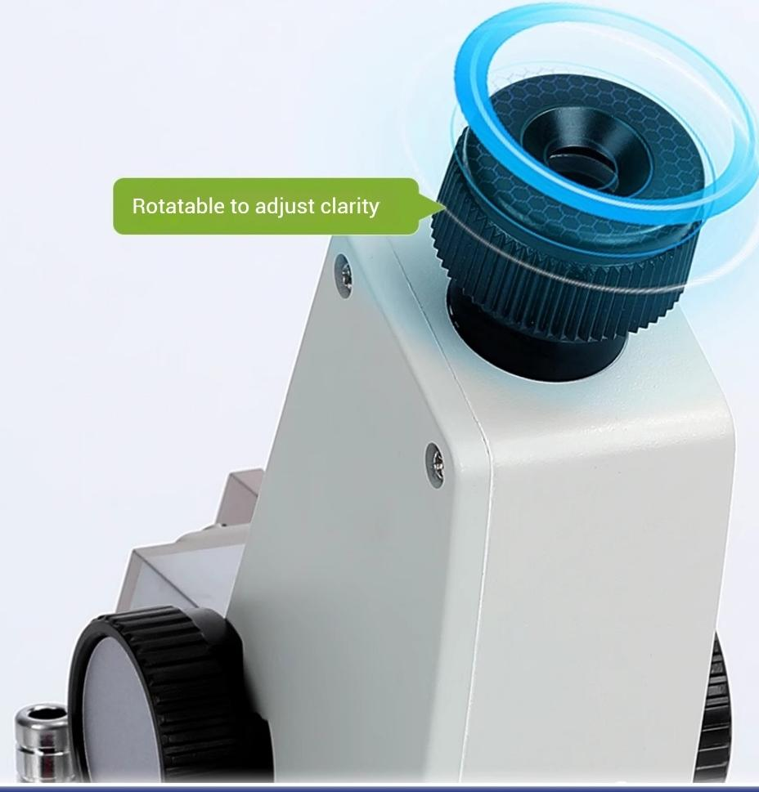


_{Visual} _{Aim} ^{Greater} ^{accuracy}
Using visual aiming,optical dial
reading temperature digital display,
simple and reliable
%
0 5 10
,3201,3301,340 1,
nD

Slide 2

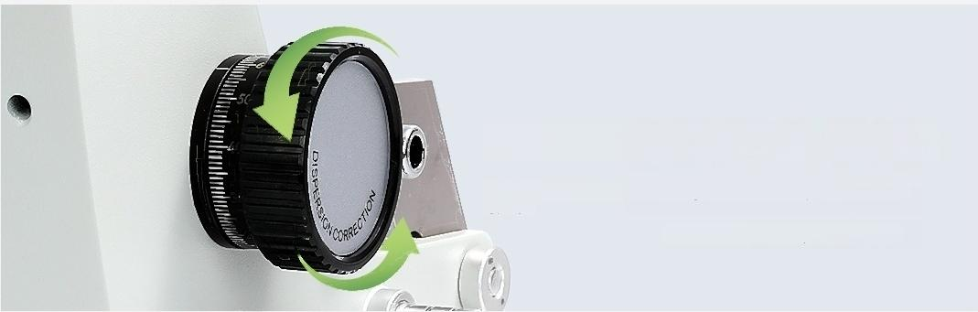

Eyepiece tube
Rotatable to adjust clarity
Dispersion adjustment handwheel
When there is no color in the bright-dark boundary line in the field
of view
It is the current dispersion value
Refractive index scale
Adjustment handwheel
Rotate to adjust the refractive index

Slide 3
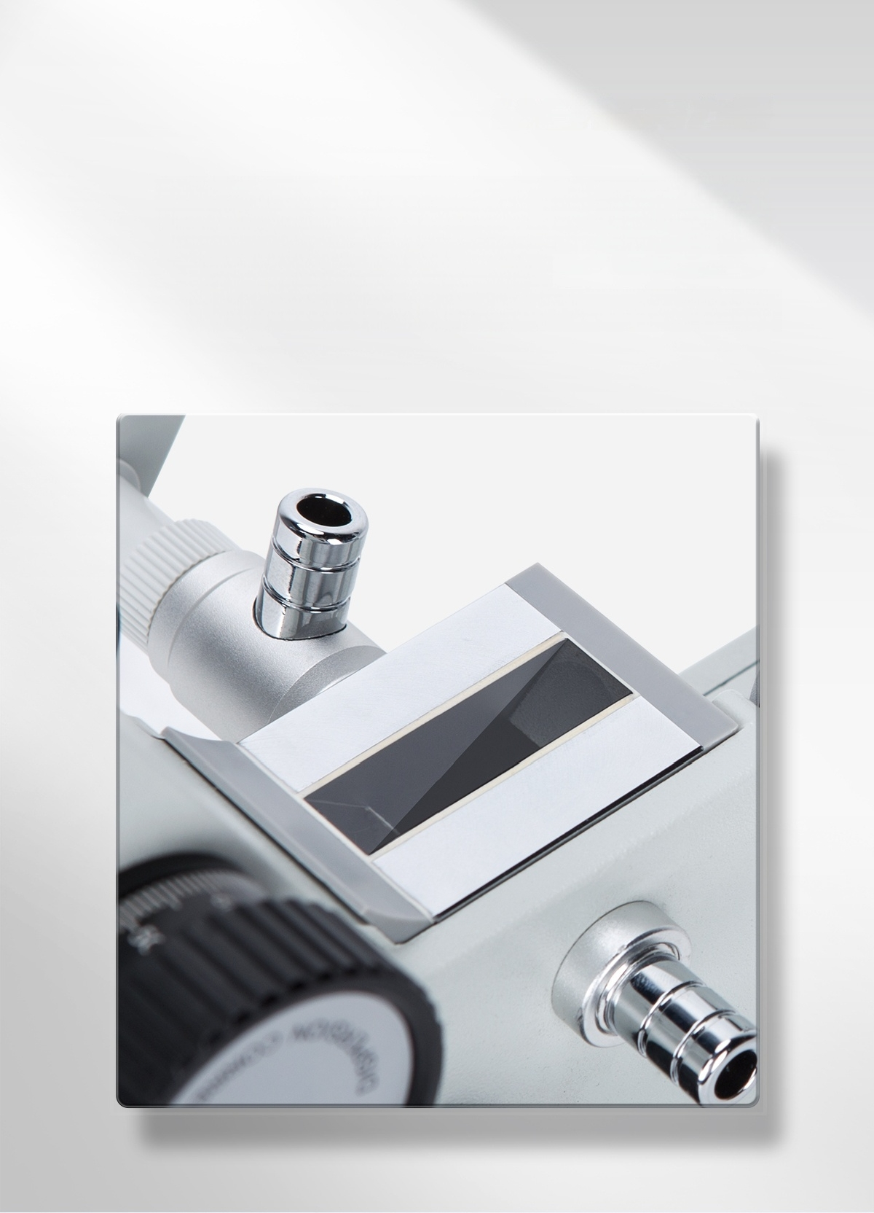
High-definition prism has good
light transmittance
The prism is made of hard glass,and the data is clearly visible.

Slide 4

I product parameters detailed
Product Model | WYA-2WAJ
Observation method | Single eye
Refractive index measurement range | 1.3000～1.7000(nD)
Refractive index measurement accuracy | ±0.0002nD
Sugar content measurement range | 0~95%(brix)
Sugar content measurement accuracy | ±0.2(Brix)
Average dispersion indication | ±0.0005nD
Standard block specifications | 38×15×9mm
Temperature display | Digital Thermometer
Thermometer power supply | Button battery
Net Weight | 1.75kg
Product dimensions (L×W×H) | 100×200×240mm

Slide 5
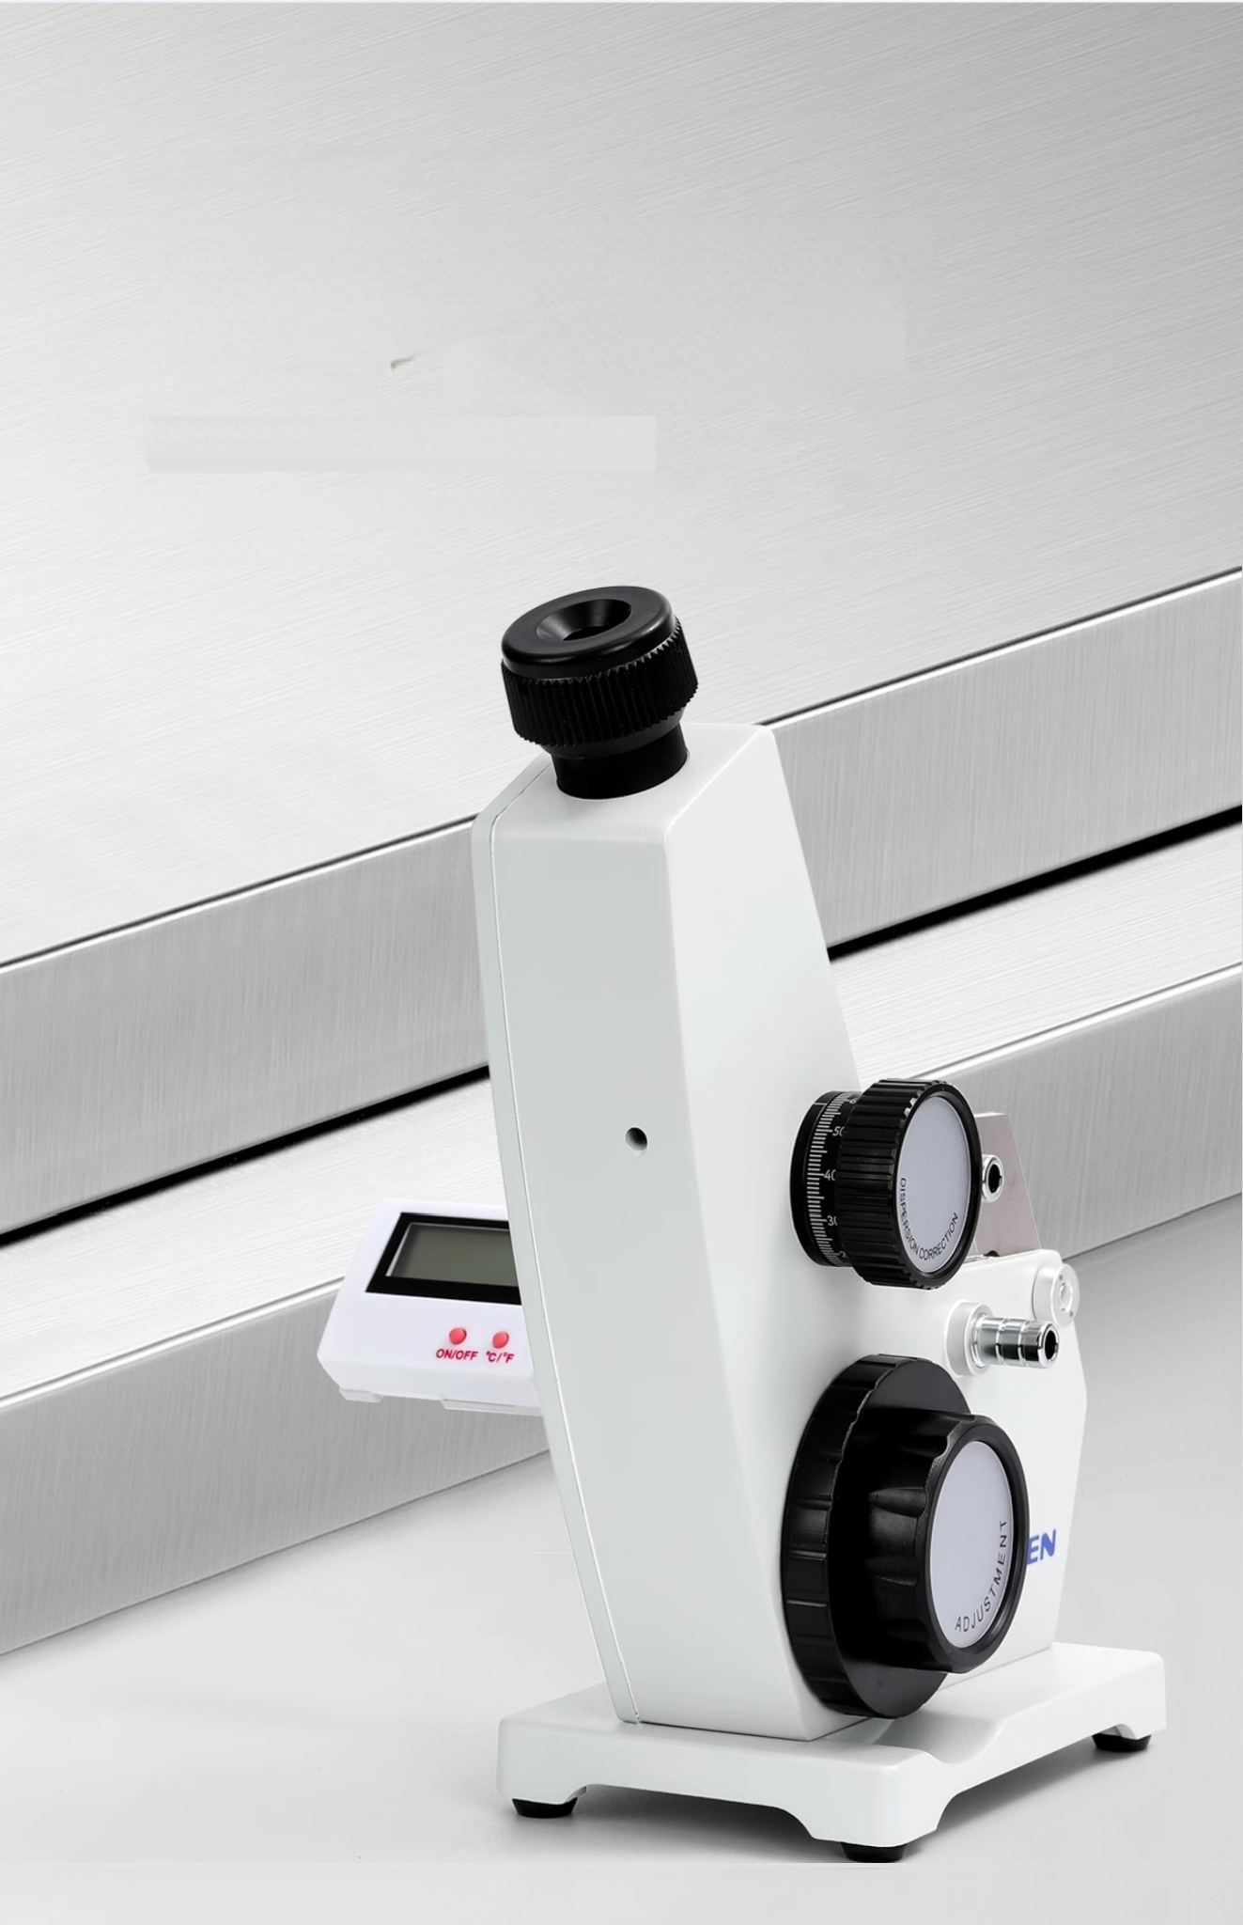
「Stainless Long-lasting steel 」Durability
The base is made of stainless steel.
High-quality material with excellent stability

Slide 6
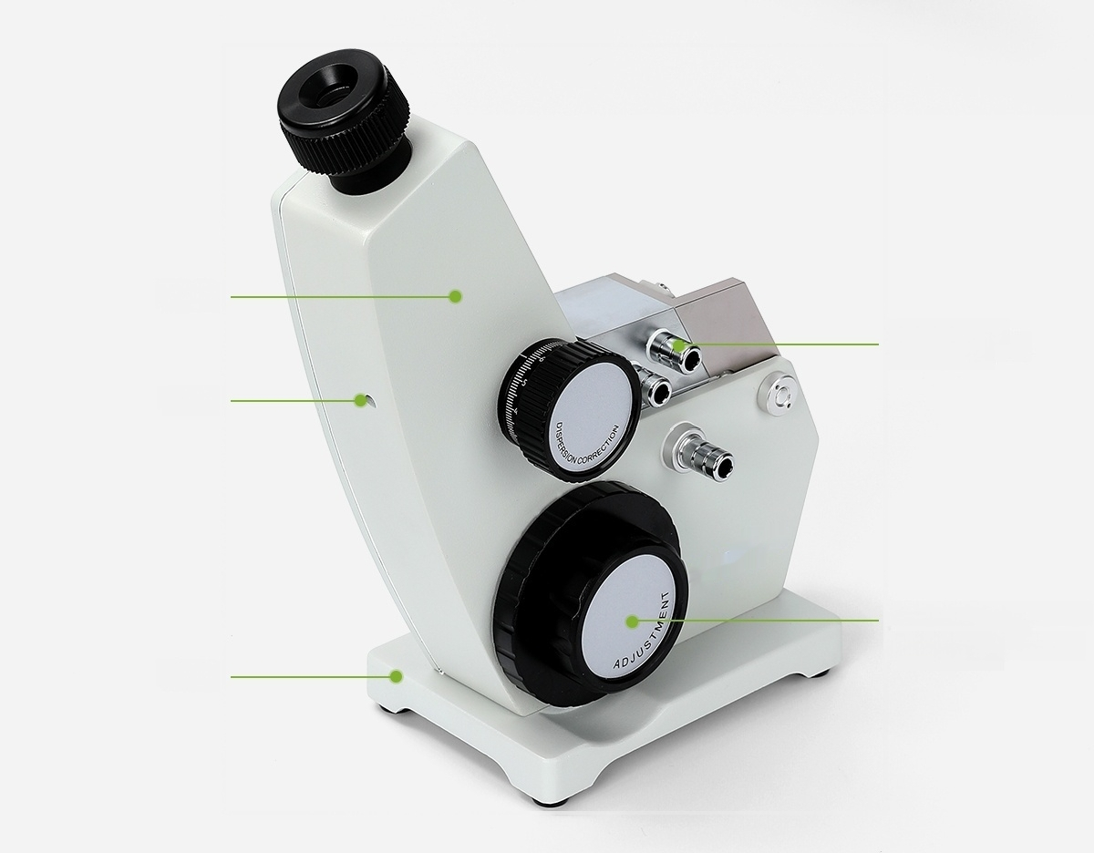
Shell
 | Thermostat connector
Screw
Refractive index scale Adjustment handwheel
Base

Slide 7
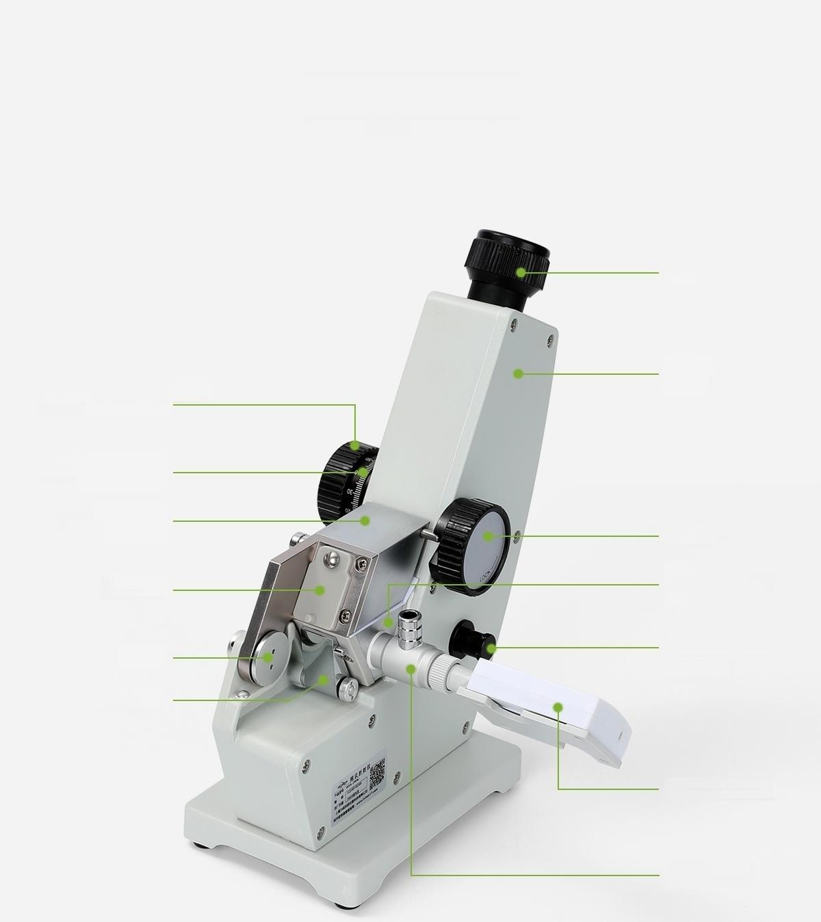
Instrument details
Eyepiece
Cover
plate
Latch
Refraction
prism holder
Illumination scale dial Condenser
Digital Thermometer
Thermometer
holder
Dispersion adjustment handwheel
Dispersion value
scale circle
Entrance
prism holder
Shade
Hinge
Reflector

Slide 8
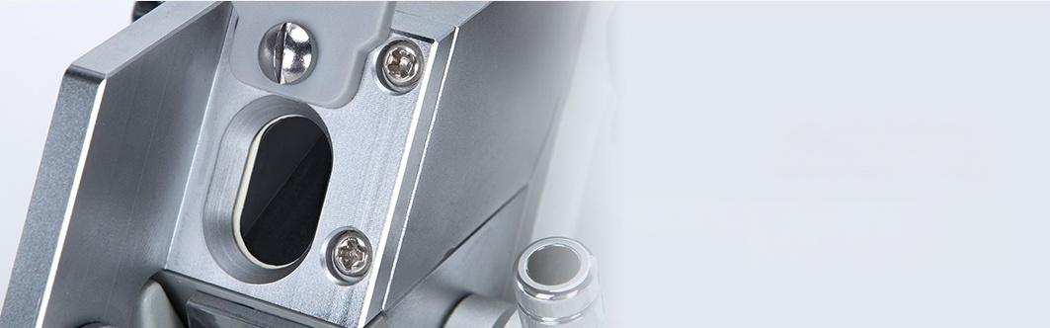


Entrance Prism
Light passes through the entrance prism into Theinstrument,viewing clearly
Bromonaphthalene
Drop 1~2 drops onto the
high-definition prism and place the
standard module for calibration
nd=1.5167
Standard Module
After dropping bromonaphthalene on the
prism
Place the standard module for calibration

Slide 9
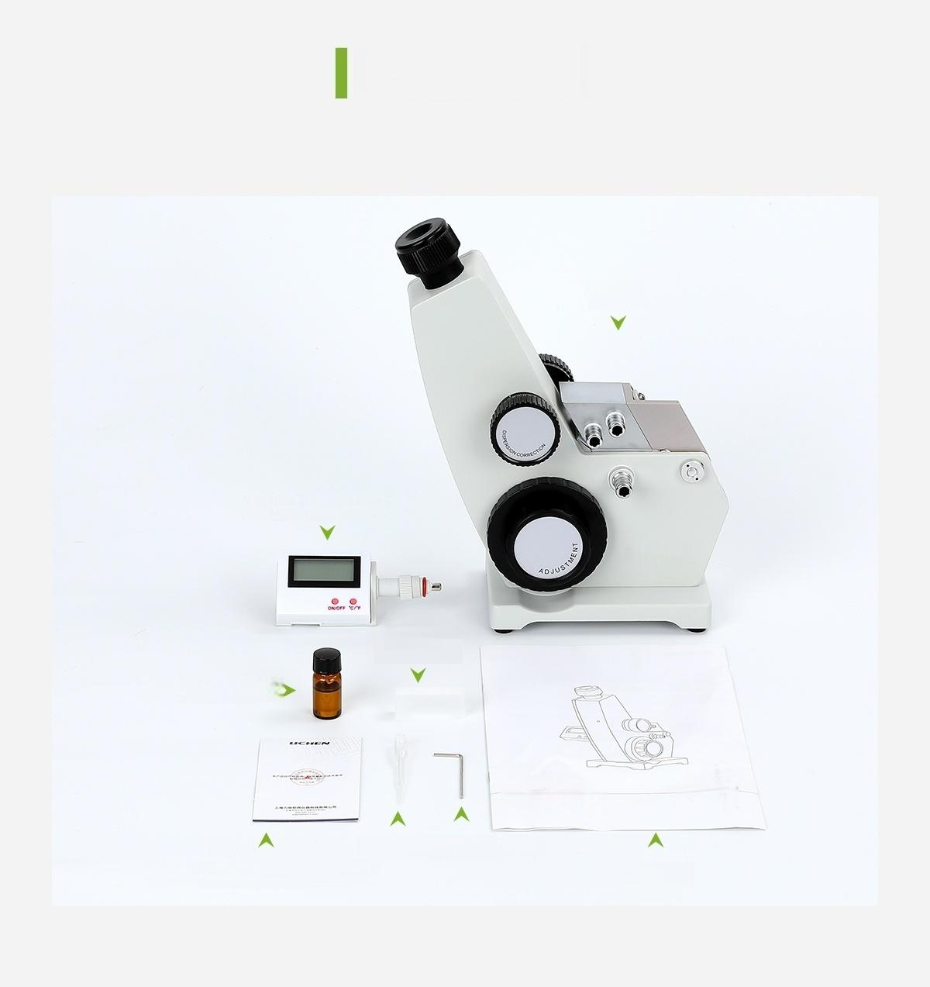
Packing List
packing list
Host
Digital Thermometer
Standard
Module
Bromonaphthalene )
合格证
USLe5NSTRUCTIONS
mmT 位 ns. 语 w
Dropper Hexagon wrench
Certificate of Quality/Warranty Card User
Manual

Slide 10
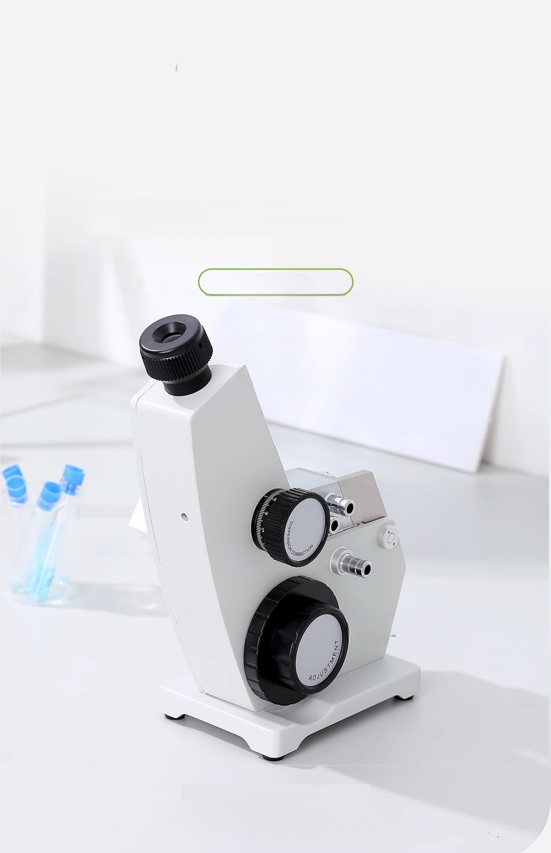
Abbé Refractometer
Digital temperature display,simple and reliable
WYA Series

