Slide 1
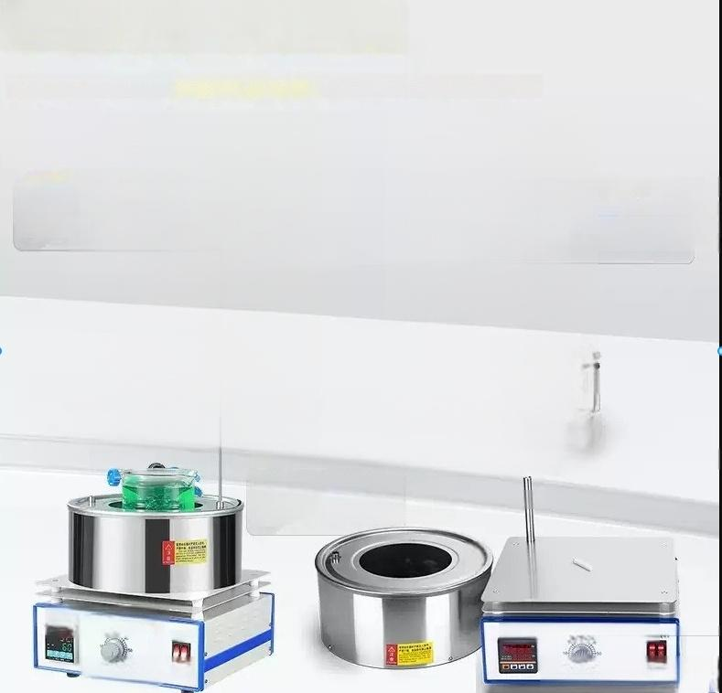
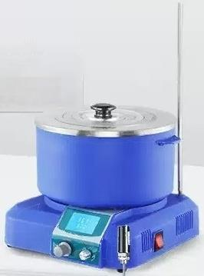
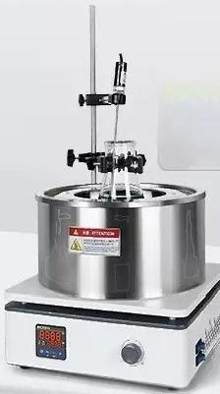
Dual purpose precise temperature control for
^{water} ^{and} ^{oil} 」
From basic to profe ssional,multiple series of oil bath pots flexibly adapt to various experimental scenarios
LC-JR flagship model
Split design
Temperature control range with timing function:
RT-350℃
LC-OB Professional Edition
Thickened 304 stainlens steol pot body Equipped with timing function
Temperature control range:RT-300℃
DF basic model
Mixing capacity:0.8~15L Split design
Temperature control range:RT-300℃
田
FNhPE-1018 Zhou
apabswaan
CHEN DF-101S Fower Application
Enfifanx Jvc

Slide 2
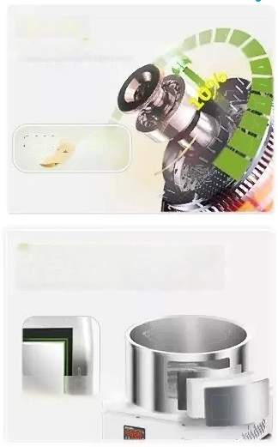
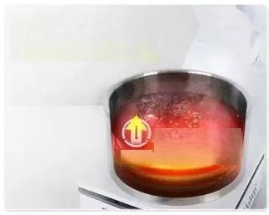

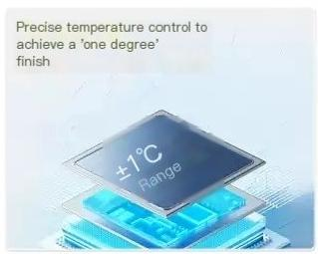
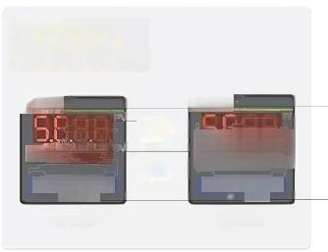
new generation
Motor control technology
2600 2800
RNgl jions RPM
Adding insulation layer,thickening
the pot body,increasing power and
heating efficiency
1mm thick pot body
Heating speed is three
times that of similar
mixers
^{speed} 300%
bath pot
A constant
temperature oil
50 Four Series
LED display adds
timing function
UHEN
合UFX ^{BB0.0}
《
◎
Temperature setting
UCHEN
t 8899”
◎1与 I-1+
-
BES time setting
R

Slide 3
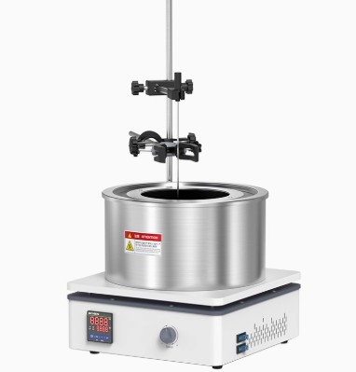

Slide 4

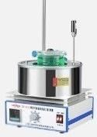
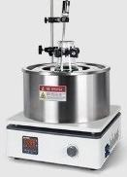
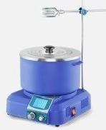
series
DF basic model
OB Professional i i^{r} and efficient 0.8/1.5/2/3/5L 0.8/1.5:0-2200rpm 2/3/5:0-2800rpm RT-300℃ | Style JR flagship model Split ^{t} ^{c}_{h}ª_{i} ^{le}_{her} temperature contro 3L 0-2600rpm RT-350℃
Purchase ecommer ation
Divers
_{i} els with
cost-effectiv
eness
ccu
ate
o
m
ng
g
heatng
Mixing volume ^{0.8/2/5/10/15L}
speed range 0-2600rpm
Temperature range mperature control accuracy( Timing Display mode | RT-300℃ ±1℃ X LED dgital tube
^{1℃} ±1℃
√(Umited toLC-JR-3D)
LED digital tube
3A:LED 3D:LCD
digital tube screen
Inner liner materal ³⁰⁴ ^{stainless} ^{steel}
DF-101Z:Built in,
temperature ser sor ^{other} ^{models} ^{are}
Thickened 304 stainless steel 304 stainless steel
External External/lnternal
external

Slide 5
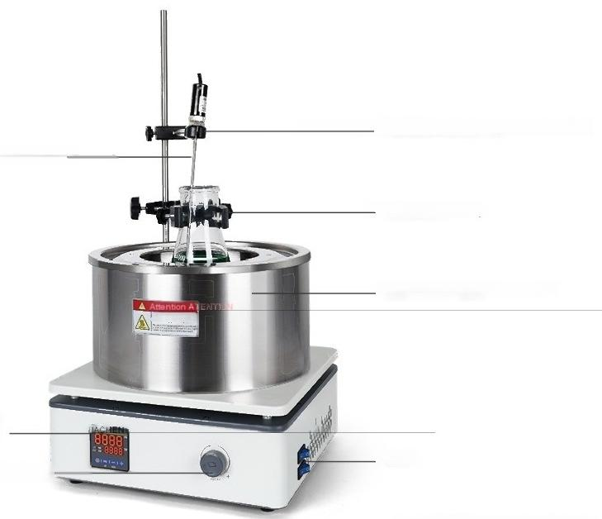
Heat collecting magnetic stirrer
LC-OB series
Send temperature sensor bracket
External temperature sensor
-Send flask clamp
Thickened 304 stainless steel
LED temperature
control instrument
(with timing)
Speed control knob
switch
*Taking LC-OB-3Las an example to showcase
the model

Slide 6



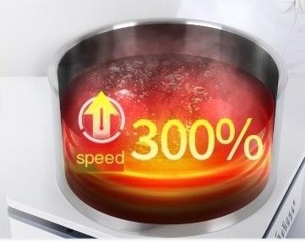
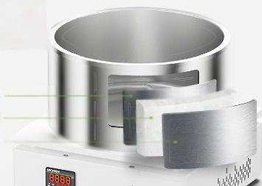
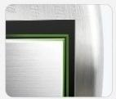
The 'New
Generation'
Motor control
technology
G8 rmiu
cmr
2600 2800
RPM
Upgrade
to
RPM
Heating speed is
Three times the size of the same type
of mixer
Under strong thermal radiation,the temperatu
re is uniform and the thermal efficiency is
higher
Adding insulation layer,thickening the pot body,increasing power
and heating efficiency
304 stainless steel inner liner
XPS
304stainless steel shell
1mm thick pot body

Slide 7
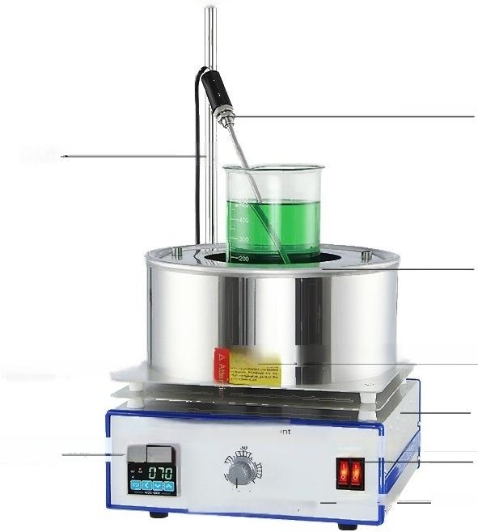
External temperature sensor
Split style(for detachable pot body)
tistnerypbt to use a ruerwthout nyone wokng onit,and iah coitions ar pohibited
plate
bracket
Heat dissipation
Heat dissipation hole
uCHENatuFe101stcolecte
Temperatur cotolinsru en
5P.
20 1f
Hatup m
Heating/power switch
_Speed control knob
so
。
apahahtben 。
ower
*Display model:Taking DF-101S as an example

Slide 8
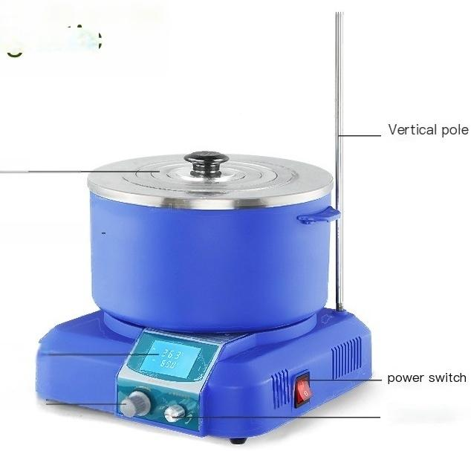
JR series heat
collecting magnetic
stirrer
Detachable pot lid
Detachable pot body—
LCD screen(with timer)
Speed control knob
Temperature knob
*Taking LC-JR-3D asan example to showcase the

Slide 9
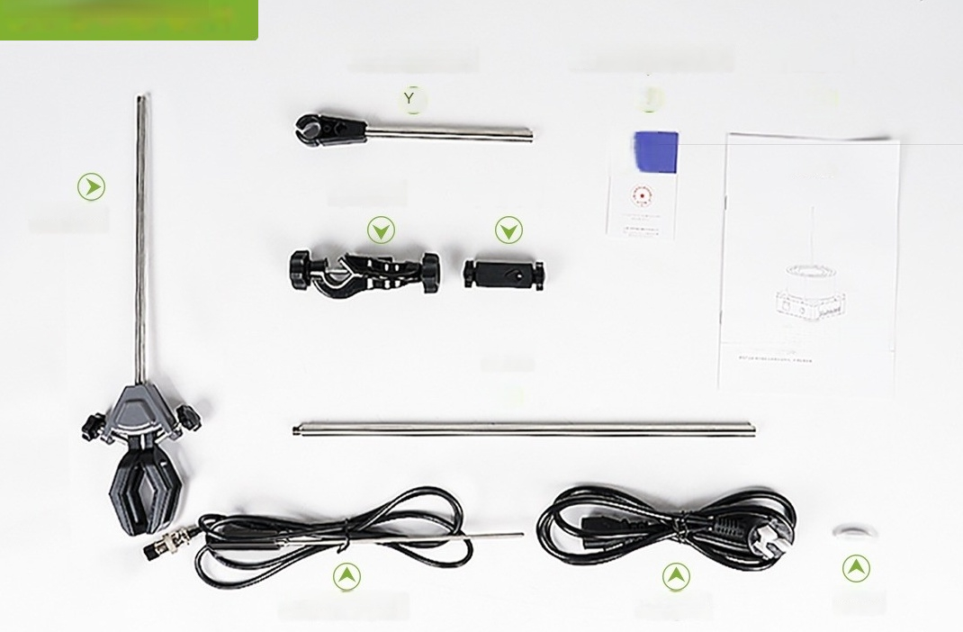
OB Ol Bath Pot-Accessonies
Sensor bracket
Cross clamp Cross clamp
beaker clamp
bracket
Y
temperature sensor
Certificate of Conformity/Warranty Card
Y
*
power line
instructions
Y
operation instructions
magneton

Slide 10
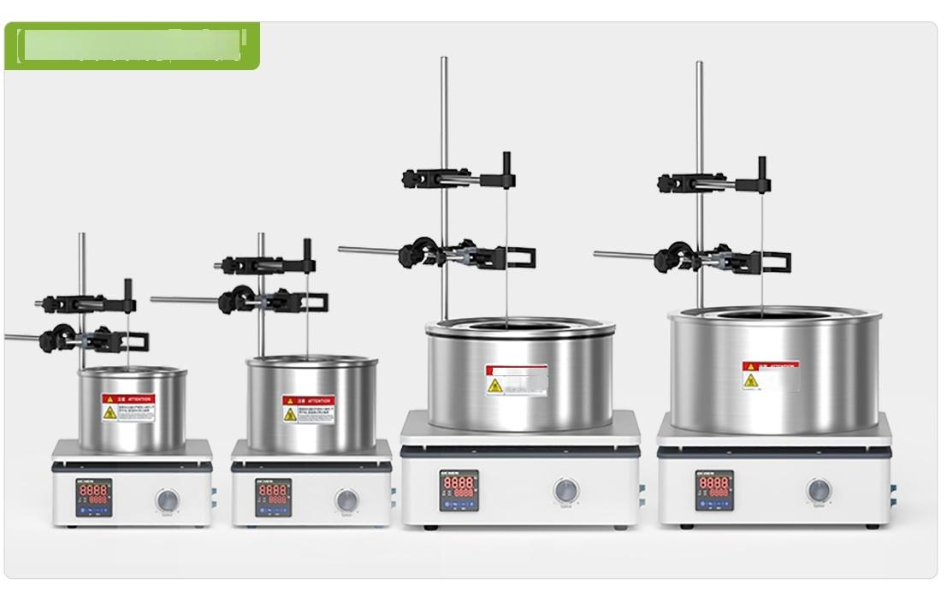
OB oil bath pot - main unit
△

Slide 11


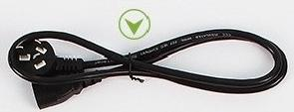



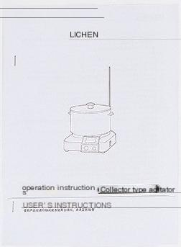








JR Oi Bath Pot-Accessories
power line
bracket
beaker clamp
temperature sensor
Certificate of Conformity/Warranty Card
magneton
fuse ^{Cross} ^{clamp}
instructions

Slide 12
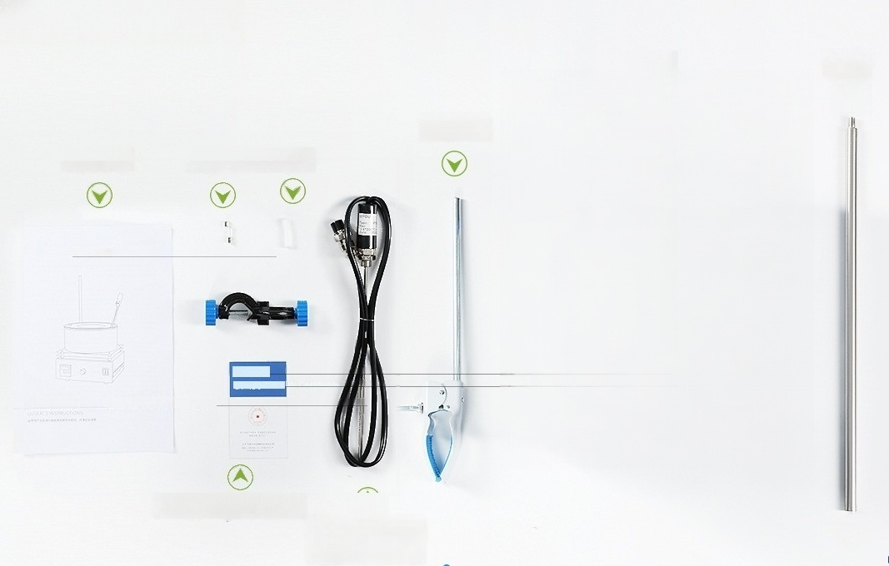

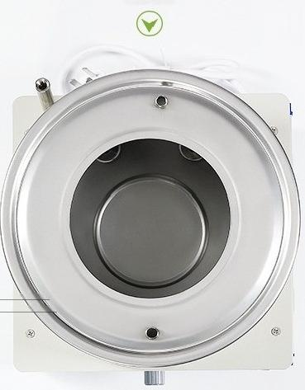


DF oil bath pot
host bracket
beaker clamp
^{instructions} Fuse magnet
Certificate y Card
of Conformity/Warrant
Temperature sensor (excluding
DF-101Z)

