Slide 1

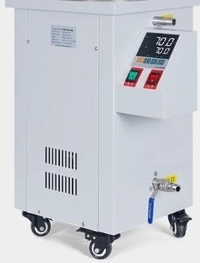
High temperature circulating oil bath pot
304 stainless steel
Intelligent display
Over temperature
alarm
★ SN GXk series

Slide 2
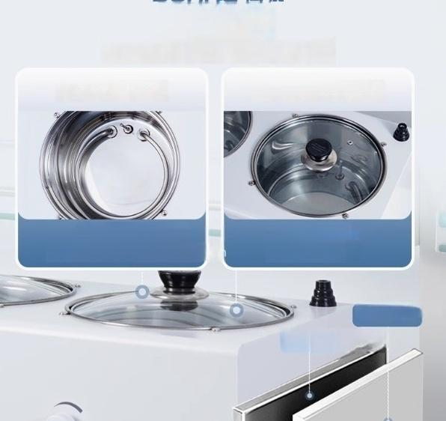
High quality material
selection
Corrosion resistant,long-lasting and durable
^{Stainless} ^{steel} ^{inner} ^{liner} Transparent glass lid
Integrated molding
Not easy to rust,easy to ca
Improve insulation
performance for
easy observation
Electrostatic spraying
cold-rolle d steo

Slide 3
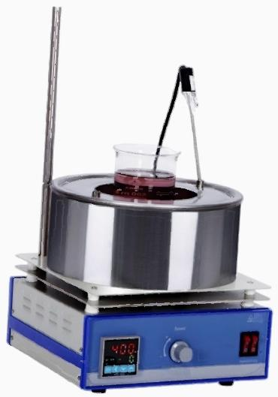
名
sunne
△

Slide 4
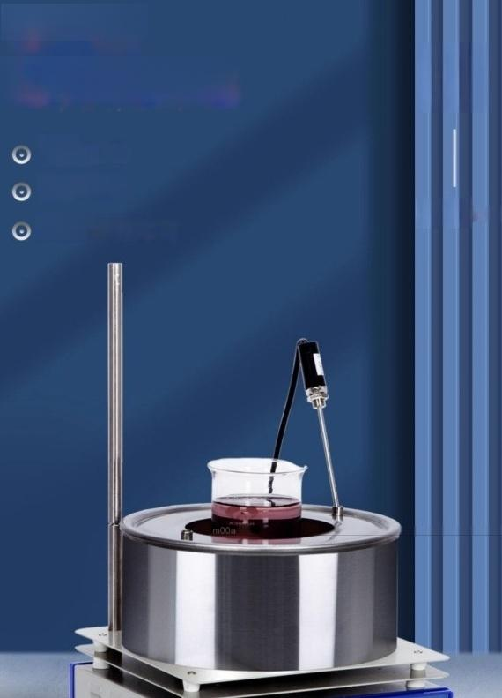

Collector type
A magnetic stirrer
Precise oporature
Dual use of water and oil
Fast heating and high eficiency

Slide 5







Six major innovations and upgrades
characteristic
Low noise
characteristio
characteristic
Constant temperature
^{heating} Dual use of water and oil
characteristic
safety protection
characteristic
Clear display
characte ristic
High quality stainless steel

Slide 6
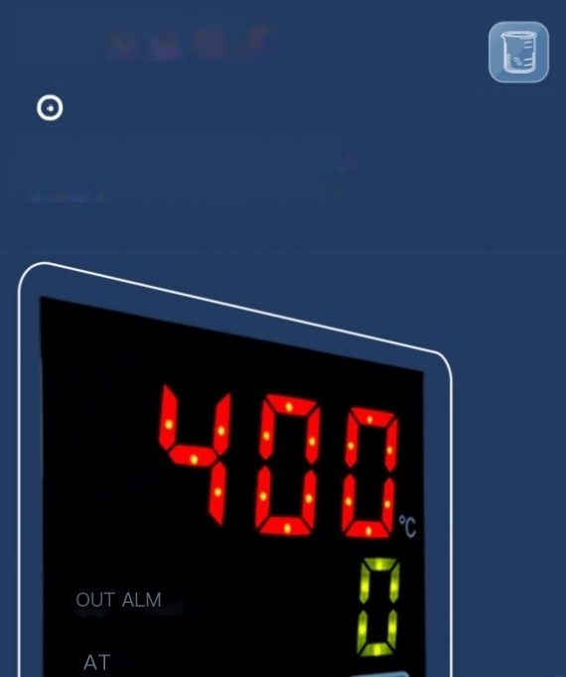
PID temperature control
technology
The LED digital display shows the set temperature
and curent temperature dlearty and intuitively

Slide 7
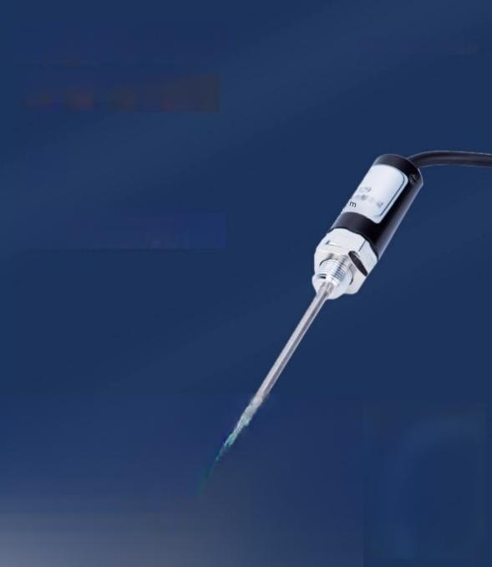

External PT100
temperature sensorr
A MAGNETIC STIRRER
High quality stainless stael support rods and
sensors provide mora accurata tamperature
control and more raliabla us⁸
100℃

Slide 8
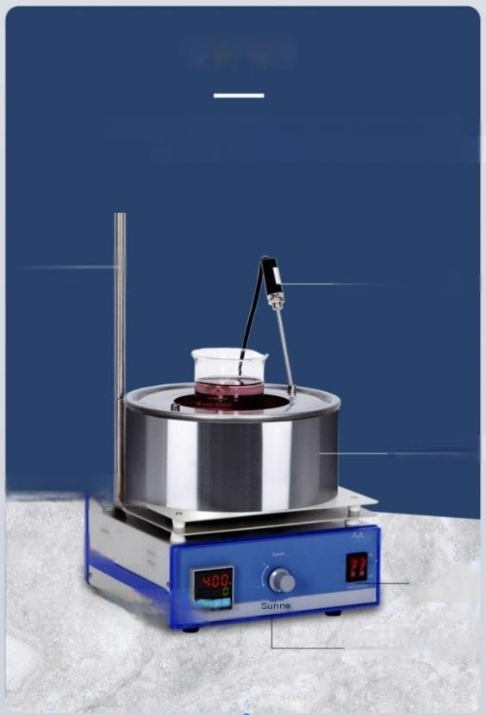
structural analysis
The heating part is iolated from the electrical box by a heat disipation plate
High tomperatune dos notafact the alactrical prformanco of the entiro mac
bracket
temperature sensor
Stainless stee pot t
Heat disipation plate
Heat dissipation hole
Digital temperaturec niro
Power switch, heating
switch
Speed control knob

Slide 9
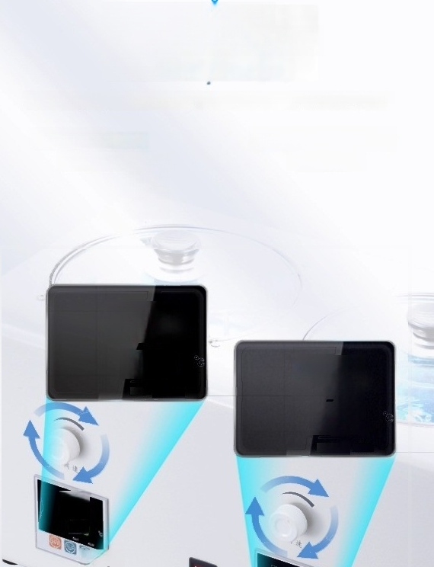

Porous individual
erature
Optional gynchronous/asynchronous control speed series,convenient sample prooessing,and more
uhiform hěating temperature
control of speed/temp
RT+5-300℃
Temperature range
Start at-2600r/min
speed range
188
208
OUT
ALM
128
2 18
OUT ^{ALM}
B8
208
AT-205

Slide 10
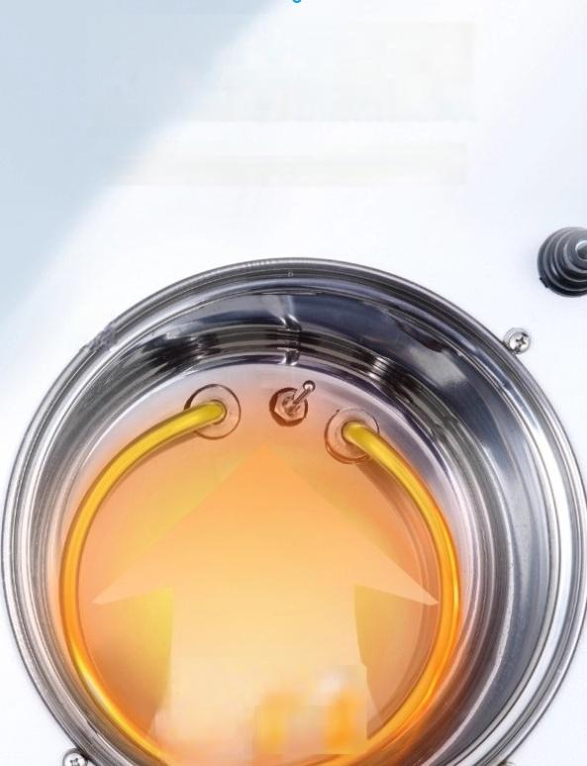
304 stainless steel heating tube heats up quickly and efficiently
Circular 304 stainless steel electric heating tube provides uniform heat distribution,strong corrosion resistance,and good heat resistance.

Slide 11
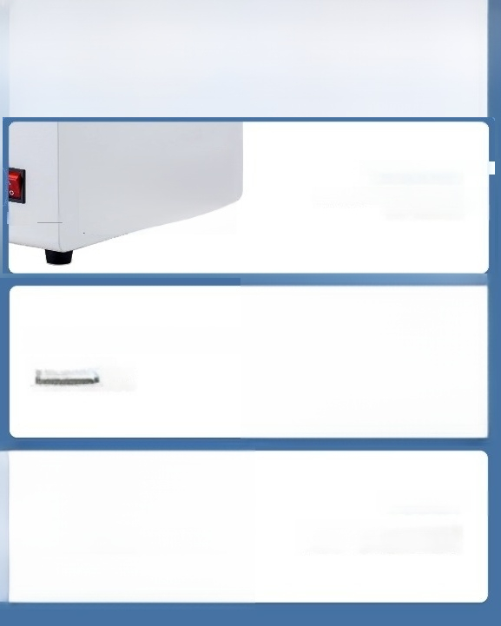
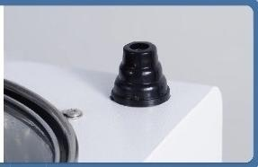
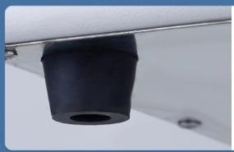
Instrument detail display
DETAIL
DISPLAY
Square heat dissipation window
ouiklkdiipato the intornal heato the Extended service life
souroe
三
Reserved bracket | installation | port
Optional bracket set for easyfixation of round bottom containers
Rubber feet
Anti slip design ensures the product is stable and does not shake,making operation safer and more reassuring

Slide 12

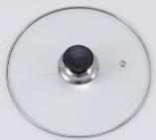
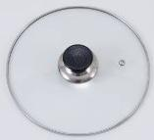




Display of accessory list ^{DETAIL}
DISPLAY
Glass lid(depending on the number of holes)
power line
Sunne
Multi connected heat collectina forco me
operation instructions
S-
magneton fuse
(Depending on the number of holes)
instructions
Certificato of Conformity/Warranty Card

Slide 13
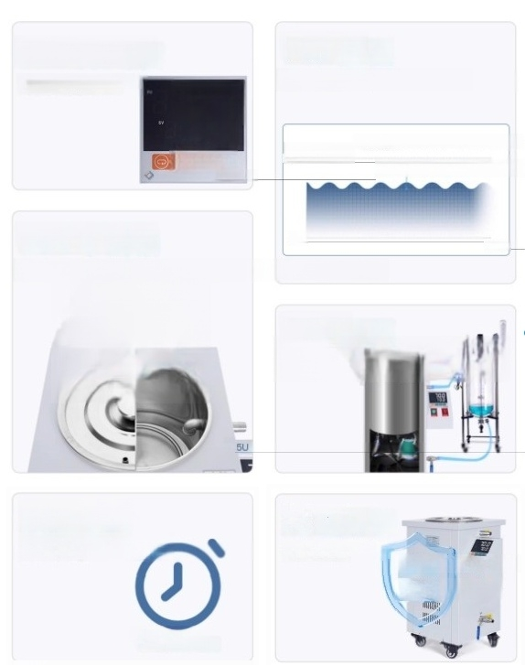
LED digital tube
The reading is intuitive and
accurate
70.0 70.0
O
ID-8000
PID temperature
control
Accurate temperature control
Temperature control accuracy±1℃ Durable and stable temperature
20mmerature
304 stainless steel 00
Stable performance,corrosion resistance,easy to clean
timo
Intelligent timing
Convenient experimen
0-9999min
Can cireulate
externally
Widely aplicable in variousf
Over temperature
alarm
Safe and reliable
over-tempurature
call the police

Slide 14
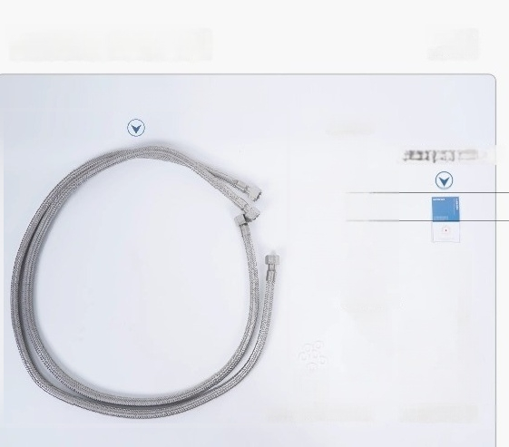




Display of accessory list ^{DETAIL}
DISPLAY
Stainless steel crculation pipe
instructions
Certificato of Conformity/
iin
Bina not
PTFE Ta ape
joint
PTFE gaskets(6 pieces) Outlet valve

