Slide 1
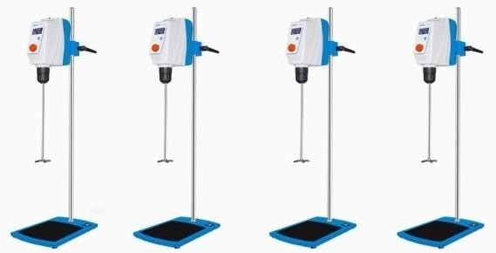
RWD50
Mixing volume L:20
RWD100
Mixing volume L:40
RWD150
Mixing volume L:60
RWD200
Mixing quantity L:100

Slide 2
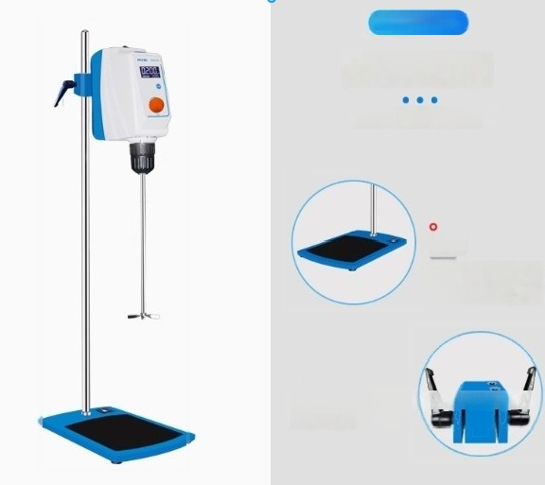
Product datails
Product Details
More attention to detail
base
Adding a layer of protective film on the bottom plate makes the instrument more stable and durable during operation.
o
The independently developed clamp is more stable and safe

Slide 3
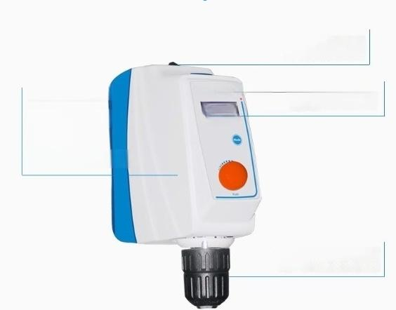
Stirring blade penetration hole, convenient for container replacement
brushless do moto
。Easy maintenance
· Low noise
. High torque
. Accurate speed cortrol
HUXIRvroo
0200
LCD displays speed and time
Self locking drill bit camp.
tool free installation of mixing
paddle

Slide 4
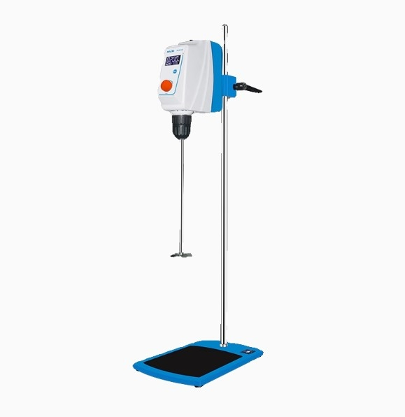

Slide 5







RWD
Top mounted electric mixer
RWD50/100/150/200
secure
light
Low noise
high efficiency

Slide 6
PRODUCT MODEL RWD50 |  | RWD100 | RWD150 | RWD200
Adapter input voltagev | 100~240 | 100~240 | 100~240 | 100~240
Adapter output voltagev | 24 | 24 | 24 | 36
Frequency Hz | 50~60 | 50~60 | 50~60 | 50~60
Mixing volume | 20 | 40 | 60 | 100
Speed range rpm | 30~2200 | 30~2200 | 30~2200 | 30~1600
Speed display | LCD | LCD | LCD | LCD
Speed accuracy rpm | ±1 | ±1 | ±1 | ±1
Speed Contro | Coarge adjustment+fino adjustmeht | Coarse adjustment+fin adjustment | e Coarse adjustment+fin adjustment | e Coarse adjustment+fin eadjustment
Timing range min | 1~9999 | 1~9999 | 1~9999 | 1~9999
time display | LCD | LCD | LCD | LCD
Torque N.cm | 40 | 60 | 80 | 100
Viscosity mpa.s | 10000 | 50000 | 80000 | 100000
Input power W | 60 | 120 | 160 | 400
Output power W | 50 | 100 | 150 | 200
Protection level | IP42 | IP42 | IP42 | IP42
motor protection | Display fault automatic stop | Display fault automatic stop | Display fault automatic stop | Display faultautomatic stop
overload protection | Display fault automatic stop | Display fault automatic stop | Display fault automatic stop | Display fault automatic stop
Safety protection | rgtective cover+anti slip pad Chuok protective cover+anti slip pad Chuck protective cover+aht 51IP P
Allowable ambient tomporat | 5~40 | 5~40 | 5~40 | 5~40
Allow ambient humi | dity% 80 | 80 | 80 | 80
Host instrument size m | m 210*290*800 | 210*290*800 | 210*290*800 | 230*330*987
Host packaging size m | ^{m} 480*470*360 | 480*470*360 | 480*470*360 | 480*470*360
Package size mm | 820*365*1200 | 820*365*1200 | 820*365*1200 | 820*365*1200
Net weight of host instru Gr⁰6S weight of host pack | ^{ment} ^{kg} 6.5 | 6.5 | 6.5 | 6.5
 | ^{aging} kg7.7 | 7.7 | 7.7 | 7.7
Natweightof the setof inatr | uments in ka7 | 7.5 | 8 | 9
Package gross we | ight kg 9.2 | 11 | 12 | 13
ure ℃

Slide 7
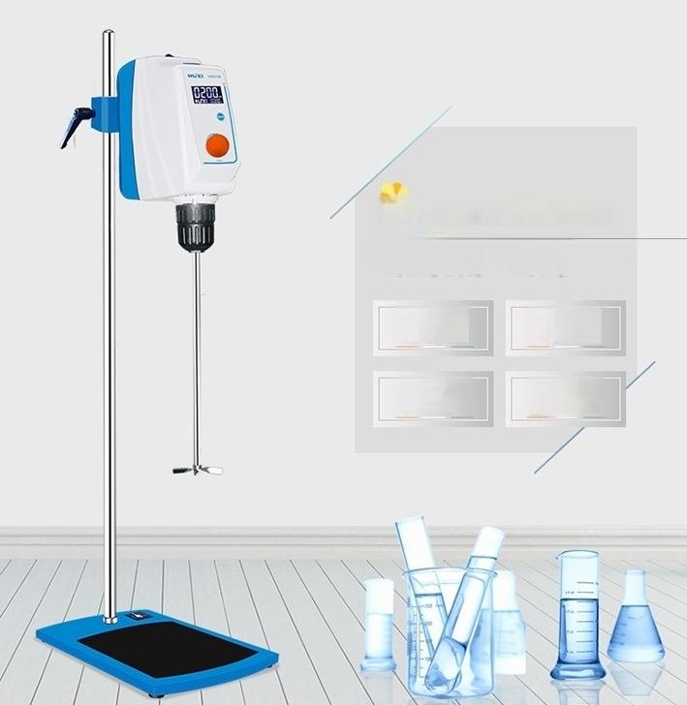
Shanghai Analysis Top mounted Electric Blender
THE NE GERATION OF KID TRAHPOLINE
LCD display,showing set and actual values 10 tHroTC wTE1ALS FROHNITC sraTUs
Automatically
adjust
torque
Accurate and
^{oi}gnth^{r} ^{lnladbll} ^{w}
speeds
Multiple
overload
protections
Safety
circuit
setting

Slide 8

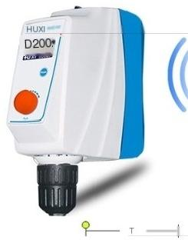

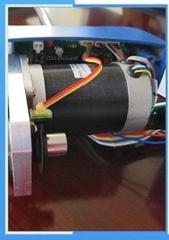
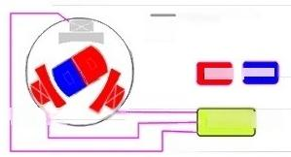



The instrument adopts a brushless DC motor
Brushless DC motor,no need to replace carton
brushes,low noise,high torque,easy to maintain. Smooth start-up,effectively preventing sample
overflow.
Aelectrode
Reference level l
Antanti ant
^{Balechode} Brushlese Esc
creators KMZDS
1.High friction and loss.Brushed motors are equipped with electric brush devicea,which require the motor to ba turned on periodically to clean the carbon brushes. | Device compari son | 1.Brushless,low interference No need for electric brushes,no elactric sparks generated during the operation of brushed motors,greatly reducing the interference of electric sparks on remots control radio equipment
2.High heat generation and short lifespan |  | 2.Long lifespan and low maintenance cost
h ^{co} ªd^{ct} c ^{tna} r ^{be}i ^{we} nigh, ulti ^{ctriinc}a | Compar | Without brushesthe wear of brushless
high overall rasistance of the motorwhich is | son of | motors is mainly on the bearings From a
prone to heat generation,leading toa dacrease in motor performance and affecting the lifespan of the motor. | lifespan | mechanical perspective,when necessary. only some dust removal maintenance is needed.
he
nt
re
sta
t
the
e
le
rus
an
o
mu
s
res
n
g
3.Low efficiency,low output power.
Most of the electrical eneigy is converted into heat energyand the conversion of
kinetic energy is low,so the output power is not large and the efficiency is not
high.
3.Low noise and amooth operation.The brushless motor without brushes greatly
reduces friction during operation,resulting in
great support for the stability of the model operation.
Pgrform
anoe
cmpari
smooth operation and lower noise,which isa

Slide 9
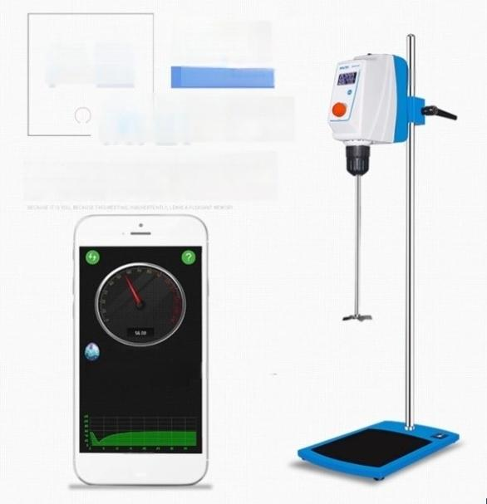
34dB
Average decibe
Sound
Test low noise
30 decibels is equivalent to a desert night.In laboratory tests without any treatment,the actual noise of the
product is even lower than this
Small yalue paximum value. B 3HO S6.9 S5.0
C

Slide 10
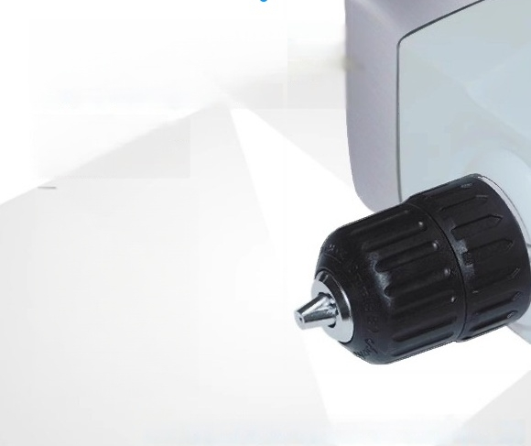
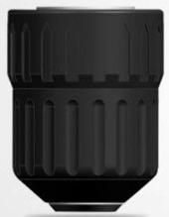

The back shel is made of high-quality aluminum alloy self-locking drillbit clamp,whch is easy to stabilize and prevents the mixing blade from
falling.The speed reaches 2200rpm
The rewed spir the souroe of
creacorumhe eauty of the materal
is in the prmtive formthe The
shackesand then you wartain a
state of harmony.
Imported clamp head,easy installation,stable and not loose

Slide 11
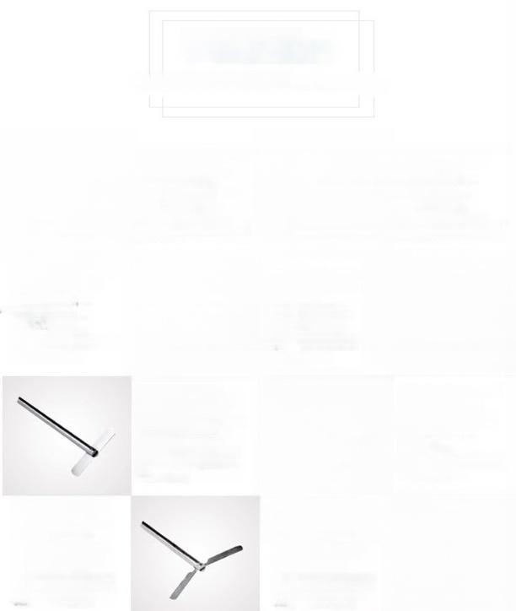
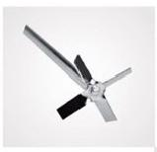
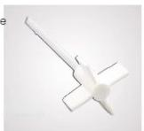
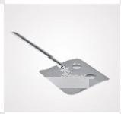
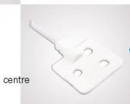
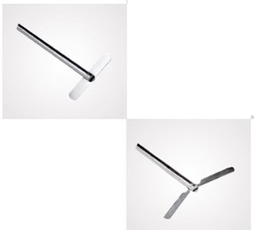
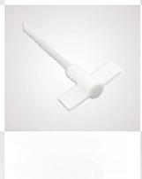
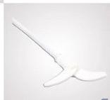
Product Accessories Seection
PRODUCT INFORMATION
Four bladed agitator blade
Rod length:400mm,
mixing blade diameter
50mm,mixing rod
diameter:8mm,material:
316 stainless steel,
application:standard
mixing award,medium
Suitable for high-speed applications.
Four bladed agitator blade Rod length:350mm
Mixing bladem
Mixing rod
TE
coating
Application:Standard
mixing blade,suitable for medium and high speeds
diameter:65mm
Fan type mixing blade
Rod length:400mm
Mixing blade
ameteY58mm
Mixing rod
steel
Application:Mild stiring performance,moderate Low speed use
One line agitator rod
length:400mm agitator
blade diameter:60mm
agitator rod diameter:8mm material:316 stainless
steel application:low
viscosity medium mixing.
medium high speed use
Fan type mixing blade
Rod ength:350mm
Mixing blade
^{i} ⁶ _{t} _{r} _{l:} ^{r}
coating Application:
Mild mixing performan
ce,
Low speed use
One line agitator blade Fod length:350mm
xing blade diameter Mixing rod。
ial
Aels Mxing oflow
High speed use
_{stainlesS} 8m
dia
meter:
8m
M
xing
ro
ia
mete
8m
M
ia
PTFE
diameter:8mm
Centrifugal agitator
Rod length:400mm
Stirring blade diameter
90mm Stirring rod
diameter:8mm
Material:316 stainless
two blades open with
increasing speed,
suitable for narrow
mouth round bottles and
use
Centrifugal mixing
blade rod length:
eter^{M}: m i ing
rod diameter:8mm
blades open with
increasing speed,
suitable for narrow
mouth round bottles and
use
350mm
ing
bla
de
diam
5m
M
x
steel Applicaton:The
Material:PTFE coating
ApplicationThe two
medium to high speed
medium to high speed

