Slide 1
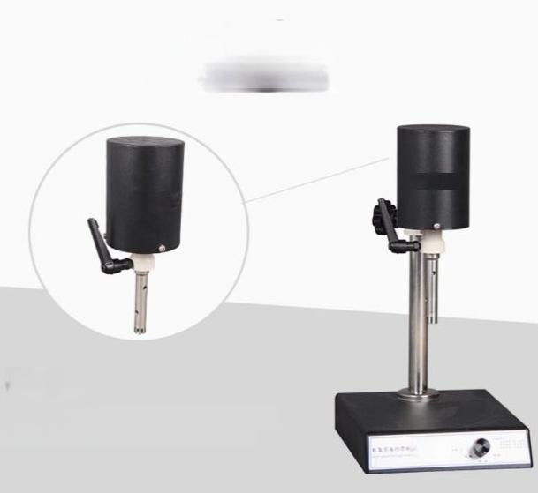
TABLE LAMPGood products are born
from the pursuit of details:natural
light,noscreen flickering,noradiation.
Drive motor
The drive motoradopts a miniature motor with
large output powerand compact structure.

Slide 2
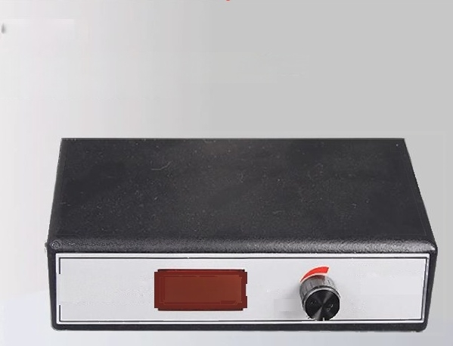
Control Panel
By adopting a high-speed regulating system,the speed
measurement adopts electronic circuits and presents clear digital display.It is convenient to use.
Shudan High speed homogenizer
B.8.Day
Wnd aln thewnd
Wance

Slide 3
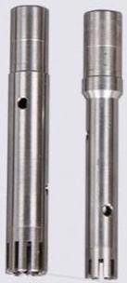
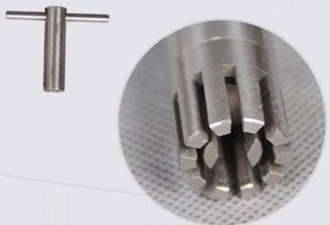
Stainless steel homogenizer knife,T-shaped lock
The stainless steel homogenizerknives are avalable in two specifications:12mm and 18mm.

Slide 4
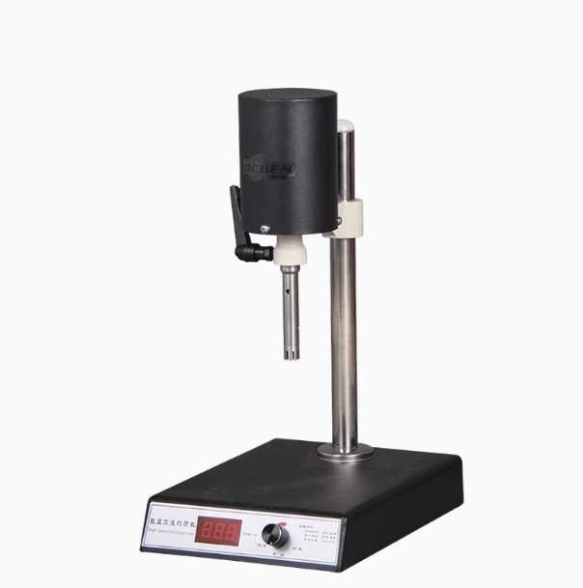

Slide 5
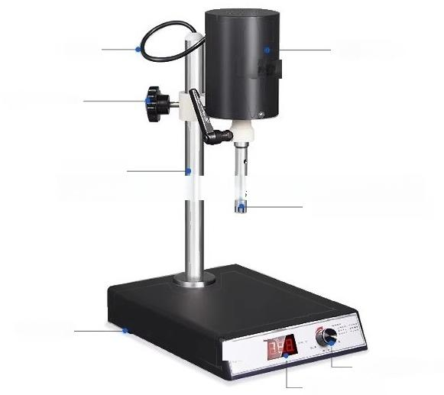
Instrument analysis
//
Powercord
Drive motor
Adustment nut for elevation
stainlessteelsupport,stanles stelhomogenizerknife,Ttype lock
Anti-slip footrest
Speed control knob Digital display

Slide 6
List of Instruments
Name | quantity
Mainframe(Homogenizer) | One unit/One set/One piece
Power cord | 1 root
F18 Homogenizer Blade | 1.
φ12 homogenizer blade | 1.Put
T-typelock | 1.Put
Product Instruction Manual | 1 copy
Cerificate of Conformit,Waranty Card | 1copy
Instrument maintenance
Do not idle the machine when it is turned on.
2.The cutting tools are consumables and need to be repaired or replaced.
3.After the work is completed,remove the cutting tools and rinse them with clean water before drying them.
Attention:Please be cautious of safety when the machine is running at high speed.

