Slide 1
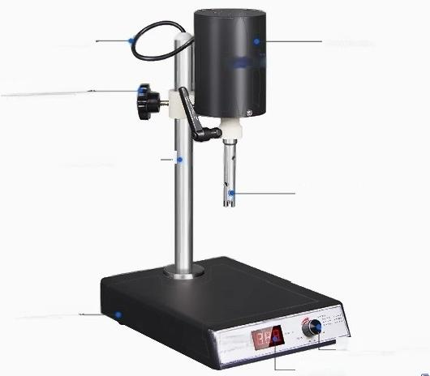
Instrument analysis
HOMOGENIZER
II
power line
Adjust the lifting nut
Stainless steel bracket
Ant slip footrest
Drive motor
铅 aap%9menizer
Speed control knob Digital display
SUr Jnne
至E 单

Slide 2

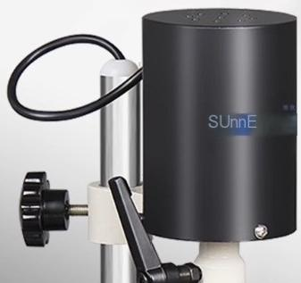
High speed drive motor
AC carton brush motor,stepless speed regulation,high torque,high output power,stable operation

Slide 3
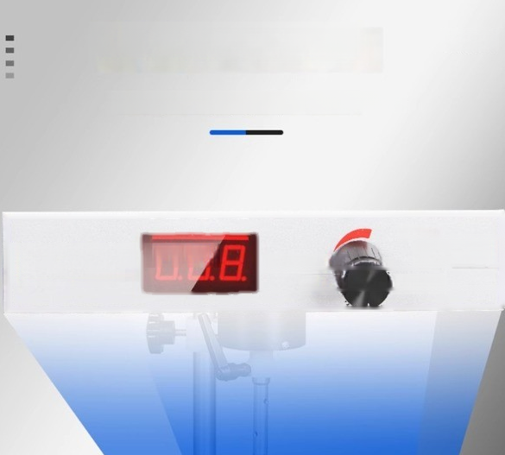
Digital control panel
LED digital display speed,intuitive and clear
TiDs
Digital high-speed homd
High speed homogenizer
Rlaoadheranslatg
genizer Gnsicentound
low spee high speed
10000 revolution e rotation.
High timel

Slide 4
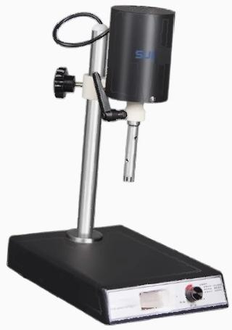
^{n} ^{se} 89

Slide 5
HOMOGENIZER
model | SN-FJ200-S
supply voltage | AC220V/50Hz
Power W | 220
Display mode | LED digital tube
Speed range rpm | φ12:300-23000;φ18:300-20000
Maximum stirring amount(H2O)ml | 300
Suggested mixing amount(HO)ml | 200
Lifting method | hand movement
Lifting stroke mm | 170
Motor type | Carbon brush motor
Net weight kg | 7.5
Product size mm | 210*290*500

Slide 6
Instrument List
Serial Number | name | quantity
1 | host | 1unit
2 | power line | 1 piece
3 | 18 Homogenization Knife | 1 piece
4 | 12 homogeneous knives in the middle | 1 piece
5 | T-shaped lock | 1 piece
6 | operation instructions | 1 copy
7 | Certificate of conformity,warranty cad | 1 copy
Instrument maintenance>>
1.Do not idle during startup
2.The cutting tool is a vulnerable part that needs to be repaired or replaced
3.After finishing the work,remove the cutting tools and rinse them with clean water to dry
Attention:Please pay attention to safety when the machine is running at high speed

