Slide 1
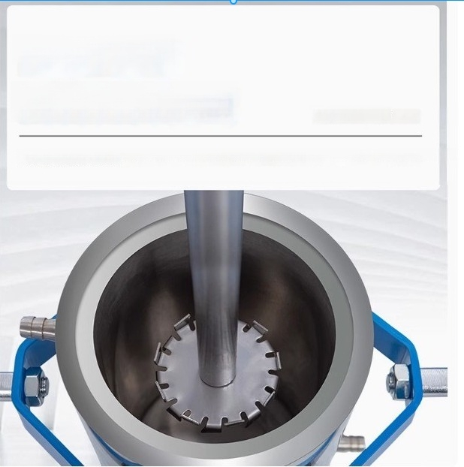
Chain/Round Tube
Two lifting methods
Inteograting djepersion and stiring functions,the two proceses of disporsion and homogenization are complatod by one
machine and one container

Slide 2
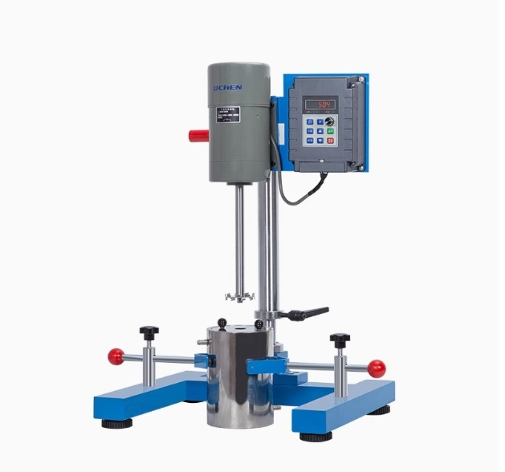

Slide 3
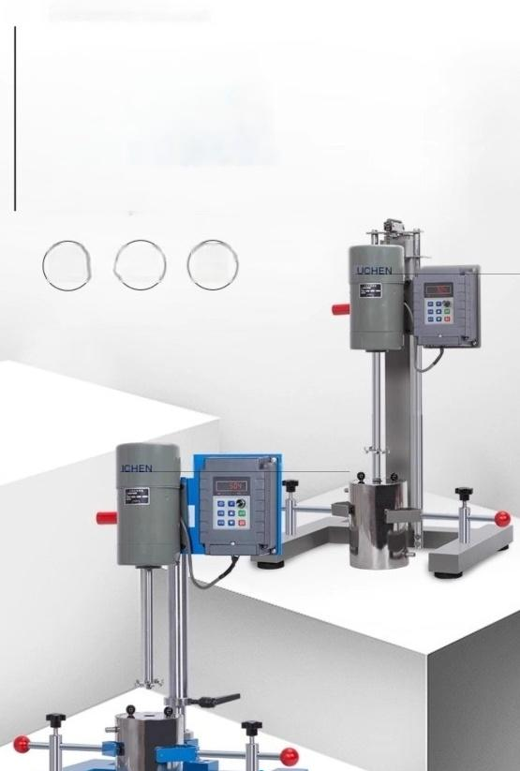
₊ ^{DISPERSION} ^{MACHINE}
Intelligent digital
multifunctional
disperser
FS regular model/JFS variable frequency model
Efficient
processing
Intolligont Brushless motor
digital
display

Slide 4
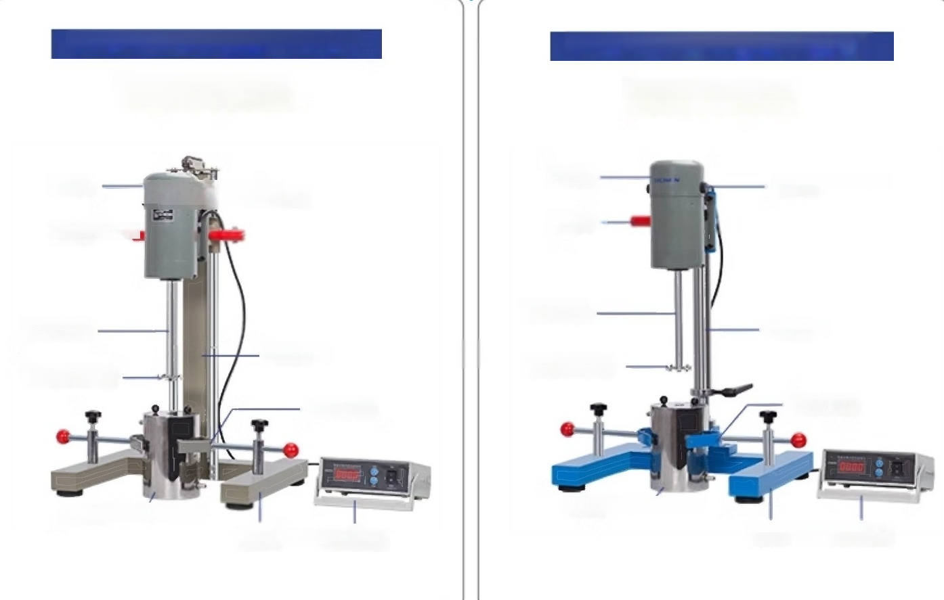
FS series S-type disperser(square tube)
Chain lifting type
N carbon brush handle
FS series ST type disperser (round tube)
Round tube lifting type
host
host
handle
carbon brush
rotation axis
Column
Dispersed impeller
retainer
Material cylinder
Base speed regulator
rotation axis
Dispersed impeller
Column
retainer
Material cylinder
base governor

Slide 5
Usage and maintenance
1.When using,fix the selected grinding disc or dispersing impeller to the shaft.
2.Tighten the bolt of the rotary motor,adjust the height position of the shaft and container,clamp the motor seat and container,put the material in and cover the container lid.
3.Before turning on the power switch,it is necessary to adjust the speed to the minimum, wait until the initialization of the controller is completed,the four digit digital tube displays
0.0,and then adjust the speed to the required sped.When the speed is greater than 4000r/min,it is not advisable to drive an empty car.

