Slide 1
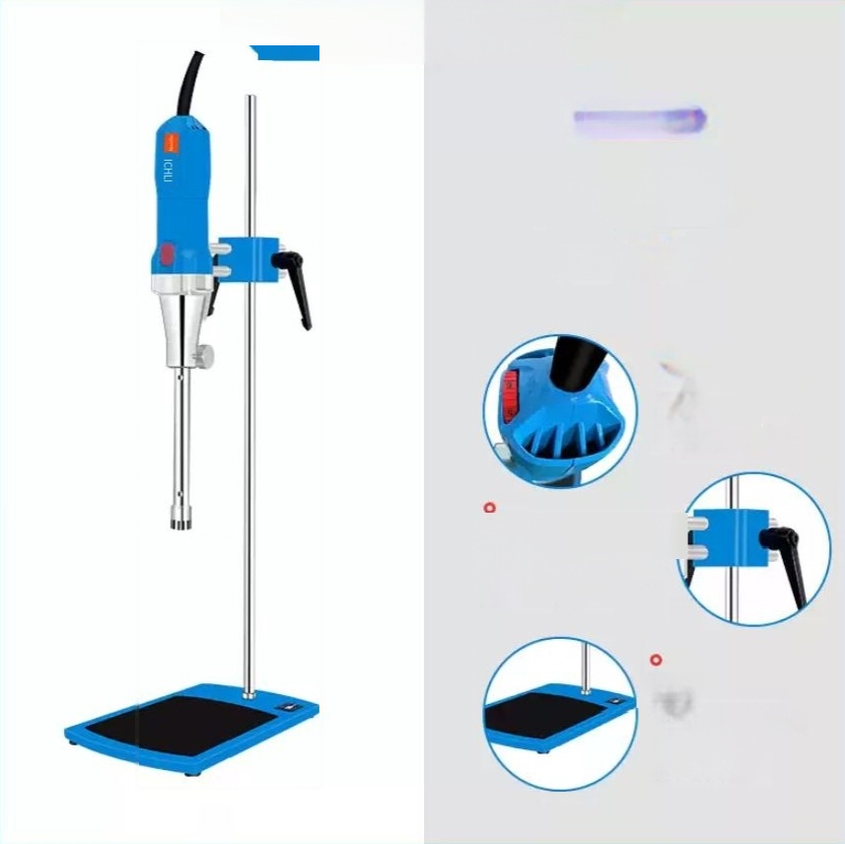
HUXI
Product details
● ● ●
Pay more attention to the details.
0
6-speed gear shifting
Just by gently turningit,you can adjust the speed
conveniently and quickly.
Self-developed "Square Clamp"
type chuck,with user-friendly
design,it offers better fixation
and greater stability.
Anti-slippad base plate Equipped with anti-slippads,
the base plate is reinforcedto
make the experiment safer, easierto cleanand more
durable.

Slide 2
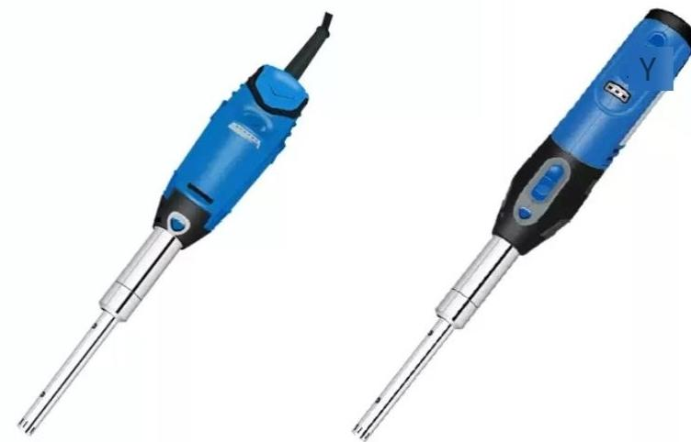
Processing capacity of
HR-6B(in ml):0.2-150
Handling viscosity(MPa-s):200
Process type:Batch processing with small quantities
HR-10B
Processing capacity:0.2-150 ml Handling viscosity(MPa-s):10
Process type:Batch processing with small quantities

Slide 3
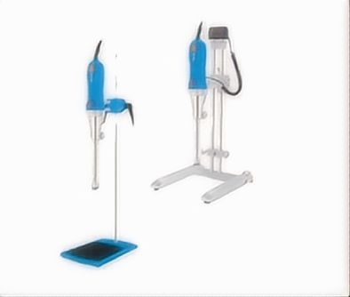

Slide 4
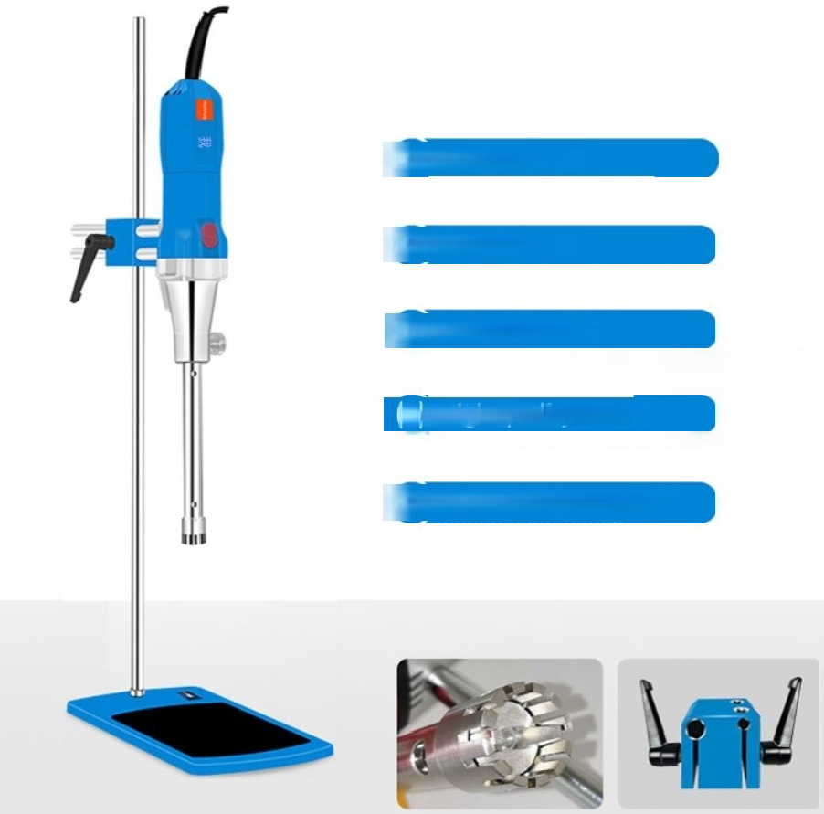
01)Stainless steel working head
Reusable and flexible in assembly
02)Dual overload protection
Overload protection,double insulation forprotection,ensuringyoursafety
guarantee
03)Adjustable rotational speed(rpm)
lst gear:10,0002nd gear:15,0003rd gear:20,000
4th gear:24,0005th gear:28,0006th gear:31,00
(4)High-quality motor
Long-lifedesign,capable of operatingstablyforacontinuousperiod of about4hours.
05)The overall structure design is reasonable.
The materials are of highquality and the
productislightweight and portable.

Slide 5
Product parameters
Give you a different experience
model | HR-500 | HR500-D
Host item number | 1004010001 | 1004011001
Package item number | 1004010000 | 1004011000
model | basic type | Digital display type
Speed display mode | Scale display | led display
speed range | 10000-31000 | 10000-31000
power | 500W | 500W
power supply | 220V/50/60HZ | 220V/50/60HZ
Speed Control | stepless speed regulation | stepless speed regulation
Processing capacity | 0.2ml-7000ml(H20) | 0.2ml-7000ml(H20)
Standard working head | HR500-25G | HR500-25G
Contact maerial material material | SS316L | SS316L
Immerse the material into the shaft sleeve material | PTFE | PTFE

Slide 6
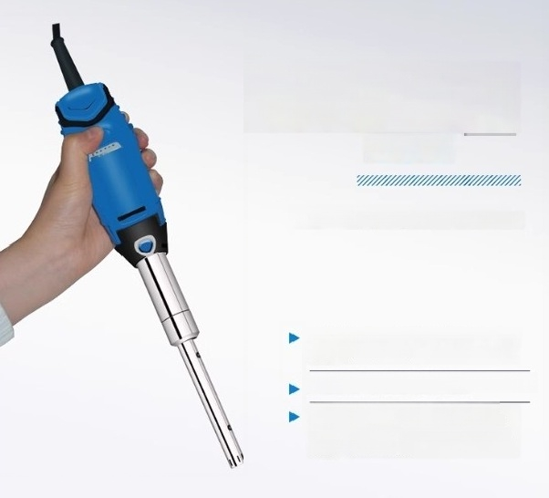
HR-6B trace
homogenizer
Processing capacity(H2O)0.2-150ml
Handheld operation,lightweightand convenien t,larnge capacity battery
Suitable for laboratory mobile operations
Mainly used for animal and plant tissue fragmentation,homogenization,medical diagnosis,micro dispersion emulsification, and homogenization.

Slide 7
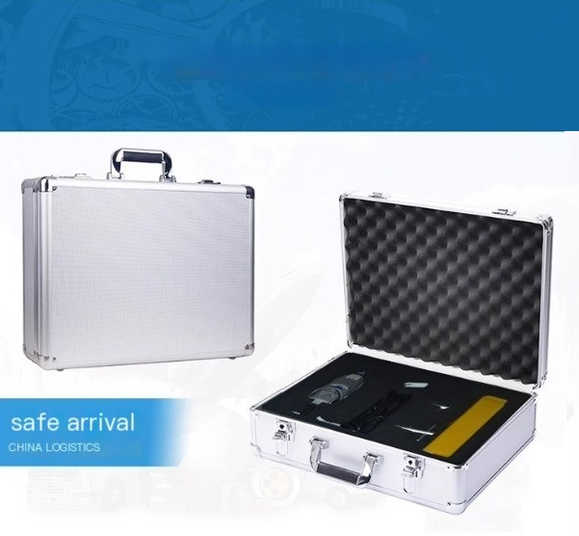
Aluminum box packaging for safe delivery
WHOLE MACHINE

