Slide 1
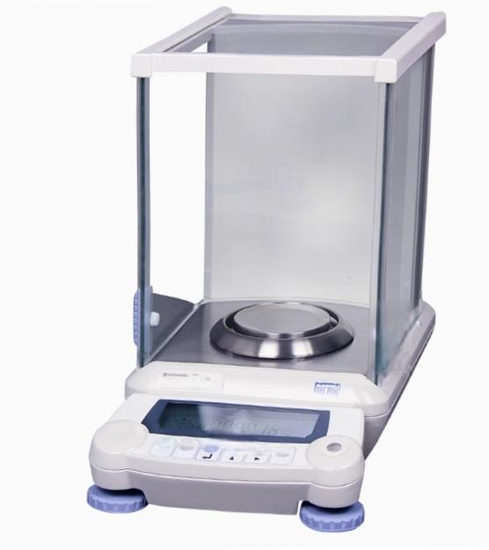
1

Slide 2
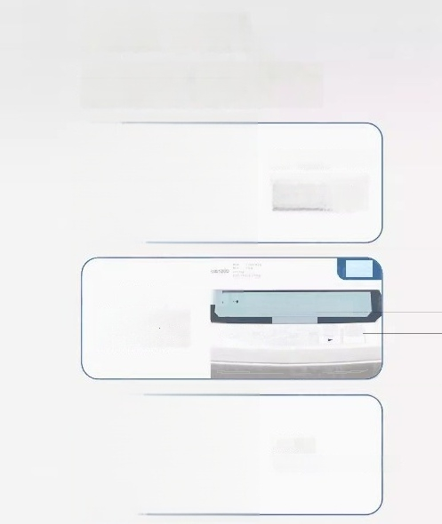
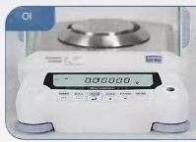
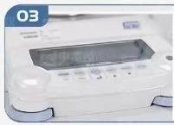
Detail Display
AuW-D dual range semi micro balance AUW/AUY analytical balance
Aluminum body type
Aluminum intagrated
LCD display screen
Used for otting
PINT
shield
Waterproof and anti pollution

Slide 3

Weighing black technology
Make experiments more efficient
Electronic Analytical Balance AUW Series
Automatic Range Calibration Data Management Direct Window

Slide 4

Automatic range calibration
Fully automatic internal
school
PSC fully automatic internal calibration (AUW/AUX series)
When the temperature changes,the balance will automatically calibrate
Clock CAL Automatic Internal Calibration(AUW Series)
At the scheduled time,the balance will automatically calibrate

Slide 5

data management
GLP/GMP/ISO
GLP/GMP/ISO calibration records
(AUW/AUX series)calibration records can have time and date,in compliance with
GLP/GMP/ISO requirements

Slide 6
All functions of electronic analytical balance
①Loading the new generation quality sensor"UniBloo"
②Built in PSC automatic calibration function (AuW-D/AUW)
③Use the timed calibration function (Auw-D/AuW)
④Built in "direct window"function:only one cable is needed to connect to the PC, and no software needs to be installed to achieve data transmission
⑤Can bo used asa spooifio gravity metor when paired with a spocifio gravity measuring devico
⑥Different weighing modes can be adopted acoording to differentenvironmental requirements Compliant with GMP/GLP/SO data recording requirements (AUW-D/AUW)
⑧Equipped with hook weighing and fault self diagnosis function

Slide 7
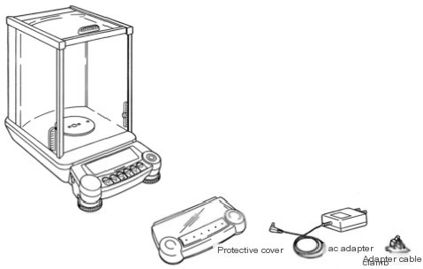




AUW-D Dual Range Semi Micro Balance AUW/AUY Analytical
Balance
Weighing plato
Disc holder
arFn
Rperating Instructio
Balance body
Standard packaging | number
Balance body | 1
Weighing plate | 1
Disc holder | 1
Anti convection circle | 1
ac adapter | 1
Adapter cable clamp | 1
Operating Instructions | 1
Operation instruction card | 1
inspection certificate | 1
Protective cover | 1

Slide 8
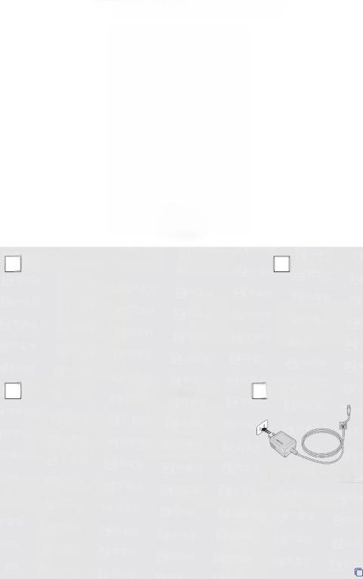
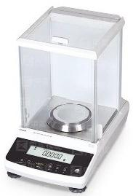




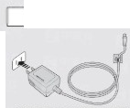




ATX/ATY Analytical Balance
Balance host (windproof cover)[1] □Trey[l] Bi 能 FPPrt
Protective cover[1]
Windproof ring[1]
]ACadapaer[1]
h 贼 dapter
MdgydPHrom
MR8jage single page:Operation
☑onatnoMauIT

