Slide 1
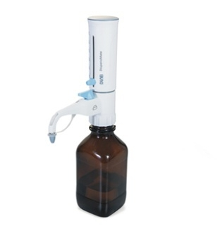

Slide 2

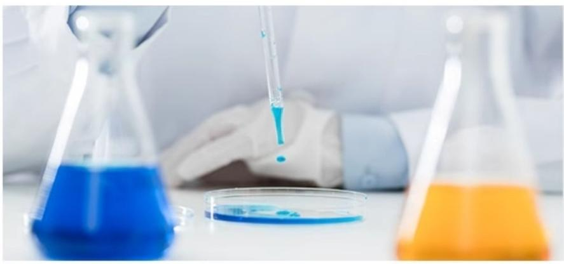
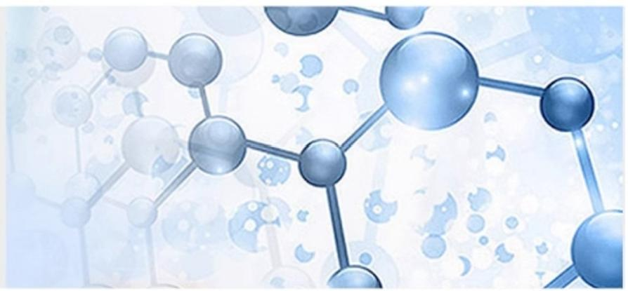
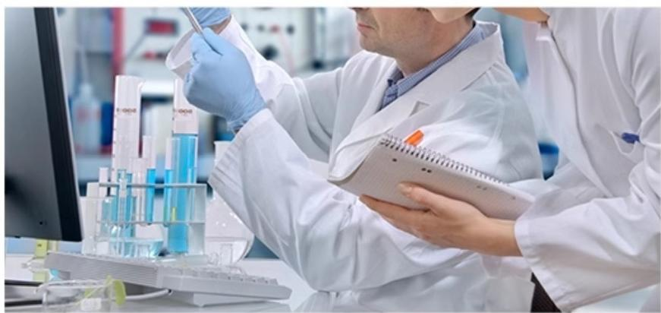
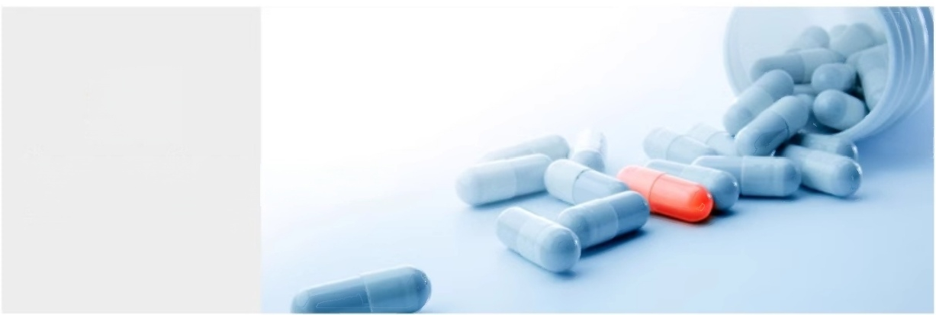
Widely applicable precise needs
Used in chemical analysis,food industry,environmental analysis,and other fields
01
Laboratory
Laboratory
02
Chemical analysis
Chemical synthesis
03
Physicochemical analysis
Physicochemical
04
Biopharmaceuticals
Biopharmaceutical

Slide 3
^{Bottleneck} ^{Dispenser} DispensMate Series
Features and Advantages:
·Chemically resistant;
·Four models meet and cover the capacity range of 0.5-50mL;
·Convenient design ensures simple and economical cleaning and maintenance of the dispenser;
·Made of PTFE,FEP,BSG,PP and other materials;
·Maximum pressure resistance of 500mbar,maximum viscosity resistance of 500mm2/s,maximum
Liquid temperature resistance of 40℃,maximum liquid density of 2.2g/cm3;
·The specifications of the five types of bottle mouth adapters included:S40,GL32,GL38,GL25,GL28.
A=Accuracy _{t} ^{icient} ^{of}
CV
C
oeff
va
a
ion
Range mL | Scale mL | A≤± |  | CV≤
 |  | % | μ L | % | μ L
0.5~5 | 0.1 | 0.5 | 25 | 0.2 | 10
1.0~10 | 0.2 | 0.5 | 50 | 0.2 | 20
2.5~25 | 0.5 | 0.5 | 125 | 0.2 | 50
5.0~50 | 1.0 | 0.5 | 250 | 0.2 | 100

Slide 4
^{Bottleneck} ^{Dispenser} DispensMate-Pro series
Features and Advantages:
·Chemically resistant;
·Whole high-temperature disinfection and sterilization;
·Reflux valve design,reduces reagent waste,and prevents dripping when not in operation;
·"Embedded locking method,"protects rapid,reliable,and highly reproducible volume setting;
·Humanized design,easy to disassemble and clean,reducing maintenance costs;
6 types of adapters,covering a capacity range of 0.5-100mL,meeting different user needs;
·Maximum pressure resistance of 500mbar,maximum viscosity resistance of 500mm2/s, maximum liquid temperature resistance of 40℃
Maximum liquid density resistance 2.2g/cm3;
·Stretchable liquid absorption tube,compatible with
different specifications of reagent bottles.
Range | Graduation ml | A≤± |  | CVs
 |  | % | μl | % | μl
0.5-5 | 0.1 | 0.5 | 25 | 0.2 | 10
1.0-10.0 | 0.2 | 0.5 | 50 | 0.2 | 20
2.5-25.0 | 0.5 | 0.5 | 125 | 0.2 | 50
5.0-50 | 1.0 | 0.5 | 250 | 0.2 | 100
10-100 | 2.0 | 0.5 | 500 | 0.2 | 200
DispensMate-Pro
Part Number | Specification ml
7032111005 | 10-100ml
7032111004 | 5.0-50ml
7032212003 | 2.5-25ml
7032212002 | 1.0-10ml
7032212001 | 0.5-5ml

Slide 5
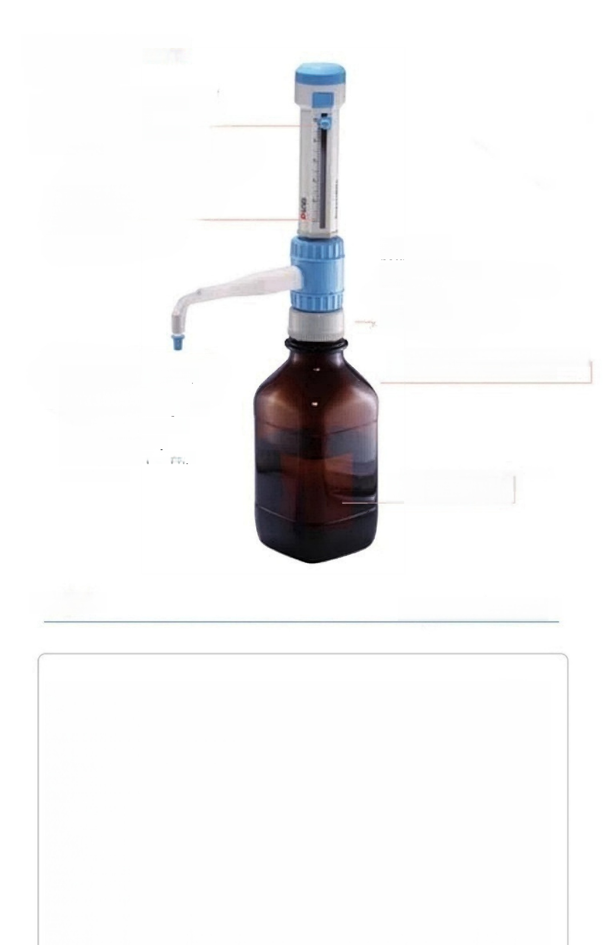
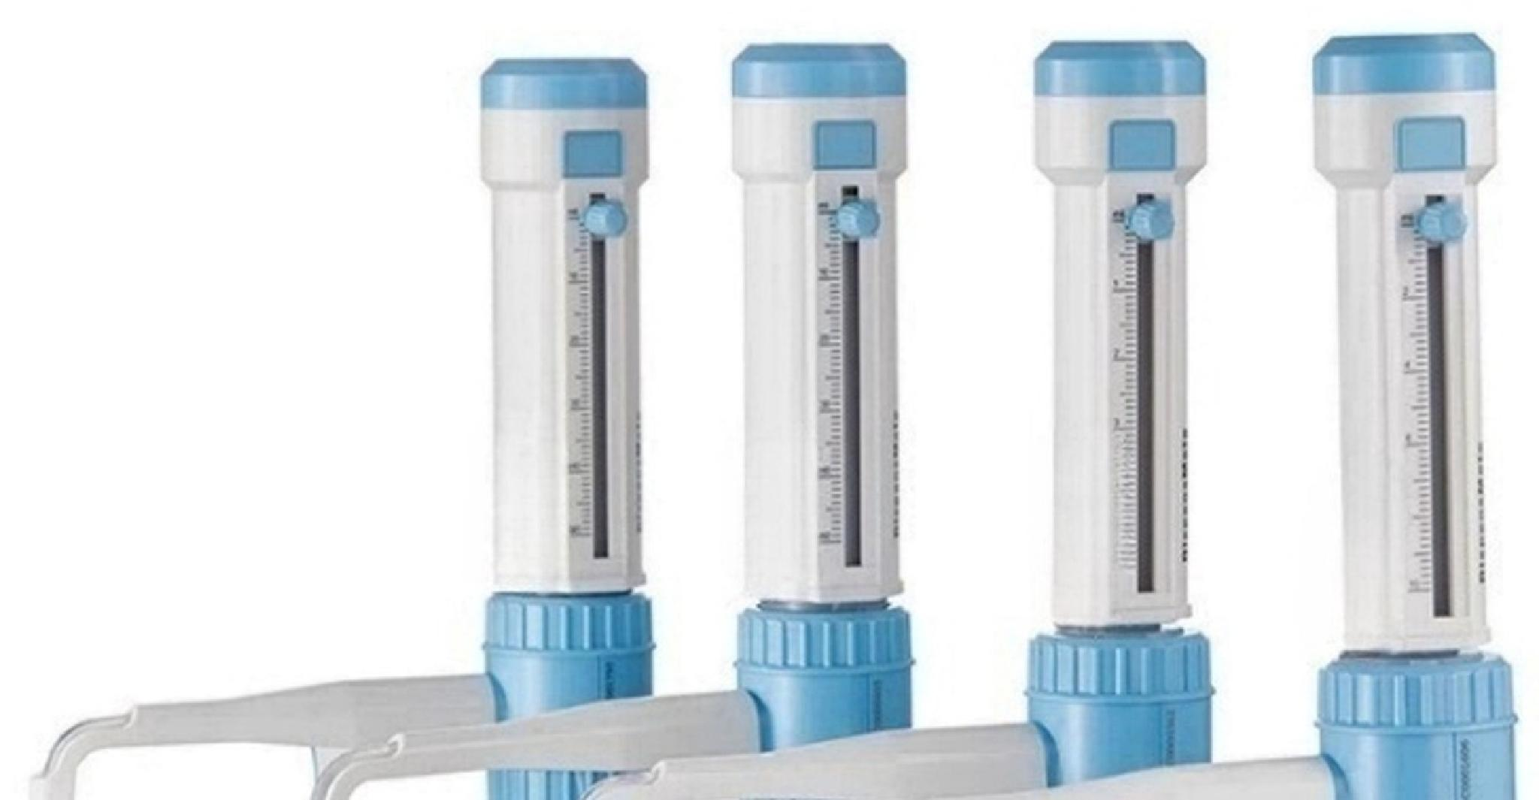
DispensMate
Bottleneck Dispenser
Smooth and precise piston
sliding up and down,
making operation easy and
comfortable
Quick volume
setting,precise
scale design
Five types of
bottle mouth
adapters included, suitable for
laboratories Most reagent bottles
Drainage pipe safety cap,can prevent
contact with reagents, even when wearing
gloves,it is very
convenient to install
or remove
Transparent suction tube,suitable for various sizes of reagent bottles
Note:Product(excluding
brown reagent bottles)
^{Real} ^{shot} DispensMate Series

