Slide 1
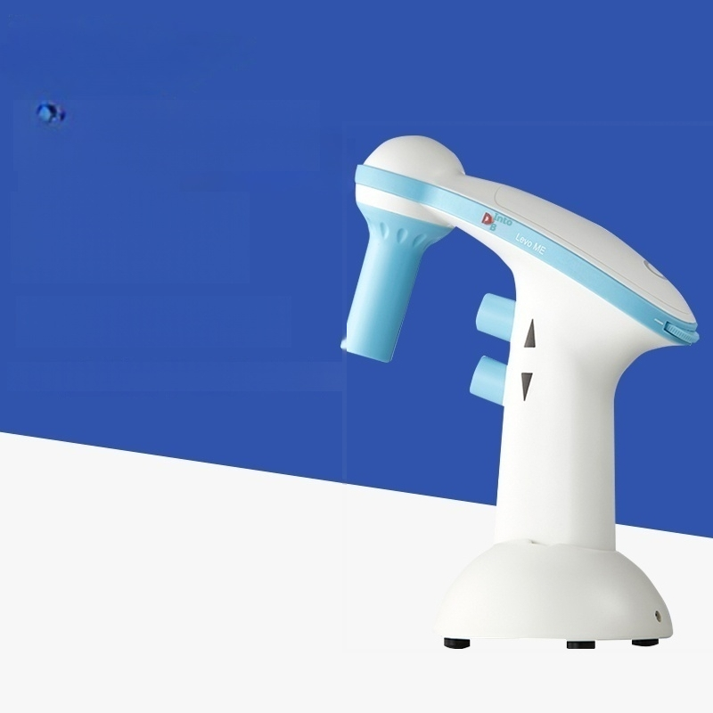
Large capacity electric
Pipettes
Levo Plus/levo ME
The working speed can be adjusted arbitrarily

Slide 2
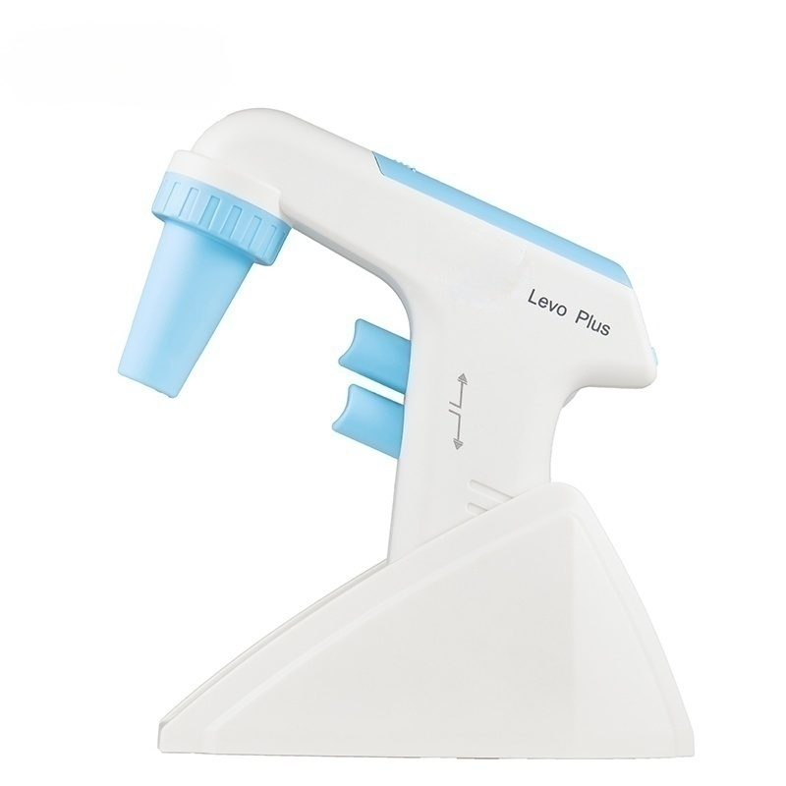

Slide 3
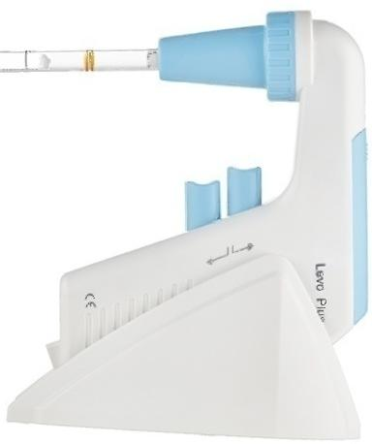
Ui
pfiliuo

Slide 4
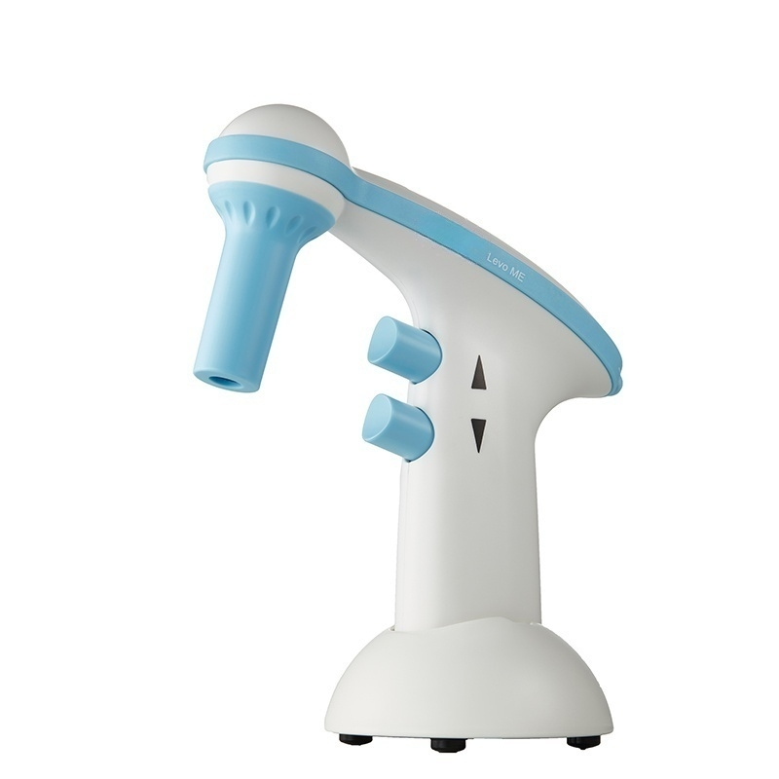

Slide 5
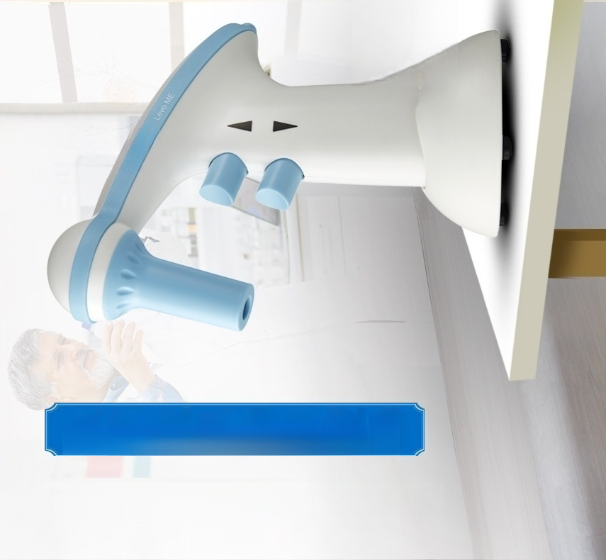
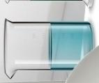
Large capacity electric pipette
The working speed can be Accurate and reliable adjusted arbitrarily

Slide 6
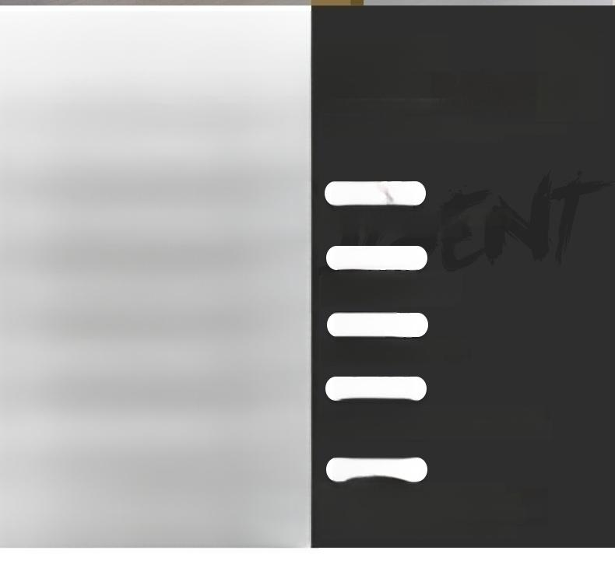
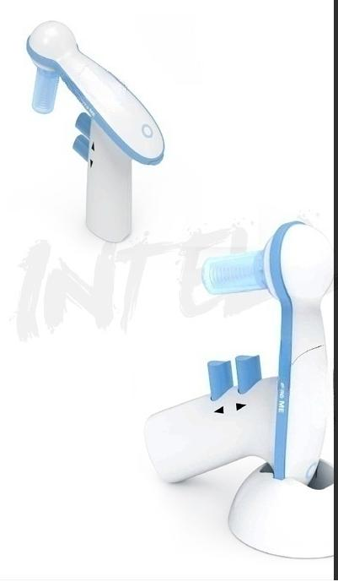

Why choose
Pipette
NMTSOHASLDSTTSSPOTASTIEETSLARCESTLAKETO
SERUNG T⁵0 WHOSERAFIDEXPANSCN 5FUELEDBYMELTINGGLACIEESANDNCFEASEDRAJN
ACORDNG TONEW RESEARCH.THE SERLNGTS⁰WASMEASJREDAT
Accurate
measurement
High quality pump to ensure accurate
and reliable pipetting work
Adjustable speed
The working speed can
be adjusted arbitrarily
One-handed
Small and lightweight,suitable
for one-handed operation
High adaptability
Suitable for various 0.1-100ML capacity glass and plastic pipettes on the market
Disinfection filter
membrane
It can be adapted to hydrophobic
high-temperature disinfection filter membrane to prevent the damage to equipment caused by back suction.
operation

Slide 7
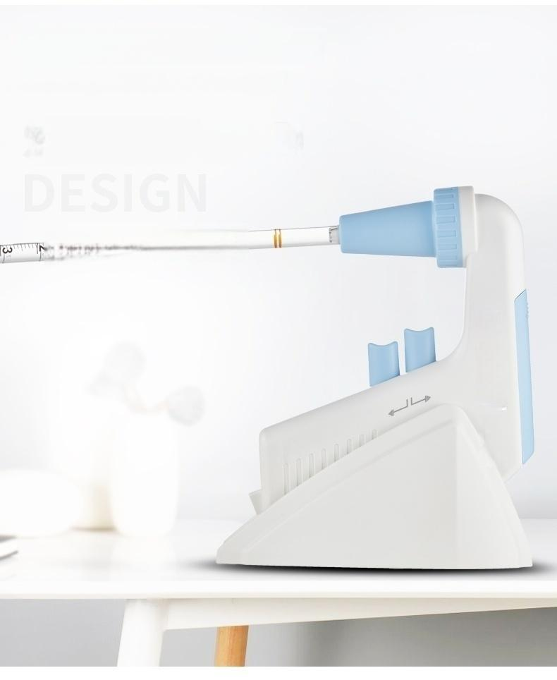
Applicable 0.1-100ml pipette
High-power motor can quickly fill 100ml liquid
MPL F E
Plililem
[
LevoPlu

Slide 8
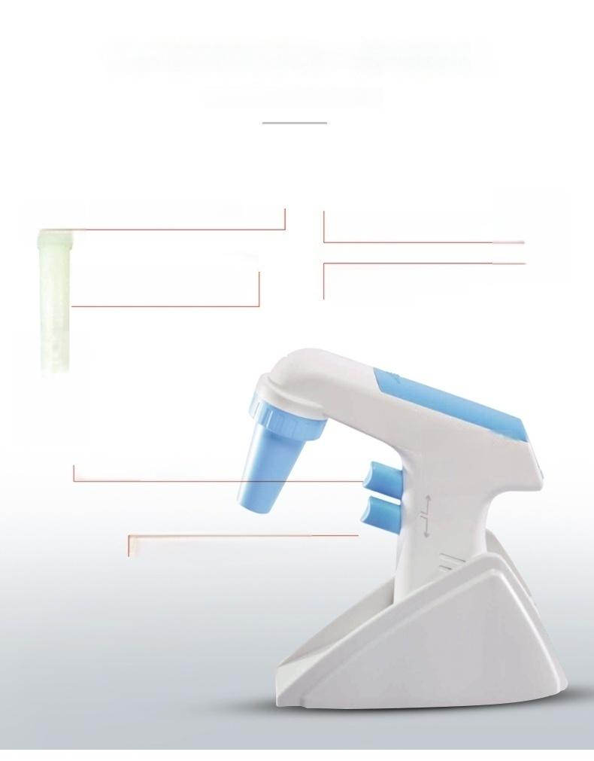



Fingertip control suction,liquid button
Guaranteed accuracy of pipetting
Equipped with replaceable 0.45um hydrophobic filter
Large LCD screen displays 8 speed settings and power information
Touch the governor button to easily adjust the suction and liquid separation
Silicone adapter,suitable for
0.1-100ml pipette,can be sterilized by high temperature and high pressure
t wL evo Plus
Plpette operation button for
easy plpetting
Gravity drainage by controlling
the drainage operation button

Slide 9

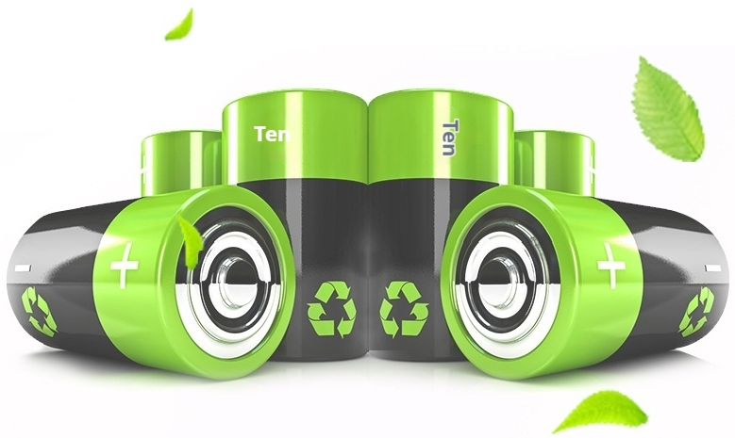
High-capacity Li-ion
Can work intermittently for 8 hours,charging time 2-3 hours

Slide 10
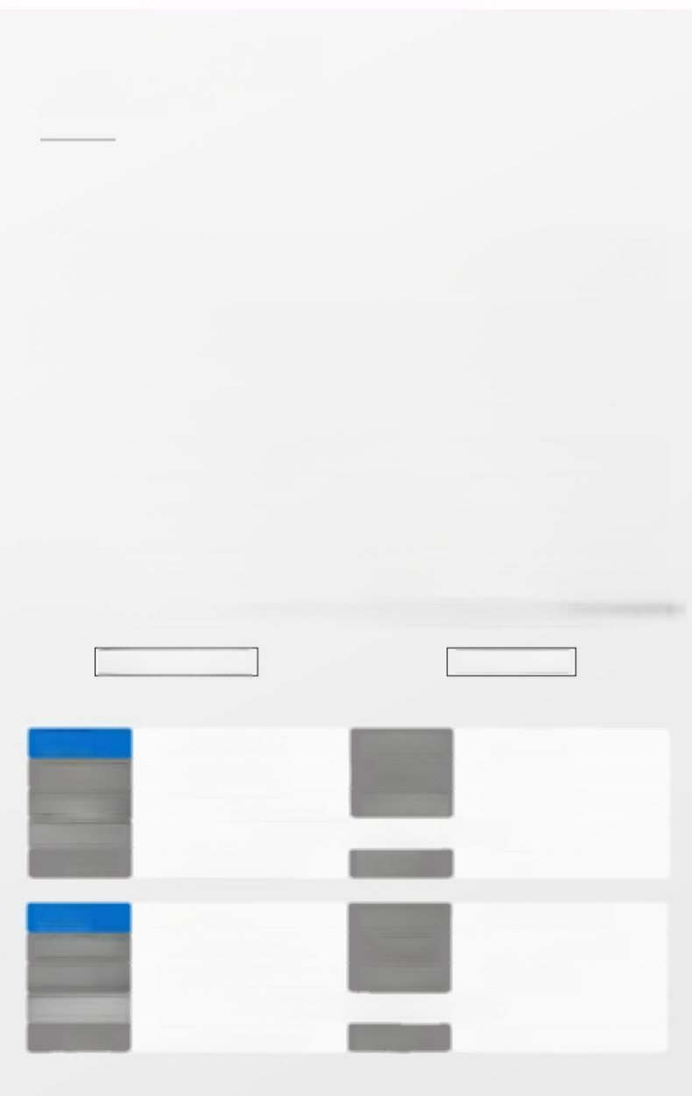
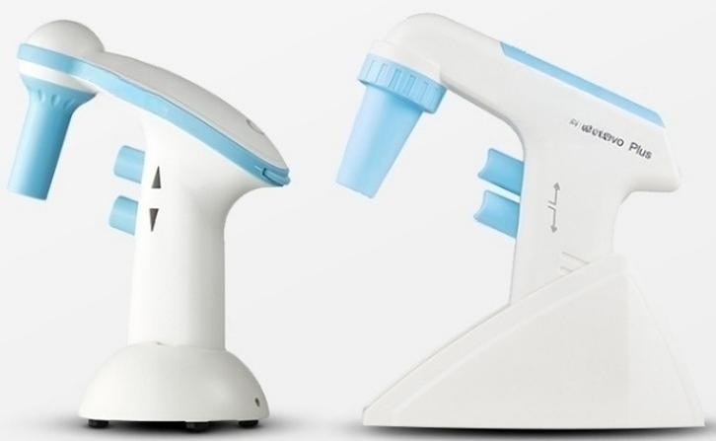
BASIC PARAMETERS
Basic Parameters
LEVOME Economy LEVO PLUS
Model | LEVOME Economy | Absorption speed | 25ML<7S
Drainage speed | Electric/Gravity | Battery | Lithium battery
Battery Usage Time | Can be used intermittently for more than 8 hours | Charging Time | Only 2-3 hours
Pipette type | Plastic or glass tubes(0.1-100ml);Pasteurization tubes
Filter | 0.45um hydrophobic | Weight | 200g
filter membrane
Model | LEVO PLUS | Absorption speed | 25ML<5S(8th gear)
Drainage speed | Electric(6th gear)/Gravity | Battery | Replaceable lithium battery
Battery Usage Time | Can be used intermittently for more than 8 hours | Charging Time | Only 2-3 hours
Pipette type | Plastic or glass tubes(0.1-100ml);Pasteurization tubes
Filter | 0.45um hydrophobic | Weight | 200g
filter membrane

Slide 11
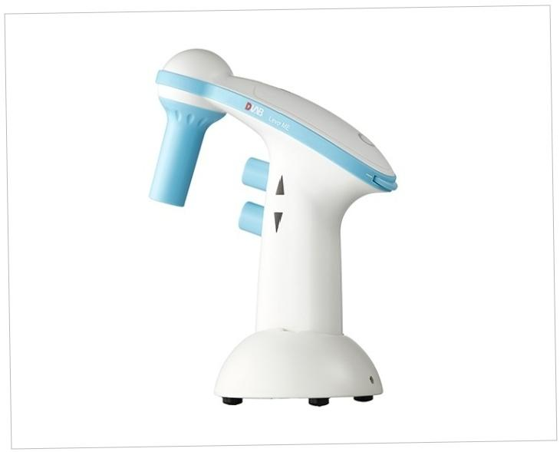
Product display quality embodiment
Experimental large-capacity electric pipette

