Slide 1
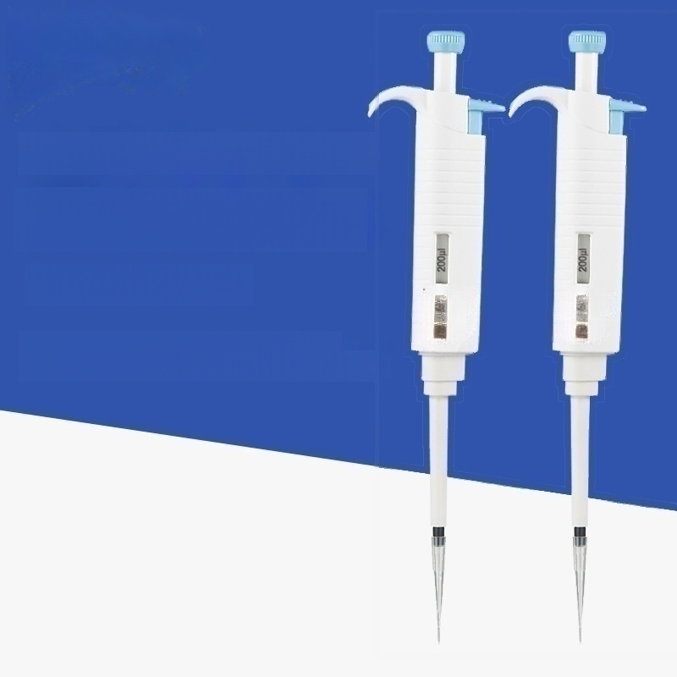
Full disinfection manual Adjustable pipette
MicroPette Plus
The whole branch can withstand high
temperature and high pressure disinfection

Slide 2
parameter
Product Information
MicroPetteplus fully sterilized manual(adjustable)pipettes:
· ^{l} _{i} _{i} _{io} ª;^{n} ^{withstand} ^{high} ^{temperature} ^{and} ^{high}
·The use of ergonomic design,operating experience; Wide range,0.1uL to 5000uL;
·Easy calibration,simple and convenient maintenance;
Adopt new materias and withstand high temperature and high pressure structure;
Correct liquid separation,each MicroPetteplus pipette is carried out according to EN/ISO8655 standard Calibration.
MicroPetteplus multiple channels:
8-channel and 12-channel pipettes of various ranges are suitable for standard 96-wellplates;
The lower part of the pipette can rotate 360 degrees to facilitate pipetting;
·Each nozzle is equipped with an independent piston device to facilitate maintenance; The nozzle connection is made of composite material with excellent sealing performance;
·Compatible with most brand nozzles.
The wh
o
r
nc
h
c
pressur
e
n
t
ec
n

Slide 3
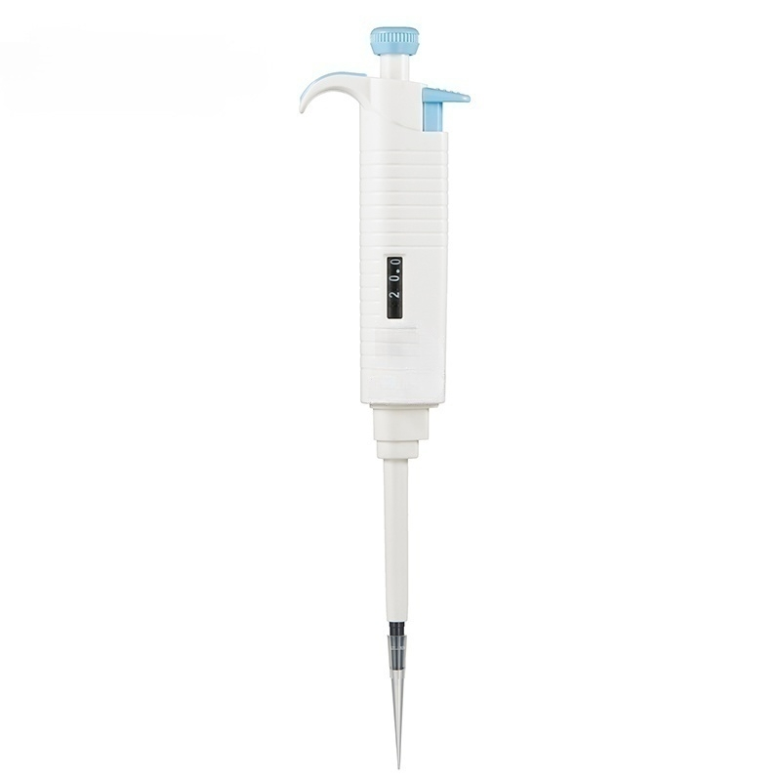

Slide 4
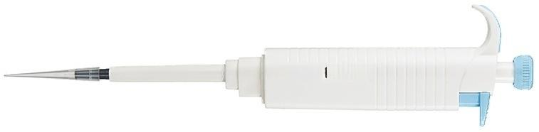
DUB
2-20μl
20.0

Slide 5
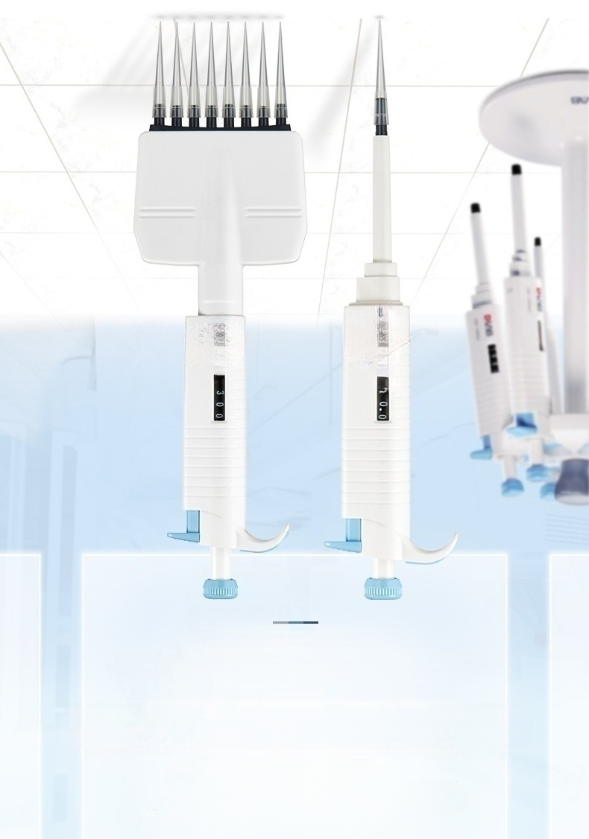
(səμas snd228doJD!W)
Э!гИде чэиелд ароцм ачзуо иопэаjи!s!р aunssad цБгч рие алпделэашэд чб!Н
ə11əd!d əjqeisn!pe paz!!Jais KIIny

Slide 6
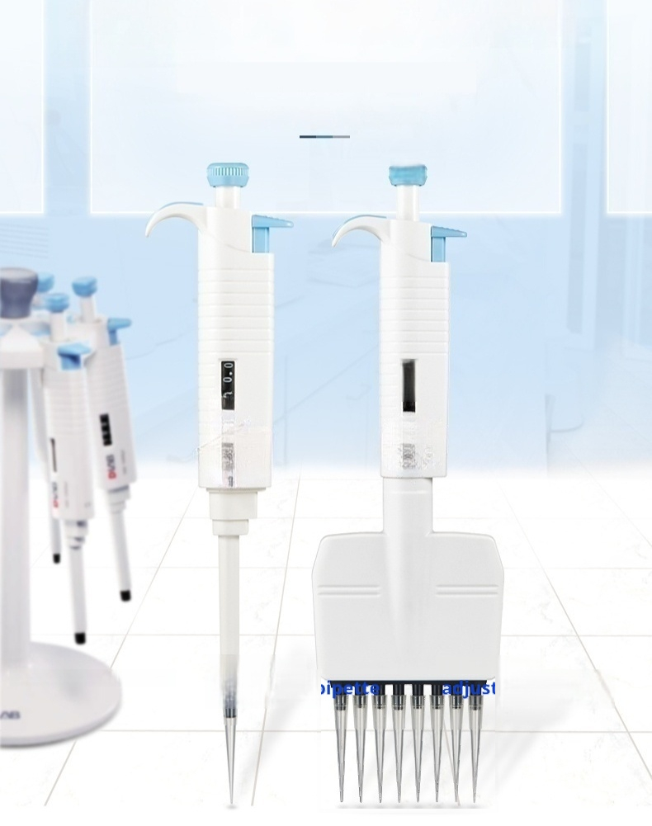
Model Display
Ⅲ
300
Single channel adjustable pipette
8-channel
ajustable pipeter
12-channel
agjustable pipette

Slide 7
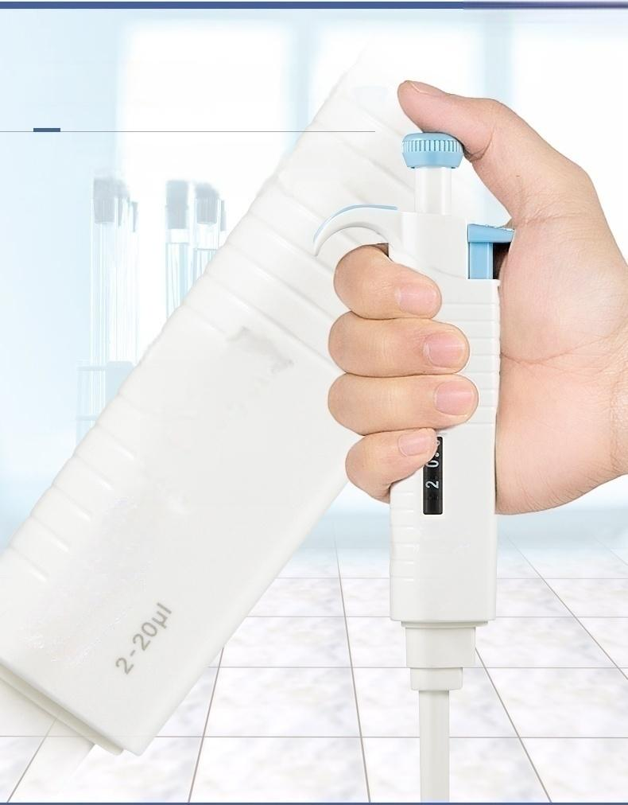

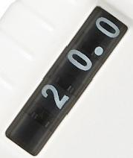
MicroPette Plus
Wide measurement range
Digital window with a wide measurement range from 0.1μL to 5000μL;ergonomically designed for a comfortable operating experience.
noz-乙

Slide 8
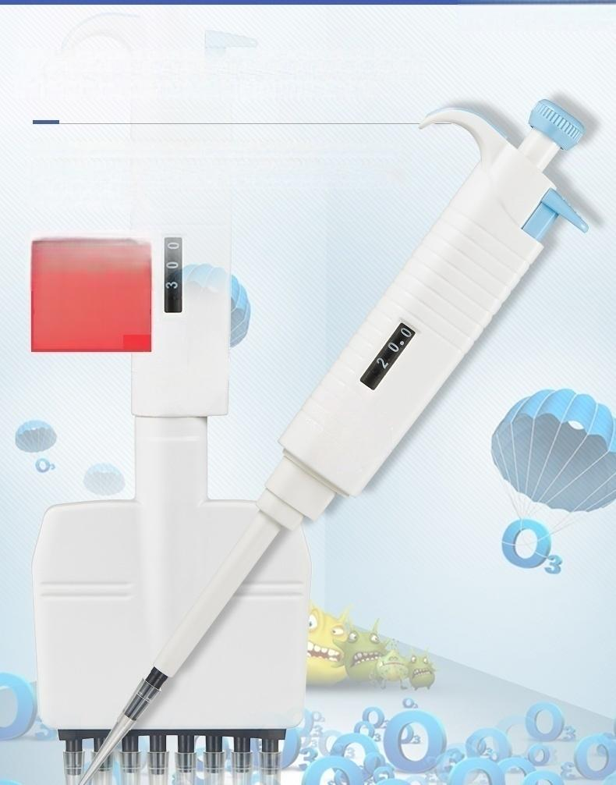
High temperature and high pressure
disinfection of the whole branch
Adopt new materials and withstand high temperature and high pressure structure;
Each MicroPettePlus pipette is calibrated to EN/ISO8655.
121℃
High temperature
and high pressure
disinfection of the
whole branch
MicroPette Plus

Slide 9
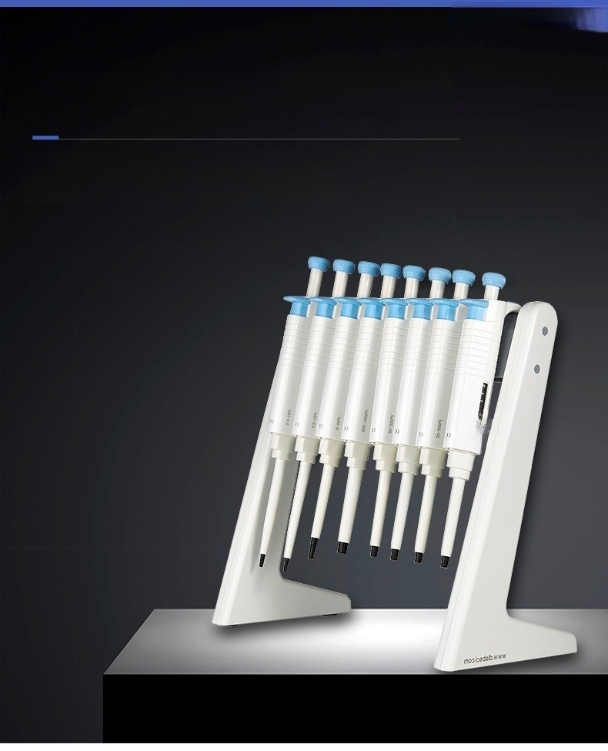
MicroPette Plus
Accurate and reliable sampling analysis
Easy calibration,simple maintenance
Handle hook,desktop finishing more convenient

Slide 10
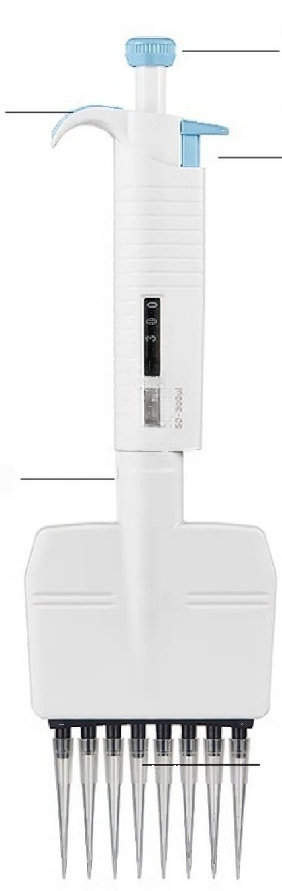
Product Resolution
Easily rotate the counter knob to select the dispensing amount Ergonomically designed finger support for Quick and simple Nozzle ejector Removable components for easy maintenance High chemical stability of nozzle coupling
MicroPetteplus multi-channel features advantages: 8-channel and 12-channel pipettes of various measuring ranges are suitable for standard 96-well plates;The lower half of the pipette can rotate 360 degrees to facilitate pipetting; · Each nozzle is equipped with an independent piston device to facilitate maintenance;
one-handed operation
50-300ul

Slide 11
Disinfection for 20 minutes,do not need special preparation to
disinfect the whole branch.After disinfection,it must be left for
more than 12 hours to fully cool and dry.
It is recommended to check the performance of the pipette after each high
After high temperature and high pressure disinfection every 10 times, the piston and sealing ring of the pipette should be lubricated again.
temperature and high pressure disinfection.Also built.

Slide 12
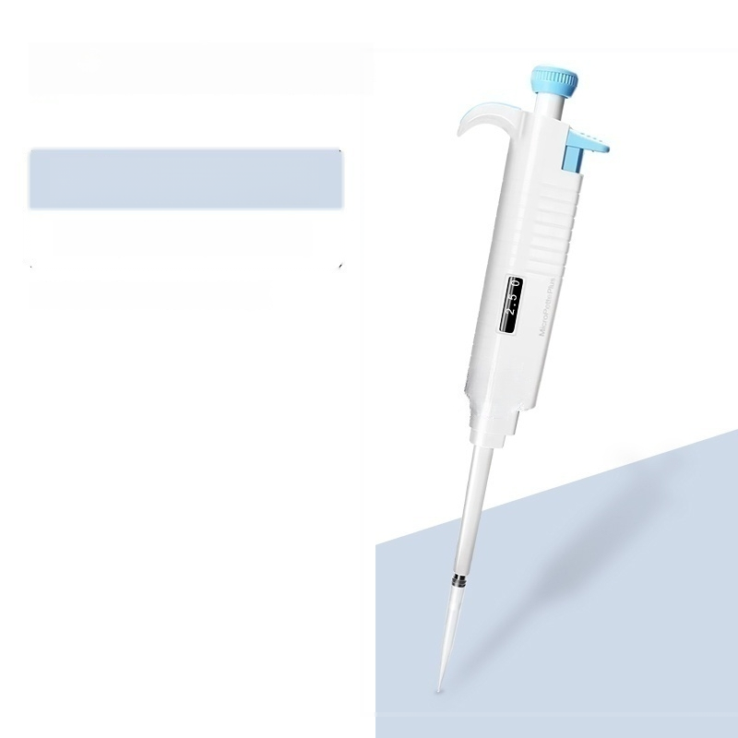
Range:0.1～2.5μl
Send 10μl tips(about 200)
Unit conversion:1ml=1000ul

Slide 13
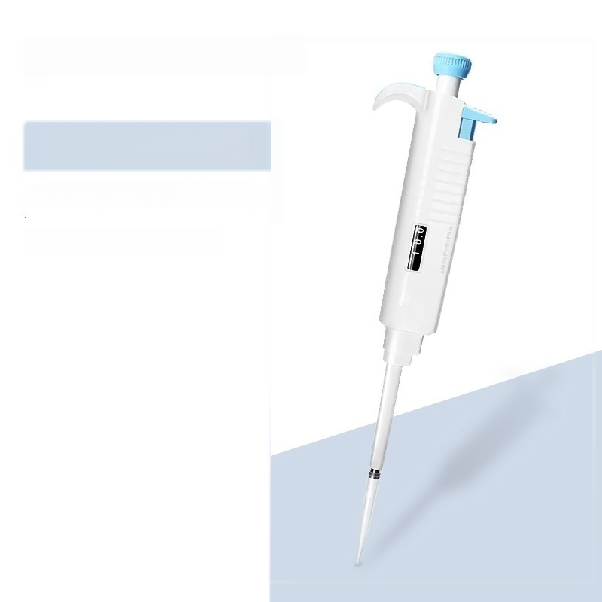
Range:0.5~10ul
Includes 10ul pipette tip(about 200 pieces)
Unit conversion:1ml=1000ul

Slide 14
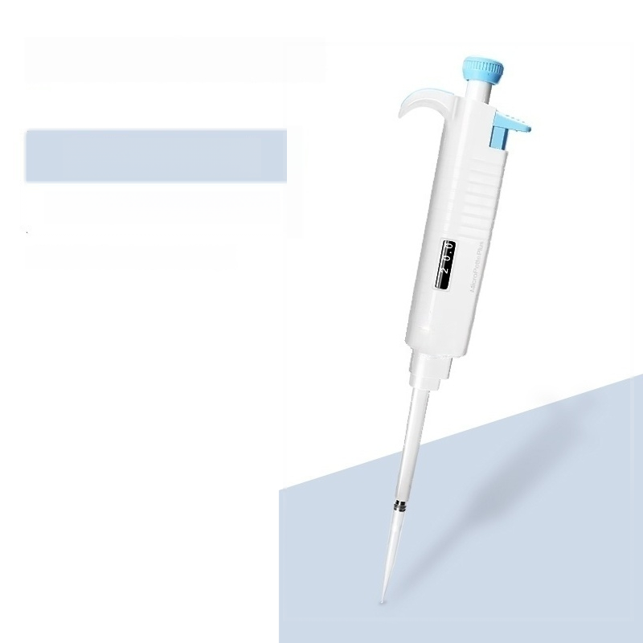
Range:2～20μl
Send 200μl tips(about 200)
Unit conversion:1ml=1000ul

Slide 15
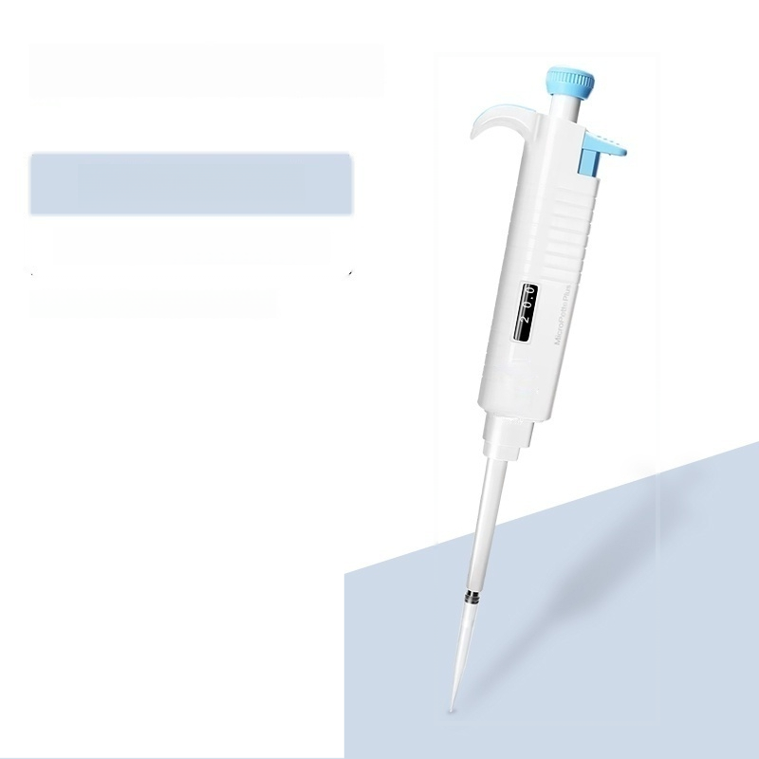
Range:5～50ul
Send 200μl tips(about 200)
Unit conversion:1ml=1000ul

Slide 16
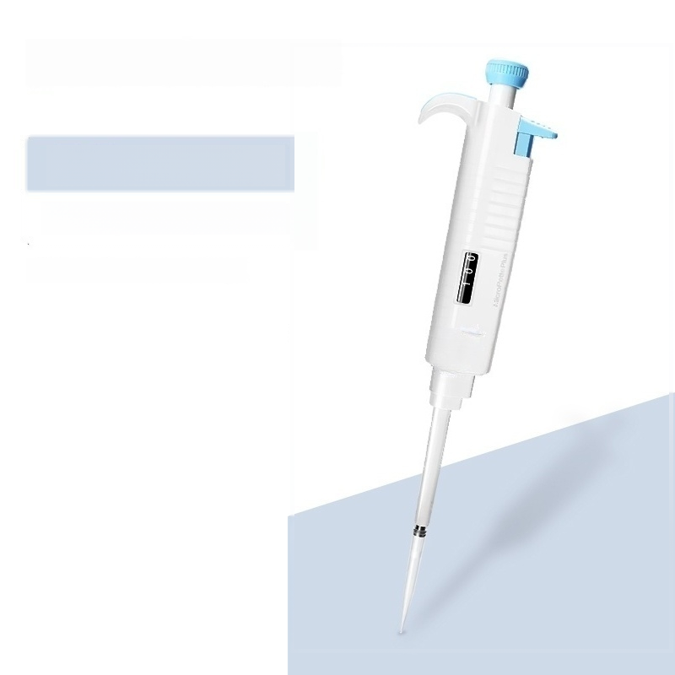
Range:10～100μl
Send 200μl tips(about 200)
Unit conversion:1ml=1000ul

Slide 17

Range:20～200μl
Send 200μl tips(about 200)
Unit conversion:1ml=1000ul

Slide 18

Range:50～200ul
Send 1ml suction head(about 100)
Unit conversion:1ml=1000ul

Slide 19
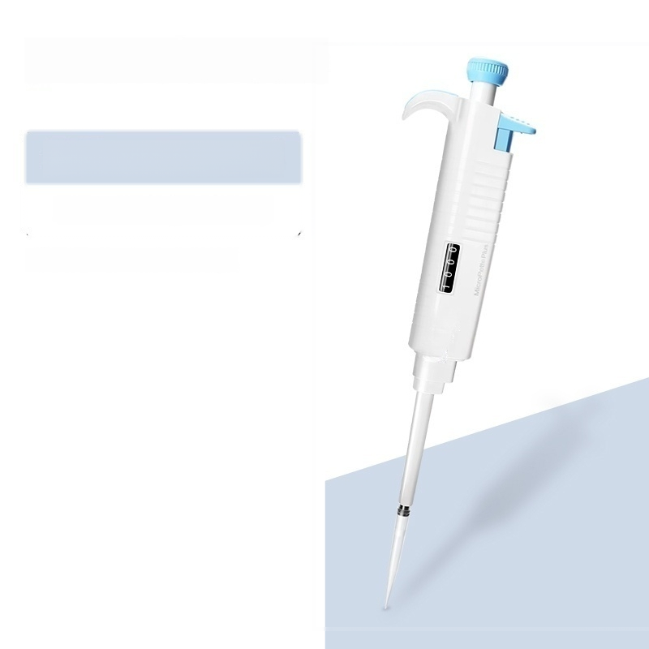
Range:100～1000ul
Send 1ml suction head(about 100)
Unit conversion:1ml=1000ul

Slide 20
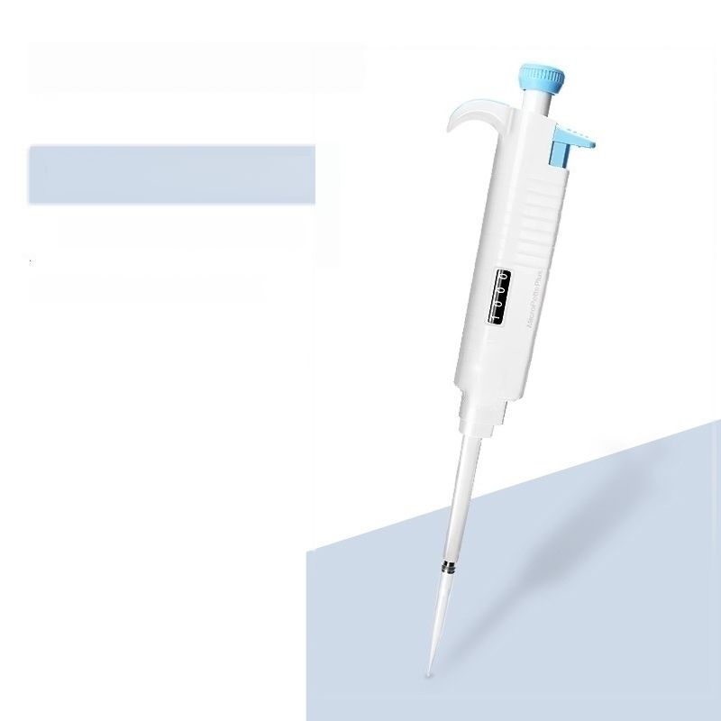
Range:200～1000ul
Send 1ml suction head(about 100)
Unit conversion:1ml=1000ul

Slide 21

Range:500~5000μl
Includes 5ml pipette tip(1 small pack)
Unit conversion:1ml=1000ul

Slide 22

Range:1~10ml
Send 10ml tip(1 packet)
Unit conversion:1ml=1000ul

Slide 23
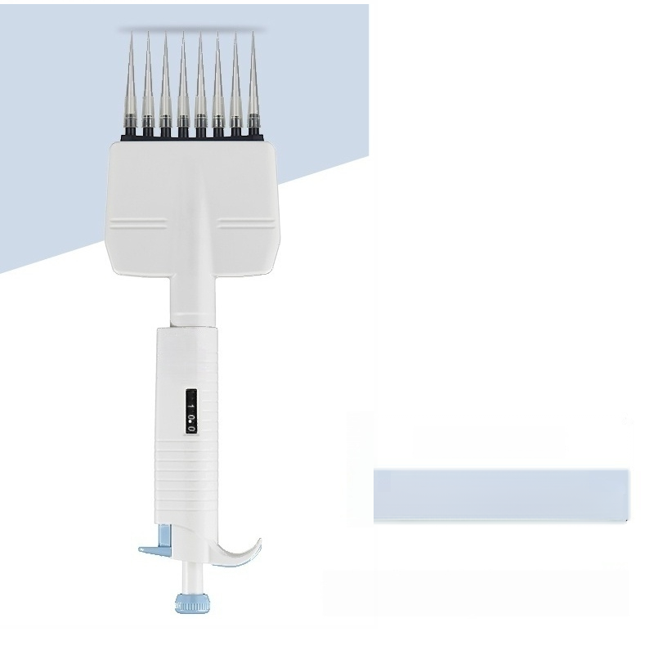
InOt-S"0 :อbuer
21əd!d əqeisn!pe paz!llนอาร AjInjเอนนะนว-8

Slide 24
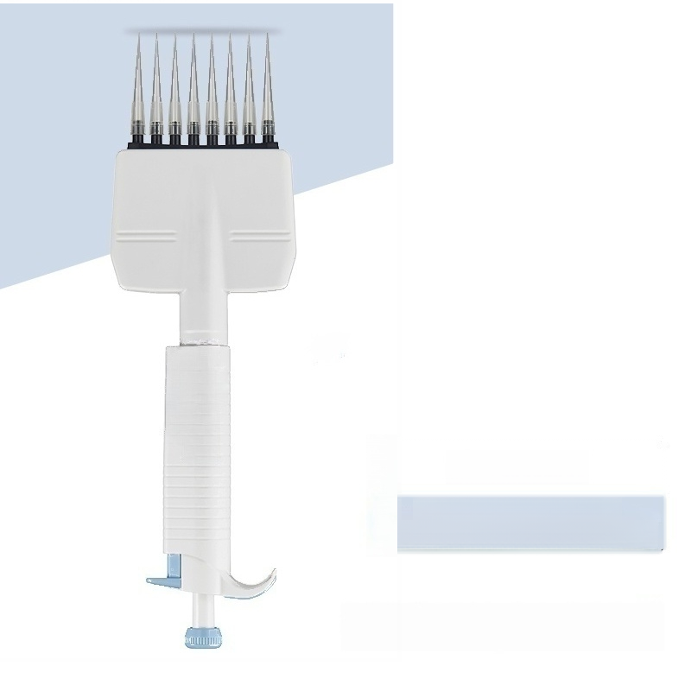
inos-s | :อbuey
21əd!d paz!llนอาร | əqeisn!pe AjInjเอนนะนว-8

Slide 25

300
inooc-os :อ6uey
21əd!d əqeisn[pe paz!!!เอาร Ajiny เอนนeนว-8

