Slide 1
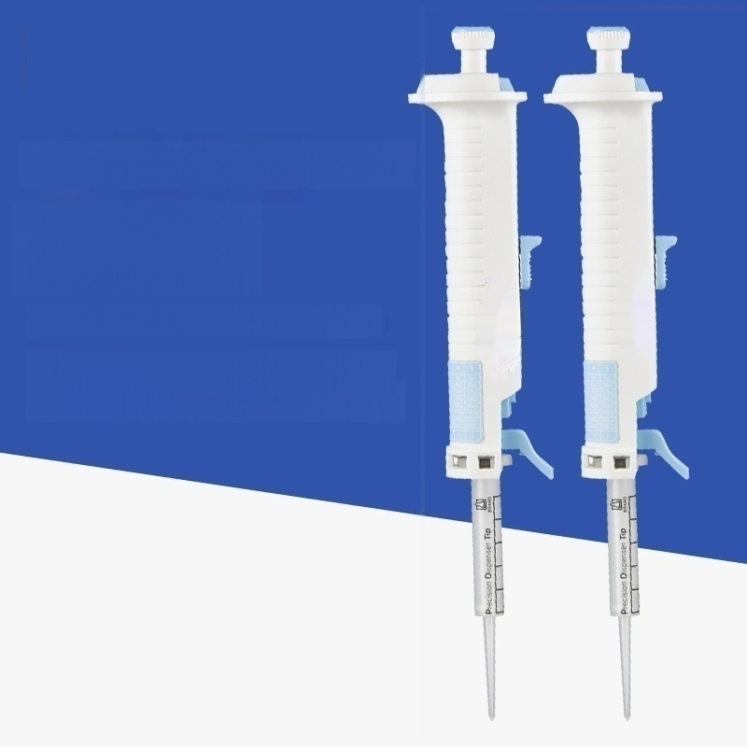
Continuous distribution Pipettes
StepMate manual continuous distributor
Wide range of measurement and maintenance-free design

Slide 2
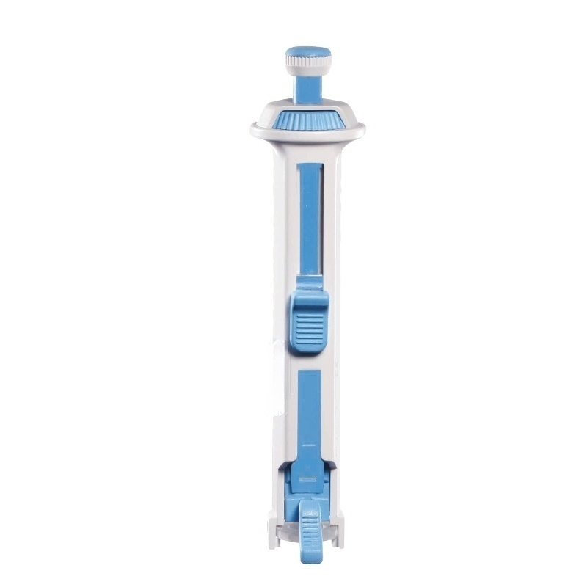

Slide 3
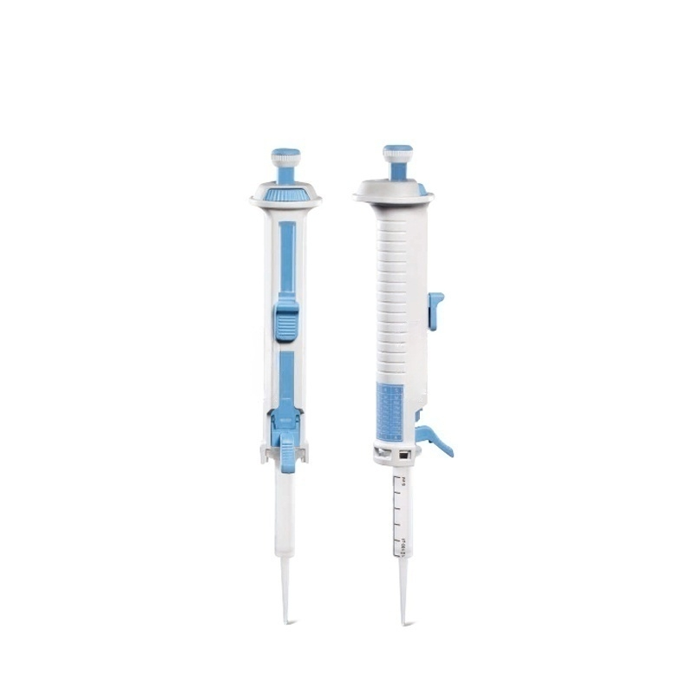

Slide 4
