Slide 1
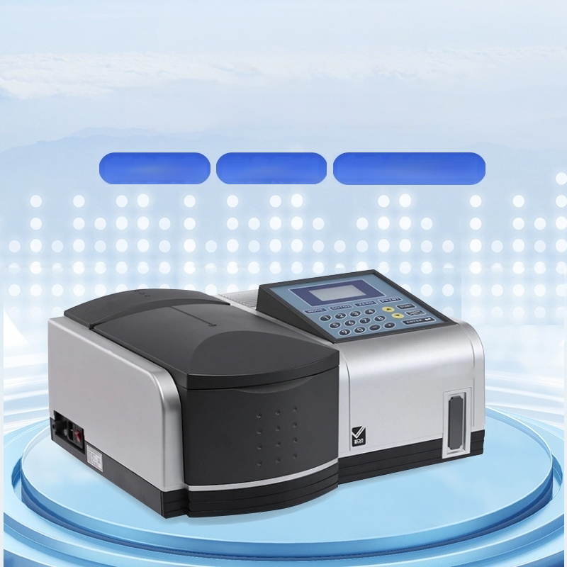
T6 Series UV
Visible Spectrophotometer
Low stray light Excellent stability High automation level

Slide 2
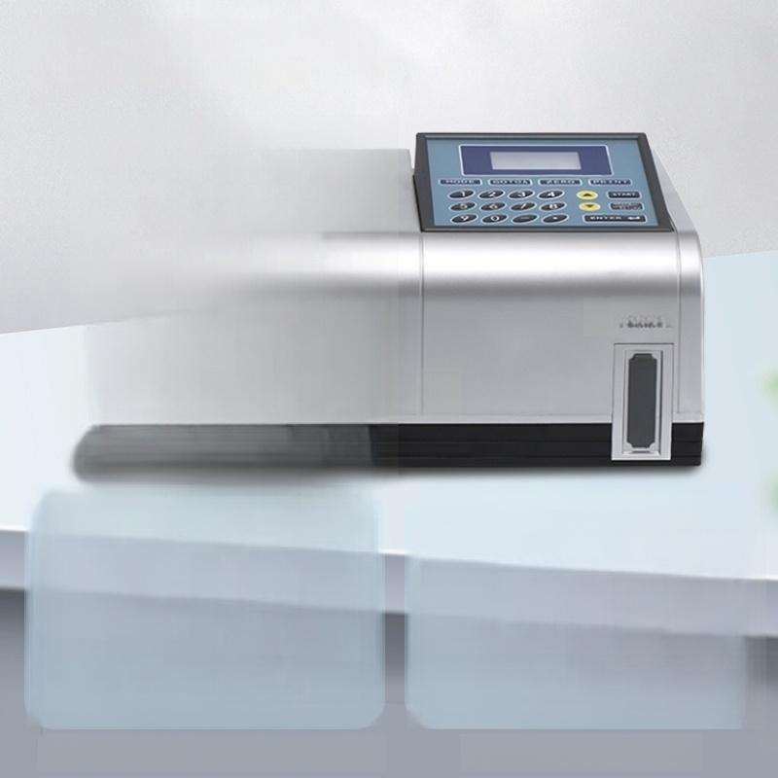
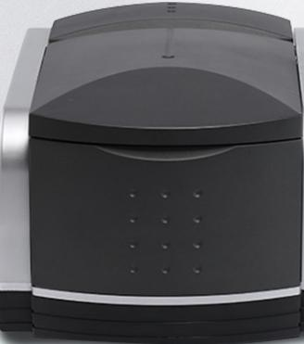

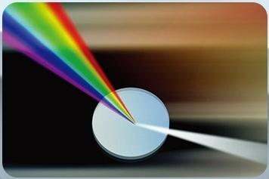
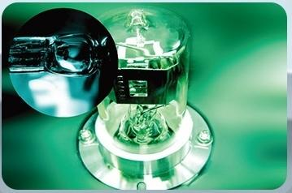
Excellent stability
Puxike
Tongyong.. P6NEAL
Fully sealed monochromator structure
High-quality light source

Slide 3
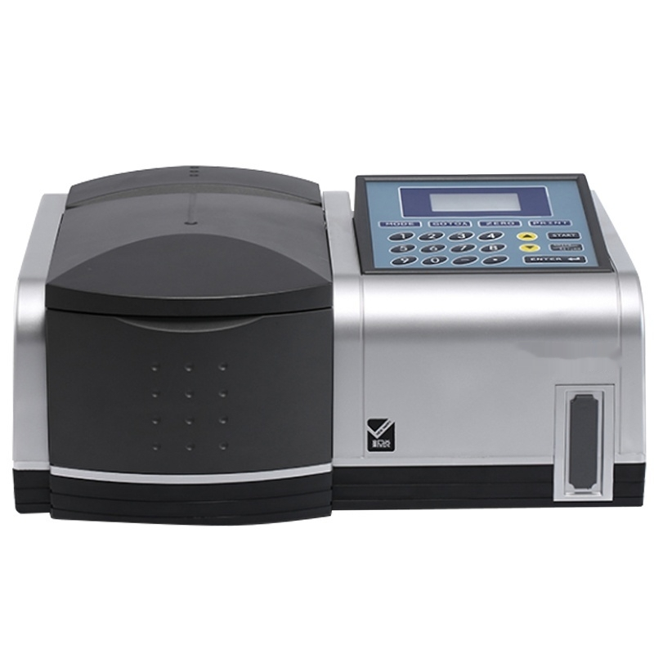

Slide 4


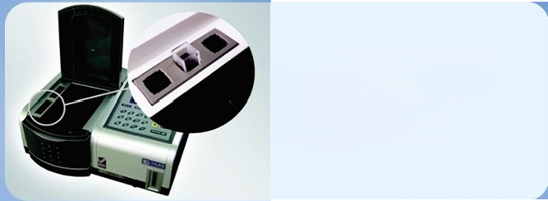
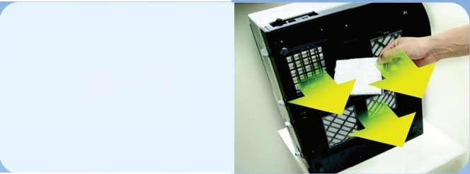

Product Details Product details
Built-in color comparison m storage rack
A sample cellstorage rack is set on one side of the sample
chamber for user convenience
Convenient washable
dust-proof filter screen
Equipped with washable dust-proof
filter screen design,
Ensures internal instrument cleanliness
and facilitates maintenance.
Rich extended functions
T6 series products have dedicated function card
slots.Inserting different function cards enables
convenient completion of functions such as pesticide residue detection,DNA/protein
measurement,and full-spectrum scanning,
meeting various user needs.

Slide 5


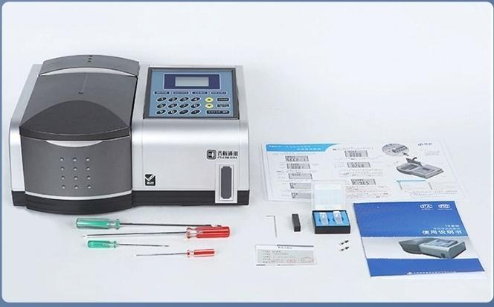
Packing List _{Packing} _{list}
T6 New Century Standard Configuration T6 new Yue standard configuration Quantity
UV-Vis Spectrophotometer Host(5-cell/8-cell) | Visible Spectrophotometer Host(5-cell/8-cell) | 1
Certificate of Compliance | Certificate of Compliance | 1 piece
Quartz CuvetteI | Glass Cuvette Ⅲ | 2 Pieces
Quantitative Measurement Function Card |  | One set
Combination Tool | Combination Tool | One set
Fuse(2A) | Fuse(2A) | 2 Pieces
Power Cable | Power Cable | 1 root
User manual | User manual | 1 of this
Packing list | Packing list | 1 piece

Slide 6

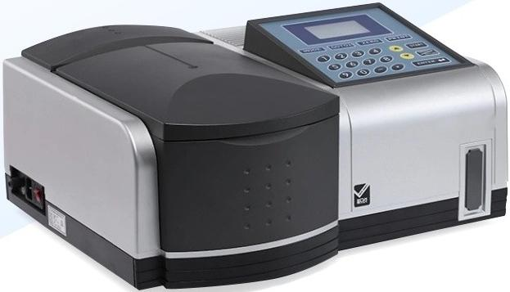
UV-Vis Spectrophotometer
T6 New Century
Wavelength
range:
5-Compartment Tank
190nm~1100nm
■ Wavelength indication error:+1.0nm
_{a}^{l} _{i} : ^{≤0.2nm}
·Wave
en
gth
repeat
b
lity

Slide 7

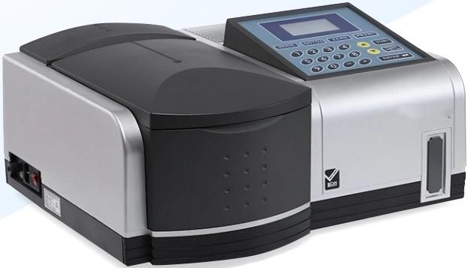
UV-Vis Spectrophotometer
T6 New
·Wavelength
range:
Century(8-cell)
190nm~1100nm
■ Wavelength indication error:+1.0nm
^{h}: ^{≤0.2nm}
·Wavelengt
repeatability

Slide 8


Visible Spectrophotometer
T6 Xinyue
·Wavelength
range:
5-Compartment
Tank
: 325nm~1100nm
■ Wavelength indication error:+2.0nm
_{a}^{l} _{i} : ^{≤0.4nm}
·Wave
en
gth
repeat
b
lity

Slide 9
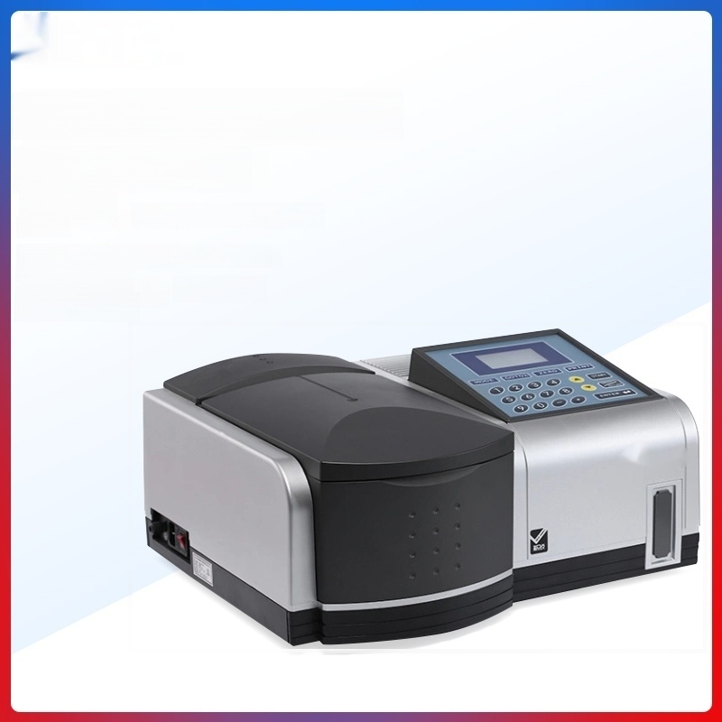
Spectrophotometer
T6 Xinyue (8-cell)
^{ength} : 325nm~1100nm
■ Wavelength indication error:+2.0nm
^{l} _{i} : ^{≤0.4nm}
Visible
·W
a
ve
l
ra
n
ge
:
·Wave
e
gt
h
repeat
a
lit
y

Slide 10


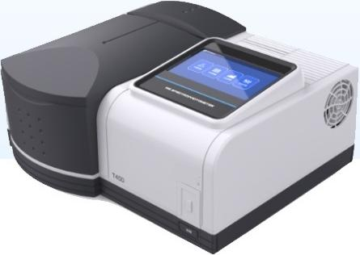
T400E
Visible Spectrophotometer(8-cell)

Slide 11



T400F
Visible Spectrophotometer (Five-Cell)

Slide 12



T500E
UV-Vis Spectrophotometer(8-Well Cell)

Slide 13


T500F
UV-Vis Spectrophotometer(5-Cell)

