Slide 1
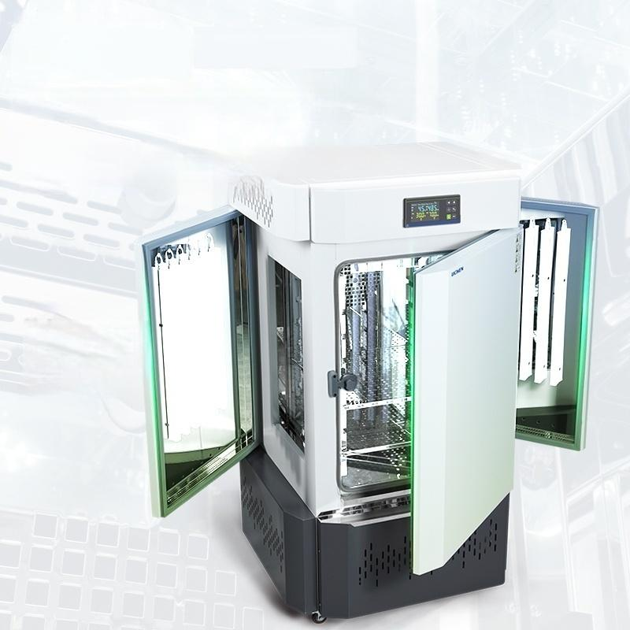
Level 6
dimming
Stable illuminance
Double-sided/four-sided lighting options
Level 6 dimming,light intensity 10,000 lux/18,000 lux
optional,top lighting function,waterproof high
brightness
Potato

Slide 2
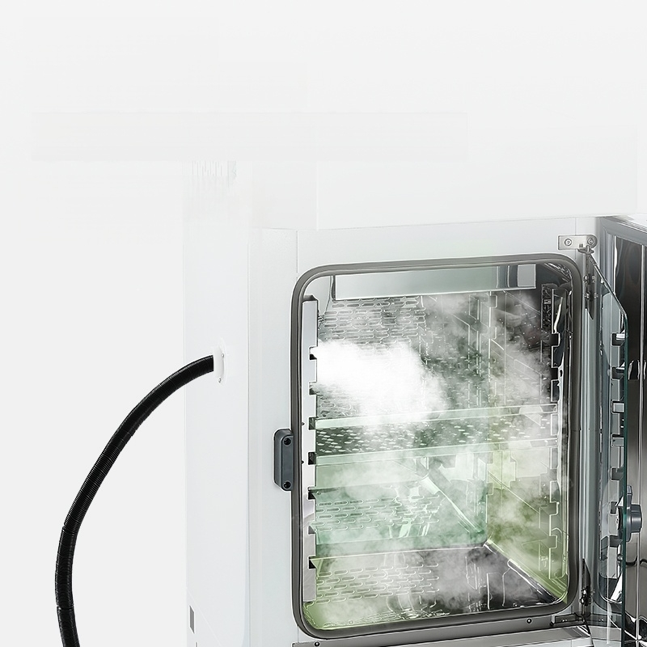
Ultrasonic
humidification」
Fine mist,efficient humidification
The CPU microprocessor
performs control with high
precision and good stability.

Slide 3
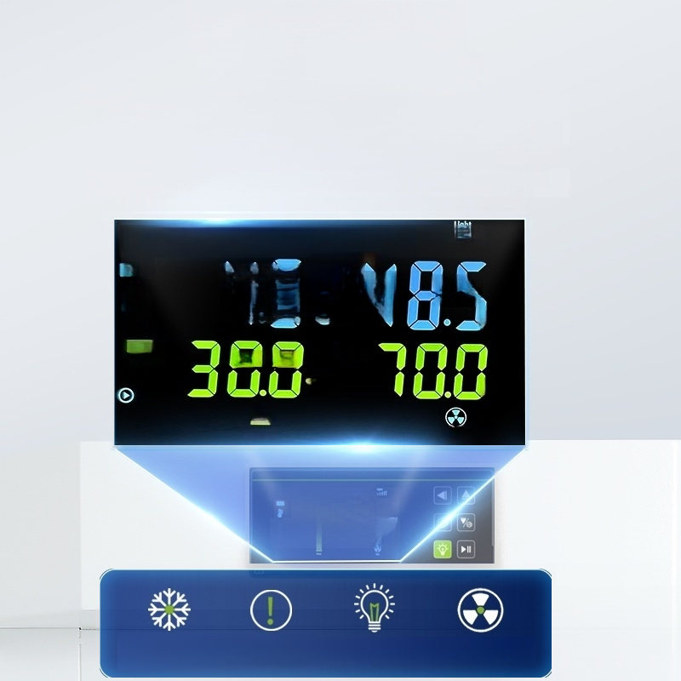
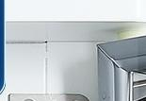
LCD Liquid Crystal
Display 」
High-definition display,
energy-saving and power-efficient
Embedded instrument panel,easy to operate with timer,temperature control,and humidity control
Cycle:01 Time:0000 Step:0 /01l
4.5.3
C %RH
Heat Fan
Gycde:0 I Tme:00009mp:0V⁰
4.5.848.5
PV
%RH
SV SV
300."700
Cooling indicator Alarm indicator light light
Lighting indicator Fan indicator light

Slide 4
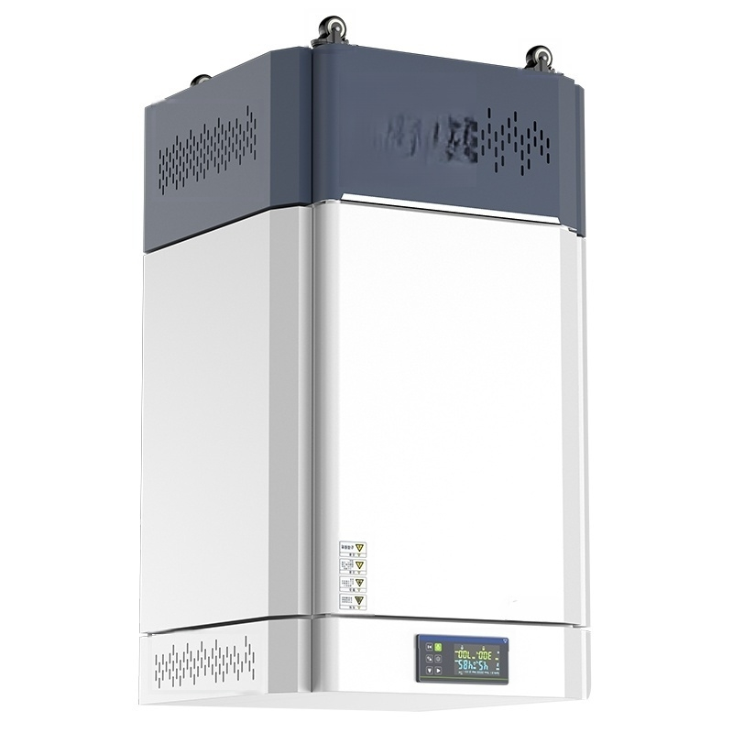

Slide 5
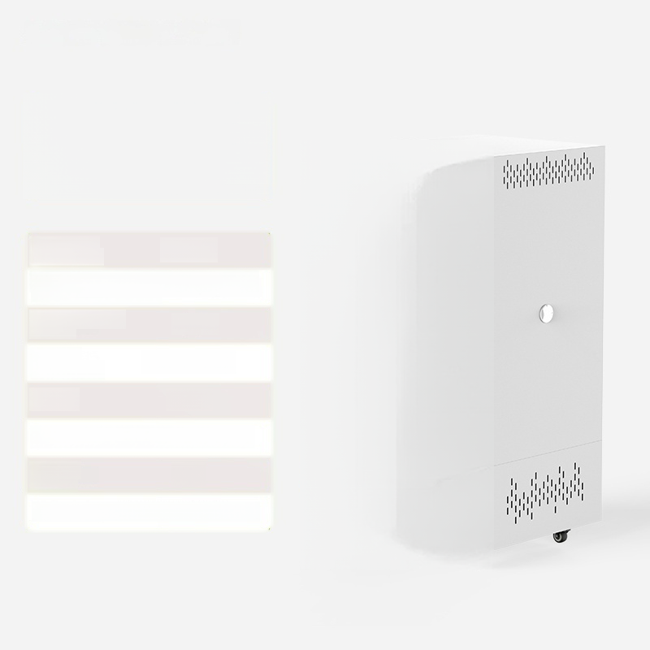

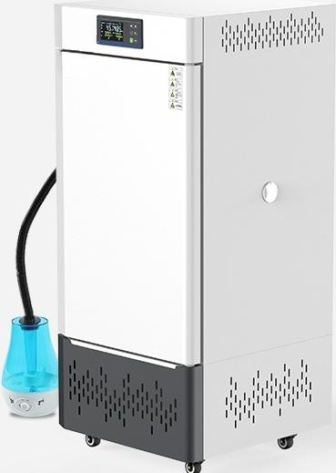
LC-QHX-70T
Artificial climate chamberr
Temperature 5~60℃ control range:
Illumination intensity.0~10,000 Lux (6 adjustable levels)
Number ofilluminated surfaces: | 2 sides
^{Humidity} 50%~90%RH control range:
Power: 400W
Studio dimensions:350×400×500mm
Effective _{70L} volume:
Product Size: 575×555×1170 mm

Slide 6
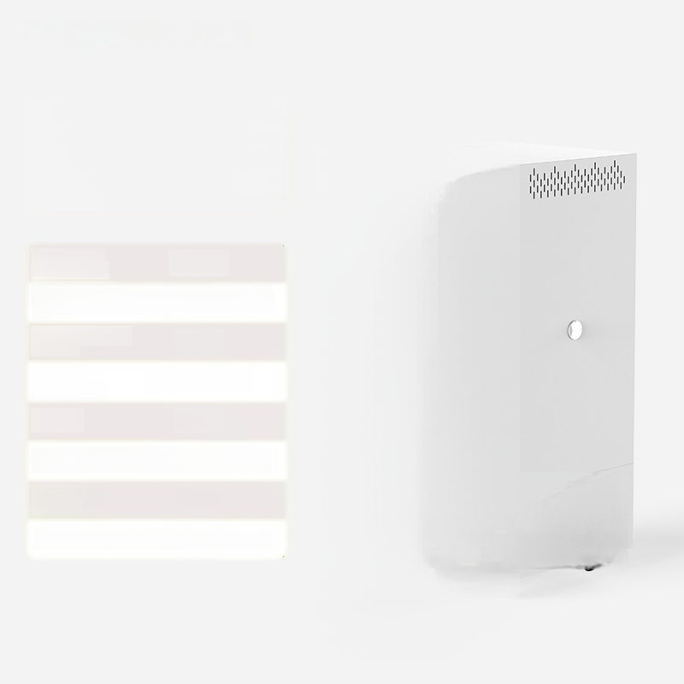

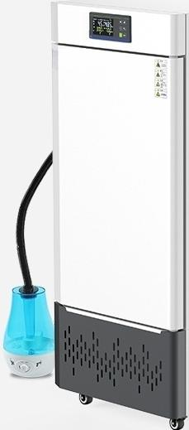
LC-QHX-150T
Artificial climate chamber
Temperature 5~60℃
Illumination intensity.0~10,000 Lux (6 adjustable levels)
Number ofilluminated ₂ _{sides} surfaces:
^{Humidity} 50%～90%RH control range:
Power: 600W
Studio size:4400×500×750 mm
Effective 150L volume:
^{Product} Size:625×655×1420mm
control range:

Slide 7
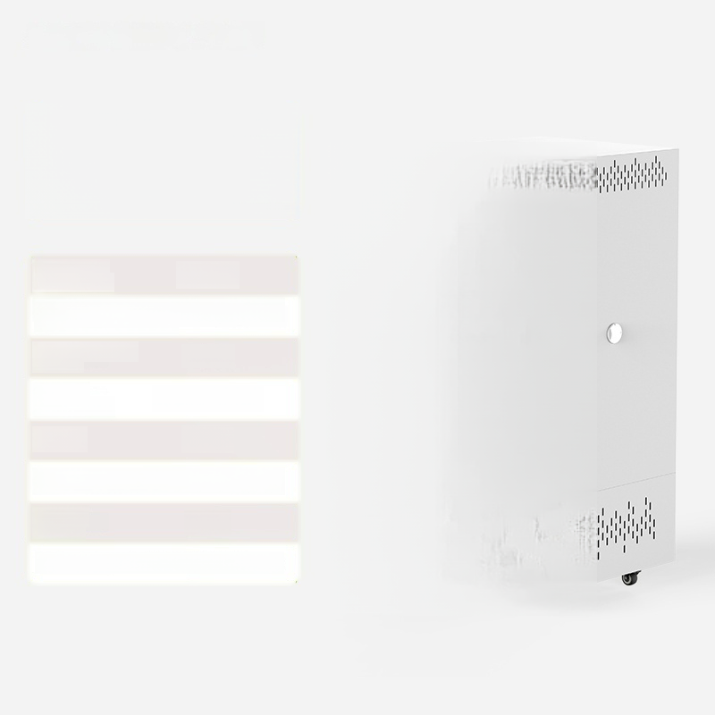

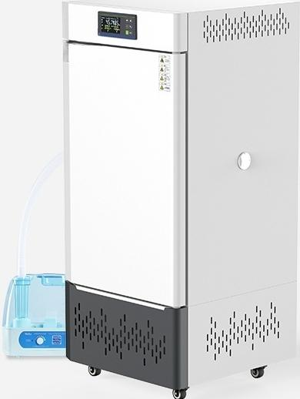
LC-QHX-250T
Artificial climate chamberr
Temperature 5~60℃
Illumination intensity.0~10,000 Lux (6 adjustable levels)
Number ofilluminated 2 sides surfaces:
^{Humidity} 50%～90%RH control range:
Power: 800W
Workspace size:500×550×900 mm
Effective _{250L} volume:
Product Size: 740×705×1560mm
control range:

Slide 8
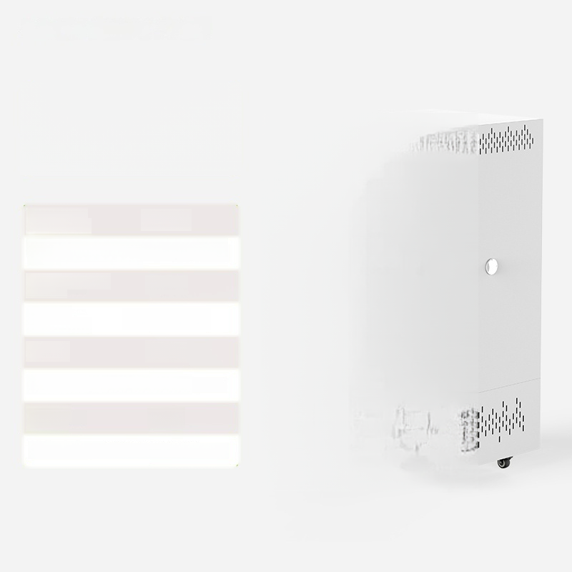


LC-QHX-360T
Artificial climate chamber
Temperature 5~60℃ control range:
Illumination intensity.0~10,000 Lux (6 adjustable levels)
Number ofilluminated 2 sides surfaces:
^{Humidity} 50%～90%RH control range:
Power: 900W
Studio size:600×600×1000mm
Effective volume: | 360L
^{Product} ^{Size:}835×755×1695 mm

Slide 9


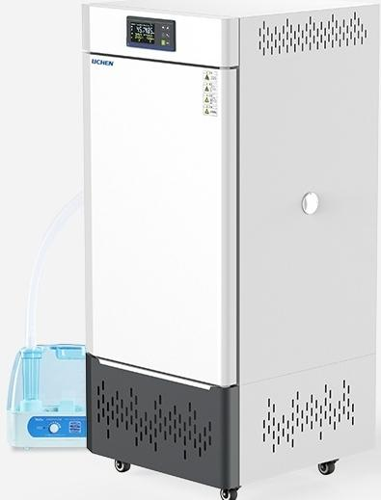
LC-QHX-460T
Artificial climate chamberr
Temperature 5~60℃ control range:
Illumination intensity.0~10,000 Lux (6 adjustable levels)
Number ofilluminated surfaces: | 2 sides
^{Humidity} 50%～90%RH control range:
Power: 1000W
Studio dimensions:650×650×1100mm
Effective 460L volume:
Product Size:885×805×1795 mm

Slide 10
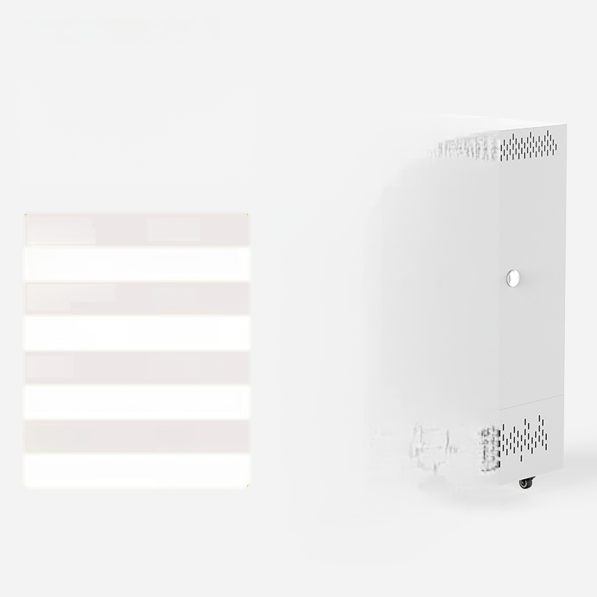

LC-QHX-600T
Artificial climate chamber
Temperature 5~60℃ control range:
Illumination intensity.0~10,000 Lux (6 adjustable levels)
Number ofilluminated surfaces: | 2 sides
^{Humidity} 50%～90%RH control range:
Power: 1200W
Studio dimensions:680×800×1100mm
Effective 600L volume:
Product Size: 920×955×1795 mm

Slide 11
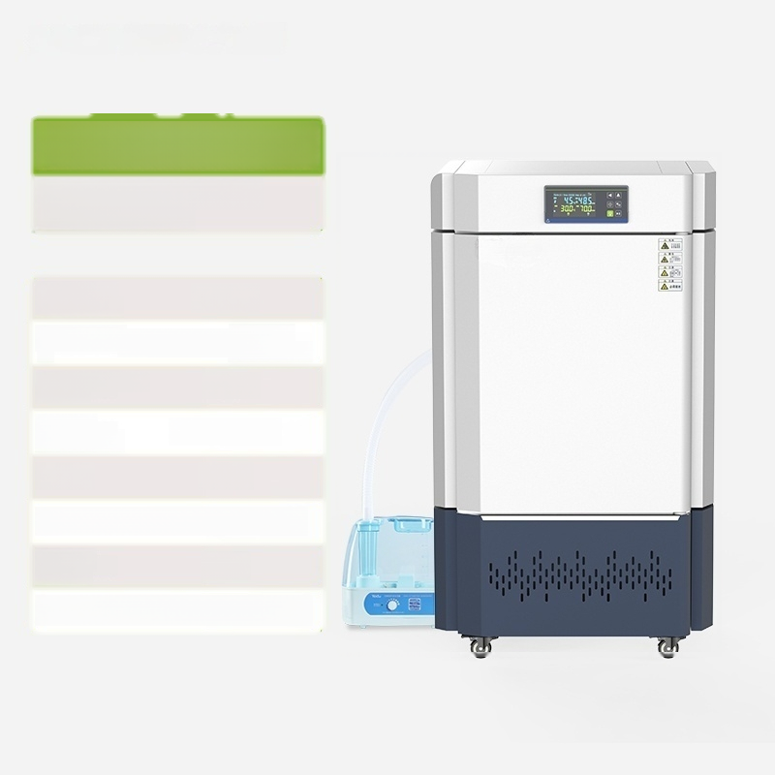
LC-QHX-180F
Artificial climate chamber (strong light type)
Temperature 5~60℃ control range:
^{Light} ^{intens} t~_{y1.8000} _{Lux} ( | (6 levels adjustable)
Number of illuminated 4 sides surfaces:
^{Humidity} 50%~90%RH
Power: 900W
Workspace size:5500×500×750 mm
Effective _{180L} volume:
Product Size:750×850×1525mm
control range:

Slide 12
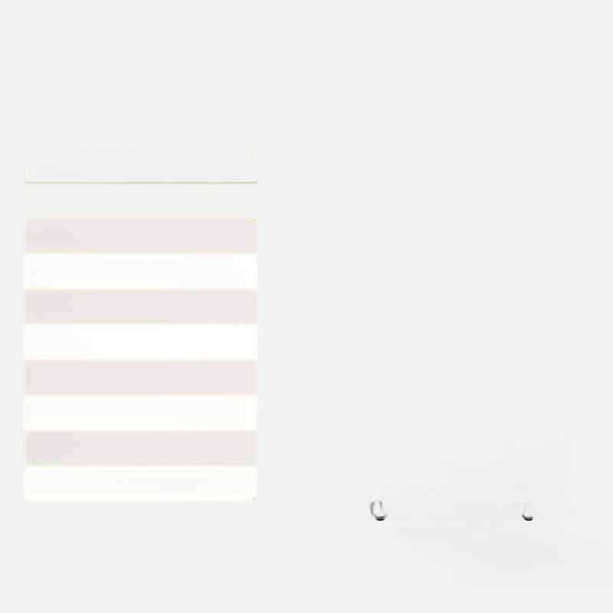

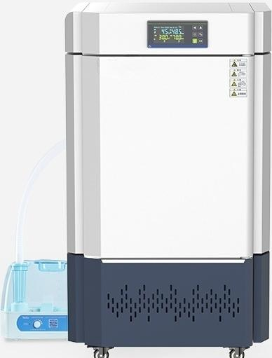
LC-QHX-180F
Artificial Climate Chamber
(Bright Light Type)
Temperature 5~60℃ control range:
^{Light} ^{intensi}0t ₈₀₀₀ _{Lux} ( | (6 levels adjustable)
Number of illuminated ₄ _{sides} surfaces:
^{Humidity} 50%~90%RH
Power: 900W
Workspace size:5500×500×750 mm
Effective _{180L} volume:
Product Size:750×850×1525mm
control range:

Slide 13

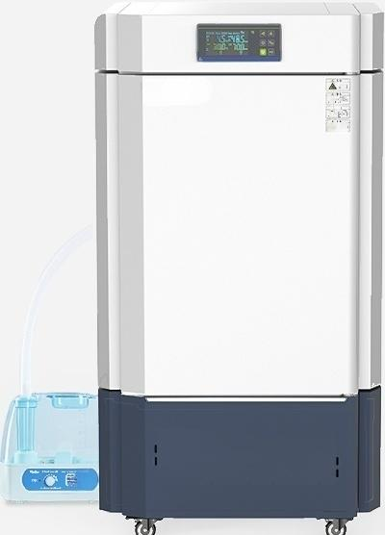
LC-QHX-360F
Artificial climate chamber (strong light type)
2
▲
△
A
Temperature 5~60℃ control range:
Light ( | ^{intensity.} _{0~18000} _{Lux} (6 levels adjustable)
Number of illuminated 4 sides surfaces:
^{Humidity} 50%~90%RH control range:
Power: 1100W
Studio size:600×600×1000mm
Effective 360L volume:
Product Size: 850×945×1775 mm

Slide 14
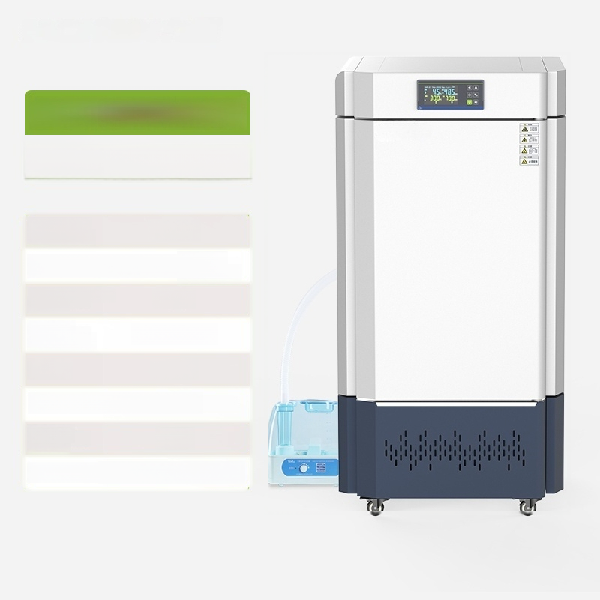
LC-QHX-460F
Artificial Climate Chamber
(Bright Light Type)
Temperature 5~60℃ control range:
Light Intensity.o~18000 Lux(6 ^{levels} adjustable)
Number of illuminated 4 sides surfaces:
^{Humidity} 50%~90%RH control range:
Power: 1200W
Studio Size:600×650×1100mm
Effective 460L volume:
Product Size:845×1000×1875 mm

Slide 15
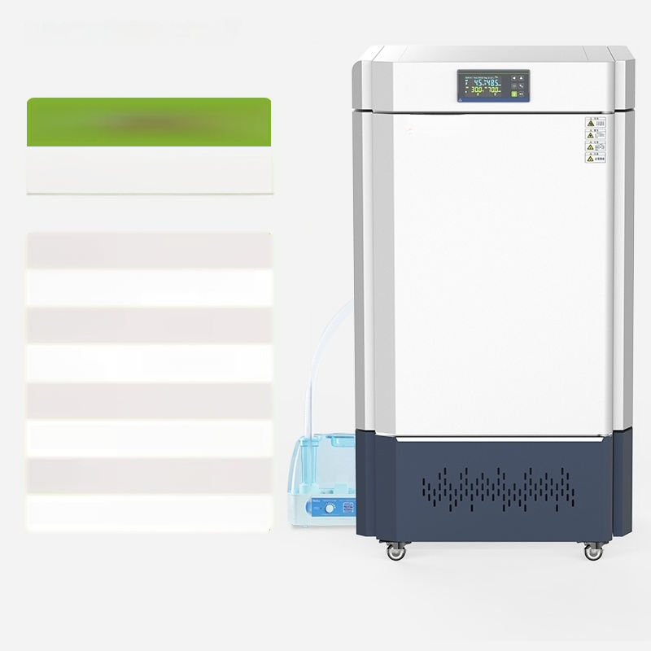
LC-QHX-600F
Artificial climate chamber
(strong light type)
Temperature 5~60℃ control range:
Illumination intensity:0~18000Lux(6 adjustable levels)
Number ofilluminated surfaces: | 4 sides
^{Humidity} 50%~90%RH control range:
Power: 1300W
Studio dimensions:680×800×1100mm
Effective 600L volume:
Product Size:950×1140×1920 mm

