Slide 1
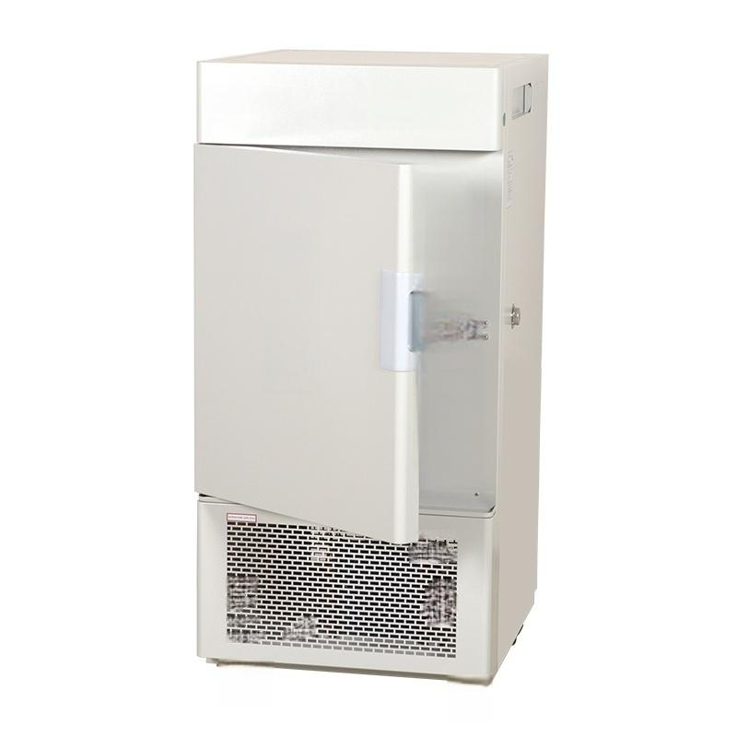





Low temperature incubator
r
二
早
早 □T

Slide 2
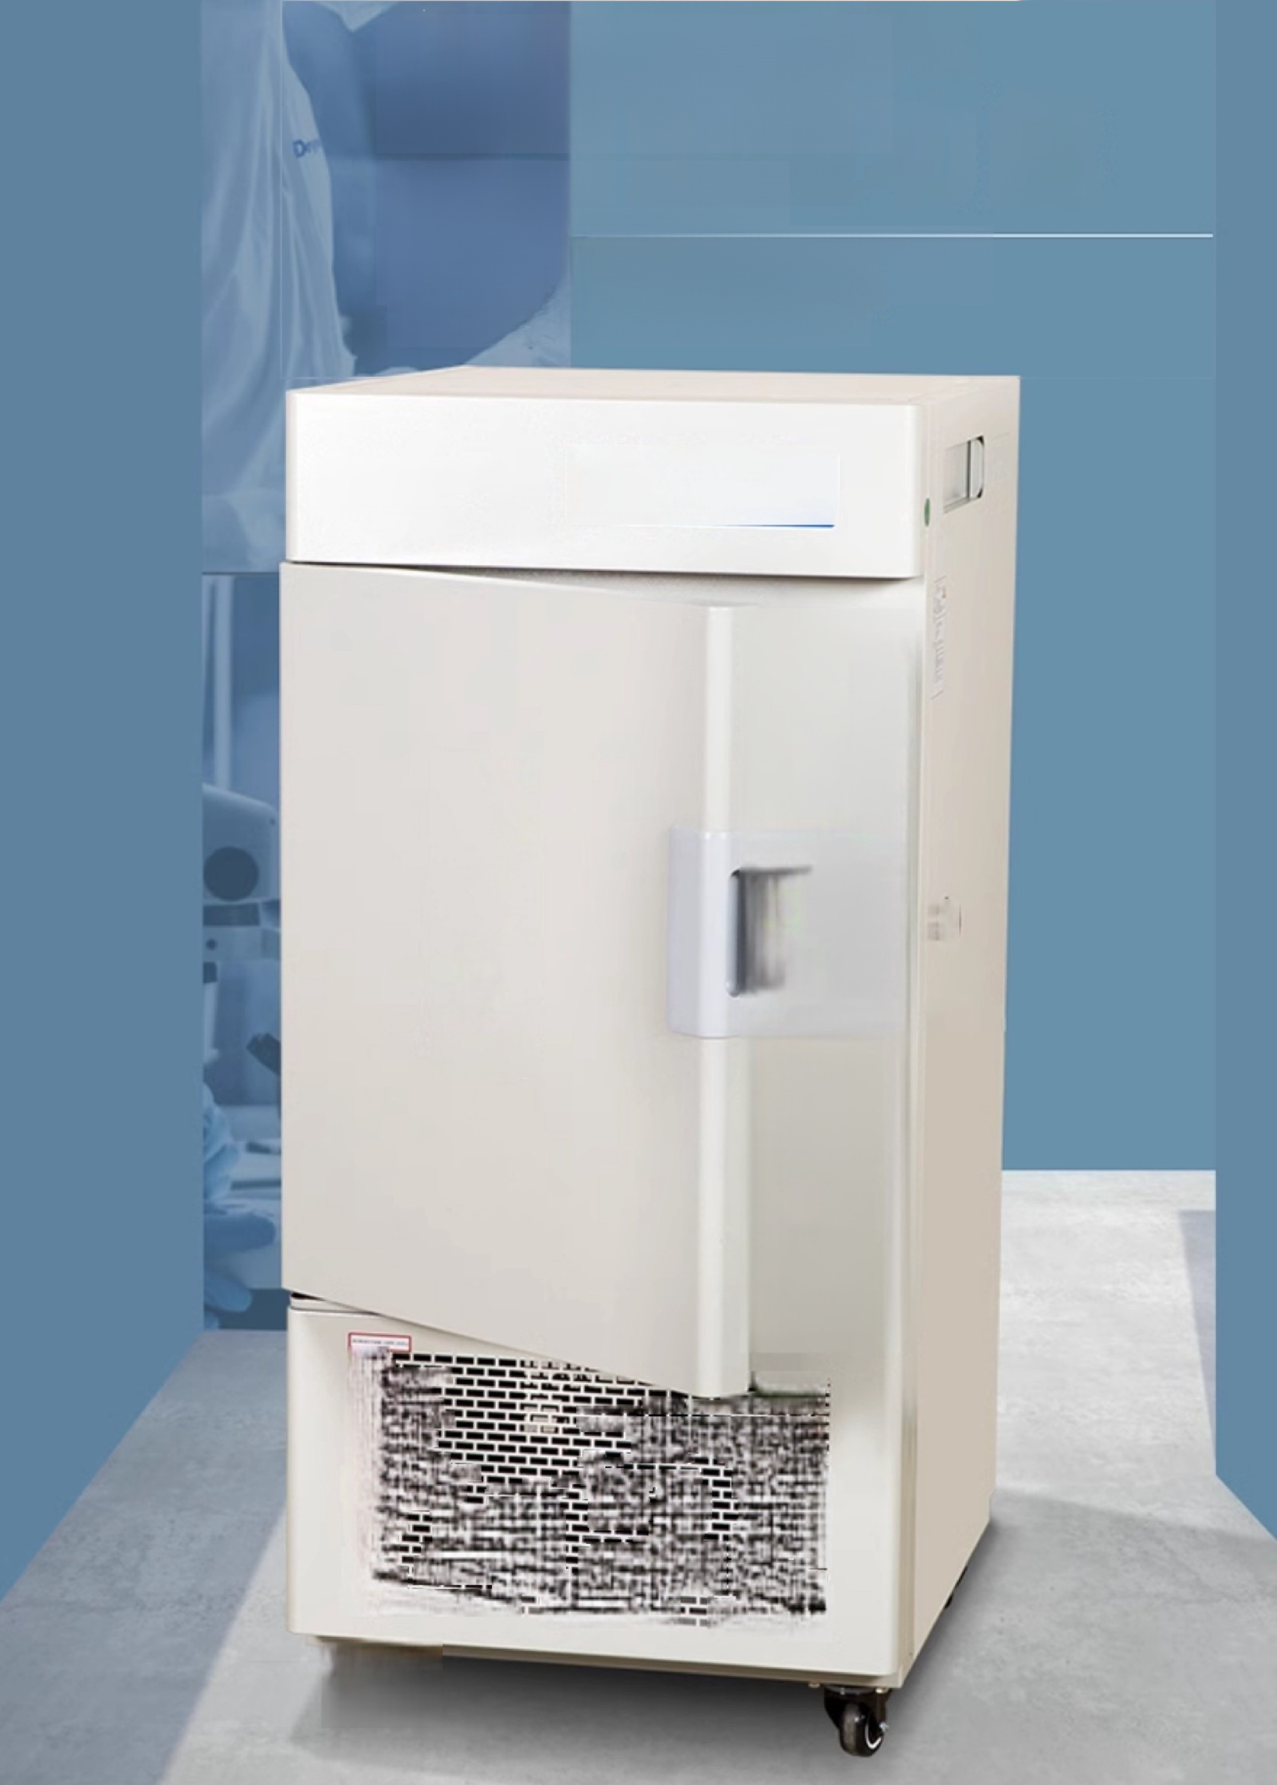
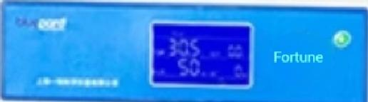
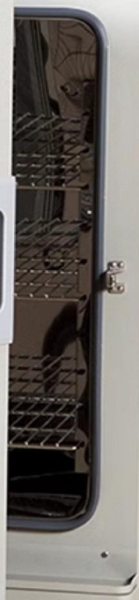
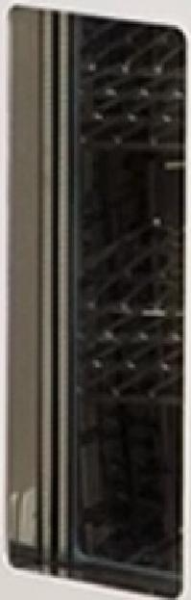
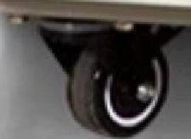
Low temperature
incubator
Multi-segment
programming function LRH Series (Incubator Series)
Low temperature
incubator
L
I 二
_
4 十
二
P
L
二
_
口
品
十
□
平
_
__
- 1
□T
早
_

Slide 3
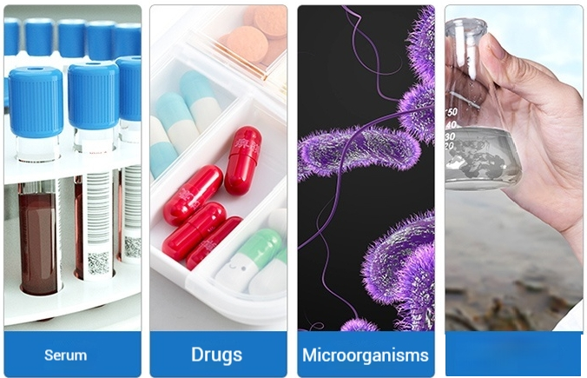
LRH Series -Low Temperature Incubator
Application Areas
Widely used for storing culture media,serum,medicines,as wellas microbial cultivation and environmental testing.
Environmental
Testing

Slide 4

LRH Series-Low Temperature Incubator
Technical Parameters
Model Parameter | LRH-50CL LRH-50CA LRH-50CB | LRH-100CL LRH-100CA LRH-100CB | LRH-150CL LRH-150CA LRH-150CB | LRH-250CL LRH-250CA LRH-250CB | LRH-500CL LRH-500CA LRH-500CB
Temperature control Scope | L:-10~65℃ A:-20～65℃ B:-40~65℃
mperature division Resolution | 0.1℃
Temperature fluctuation Mobility | High temperature:±0.5℃ Low temperature:±1.0℃
Power Supply Voltage | AC220V 50HZ AC220V 50HZ AC220V 50HZ | AC220V 50HZ AC220V 50HZ AC380V 50HZ | AC220V 50HZ AC220V 50HZ AC380V 50HZ | AC220V 50HZ AC220V 50HZ AC380V 50HZ | AC220V AC220V AC380V | 5 | 50HZ 50HZ 50HZ
Working cycle Ambient temperature | +5~35℃
Enter Power | 1100W 1100W 2800W | 1100W 1200W 4100W | 1300W 1300W 5100W | 1500W 1600W 6100W | 2250W 2550W 7100
Inner tank size (mm)W ×D×H | 400×300×420 400×300×420 400×380×450 | 500×400×600 500×400×600 500×400×600 | 550×405×670 550×405×670 550×430×670 | 600×500×830 600×500×830 600×600×700 | 670×720×1020 670×720×1020 800×700×900
Dverall Dimensions (mm)W ×D×H | 660×720×930 660×720×930 650×1040×1650 | 650×770×1320 650×770×1320 700×1040×1750 | 690×800×1410 690×800×1410 750×1040×1810 | 740×900×1580 740×900×1580 800×1160×1850 | 850×1100×1930 850×1100×1930 1000×1210×1980
Cargo rack (Standard) | 2 pieces | 3 pieces
Timing | 0-9999min
^{ge*}Performance parameter testing under no-load conditions:ambient temperature 20℃,ambient humidity 50%RH
ran

Slide 5
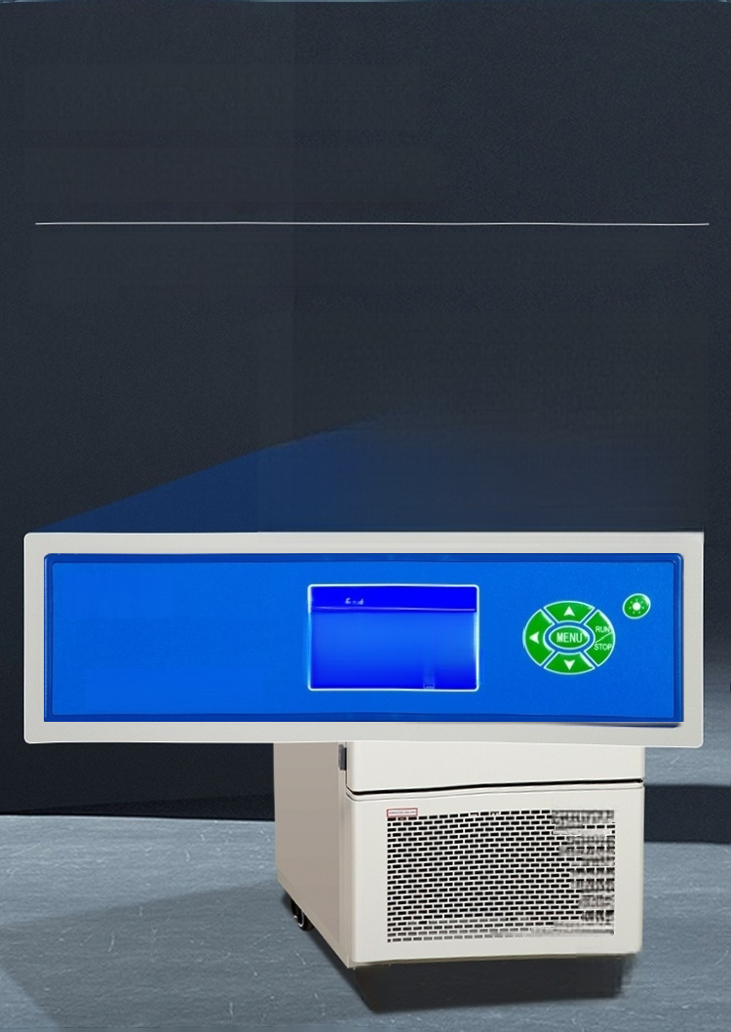
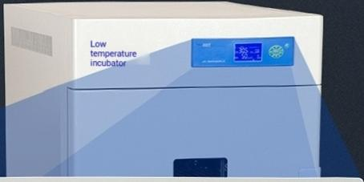

LCD Multi-segment
Programmable Controller
Multiple parameters displayed on one screen,menu-style operation interface, can simplify complex test processes,truly achieve automatic control and
operation
bluepard
 | 305 c sEr | 00.
 | HUWI 50 s SET | 0
Shanghai Yiheng Scientific Instruments Co.,Ltd.
三 一
早
二
三
= 的
J

Slide 6
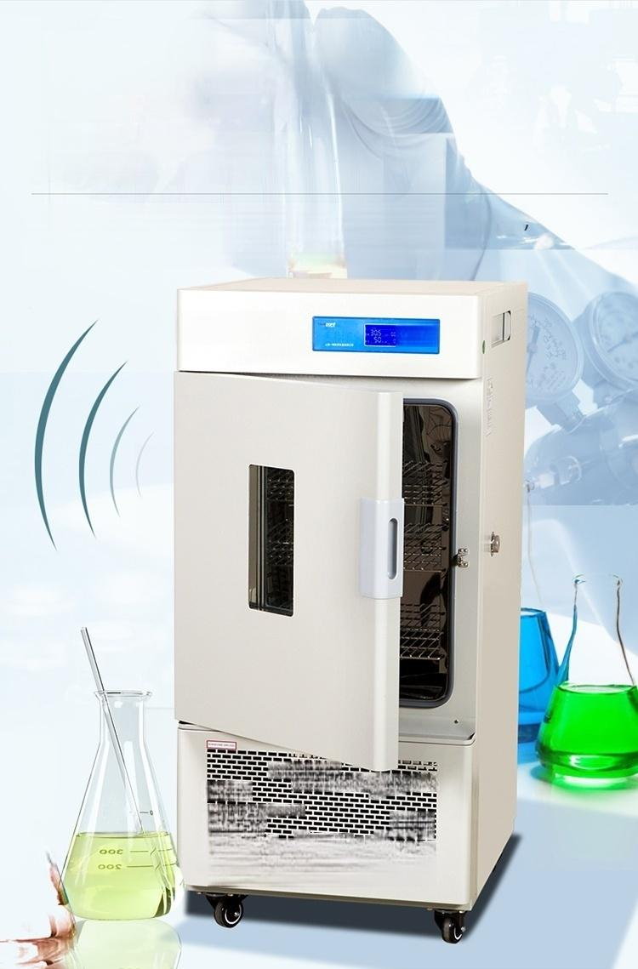
Temperature Limiting Alarm
System
Automatic Interruption
Equipped with an independent temperature limiting alarm system, automatically interrupts when the temperature exceeds the limit to ensure safe operation of the experiment and prevent accidents.
Low temperature
incubator Fortun⁸
Lm 002
苦

Slide 7
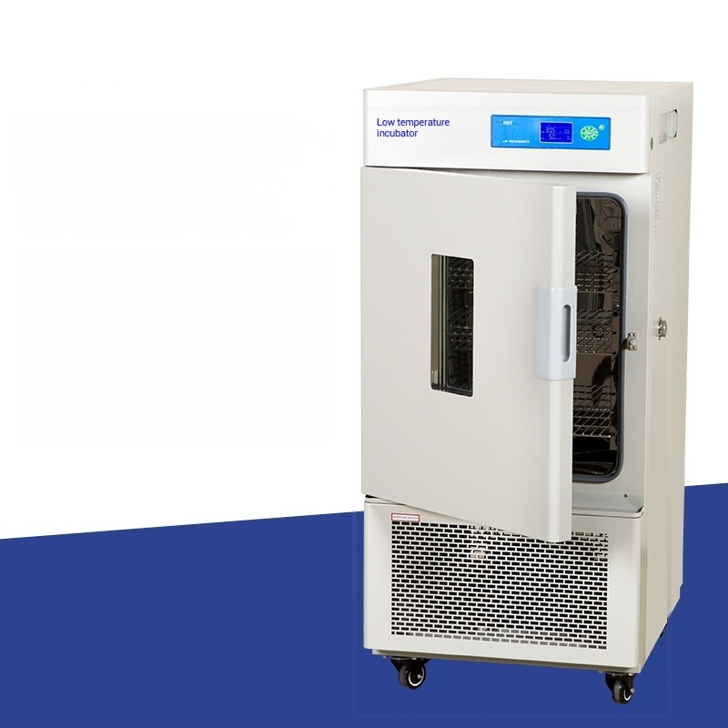
Low temperature incubator
Model:LRH-50CL
Temperature control
range:-10~65℃
Temperature resolution:0.1 ℃
Lining dimensions:400X300X420 Object holder
(standard):2 pieces

Slide 8

Low temperature incubator
Model:LRH-50CA
Temperature control range:-20~65℃
Temperature resolution:0.1 ℃
Lining dimensions:400X300X420 Object tray(standard):2 pieces

Slide 9

Low temperature incubator
Model:LRH-50CB
Temperature control range:-40~65℃
Temperature resolution:0.1 ℃
Inner tank size:400X380X450 Object tray(standard):2 pieces

Slide 10
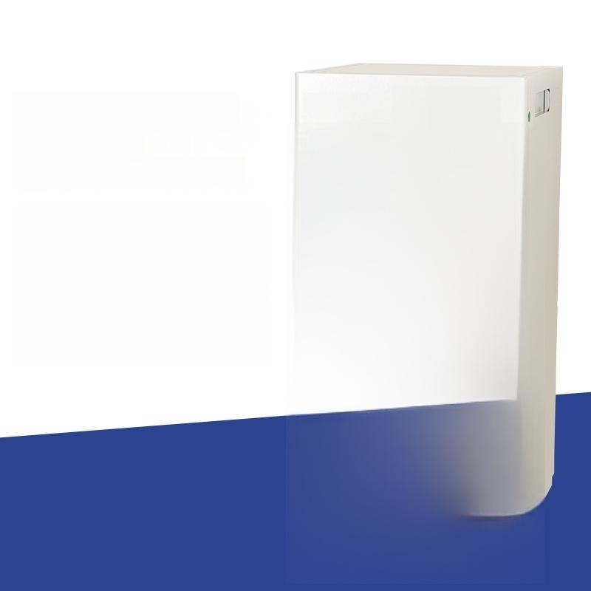

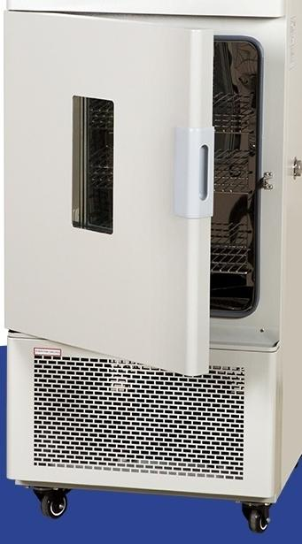
Low temperature incubator
Model:LRH-100CL
Low temperature
incubator
Temperature control
range:-10~65℃
Temperature resolution:0.1 ℃
Inner chamber size:500X400X600 Object tray(standard):3 pieces

Slide 11

Low temperature incubator
Model:LRH-100CA
Temperature control range:-20 to 65℃
Temperature resolution:0.1 ℃
Inner chamber size:500X400X600 Object tray(standard):3 pieces

Slide 12

Low temperature incubator
Model:LRH-100CB
Temperature control range:-40~65℃
Temperature resolution:0.1 ℃
Inner chamber size:500X400X600
Load-bearing tray
(standard):3 pieces

Slide 13

Low temperature incubator
Model:LRH-150CL
Temperature control
range:-10~65℃
Temperature resolution:0.1 ℃
Lining dimensions:550X405X670 Object tray(standard):3 pieces

Slide 14
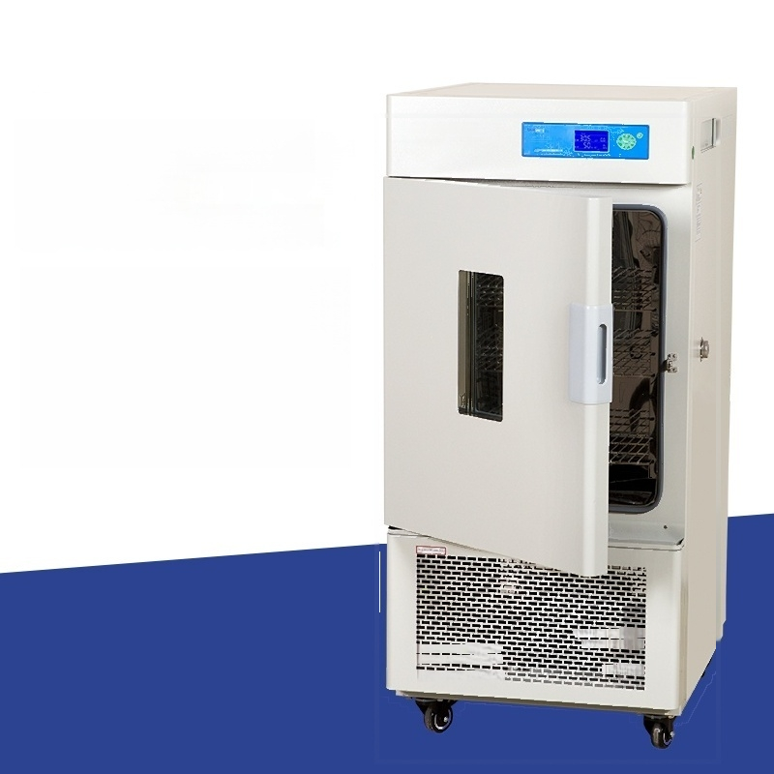
Low temperature incubator
Model:LRH-150CA
Low temperature
incubator
Temperature control range:-20~65℃
Temperature resolution:0.1 ℃
Lining dimensions:550X405X670 Load-bearing tray
(standard):3 pieces
一

Slide 15

Low temperature incubator
Model:LRH-150CB
Low temperature
incubator
Temperature control range:-40~65℃
Temperature resolution:0.1 ℃
Inner chamber size:550X430X670 Object tray(standard):3 pieces
一

Slide 16

Low temperature incubator
Model:LRH-250CL
Temperature control range:-10~65℃
Temperature resolution:0.1 ℃
Lining dimensions:600X500X830
Object tray(standard):3 pieces

Slide 17

Low temperature incubator
Model:LRH-250CA
Temperature control range:-20~65℃
Temperature resolution:0.1 ℃
Lining dimensions:600X500X830
Object tray(standard):3 pieces

Slide 18

Low temperature incubator
Model:LRH-250CB
Temperature control range:-40~65℃
Temperature resolution:0.1 ℃
Lining dimensions:600X600X700
Object tray(standard):3 pieces

Slide 19

Low temperature incubator
Model:LRH-500CL
Temperature control
range:-10~65℃
Temperature resolution:0.1℃
Lining dimensions:670X720X1020 Object tray(standard):3 pieces

Slide 20

Low temperature incubator
Model:LRH-500CA
Temperature control range:-20~65℃
Temperature resolution:0.1 ℃
Lining dimensions:670X720X1020
Object tray(standard):3 pieces

Slide 21

Low temperature incubator
Model:LRH-500CB
Low temperature
incubator
Temperature control range:
-40~65℃
Temperature resolution:0.1℃
Inner liner size:800X700X900 Object tray(standard):3 pieces
一

