Slide 1



8.88.8.
uCHEN
OFF

Slide 2

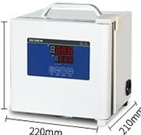
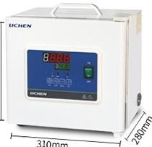
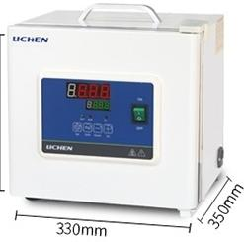
Incubator -Parameters
BXP-2
BXP-6
BXP-16
22mm
30mm
370mm
Product Model | BXP-2 BXP-6 BXP-16
Voltage/Frequency | AC220V 50Hz
Power | 80W | 100W | 150W
Display mode | LED digital tube
Temperature control ran | ge RT+5~45℃
Temperature control acc | uracy ±1℃
Temperature uniformity | ±2℃
Timing range | 0~9999 minutes
Inner chamber size(DXWXH) | 140×110×120mm | 230×180×160mm | 250×250×250mm
Effective Capacity | 1.6L | 6.4L | 12L
Net weight Kg | 4 | 8 | 9.5
Product size(DXWXH) | 210×220×220 mm | 280×310×300 mm | 350×330×370 mm

Slide 3
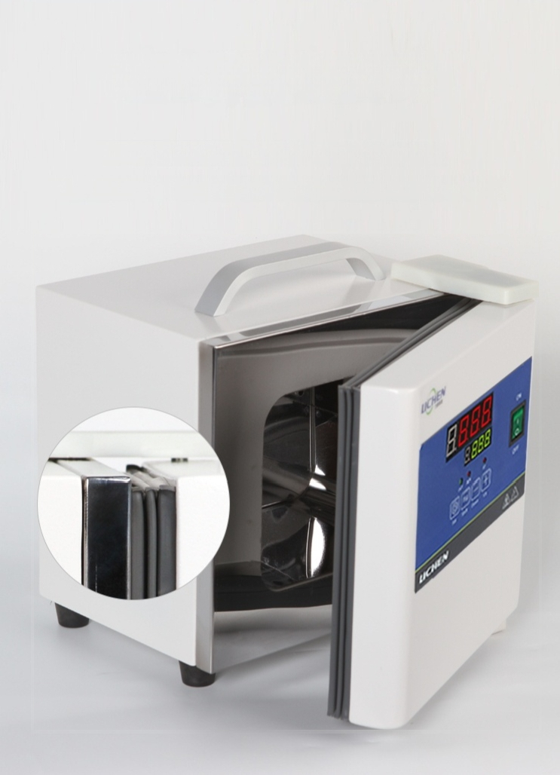
Sealed insulation design
Integrated inner tank structure,simple and beautiful overall,
Magnetic gasket sealing and safe,convenient door lock device

Slide 4
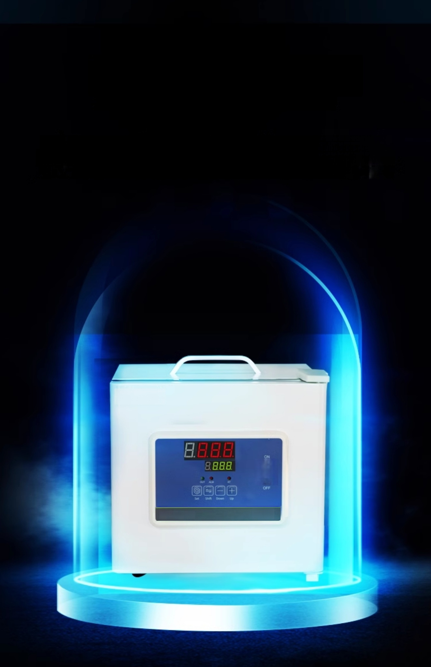

Safety cannot be ignored.
Equipped with over-temperature power cutoff and alarm indicator system,
when the controlled temperature exceeds the set upper limit,the instrumentt
automatically cuts off power output and sounds an alarm.
LICHEN
LCHEN 金 Δ

Slide 5


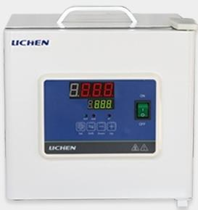
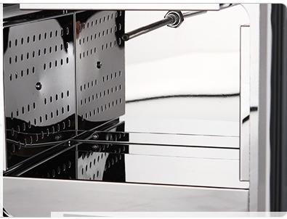
Product
High-quality details
product
Quality details
01
Using intelligent
PID temperature control instrument
02
Four-wall surround
heating
Internal temperature is uniform

Slide 6
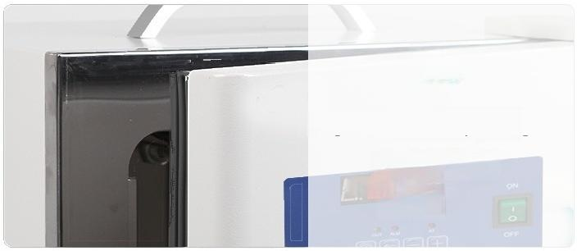
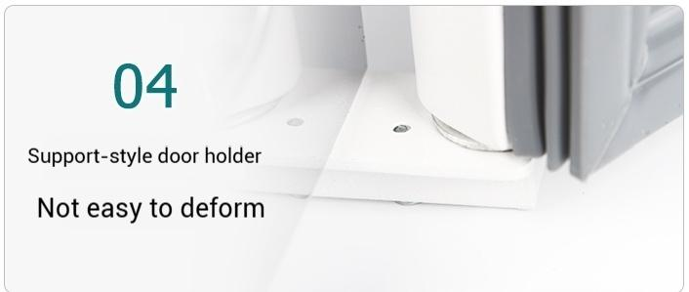
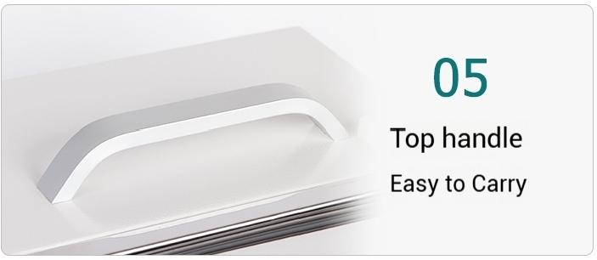
03
Magnetic door opening
Good sealing
日 □ □
B.8B 日

Slide 7
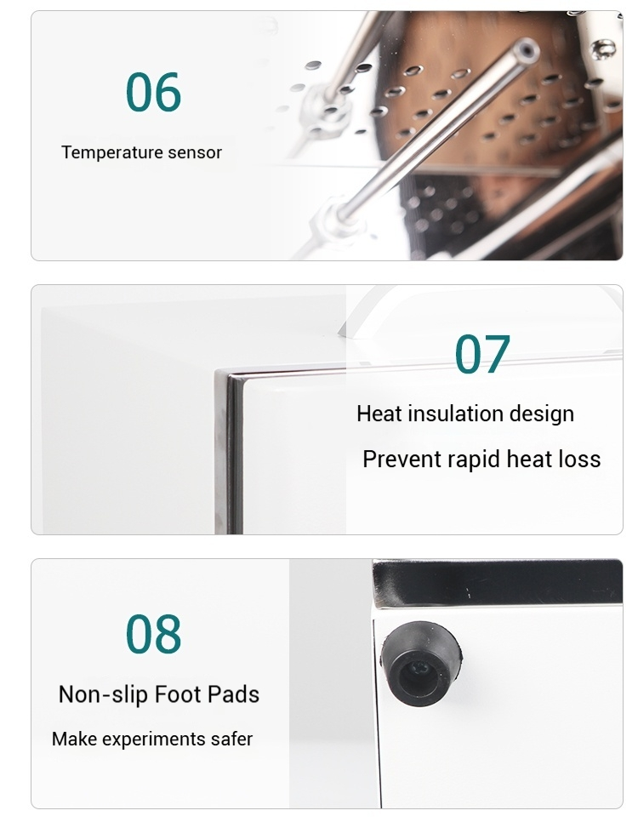

Slide 8
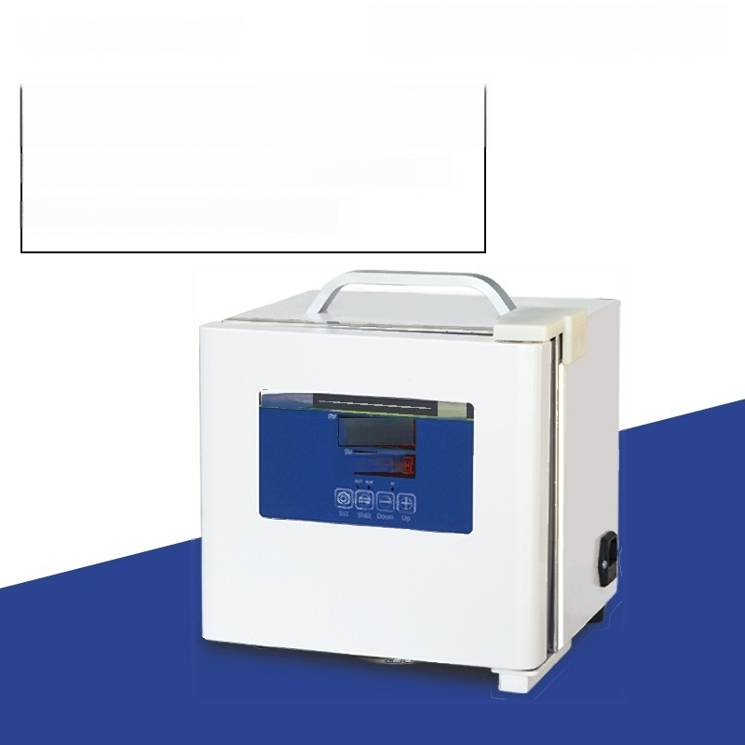
Portable incubator
BXP-2 model
Inner chamber size:110x140x120mm
Temperature control range:RT+5~45℃
uCHEN
8.8.8.8
8.888
Δ△

Slide 9
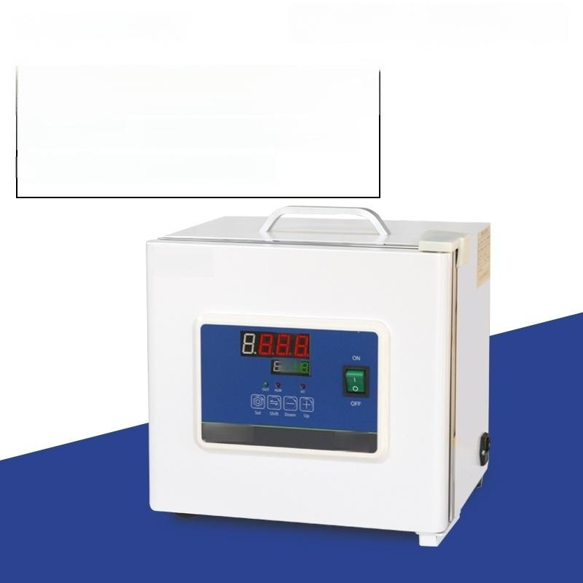
Portable incubator
BXP-6 Model
_{i} ^{r}_{:1} ^{Chamber} 180x230x160mm
In
n
e
S
z
e
Temperature Control Range:RT+5~45℃
LICHEN
B8.
UCHEN
金▲

Slide 10
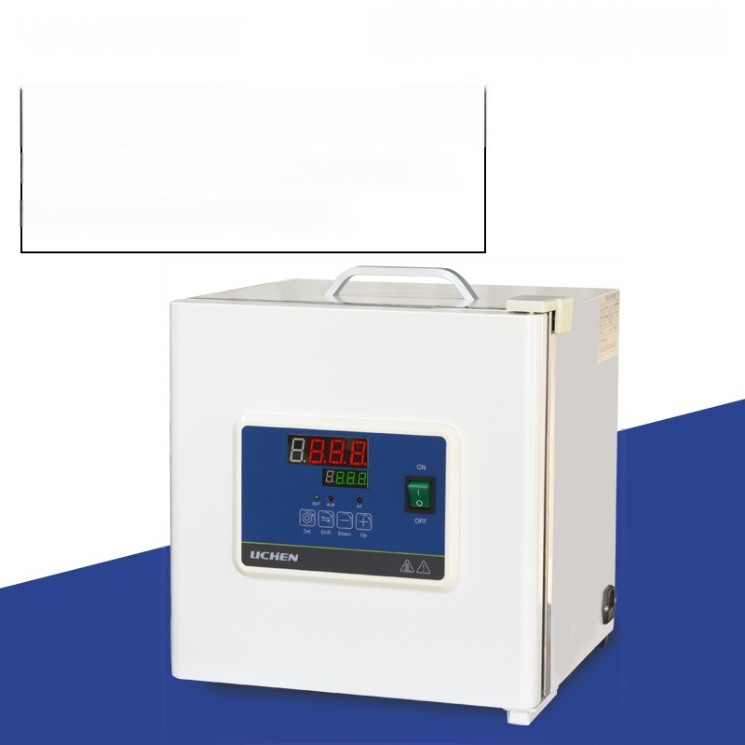
Portable incubator
BXP-16 Model
Inner liner size:250x250x250mm
Temperature Control Range:RT+5~45℃

