Slide 1
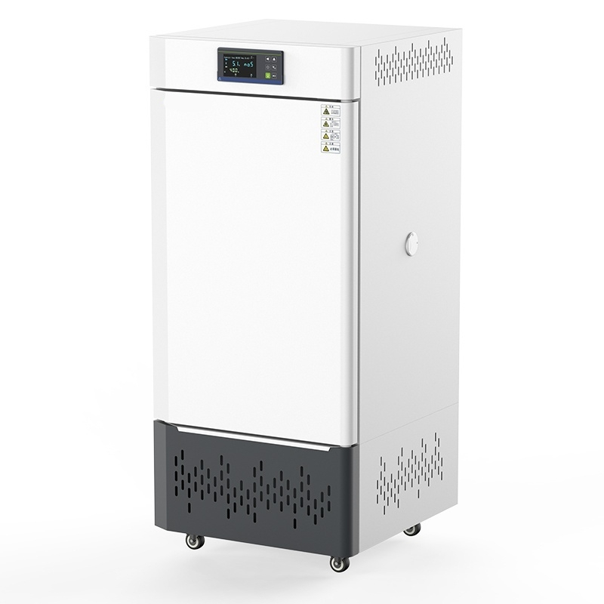

Slide 2
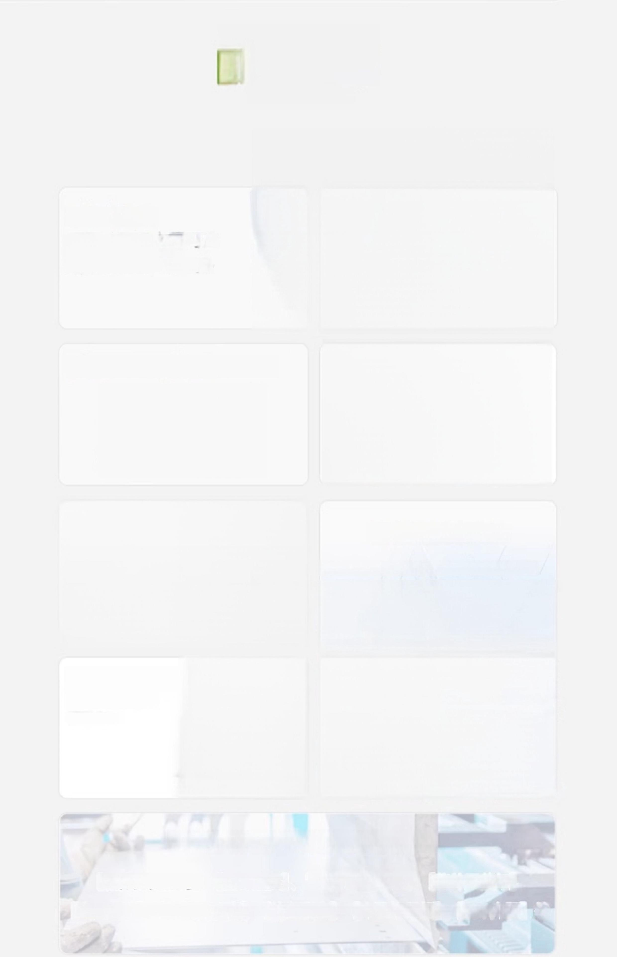
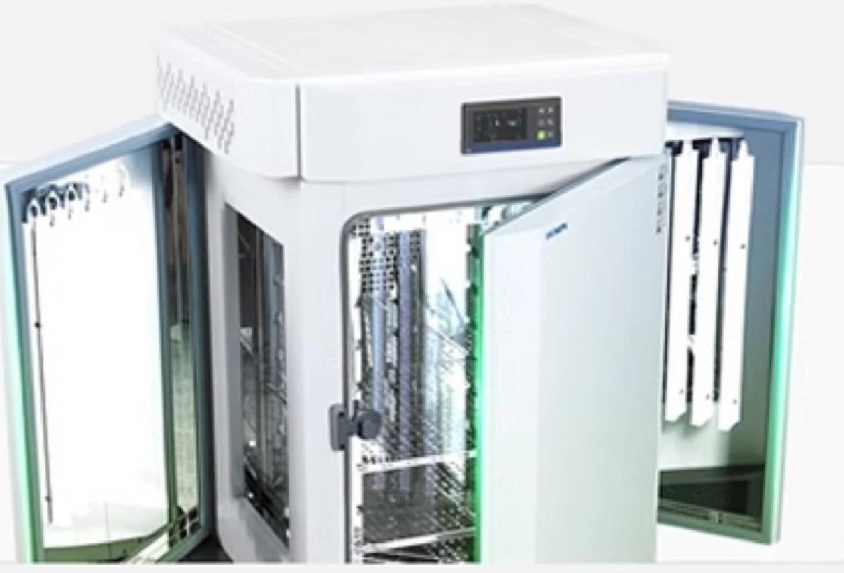
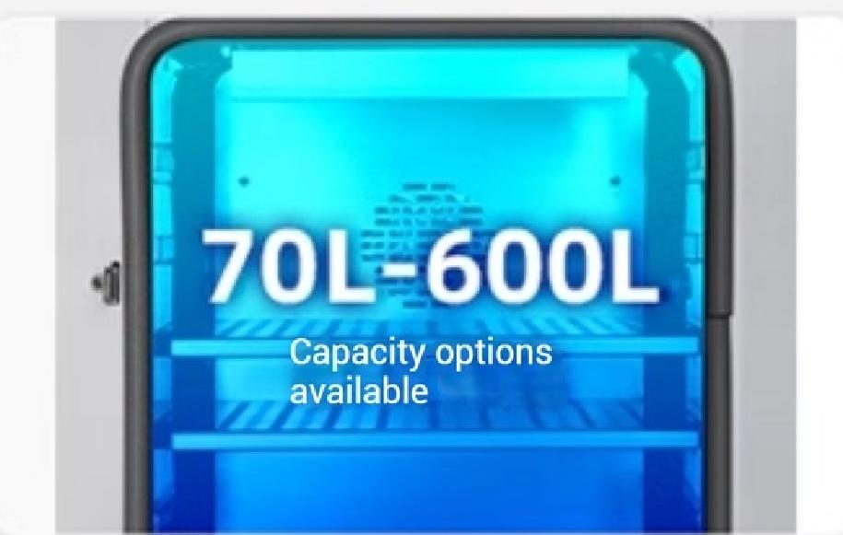
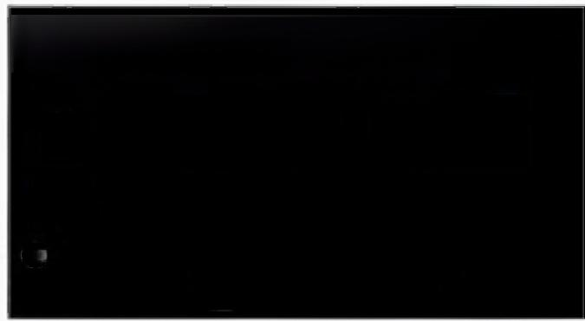
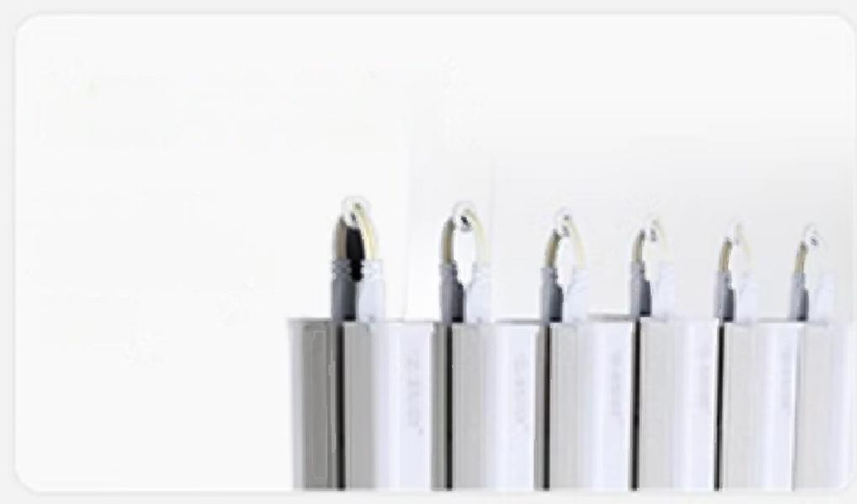
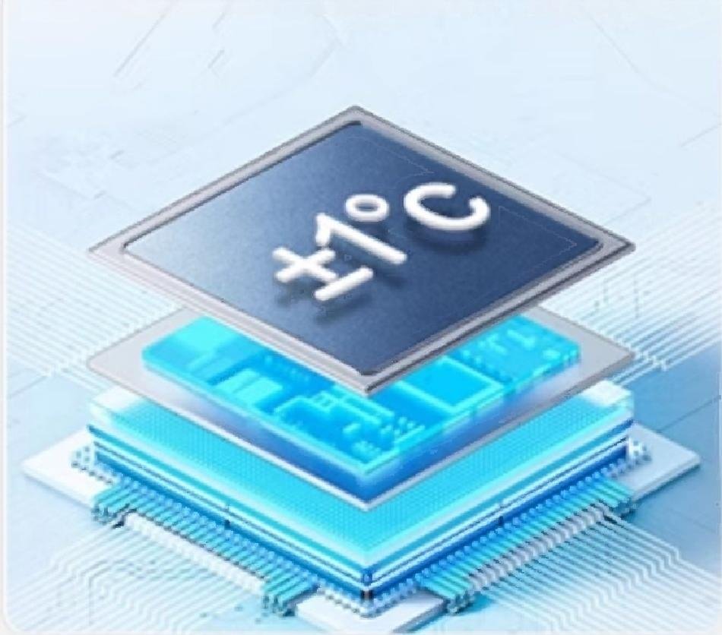
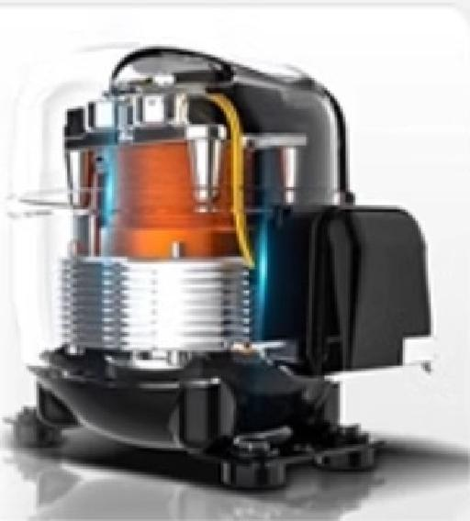
Selling point
overview
Product Features
Level 6 dimming
Double-sided/four-sided
illumination optional,light
intensity 10,000 lux/18,000 lux
Large screen LCD digital display
cycle:01 Time:0000 Step:0v0:i
5.1.no.5
四
40.0.c
Silk
0
⑧
LED cold light source
No self-heating,
Does not interfere with
inside the box
Temperature
Intelligent control system
Adjustable internal temperature and illumination;
With power-off memory,over-temperature self-limiting,intelligent timing
High-equipped
compressor
Powerful Cooling
Support multiple customized services
【Box punching service】【Foreign plug】
【50kg load-bearing
shelf】
【UV sterilization lamp】
【Export packaging】,【Touch screen instrument】,【Programmable instrument】,【Built-in printer】,【304 inner tank】,etc

Slide 3
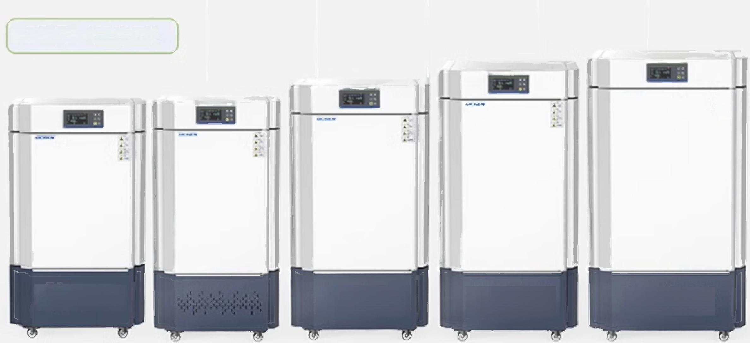
F Series(High Brightness Type)
Model | LC-GZX-180F (High Brightness Type) | LC-GZX-280F (High Brightness Type) | LC-GZX-360F (High Brightness Type) | LC-GZX-460F (High Brightness Type) | LC-GZX-600F (High Brightness Type)
Display mode | LCD Liquid Crystal Display
Temperature 5~60℃ control range
Temperature Resolution0^{.1℃} |  | 0.1℃ | 0.1℃ | 0.1℃ | 0.1℃
Temperature _{±1℃} |  | ±1℃ | ±1℃ | ±1℃ | ±1℃
Sunlight intensity |  | 0~18000Lux(6 adjustable levels)
Number of 4 sides illuminated surfaces |  | 4 sides | 4 sides | 4 sides | 4 sides
Timing range 0~9999 min |  | 0~9999 min | 0~9999 min | 0~9999 min | 0~9999 min
Workspace size 500×500 (L×W×H) ×750 mm |  | 550×550 ×900 mm | 600×600 ×1000 mm | 600×650 ×1100 mm | 680×800 ×1100 mm
Effective Capacity 180L |  | 280L | 360L | 460L | 600L
Number of standard partitions 2 pieces |  | 2 pieces | 2 pieces | 2 pieces | 2 pieces
Maximum load 15 capacity of partitions |  | 15 | 15 | 15 | 15
Power supply voltage | AC220V 50Hz | AC220V 50Hz | AC220V50Hz | AC220V50Hz | AC220V50Hz
Power 900W |  | 1000W | 1100W | 1200W | 1300W
control accuracy

Slide 4
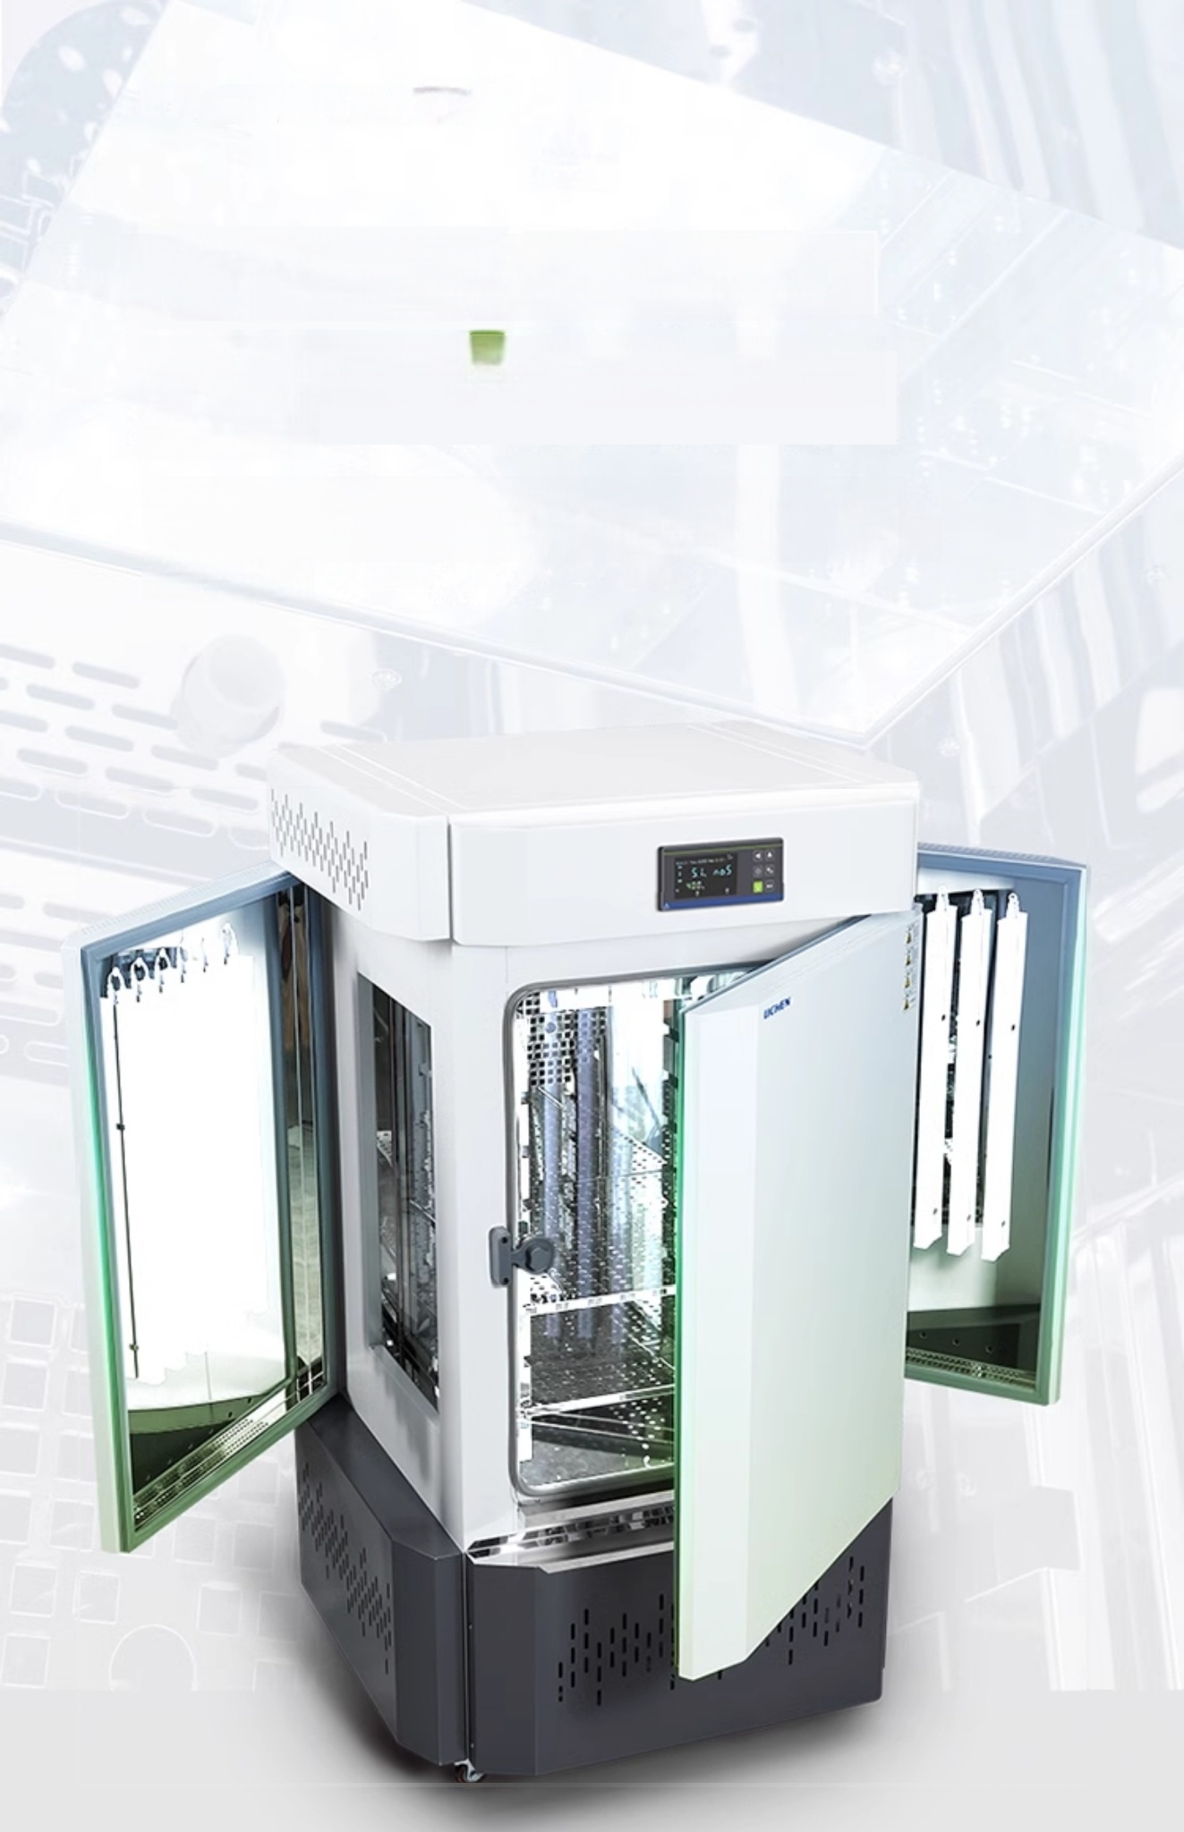
Level 6 dimming Stableilluminance
Double-sided/four-sided lighting options
Level 6 dimming,light intensity 10,000 lux/18,000
lux optional,top lighting function,waterproof high brightness

Slide 5
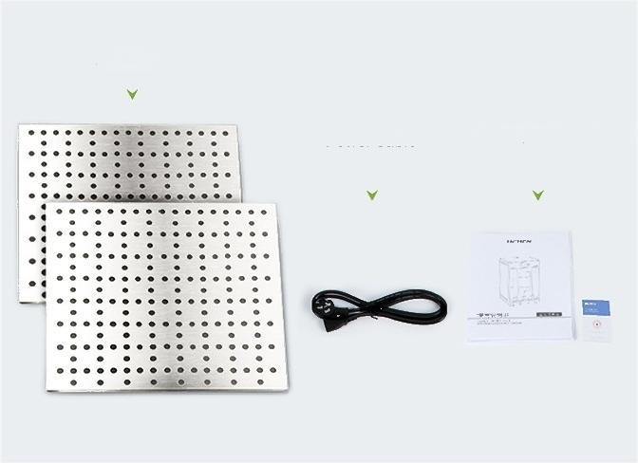
packing list
Partition
_{Power} _{Cable} Manual/Certificate of conformity

Slide 6


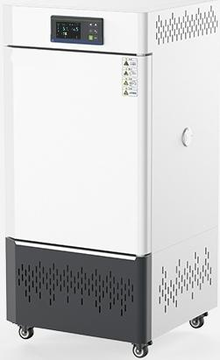
LC-GZX-70T
Light Cultivation Incubator
Temperature control range: |  | 5~60℃
Light Intensity. | 0~10000 |  | Lux((6 levels adjustable)
Number of illuminated ₂ _{sides}
Timing range: 0~9999 min
Power: 400W
Studio size: 350×400×500 mm
Effective volume: | 70L
Product Size: 575×555×1170 mm
surfaces:

Slide 7


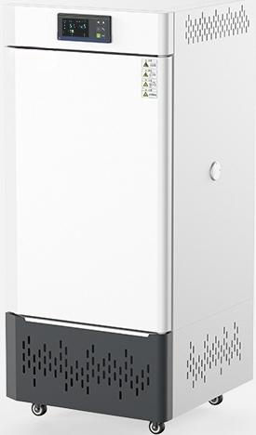
LC-GZX-150T
Light Cultivation Incubator
Temperature control range: | 5~60℃
Illumination intensity:0~10,000 Lux(6 adjustable levels)
Number ofilluminated surfaces: |  | 2 sides
Timing range: 0~9999 min
Power: 600W
Studio size: 400×500×750 mm
Effective volume: | 150L
^{Product} ^{Size:} 625×655×1420 mm

Slide 8
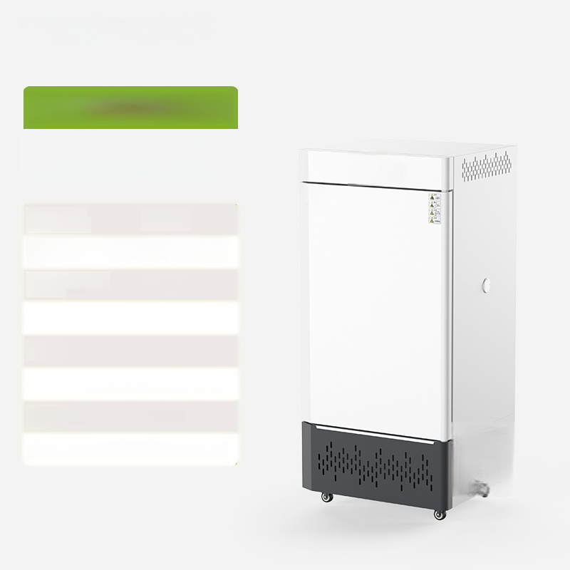

LC-GZX-250T
Light Cultivation Incubator
Temperature control range: | 5~60℃
Illumination intensity:0~10,000 Lux(6 adjustable levels)
Number ofilluminated surfaces: |  | 2 sides
Timing range: 0~9999 min
Power: 800W
Studio size: 500×550×900 mm
Effective volume: | 250L
Product Size: 740×705×1560 mm

Slide 9
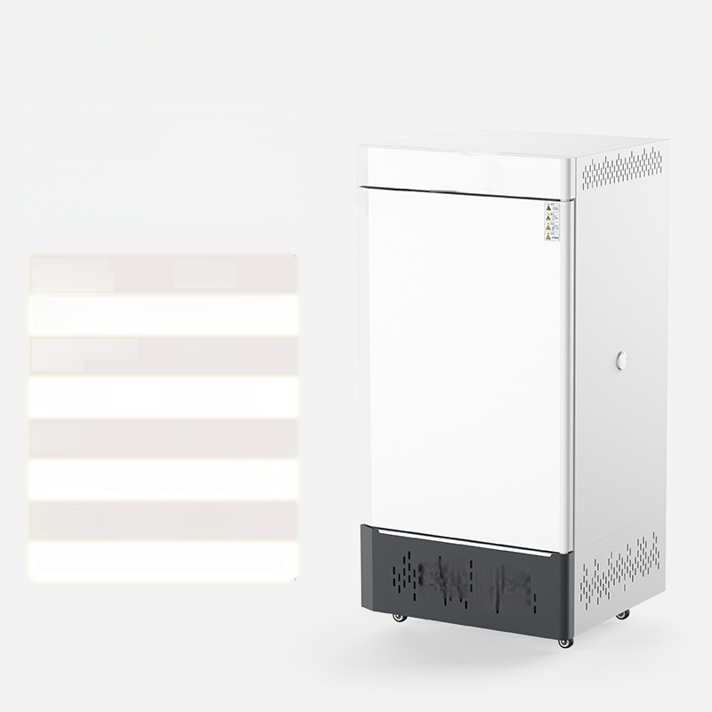

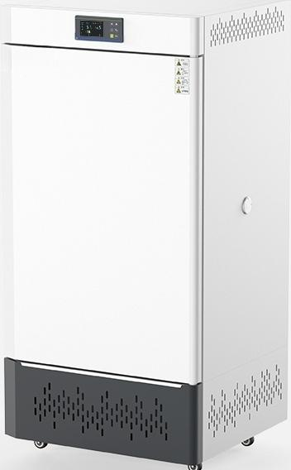
LC-GZX-360T
Light Cultivation Incubator
Temperature control range: | 5~60℃
Illumination intensity:0~10000Lux(6 adjustable levels)
Number ofilluminated surfaces: |  | 2 sides
Timing range: 0~9999 min
Power: 900W
Studio size:600×600×1000mm
Effective volume: | 360L
Product Size: 835×755×1695 mm

Slide 10
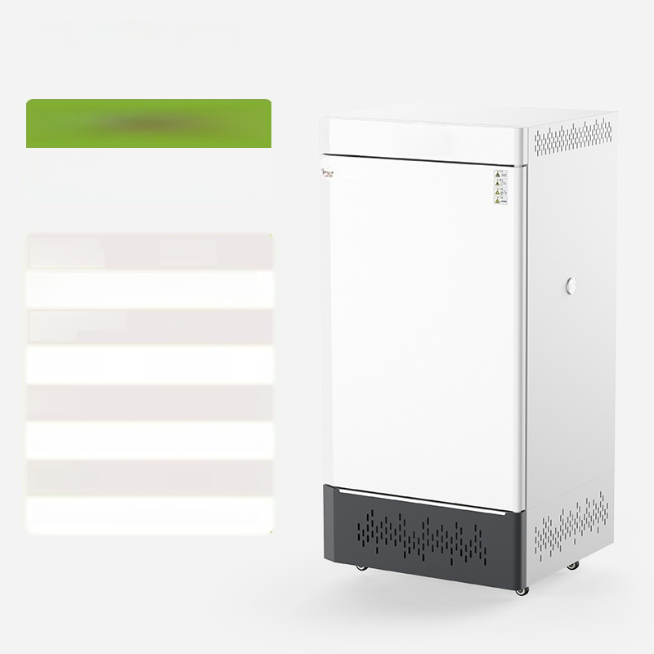
LC-GZX-460T
Light Cultivation Incubator
Temperature control range: | 5~60℃
Illumination intensity:0~10000Lux(6 adjustable levels)
Number ofilluminated surfaces: |  | 2 sides
Timing range: 0~9999 min
Power: 1000W
Studio dimensions:650×650×1100mm
Effective volume: | 460L
Product Size: 885×805×1795 mm

Slide 11
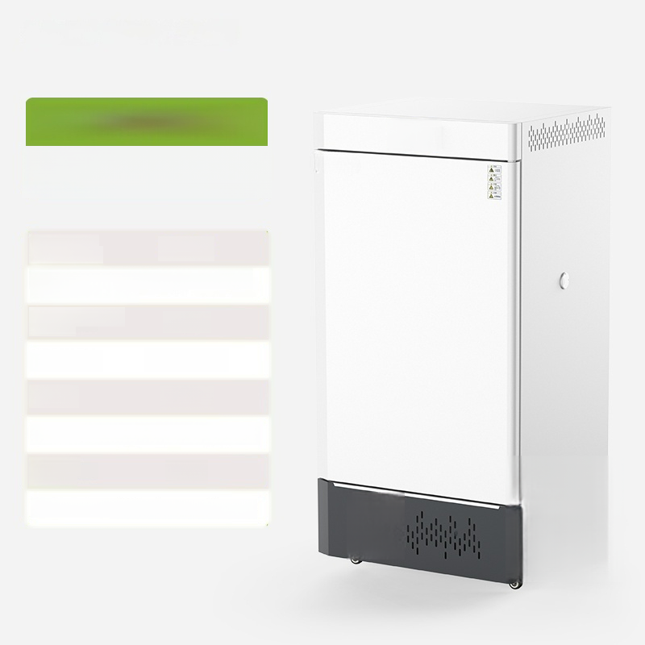
LC-GZX-600T
Light Cultivation Incubator
Temperature control range: | 5~60℃
Illumination intensity:0~10000Lux(6 adjustable levels)
Number ofilluminated surfaces: |  | 2 sides
Timing range: 0~9999 min
Power: 1200W
Studio dimensions:680×800×1100mm
Effective volume: | 600L
Product Size:920×955×1795 mm
1

Slide 12
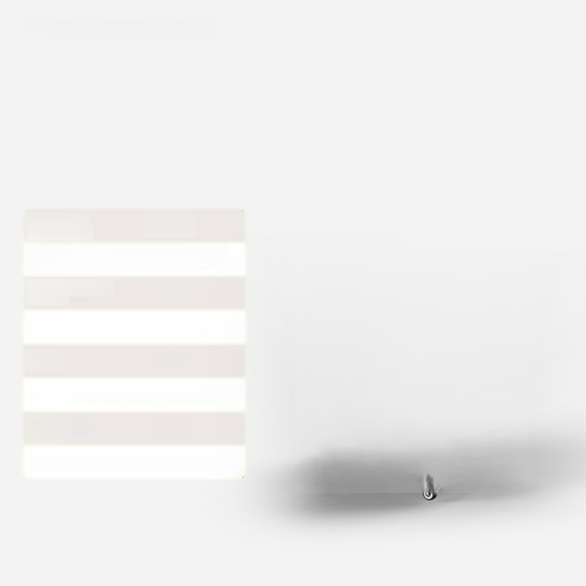

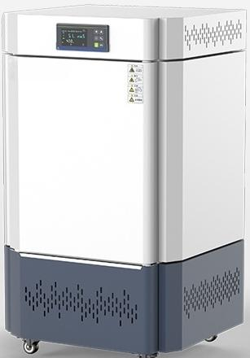
LC-GZX-180F
Light-illuminated incubator (high-intensity light type)
Temperature control range: | 5~60℃
Illumination intensity:0~18000Lux(6 adjustable levels)
Number ofilluminated surfaces: |  | 4 sides
Timing range: 0~9999 min
Power: 900W
Studio size: 500×500×750 mm
Effective volume: | 180L
Product Size: 750×850×1525 mm

Slide 13


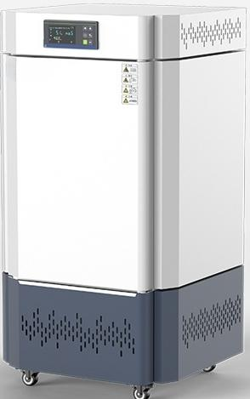
LC-GZX-280F
Light-illuminated incubator (high-intensity light type)
Temperature control range: |  | 5~60℃
Light Intensity. | 0~18000 |  | Lux((6 levels adjustable)
Number of illuminated surfaces: |  |  |  | 4 sides
Timing range: 0~9999 min
Power: 1000W
Studio size: 550×550×900 mm
Effective volume: | 280L
Product Size: 800×900×1675 mm

Slide 14


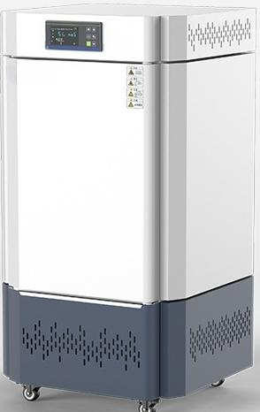
LC-GZX-280F
Lighted incubator
(high-intensity type)
Temperature control range: | 5~60℃
llumination intensity:0~18000 Lux Q~18000 Lux (6 adjustable levels)
Number of illuminated surfaces: | 4 sides
Timing range: 0~9999 min
Power: 1000W
Studio size:600×6005900n900 mm
Effective volume: | 280L
Product Size: 800×900×1675 mm

Slide 15
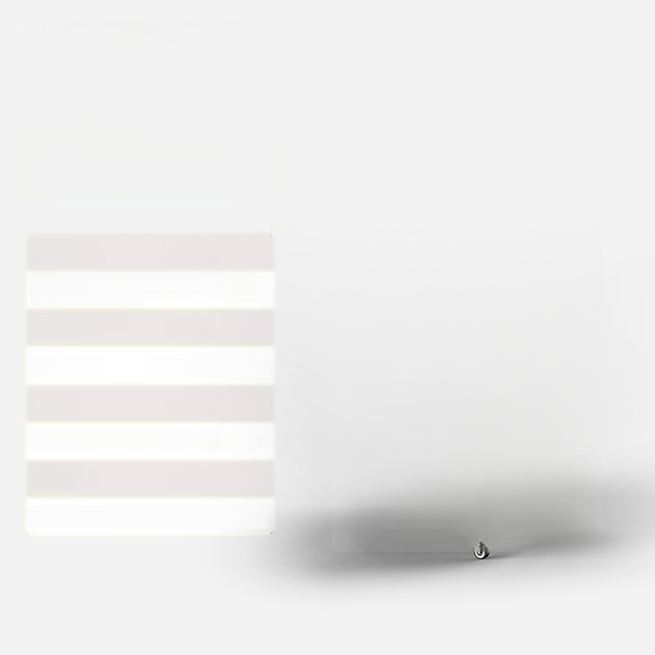

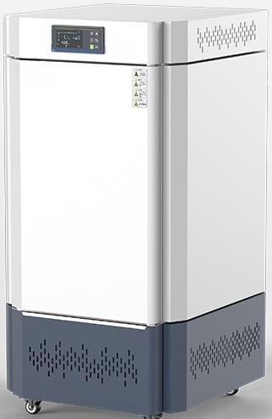
LC-GZX-460F
Light Cultivation Box(Strong Light Type)
Temperature control range: | 5~60℃
Illumination Intensity:0~18000Lux(6 adjustable levels)
Number ofilluminated surfaces: |  | 4 sides
Timing range: 0~9999 min
Power: 1200W
Studio Size:600×650×1100mm
Effective volume: | 460L
Product Size:845×1000×1875 mm

Slide 16
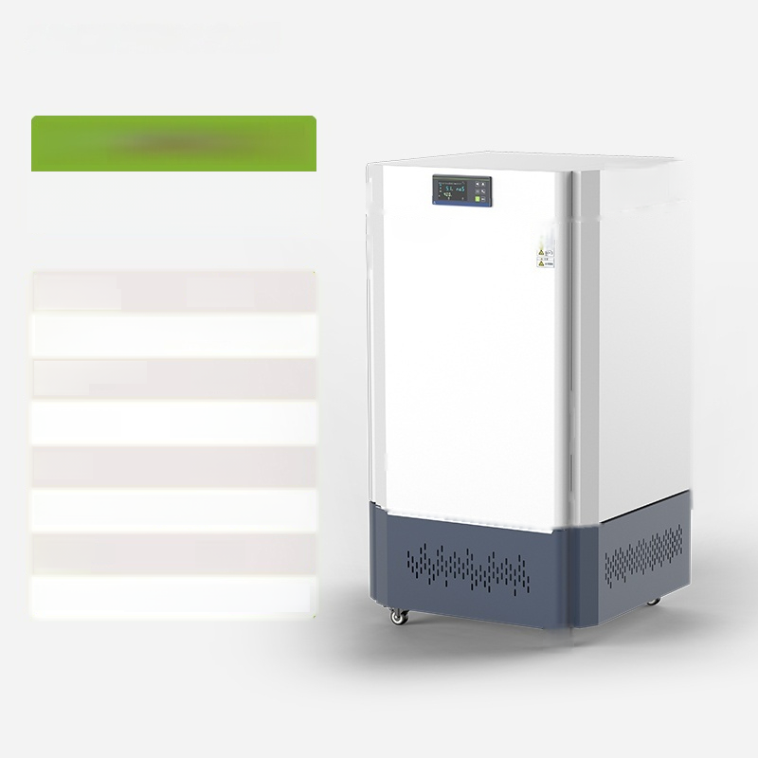
LC-GZX-600F
▲
Light-illuminated incubator
(high-intensity light type)
Temperature control range: | 5~60℃
Illumination intensity:0~18000 Lux(6 adjustable levels)
Number ofilluminated surfaces: |  | 4 sides
Timing range: 0~9999 min
Power: 1300W
Studio size:680×800×1100 mm
Effective _{600L} volume:
Product Size:950×1140×1920 mm

