Slide 1
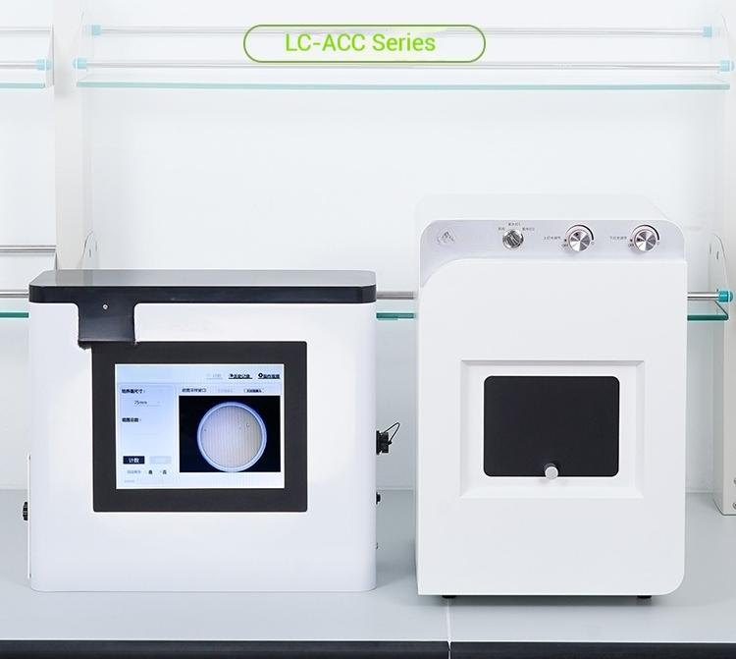
Fully automatic colony counter
Intelligent Recognition for Efficient Counting

Slide 2
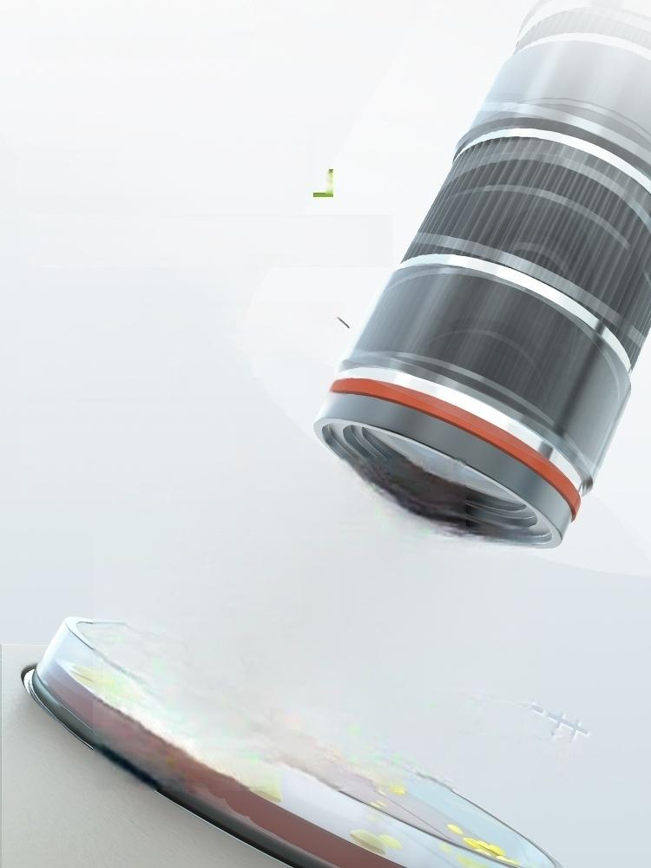
「16 million pixels
High-resolution camera
Automatically cuts off peripheral
images of petri dish to ensure clearer
image,with manual parameter
adjustment for counting available
LC-ACC-500:5MP
LC-ACC-1600:16MP
an detect
0.5mm colonies

Slide 3
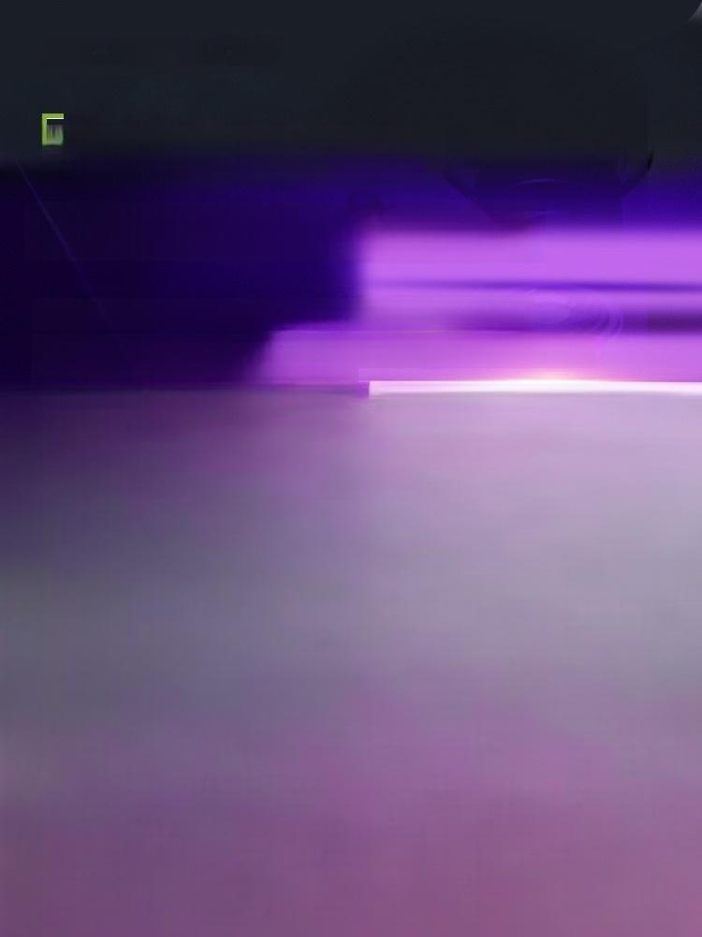
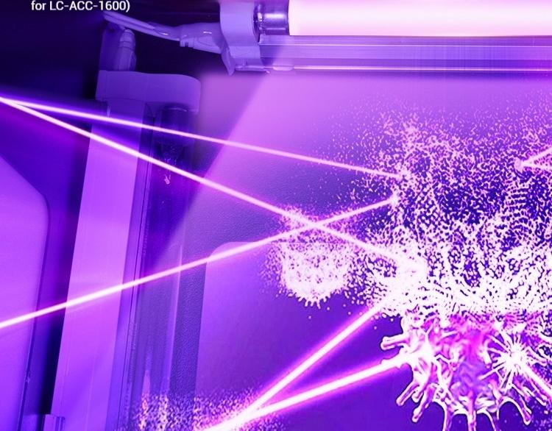
UV sterilization function &
Light source intensity adjustable
Effectively prevent pathogenic bacteria to avoid harm to human body;
The illuminating lamp can adjust the light source to meet the observation
Of colonies on different culture media (Only

Slide 4
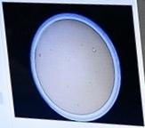

④2
旗g0
9a6 互慢
)
Base
e
9

Slide 5


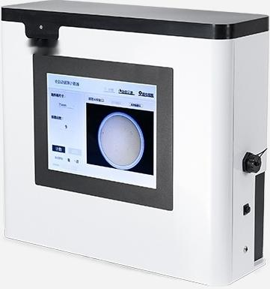
LC-ACC-500
Fully automatic colony counter
Lens resolution: 5million
Minimum measurable 0.5mm colony diameter.
Counting Fully enclosed light box environment: counting
Counting Manual control for fully method: automatic counting
Error rate: | <±10%
Product Size: 440×150×390mm

Slide 6
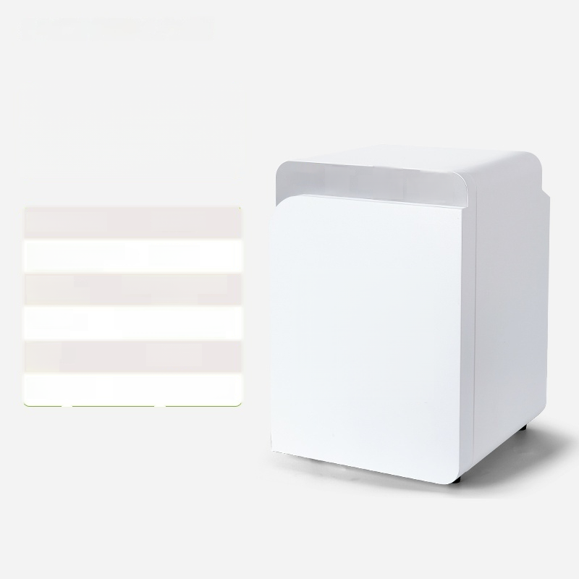



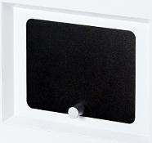
LC-ACC-1600
Fully automatic colony counter
a
Lens resolution: 16 million
Minimum measurable 0.5mm colony diameter.
Counting Fully enclosed light box environment: counting
Counting Manual control for fully method: automatic counting
Error rate: | <±10%
Product Size: 320×350×500mm

