Slide 1
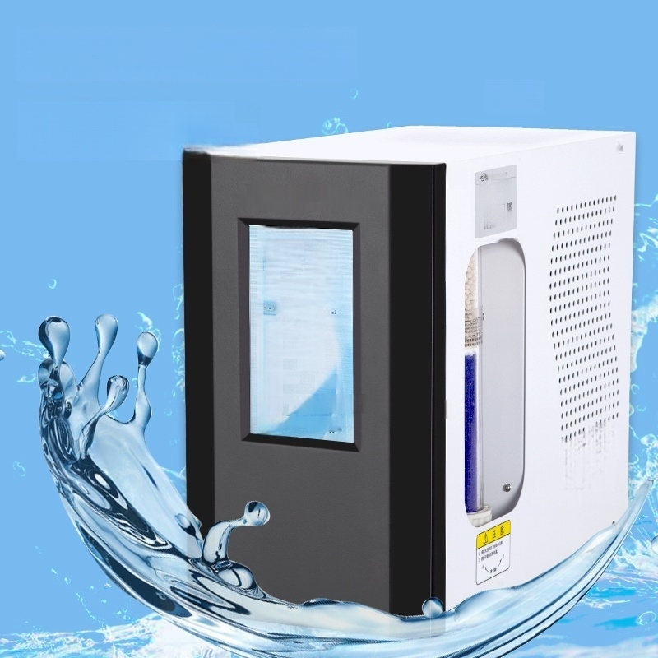
Auto-refill Function
Control pump for liquid
refill without manual refill
LGHCold Dry Hydrogen
Generator
^{干遇灰} 12
^{徐力}1.2
u
@
更 更
地监班
300
边 干
飞解帜态
态世录态
*量年
动
OperationNormal
e 6 l-4
01i5

Slide 2
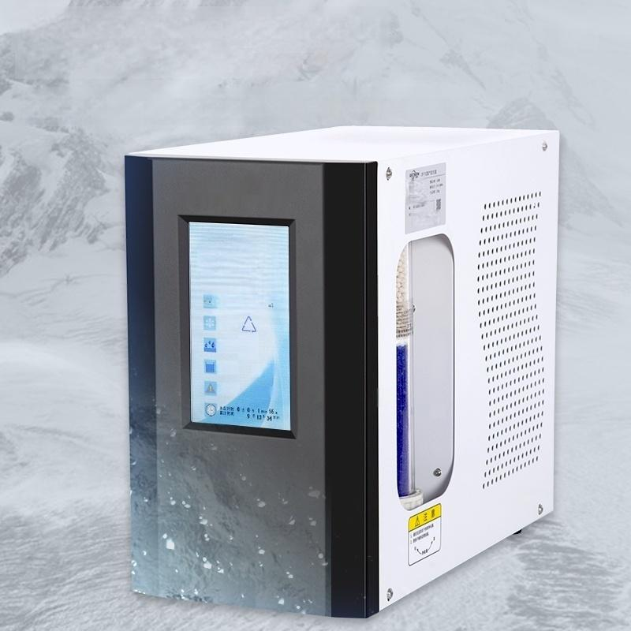
Pressure Swing Adsorption Dehumidification
Adopting low-temperature refrigeration drying and pressure swing
! ^{冷平善度} 12
.
沿下块5
^{这} ^{解} ^{次} △
本世乘态 *无督然
^{在通当} _{T}
1
⑥
IIl
adsorption dehumidification technology
)s 冲
力
1
2
e
30
0

Slide 3
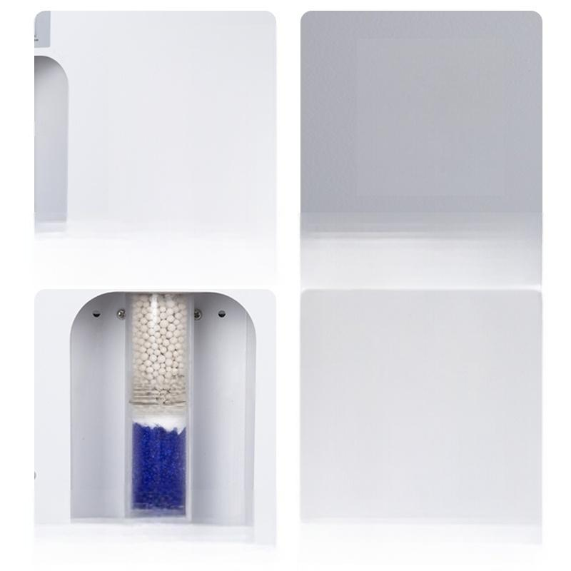

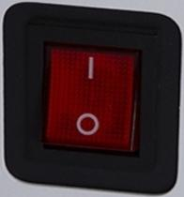
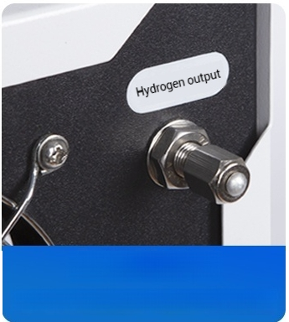

景
Cooling holes
Internal heat dissipation of the
instrument
Power Switch
Turn on/off the instrument
Hydrogen outlet
Connect with gas path tubes and link to the chromatograph
unio
22
注
0
t1K
t
Purification
tube
Made of color-changing silica gel and 5A molecular sieve
Used to purify impurities in hydrogen

Slide 4
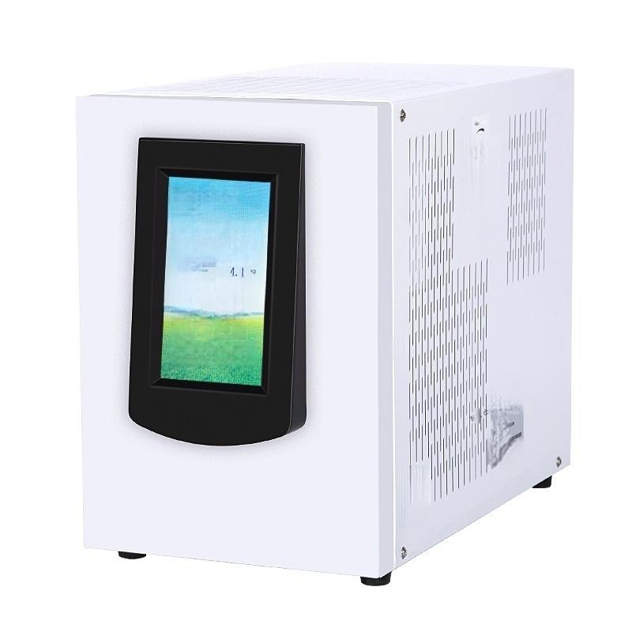

LGA Cold Dry AIr
Generator
Cals-ad pruduct
Force 4.0
Flat state
在象有
自 4 页 n+27
41614
air genesat0
w

Slide 5
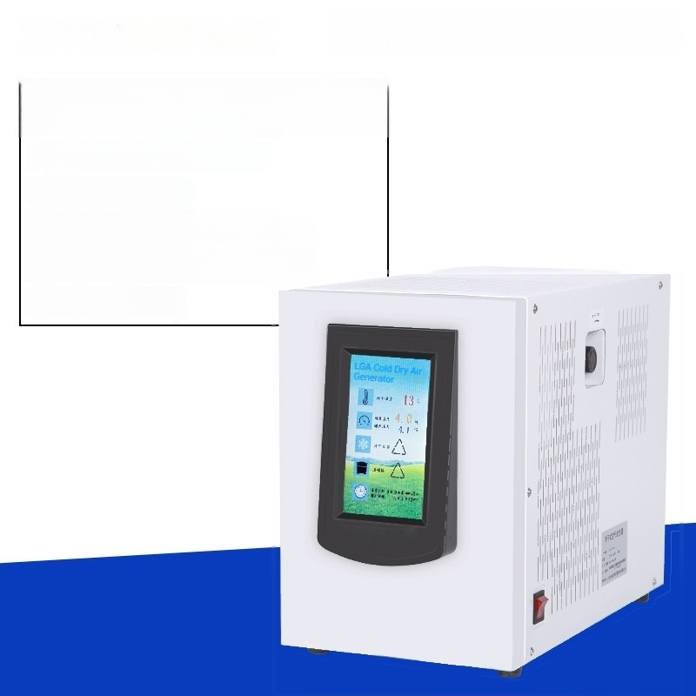
Cold Dry Air Generator
LC-LGA-3
Power Supply:220V 50Hz
Power:150W
Output Flow:0~3L/min
Output Pressure:0～0.4Mpa Net Weight:30Kg

Slide 6
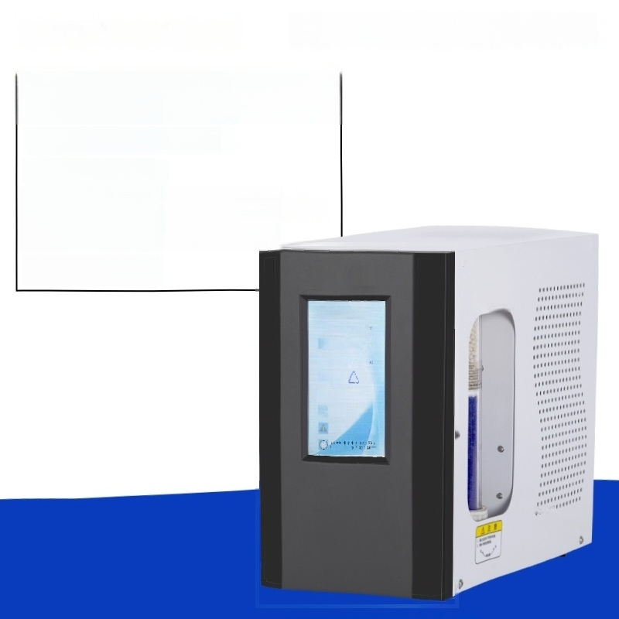

Cold Dry Hydrogen Generator
LC-LGH-300
Power Supply:220V 50Hz
Power:150W
Output flow:0～300ml/min
Output pressure:0～0.3MPa
Net weight:12Kg
+ 12
1.2-
国 300
3+
这 *Public
Kx
^{e5} , 工 *

