Slide 1

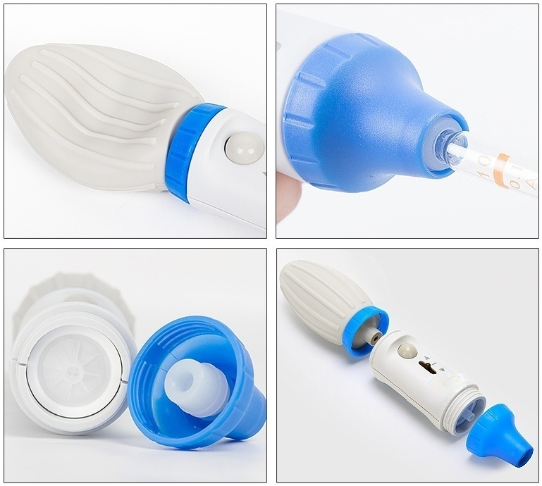
Real shot

Slide 2

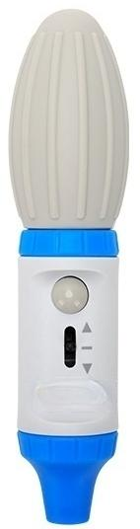
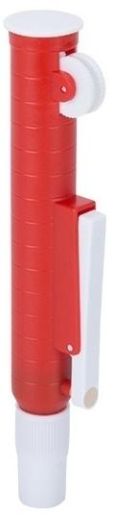
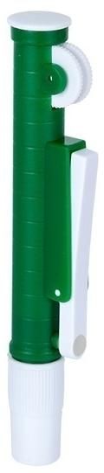
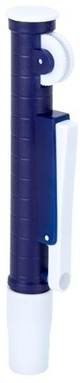
Model
LClevo
Range 0.1~100m
LClevo-B25
Range:25ml
LClevo-B10
Range:10ml
LClevo-B2
Range:2ml

Slide 3
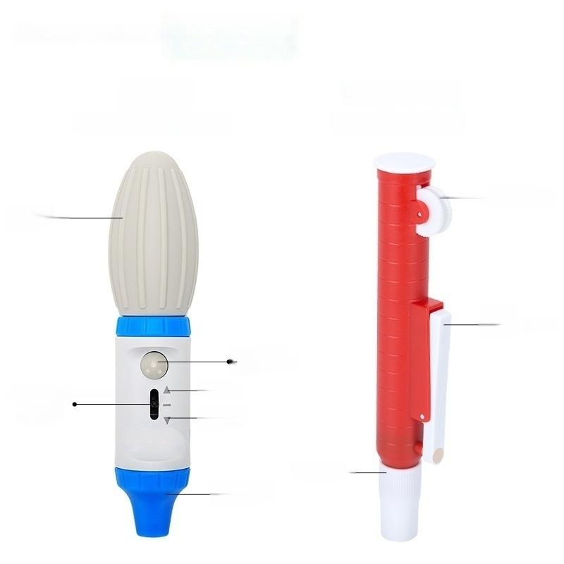

Parsing
LClevo
Large capacity pipette
LClevo-B25
Small pipette pump
·Rotating
Rubber ball ·
finger wheel
·Liquid
discharge button
Blow-out
button
Suction and discharge of liquid
Control
Lever
·Suction
liquid
Discharge liquid
Cerebrospinal tube nozzle ·
Spinal canal
opening

Slide 4
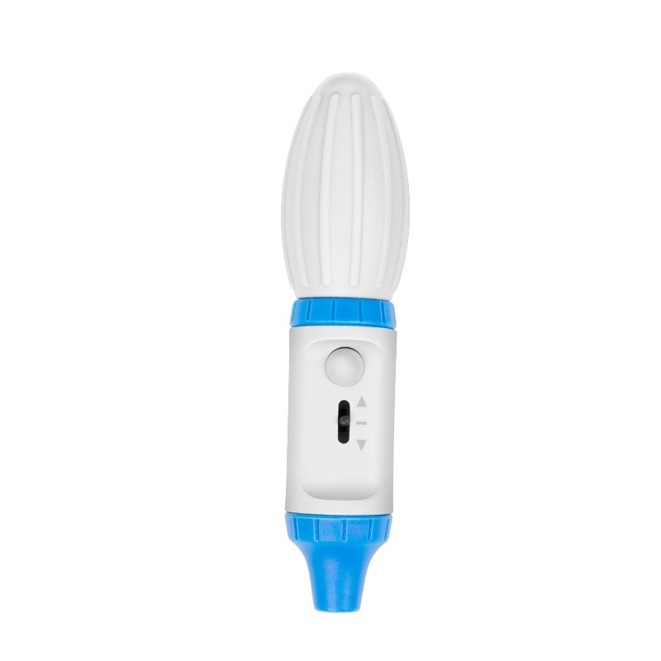

Slide 5
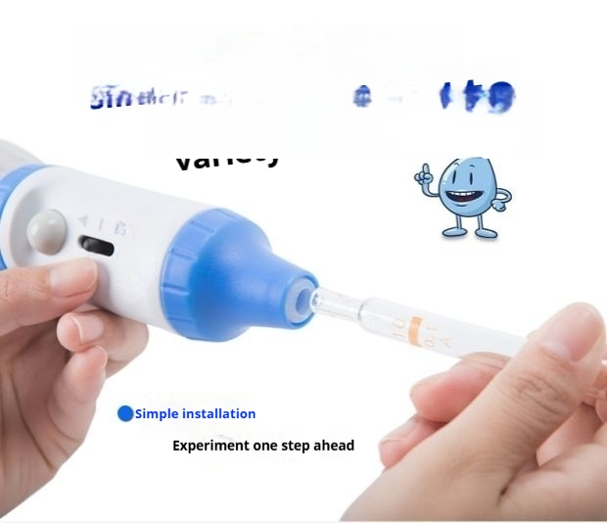
_{Contains} Adapter
cilicone gel
Adapt to aPIpeLLC

Slide 6
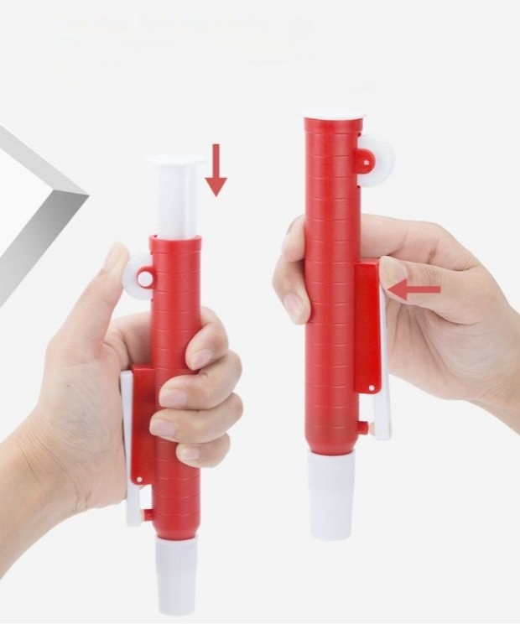
Multiple drainage modes
Rotating control wheel and drainage button provide dual options for drainage,making it more convenient.

Slide 7

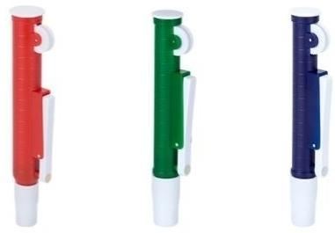
Multiple specifications
available for your selection
Select a pipette that meets your liquid transfer requirements.
LClevo LClevo-B25 LClevo-B10 LClevo-B2

Slide 8
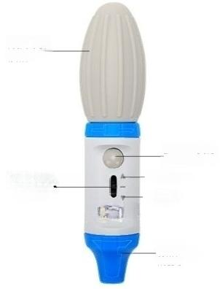

Rubber
ball ·
Suction and drainage Control
Lever
·Rotating
finger wheel
·Drainage
button
Blow-out
button
Suction liquid
Drainage
Spinal canal nozzle
Spinal cana l nozzle.
Model | Image | Product Name | Range | Color
LClevo |  | Large-capacity pipette pump | 0.1~100ml | Blue
LClevo-B2 |  | Small pipette pump | 2ml | Blue
LClevo-B10 |  | Small pipette pump | 10ml | Green
LClevo-B25 |  | Small pipette pump | 25ml | Red

Slide 9
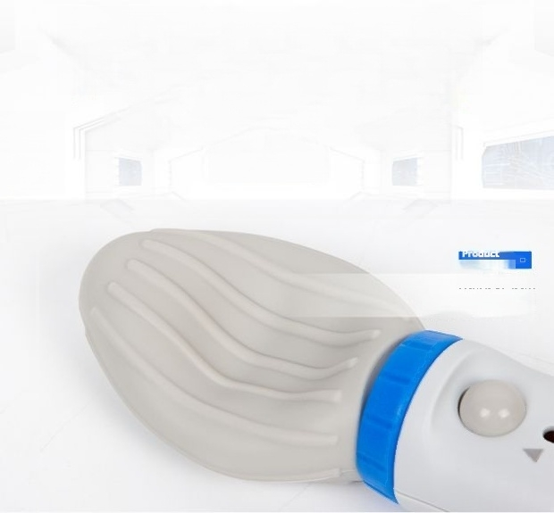

Heart to build Every detail
High quality is Hard truth
details one
Rubber ball
Easy and convenient to operate

Slide 10

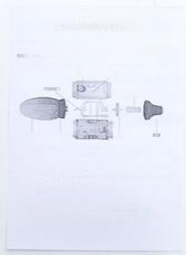





Packing List
Select the pipette that meets your liquid transfer requirements.
武二量心流苏作
a
s
三地
eu t
c
大 t**
a 元
那 热 世

