Slide 1
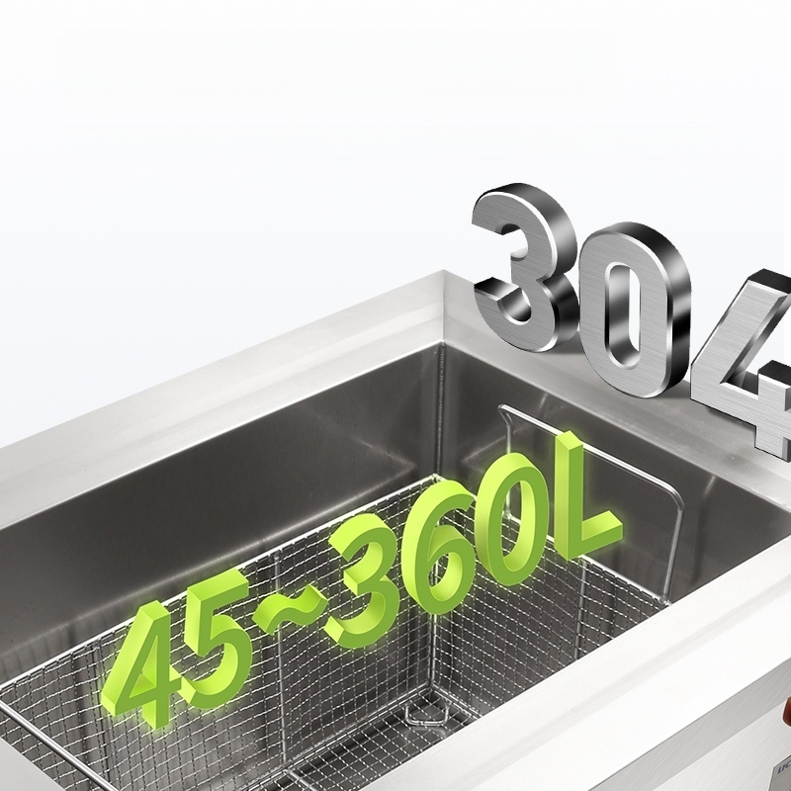
45L-360L capacity available
Suitable for large-scale product cleaning or cleaning multiple styles together.

Slide 2
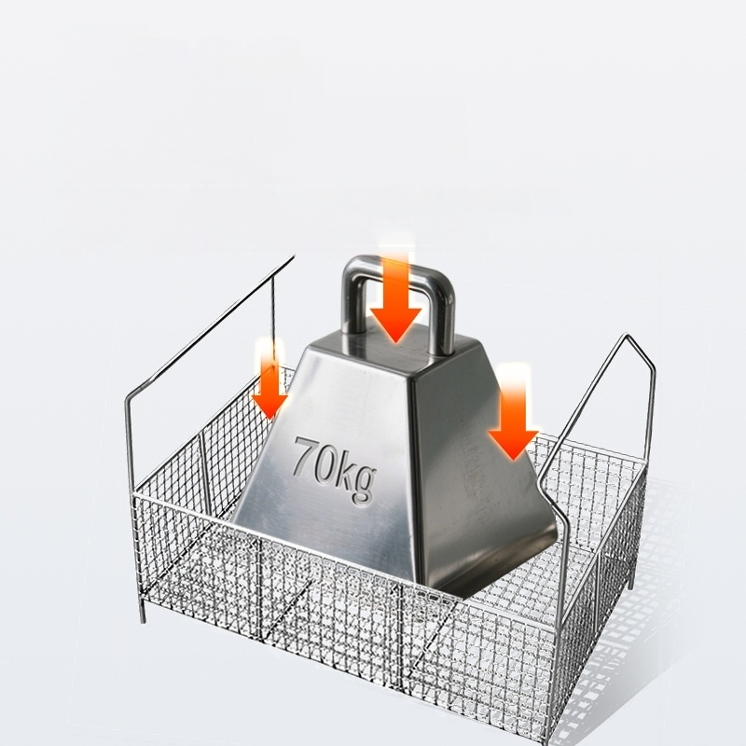
Super
load-bearing 」
70kg weight capacity,no deformation.
304 Stainless Steel Cleaning Basket,High Load Capacity, Special Frame Design for Enhanced Weight Bearing.

Slide 3
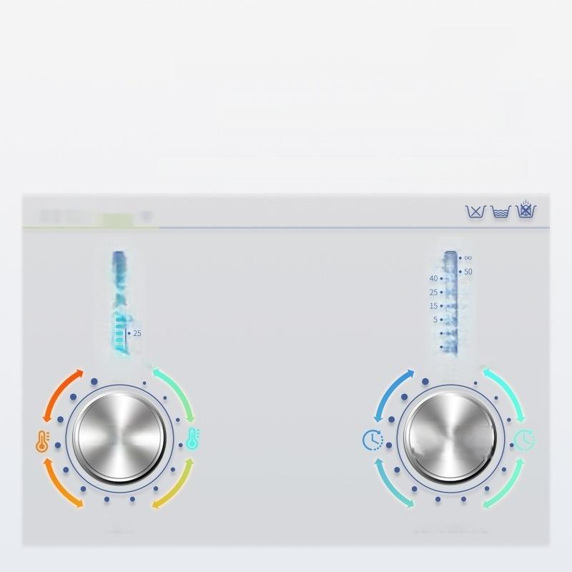
Multiple time control+temperature
adjustment 」
Meet diverse needs
Simple timing temperature control,easier to use and clean.
80·
70·
60·
50·
40·
30·
20·
TEMP
TIME
60·
·30
·20
·10
·4
3
·2
1
·75
·65
0…0…
………
·55
·45
·35
·15
℃
0……………………0…0
OFF
14 holes
◎
OFF
MIN
13-speed
HEAT ULTRASONIC

Slide 4
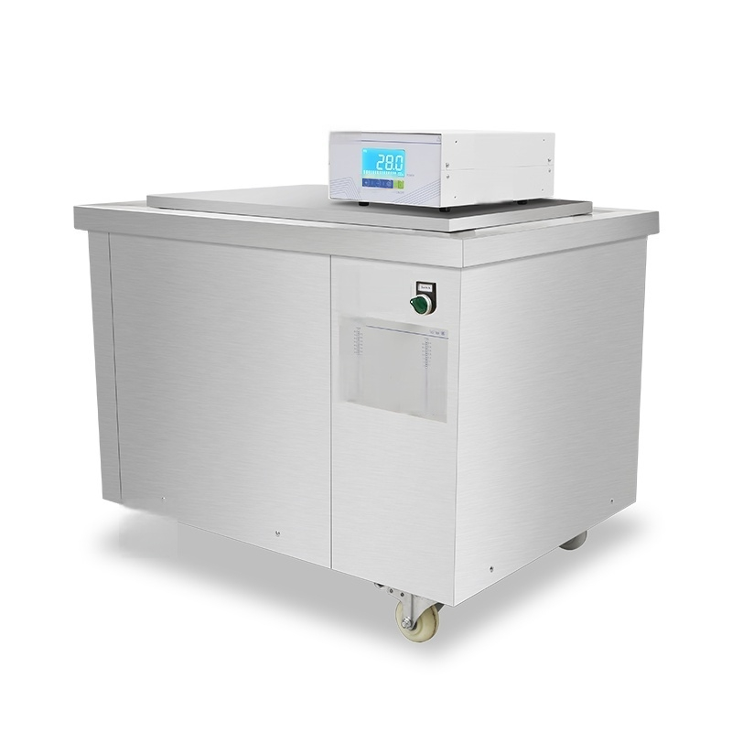






uCHEN
lre
BCH

Slide 5
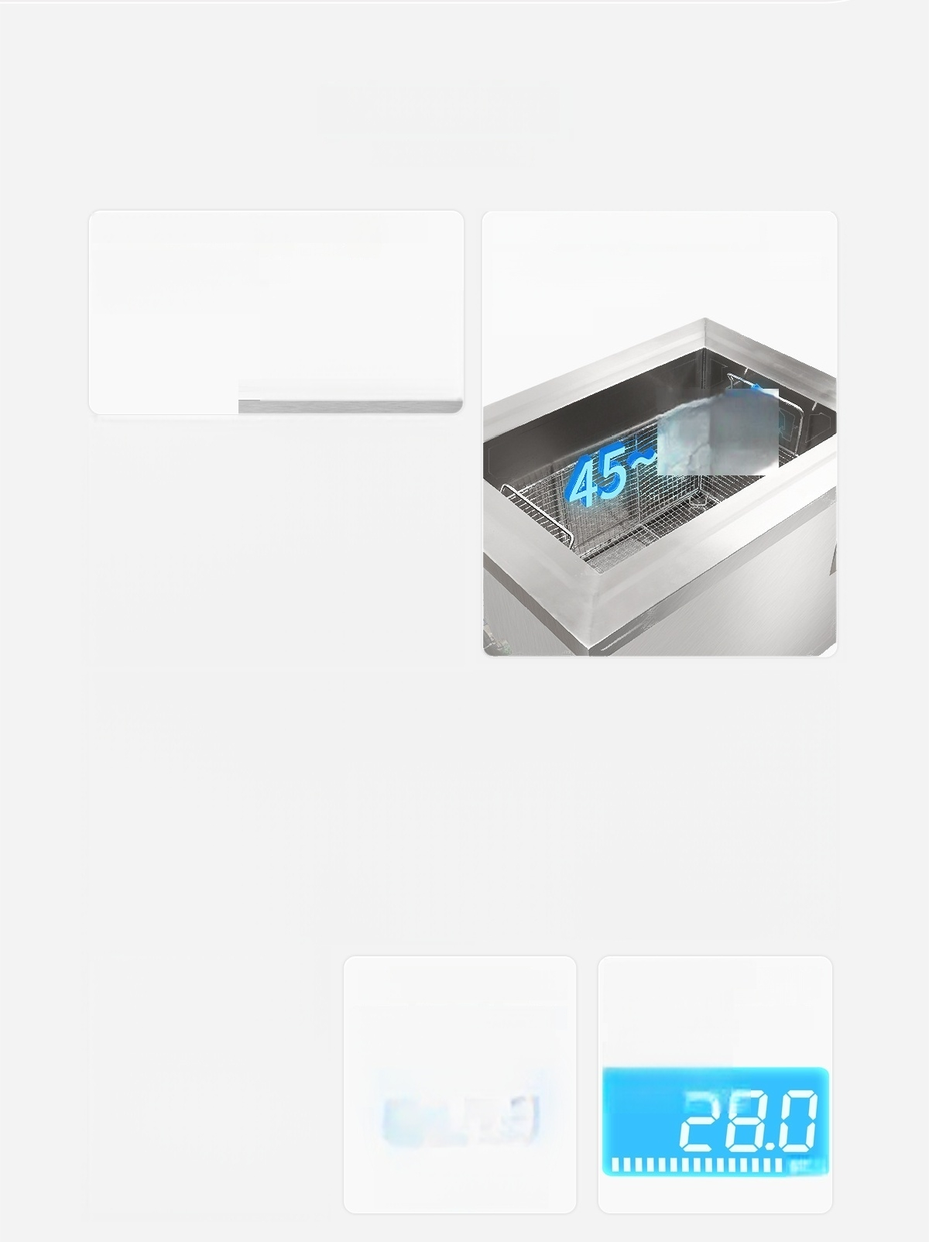
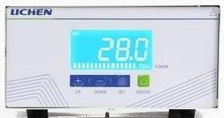
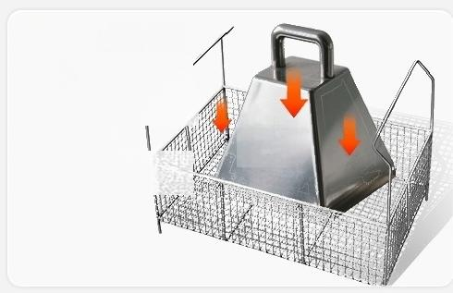
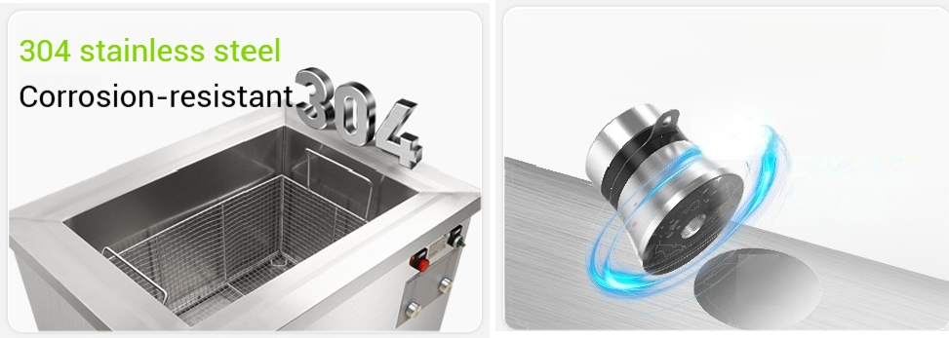
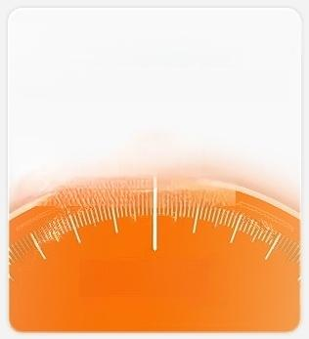

Product Features
Product Features
Efficient Ultrasonic Generator
Stable Output,
Easy Operation
Multiple Batch Cleaning
8 Volumes,Suitable for Large Batch and Various Style
Cleaning
Super
load-bearing
Load-bearing without
deformation
360L
70kg
High Power Industrial
Transducer Long Service Life, Good Cleaning
Effect
60W
i
Multiple temperature
controls
Multiple
Temperature
Setting Options
14 holes
Time-controllable
Always-on mode and multiple time settings
Broad Power
Regulation
10%～100%
Intelligent
Adjustment
100%

Slide 6
Detailed product parameters
Product parameters
Model | LC-LUC-45 | LC-LUC-60 | LC-LUC-96 | LC-LUC-120
Ultrasound Power | 750W | 1000W | 1300W | 1500W
Heating power | 2000W | 3000W | 3000W | 3000W
Ultrasonic Frequency | 40KHz | 40KHz | 40KHz | 40KHz
Vibrating head quantity | 15 | 20 | 26 pcs | 30
Inner tank capacity | 45L | 60L | 96L | 120L
Inner groove size (L×W×H) | 500×300×300 mm | 500×400×300 mm | 600×400×400 mm | 600×500×400 mm
Timing duration | 1-60 min adjustable/ ON(Normally Open)
Temperature control range Cleaning basket dimensions (L×W×H) | RT-80℃ | RT-80℃ | RT-80℃ | RT-80℃
 | 460×260×250 mm | 460×360×250 mm | 560×360×350 mm | 560×460×350 mm
Power supply voltage | AC:220V/50HZ | AC:220V/50HZ | AC:220V/50HZ | AC:220V/50HZ
Total Power | 2750W | 4000W | 4300W | 4500W
Net Weight | 50Kg | 65Kg | 68Kg | 95Kg
Product Size (L×W×H) | 760×530×580 mm | 760×580×550 mm | 870×580×720 mm | 870×680×670 mm

Slide 7
Model |  | LC-LUC-140 | LC-LUC-180 | LC-LUC-270 | LC-LUC-360
Ultrasound Power |  | 2000W | 2500W | 3500W | 4250W
Heating power |  | 6000W | 6000W | 9000W | 9000W
Ultrasonic Frequency |  | 40KHz | 40KHz | 40KHz | 40KHz
Vibrating head quantity |  | 40 | 50 | 70 pieces | 85 pcs
Inner tank capacity |  | 140L | 180L | 270L | 360L
Inner (Lgfobvel) size |  | 700×500×400 mm | 800×500×450 mm | 600×400×400 mm | 1000×600×600 mm
Timing duration |  | 1-60 minutes adjustable/ON
Temperature control range |  | RT-80℃ | (perman RT-80℃ | ent on) RT-80℃ | RT-80℃
Cleaning basket dimensions (L×W×H) |  | 660×460×350 mm | 760×460×400 mm | 860×590×400 mm | 960×560×550 mm
Power supply voltage |  | AC:380V/50HZ | AC:380V/50HZ | AC:380V/50HZ | AC:380V/50HZ
Total Power |  | 8000W | 8500W | 12500W | 13250W
Net Weight |  | 99Kg | 115Kg | 128Kg | 160Kg
Product (L×W×H) | Size | 970×680×670 mm | 1070×680×730 mm | 1170×780×780 mm | 1270×780×880 mm
*Dimensions are manually measured with slight errors;please refer to the actual product.

Slide 8
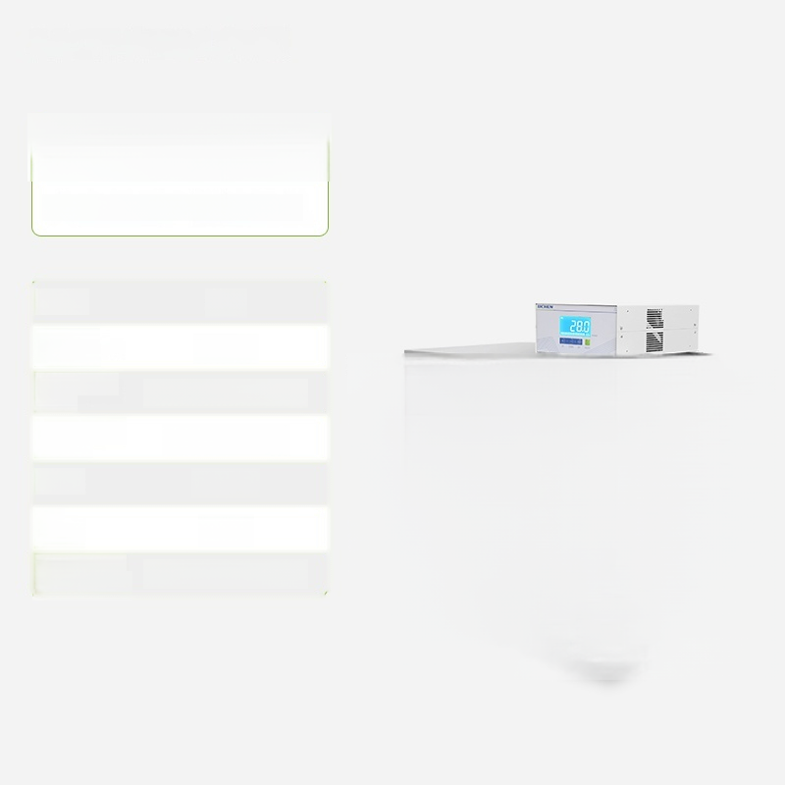

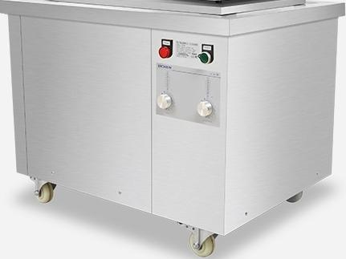
LC-LUC-45
Large Capacity Ultrasonic Cleaner
Volume: 45L
Ultrasonic Frequency | 40KHz
_{size:} 500×300×300mm
Power supply voltage: | AC:220V/50HZ
Power: 2750W
Net Weight: | 50Kg
Product Size: 760×530×580mm
Inner tank
(L×VV×n)

Slide 9
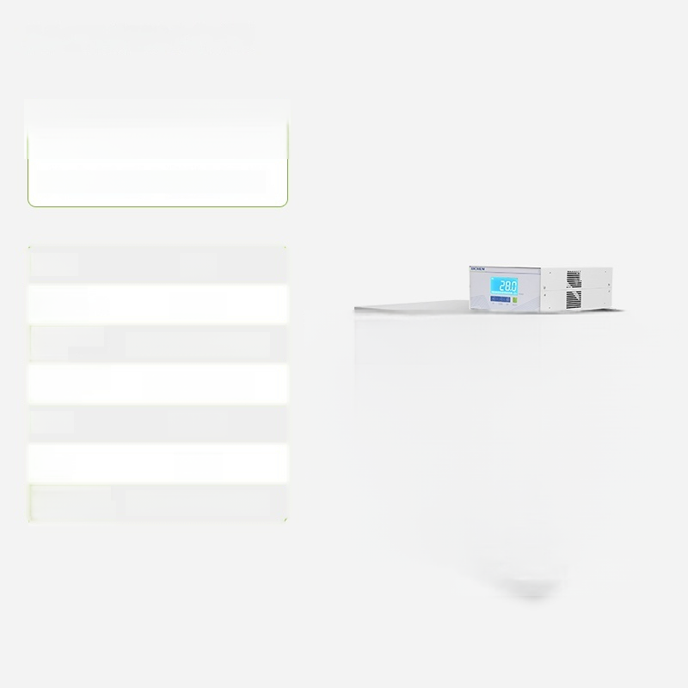

LC-LUC-60
Large Capacity Ultrasonic Cleaner
Volume: 60L
Ultrasonic Frequency | 40KHz
_{size:} 500×400×300mm
Power supply voltage: | AC:220V/50HZ
Power: 4000W
Net Weight: | 65Kg
Product Size: 760×580×550mm
Inner tank
(L×VV×n)

Slide 10
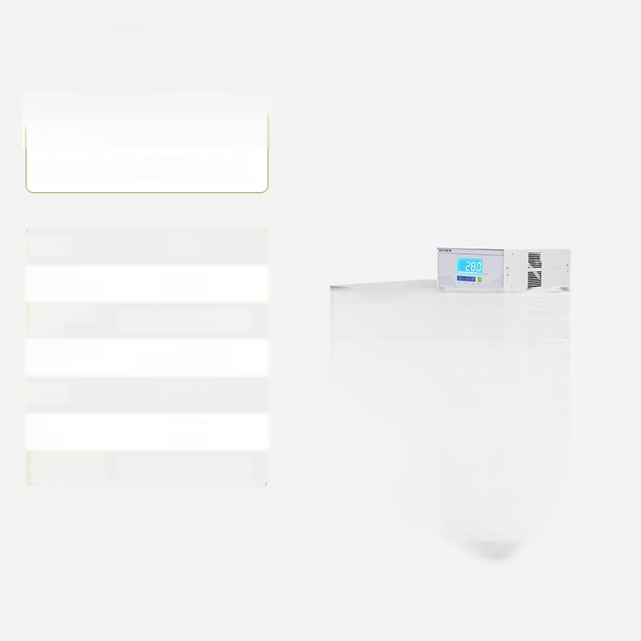

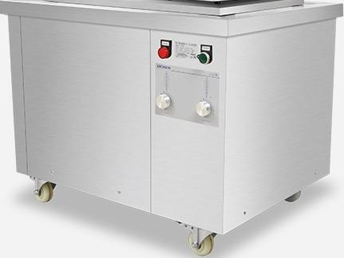
LC-LUC-96
Large Capacity Ultrasonic Cleaner
Volume: 96L
Ultrasonic Frequency | 40KHz
_{size:} 600×400×400mm
Power supply voltage: | AC:220V/50HZ
Power: 4300W
Net Weight: | 68Kg
Product Size: 870×580×720mm
Inner tank
(L×VV×n)

Slide 11


LC-LUC-120
Large Capacity Ultrasonic Cleaner
Volume: 120L
Ultrasonic Frequency | 40KHz
_{size:} 600×500×400mm
^{Power} ^{supply} AC:220V/50HZ voltage:
Power: 4500W
Net Weight: | 95Kg
Product Size: 870×680×670mm (L×VV×n)
Inner tank

Slide 12


LC-LUC-140
Large Capacity Ultrasonic Cleaner
Volume: 140L
Ultrasonic Frequency |  | 40KHz
_{size:} 700×500×400mm
Power supply voltage: |  | AC:380V/50HZ
Power: 8000W
Net Weight: |  | 99Kg
Product Size: (L×VV×n) | 970×680×670mm
Inner tank

Slide 13


LC-LUC-180
Large Capacity Ultrasonic Cleaner
Volume: 180L
Ultrasonic Frequency | 40KHz
_{size:} 800×500×450mm
Power supply voltage: | AC:380V/50HZ
Power: 8500W
^{Net} 115Kg
Product Size: 1070×680×730mm
Inner tank
Weight:
(L×VV×n)

Slide 14
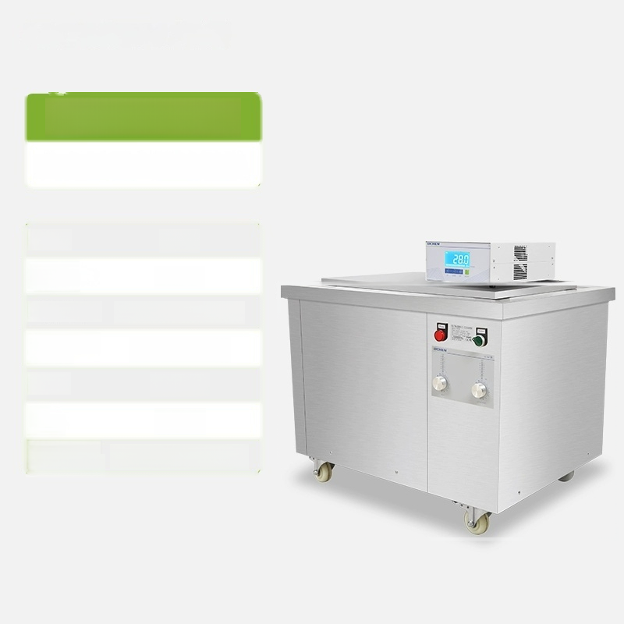
 | LC-LUC-270
Large Capacity Ultrasonic Cleaner
Volume: 270L
Ultrasonic Frequency |  | 40KHz
Inner tank size:900×600×500mm
^{Power} ^{supply} AC:380V/50HZ voltage:
Power: 12500W
Net 128Kg Weight:
Product Size: (L×VV×n) | 1170×780×780mm

Slide 15


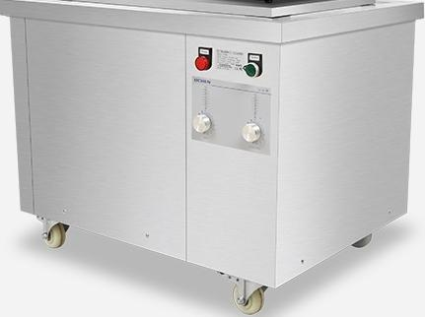
LC-LUC-360
Large Capacity Ultrasonic Cleaner
Volume: 360L
Ultrasonic Frequency | 40KHz
_{size:} 1000×600×600mm
Power supply voltage: | AC:380V/50HZ
Power: 13250W
Net Weight: | 160Kg
Product Size: 1270×780×880mm (L×VV×n)
Inner tank

