Slide 1
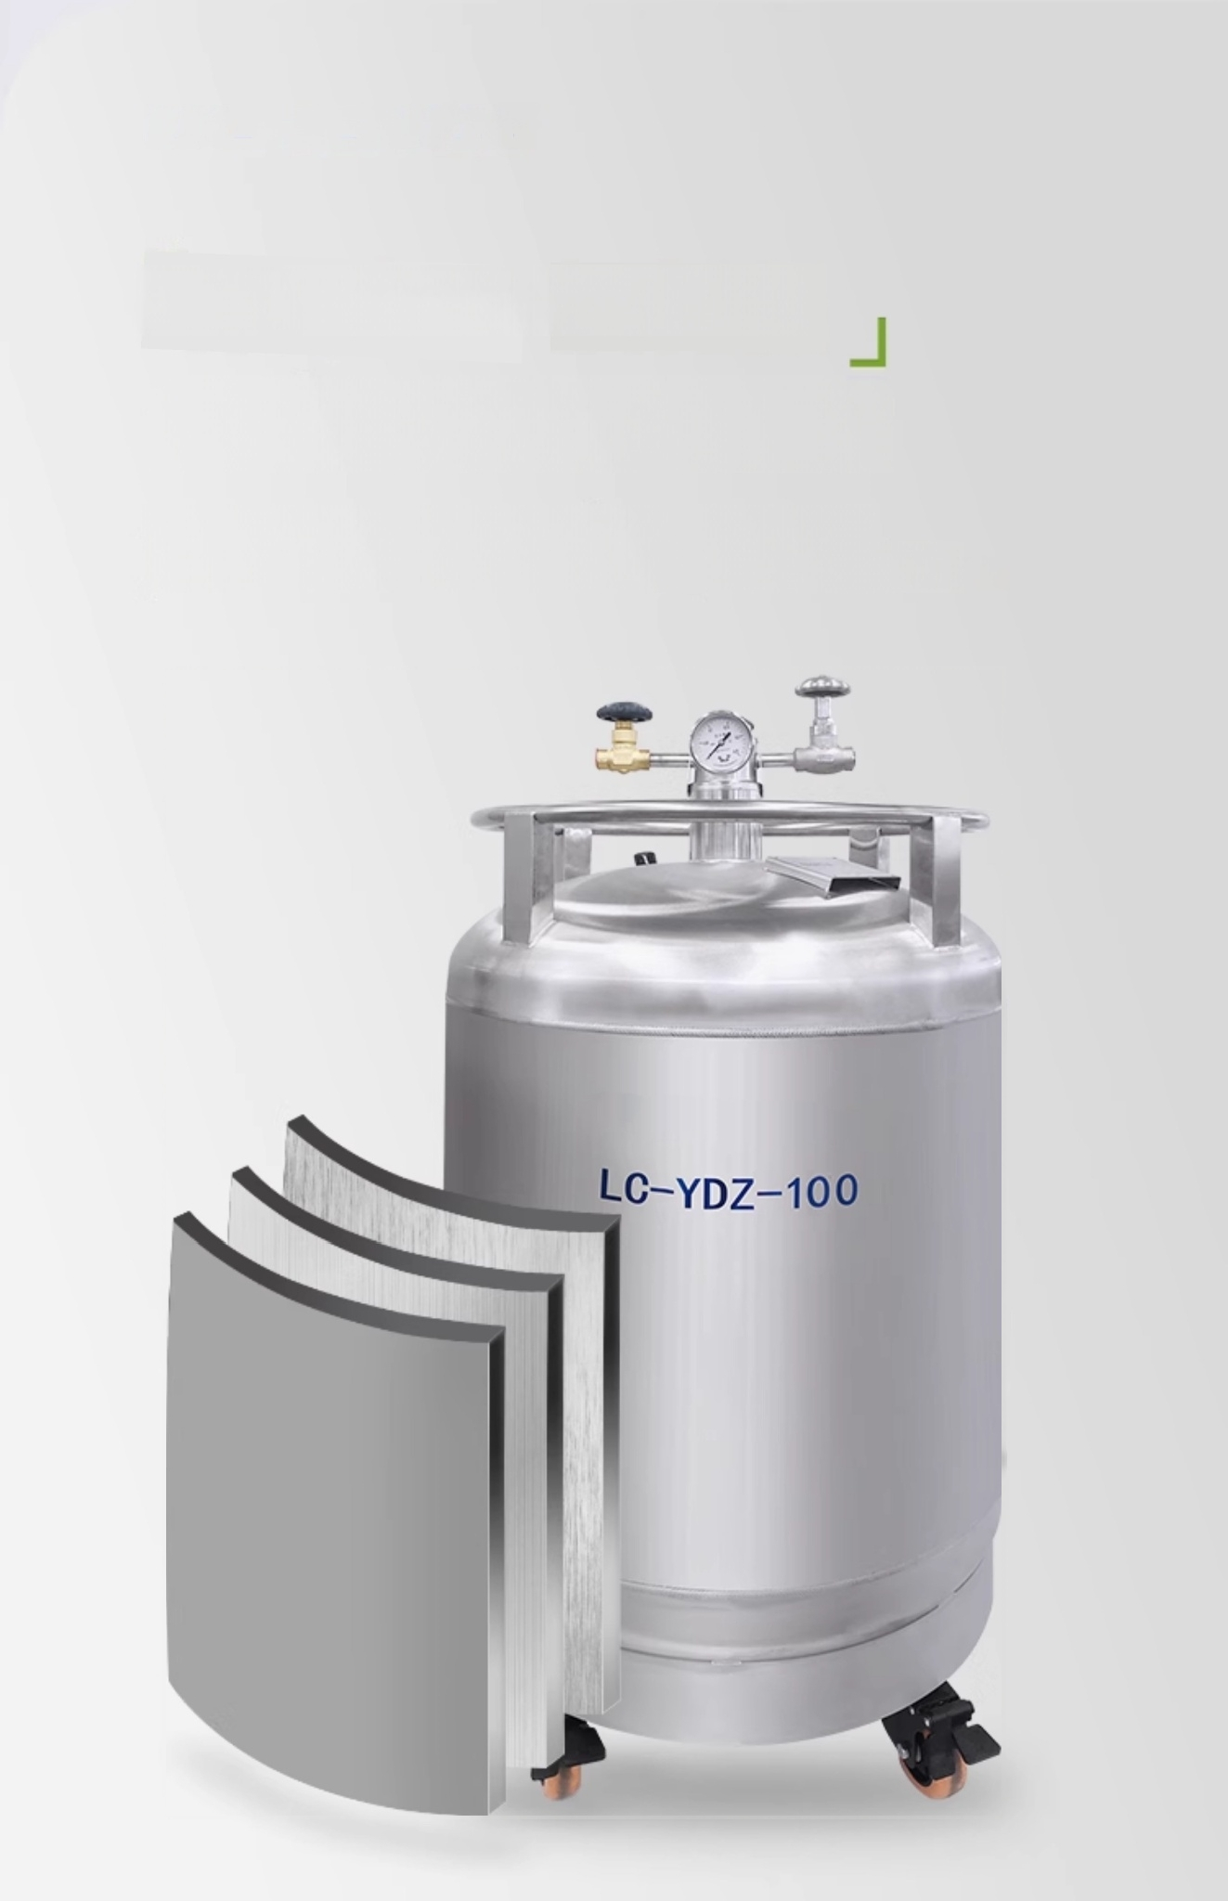
Keeps warm well. Low loss
High-strength stainless steel material
Vacuum insulation and bellows neck for liquid nitrogen
containers minimize evaporation loss,reducing consumption.

Slide 2
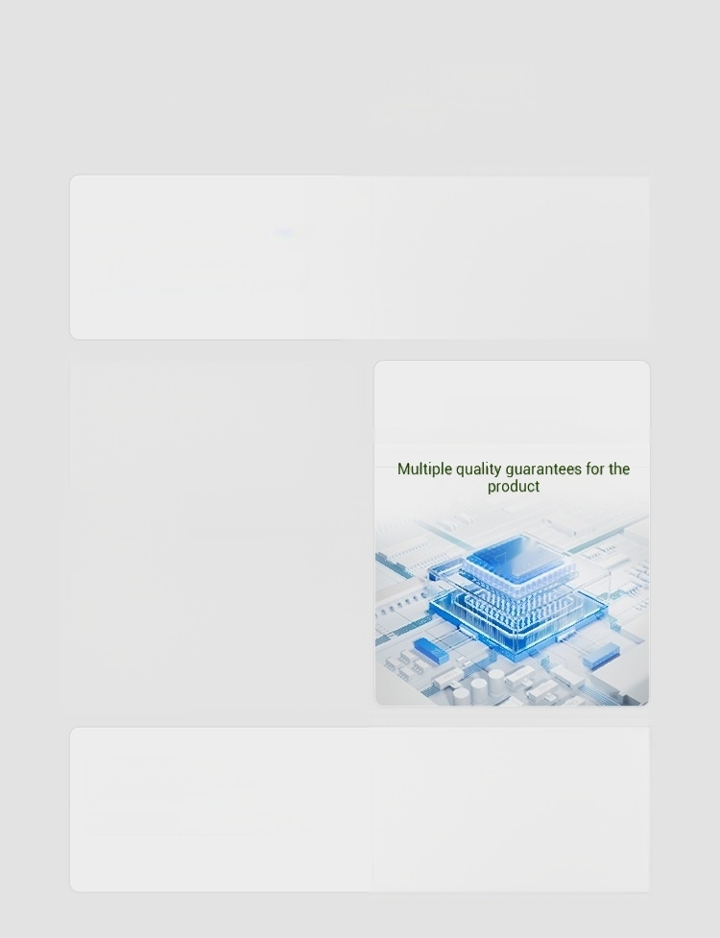
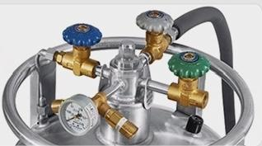
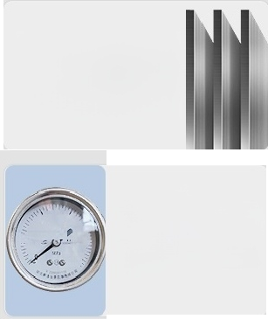

Key Selling Points Overview
Overview of selling points
Double safety automatic control valve structure
Dual safety protection measures
Austenitic stainless
steel
Good vacuum and low
temperature performance
Pressure
stabilization system
device
Ensure stableliquid flow rate
CE certification
National Low Temperature Center test report
0.1
0.15
三0.05
5
0.2
025
Optional signal
interface
Achieve remote signal transmission

Slide 3
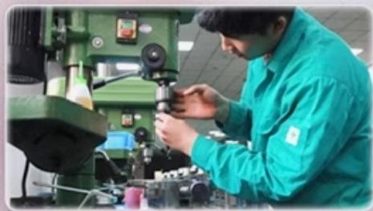
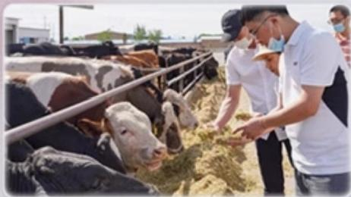
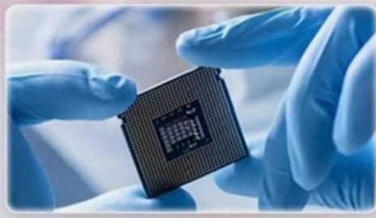

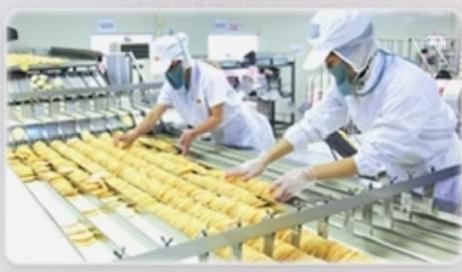
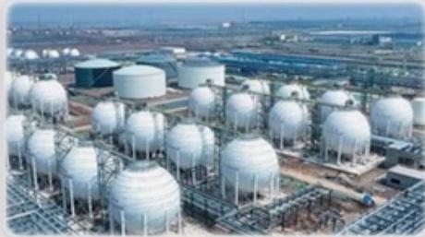
Wide application
Meet various experimental
requirements
Suitable for short-term transportation and storage of liquid nitrogen;also
serves as a cold source for other refrigeration equipment in mold industry,
animal husbandry,sanitation,semiconductors,food,aerospace,military,
and low-temperature chemical industries/fields.
Mold industry
Animal Husbandry
Semiconductor
Aerospace
Food Industry
Low-Temperature Chemical Industry

Slide 4

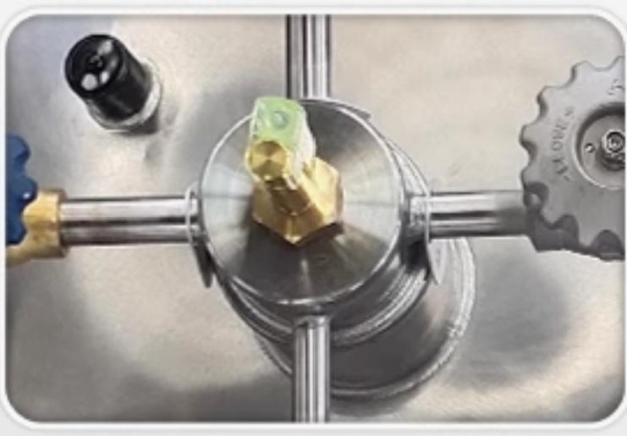
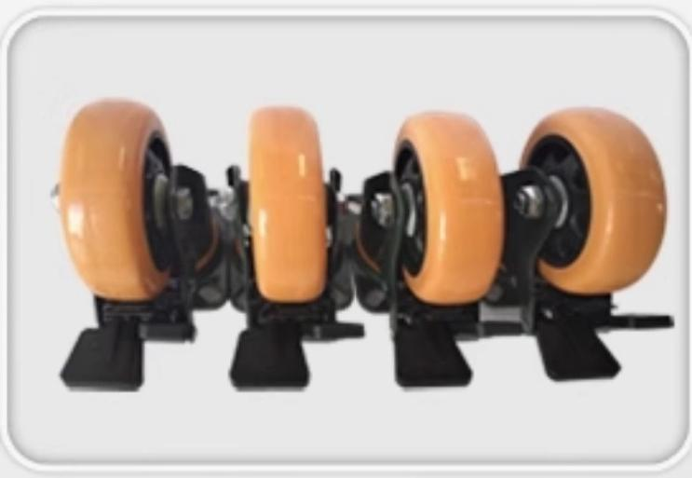
Mechanical liquid level gauge
Easy to observe liquid level
High load capacity moving casters
Quick and convenient movement

Slide 5
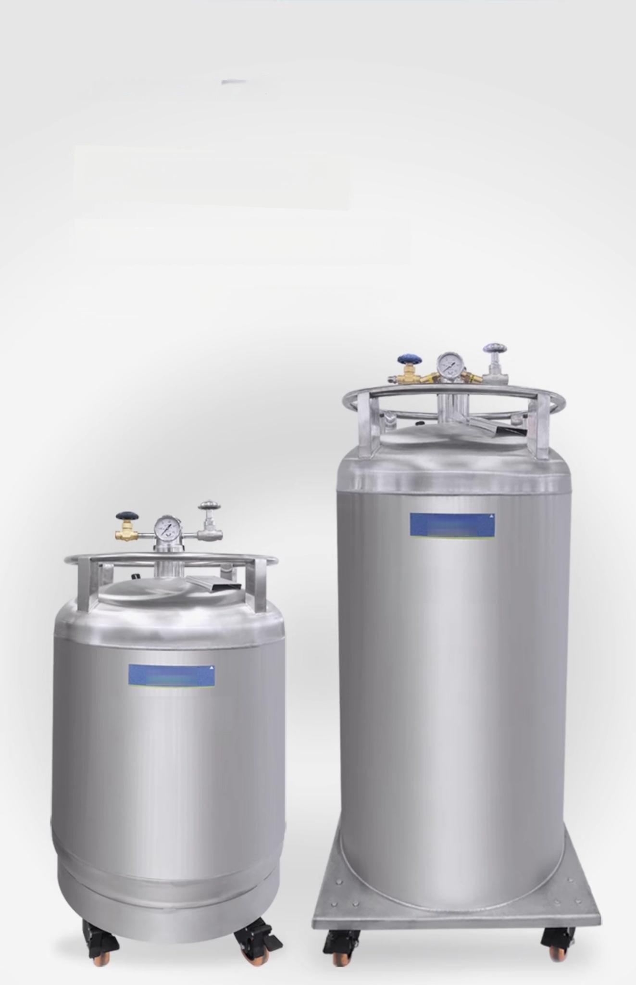
「Humanized design」
Standard mechanical level gauge
Equipped with high-load mobile casters for easy
movement.LC-YDZ-230:2 fixed,2 swivel casters.
LICHEN
LC-YDZ-230
LUCHEN
LC-YDZ-100

Slide 6
Detailed product parameters
Product parameters
Model |  | LC-YDZ-30 | LC-YDZ-50 | LC-YDZ-100 | LC-YDZ-200 | LC-YDZ-230
Effective Volume(L) |  | 30 | 50 | 100 | 200 | 230
Infusion rate L/min) |  | ≥5 | ≥3.3 | ≥4.3 | ≥3.7 | ≥5.7
Outer diameter of the tank (mm) |  | 404 | 455 | 556 | 656 | 656
Standard working pressure (Mpa) |  | 0.05 | 0.05 | 0.05 | 0.05 | 0.05
Maximum working pressure (Mpa) |  | 0.09 | 0.09 | 0.09 | 0.09 | 0.09
Height(mm) |  | 850 | 960 | 1120 | 1280 | 1580
Static liquid nitrogen Daily evaporation rate(%) |  | 3 | 2.2 | 1.2 | 0.8 | 0.6
Static liquid nitrogen Shelf life(d) |  | 33 | 45 | 83 | 125 | 166
Use of the |  | Ambient temperature0～40℃,relative ts humidity s85%RH
h | environment Temperature and umidity requiremen
 |  | 29.5 | 38 | 63 | 96 | 130
Empty weight (KG)
Product size mm (Outer Diameter X Height) |  | φ404*850 | φ455*960 | 中556*1120 | φ656*1280 | 中656*1580

Slide 7
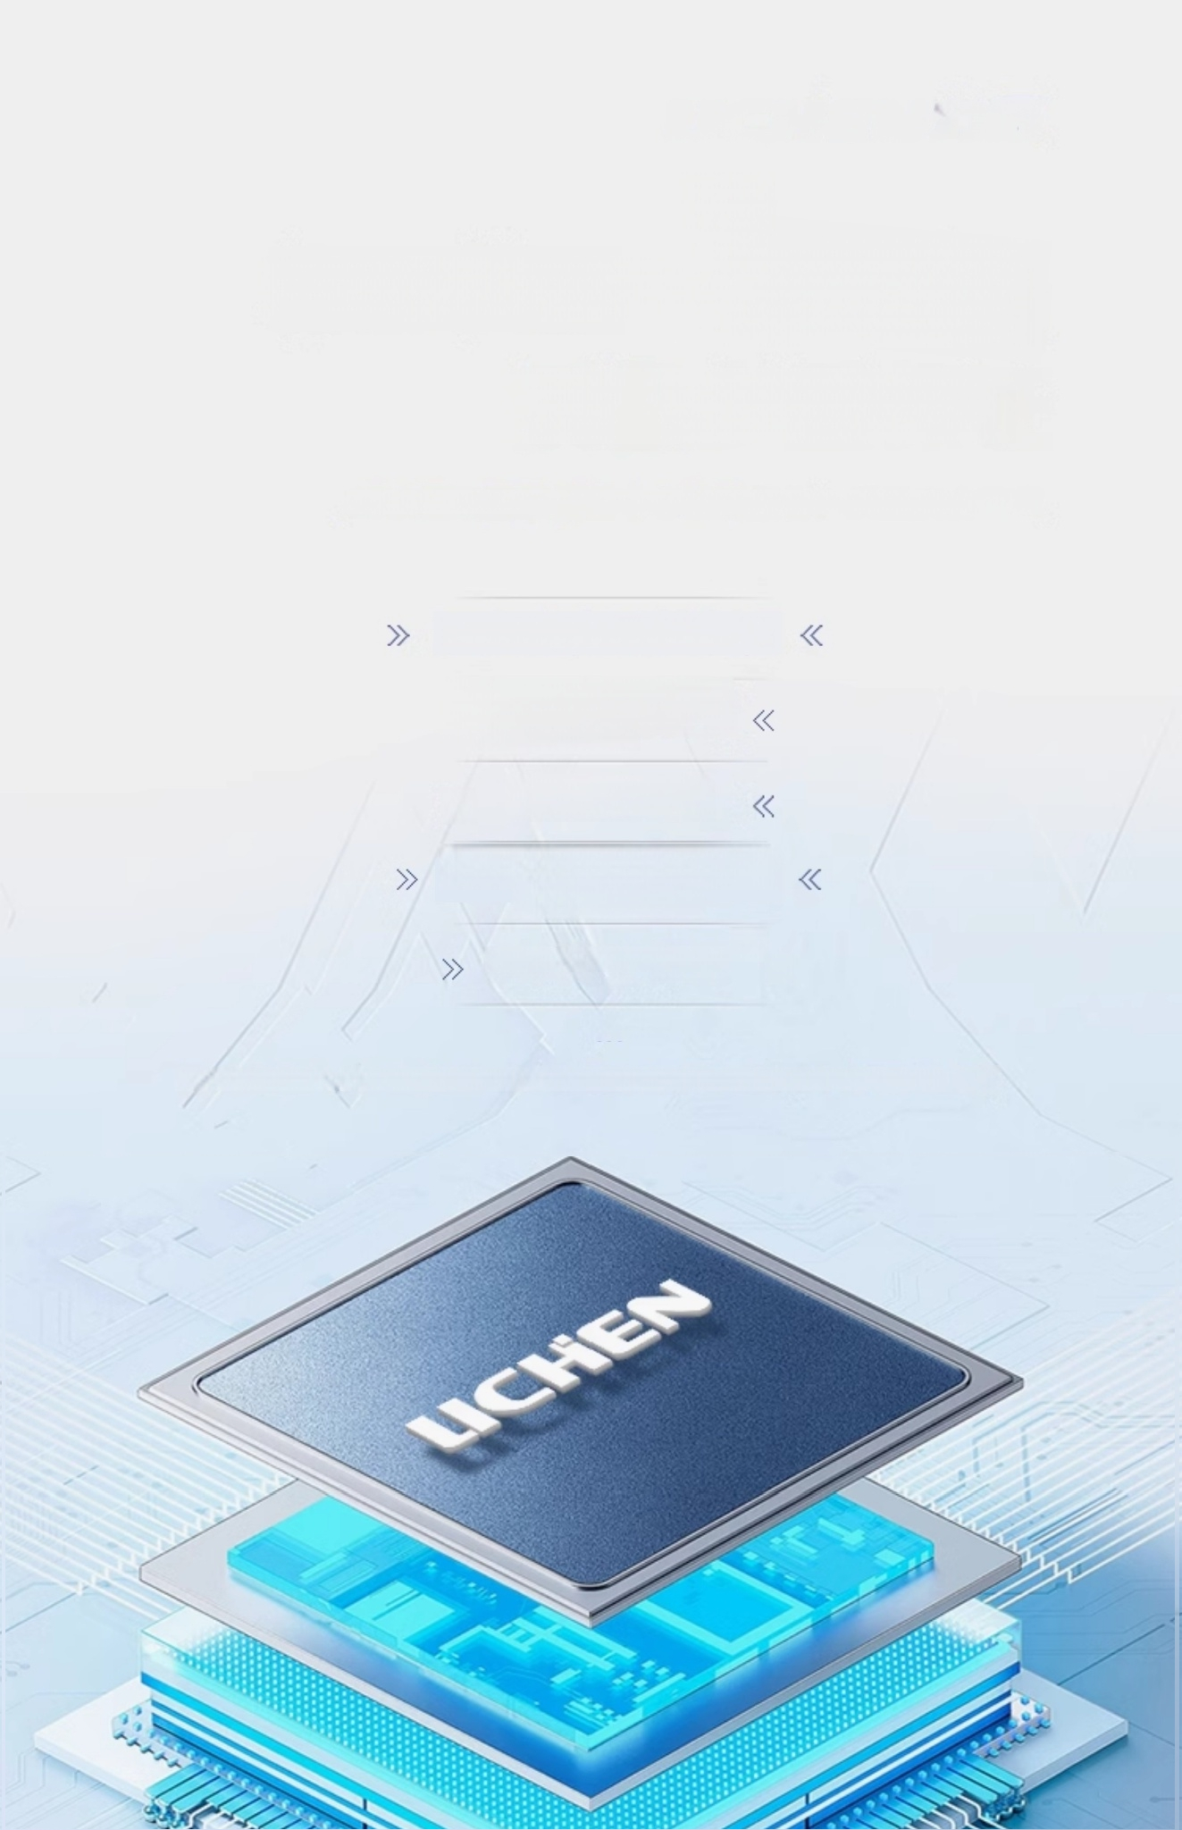
CE
^{Voltage} ^{Stabilizer} Certification
Multiple Quality Guarantees
CE Certification &National Low-Temperature Center Test ReportSafe and Reliable Quality
Dual Safety Automatic Control Valve
>Voltage Stabilization
System Device
》 CE certification
National Low-Temperature
Center Testing
5-Year Vacuum Insulation 《
[1]5-Year Vacuum Insulation Guaranteed;if insulation fails due to non-human factors,free replacement within 5 years
[1]

