Slide 1
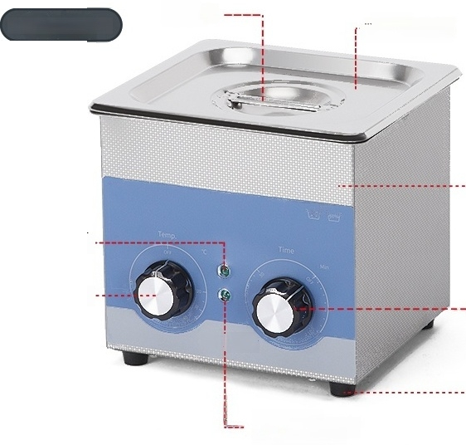
Product Parameters ^{Product} ^{Parameters}
Economical/Mechanical/Digital model,stainless steel body,sink
one-time stamping forming;
Cover
handle Sound
insulation cover
Mechanical model
Stainless
steel housing
Heating indicator
light … …
Temperature
^{Control...} Time Settings
sU_{hn}
-- Rubber Feet
Ultrasonic
indicator light

Slide 2
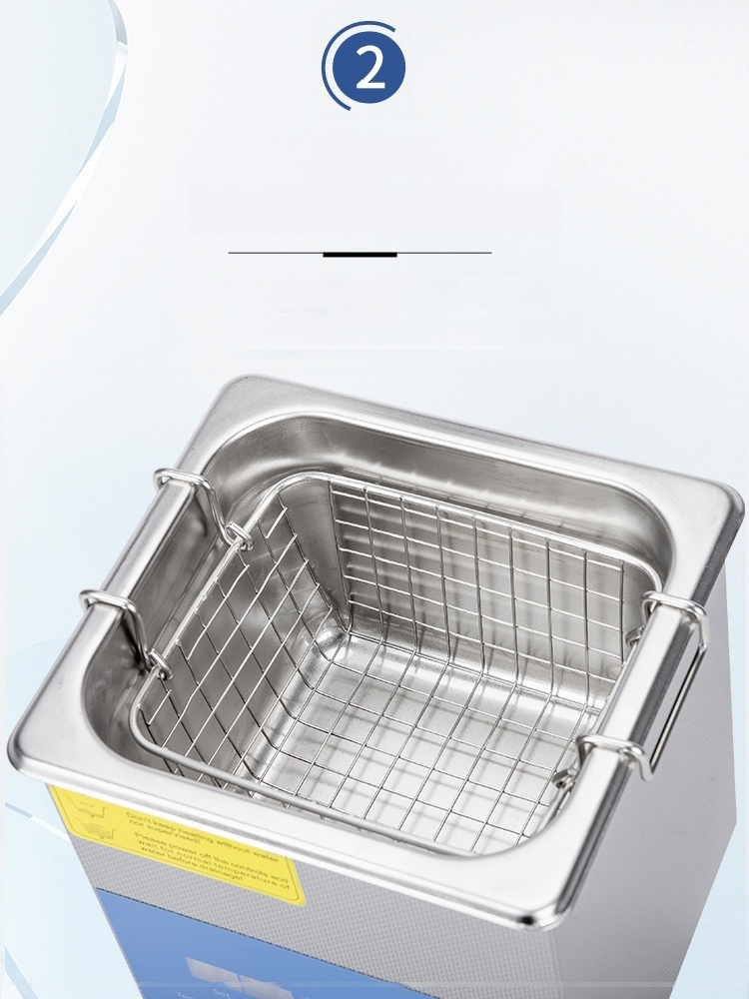
Stainless steel body
Sink formed in one stamping
No welding,leak-proof,corrosion-resistant
Washing basket made of 304 stainless steel

Slide 3
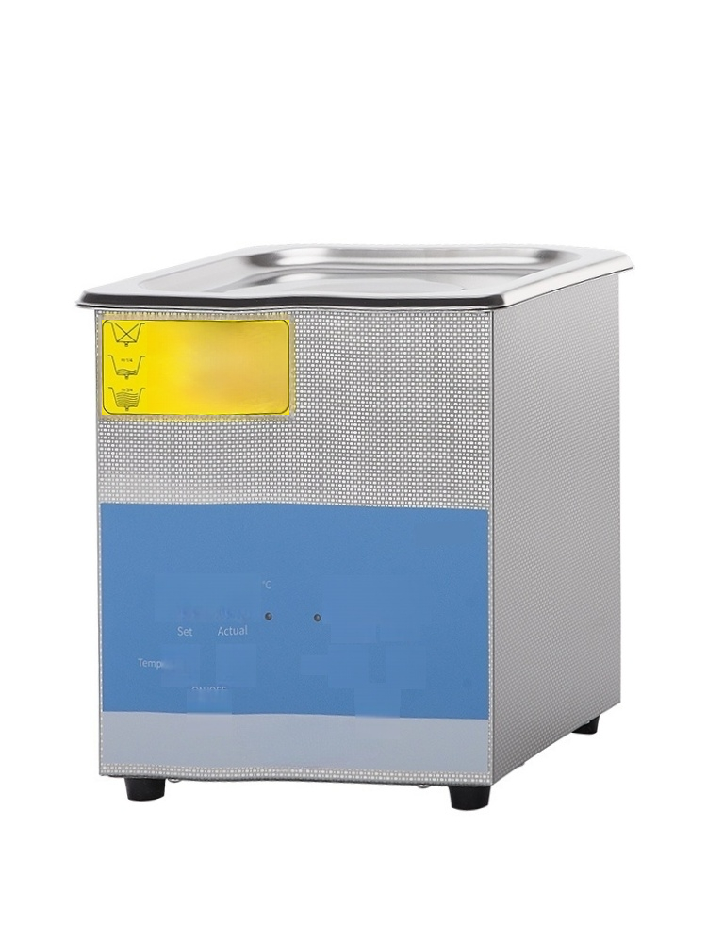







Do not plug power source before filling or emptying tankl
Don't keep heating without water
Please power of the controls and wait for normal temperature of water before drainagel
nor supervised
Minute
Time.
Second
ON/OFF

Slide 4



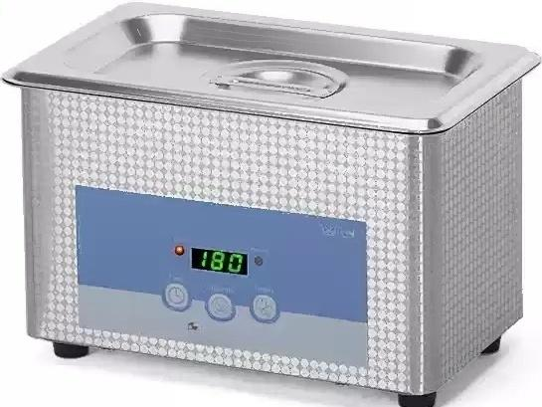
Ultrasonic cleaning machine
SN-QX-08E | No cleaning basket
Display:LED display Power(W):35 | Number of transducers:1
^{Tank} ^{capacity:0.8L} T₍ n _{r} , 1 - _{e} _{t} ₎s
Tank dimensions mm:155×90×65(L×W×H)
i
m
g
ura
i
8
1
80
o
n:
5
s
pe
gme
t
to
tal
eg
With degassing function

Slide 5


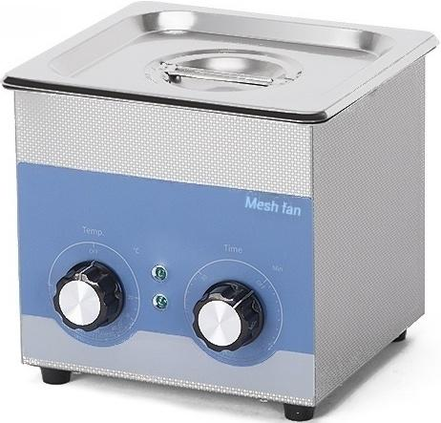
Ultrasonic cleaning machine
SN-QX-13
Display:Knob+indicator light | Power(W):160 ^{Number} ^{of} ^{transducers:1}
Inner tank capacity:1.3L | Timing duration:1-30min
Inner dimensions(mm):150×140×65(L×W×H)
Temperature range:Room temp-80℃
Heating power:100W

Slide 6
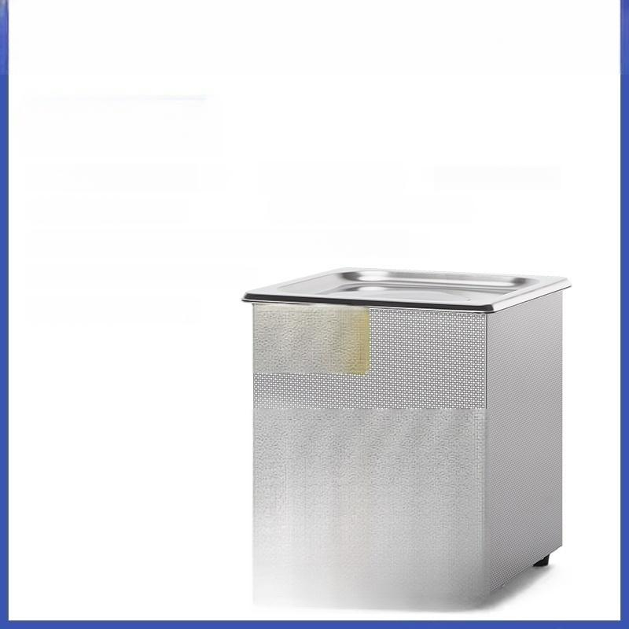



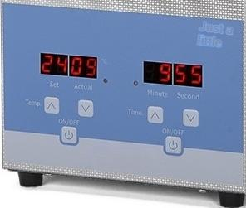
Ultrasonic cleaning machine
SN-QX-13D
Display:LED display Power(W):160 ^{Number} ^{of} ^{transducers:1}
Inner tank capacity:1.3L Timer duration:0-99min
Inner dimensions(mm):150×140×65(L×W×H)
Temperature range:room
Heating power:100W
temp-80℃
h
Tcg0hwg
o
nG
waitetnofmal tm
bn

Slide 7


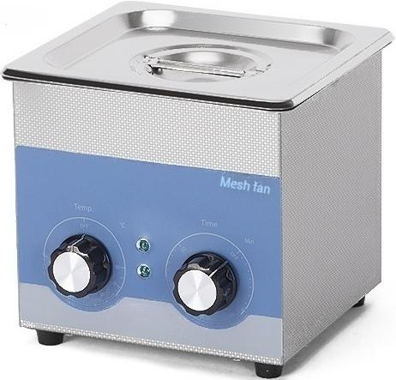
Ultrasonic cleaning machine
SN-QX-20
Display:Knob+indicator light
Inner tank capacity:2L
Power(W):160 ^{Number} ^{of} ^{transducers:1} Timing duration:1-30min
Inner tank dimensions(mm):150×140×100(L×W×H)
Temperature contro range:Room temp-80℃
Heating power:100W

Slide 8
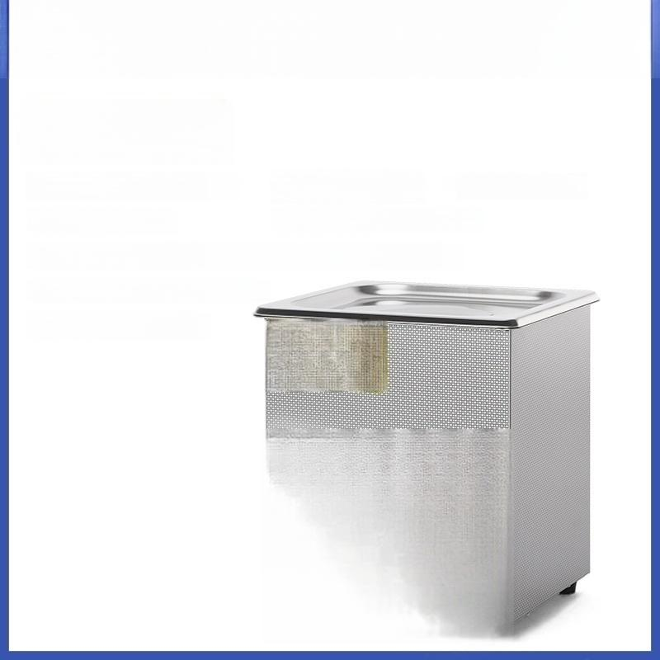




Ultrasonic cleaning machine
SN-QX-20D
Display:LED display Power(W):160 ^{Number} ^{of} ^{transducers:1}
Inner tank capacity:2L Timer duration:0-99min
Inner tank dimensions(mm):150×140×100(L×W×H)
Temperature range:room
Heating power:100W
temp-80℃
^{h} cg0ghgk
Pot sp
aleoma coo
wbn

Slide 9


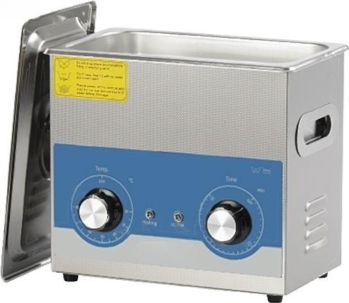
Ultrasonic cleaning machine
SN-QX-32
Display:Knob+Indicator Light Power(W):220 ^{Vibrating} ^{Head} ^{Quantity:2}
Inner Tank Capacity:3.2L Timer Duration:1-30min
Inner Tank Dimensions(mm):240×140×100(L×W×H)
Temperature range:Room temp-80℃
Heating power:100W

Slide 10


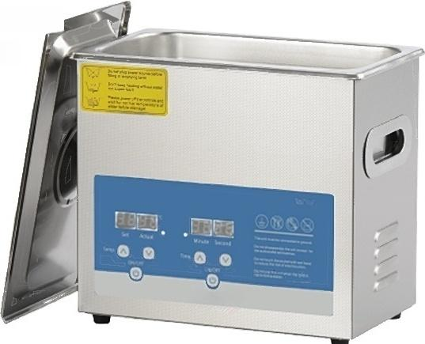
Ultrasonic cleaning machine
SN-QX-32D
Display:LED display | Power(W):220 Vibrating Head Quantity:2
Inner Tank Capacity:3.2L | Timer duration:0-99min
Inner Tank Dimensions(mm):240×140×100(L×W×H)
Temperature range:room temp-80℃
Heating power:100W

Slide 11


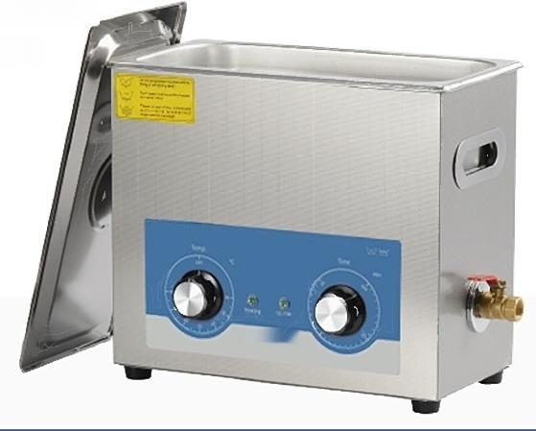
Ultrasonic cleaning machine
SN-QX-65
Display:Knob+indicator Inner tank capacity:6.5L
light
Power(W):480
Number of
heads:3
vibrating
Timing duration:1-30min
Inner tank dimensions(mm):300×155×150(L×W×H)
Temperature range:Room temp-80℃
Heating Power:300W

Slide 12


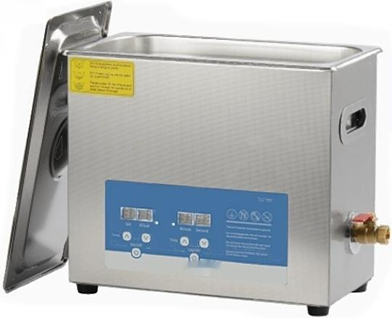
Ultrasonic cleaning machine
SN-QX-65D
Display:LED display Power(W):480 ^{Number} ^{of} ^{vibrating} ^{heads:3}
Inner tank capacity:6.5L Timer duration:0-99min
Inner tank dimensions(mm):300*155*150(L×W×H)
Temperature range:Room temp-
80℃
Heating Power:300W

Slide 13



Ultrasonic cleaning machine
SN-QX-100
Display:Knob+Indicator Light Power(W):540 ^{Number} ^{of} ^{Transducers:4}
Tank Capacity:10L Timing Duration:1-30min
Tank Dimensions(mm):300×240×150(L×W×H)
^{perature} ^{control} ^{range:Room} ^{temp-}
Heating Power:300W
Te
80

Slide 14


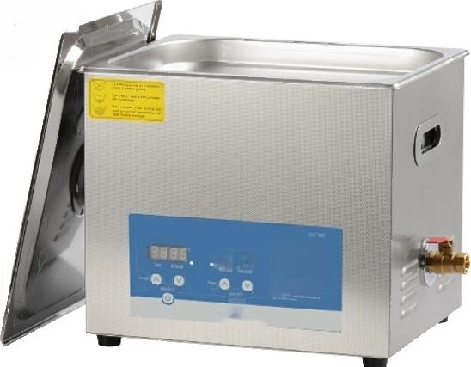
Ultrasonic cleaning machine
SN-QX-100D
Display:LED display | Power(W):540 ^{Number} ^{of} ^{Transducers:4}
Tank Capacity:10L | Timer duration:0-99min
Tank Dimensions(mm):300×240×150(L×W×H)
Temperature range:Normal temp-80℃
Heating Power:300W
9898
四
④8酸8
二

Slide 15


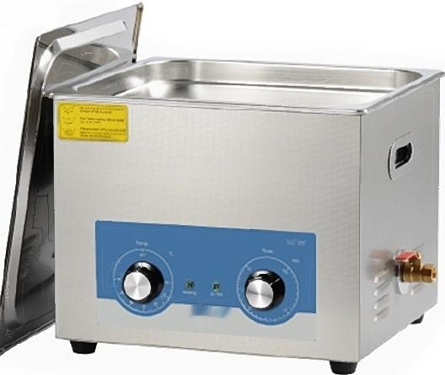
Ultrasonic cleaning machine
SN-QX-150
Display:Knob+indicator light
Inner tank capacity:15L
Power(W):760
Number of
heads:6
vibrating
Timing duration:1-30min
Inner tank dimensions(mm):330*300*150(L×W×H)
Temperature range:room temp-80℃
Heating Power:400W

Slide 16


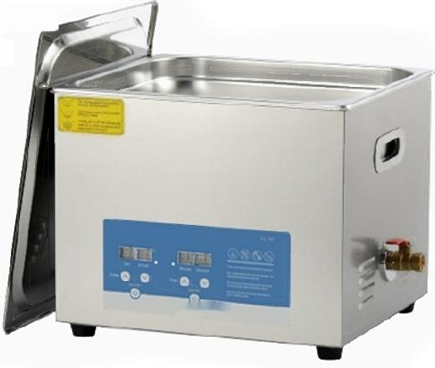
Ultrasonic cleaning machine
SN-QX-150D
Display:LED display Power(W):760 ^{Number} ^{of} ^{vibrating} ^{heads:6}
Inner tank capacity:15L Timer duration:0-99min
Inner tank dimensions(mm):330*300*150(L×W×H)
Temperature range:room temp-80℃
Heating Power:400W

Slide 17


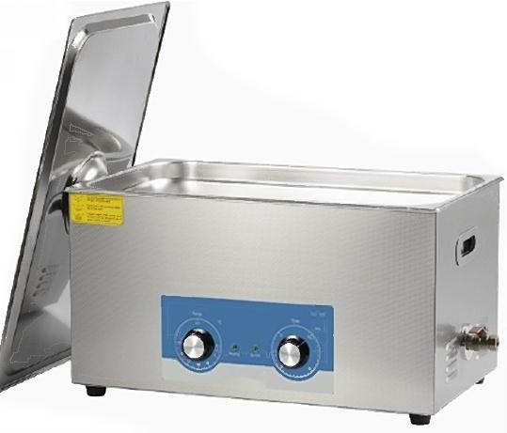
Ultrasonic cleaning machine
SN-QX-220
Display:Knob+indicator
Tank capacity:22L
light
Power(W):980 Number of transducers:8 Timing duration:1-30min
Tank dimensions(mm):500×300×150(L×W×H)
Temperature range:room temp-
Heating Power:500W
80℃

Slide 18


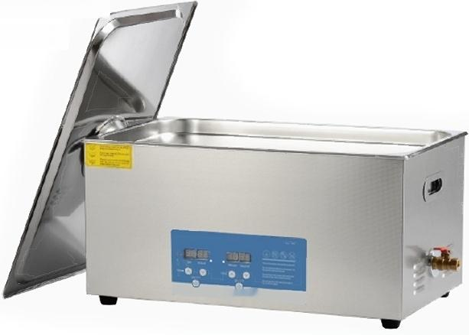
Ultrasonic cleaning machine
SN-QX-220D
Display:LED display Power(W):980 ^{Number} ^{of} ^{transducers:8}
Tank capacity:22L Timer duration:0-99min
Tank dimensions(mm):500×300×150(L×W×H)
^{perature} ^{control} ^{range:Room} ^{temp-}
Heating Power:500W
Te
80

Slide 19


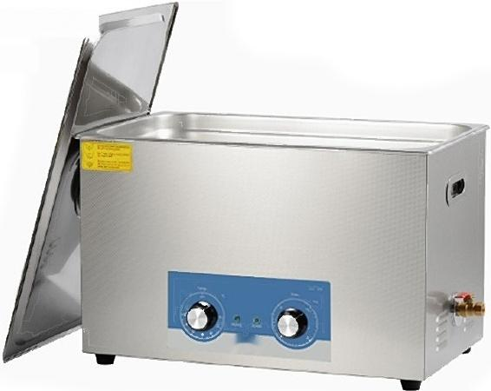
Ultrasonic cleaning machine
SN-QX-300
Display:Knob+Indicator Light Power(W):1100 ^{Number} ^{of} ^{Transducers:10}
Tank Capacity:30L Timer Duration:1-30min
Tank Dimensions(mm):500×300×200(L×W×H)
Temperature range:room temp-80℃
Heating Power:500W

Slide 20


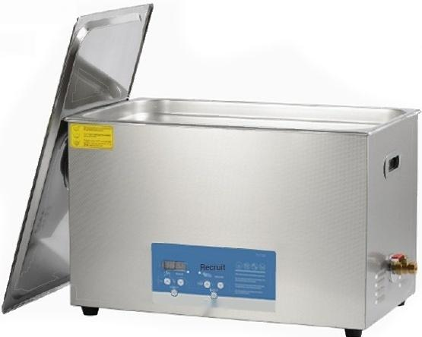
Ultrasonic cleaning machine
SN-QX-300D
Display:LED display Power(W):1100 ^{Number} ^{of} ^{transducers:10}
Tank capacity:30L Timing duration:0-99min
Tank dimensions(mm):500×300×200(L×W×H)
Temperature range:Normal-80℃
Heating Power:500W

