Slide 1
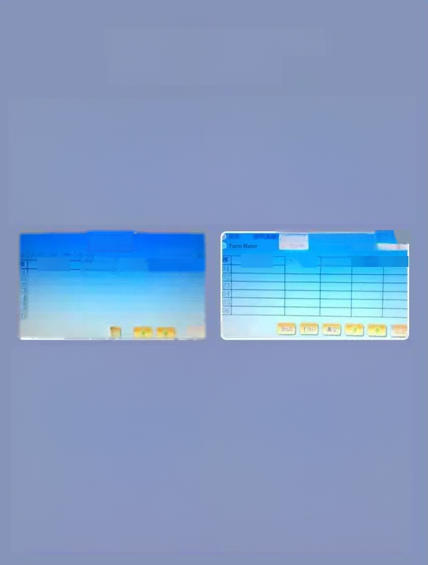

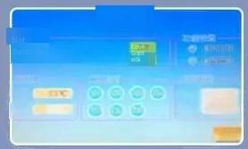
Touch screen operation is simple and intuitive
Automatic moisture
meter
Timey Beonds
Settings
0.002 lg
ouput
EK time 610213
0℃
 |  | Reco Se Nmboak | rd | WpScore
是
1C
tgate
Me
Test:Go to the test screen
Record:Read the previously stored data
Settings:
1.System test:manually test the function of the instrument.
2.Electronic balance:calibration balance and manual zero
3.Thermocouple:Display thermocouple to measure temperature and correct furmace temperature
4.Function setting:automatic printing(accordingto user needsto choose whether to print automaticaly,whetherto automatically number by date).
5.Time calibration:Modify the date and time
description
Function introduction and

Slide 2
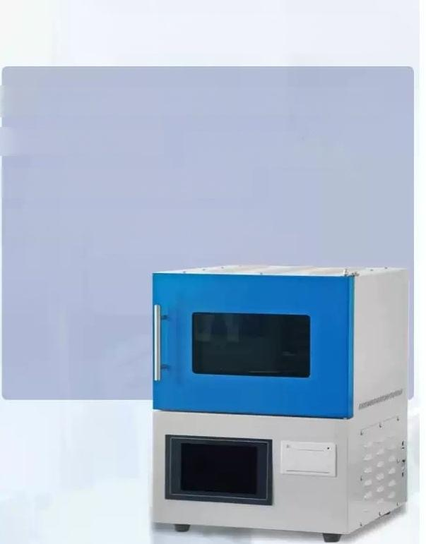
Main technical parameters
Power supply:220V,50Hz rated input power:2800w
Number of samples:1-9 ^{Single} ^{sample} ^{weight:}
9-11g(analytical water is 0.9-1.1g)
Weighing resolution:0.0001g
Sample size:not more than 6mm
(No more than 0.2mm for analysis water)

Slide 3
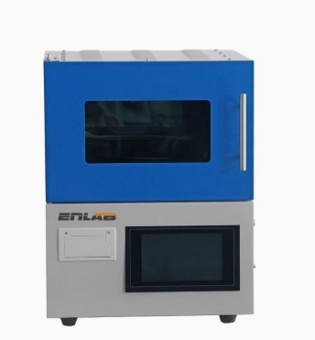

Slide 4
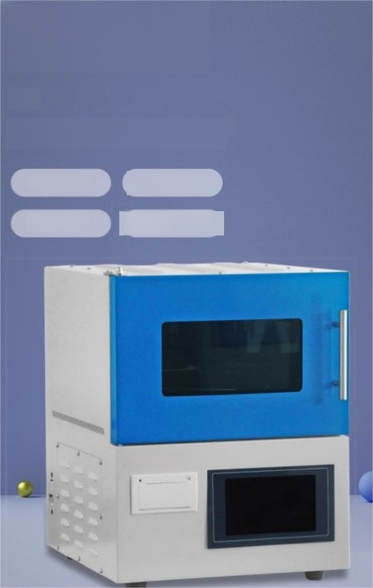
Microcomputer
moisture tester
一
Mainly used for coal,meat,wood and other total moisture(and analytical water)determination
Multiple functions
High accuracy
Fast determination speed
Easy to operate and good perfomance

Slide 5






Performance characteristics
Many test samples
Fast speed
Test accurately
Easy to operate
Long lasting
Save time and effort

Slide 6
Working principle
Measurement principle
Weighacertain amountof samples with particle size lesthan 6mm,placed in thefumace body of the moisture meter,and the moisture quickly evaporates after high temperature.The mosture contentis calculated according to the weightloss of the sample afterdrying.
Drying Principle
Use4high-efficiencyenergy-savingcarbon heatingtubesin thefurmacecavity, quickly rise to theset temperature,the samplein thefurnaceturntable rotatesata constantspeed,so that each sample is heated evenly,driven byhigh temperature watervaporization evaporation,so that the sampledry.

Slide 7
Test operation
process and
description
1.Turn on the power switch of the moisture meter and click the ELB-CM100 icon on the desktop of the
computer to enter
2.Full water:Select the experiment projectfull water,
heating time 20 minutes,heating temperature 145
degrees,constant weight test on(recommended:constant weight accuracy0.0050,constant weight time5minutes)
3).Analyze water:Select the experimental item to analyze water,heating time 20 minutes,heating temperature 145 degrees,constant weight test off(i.e.remove√).

Slide 8


Main parameter
Power supply:220V,50Hz.
Rated input power:2800W.
Number of samples:1-9.
Single sample weight:9-11g(0.9-1.1g for analytical water).
Weighing resolution:0.0001g.
Sample size:not more than 6mm(analytical water is not more than 0.2mm).

Slide 9
Packing list 测量仪器
sequence number | Aoocming nTe | Single position | Quantity | note
1 | Moisture meter
2 | Hydration cup | one | 9 alumi | hum
3 | Turntable | one
4 | Quart weighing rods | The root |  | Fragile
5 Mettlerelectronic Balance |  |  | 1
6 | Weighing pallet | a | one
7 | Center pivot | one
8 | Printer paper
9 | Stainless steelplate | block
10 | Safety tube | the | 2
11 | Heating tubes | the
wdwe | nstruction manual
13 | Certifcate of Conlormity

