Slide 1
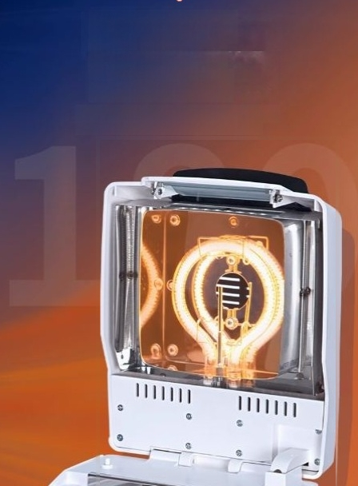
High efficiency
halogen lamp
heating 180°C
Heatingtemperature,can quckly andevenlydry
tems,meet thevast majority of sample tests

Slide 2
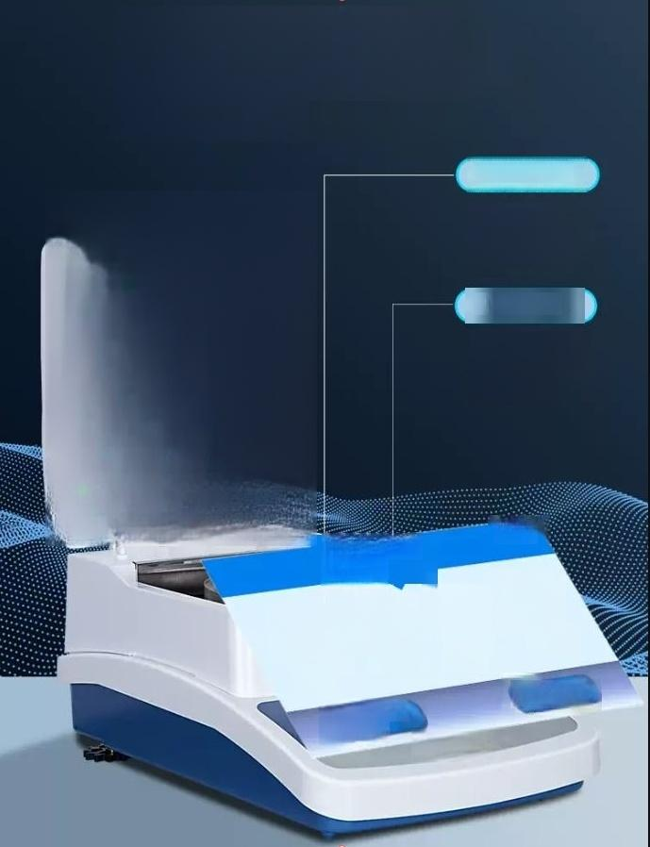
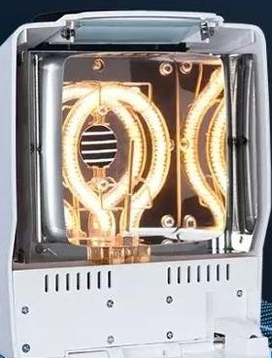





High efficiency halogen
lamp heating two modes
are available
Automatic drying
Automatic stop
operation when the weight loss perunit timeis less than 1mg
Timed drying
Preset drying time
Measures moisture loss within a
specified time
15:51
Combined
Home
current Timed dying record
Database
Calibrate
Automatic
drying
Power off

Slide 3
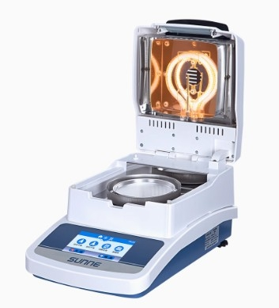

Slide 4

Six major upgrade
technology innovation
highlights first look
Touch display
new color TFT
Hom
Data storage
Upto 18sets of storage
数据库
High eficiency halogen lamp heating180°C
Linear calibration
20g/50gdouble weight
calibration
Two drying modes Auto
drying/timed drying
0
RS232 interface
Connecingpinter

Slide 5

Product parameter
Meet different needs
Model number | SN-SH-10A SN-DHS-16 SN-DHS-16A SN-DHS-20A
Input power/frequency | AC220V/50hz
power | 480 w
Maximum weighing | 50g | 110g | 110g | 110g
Weighing shows acuracy | 0.005g | 0.005g | 0.002g | 0.001g
Mcsture contentmeasurement range | 0-100%
Moisture determination accuracy | ±0.5%(23g)
Moisture display accuracy | 0.02% | 0.02% | 0.01% | 0.01%
Moisture determination repeatabiity er | rpr 0.2% | 0.2% | 0.1% | 0.1%
Temperature range | 60℃-200℃(180-200℃ Continuous use time recommended for s5min)
Temperature display accuray | 1℃
Temperature sensortype | PT1000
Heating method | Ring halogen lamp | Hgh efficiency halogen lamp
End point control | Timed,automatic
Time selection range | 0to 99min(adjusted in 1min)
Weighing pan diameter |  | 90mm and dry weight content%,ATRO dry weight,ATRO wetweight,etc have
Display content | Nine ways:Moisture /
RS232 interface
Net weight | 4.5kg
Product size | 375×220×180mm

Slide 6
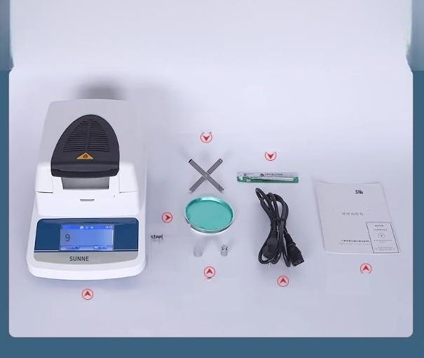
Packinglist
Sky flat shelves
Tweezers
Stainless
Sample tray
(2)
Weights
(20℃,50℃)
Certificate of Specification
Power cord
Moisture meter host

Slide 7
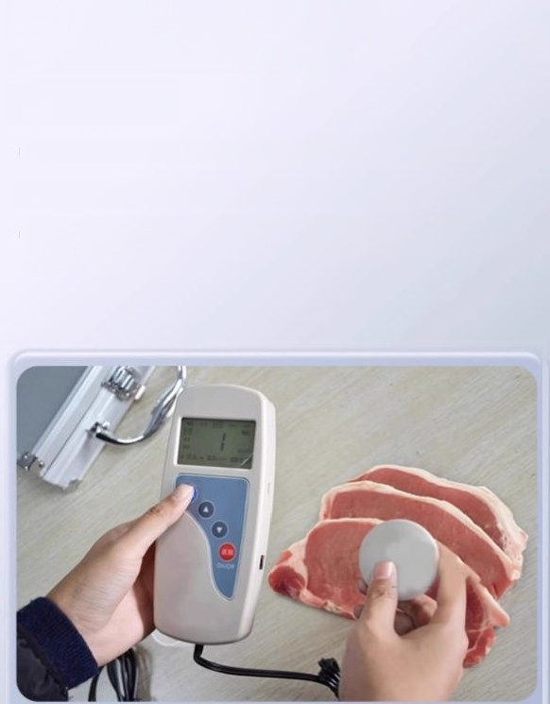
Automatic alarm/automatic calculation and automatic
data storage
1/
Can detect fresh meat such as pig,cow,sheep and chicken with water limit standard
I The instrument can store 5000 sets of data and query each test data
With automatic alarm function,the instrument wil make an alarm sound when the detection exceeds the standard and the measurement error is too large(more than 2%)

Slide 8

Easy to operate
and fast to
measure
The sensor of the instrument adopts needle electrode,which willnot affect the tissue structure,appearance and physical,chemical and biological properties of the
sample,and the measurement process will not damage the sample
The intelligent instrument can automatically calculate and set the reference value, automatically judge the result,measure the error exceeding the standard,low power alarm and so on

Slide 9

Packing list
Seria number | Name | Quantity
1 | Main machine (including detection probe,probe protective cover, rechargeable lithium) | a set of
2 | Chargers | one
3 | Data cable | One
4 | Meat moisture meter data processingsystem(optional | -One
5 | Instructions | copy
6 | A certificate/warranty card | A copy

Slide 10
Product mocel | SN-MMT-1 | SN-MMT-1P
Measuring range | 65-85% | 65-85%
Sampling time | Once sampling time<Is | One sample time<1s
Sampling times | Output a measurement result every 10 sample ora single sample direct measurement | Outputa measurement result every 10samples ora singlesampledirert me3surement
MerurenentEmor | s1.0%in the 70-78%range | s1.0%in the70-78%range
Repeatablty error | s0.5%in the 70-78%range | s0.5%in the 70-78%range
The source | Ac/DC(with rechargeable lithium) | Duspuposewiharechagbleithium baney
 | About45mW | About 45mW
shmant Fernce | 1 6 7 × 7 0 × 3 0 mm | 1 6 7 × 7 0 × 3 0 mm
Manengnewaigh | 200g | 200g
show | Blue backlitLCD(allChinese display) | Blue backlit LCD(all Chinese display)
Audible and visual alarm | Theinstumentatmicalyenitso.dndigt a | When the test data exeeds thejudgment standard Theinshumentauomricllyenitn audibleandwsualalamm
standard Setting | The judging standard ofeachvariety can be set | Each breed can be set to judge the standard
ambient humidity Ambient | 20-90%h | 20-9096 RH
temperature | 040*℃ | 0~40℃
Data storage | Theinstrument can store 6000 sets of data | The instrumentcan store 6000 sets of data
DataQuery | The instrument can quey each stored data | The instrument can query each stored data and the instrumentcan transfer the
Compuberocnnecicn | Theinstumentcntmserseddtthecnmpu | saved data to the computer
Aluminum Cre | / | 1
Adapterinput | 220vAC | 220vAC
Adapter output | DC9V.250MA | DC9V.250MA

