Slide 1
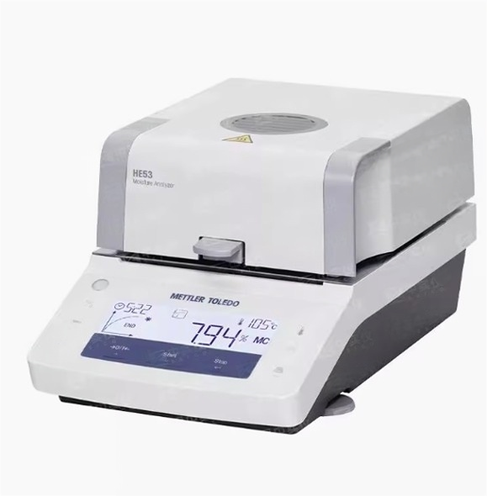

Slide 2
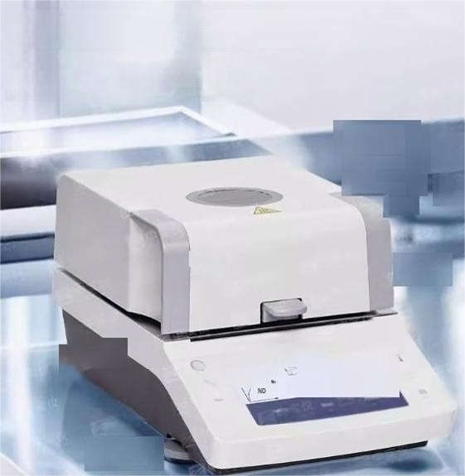
Uniform heating and accurate weighing
Halogen lamp with stainless steel heating bin
heating faster and more uniform,heating
temperature 50-160℃

Slide 3

High brightness display
Multi-data one-screen display
Information and results can be easily read in various light conditions

Slide 4
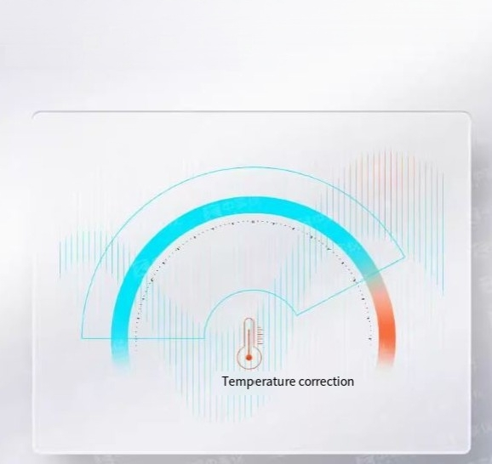
Temperature correction function
Temperature correction at 100°C/160°C

Slide 5
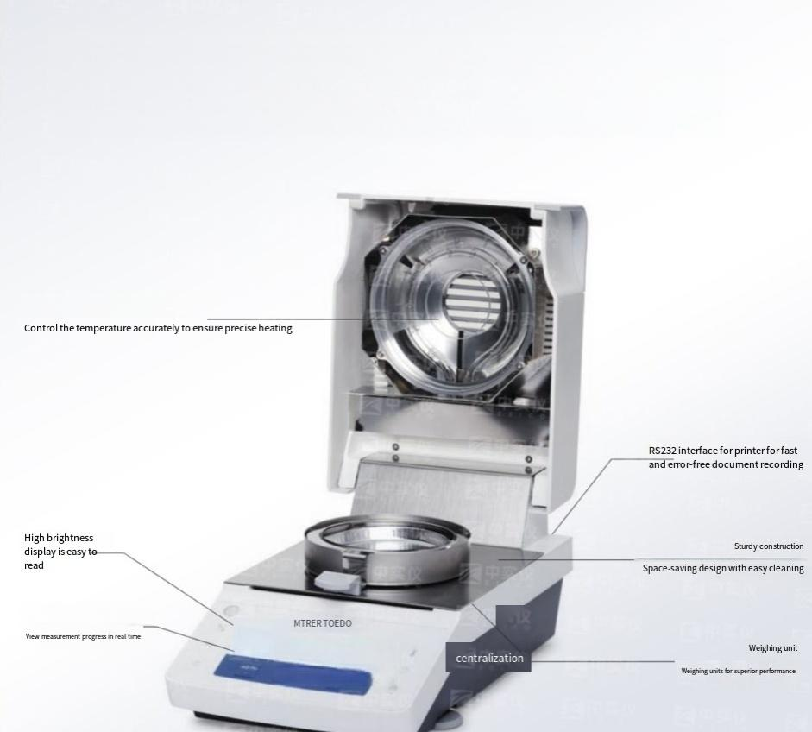
Product parameters.
Halogen lamp heating
Progress display area

Slide 6
Moisture tester
Repeatabiity 2g sample,0.15%
 | 0.05%for 10gsamples
Heatingprogram Readability | Standard,quick
 | 1mg,0.01%MC
Method storage
Storing Results
Suggestion %MC | 1.0--100%MC
Result processing | Progress display area
Shutdown criteria | 1Automatic,timed(1-120 minutes)
Heat up temperature | 50-160°C(1°C increments)
Test and correction | Temperaturecorrection at 100c/160C
 | 50g externalcheckweight
Display mode | %MC,%DC,%AM,%AD,g
port | RS232
range | 54g
Display screen | Backlit LCD display
Diameter(WxDXH) | 183×334x161 mm(341mm cover open)
1
1

Slide 7

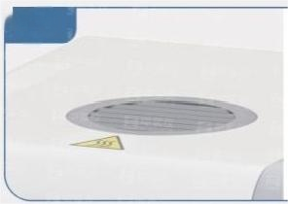
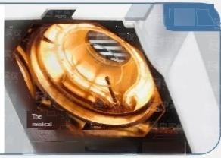
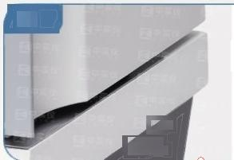
Show the details.
To do agood job,you must first sharpen your tools
Top heat sink
Topholefor
efficient and fast
heat dissipation
Halogen drying Heatfasterand more evenly with astainless steel heating bin
 | Gaden shyi
 | Sturdy shell Metal housing with stainless steel surface for easy cleaning

Slide 8
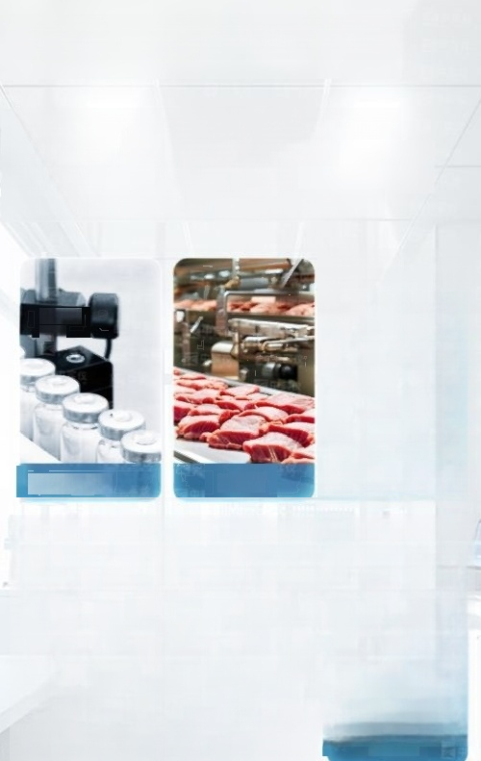




A wide range of applications.
Basic moisture tester series products can be widely used in pharmaceutical,food,
beverage,agriculture,chemical,
environmental protection and other fields
pharmacy Food
Eco-fiendy

