Slide 1

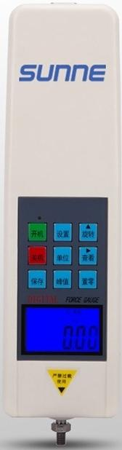

Digital display for easy reading.
High precision and high resolution.
Equipped with backlight function.
Two Measurement Modes
Peak Hold Function

Slide 2
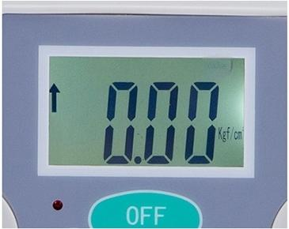
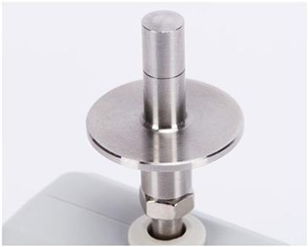
Exquisite Craftsmanship Fashionable and Aesthetic
NO.1
Digital Screen
Clear,readable display on a
More Convenient to Use
sleek large screen.
NO.2
Test bar
Large/Small Presser Foot
Scale line

Slide 3
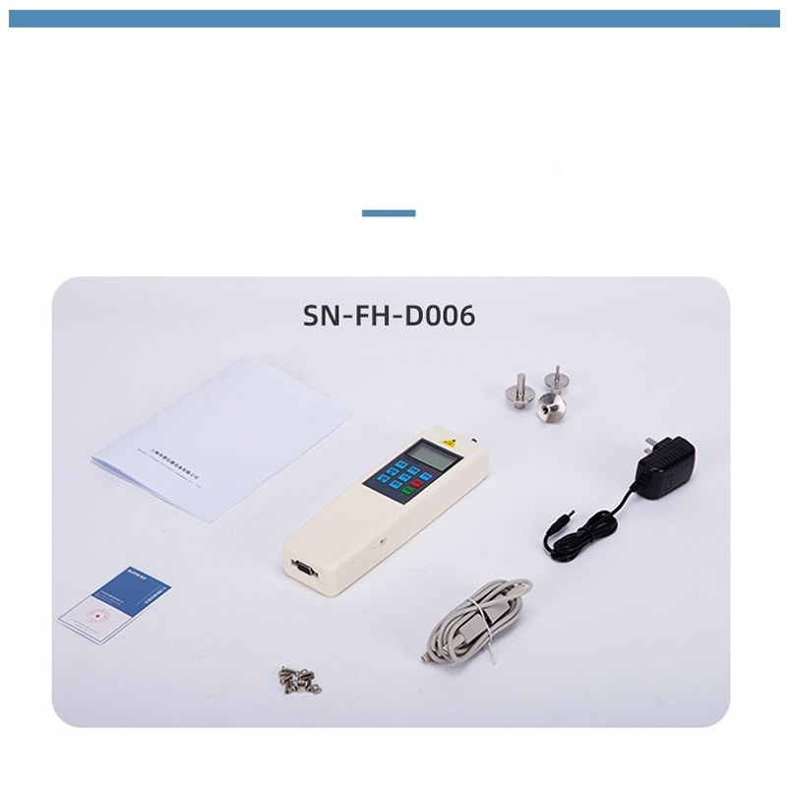
FRUIT HARDNESS TESTER
Product Packing List

Slide 4


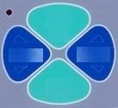
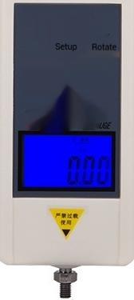
0FF
ON
UNIT ZERO
SET

Slide 5

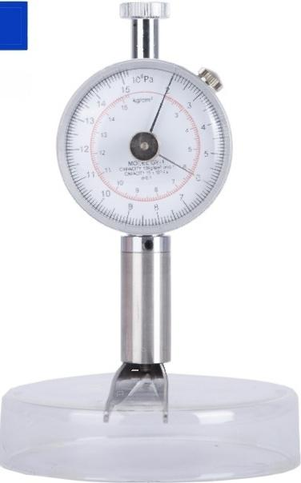
SN-FH001
Scale Reading:2-15KG/CM²(×10⁵Pa) Probe Size:φ3.5MM
Accuracy:±0.1
Dimensions:140×60×30mm
Weight:0.3KG
Fruit Hardness Tester

Slide 6
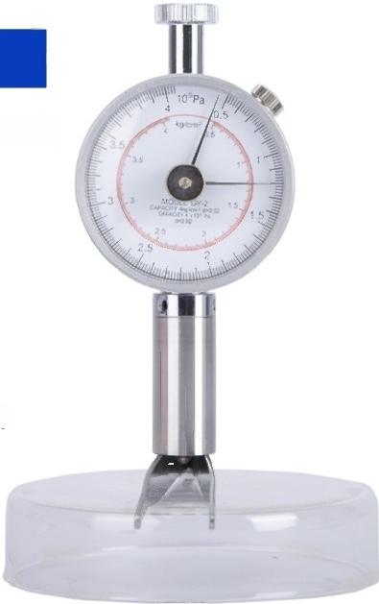

SN-FH002
Scale Reading:0.5-4KG/CM²(×10⁵Pa) Probe Size:φ3.5MM
Precision:±0.02
Dimensions:140×60×30mm
Weight:0.3KG
Fruit Hardness Tester

Slide 7
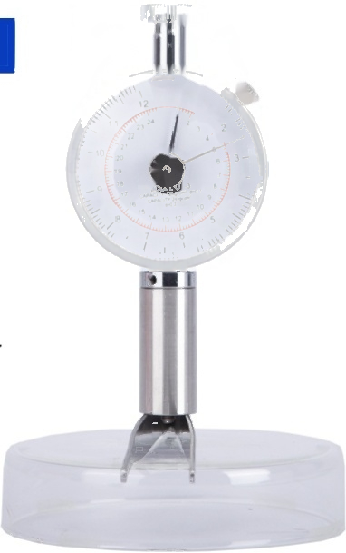

SN-FH003
Scale Reading:0.5-12 KG/CM²
Probe size:φ11mm
1
Accuracy:±0.1
Dimensions:140×60×30mm
Weight:0.3KG
M
4
Fruit Hardness Tester

Slide 8
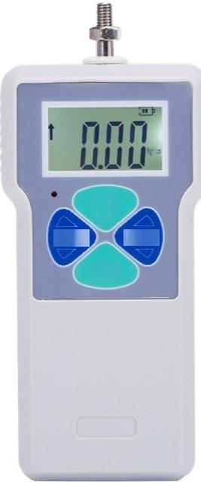

OFF
ON
UNIT ZERO
SET
SN-FH-D004
Range:0.2~15 KGF/CM²(×105 Pa) Probe size:φ11.1mm
Accuracy:±1%
Dimensions:160mm×71mm×35mm
Weight:260g
Fruit Hardness Tester

Slide 9
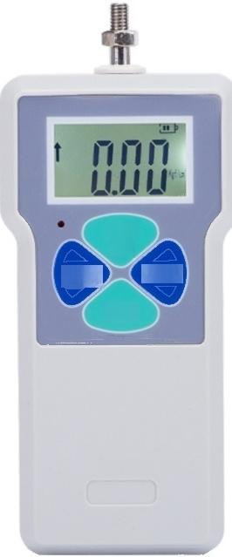

0FF
ON
UNIT ^{ZERO}
SET
SN-FH-D005
Range:0.4～30 KGF/CM²(×10⁵Pa) Probe size:φ7.9mm
Accuracy:±1%
Dimensions:160mm×71mm×35mm Weight:260g
Fruit Hardness Tester

Slide 10
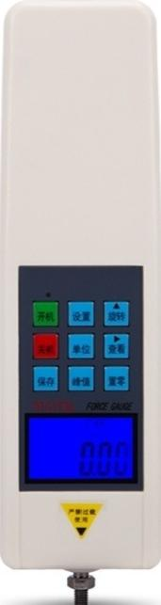

SN-FH-D006
Resolution:0.01 Kg/cm²
Accuracy:+0.5%
Precision:±1%
Dimensions:245x66x37mm
Weight:590g
Fruit Hardness Tester

