Slide 1
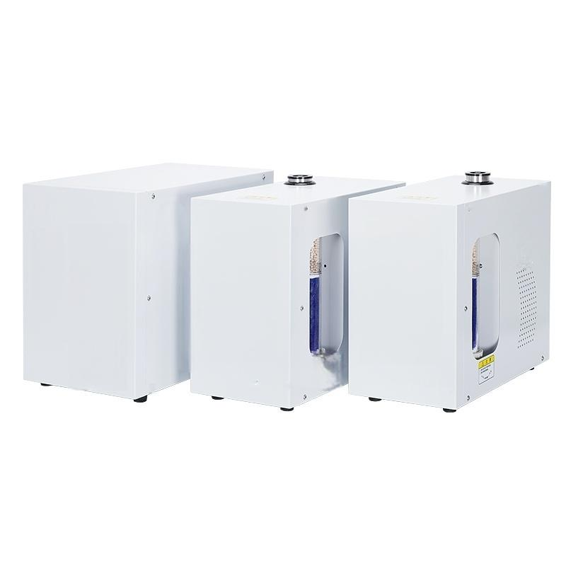


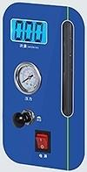
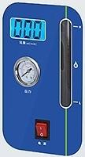

8
a1
rrr
8
tff
3
心

Slide 2
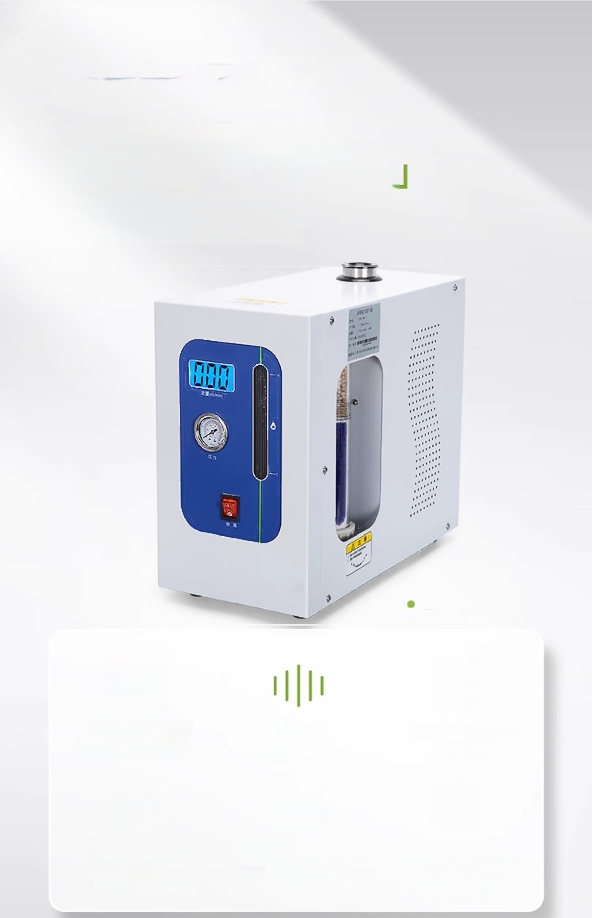





High Purity Hydrogen
Generator
99%High Purity
LC-HG-300
LCD liquid
crystal display
Silent
Operation
Non-backflow Device
Intuitive and eye-catching flow display
Chromatographic
Baseline
(Zero Noise Level) Fast Stabilization
Protects
Chromatograph
Use longer.

Slide 3
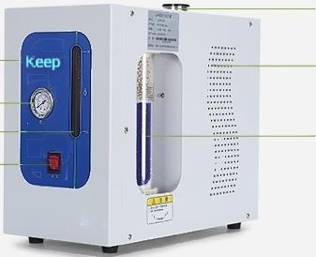
Instrument Details
Instrument details
Liquid
Filing Port
Cooling holes
Drying
Tube
LCD Screen-
Pressure
gauge Liquid Level Display Gauge
Power
Switch
-LG-HG-300/500/1000/2000 External Structure

Slide 4

Fully automatic alarm system
Leakage,overcurrent,overheat
uICHLEN
Flow rate(L/min)
Water overflow protection
function
Effectively protects gas phase
Chromatograph from
damage
Low water level alarm
Ensures electrolytic cell not to dr burn
Electricity
H Pure Water
Hydrogen Generator

Slide 5
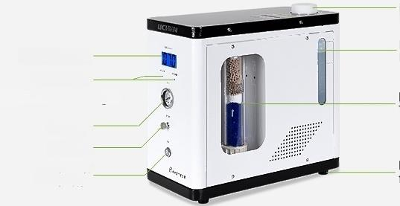
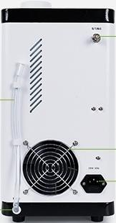
Instrument Details
Instrument details
_{i} _{t} _{on}
port
Liquid Level
LCD Screen
Normal liquid
/Alarm indicator light
Pressure
gauge
Bleed
valve
Power
Switch
Wate
r
njec
i
level
Display Gauge
Drying Tube
Base
foot
Front of Pure Water Hydrogen Generator LC-HG-300/500
Hydrogen outlet
Power outlet
Drain
Cooling fan
Drain
Back of Pure Water Hydrogen Generator LC-HG-300/500

Slide 6

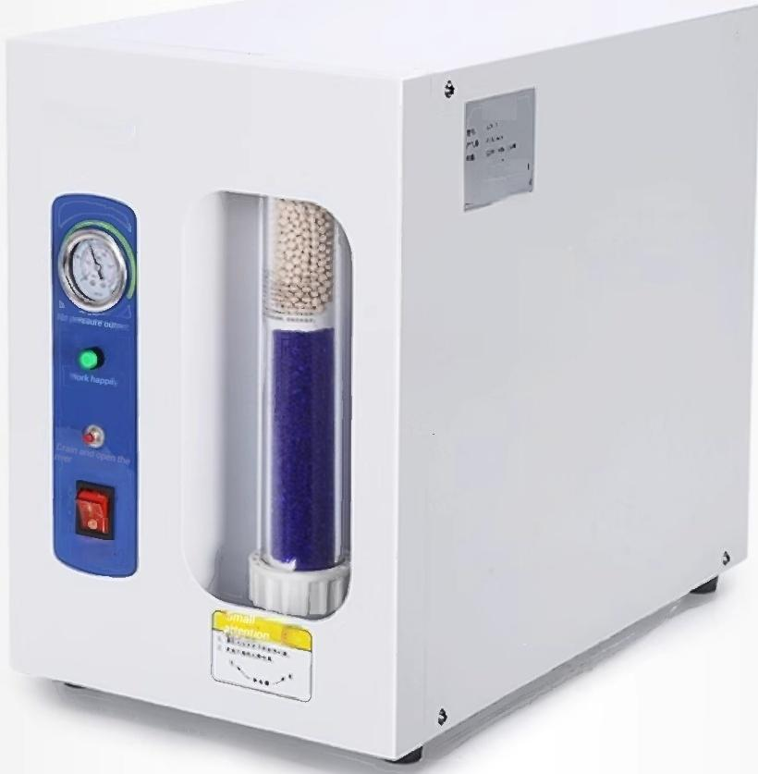






Air Generator
3
Ht
LICHEN
树
4
Telephone
≈
Three-stage
purified gas path
Two-stage
pressure
stabilization
Three-stage fully
automatic protection
Output gas is clean
Pressure Stable
Overpressure/
overcurrent/
overheat protection

Slide 7
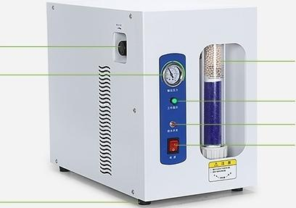
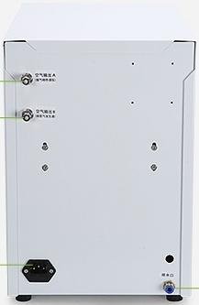

Instrument Details
Instrument details
Pressure Adjustment Knob Pressure gauge | Drying Tube
 | Working indicator light Drain switch Power Switch
Base foot
 | Front of Air Generator LCA-3/5
Air Outlet A
Air Outlet B
Power
outlet
Drain
Back of Air Generator LCA-3/5

Slide 8
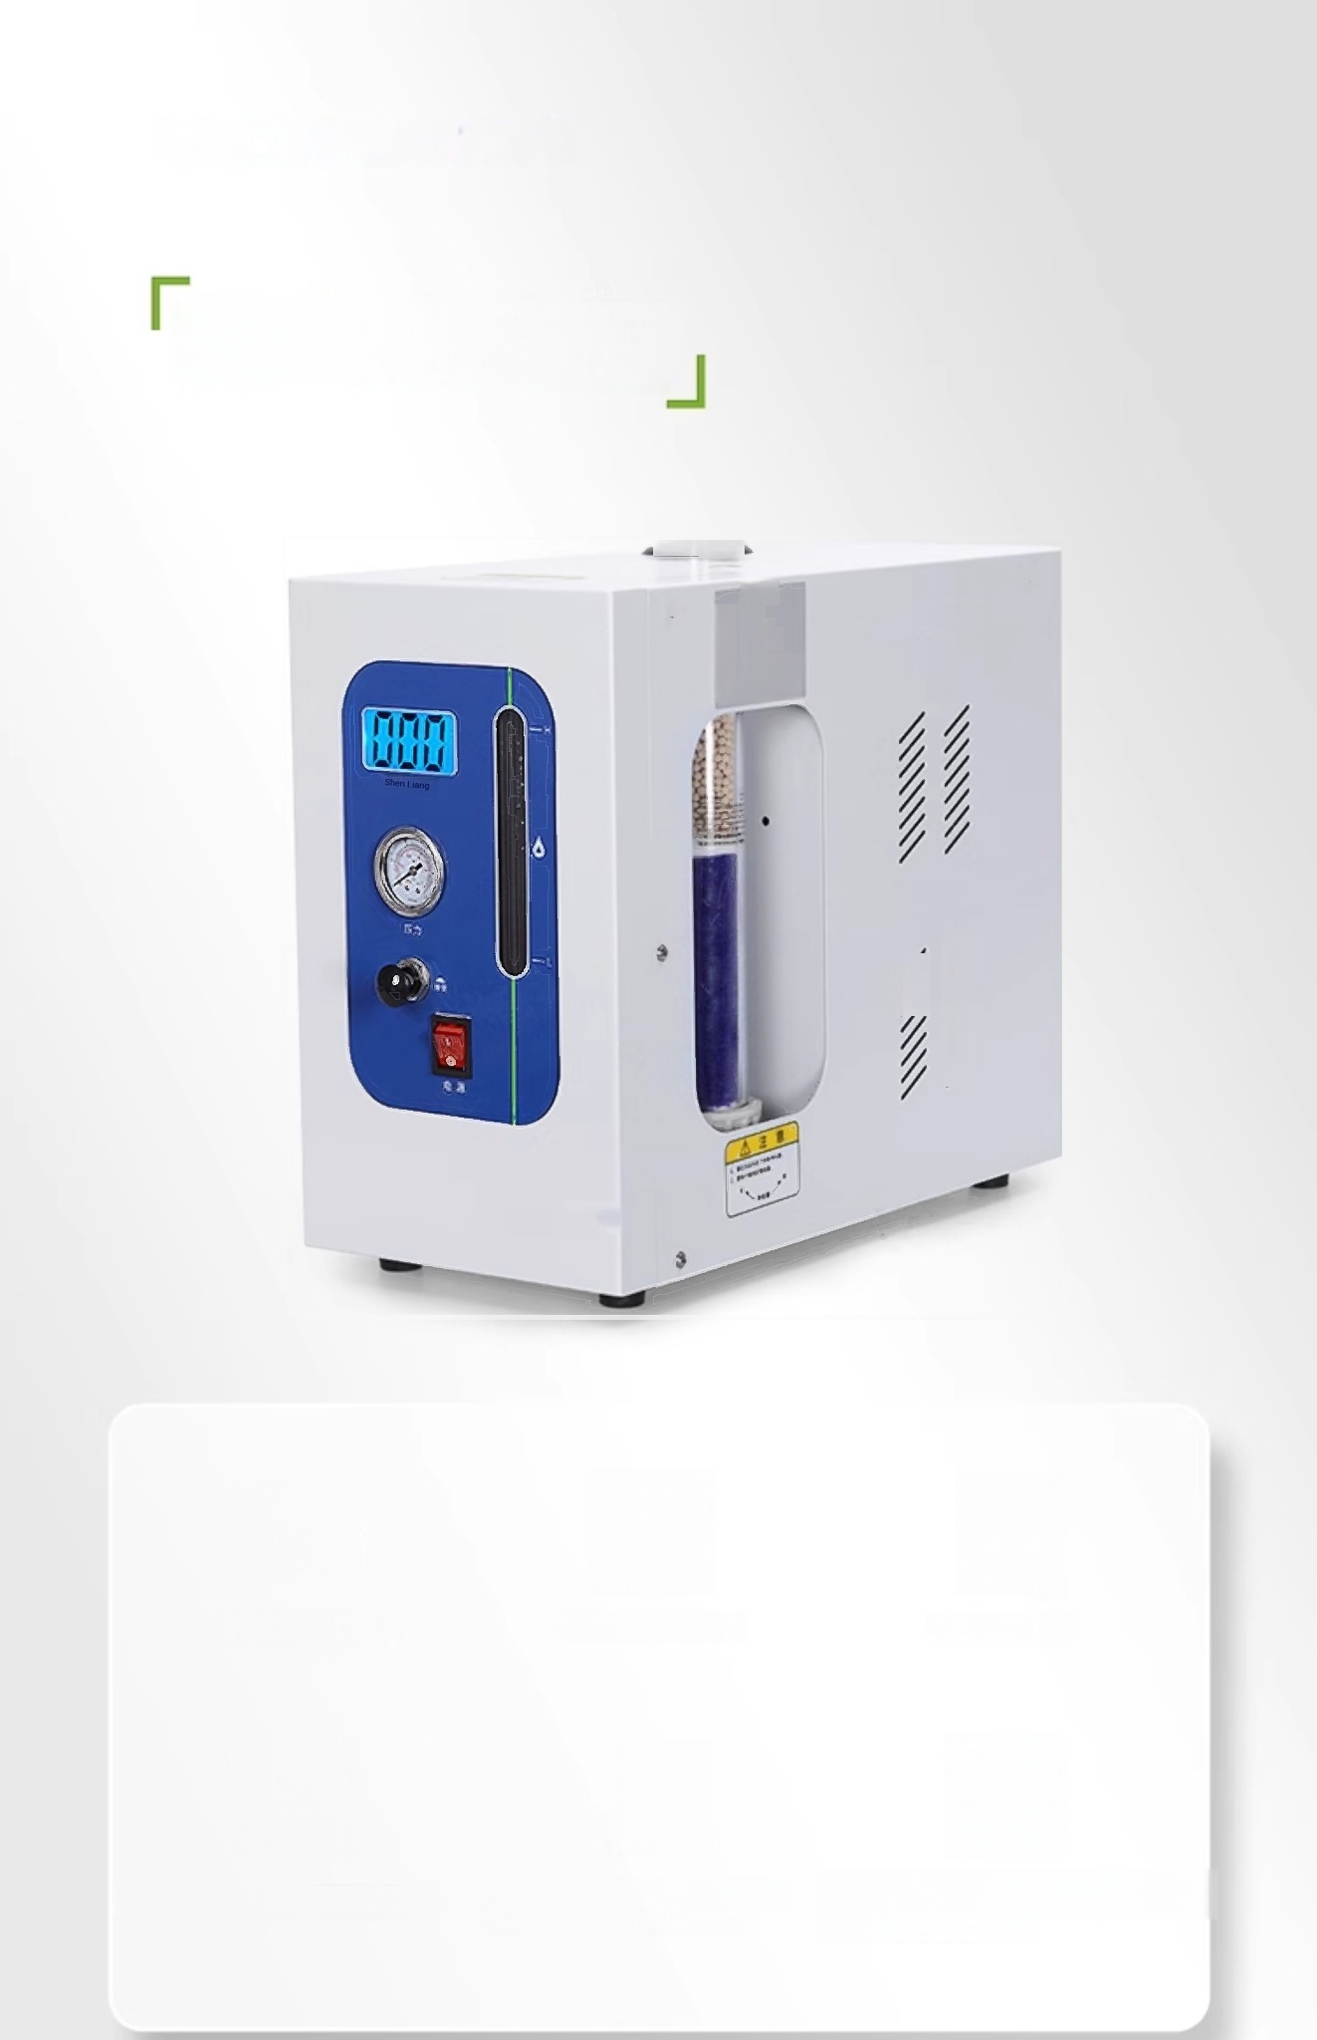






Nitrogen Generator
i
山TFa 18
iw
0
sg
3
LCD liquid crystal display
High flow precision
Safe and reliable
Intuitive and eye-catching flow display
First pressure stabilization then flow stabilization
Automatic gas path shutdown on power failure

Slide 9
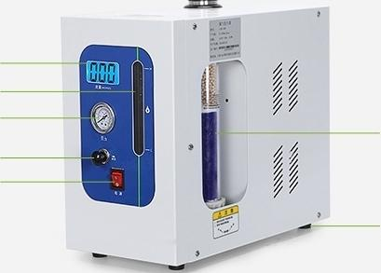
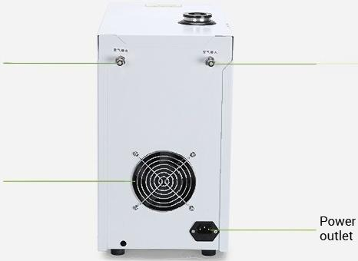
Instrument Details
Instrument details
LCDliquid
crystal display
Liquid Level
Display Gauge
Pressure
gauge
Gas Production/Air_
Release Knob
Power
Switch
Base
foot
Drying Tube
Front of Nitrogen Generator LC-LCN-300/500
Nitrogen Output Port | Air Input Port
Cooling fan
 | ·Back of Nitrogen Generator LC-LCN-300/500

Slide 10
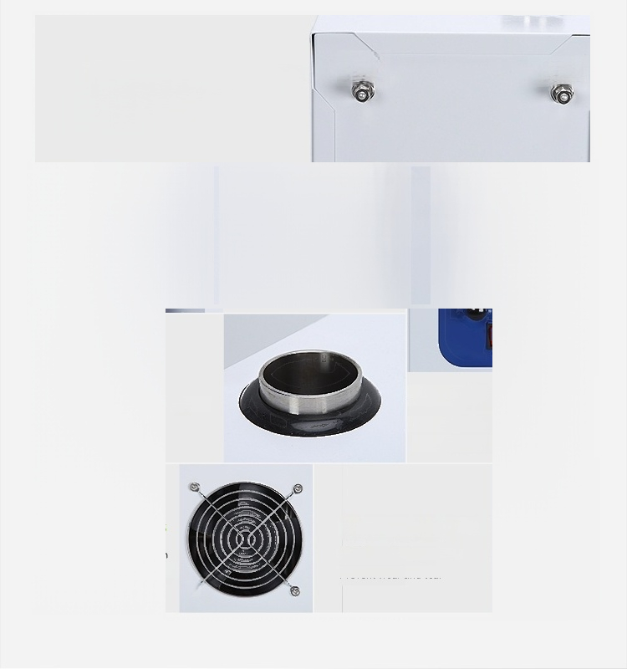
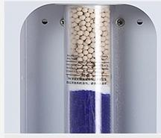
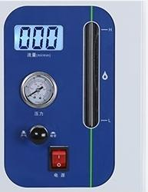

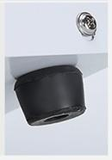
Air Inlet/Nitrogen Outlet
Equipped with AirInlet
Supply Nitrogen Output Pressure
Nitrogen Output
Air Input
Drying Tube
Ensure Output Gas Drying Protect Vapor-Phase
Equipment
Inlet
Easy Top Refilling Operation
Cooling holes
Automatic heat dissipation
Ensure normal operation
of equipment _{⑤}
Liquid Level Gauge
Measure the liquid level gauge Clear liquid level visibility
Rubber non-slip feet
Protect the workbench surface
Prevent wear and tear

Slide 11
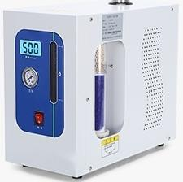
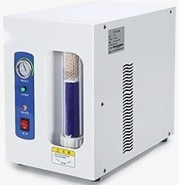
Instrument List
List of instruments
01
Hydrogen Generator LC-HG-300/500/1000/2000
Host
Power Cable
O-ring φ40.7×2(Green)
0-ring φ41.7×2(Red)
Purifier seal ringφ11.35×2(red)
air path gasket φ3.2
Air path nut M8×1φ3.2
^{r}₂ ^{ir} ^{path} ^{inner} ^{tube}
Potassium hydroxide 100G(500G for LC-HG-1000/2000)1 User manual
Certificate of Conformity,
Warranty Card
1
1 root
1
7
1
4
Two
Two
part
1 portion
1
portion
o
ut
a
φ
2
8
02
Air Generator LCA-3/5
Host
Power Cable
0-ring 中40.7×2
0-rng φ41.7×2
Purifier Sealing Ring φ11.35×2 Gas Path Gasketφ3.2
M8×1 Gas Path Nut,
φ3.2 Outer Gas Path
Linerφ2×28 Instruction Manual
Certificate of
Quality/Warranty Card
1
1 root
1
1
1
4
Two
Two
1 portion
1
portion

Slide 12






 | Nitrogen Generator | LCN-300/500 Host | 1
Power Cable |  |  | 1 root
O-ringφ40.7×2
1
 |  |  |  |  | O-ring φ41.7×2 | 1
 |  |  |  |  | Purifier Sealing Ringφ11.35×2 |  | 1
 |  |  |  |  | Gas Path Gasket φ3.2 |  | 4
 |  |  |  |  | Gas Path Nut M8×1,中3.2 | Two
 |  |  | Outer Gas Path Liner φ2×28 Two Potassium Hydroxide
 |  |  |  |  | User Manual | 1 portion
1 pack
Certificate of 1
Quality/Warranty Card portion

Slide 13
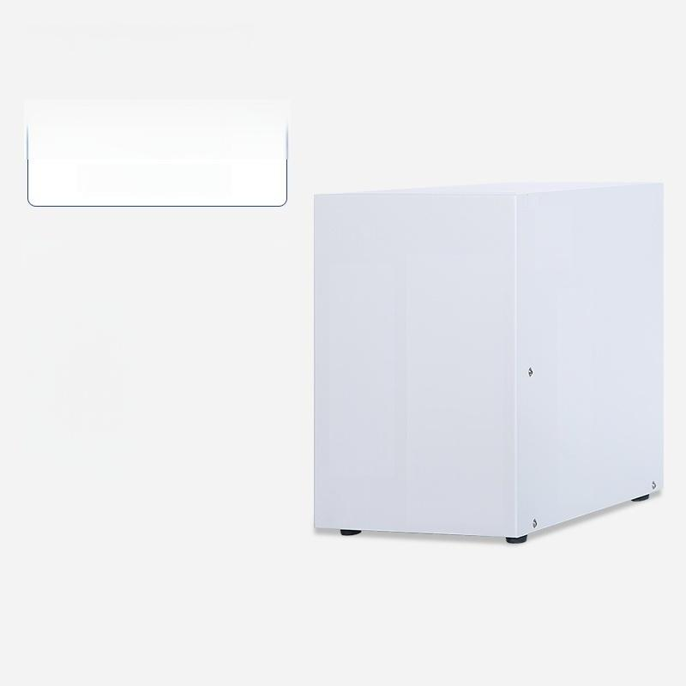


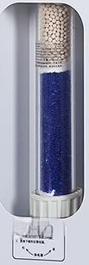
LCA-3
Air Generator
5
单 1
Purity.
Output Flow Rate:
Output
Pressure:
Display
mode:
O²≤3ppm
0~3000ml/min
0~0.4Mpa
Pressure gauge
Input Voltage/Frequency:220V±10%/50Hz
Power.
Chromatography
Connection Quantity.
≈≈≈≈≈≈≈≈≈≈≈≈≈≈≈≈≈≈≈≈≈
150W
1~2 units

Slide 14



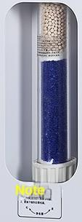
LCA-5
Air Generator
5
单 1
O²≤3ppm
0~5000ml/min
0~0.5Mpa
Pressure gauge
Input Voltage/Frequency:220V±10%/50Hz
Power.
Chromatography
Connection Quantity.
Purity.
Output Flow Rate:
Output
Pressure:
Display
mode:
≈≈≈≈≈≈≈≈≈≈≈≈≈≈≈≈≈≈≈≈≈
200W
2-3 units

Slide 15
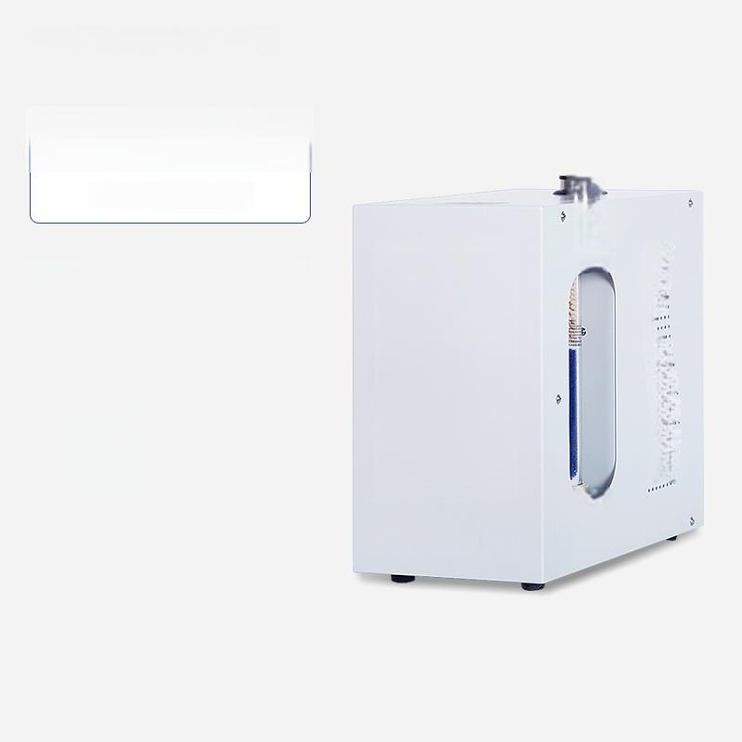



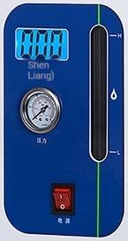

LC-HG-300
Hydrogen generator
ii
Purity.
Output Flow Rate:
Output
Pressure:
Display
mode:
ff
ff
99.99%
0～300ml/min
0～0.3Mpa
LCD screen,pressure
gauge
Input AC 220V±10%/
Power/Frequency. _{50Hz}
Power. 150W
Number of GC Units Connectable:
1~2 Units
…
r
188
f1
F
照
心

Slide 16



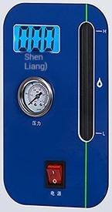
LC-HG-500
Hydrogen generator
ii
Purity.
Output Flow Rate:
Output
Pressure:
Display
mode:
ff
ff
99.99%
0～500ml/min
0～0.4Mpa
LCD screen,pressure
gauge
AC 220V±10%/
50Hz
150W
Number of GC connections:2-3units
…
r
188
f1
F
照
Input
Power/Frequency.
Power.

Slide 17

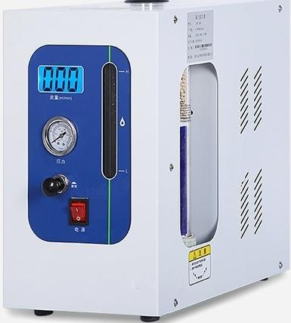
LCN-300
Nitrogen Generator
T
99.99%(oxygen content s3ppm, Water content dew point -70℃)
^{u}:^{t} ^{Flow} 0~300ml/min
^{Output} 0~0.4Mpa
_{i} ^{essure} ≤±0.001MPa
Input Power/Frequency. | AC 220V±10%/ 50HZ±1%
Power. 150W
Number of GC Units Connectable: 1~2 Units
Purity.
Outp
Rate
Pressure:
Output
Pr
Stabil
ty

Slide 18

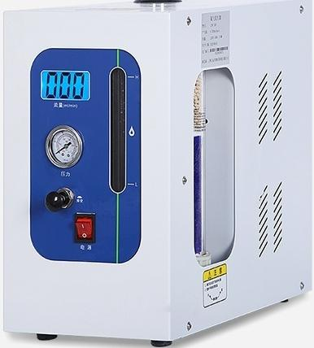
LCN-500
Nitrogen Generator
T
Purity. | 99.99%(oxygen content s3ppm, Water content dew point -70℃
^{u}:^{t} ^{Flow} 0~500ml/min
^{Output} 0~0.4Mpa
_{i} ^{essure} ≤±0.001MPa
Input Power/Frequency. |  | AC 220V±10%/ 50HZ±1%
Power. 150W
Number of GC connections:2-3 units
Outp
Rate
Pressure:
Output
Pr
Stabil
ty

Slide 19
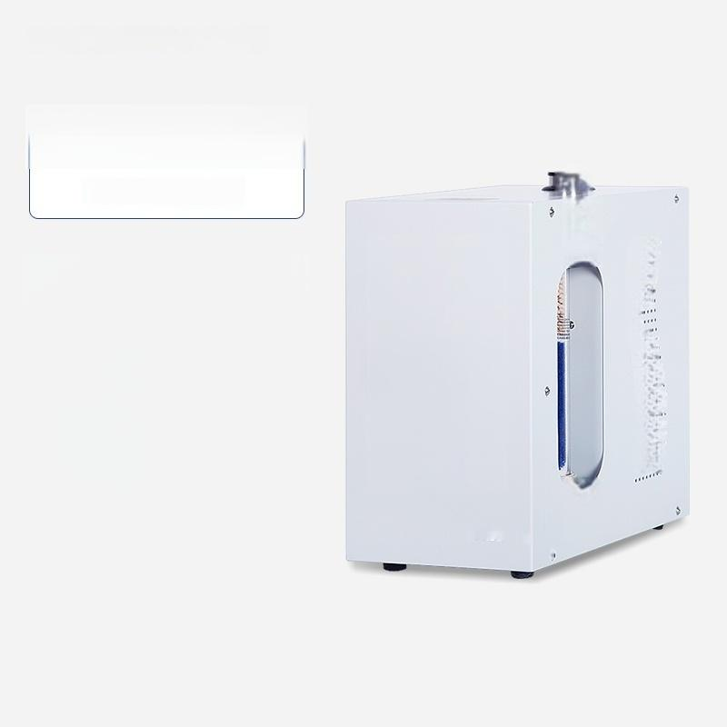


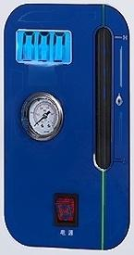
LC-HG-1000
Hydrogen generator
ii
Purity.
Output Flow
Rate:
Output
Pressure:
Display
mode:
Input
Power/Frequency:
Power.
Number of GC
units
LILL
Shen
Liang)
3 力
ff
ff
99.99%
0～1000ml/min
0.4Mpa
LCD screen,pressure
gauge
AC220V/50Hz
180W
connections:10
…
r
188
f1
F
照

Slide 20




LC-HG-2000
Hydrogen generator
ii
Purity.
Output flow.
Output
pressure:
Display
mode:
ff
ff
99.99%
0～2000ml/min
0.4Mpa
LCD screen,pressure gauge
Input
AC220V/50Hz
180W
chromatographs
that can be connected:15 units
…
r
188
f1
F
照
power/frequency.
Power.
Number of gas
心

Slide 21


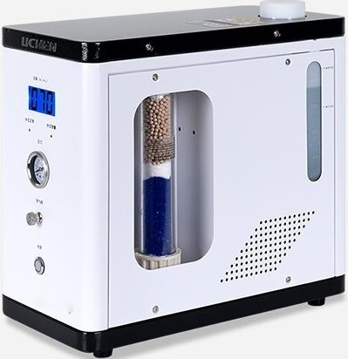
LC-SH-300
Pure Water Hydrogen Generator
Purity. | ≥99.99%
Output Flow Rate: | 0~300mL/min
Output Pressure: | 0.4Mpa
Output Pressure Stability. | ≤0.001Mpa
Input Power/Frequency. | AC 220V±10%/ 50Hz
Power. | 150W
Number of GC Units Connectable: 1~2 Units

Slide 22



LC-SH-500
Pure Water Hydrogen Generator
Purity. | ≥99.99%
Output Flow Rate: | 0~500mL/min
Output Pressure: | 0.4Mpa
Output Pressure Stability. | ≤0.001Mpa
Input Power/Frequency. | AC 220V±10%/ 50Hz
Power. | 150W
Number of GC connections:2-3units

Slide 23
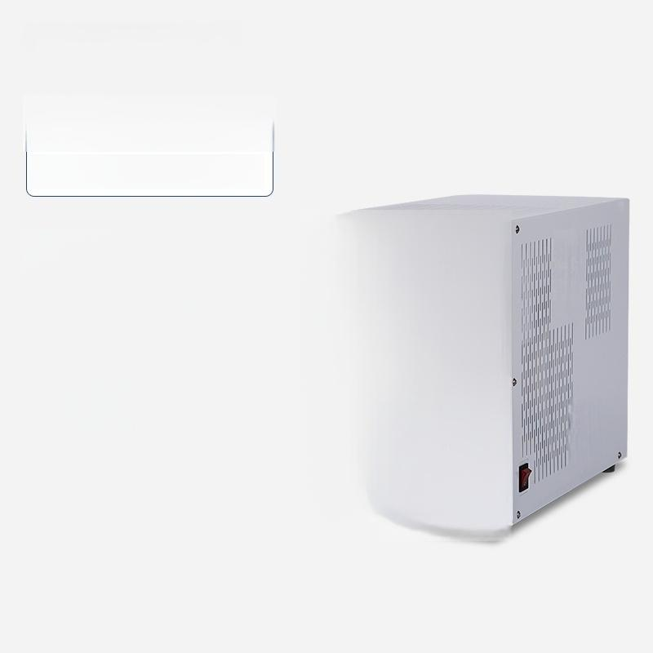

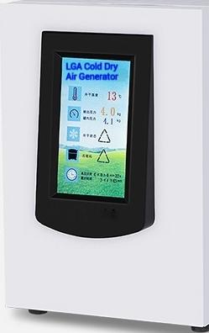

LC-LGA-3
Cold Dry Air Generator
告
Output Flow Rate:
Output
Pressure:
Display
mode:
Work
environment:
0~3L/min
0~0.4Mpa
LCD Screen
Temperature:10℃~40℃,
Humidity.s85%
Chromatography
1~2 units
Input Power/Frequency:220V±10%/50Hz
Power. 150W
Connection Quantity.

Slide 24
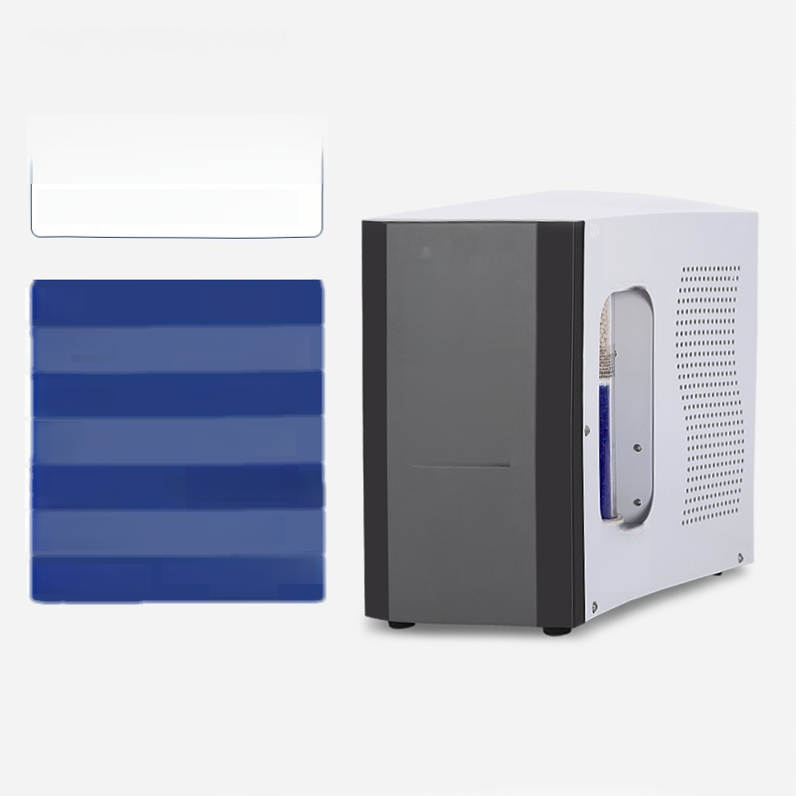


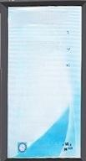

LC-LGH-300
Cold Dry Hydrogen Generator
空
5
Purity.
Output Flow
Rate:
Output
Pressure:
Display
mode:
Water Quality Requirements:
Chromatography
Connection Quantity.
Voltage/Power.
99.99%
0~300ml/min
0～0.3Mpa
LCD Screen
Distilled Water or
1~2 units
220V±10%50Hz /150W
12
…1.2
…
选 … △
匪 A857
A … E² 田
2 △
Deionized Water

