Slide 1
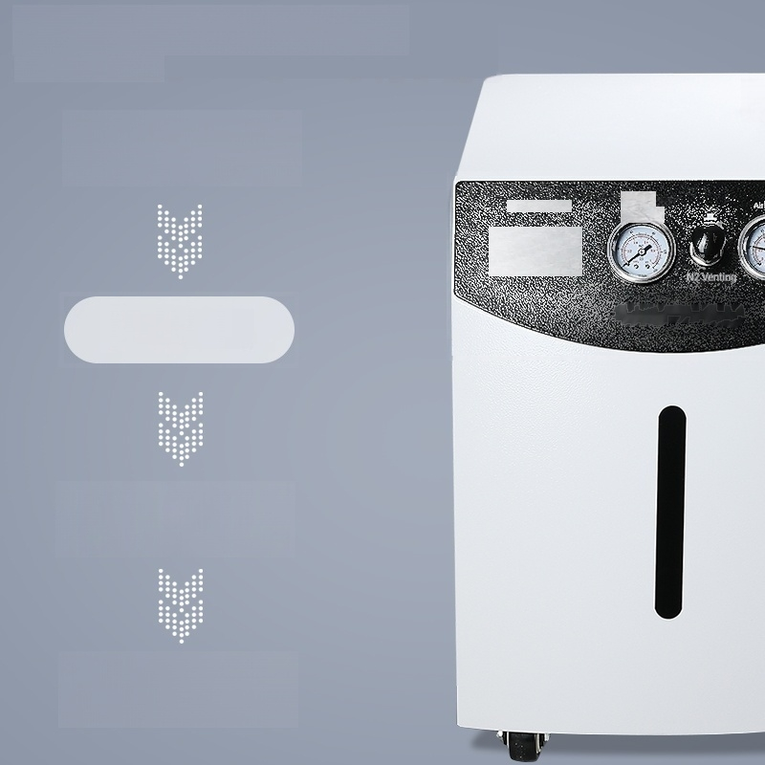
Purity Assurance Multi-Level Protection
Air Section
N² 流量 (mo
Output
pressure
P60
Three -Stage
Purification
Two-stage pressure
stabilization
Multi-Level
Protection

Slide 2
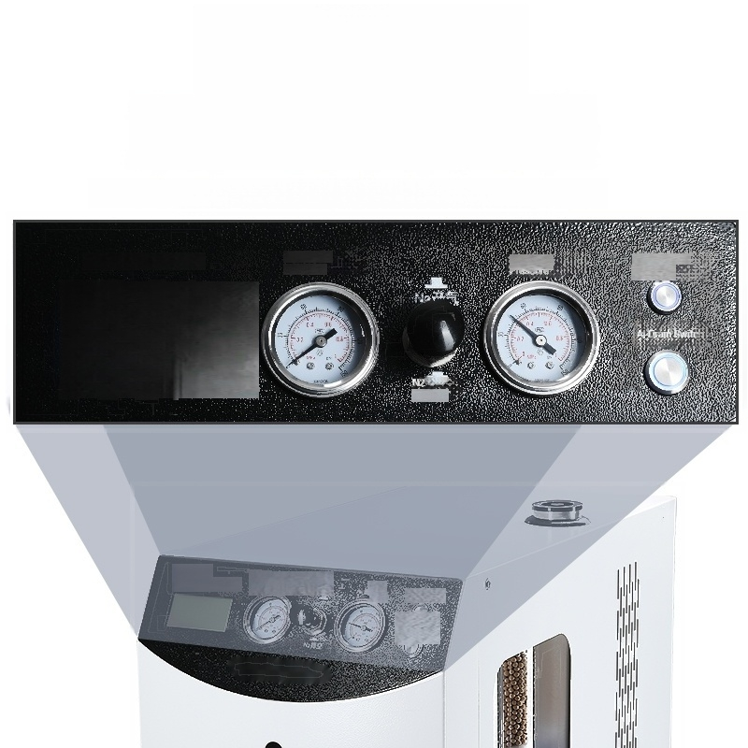
LCD display
Dual-pressure Scale Gauge
LCD Display,Right-side Liquid Level Gauge,Real-time Level Monitoring
N2 Flow Rate(ml/min)
26
N2Output Pressure
AiOuput
Ar Operation
ndicator
Venting
NWave
Quantity(ms) outoutpesoue Sell
Leili A 工作指示
最大

Slide 3
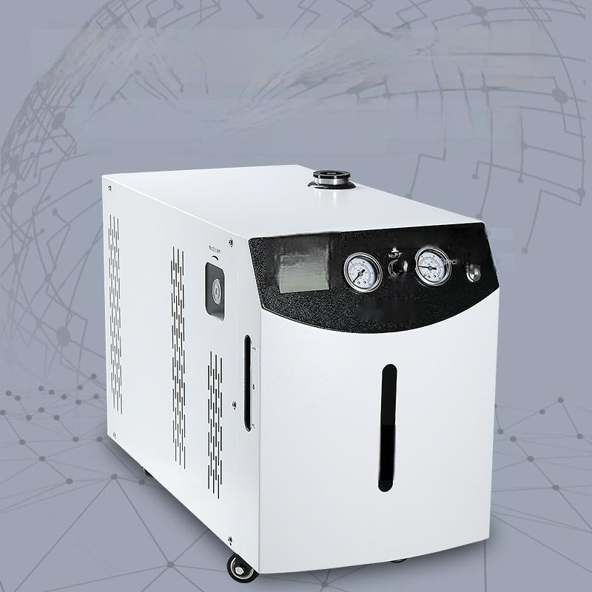
Easy to operate and energy-efficient
Just turn on the power switch to produce gas,which is more efficient and energy-saving compared to traditional gas sources.Just add
distilled water for daily use.
26
A Output Pressure
险地出压力
临2
AWorking
Dlsplay
Digital
al Water sch

Slide 4
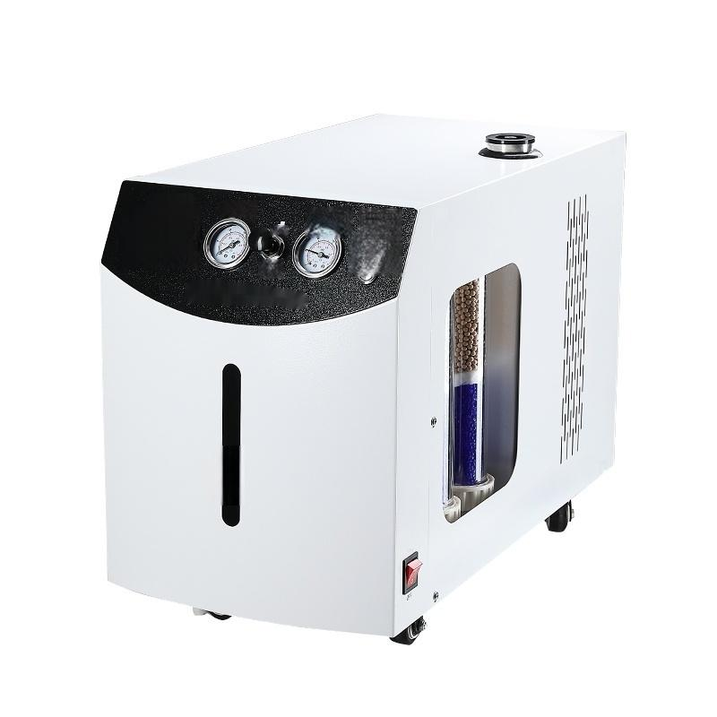
9
按 量 o
2田
险输出压力
N产气
心 燕
生力
监 Ar7 竹瓶
形 彩

Slide 5







LCD liquid crystal display
LCDUQUIDCRYSTALDSPLAY
Multi-layer board structure
MULTLAYERPLATESTRUCTLRE
Purity guarantee
PURITYASSURANCE
High efficiency and energy saving
EFFIOENTANDENERGY-SAVING
Multi-level protection measures
MULTSTAGEPROTECION
Easy to operate
CONVENIENTOPERATION

Slide 6
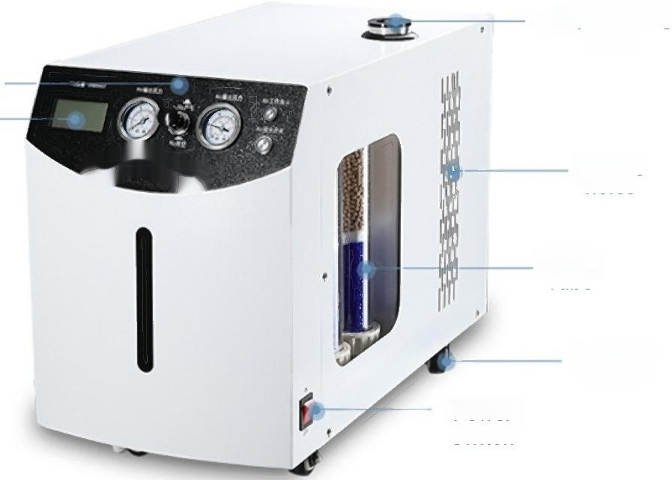
Product Parameters
Liquid Filling
Port
Control Panel
LCD liquid
Cooling
holes
Drying
Tube
Universal Wheels
Power
Switch
crystal display
Model | LC-NA-300 | LC-NA-500
Input power | AC220V/50Hz
Power | 230W | 250W
Purity | 99.94%
Flow | Nitrogen 0-300mL/min Air 0-3L/min | Nitrogen Flow Rate: 0-500mL/min Air 0-5L/min
Display mode | LCD screen,pressure gauge
Output pressure | 0.4MPa
Desiccant tube filler | Color-changing silica gel,5A molecular sieve

Slide 7
Packing List
II
Instrument Packing List Display
Serial Number | Name | Quantity
1 | Host | 1
2 | Power Cable | 1 root
3 | 0-ring 40.7×2(Green) | 1
4 | 0-ring 41.7×2(Red) | 1
5 | Purifier Sealing Ring φ11.35×2(Red) | 1
6 | Gas Path Gasket φ3.2 | 4
7 | Gas Path Nut M8×1φ3.2 | Two
8 | Outer Gas Path Liner 2×28 | Two
9 | Potassium Hydroxide 100g | 1 portion
10 | User manual | 1 portion
11 | Certificate of Quality/Warranty Card | 1 portion

Slide 8
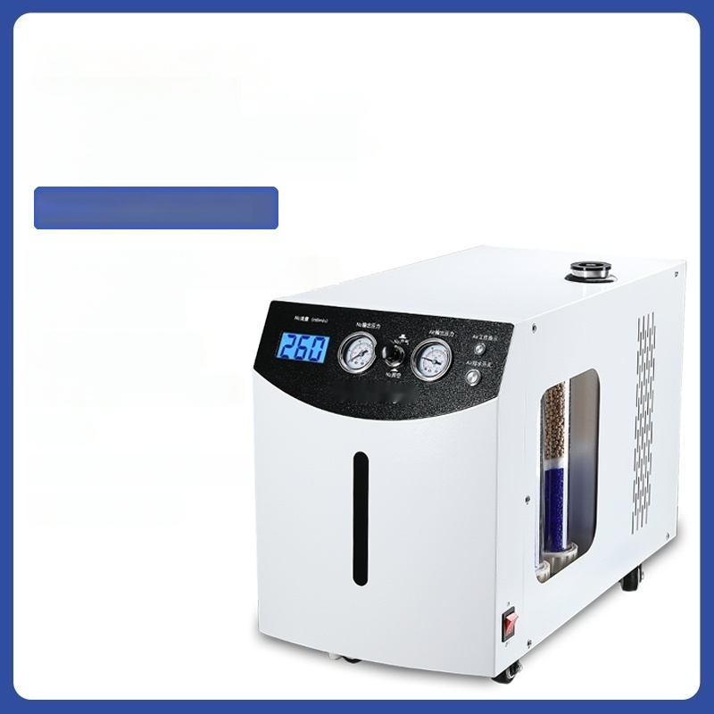
Nitrogen-Air
Integrated Machine
Model:LC-NA-300
Input Power:AC220V/50Hz
Power:230W
Purity:99.94%
Output Pressure:0.4MPa
Flow:
Nitrogen 0-300mL/min
Air 0-3L/min

Slide 9
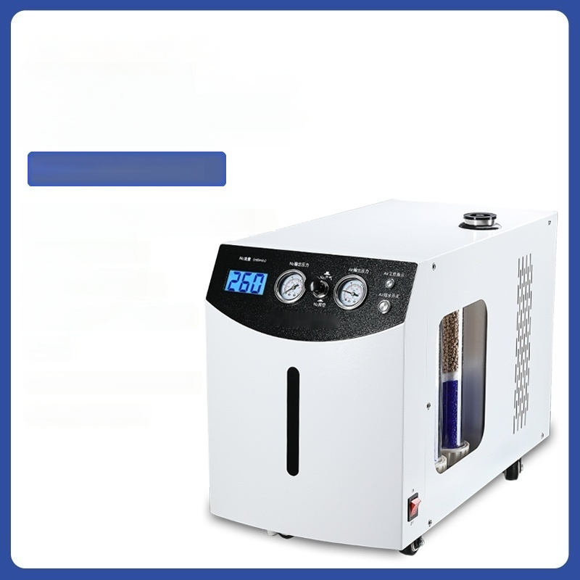
Nitrogen-Air
Integrated Machine
Model:LC-NA-500
Input Power:AC220V/50Hz
Power:250W
Purity:99.94%
Output Pressure:0.4MPa
Flow:
Nitrogen Flow Rate:0-500mL/min
Air Flow Rate:0-5L/min

