Slide 1
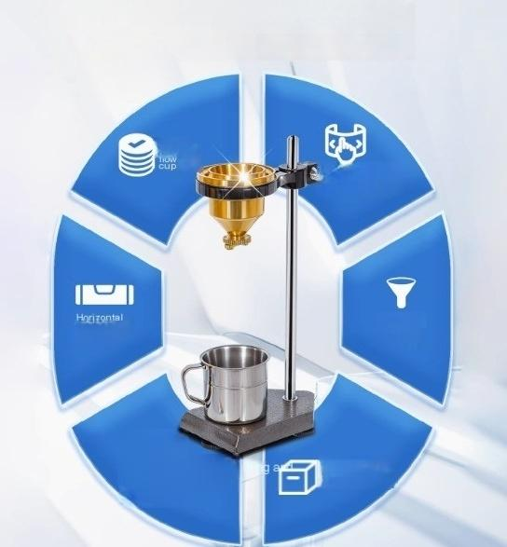
6major advantages showcase professionalism
u
Desktop/portabl e optional
bubble
(desktop)
Stainless
i
Adjustable
lowering
Bilkenf foam box

Slide 2
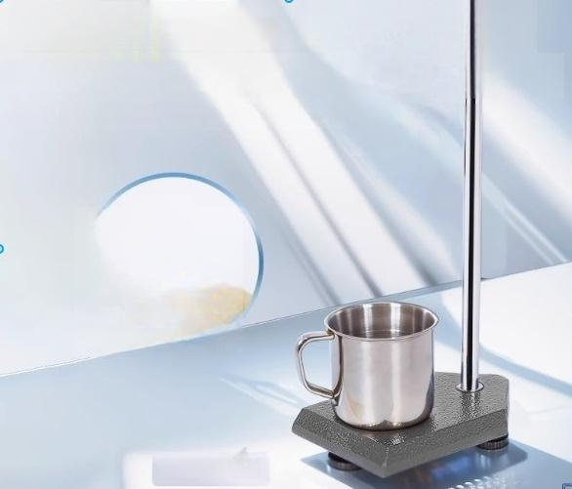


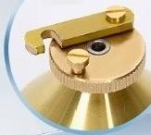
Pure brass"flow
cup
Copper core is cast to be sturdy,corosion resistant,andleng-lasting The stainles steel outflow hole of the viscosity cup is refined from pure brass
Outflow hole
LND-1 desktop

Slide 3
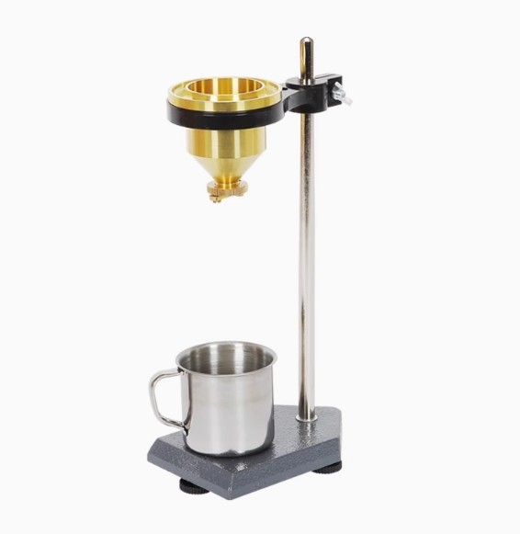

Slide 4
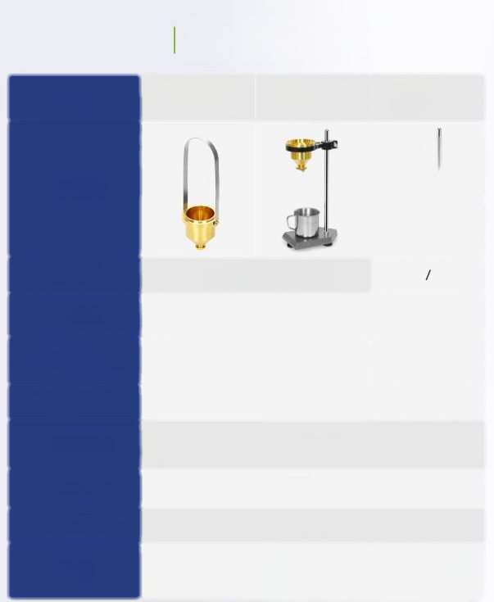

Shopping guide
Models | LND-1Portable LND-1 table top spread fourcups apply four cups | NDJ-5 Table topapply four cups
Exterior
owerinspection condition | Check over(optional
Capacity(ml) | 100±1
Innerdiameter(mm) | φ50±0.2 | φ49.5±0.2
Bore diameter(mm) | φ4±0.02 | φ4±0.2
ntan准wttr bodyAnge | +81*15'
Appearance standard | GB1723
Cup body material | Brass
Uses | Measurement of coatng products in 30s-100s | Measurement of coatng products within 150s

Slide 5
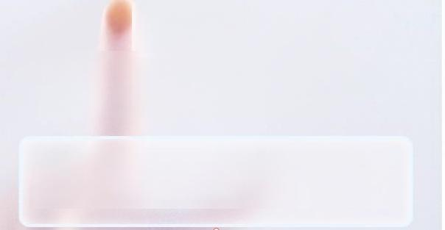
Scope of use
Suitable for viscosity measurement of coating products within 150S
Coating four cups is a portable instrument for measuring the viscosity of paint
conditions,that is,after the measured liquid is filled with a specific container,it takes time to flow out in the standard pipe hole to calibrate the viscosity of the liquid,in
seconds.

Slide 6

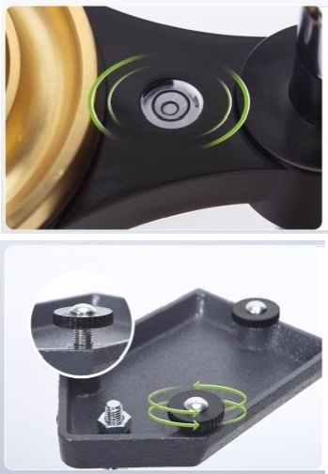
Triangle leveling accuracy up
Part 2 of 3:Leveling the Air 1 Set horizontal bubbles overhead
Improve leveling accuracy
Method 3Adjusting Nuts 1
Three-point adjusting nuts Rotate to adjust triangle height

Slide 7

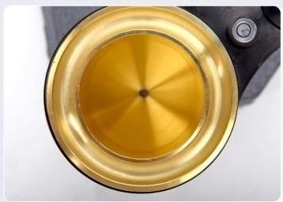
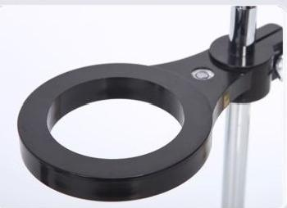
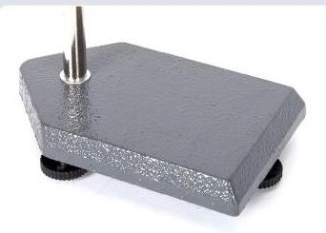
1 Stainless steel outflow
^{hol} ^{he} ^{stainless} ^{steel} ^{outflow} ^{hole} ^{for} ^{the} ^{viscosity}
cup
Made of pure brass
e
T
Annular groove
Fixed viscosity cup LND-1
desktop black ring plastic
material NDJ-5 desktop blue ring metal material
1 Frosted spray paint base
Thefrosted spray paint base is more skid resistant.The NDJ-5bench isaconcave and convexfixed base

Slide 8
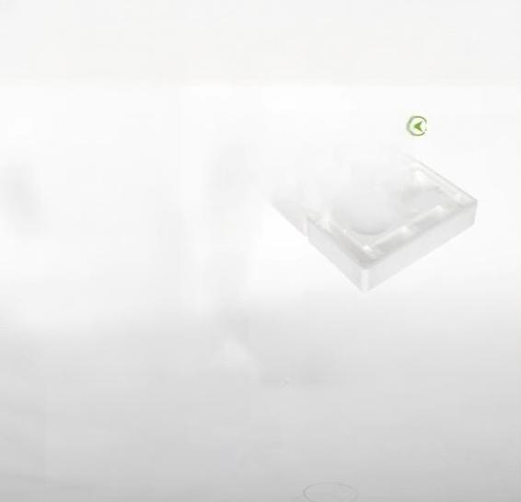
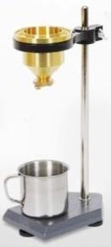
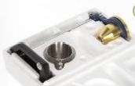

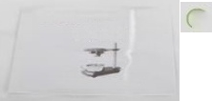

| Packing list
Thickened foam boxshipped
Mainframe
-
_{装} Instructions
二 二
Certificate of
conformity

Slide 9

1
Pre-test
preparation
After adjusting the horizontal bubble to the center,thoroughly clean and dry the viscometer thoroughly stir the paint to be
tested and maintain the temperature at 25±1℃
2 Determination
process
Adjust the viscometer to keep it level,
And place the 150ml cup under the viscometer leak nozzle.
Close the stopper on the cup to plug the leak(portable plug with yourfinger), Pour about 100mLof the sampleinto the viscometer.
Scrape a metal or glass plate over the cup,
Scrape excess liquidinto the grooves around the edges of the viscometer. Quickly open the stopper blockon the cup(portablefinger release),
the test liquid flows out vertically,with thecupto undertake,at the sametime start the stopwatch,the test liquid flows out into aline, stop the stopwatch when disconnected;Measured time is on behalf of its viscosity,the unit is second.
Take the average of the two measurements as the determination result.The difference between the two measurements should not exceed 3%of the mean.

Slide 10
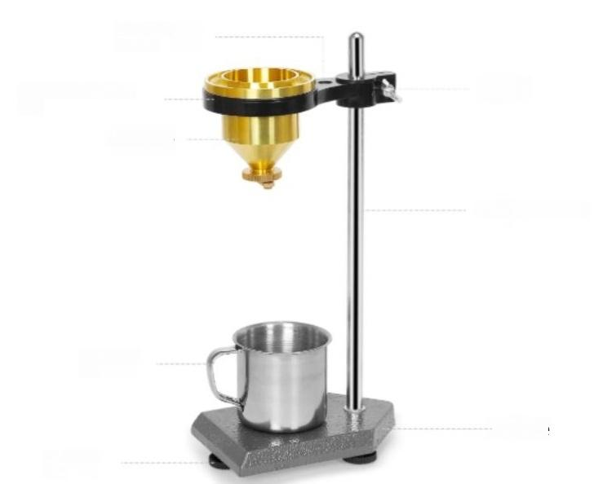
Horizontal bubble
Viscosity cup retaining
ring
Viscosity cup
Bolts
Post adjustment bar
Undertaking
cup
Base
Horizontal
feet

