Slide 1
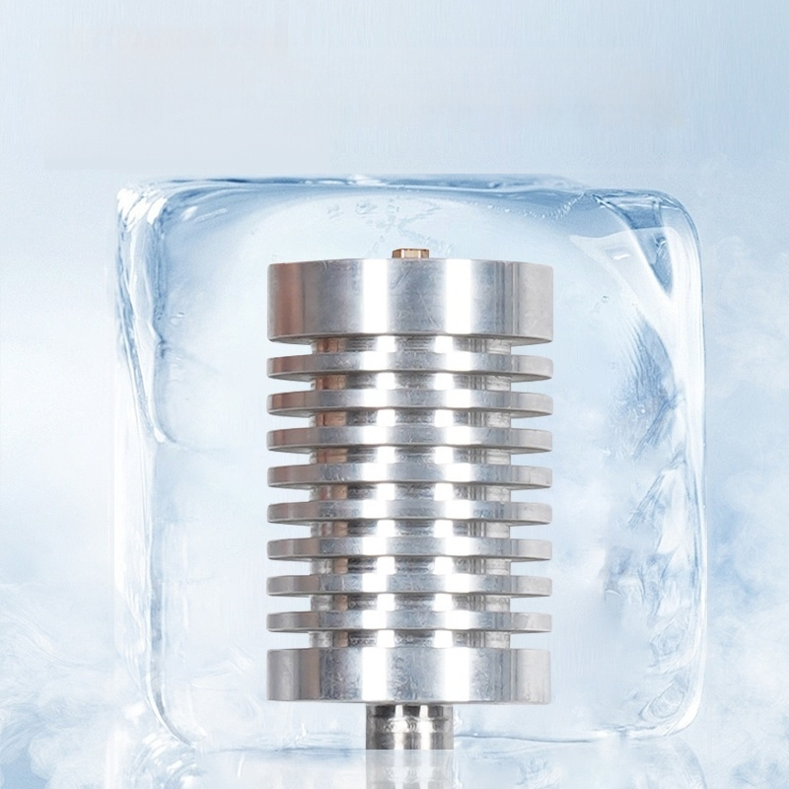
High-quality aluminum alloy pump body,
corrosion-resistant.
Cold-resistant and rust-resistant

Slide 2
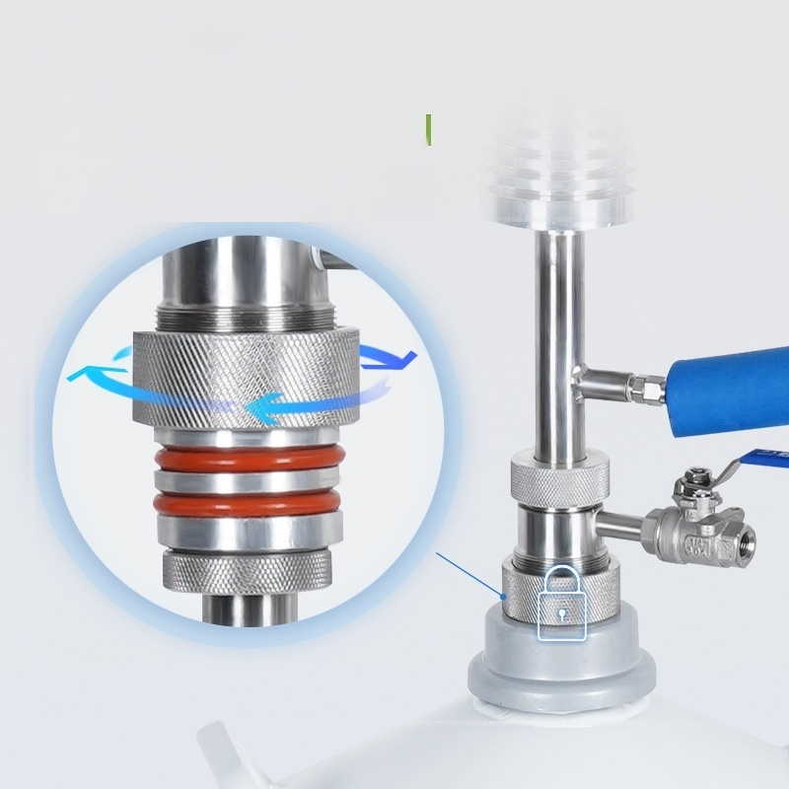
「Locking Device
Technology
Aluminum Bar Processing:
Lightweight &Easy to Operate

Slide 3
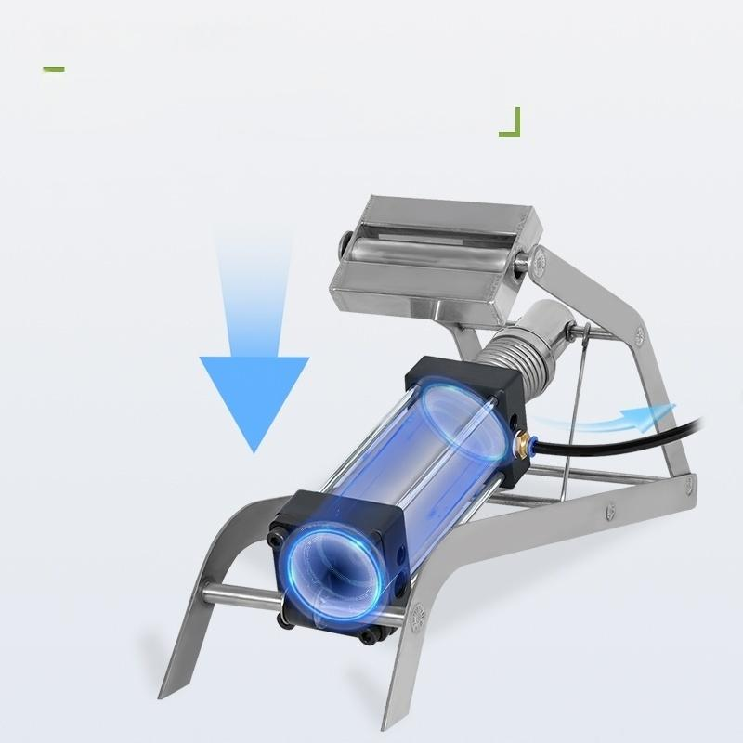
Stainless Steel Foot-Pump
High-Speed Stamping
Thickened support

Slide 4
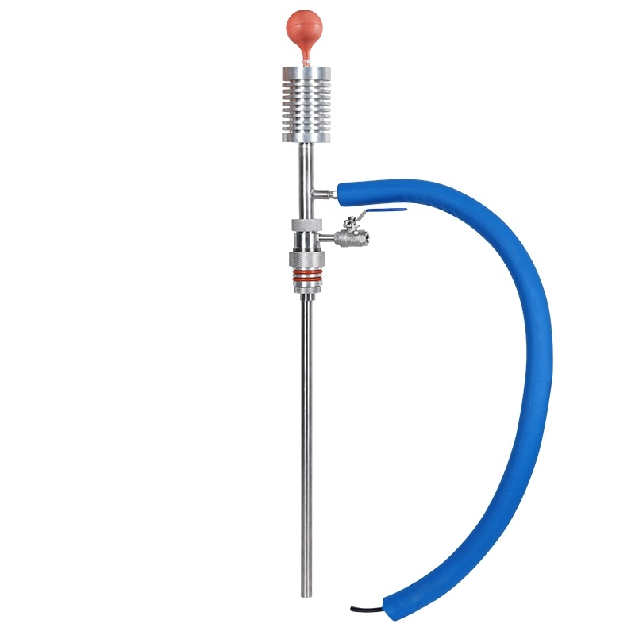

Slide 5
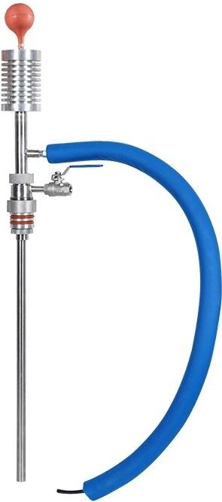
Handheld Liquid Nitrogen Pump
Maximum Discharge | Capacity.^{≥5L/min}
Head Height: ≥2m
^{Rate:} 80time/min
How it works: |  | Pinched by hand
ght: 3.5Kg
Product dimensions:160*180*1050mm
Net
Wei

Slide 6
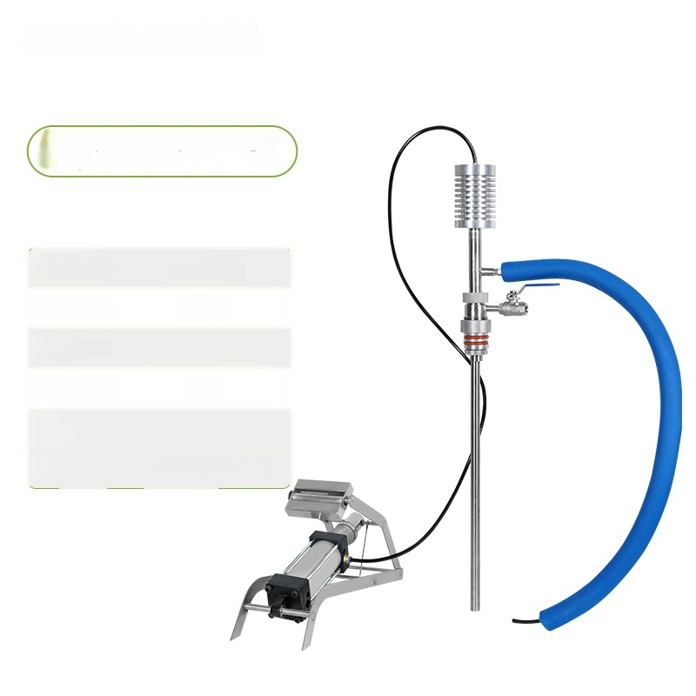
Foot-operated Liquid Nitrogen
Pump
Maximum Discharge: | ≥5L/min
Head Height: | ≥2m
Rate: | 60time/min
How it works: | Pedal
Net Weight: | 7.9Kg
Product Dimensions:106*180*1040mm

Slide 7
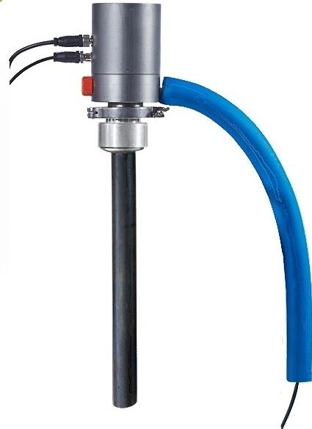
Fully Automatic Liquid Nitrogen
Pump
Maximum Discharge ≤1L/min Capacity:
Head Height: ≥2m
Rate: /
How it works:Fully Automatic
Net Weight: 3.5Kg
Product Size: 150*200*700mm

