Slide 1
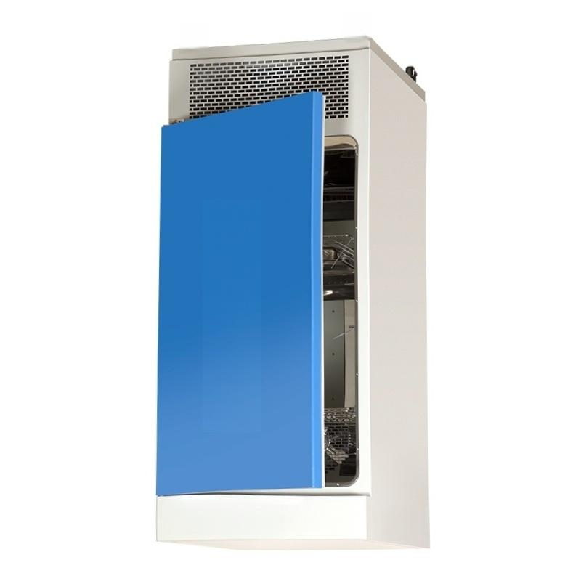



附3K

Slide 2
Mold Culture Incubator MJ Series Parameters
Parameter | MJ-70-I MJ-70F-I | MJ-150-I MJ-150F-I | MJ-250-I MJ-250F-I MJ-500F-I | MJ-150-Ⅱ MJ-250-Ⅱ MJ-500-II
Temperature control range | 0~60℃ |  |  | Humidification:15~45℃ Non-humidification 10~45℃
Temperature Resolution | 0.1℃
Temperature fluctuation | High temperature±0.5℃Low temperature±1.0℃
Temperature Uniformity | ±1.5°℃~±2.5℃(Test point at 25℃)
Humidity control range | None |  |  | 60～85%RH
Humidity deviation | None |  |  | ±5～8%RH
Power supply voltage | AC220V 50HZ
Working environment temp | erature +5～30℃
Input Power | 450W | 500W | 600W 600W 2250W | 680W 850W 2250W
Inner liner size (mm) W×D×H | 400×350×500 | 503×370×808 | 540×460×1000 540×460×1000 670×720×1020 | 550×405×670 650×500×830 670×720×1020
Overalldimension (mm) W×D×H | 530×560×1080 | 600×630×1360 | 637×662×1590 637×662×1590 850×1100×1930 | 690×800×1430 750×900×1580 850×1100×1930
Standard cargo tray | 2 pieces | 3 pieces
Timer | 0~9999min
Note:Sichuan Type I Mold Incubator not only has the features of Type I but also has microcomputer-controlled humidity

Slide 3
Model | Constant temperature and humidity box(professional type)
 | LHS-80HC-I LHS-80HC-II | LHS-150HC-I LHS-150HC-II | LHS-250HC-I LHS-250HC-II | LHS-500HC-I LHS-500HC-Ⅱ | LHS-800HC-I LHS-800HC-Ⅱ
Temperature control range | I:-5～80℃ II:-10～70℃
Temperature Resolution | 0.1℃
Temperature fluctuation | High temperature:±0.5℃Low temperature:±1℃
Humidity control range | I:40～85%RH II:40～95%RH
Humidity deviation | ±3%RH
Input Power Operating temperature | 2000W | 2100W | 2300W | 3850W | 8050W
 | +5～35℃
Power supply voltage | AC220V 50HZ
Workspace size (mm)W×D ×H | 400×400×500 | 550×405×670 | 600×500×830 | 800×700×900 | 800×590×1650
Overall Dimensions (mm)W×D ×H | 550×790×1080 | 690×800×1430 | 740×900×1580 | 000×1100×1860 | 1360×890×2000
Cargo rack (Standard) | 2 pieces | 3 pieces |  | 4 pieces
Remarks | Typelprinter optional/Typell equipped with printer
Type 80/150/2501 constant temperature and humidity chamber uses dry and wet bulbs;Type 500/8001 constant temperature and humidity chamber uses imported sensors;Chuan-type constant temperature and humidity chamber uses imported sensors.

Slide 4
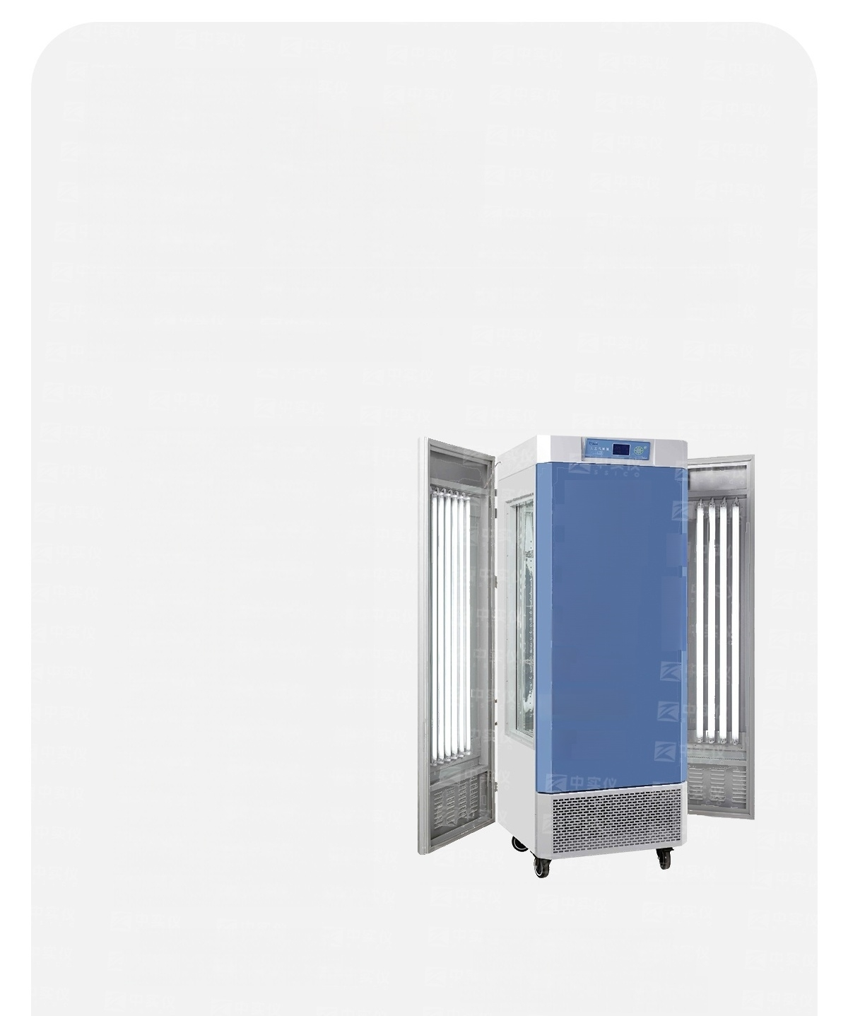
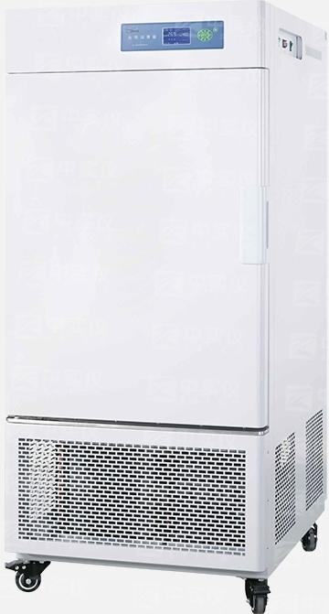
Product
Parameters o
MGC100/100P/250/250P/300A/
300B/350BP/400B/450BP/800B
850BP Light Cultivation Incubator
Zhongshi
Instrument
Zhongshi
Instrument
Zhongshi
Instrument
Zhongshi
Instrument
Zhongshl
Instrument
Z realnstrument
Zhongchi
Inetrument
2
Light Cultivation Incubator
MGC100/100P/250/250P
Light Cultivation Incubator
MGC300A/300B/350BP
/400B/450BP/800B/850BP

Slide 5
Product Introduction
● Microcomputer program controls temperature,humidity,and illumination,can
simulate daytime and nighttime temperature and humidity changes,and also can select a stable and sufficient light source for the growth environment
o Large-screen LCD display,multiple data displayed on one screen,menu-style operation interface,simple and easy to understand,convenient for
observation and operation.
● Imported brand compressors guarantee long-term continuous operation of testing equipment,environmentally friendly refrigerants,high efficiency and low energy
consumption,promoting energy saving.
● The interior is made of mirror-finished stainless steel with rounded corner
transitions;the partition bracket can be freely installed and removed,
facilitating interior cleaning.
● Up to 30 program groups can be set,each with a time range of 1-99 hours (optional).It
features an independent temperature limit alarm system that automatically interrupts when the
● temperature exceeds the limit,ensuring safe operation of experiments. No accidents occur;(Standard
configuration)
o Can be connected to a computer via RS485 interface for synchronized monitoring of the experiment process or recording experimental data; (optional)
● 可增配：带CO2 进气口(促进植物生长)及CO2 控制器；(红外线CO2
Sensor)
Model Technical indicators | Light Cultivation Incubator
 | MGC-100 MGC-100P | MGC-250 MGC-250P | MGC-300A | MGC-300B MGC-350BP | MGC-400B MGC-450BP | MGC-800B MGC-850BP
Volume | 150L | 250L | 300L | 300L | 450L | 800L
Temperature control range | No light:4~50℃Light:10~50℃
Temperature Resolution | 0.1℃
Temperature fluctuation | ±1℃
Humidity control range | 一
Humidity deviation | 一
Sunlight intensity | 0-12000LX Six level adjustable |  | 0-1500OLX Six level adjustable | 0-2000OLX Six level adjustable | 0-2500OLX Six level adjustable | 0-30000LX Six level adjustable
Illumination mode | Single-sided illumination |  | Both sidesiluminated | Three-sidedillumination |  | Partition type illumination ( Two layers)
Input Power | 1500W | 1750W | 1200W | 1450W | 2000W | 2700W
Powerr Supply | AC220V 50HZ
Working environment temperature | +5～30℃
Continuous working time | Not less than 180h
Inner liner size(mm) W×DxH | 550×400×670 | 600×610×830 | 520×550×1140 |  | 700×550×1140 | 800×590×1650
Overall dimension(mm) W×D×H | 690×800×1410 | 760×815×1550 | 830×850×1850 |  | 950×850×1850 | 1475×890×1780
Cargo rack (Standard) | 3 pieces

Slide 6

Product Parameters
Model | MGC-250BP-2 | MGC-350BP-2 MGC-450BP-2 | MGC-800BP-2 MGC-1000BP-2 | MGC-1500BP-2
Volume | 250L | 300L 450L | 800L 1000L | 1500L
Temperature control range | With light 10~50℃ No light 0~50℃
Temperature Resolution | 0.1℃
Temperature fluctuation | ±1℃
Sunlight intensity | 0~12000LX Six level adjustable | 0~2000OLX 0~25000LX Six level adjustable | 0~30000LX 0~35000LX Six level adjustable | 0-40000LX Six level adjustable
lumination mode | Partition type illumination Temperature,humidi program segm 1700W | Three-sided _{P} illumination ty,and illumination in ents,each with a time 1700W 2000W | artition lighting(two layers)Pa tensity can be set indep range of 1 to 99 hours 3700W 4800W | rtition lighting (two layers) endently,with up to 30 and 59 minutes. 5350W
Programmable function
nput Power
Power Supply | AC220V 50HZ |  | AC380V 50HZ
Working environment tem Continuous operation time | perature Continuous oper compressor auto | +5 ation for a long time (two set matic switching) 520×550×1140 700×550×1140 | ~30℃ s of imported original fully encl 965×580×1430 900×580×1600 | osed 1410×800×1500
Inner liner size(mm) W×D×H | 580×510×835
Overall dimension(mm) W×D×H | 725×740×1550 | 830×850×1850 950×850×1850 | 1475×890×1780 1410×890×1950 | 1570×1475×2050
Standard cargo tray | 3 pieces

Slide 7
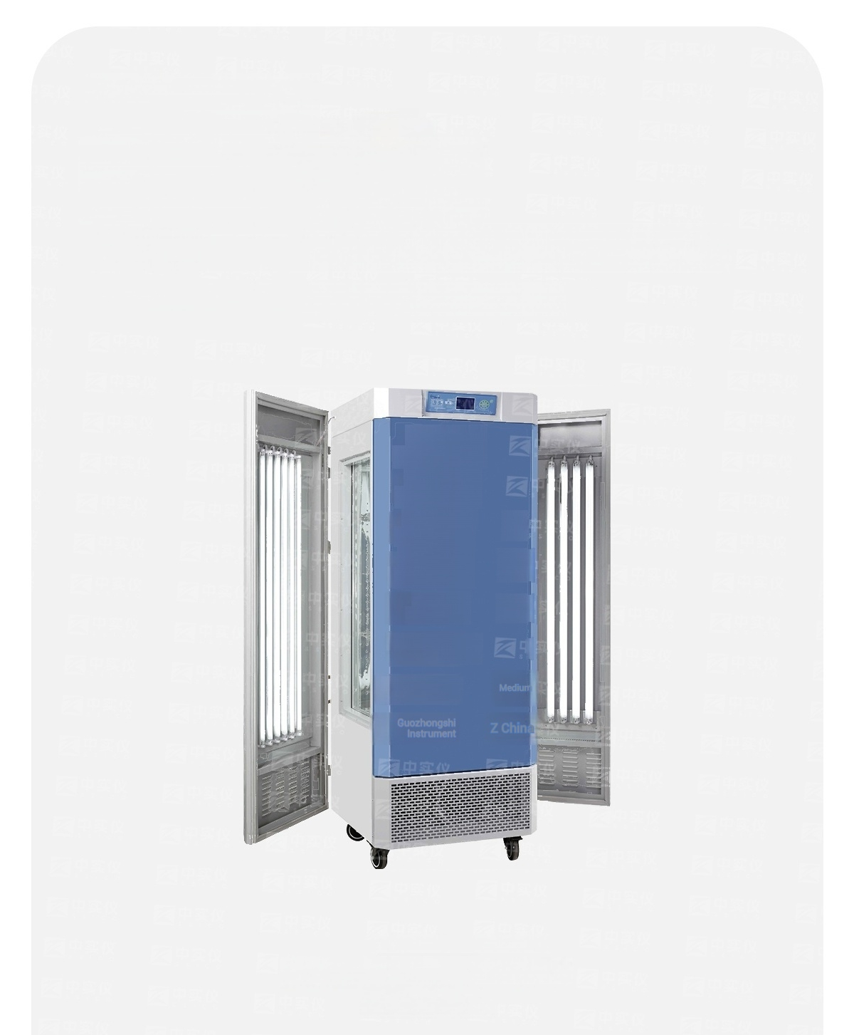
Product
Parameters o
MGC300H/350HP/400H/450HP
/800H/850HP Artificial Climate Chamber
Zhongshi
Instrument
Zhongshi
Instrument
Zhongshi
Instrument
Zhongshi
Instrument
Zhongshl
Instruent
Instrument in the
plcture
Instrument in the
Z
中 远9
plcture
Artificial climate chamber
MGC300H/350HP/400H/450HP
/800H/850HP

Slide 8
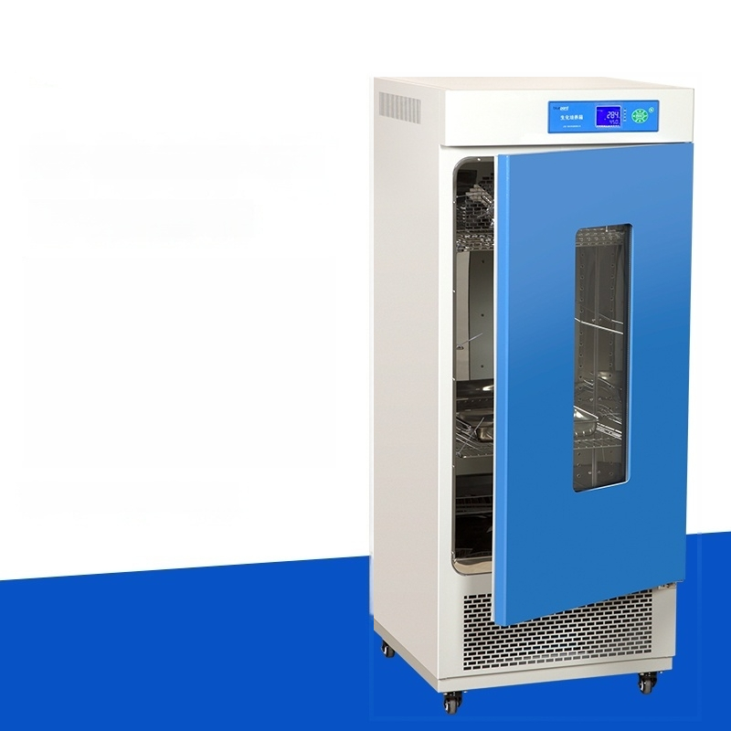
Biochemical incubator
Model:LRH-70
Temperature control
range:0~60℃
Temperature resolution:0.1 ℃
Inner tank size:400X350X500 Object holder
(standard):2 pieces
Digital display controller

Slide 9

Biochemical incubator
Model:LRH-70F
Temperature control
range:0~60℃
Temperature resolution:0.1 ℃
Inner tank size:400X350X500 Object holder
(standard):2 pieces
LCD display controller

Slide 10
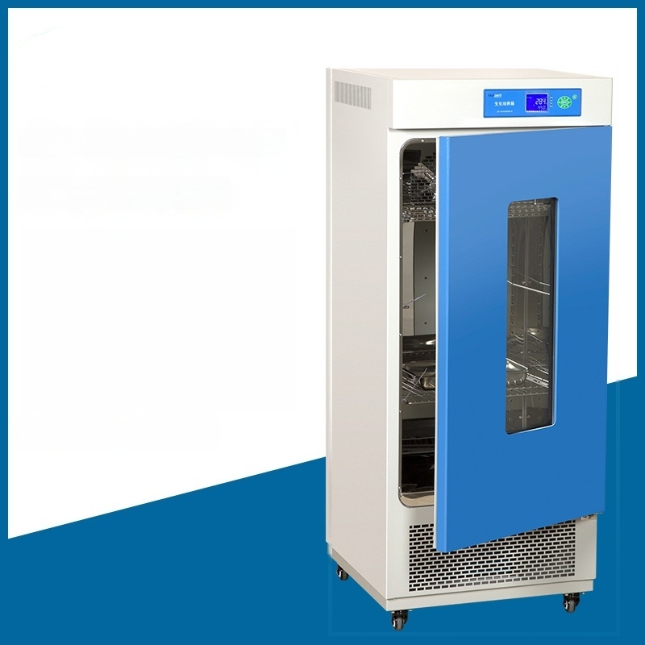
Biochemical incubator
Model:LRH-150
Temperature control
range:0~60℃
Temperature resolution:0.1 ℃
Inner tank size:503X370X808 Object tray(standard):3 pieces
Digital display controller

Slide 11
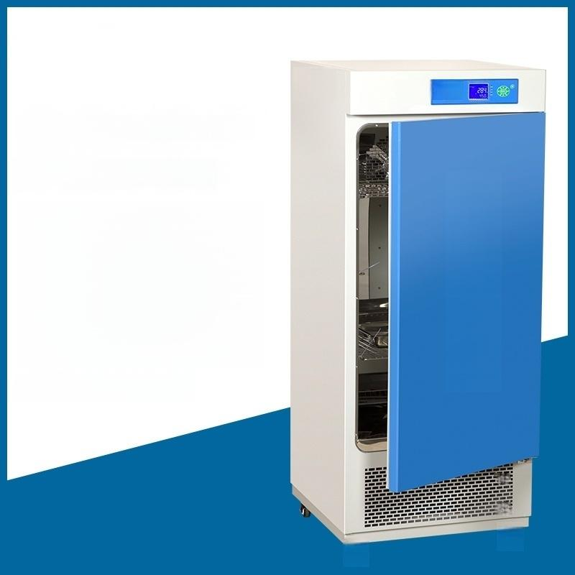


Biochemical incubator
Model:LRH-150F
Shengn Vangpai
Temperature control
range:0~60℃
Temperature resolution:0.1 ℃
Inner tank size:503X470X808 Sample tray(standard):3 pieces
LCD display controller

Slide 12

Biochemical incubator
Model:LRH-250
Temperature control
range:0~60℃
Temperature resolution:0.1℃
Inner cavity size:540X460X1000 Object carrier
(standard):3 pieces
Digital display controller

Slide 13

Biochemical incubator
Model:LRH-250F
Temperature control
range:0~60℃
Temperature resolution:0.1℃
Inner cavity size:540X460X1000 Object tray(standard):3 pieces
LCD display controller

Slide 14

Biochemical incubator
Model:LRH -500F
Temperature control
range:0~60℃
Temperature resolution:0.1 ℃
Lining dimensions:670X720X1020 Load-bearing tray
(standard):3 pieces
LCD display controller

Slide 15
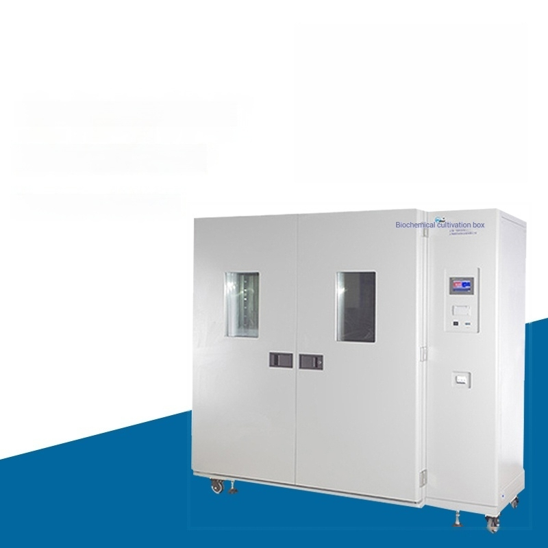
Temperature control
range:0~60℃
Temperature resolution:0.1 ℃
Inner liner size:800X590X1650
Load-bearing
(standard):3
Biochemical incubator
Model:LRH-800F
LCD display controller
tray
pieces

Slide 16

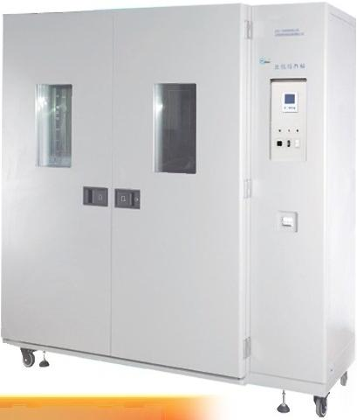

LRH-800L
Biochemical incubator
LCD display controller
Temperature control range | -10~60℃ | Inner cavity size mm | 800X590X1650
Temperature Resolution | 0.1℃ | Overall dimension mm | 1475X890X1780
Power | 2800W | Number of shelves | 3 pieces
Studio material | Stainless Steel Inner Liner | Power supply voltage | AC220V50HZ

Slide 17

Temperature resolution:0.1 ℃
Lining dimensions:1050X695X1650
Load-bearing tray
(standard):3 pieces
Temperature control range:0~60℃
Biochemical incubator
Model:LRH-1000F
LCD display controller

Slide 18



LRH-1000L
Biochemical incubator
LCD display controller
Temperature control range | -10~60℃ | Inner cavity size mm | 1550X590X1650
Temperature Resolution | 0.1℃ | Overall dimension mm | 2110X890X2050
Power | 2900W | Number of shelves | 3 pieces
Studio material | Stainless Steel Inner Liner | Power supply voltage | AC220V50HZ

Slide 19

Temperature control range:0~60℃
Biochemical incubator
Model:LRH-1500F
LCD display controller
Temperature resolution:0.1 ℃
Lining dimensions:1550X590X1650
Load-bearing (standard):3
tray
pieces

Slide 20



LRH-1500L
Biochemical incubator
LCD display controller
Temperature control range | -10~60℃ | Inner cavity size mm | 1550X590X1650
Temperature Resolution | 0.1℃ | Overall dimension mm | 2110X890×2050
Power | 3800W | Number of shelves | 3 pieces
Studio material | Stainless Steel Inner Liner | Power supply voltage | AC220V50HZ

Slide 21
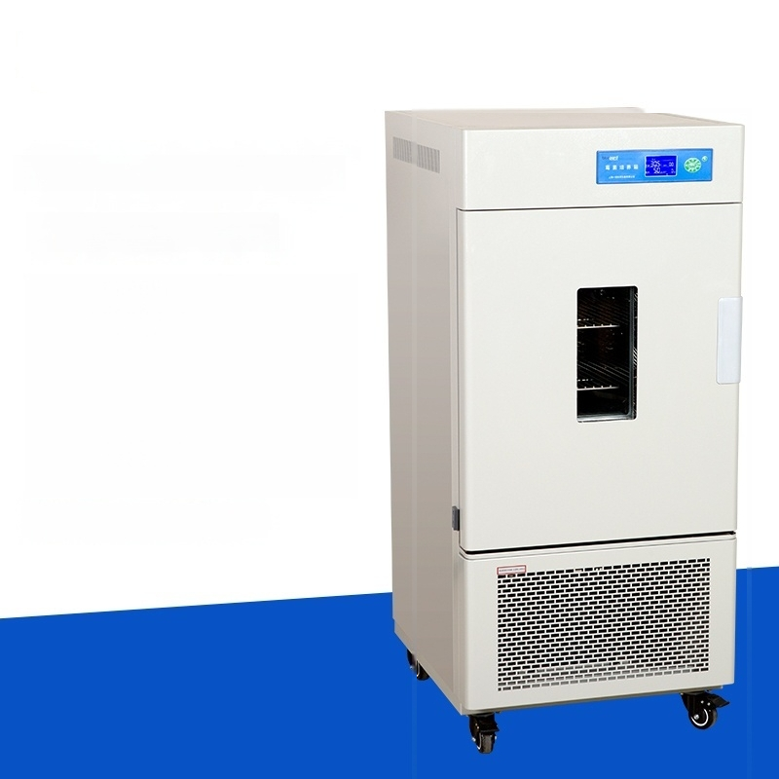
Mold Culture Incubator
Model:MJ-70-1
Temperature control
range:0~60℃
Temperature resolution:0.1 ℃
Inner tank size:400X350X500 Object holder(standard):2 pieces
Digital display controller

Slide 22
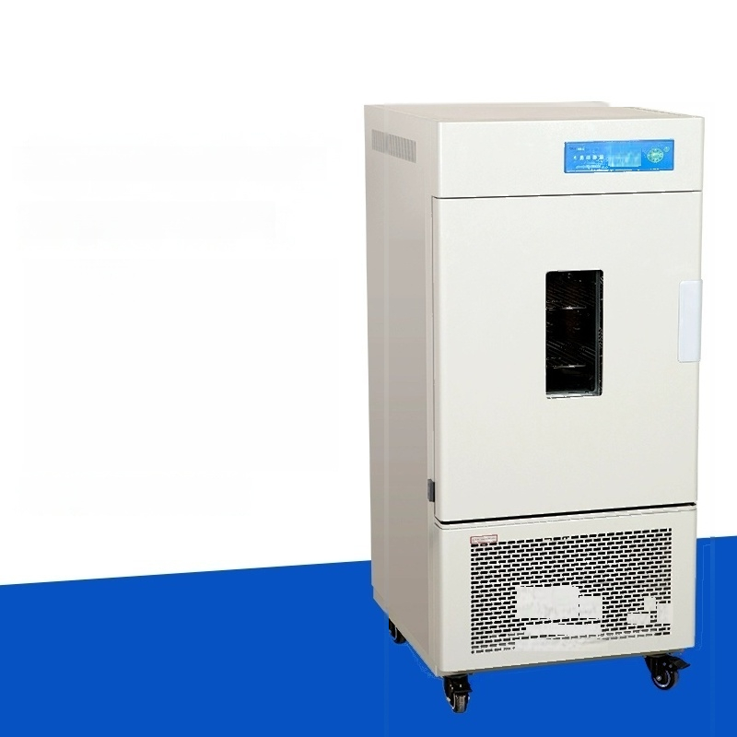
Mold Culture Incubator
Model:MJ-70F-1
姿空
Temperature control
range:0~60℃
Temperature resolution:0.1 ℃
Inner tank size:400X350X500 Object holder(standard):2 pieces
LCD display controller

Slide 23

Mold Culture Incubator
Model:MJ-150-1
Temperature control
range:0~60℃
Temperature resolution:0.1 ℃
Inner tank size:503X370X808 Object tray(standard):3 pieces
Digital display controller

Slide 24

Mold Culture Incubator
Model:MJ-150F-1
Temperature control
range:0~60℃
Temperature resolution:0.1 ℃
Inner tank size:503X370X808 Load-bearing tray
(standard):3 pieces
LCD display controller

Slide 25

Mold Culture Incubator
Model:MJ-250-1
Temperature control
range:0~60℃
Temperature resolution:0.1℃
Inner cavity size:540X460X1000 Load-bearing tray
(standard):3 pieces
Digital display controller

Slide 26

Mold Culture Incubator
Model:MJ-250F-1
Temperature control
range:0~60℃
Temperature resolution:0.1℃
Inner cavity size:540X460X1000 Object tray(standard):3 pieces
LCD display controller

Slide 27

Mold Culture Incubator
Model:MJ-500F-1
Temperature control
range:0~60℃
Temperature resolution:0.1 ℃
Lining dimensions:670X720X1020 Load-bearing tray
(standard):3 pieces
LCD display controller

Slide 28
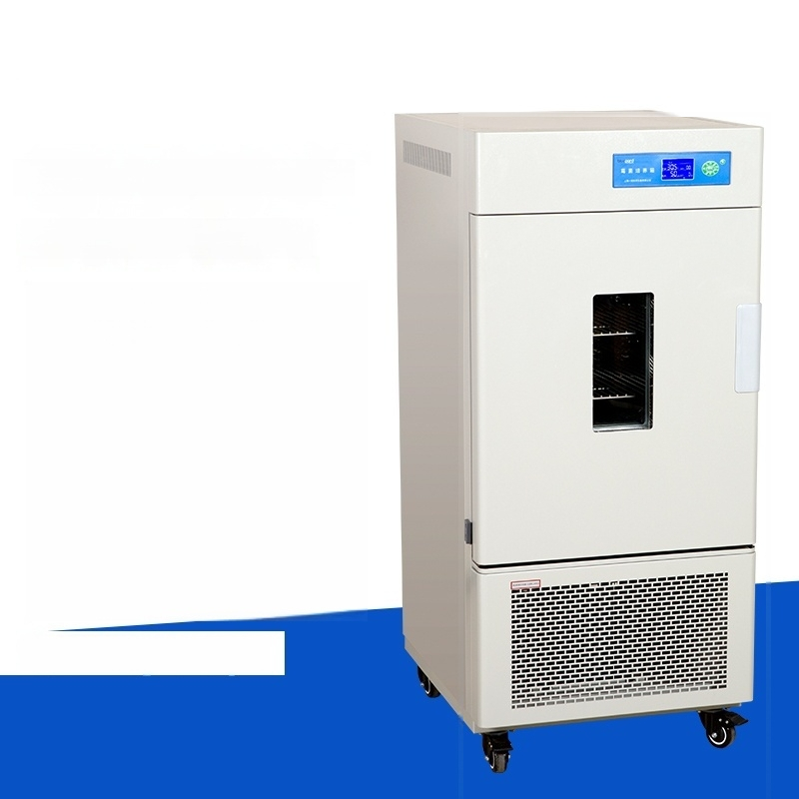
Mold Culture Incubator
Model:MJ-150-1l
Temperature Control Range:
Humidification:15~45℃
No Humidification:10~45℃
Humidity Control Range:60~85%RH Humidity Deviation:±5~8%RH Temperature resolution:0.1℃
Lining dimensions:550X405X670 Load-bearing tray
(standard):3 pieces
LCD display controller

Slide 29
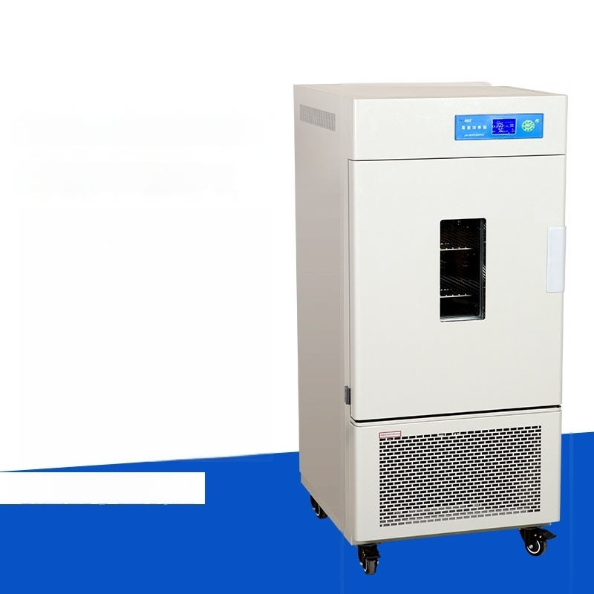
Mold Culture Incubator
Model:MJ-250-1l
Temperature Control Range:
Humidification:15~45℃
No Humidification:10~45℃
Humidity Control Range:60~85%RH Humidity Deviation:±5~8%RH Temperature resolution:0.1℃
Lining dimensions:650X500X830 Load-bearing tray
(standard):3 pieces
LCD display controller

Slide 30
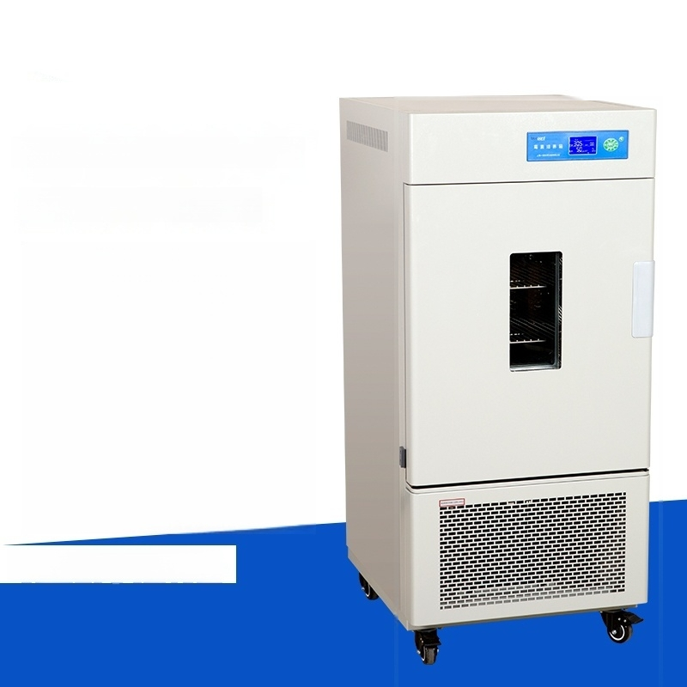
Mold Culture Incubator
Model:MJ-500-II
Temperature Control Range:
Humidification:15~45℃
No Humidification:10~45℃
Humidity Control Range:60~85%RH Humidity Deviation:±5~8%RH Temperature Resolution:0.1℃
Lining dimensions:670X720X1020 Load-bearing tray
(standard):3 pieces
LCD display controller

Slide 31
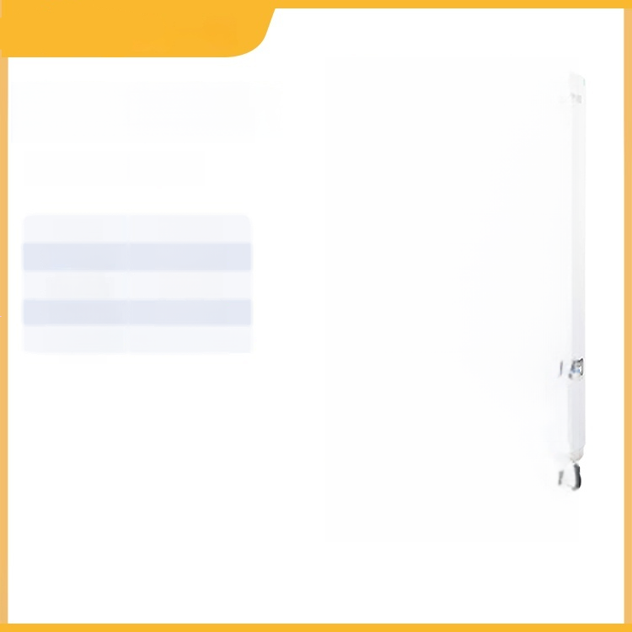
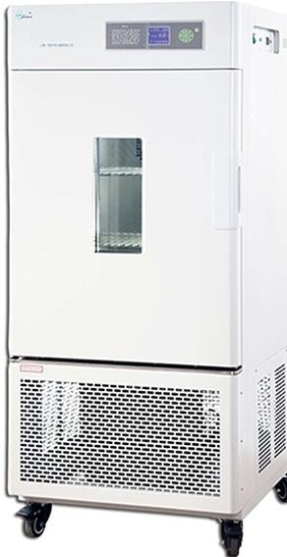
Constant temperature
and humidity chamber
LHS-80HC-I
Power | 2000W
Temperature control range | -5-80℃
Operating temperature | 5-35℃
Humidity deviation | ±3RH℃
Power supply | AC220V 50HZ
voltage

Slide 32
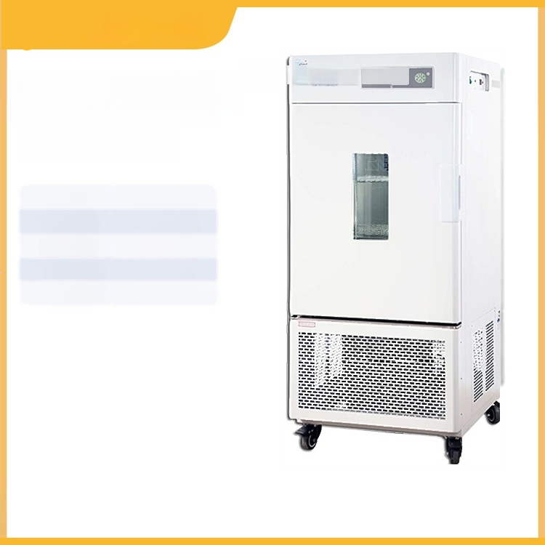
Constanteperatue and humiadycfanan
and humidity chamber
LHS-80HC-Il
Constant temperature
Power | 2000W
Temperature control range | -10-70℃
Operating temperature | 5-35℃
Humidity deviation | ±3RH℃
Power supply | AC220V 50HZ
voltage

Slide 33

Constanteperatue and humiadycfanan
and humidity chamber
LHS-150HC-I
Constant temperature
Power | 2100W
Temperature control range | -5-80℃
Operating temperature | 5-35℃
Humidity deviation | ±3RH℃
Power supply | AC220V 50HZ
voltage

Slide 34

Constanteperatue and humiadycfanan
and humidity chamber
LHS-150HC-Il
Constant temperature
Power | 2100W
Temperature control range | -10-70℃
Operating temperature | 5-35℃
Humidity deviation | ±3RH℃
Power supply | AC220V 50HZ
voltage

Slide 35

Constanteperatue and humiadycfanan
and humidity chamber
LHS-250HC-I
Constant temperature
Power | 2300W
Temperature control range | -5-80℃
Operating temperature | 5-35℃
Humidity deviation | ±3RH℃
Power supply | AC220V 50HZ
voltage

Slide 36

Constanteperatue and humiadycfanan
and humidity chamber
LHS-250HC-Il
Constant temperature
Power | 2300W
Temperature control range | -10-70℃
Operating temperature | 5-35℃
Humidity deviation | ±3RH℃
Power supply | AC220V 50HZ
voltage

Slide 37

Constant temperature and ^{constantemeatur} ^{an} ^{humiaryh} ^{n} humidity chamber
LHS-800HC-I
Power | 8050W
Temperature control range | -5~80℃
Operating temperature | 5-35℃
Humidity deviation | ±3RH℃
Power supply | AC220V 50HZ
voltage

Slide 38

Constanteperatue and humiadycfanan
and humidity chamber
LHS-800HC-Il
Constant temperature
Power | 8050W
Temperature control range | -10-70℃
Operating temperature | 5-35℃
Humidity deviation | ±3RH℃
Power supply | AC220V 50HZ
voltage

Slide 39
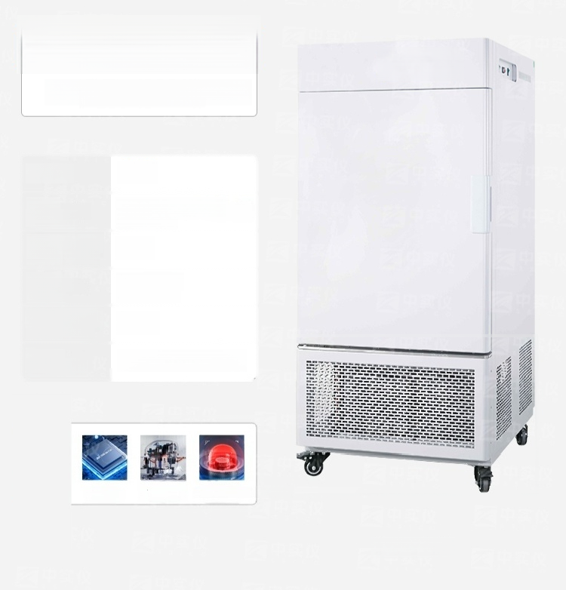

MGC-100
Light Cultivation Incubator
Volume: ^{150L}
Light 0-12000LX Six-level Intensity: adjustable
Temperature Fluctuation: | ±1℃
Lighting Single-sided Mode: illumination
Temperature Resolution: | 0.1℃
Overall Dimensions: | 690×800×1410mm
Program Control
Iimported Drand Compressor
Independent temperature limiting alarm system
MGC-100

Slide 40
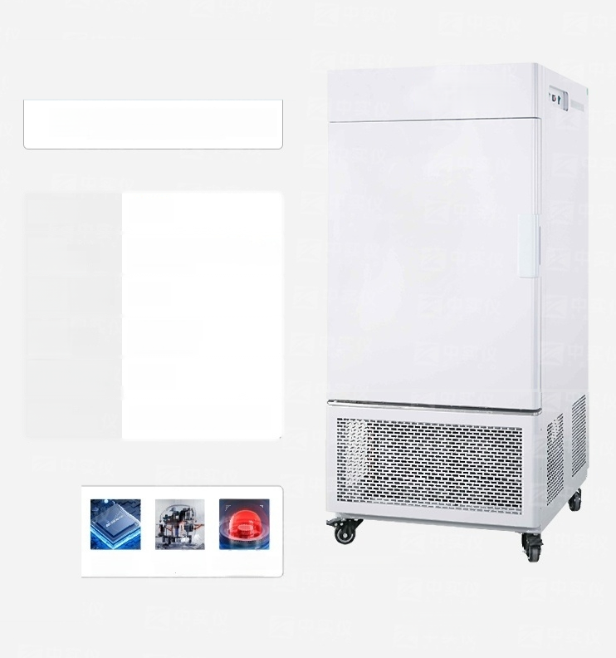

Light Cultivation Incubator
Volume: | 150L
Light Intensity: | 0-12000LX Six-level adjustable
Temperature Fluctuation: | ±1℃
Lighting Mode: | Single-sided illumination
Temperature Resolution: | 0.1℃
Overall Dimensions: | 690×800×1410mm
Program Control
Imported Drand Compressor
Independent temperature limiting alarm system
MGC-100P

Slide 41
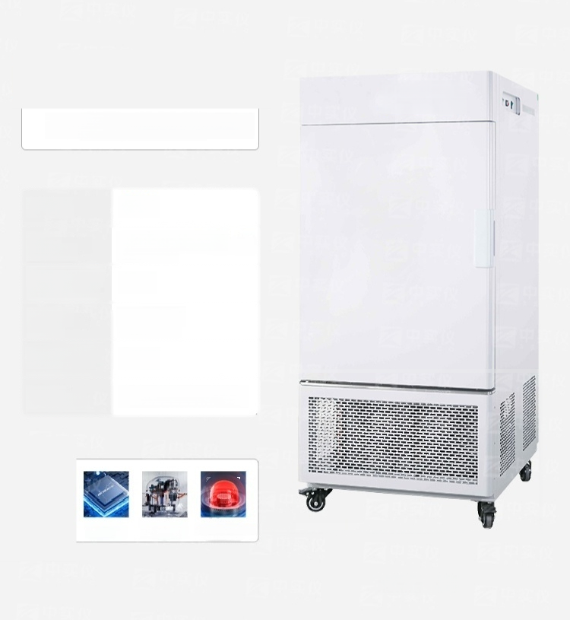

Light Cultivation Incubator
Volume: | 250L
Light 0-12000LX Six-level Intensity: adjustable
Temperature ±1℃ Fluctuation:
Lighting Mode: | Single-sided illumination
Temperature Resolution: | 0.1℃
Overall Dimensions: | 760×815×1550mm
Program Control
Imported Erand Compressor
Independent temperature limiting alarm system
MGC-250

Slide 42
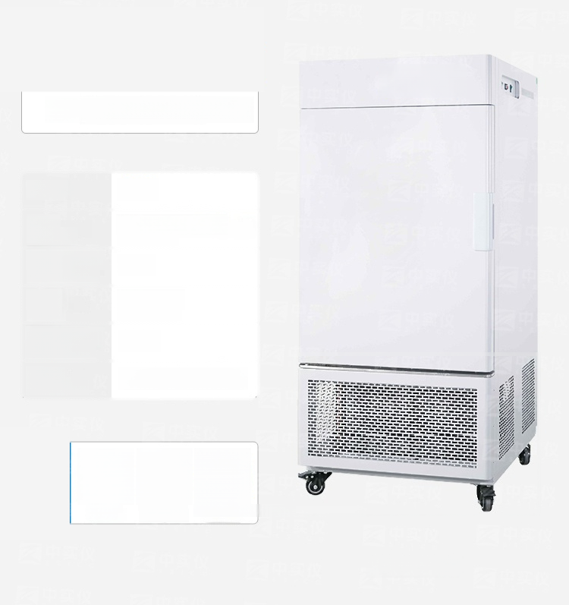




Light Cultivation Incubator
Volume: | 250L
Light Intensity: | 0-12000LX Six-level adjustable
Temperature Fluctuation: | ±1℃
Lighting Mode: | Single-sided illumination
Temperature Resolution: | 0.1℃
Overall Dimensions: | 760×815×1550mm
Program Control
Imported Brand Compressor
Independent temperature limiting alarm system
MGC-250P

Slide 43

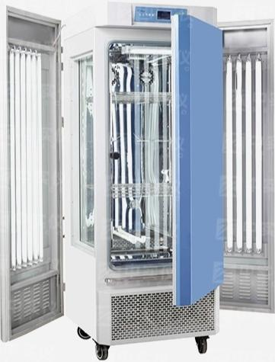
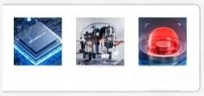
Light Cultivation Incubator
Volume: | 300L
Light Intensity: | 0-15000LX adjustable in six levels
Temperature Fluctuation: | ±1℃
Lightng Mode: | Both sides illuminated
Temperature Resolution: | 0.1℃
Overall Dimensions: | 830×850×1850mm
Meneomputr Program Control
Imported Drand Compressor
Independent temperature limiting alarm system
MGC-300A

Slide 44


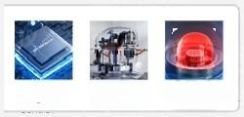
Light Cultivation Incubator
Volume: | 300L
Light Intensity: | Adjustable from 0 to 20,000 Lux in six levels
Temperature Fluctuation: | ±1℃
Lighting Mode: | Three-sided illumination
Temperature Resolution: | 0.1℃
Overall Dimensions: | 830×850×1850mm
Mereonpute
Program Control
Imported Erand Compressor
Independent temperature limiting alarm system
MGC-300B

Slide 45

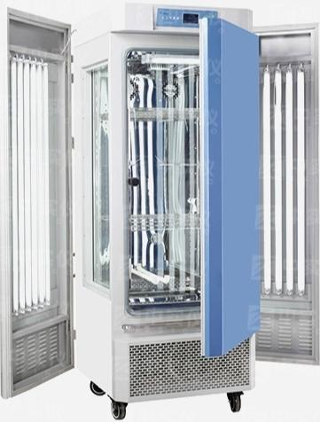
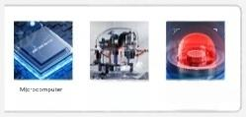
Light Cultivation Incubator
Volume: | 300L
Light Intensity: | Adjustable from 0 to 20,000 Lux in six levels
Temperature Fluctuation: | ±1℃
Lighting Mode: | Three-sided llumination
Temperature Resolution: | 0.1℃
Overall Dimensions: | 830×850×1850mm
Program Control
Imported Drand Compressor
Independent temperature limiting alarm system
MGC-350BP

Slide 46


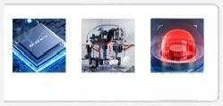
Light Cultivation Incubator
Volume: | 450L
Light Intensity: | 0-25000LX adjustable level
Temperature Fluctuation: | ±1℃
Lighting Mode: | Three-sided illumination
Temperature Resolution: | 0.1℃
Overall Dimensions: | 950×850×1850mm
MeIeeaomputu Program Control
Imported Drand Compressor
Independent temperature limiting alarm system
MGC-400B

Slide 47


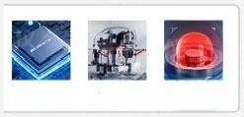
Light Cultivation Incubator
Volume: | 450L
Light Intensity: | 0-25000LX adjustable level
Temperature Fluctuation: | ±1℃
Lighting Mode: | Three-sided llumination
Temperature Resolution: | 0.1℃
Overall Dimensions: | 950×850×1850mm
MeIeeaomputu Program Control
imported Drand Compressor
Independent temperature limiting alarm system
MGC-450BP

Slide 48


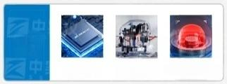
Light Cultivation Incubator
Volume: | 800L
Light Intensity: | 0-30000LX adjustable in six levels
Temperature Fluctuation: | ±1℃
Lightng Mode: | Partition type illumination (two layers)
Temperature Resolution: | 0.1℃
Overall Dimensions: | 1475×890×1780mm
Program Control
Imported Drand Compressor
Independent temperature limiting alarm system
MGC-800B

Slide 49


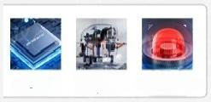
Light Cultivation Incubator
Volume: | 800L
Light Intensity: | 0-30000LX adjustable in six levels
Temperature Fluctuation: | ±1℃
Lighting Mode: | Partition type llumination (two layers)
Temperature Resolution: | 0.1℃
Overall Dimensions: | 1475×890×1780mm
Program Control
Imported Drand Compressor
Independent temperature limiting alarm system
MGC-850BP

Slide 50


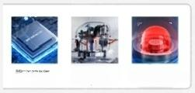
Artificial climate chamber
Volume: | 300L
Light Intensity. | Adjustable from 0 to 20,000 Lux in six levels
Temperature Fluctuation: | ±1℃
Lightng Mode: | Three-sided illumination
Temperature Resolution: | 0.1℃
Overall Dimensions: | 830×850×1850mm
Program Control
Imported Brand Compressor
Independent temperature limiting alarm system
MGC-300H

Slide 51


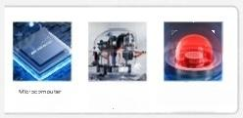
Artificial climate chamber
Volume: 300L
Light Adjustable from O to Intensity: 20,000 Lux in six levels
Temperature Fluctuation: | ±1℃
Lighting Three-sided Mode: illumination
Temperature Resolution: | 0.1℃
Overall 830×850×1850mm Dimensions:
Imported
Erand
Program Control
Compressor Independent temperature limiting alarm system
MGC-350HP

Slide 52

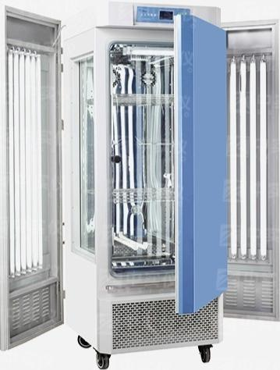
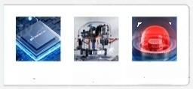
Artificial climate chamber
Volume: | 450L
Light Intensity: | 0-25000LX adjustable level
Temperature Fluctuation: | ±1℃
Lighting Mode: | Three-sided illumination
Temperature Resolution: | 0.1℃
Overall Dimensions: | 950×850×1850mm
Mereonpute
Program Control
Imported Erand Compressor
Independent temperature limiting alarm system
MGC-400H

Slide 53



Artificial climate chamber
Volume: | 450L
Light Intensity: | 0-25000LX adjustable level
Temperature Fluctuation: | ±1℃
Lighting Mode: | Three-sided illumination
Temperature Resolution: | 0.1℃
Overall Dimensions: | 950×850×1850mm
Mieeenpute
Program Control
Imported Erand Compressor
Independent temperature limiting alarm system
MGC-450HP

Slide 54


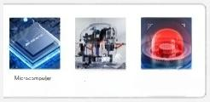
Artificial climate chamberr
Volume: | 800L
Light Intensity: | 0-30000LX adjustable in six levels
Temperature Fluctuation: | ±1℃
Lighting Mode: | Partition type llumination (two layers)
Temperature Resolution: | 0.1℃
Overall Dimensions: | 1475×890×1780mm
Program Control
Imported Drand Compressor
Independent temperature limiting alarm system
MGC-800H

Slide 55


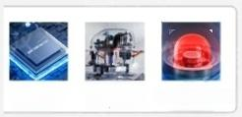
Artificial climate chamber
Volume: | 800L
Light Intensity. | 0-30000LX adjustable in six levels
Temperature Fluctuation: | ±1℃
Lighting Mode: | Partition type llumination (two layers)
Temperature Resolution: | 0.1℃
Overall Dimensions: | 1475×890×1780mm
eng
Program Control
imported Drand
Compressor Independent temperature limiting alarm system
MGC-850HP

