Slide 1
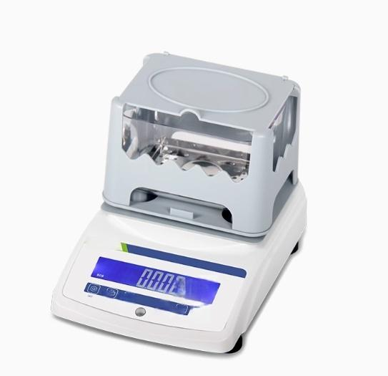
Frr
四

Slide 2
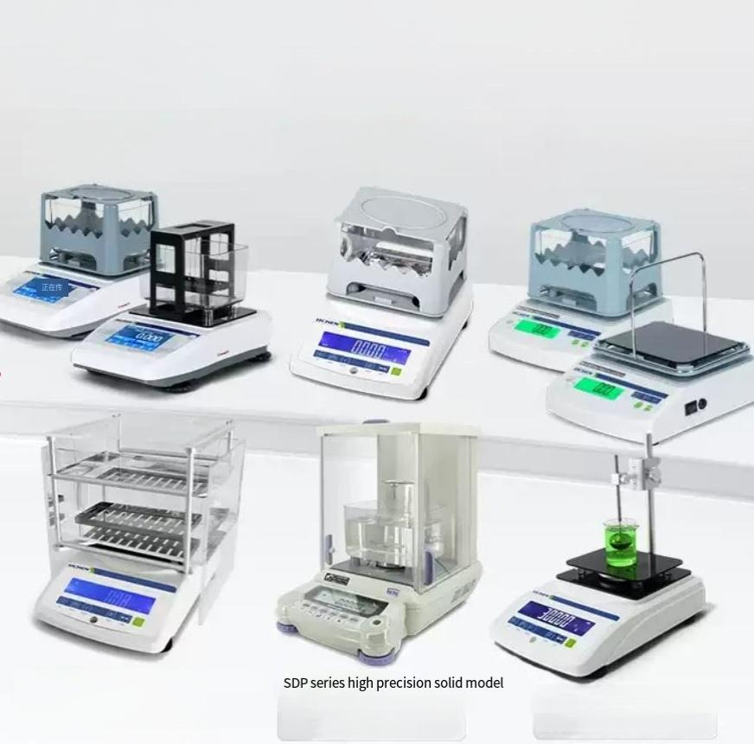



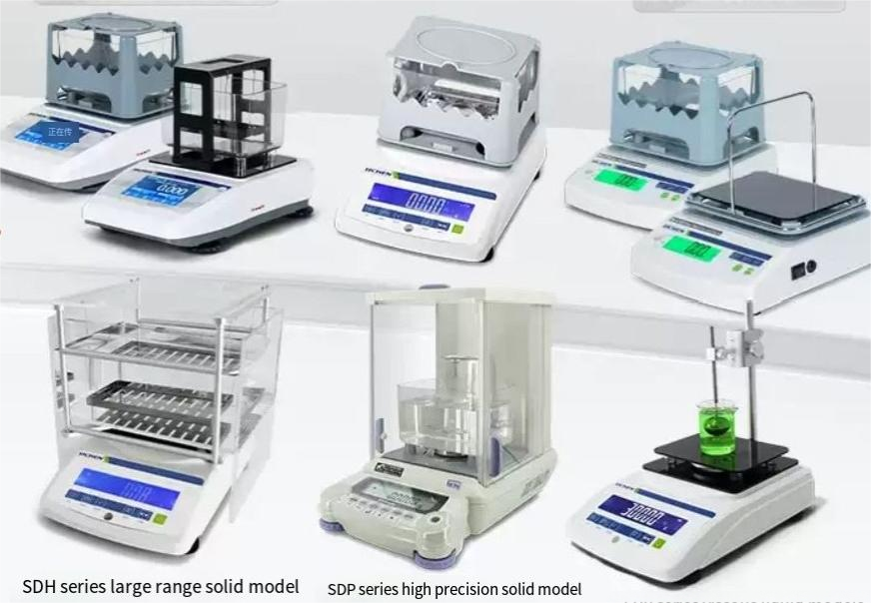
High precision electronic densitometer
High precision,multi-function,
stable,accurate and fast
^{SDT\LDT\ADT} ^{series} ^{professional} ^{models} SDB\LDB\PDB series basic model
5"color touch screen
Applicable sample:Solid\absorbent solid\liquid
Applicable sample:Solid\Liquid\powder
SMH\LMH series economy model
Applicable sample:Solid\liquid
SDH series large range solid model
Siecan be customined
Suitable sample:largevolumesolid
Electromagnetic force sensor Suitable sample:solid
LDV series viscous liquid models Suitable sample:viscous liquid

Slide 3
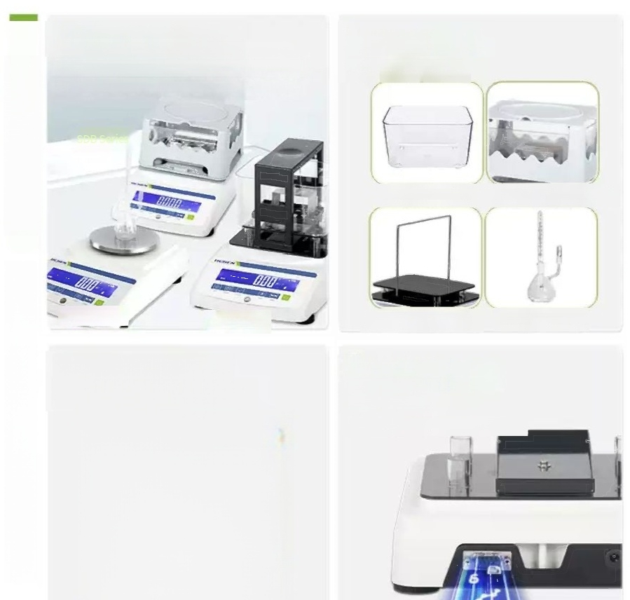
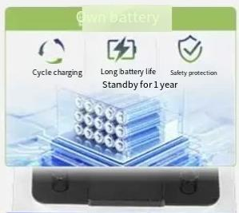
"Various models to choose from"
"Solid/liquid/solid-liquid dual use/powder models complete,with different accessories to form different densitometers
^{FDB} ^{Series} _{LDB} _{Series}
"Hd LCD LCD screen"
backlit for clear reading
"Selected density
accessories"Wear resistance
and corrosion resistance
Integrated injection molded water tank
ABS plastic/aluminum alloy measuring table
solid/liquid/powder SDB ILDBIPDB series basic models
High strength density support plate
High precision pycnometer
Standard RS232
interface for easy data transmission
Add timingto make experimentation easier

Slide 4
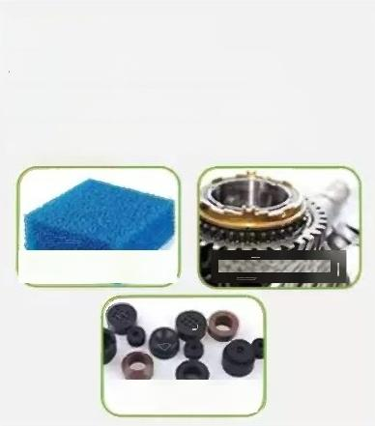
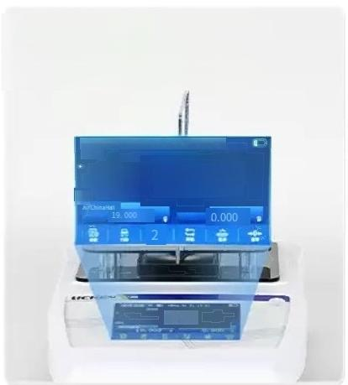
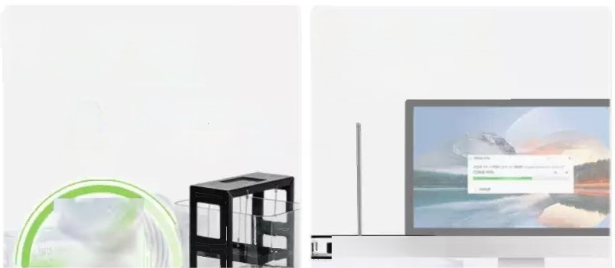

"Wide selection"
Solid,liquid/absorbent
solid/solid-liquid dual use
Water absorption solid function:After pretreatment,it can measure the porosity,oil content and otherparameters
①absorbent solid density ② Oil content of solids
Solids loss rate
The"5inch color touch screen Big screen"is simple and
intuitive with intelligent tips
Liqid Density22401213HLweightin Fquid
0.000,
0.000
ok
solid/liquid/powder SDTLDTADT series Professional
The whole series adopts "imported HBM sensor"
"Standard RS232 interface"
Convenient data transmission new timing function,make the experiment easier
0 . 0001g/cm³
^{High} ^{performance} _{Accurate} _{measurement}
3S
chip

Slide 5

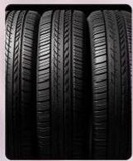
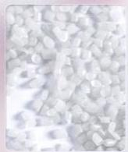
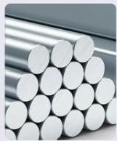
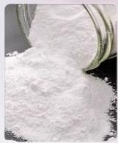
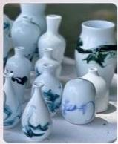

Widely used to meet the
needs of various
experiments
Liquid(mobile liquid,viscous liquid,volatile liquid,
corrosive liquid)Solid(block,particle,film,floating body)
Powders(vulcanized rubber,non-foamplastics,carbon truedensity,cement powder,natural stone)
Rubber
Plastic
Metal
Powder
Ceramic
Liquid

Slide 6



New upgraded HBM sensor
imported from Germany
Stable perfomance and accurate measurement
Imported chips
Accurate
measurement
Numerical
stability

Slide 7
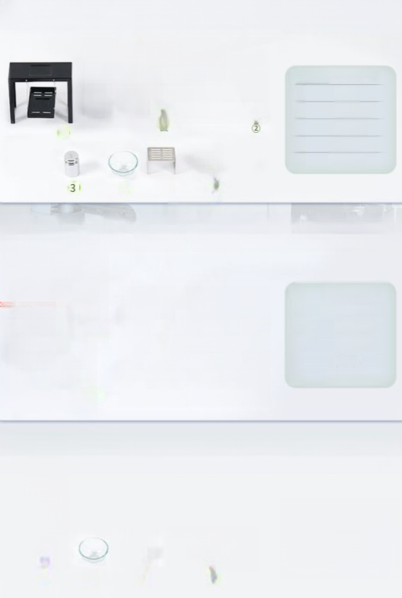
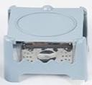



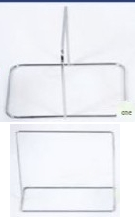
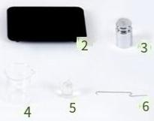




Solid density meter
accessories
①
②
③
④
⑤
Nesuingtblewithhaging bk
Sink
Beaker
tennis
Weights
Anb-toring ak
4 ⑤ 6
Liquid densitometer accessories
① | Measring brackets
② | Densitysupport plate
③ | Weights
④ | Beaker
⑤
⑥ Metal hooks
Powder densitometer accessories
① ②
③
④
Speofcgpziybomepwith
Heomiea
Glassware
Caibration weights
suinleseswegpingtap
ane
2 3 4

Slide 8
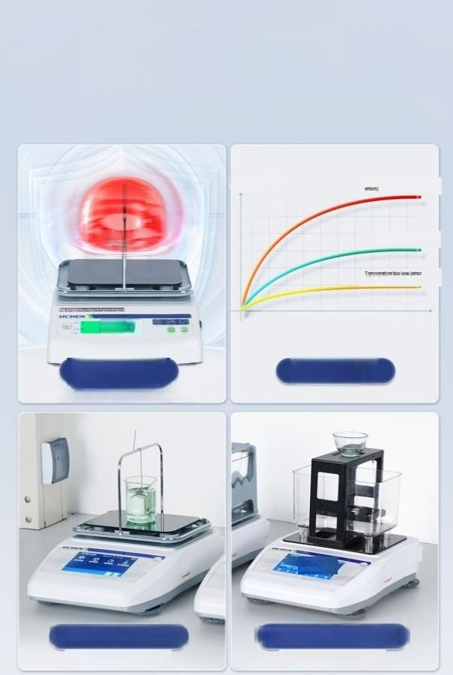
Measurement more accurate density condition setting
function
Stable performance,accurate measurement
Calbration vaue Ecesietenpenuepoducs
ldelteperueleorngcted)
ge
Thisdaaisdeeminedbythetendstitenteyndwisbytool
000置
Densityupper and lower limits
(Out of range buzzer tips)
Temperature
compensation
0000
Gravity hammerdensity setting
(Specialfor iquid density meter)
Liquid medium density setting
(Special forsolid densitometern

Slide 9
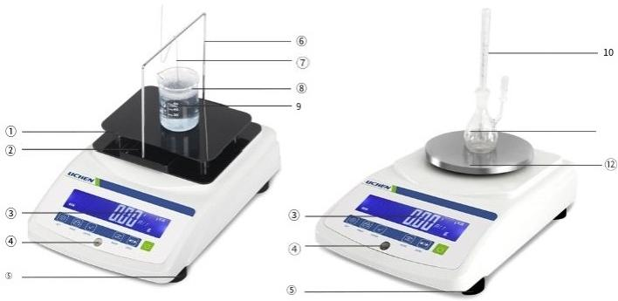
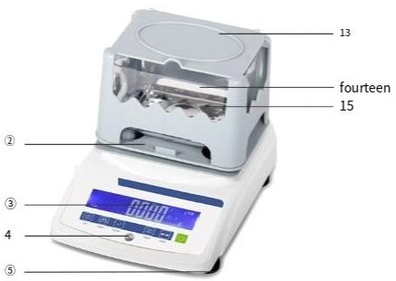
1 Solid/liquid/powder
SDB\LDB\PDB series basic model
①Density support board ② Host countertop ③ Display screen
④ Horizontal Bubble ⑤ Horizontal adjustment nut ⑥ Bracket
⑦ Metal hook ⑧ Beaker ⑨ Specific gravity hammer
⑩ Temperature gauge ⑪pycnometer ⑫Weighing plate
⑬Measuring table ⑭water channel ⑮Hanging basket

Slide 10
Basic model-SDB series solid density meter
Product Model | LC-SDB-3002 | LC-SDB-6002 | LC-SDB-9002 | LC-SDB-12002
sensor | Homegrown sensorS | Homegrown sensors | Homegrown sensors | Homegrown sensors
Weighing range | 0.01-300g | 0 . 01- 600g | 0.01-900g | 0.01-1200g
Weighingaccur | ac y 0 .01g | 0.01g | 0.01g | 0.01g
Density measuring range | >1,<lg/cm3 are acceptable | >1,<lg/cm3is acceptable | >1,<lg/cm3is acceptable | >1,<1g/cm3 is acceptable
Density accuracy | 0.001g/cm³ | 0.001g/cm³ 0.001g/cm³ |  | 0.001g/cm³
Tanpeaureompensnrion ang | 0-100℃ | 0-100℃ | 0-100℃ | 0-100℃
Liquid medium density setting range | 0001--19.999 g/cm³ | 0.001--19.999 g/cm³ | 0.001--19.999 g/cm³ | 0.001--19.999 g/cm³
Standard weig | h ts 100g | 200g | 5 0 0 g | 500g
Supply voltage | 220v/50hz | 220wv50hz | 220wv50hz | 220wv50hz
power | 10w | 10w | 10w | 10w
Net weigh | t 4kg | 4kg | 4kg | 4kg
Product size (LXWN) 190*275190*275*2 |  | 00mm*200mm | 190*275190*275*20 | 0mm*200mm

Slide 11
Product model | LC-SDB-3005 | LC-SDB-6005 | LC-SDB-1203 | LC-SDB-2003
sensor | HBM sensor | HBM sensor | HBM sensor | HBM sensor
Weighing range | 0.005-300g | 0.005-600g | 0.001-120g | 0.001-200g
Weighing accurac | 0.005g | 0.005g | 0.001g | 0.001g
Density measurng range | >1,<lg/cm3 are acceptable | >1,<1g/cm3 is acceptable | >1,<1g/cm3 is acceptable | >1,<1g/cm3 is acceptable
Density accuracy | 30.001g/cm³ | 0.001g/cm³ | 30.0001g/cm³ | 30.0001g/cm³
Temperature compensation ra^{nge} | 0-100°℃ | 0-100℃ | 0-100℃ | 0-100℃
Liquid medium
density setting | 0.001--19.999 | 0.001--19.999 | 0.0001--19.9999 | 0.0001--19.9999
range | g/cm³ | g/cm³ | g/cm³ | g/cm³
Standard weights | 100g | 200g | 100g | 100g
Supply voltage | 220v/50 hz | 220wv50hz | 220wv50hz | 220wv50hz
power | 10w | 10w | 10w | 10w
Net weight 4kg |  | 4kg | 4kg | 4kg
Product Size 190*275190*275*20 (LXWXH) |  | 0mm*200mm | 190*275190*275*200 | mm*200mm

Slide 12
Basic model-LDB series liquid densitometer
 | Product Mode | Ic-ldb-3002 | LC-LDB-6002 | LC-LDB-3005 | LC-LDB-1203系列
 | _{sensor} ;Homegrown sensor |  | Homegrown sensors | HBM sensor | HBM sensor
 | Weighingrange 0.01-300g |  | 0.01-600g | 0.005-300g | 0.001-120g
 | Weighing accuracy 0.01g |  | 0.01g | 0.005g | 0.001g
 | Density measuring 0.001--19.999 range g/cm³ |  | 0.001--19.999 g/cm³ | 0.001--19.999 g/cm³ | 0.001--19.999 g/cm³
 | Density accuracy0.001g/cm³ |  | 0.001g/cm³ | 0.001g/cm³ | 0.0001g/cm³
 | Standard weights 100g |  | 200g | 100g | 100g
 | nput power supply ^{220v/50} ^{hz} |  | 220v/50 hz | 220v/50 hz | 220v/50 hz
 | power | 10w | 10w | 10w | 10w
 | Net weight 4kg |  | 4kg | 4kg | 4kg
 | Product Size 268*192268*192 (LXWXH) |  | *215mm*215mm | 268*192*215mm | 268*192*215mm

Slide 13
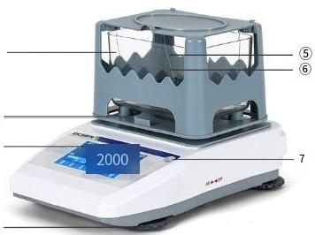
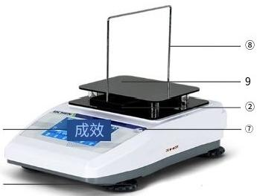
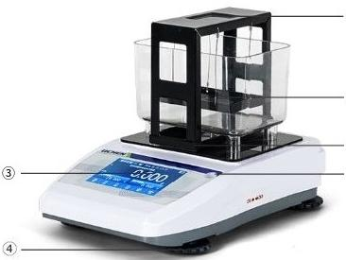
1 Solid/liquid/absorbent solid
SDT\LDT\ADT series professional models
①
② ③
④
⑤
③
4
⑤
⑥
② ⑦
①Water Tank ②Countertop
⑥Hanging basket ⑦Horizontal bubble
③Display
⑧Stand
④Horizontal adjustment nut ⑤Measuringtable Density support plate

Slide 14
Professional model-SDT series touch screen solid density meter
Models | LC-SDT-LC- 12002 | SDT-LC-SDT 3205 | LC-SDT系列 6205 1203 |  | LC-SDT系列 2203 | LC-SDT系列 -3203
Sensors | HBM sensor | HBM sensor HB | M sensor | HBM Sensor | HBM sensor | HBM sensor
WigingTg | 0.01-1200g | 0.005-320g | 0.005-620g | 0.001-120g | 0.001-220g | 0.001-320g
Weighing accurac | y 0.01g | 0.005g | 0.005g | 0.001g | 0.001g | 0.001g
DansiymesuningTg | >1g/cm3 <1g/㎝ | >1g/cm3 ≤1g/cm | >1g/cm3 <1g/㎝ | >1g/cm³ <1g/cm³ | >1g/cm3<1 g/cm² | >1g/㎝³1g/㎝³
DansiymeBurenent uncy | 0.001g/㎝ | 0.001g/cm 0 | .001g/cm 0.0 | 001g/cm 0.00 | 01g/cm 0.0001g/cm
Mesurenentsttyime | <3s | :3s | <3s | <3s | 3s | <3s
Liquid medium denesity ettngrange | No limit | No Limit | No Limit | No Limit | No Limit | No Limit
Mepuningtie m0na | Plastic | Plastic | Plastic | Aluminumalloy | Auminumaloy | Huminum aloy
Citeticnweigscme tndn | 500g | 100g | 200g | 1 0 0 g | 100g | 100g
supply woltage | 220V50/60Hz | 220V50/60Hz | 220V50/60hz |  |  | 220v50/60Hz
power | 10w | 10w | 10w | 10w | 10w | 10w
Net weight | 2kg | 2kg | 2kg | 2kg | 2kg | 2kg
Productsie | 200*290*220mm | 200*290*220mm | 200*290*220mm | 200*290*220mm | 200*290*220mm | 200*290*220mm

Slide 15
Professional-LDT Series touch screen liquid density meter
Models | Ic-ldt-3205 | lc-ldt-1203
sensor | HBM sensor | HBM sensor
Weighing range | 0.005-320g | 0.001-120g
Weighing accuracy | 0.005g | 0.001g
Density measuring rang | >1g/cm2,≤1g/㎝ | >1g/cm,<1g/cm
Density measurement ac_{curacy} | 0.001g/cm³ | 0.0001g/㎝
Measurement stabilit^{y} ^{time} | <3s | <3s
Specific gravity hammer(weight)density | setting range No limits | No Limit
Measured values | Weight value,density v | alue,Baume degree,concentration
Calibration weights com | e standard 100g | 100g
Supply voltage | 220v50/60Hz | 220v50/60Hz
power | 10w | 10w
Net weight | 2kg | 2kg
Product size(L×WXH) | 200×290×220mm | 200×290×220mm

Slide 16
Professional model-ADT series touchscreen multi-function solid density meter
Models | lc-adt-3205 |  | c-adt-1203
sensor | HBM sensor |  | HBM sensor
Weighing range | 0.005-320g |  | 0.001-120g
Weighing accuracy | 0.005g |  | 0.001g
Density measurng range | >1g/cm³，<1g/cm³ |  | 米 >1g/cm³，<1g/cm³
Density measurement accurac y |  | 0.001g/cm² | 0.0001g/㎝
Measurement stabili | ty time <3s |  | <3s
Liquid medium density sett | ing range No limit |  | No Limit
Measuring table ma | terial Plastic |  | Aluminum alloy
Calibration weights co | me standard 100g |  | 100g
Supply voltage | 220v50/60Hz |  | 220v50/60Hz
powe | 10w |  | 10w
Net weight | 2kg |  | 2kg
Product Size(LXWXH) | 200×290×200mm |  | 200×290×200mm

Slide 17
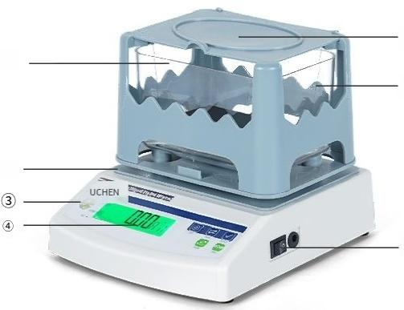
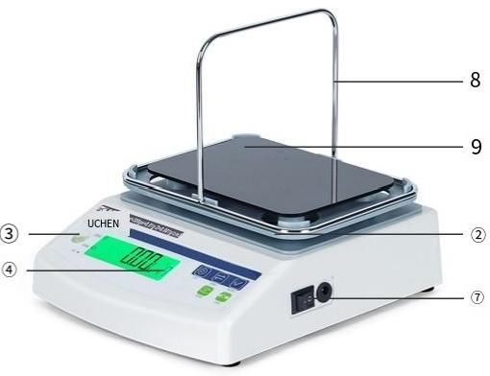
Solid/liquid SMH\LMH
series economy models
⑤
⑥
③Horizontal bubble
⑧stand
①
②
③
① Water Tank ②Countertop
⑥ Hanging basket ⑦Switch
_{④Display} ^{asuring} Density support plate
⑤
e
ta
e

Slide 18
Economy model-SMH series solid density meter
Model | lc-smh-3002e | lc-smh-3002 | lc-smh-6002
sensor | Strain gauge sensor | High precision strain gauge sens0T | High precision strain gauge sens
Weighing range | 0.01-300g | 0.01-300g | 0.01-600g
Waighingacouracy | 0.01g | 0.01g | 0.01g
Density measuring range | ≥1g/cm³，<1g/cm³ | ≥1g/cm³，<1g/cm³> | 1g/cm³，<1g/cm³
Density accuracy | 0 . 001g/cm³ | 0 . 001g/cm³ | 0 . 001g/cm³
Temperature compensati on range | 0-100℃ | 0-100*℃ | 0-100*℃
Lquid medium density setting rang | 0-19.999g/cm³ | 0-19.999g/cm | 0-19.999g/cm³
Standard weighte | 100g | 100g | 200g
Supply voltages | 220v50hz | 220v50hz | 220v50hz
power | 10w | 10w | 10w
Net weight | 2.1kg | 2.1kg | 2.1kg
Product size(L×WXH) | 160x240x200mm | 160x240x200mm | 160×240×200mm
or

Slide 19
Economy model-LMHseries liquid densitometer
Model | lc-lmh-3002
Weighingrange | 0.01-300g
Weighing accuracy | 0.01g
Denstymesuningrang | 0.001--19.999g/㎝
Density accuracy | 0.001g/㎝
Standard weights | 100g
Supply voltage | 220v50hz
power | 10w
Net weight | 2.1kg
Product size(L×W×H) | 160×240x200mm

Slide 20
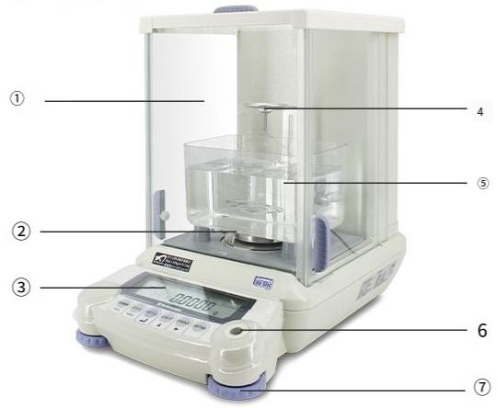
Micro solid sample measurement
SDP series high precision solid model
①Windproof
cover⑥
horizontal bubble
②C-type support⑦
Horizontal adjustment nut
③Display screen ④Measuring table ⑤Sink

Slide 21
High precision solid-SDP series solid density meter
Model | LC-SDP-1204 | LC-SDP-2204
sensor | Electromagnetic force sensor | Electromagnetic forcesensor
Weighingrange | 0.0001-120g | 0.0001-220g
Weighing accuracy | 0.0001g | 0.0001g
Density measuringrange | >1,<lg/cm are acceptabl | e >1,<lg/cm3are acceptable
Densityaouracy | 0.0001g/㎝ | 0.0001g/cm³
Liquid medium densty setting range | 0.001--19.999g/㎝³ | 0.001--19.999g/cm³
Standard weights | 100g | 200g
Supply voltage | 10kg | 10kg
power | 220v/50 hz | 220v/50 hz
Net weight | 15w | 15w
Product size(L×WXH) 220×330×310mm |  | 220×330×310mm

Slide 22
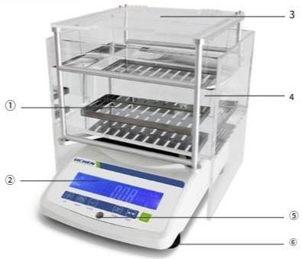
1 Large volume solid sample
preferred SDH series large range solid model
①hanging basket ②Display ③Measuring table ④Sink ^{⑤Horizontal} ^{bubble} ^{⑥Horizontaladjustment} ^{nut}

Slide 23
Large range solid model-SDH series solid density meter
Model | LC-SDH-20002 | lc-sdh-30002
sensor | HBM sensor | HBM sensor
Weighing range | 0.01-2000g | 0.01-3000g
Weighing accuracy | 0.01g | 0.01g
Density measuring range | >1,<1 is fine | >1,<lis OK
Density accuracy | 0 . 001g/cm³ | 0.001g/cm³
Temperaturecompe nsation range | 0-100℃ | 0-100*℃
Liquid medium density setting range | 0.001--19.999g/cm³ | 0.001--19.999g/㎝
Standard weights | 1000g | 2000g
Supply voltage | 220v/50 hz | 220v/50 hz
power | 10w | 10w
Net weight | 8kg | 8kg
Product size (L×WXH) | 270×200×250mm | 270×200×250mm

Slide 24
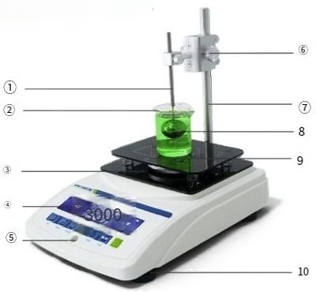
LDV series viscous liquid for medium
and high viscosity liquid samples
①GAMMA ball connecting rod | ②Beaker | ③host table top | ④Display ⑤Horizontal bubble
⑥Elevating platform | _{o}^{E}_{l}ele^{vatingpedestal} ^{standing} | ⑧GAMMA ball | Density support plate OHorizontaladjustment nut

Slide 25
Viscous liquid-LDV series viscous liquid densitometer
Noddnumba | LC-LDV-3002系列 | LC-LDV-6002系列 | LC-LDV-3005系列 | LC-LDV-1203系列
sensor | German HBM sensor | German HBM sensor | German HBM sensor | German HBM sensor
Weighing range | 0.01-300g | 0.01-600g | 0.005-300g | 0.001-120g
Wighingresalution | 0.01g | 0.01g | 0005g | 0.001g
Densiymersurenentaourac | y 0.001g/㎝ | 0.001g/㎝³ | 0.001g/㎝³ | 0.0001g/㎝
Density measuring range | 0.001~ 15.000g/cm³ | 0.001~ 15.000g/cm³ | 0.001~ 15.000g/cm³ | 0.0001 15.0000g/㎝
Measurement stability time | 10s | 10s | 10s | 10s
calibrate weight specfications | 100g | 200g | 1 0 0 g | 100g
Suppy voltage 220v50/60Hz | 220v50/60Hz | 220v50/60Hz | 220v50/60Hz | 220v50/60Hz
power | 10w | 10w | 10w | 10w
Net weight | 3.5kg | 3.5kg | 3 . 5 kg | 3.5kg
Product size | 190x×274x×210mm | 190×274×210mm | 190×274×210mm | 190×274 ×210mm

Slide 26
Packing List
SDB/LDB/PDB series basic model
Serial Number | SDB Series solid density meter | LDB seres liquid densitometer | PDBseries powder densitometer
1 | Main Engine | Mainframe | Densitometer host
2 | Measuring table(with hangingbasket | Beaker | Pycnometer(with thermometer
w | Sink | Glass specific gravity hammer | Glassware
4 | Anti-floating rack | Measuring brackets | Weights
5 | Beaker | Density support plate | Stainless steel weighing plates
O | Tennis balls | Metal hooks | Power adapter
7 | Tweezers | Weights | Product instructions
o | Weights | Power adapter | Certificate/warranty card
O | Power adapter | Product specification
10 | Product Instruction | s Certificate/warranty card
11 | Certificate ofconformity/warranty card |  | /

Slide 27
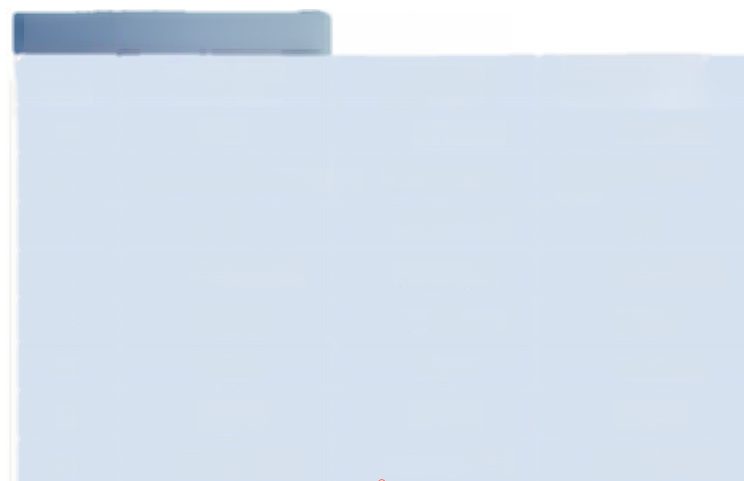
SDT/LDT/ADT series profe |  | ssional models
Serial Number | SDT series touch screen solid density meter | LDT series touch screen liquid densitometer | ADT series touch screen multifunctional solid density meter
one | Host | Mainframe | Mainframe
2 | Measuring table(with hanging ba | sket) Density support board | Measuring table(with hanging basket)
3 | Sink | Measuring brackets | Sink
4 | Anti-floatingrack | Metal hooks | Anti-floating rack
5 | Beaker | Specific Gravity hammer | Beaker
6 | Tennis | Beaker | Tennis ball
7 | Weights | Weights | Weights
8 | Power adapter | Power adapter | Power adapter

Slide 28
SMH/LMH series econdmy models
Seria number | SMH series digital solid density | meter LMH series liquid densitometer
 | Host | Mainframe
2 | Measuring table(with han | ^{ging} ^{basket)} _{Beaker}
3 | Sink | Glass specfic gravity hammer
4 | Anti-floating rack | Densitometer holder
5 | Beaker | Density support plate
6 | Tennis | Metal hooks
7 | Weights | Weights
8 | Power adapter | Power adapter
9 | Product instructions | Product specifications
10 | Certificate/warranty card | Certifcate ofcorformty/Waranty card

Slide 29
SDHSDDHLDDSejies
Serisl number | SDP series high precision sofid density meter |  | SDH series large range solid density meter | LDVseries viscous quid densitometer
 | Host |  | Mainframe | Mainframe
2 | Measring table with hangng basket) |  | Measuring table {with hanging basket) | ihing pedestal hithupigt poke
3 | C-bracket |  | Sink | Lifting table
4 | Sink |  | Weights | Standard GAMMA ball
5 | Anti-floating Rac |  | Power adapter | Density support board
6 | Beaker |  | Productinstructions | Allen wrench
7 | Tennis |  | Certificateharranty card | Hexsocket screws
8 | Tweezers |  | / | Beaker
9 | Weights |  | / | Weights
10 | Power adapter |  | / | Power adapter
11 | Product instructions |  | / | Productspecfications
twehve | Certificate/warranty card |  | / | etifcate o conformity/Warranty card

