Slide 1
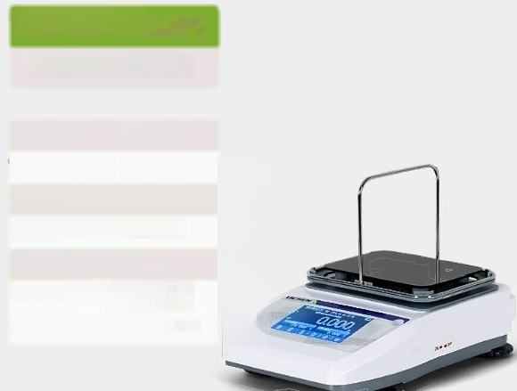
LC-LDT-3205
Touch screen liquid density meter
Weighing range: ^{0.005-320g}
Weighing aocuracy: 0.005g
Density measurement range:>1g/cm3,
Density measurement accuracy：0.001g/cm2
Measurement stability time:≤3s
Measurement value:gehsIty value, Bomei deg rae, concentration
Product size: 200*290*220mm
<1g/cm3
Weight value,

Slide 2
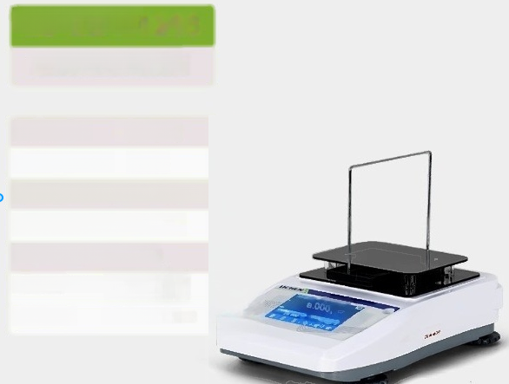
LC-LDT-1203
Touch screen liquid density meter
Weighing range: 0.001-120g
^{Weighing} ^{aocuracy:} 0.001g
Density measure ment range:>1g/m3,
Density measurement accuracy：0.0001g/cm3
Measurement stability time:<3s
Weight value, Measurement value:0ehsItyVaI0e, Bomei degree, Cohcentration
Product size: 200*290*220mm
<1g/cm3

Slide 3
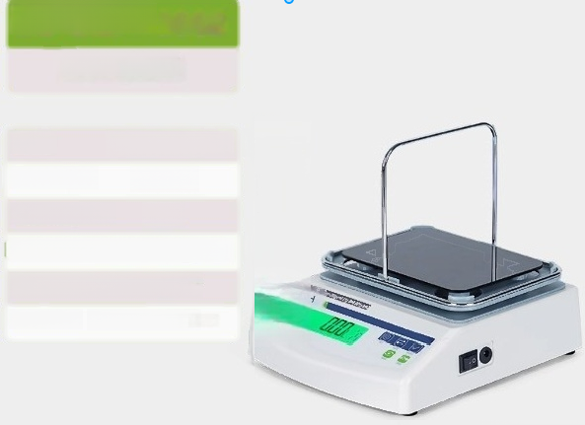
LC-LMH-3002
Liquid Density Meter
_{Sensor:}High precision strain gauge sensor
Weighing range: 0.01-300g
Weighing accuracy 0.01g
Density measurement range：0.001-2.00g/cm3
Density measurement accuracy： 0.001g/cm2
Product size: 160x240x200mm

Slide 4
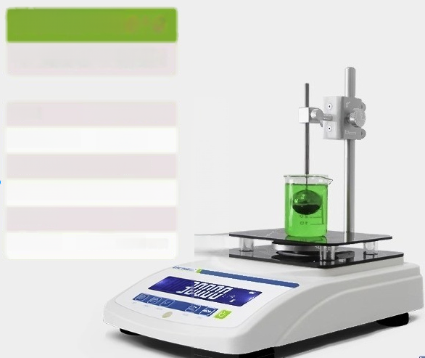
LC-LDV-3002
Viscous liquid densitometer
Sensor German HBM sensor
Weighing range: ^{0.01-300g}
Panity measurement 0.001g/cm2
Density measurement accuracy:0.001-15.000g/cm3
Stable time: 10s
Product size: 190X274X210mm

Slide 5
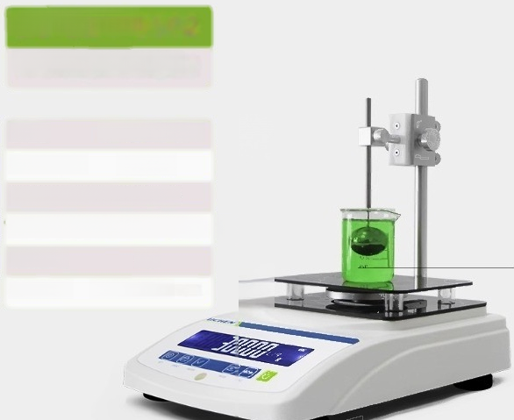
LC-LDV-6002
Viscous liquid densitometer
Sensor: German HBM sensor
Weighing range: 0.01-600g
Dansity measurement 0.001g/cm2
Density measurement accuracy:0.001-15.000g/cm3
Stable time: 10s
Product size: 190X274X210mm

Slide 6
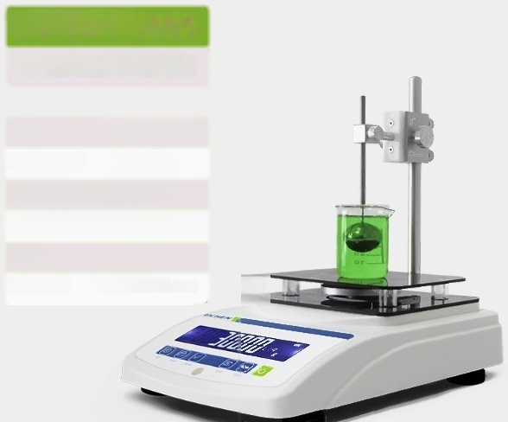
LC-LDV-3005
Viscous liquid densitometer
Sensor: German HBM sensor
Weighing range: ^{0.005-300g}
Pnty measurement 0.001g/cm2
Density measurement accuracy:0.001-15.000g/cm3
Stable time: 10s
Product size 190X274X210mm

Slide 7
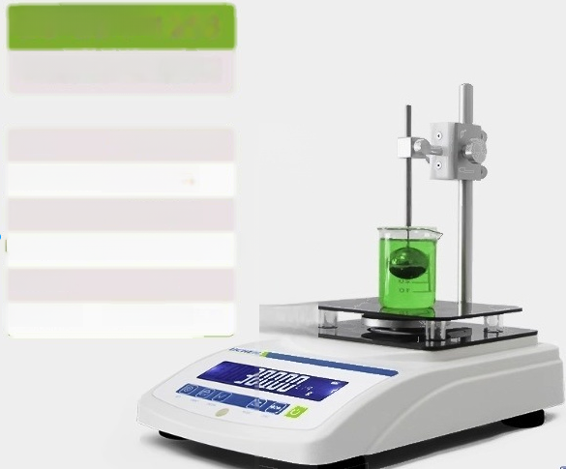
LC-LDV-1203
Viscous liquid densitometer
Sensor: German HBM sensor
Weighing range: ^{0.001-120g}
Dengity measurement 0.0001g/cm2
Density measurement accuracy:0.0001-15.000g/cm3
Stable time: 10s
Product size: 190X274X210mm

Slide 8
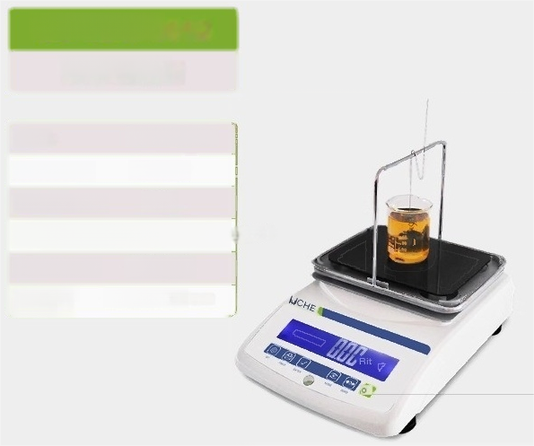
LC-LDB-3002
Liquid Density Meter
Sensor Domestic sensoIS
Weighing range 0.01-300g
Weighing accuracy. ^{0.01g}
Density measurement range:0.001-19.999g
Density accuracy. 0.001g/cm2
Product size: (LXWXH) | 268X192X215mm
/cm3

Slide 9
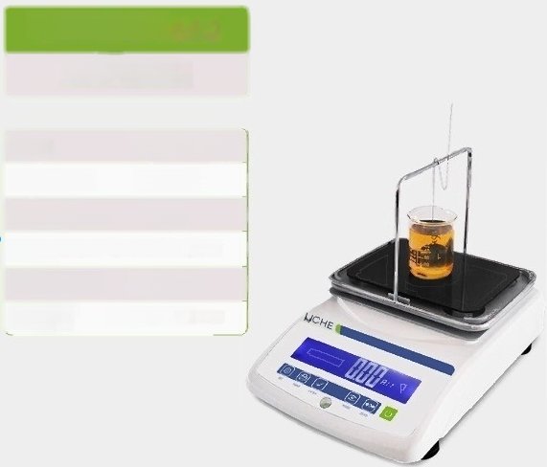
LC-LDB-6002
Liquid Density Meter
Sensor Domestic sensors
Weighing range: ^{0.01-600g}
Weighing accuracy. ^{0.01g}
Density measure ment range： 0.001-19.999g/cm2
Density accuracy: 0.001g/cm2
Product size: (LXWXH) | 268X192X215mm

Slide 10
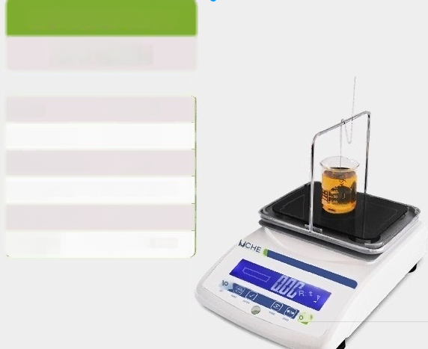
LC-LDB-3005
Liquid Density Meter
Sensor. HBM sensor
Weighing range: ^{0.005-300g}
Weighing accuracy. 0.005g
Density measurement range：0.001-19.999g/cm2
Density accuracy ^{0.001g/cm2}
Product size (LXWXH) | 268X192X215mm

