Slide 1
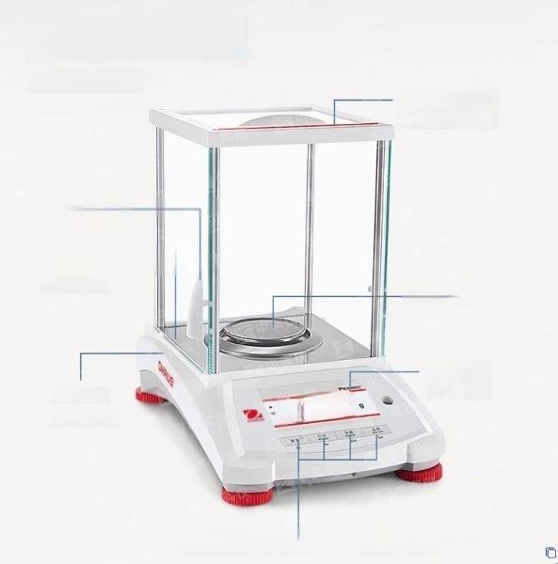
Detail display.
PX series balance
Red ESR grounding
static elimination
strip
glass door
Aluminum die-casting
Stainless steel scale pan
Metal base
Backlit LCD
display
screen
RS232,
USB interface
4 mechanical buttons (zero/print/function/peel)

Slide 2
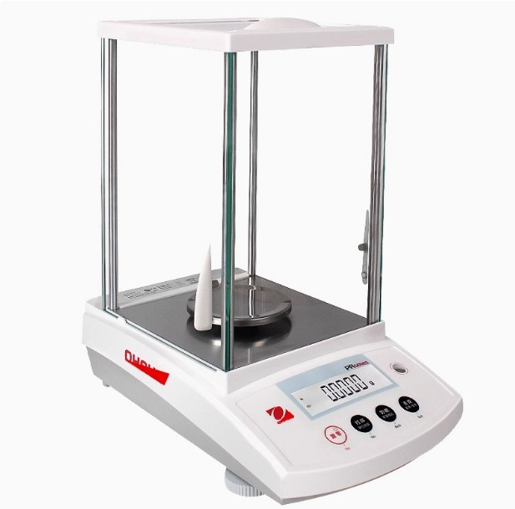

Slide 3

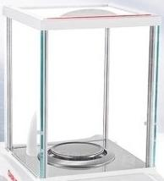

Weighing black technology
Make experiments more efficient
^{Electronic} ^{Anaytical} ^{Balance} ^{PR/PX} ^{Series}
Basic weighing piece weighing 1%weighing

Slide 4
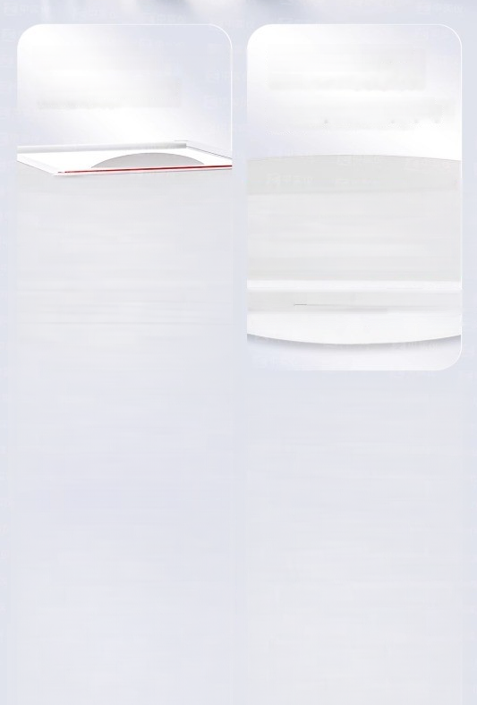
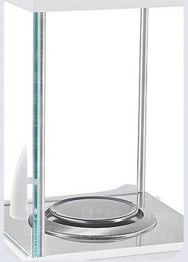

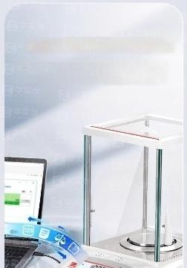
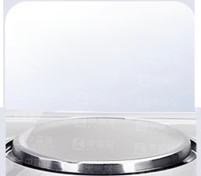
ESR static elimination strip
Equipped with a red ESR static
elimination strip for a smoother
wind cover
Dual row display of GLP/GMP
real-time clock on the
screen
The second line can display Chinese.
progress
PIONEER
operation prompts for the balance,with
intuitive range'bars showing weighing
Zoroing | GHRting 000ver3I0n No | 盈 Back | 品 Exit | 。
Yen
Standard USB and RS232 interfaces
Enable the balance to communicate with computers and PLCs, and the balance is also equipped with anti-theft safety locks
Stainless steel scale pan
Aluminum die-casting metal base stainless steel scale pan

Slide 5

4 mechanical buttons for
automatic peeling/power-saving settings
Quicklyenter the weighing mode
and automatically remove the
First level password protection
Ensure the safety of the balance settings
skin.with optional range
calibration points

Slide 6
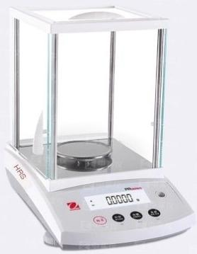
Basic PR series
All functions
Adaily weighing balance that is easy to operate,has excellent performance,and is affordable in price
●Meet the weighing needs of laboratories,industries,and educational fields
● 3common weighing modes
Simple design,convenientand easy to use-large backlit display screen,simple user interface,can be used without training
Clever design,sturdy and durable-Exquisite design,spacious weighing space,sturdy and durable structure,and ta less steel scale pan make sam pe placement conv nient,and the balance is always reliable and durable
●Front level adjustment foot,convenient for users to adjust the level
d
-
n
t
l
i
s
e

Slide 7
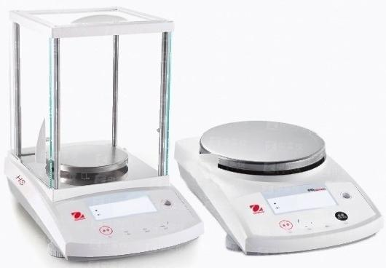

Basic PR series
DO⁰0,
、
PR223ZH/E PR423ZH/E PR1602ZH/E PR2202ZH/E
PR4202ZH/E PR6201ZH/E
All functions
●Adaly weighing balance that is oary to operato,hasoxcellent performance,and is affordable in price
Meet the weighing needs of laboratories,industries,and educational fields
● 3common weighing modes
Simple design,convenientand easy to use-large backlit display screen,simple user
interface,can be used without training
●Clever design,sturdy and durable-Exquisite design,spacious weighing space,sturdy and durable structure,and stainless steel scale pan make sample placement convenient,and the balance is aways reliable and durable
Front level adjustment foot,convenient for users to adjust the level

Slide 8
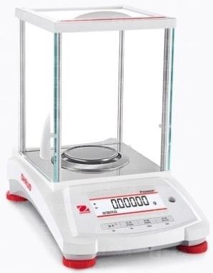
Basic PX series
All functions
The display soreen hasdual lines,and the second line can display Chinse
●
operation prompts for the balance,which can be easily set without referring to the manual
●Comes with a red ESR statio elimination strip.
● First level password protection ensures the security of the balance settings
●The intuitive range bar displays the weighing progress.
Standard USB and RS232 interfaces
●GLP/GMPreal-time clock.
●Aluminum die cast metal base.
●Stainless steel scale pan.
● 4 mechanical buttons,quickly enter weighing mode
● Automatic peeling,optional range calibration point
● 鼎naving settings,greenerand more enwironmentally

Slide 9
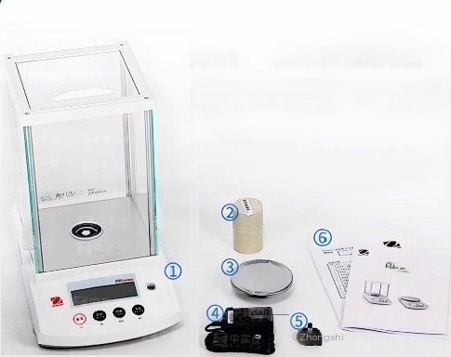
_{①} _{Host} ②Woight(optional)③Woighing pan
4 Power cords⑤ Power plug ⑥ Instruction manual

