Slide 1
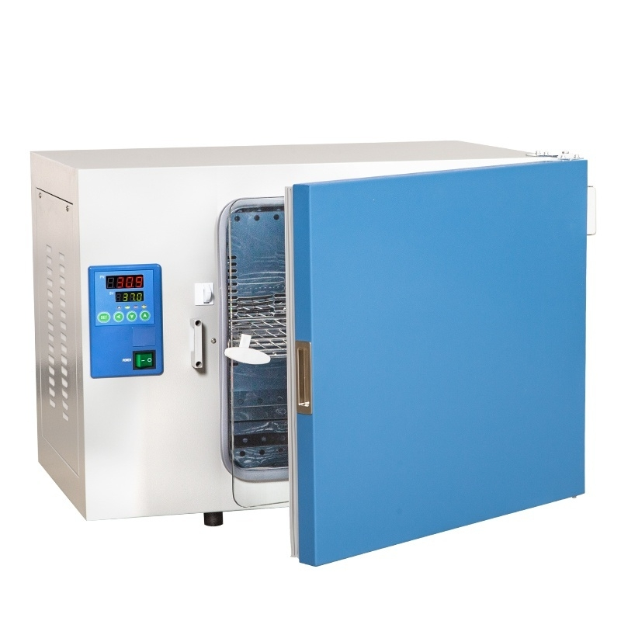

Slide 2
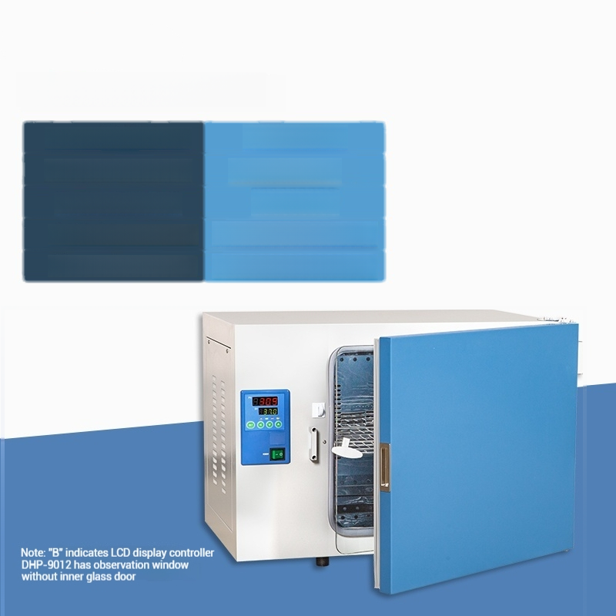
Model:DHP-9012
Temperature control range | RT+5～65℃
Temperature Uniformity | ±1.5℃(at 37℃)
Capacity/lnput Power | 16L/200W
Inner Chamber Size W×D×H | 250×260×250mm
Overall Dimensions W×D×H | 530×480×420mm

Slide 3

Model:DHP-9012B
Temperature control range | RT+5～65℃
Temperature Uniformity | ±1.5℃(at 37℃)
Capacity/lnput Power | 16L/200W
Inner Chamber Size W×D×H | 250×260×250mm
Overall Dimensions W×D×H | 530×480×420mm

Slide 4

Model:DHP-9032
Temperature control range | RT+5～65℃
Temperature Uniformity | ±1.5℃(at 37℃)
Capacity/lnput Power | 35L/200w
Inner Chamber Size W×D×H | 340×320×320mm
Overall Dimensions W×D×H | 620×490×490mm

Slide 5

Model:DHP-9032B
Temperature control range | RT+5～65℃
Temperature Uniformity | ±1.5℃(at 37℃)
Capacity/lnput Power | 35L/200w
Inner Chamber Size W×D×H | 340×320×320mm
Overall Dimensions W×D×H | 620×490×490mm

Slide 6

Model:DHP-9052
Temperature control range | RT+5～65℃
Temperature Uniformity | ±1.5℃(at 37℃)
Capacity/lnput Power | 50L/300w
Inner Chamber Size W×D×H | 415×360×355mm
Overall Dimensions W×D×H | 690×500×500 mm

Slide 7

Model:DHP-9052B
Temperature control range | RT+5～65℃
Temperature Uniformity | ±1.5℃(at 37℃)
Capacity/lnput Power | 50L/300w
Inner Chamber Size W×D×H | 415×360×355mm
Overall Dimensions W×D×H | 690×500×500 mm

Slide 8

Model:DHP-9082
Temperature control range | RT+5～65℃
Temperature Uniformity | ±1.5℃(at 37℃)
Capacity/lnput Power | 80L/400w
Inner Chamber Size W×D×H | 500×400×400mm
Overall Dimensions W×D×H | 780×530×560 mm

Slide 9

Model:DHP-9082B
Temperature control range | RT+5～65℃
Temperature Uniformity | ±1.5℃(at 37℃)
Capacity/lnput Power | 80L/400w
Inner Chamber Size W×D×H | 500×400×400mm
Outer Dimensions W×D×H | 780×530×560 mm

Slide 10

Model:DHP-9162
Temperature control range | RT+5～65℃
Temperature Uniformity | ±1.5℃(at 37℃)
Capacity/lnput Power | 160L/600w
Inner Chamber Size W×D×H | 500×500×650mm
Overall Dimensions W×D×H | 790×630×810mm

Slide 11

Model:DHP-9162B
Temperature control range | RT+5～65℃
Temperature Uniformity | ±1.5℃(at 37℃)
Capacity/lnput Power | 160L/600w
Inner Chamber Size W×D×H | 500×500×650mm
Overall Dimensions W×D×H | 790×630×810mm

Slide 12

Model:DHP-9272
Temperature control range | RT+5～65℃
Temperature Uniformity | ±1.5℃(at 37℃)
Capacity/lnput Power | 270L/750w
Inner Chamber Size W×D×H | 600×600×750mm
Outer Dimensions W×D×H | 890×740×910mm

Slide 13

Model:DHP-9272B
Temperature control range | RT+5～65℃
Temperature Uniformity | ±1.5℃(at 37℃)
Capacity/lnput Power | 270L/750w
Inner Chamber Size W×D×H | 600×600×750mm
Overall Dimensions W×D×H | 890×740×910mm

Slide 14

Model:DHP-9402(Vertical)
Temperature control range | RT+5～65℃
Temperature Uniformity | ±2.0℃(at 37℃)
Capacity/lnput Power | 420L/1100w
Inner Chamber Size W×D×H | 640×585×1355 mm
Dimensions W×D×H | 780×750×1880 mm

Slide 15

Model:DHP-9602(Vertical)
Temperature control range | RT+5～65℃
Temperature Uniformity | ±2.0℃(at 37℃)
Capacity/lnput Power | 1000L/2200w
Inner Chamber Size W×D×H | 890×740×1590mm
Dimensions WXDXH | 1050×880×2060mm

