Slide 1
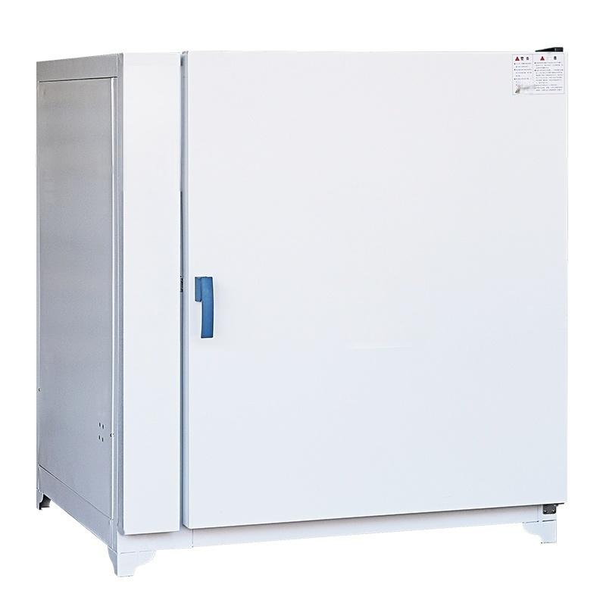

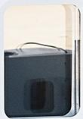
3
11
l
II
l
I₁
li
I
Ii
I
lI
l
I1
I1
11
I
I
l

Slide 2
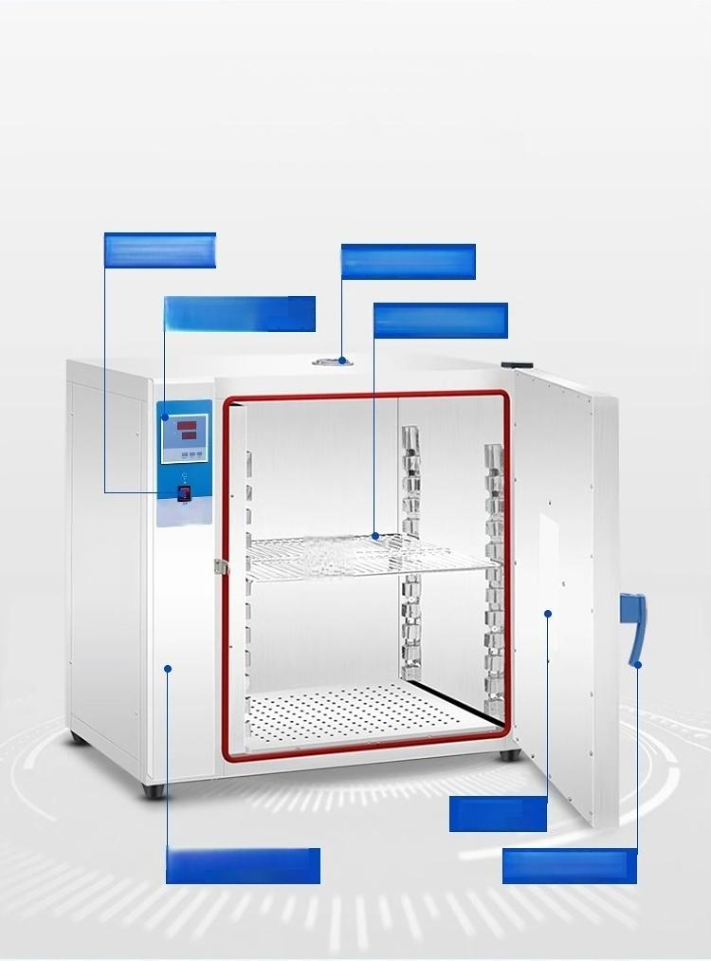
Product function analysis
Multifunctional and durable,it is a good choice for you
Control switch
Top ventilation hole
Intelligent temperature
control instrument Stainless steel shelf
5Lne
Observation
Window
Electrostatic spray plastic
body ^{Press-type} ^{handle}

Slide 3
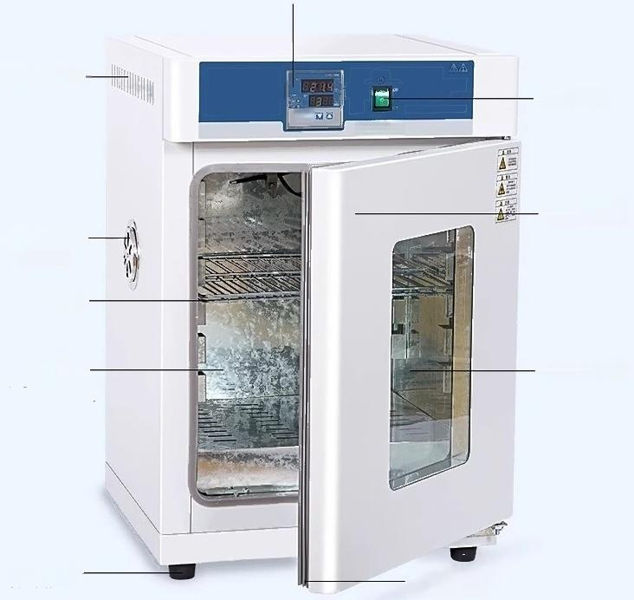
Smart Temperature Control Instrument
Side heat
dissipation holes
图
SunnE
Adjustable side
Vent hole
Partition
Inner Liner
(A galvanized/B
stainless steel)
Rubber sole_
bottom
Control
switch
Magnetic box door
Glass observation
window
Silicone
sealing strip

Slide 4
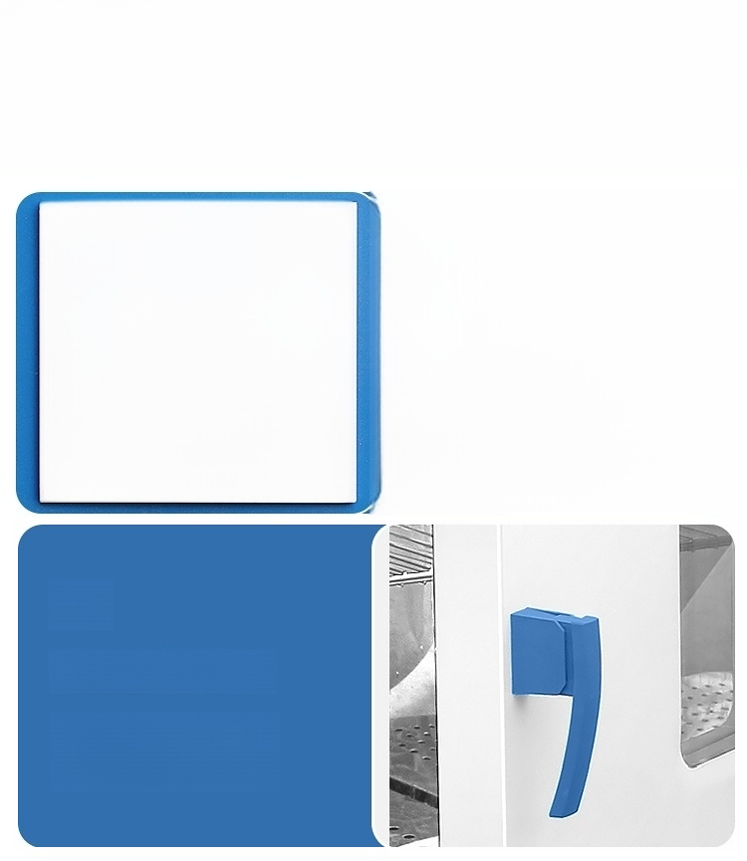
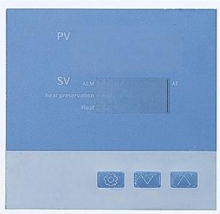
Details Display
B8
9983
Set/AT Dec Inc
01/
Microcomputer intelligent constant temperature
Multi-functional helps you
Solve experimental
troubles
[Model:303-0A]
02/
Press-type handle
Selected precision steel plastic
Made with a beautiful and comfortable design

Slide 5
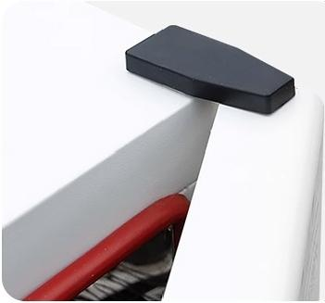


03/
Reinforced hinge
More secure and reliable to use
04/
Mirror-finished stainless
steel inner liner
Strong anti-corrosion,more
aesthetically pleasing
05/
Top exhaust vent
Freely control heat dissipation

Slide 6
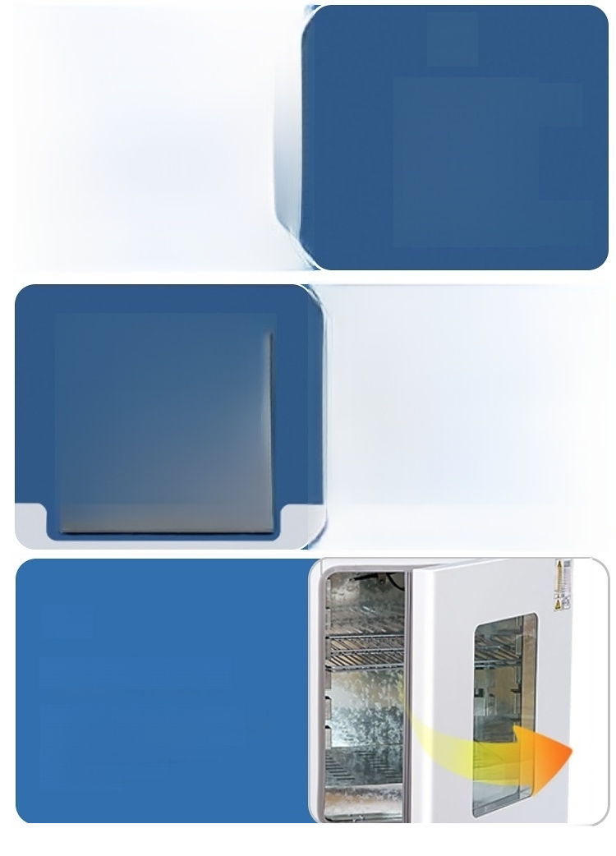

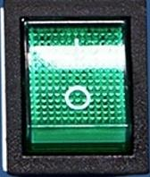
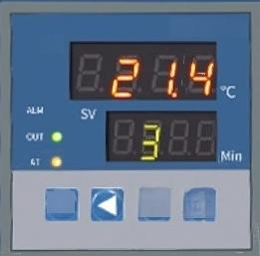
06/
Control switch
Independent power switch,easy to operate
ON
OFF
07/
Smart Temperature Control Instrument
Microcomputer PID temperature
control technology LED digital
display
[Model:SN-DH-25A]
XMTD-7000
PV
SET △
理
08/
Magnetic box door
Magnetic absorption function,
integrated handle-free design,
beautiful and comfortable,
Convenient opening
and closing

Slide 7

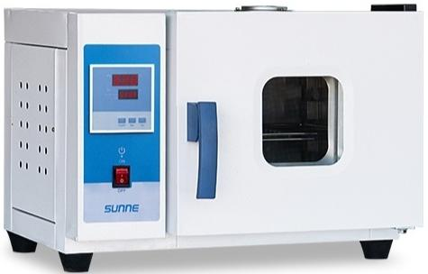
Electric thermostatic incubator【Fully upgraded】
Product Model 303-0A Volume 16L
Liner material ^{anized} ^{inner} Power _{300w} Temperature Room temperature
Ga
v
ta
k
Inner tank size 25×25×25cm
^{range} +10°-70°
Application range:
Sprouting and germination
Bacterial culture
Farm incubation

Slide 8
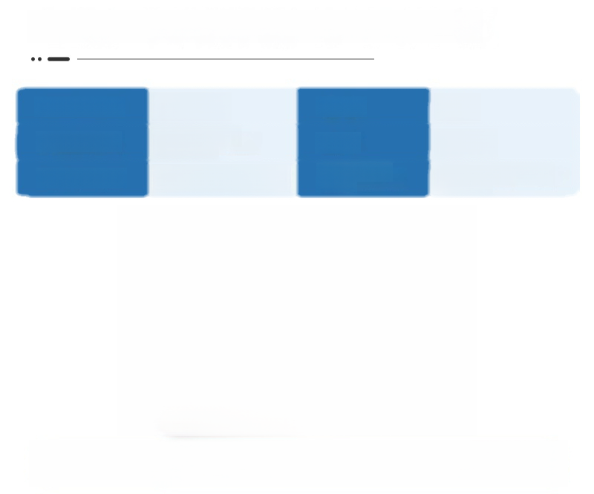

Electric thermostatic incubator【Fully upgraded】
Product Model | 303-0B | Volume | 16L
Liner material | Stainless Steel Inner Liner | Power | 300w
Inner tank size | 25×25×25cm | Temperature range | Room temperature +10°-70°
Application range:
Sprouting and germination
Bacterial culture
Farm incubation

Slide 9

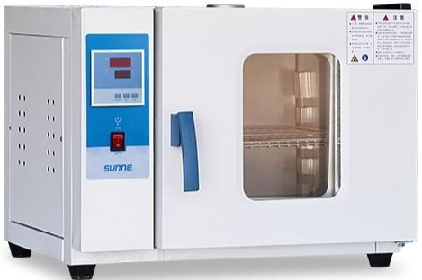
Electric thermostatic incubator【Fully upgraded】
Product Model
Liner material Inner tank size
303-1A
Galvanized inner tank
35×35×35cm
Volume
Power
Temperature range
43L
500w
Room temperature +10°-70°
Application range:
Sprouting and germinaion
Bacterial culture
Farm incubation

Slide 10

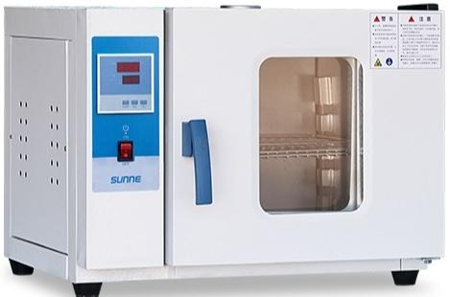
Electric thermostatic incubator【Fully upgraded】
Product Model | 303-1B | Volume | 43L
Liner material | Stainless Steel Inner Liner | Power | 500w
Inner tank size | 35×35×35cm | Temperature range | Room temperature +10°-70°
Application range:
Sprouting and germination
Bacterial culture
Farm incubation

Slide 11

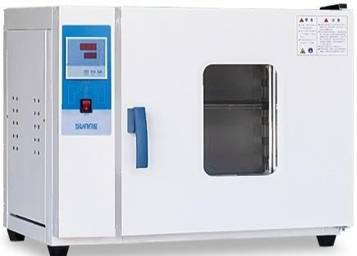
Electric thermostatic incubator【Fully upgraded】
Product Model
Liner material Inner tank size
303-2A
Galvanized inner tank
45×35×45cm
Volume
Power
Temperature range
70L
700w
Room temperature +10°-70°
Application range:
Sprouting and germination
Bacterial culture
Farm incubation

Slide 12


Electric thermostatic incubator【Fully upgraded】
Product Model | 303-2B | Volume | 70L
Liner material | Stainless Steel Inner Liner | Power | 700w
Inner tank size | 45×35×45cm | Temperature range | Room temperature +10°-70°
Application range:
Sprouting and germination
Bacterial culture
Farm incubation

Slide 13

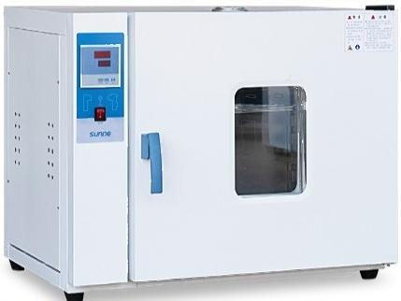
Electric thermostatic incubator【Fully upgraded】
Product Model
Liner material Inner tank size
303-3A
Galvanized inner tank
55×45×55cm
Volume
Power
Temperature range
136L
1100w
Room temperature +10°-70°
Application range:
Sprouting and germination
Bacterial culture
Farm incubation

Slide 14


Electric thermostatic incubator【Fully upgraded】
Product Model
Liner material
Inner tank size
303-3B
Stainless Steel Inner Liner
55×45×55cm
Volume
Power
Temperature range
136L
1100w
Room temperature +10°-70°
Application range:
Sprouting and germination
Bacterial culture
Farm incubation

Slide 15
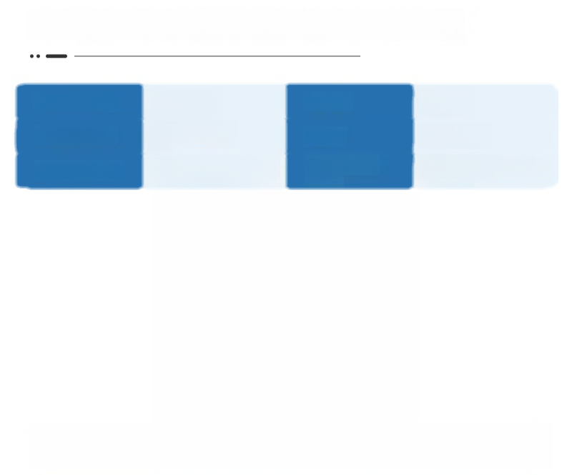
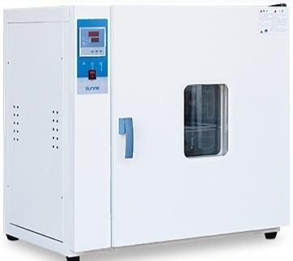
Electric thermostatic incubator【Fully upgraded】
Product Model 303-4A Volume 225L
Liner material ^{anized} ^{inner} Power _{1200w} Temperature Room temperature
Ga
v
ta
k
Inner tank size 60×50×75cm
^{range} +10°-70°
Application range:
Sprouting and germination
Bacterial culture
Farm incubation

Slide 16

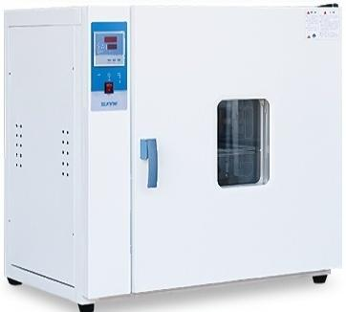
Electric thermostatic incubator【comprehensive upgrade】
Product Model | 303-4B | Volume | 225L
Liner material | Stainless Steel Inner Liner | Power | 1200w
Inner tank size | 60×50×75cm | Temperature range | Room temperature +10°-70°
Application range:
Germination and sprouting
Bacterial culture Farm incubation

Slide 17
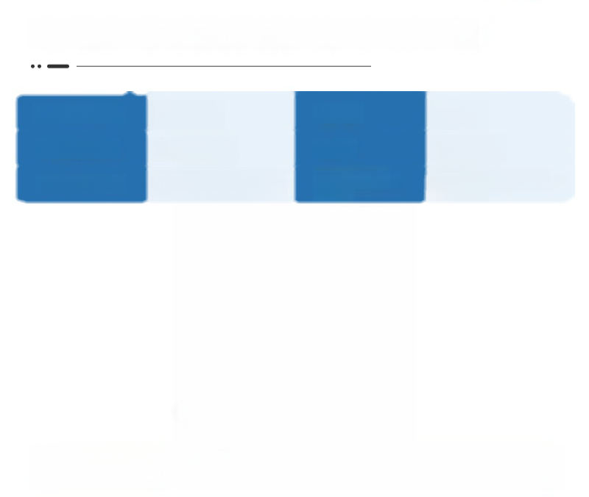
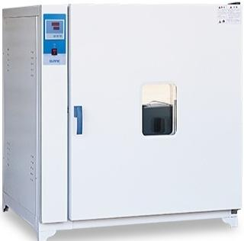
Electric thermostatic incubator【Fully upgraded】
Product Model | 303-5A | Volume | 640L
Liner material | Galvanized inner tank | Power | 1500w
Inner tank size | 80×80×100cm | Temperature range | Room temperature +10°-70°
Application range:
Sprouting and germination
Bacterial culture
Farm incubation

Slide 18

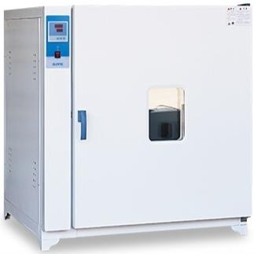
Electric thermostatic incubator【completely upgraded】
Product Model | 303-5B | Volume | 640L
Liner material | Stainless Steel Inner Liner | Power | 1500w
Inner tank size | 80×80×100cm | Temperature range | Room temperature +10°-70°
Application range:
Germination and sprouting
Bacterial cultivation Farm incubation

Slide 19
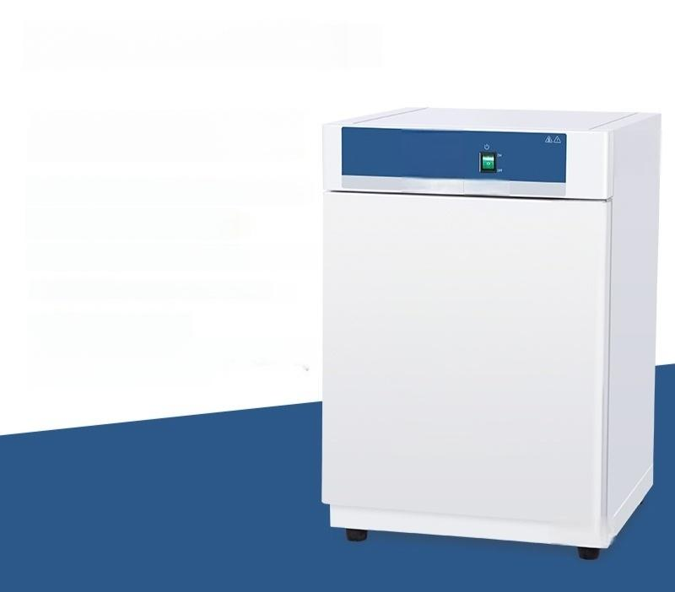




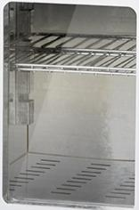
Model:SN-DH-25A
Multiple specifications
available,meet different needs
Temperature control range:RT+5-60°℃
Timing range:0-9999min
Inner tank material:Galvanized inner tank
Inner liner size:250x300x250mm Effective capacity:18.8L
Maximum number of partition ) layers:3(standard 2)
SUnnE

Slide 20
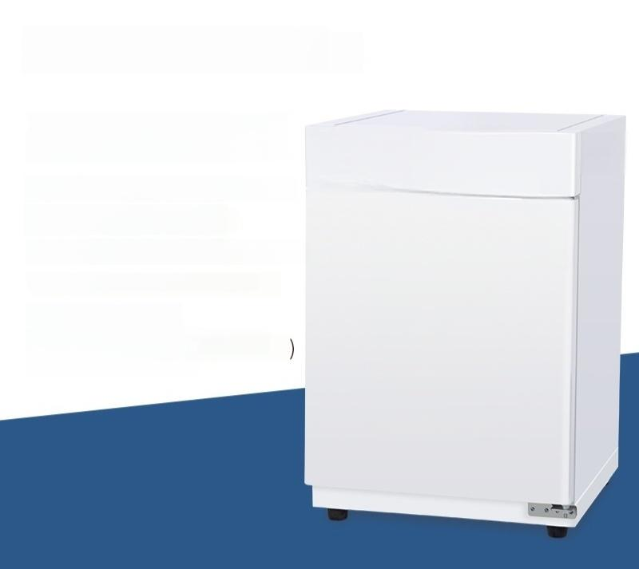




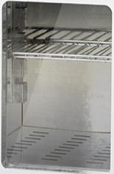
Model:SN-DH-25B
Multiple specifications
available,meet different needs
SUnnE
Temperature control range:RT+5-60℃
Timing range:0-9999min
Inner tank material:Stainless steel inner
Inner liner size:250x300x250mm
Effective capacity:18.8L
Maximum number of partition layers:3(standard 2)
tank

Slide 21





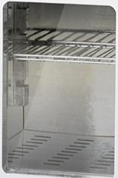
Model:SN-DH-36A
Multiple specifications
available,meet different needs
Temperature control range:RT+5-60℃
Timing range:0-9999min
Inner tank material:Galvanized inner tank
Inner liner size:360x360x360mm Effective volume:46.7L
Maximum number of partition ) layers:5(standard 2)
SUnnE

Slide 22





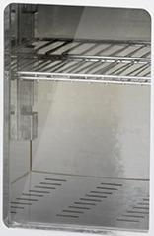
Model:SN-DH-36B
Multiple specifications
available,meet different needs
Temperature control range:RT+5-60℃
Timing range:0-9999min
Inner tank material:Stainless steel inner tank
Inner liner size:360x360x360mm
Effective capacity:46.7L
Maximum number of partition ) layers:5(standard 2)
SUnnE

Slide 23
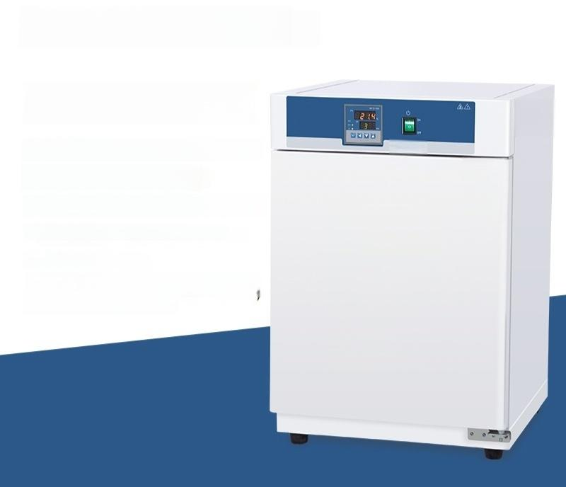



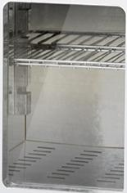
Model:SN-DH-40A
Multiple specifications
available,meet different needs
Temperature control range:RT+5-60℃
Timing range:0-9999min
Inner tank material:Galvanized inner tank
Inner liner size:420x420x420mm
Effective volume:74L
Maximum number of partition ) layers:6(standard 2)
SunnE

Slide 24





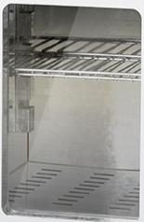
Model:SN-DH-40B
Multiple specifications
available,meet different needs
Temperature control range:RT+5-60℃
Timing range:0-9999min
Inner tank material:Stainless steel inner tank
Inner liner size:420x420x420mm
Effective volume:74L
Maximum number of partition ) layers:6(standard 2)
SUnnE

Slide 25






Model:SN-DH-50A
Multiple specifications
available,meet different needs
流△
Temperature control range:RT+5-60°℃
Timing range:0-9999min
Inner tank material:Galvanized inner tank
Inner tank size:500x500x500mm
Effective volume:125L
Maximum number of partition )
layers:7(standard 2)
SunnE

Slide 26
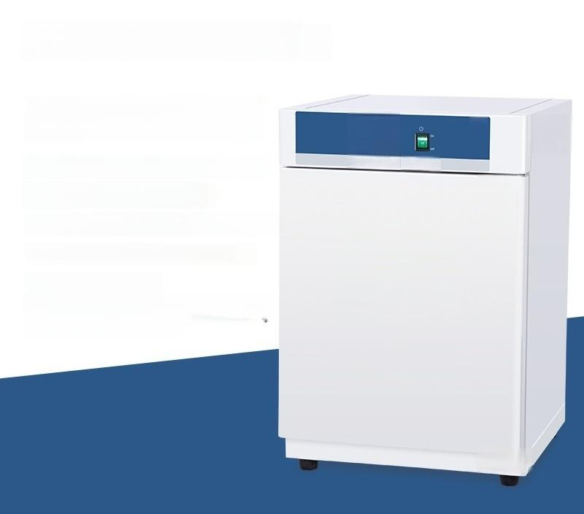


Model:SN-DH-50B
Multiple specifications
available,meet different needs
流△
Temperature control range:RT+5-60°℃
Timing range:0-9999min
Inner tank material:Stainless steel inner tank
Inner tank size:500x500x500mm
Effective volume:125L
Maximum number of partition ) layers:7(standard 2)
SunnE

Slide 27
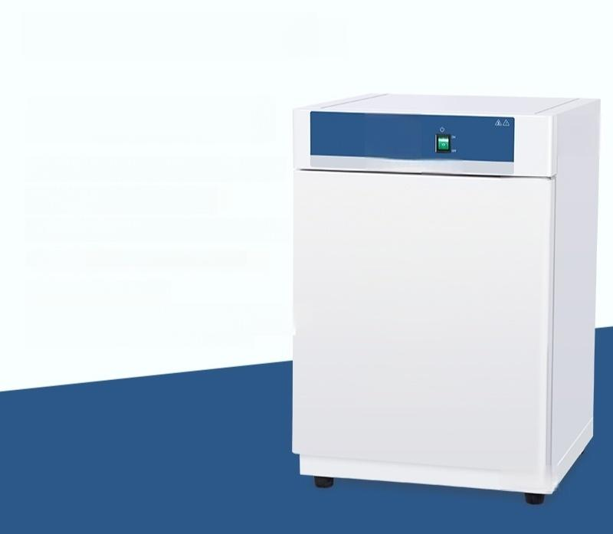




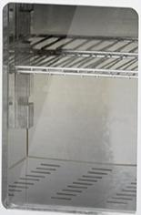
Model:SN-DH-60A
Multiple specifications
available,meet different needs
Temperature control range:RT+5-60℃
Timing range:0-9999min
Inner tank material:Galvanized inner tank
Inner tank size:600x600x600mm
Effective volume:216L
Maximum number of partition layers:
15 pieces(standard 2 pieces)
SUnnE

Slide 28




Model:SN-DH-60B
Multiple specifications
available,meet different needs
Temperature control range:RT+5-60℃
Timing range:0-9999min
Inner tank material:Stainless steel inner tank
Inner tank size:600x600x600mm
Effective volume:216L
Maximum number of partition ) layers:9(standard 2)
SUnnE

