Slide 1
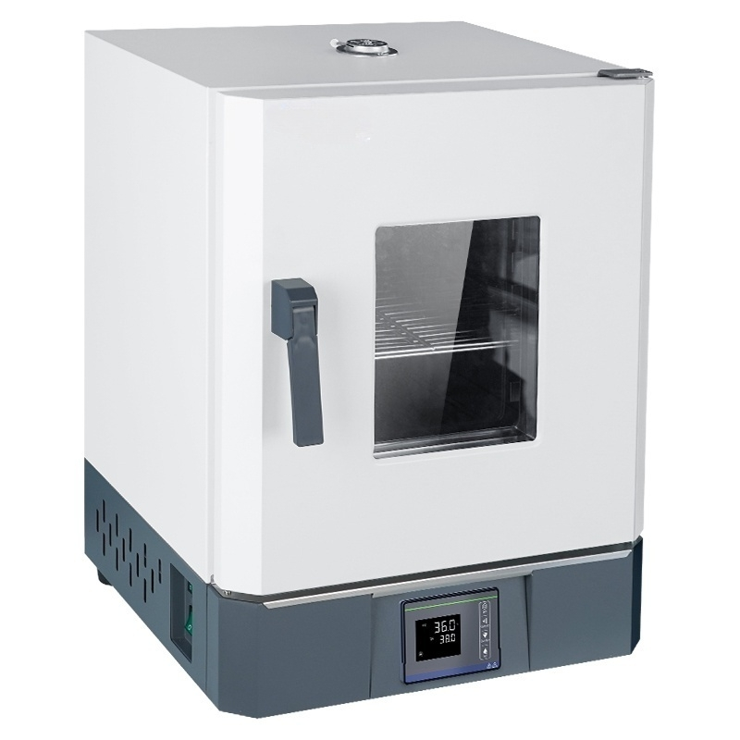

Slide 2
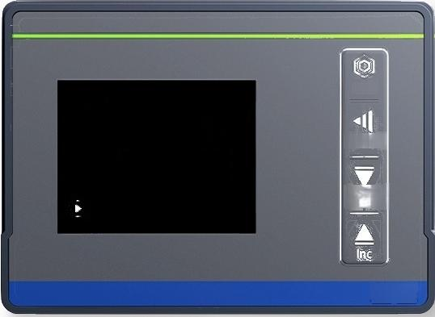
LCD liquid crystal display
Smart Temperature Control Instrument
Intelligent digital display PID temperature control instrument with stable temperature
control accuracy,featuring timing,over-temperature alarm,temperature deviation
correctionself-tuning,power-off memory,and faut self-diagnosis functions
36.0
Set
Shift/AT
Dec/Rst
PV
^{sV} 38.0
▲△

Slide 3
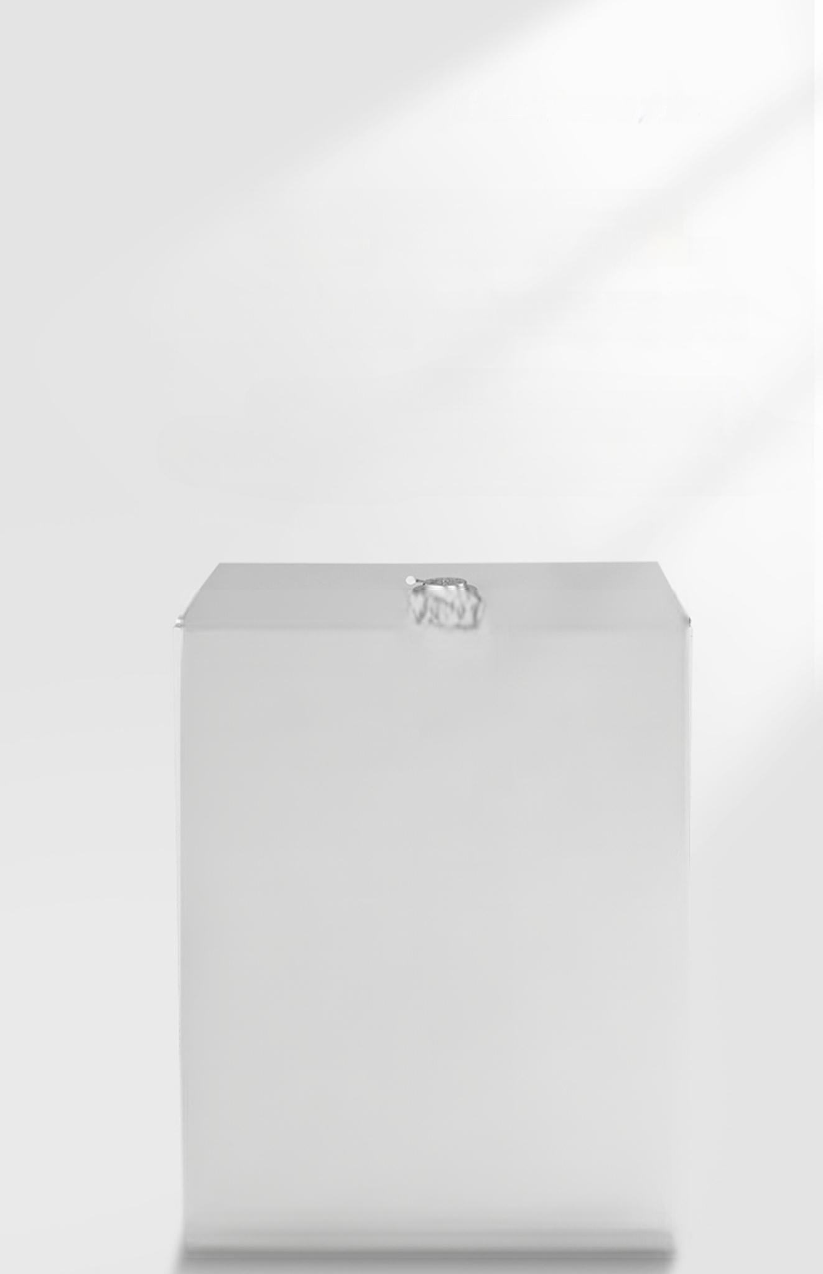
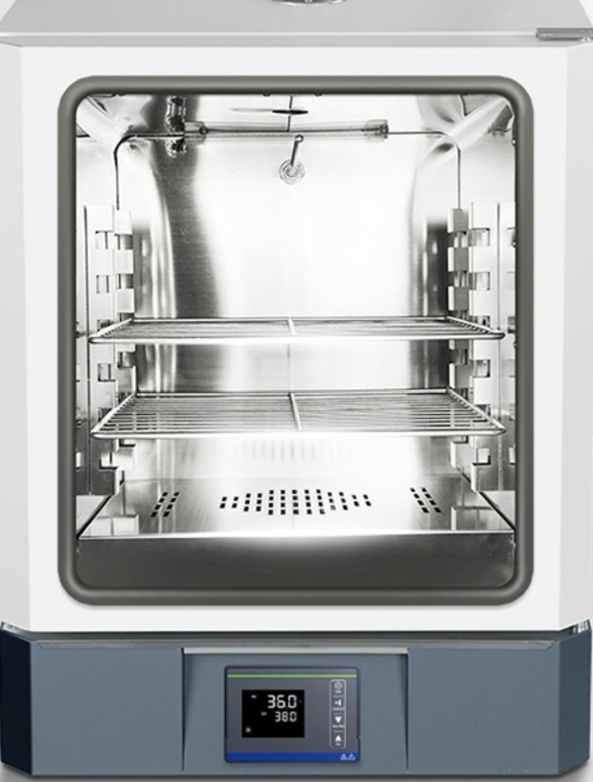
厂 Mirror-finished stainless steel
inner liner 」
The internal partition spacing is adjustable
The BS type uses a mirror-finished stainless steel inner liner,with rounded corners for easy cleaning of the internal grid partitions,and the partition spacing is adjustable,making the interior
Airflow circulation is smoother,and stacking partitions double the load-bearing capacity

Slide 4

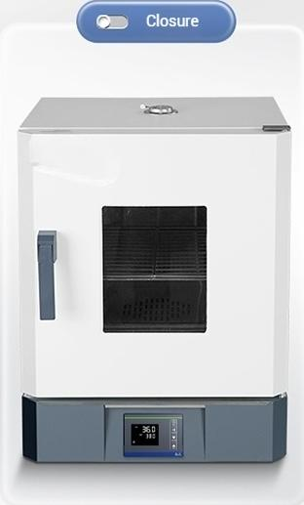

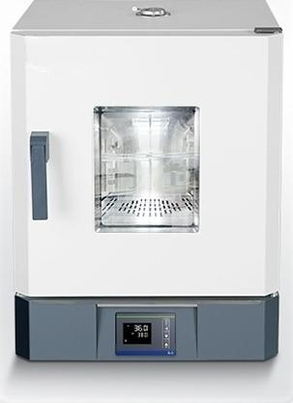
New items added
inside the box
^{厂} LED lighting strip
An additional LED lighting strip has beeninstalled inside the box with a user-friendly design,providing intuitive visibility to observe the sample cultivation status,making nighttime experiments more considerate.
Open

Slide 5
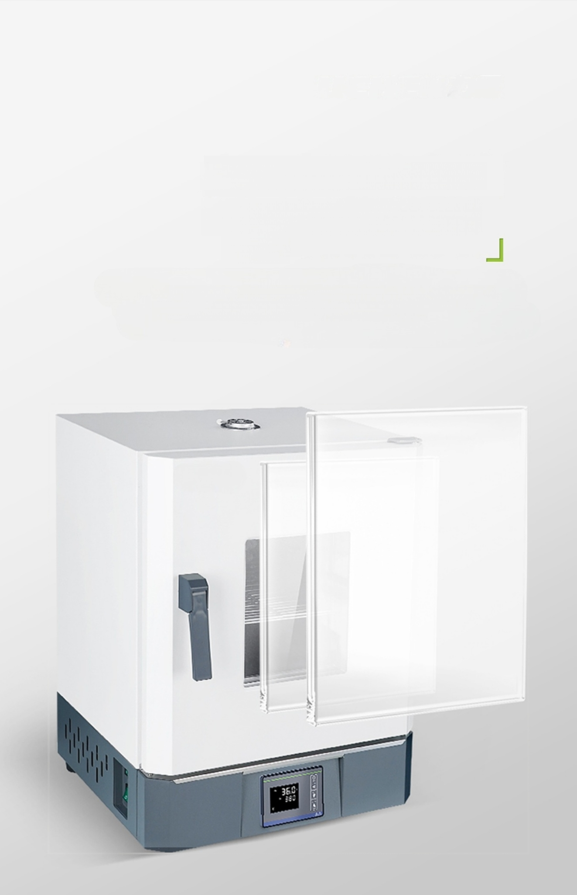
Large-area observation window
厂Double-layer tempered
glass
Large observation window for easy monitoring of sample status without opening
the door;maintains constant temperature inside the chamber.Double-layer
tempered glass provides clear visibility and enhanced insulation.

Slide 6

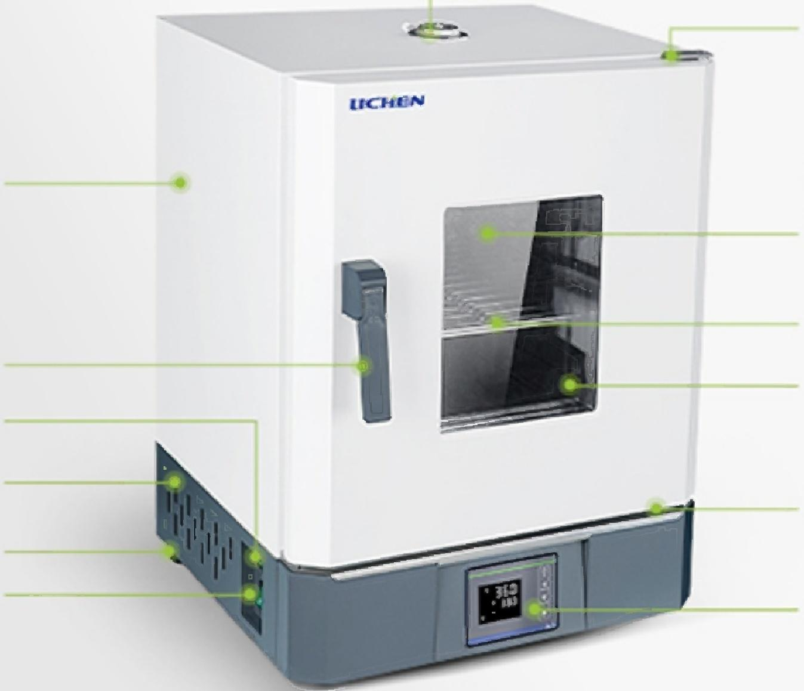
Instrument details
Instrument details
Top ventilation hole
Hinge
Cold-rolled sheet/
Stainless Steel
Inner Liner
Partition
Tempered glass
observation window
Corrosion-resistant
water collection plate
LCD liquid crystal instrument
Electrostatic spray plastic body
Handle
Lighting switch
Cooling holes
Foot
Power Switch

Slide 7
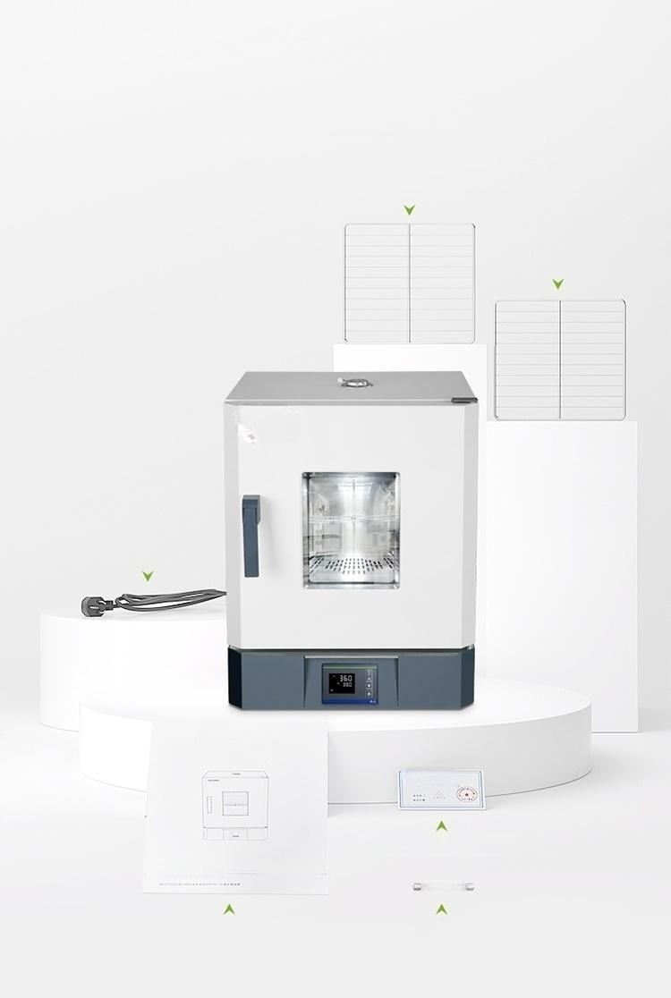
Instrument list
List of instruments
Partition(1)
Partition(2)
Power Cable
N-shaped
Certificate of Conformity
User manual n
C □
User Manual Fusex2
silyerjoint.

Slide 8


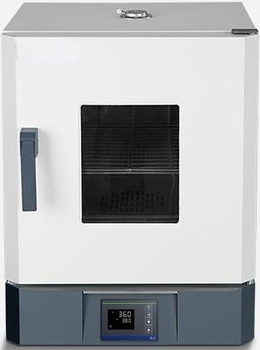
LC-HN-25S
Electric Constant
Temperature Incubator
Display | _{mode:}^{LCD} ^{liquid} ^{crystal}
Power: 300W
Temperature RT+5℃~100℃ control range:
Timing range:0~9999min
^{Volume:} 15.6L
Sample Shelf:2 pieces
Inner Chamber Siz2e5:0^{×250×250mm}
instrument
★High-quality cold-rolled galvanized iron tank

Slide 9


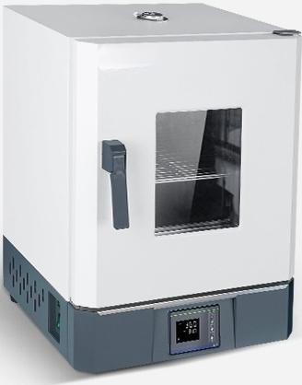
LC-HN-25BS
Electric Constant
Temperature Incubator
Display | _{mode:}^{LCD} ^{liquid} ^{crystal}
Power: 300W
Temperature RT+5℃~100℃ control range:
Timing range:0~9999min
^{Volume:} 15.6L
Sample Shelf:2 pieces
Inner Chamber Siz2e5:0^{×250×250mm}
instrument
★Mirror-finished Stainless Steel
Thickened Inner Chamber

Slide 10


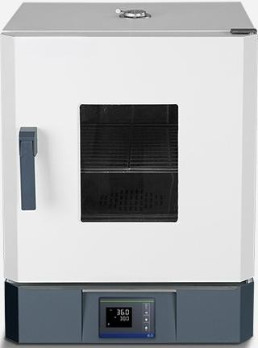
LC-HN-36S
Electric thermostatic incubator
Display | _{mode:}^{LCD} ^{liquid} ^{crystal}
Power: 400W
Temperature RT+5℃~100℃ control range:
Timing range: 0~9999min
Volume: ^{42L}
Sample tray:2 pieces
Inner tank si3z5e0:×350×350mm
instrument
★High-quality cold-rolled galvanized iron tank

Slide 11


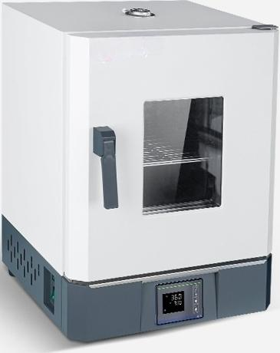
LC-HN-36BS
Electric Constant
Temperature Incubator
Display | _{mode:}^{LCD} ^{liquid} ^{crystal}
Power: 400W
Temperature RT+5℃~100℃ control range:
Timing range:0~9999min
Volume: 42L
Sample Shelf:2 pieces
Inner Chamber Si 0:^{×350×350mm}
instrument
★Mirror-finished Stainless Steel
Thickened Inner Chamber

Slide 12


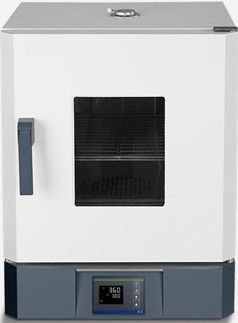
LC-HN-40S
Electric Constant
Temperature Incubator
Display | _{mode:}^{LCD} ^{liquid} ^{crystal}
Power: 500W
Temperature RT+5℃~100℃ control range:
Timing range:0~9999min
Volume: ^{70L}
Sample Shelf:2 pieces
Inner Chamber350×450×450mm Size:
instrument
★High-quality cold-rolled galvanized iron tank

Slide 13


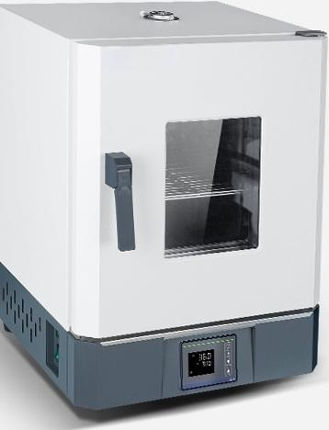
LC-HN-40BS
Electric Constant
Temperature Incubator
Display | _{mode:}^{LCD} ^{liquid} ^{crystal}
Power: 500W
Temperature RT+5℃~100℃ control range:
Timing range:0~9999min
Volume: ^{70L}
Sample Shelf:2 pieces
Inner Cavity Si3z5e0:×450×450mm
instrument
★Mirror-finished Thickened Stainless Steel Inner Cavity

Slide 14


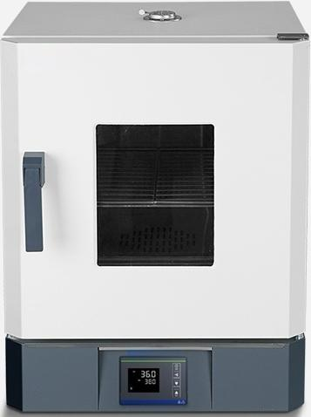
LC-HN-50S
Electric thermostatic incubator
Display | _{mode:}^{LCD} ^{liquid} ^{crystal}
Power: 600W
Temperature RT+5℃~100℃ control range:
Timing range:0~9999min
Volume: ^{136L}
Sample tray:2 pieces
Inner tank si4z5e⁰:^{×550×550mm}
instrument
★High-quality cold-rolled galvanized iron tank

Slide 15


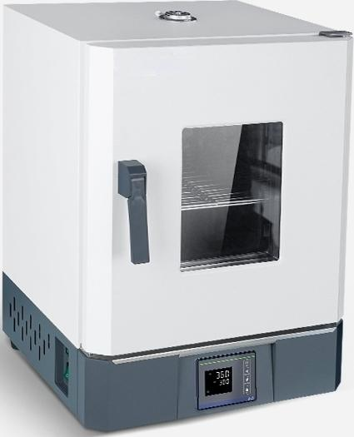
LC-HN-50BS
Electric Constant
Temperature Incubator
Display | _{mode:}^{LCD} ^{liquid} ^{crystal}
Power: 600W
Temperature RT+5℃~100℃ control range:
Timing range:0~9999min
Volume: ^{136L}
Sample Shelf:2 pieces
Inner Chamber450×550×550mm Size:
instrument
★Mirror-finished Stainless Steel
Thickened Inner Chamber

Slide 16


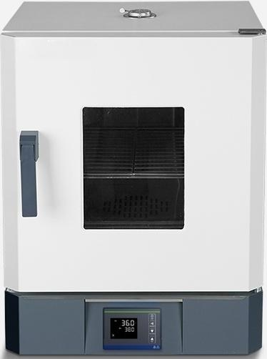
LC-HN-60S
Electric Constant
Temperature Incubator
Display | _{mode:}^{LCD} ^{liquid} ^{crystal}
Power: 800W
Temperature RT+5℃~100℃ control range:
Timing range:0~9999min
Volume: ^{210L}
Sample Shelf:2 pieces
Inner Chamber500×600×700mm Size:
instrument
★High-quality cold-rolled galvanized iron tank

Slide 17


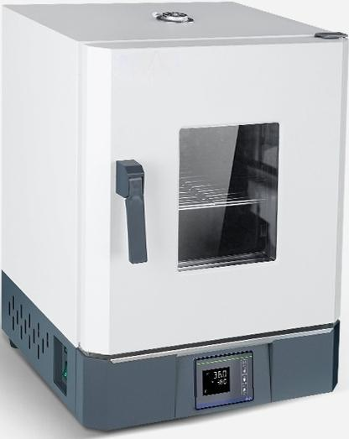
LC-HN-60BS
Electric Constant
Temperature Incubator
Display | _{mode:}^{LCD} ^{liquid} ^{crystal}
Power: 800W
Temperature RT+5℃~100℃ control range:
Timing range:0~9999min
Volume: 210L
Sample Shelf:2 pieces
Inner Chamber Siz5e0:0^{×600×700mm}
instrument
★Mirror-finished Stainless Steel
Thickened Inner Chamber

Slide 18

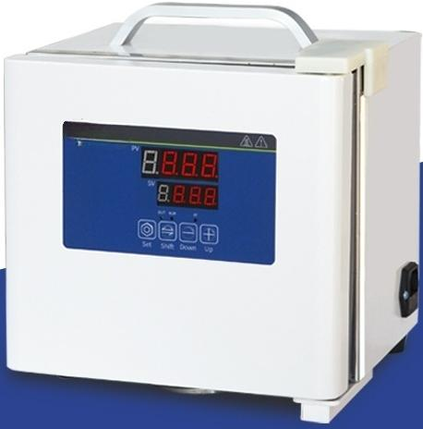
Portable incubator
BXP-2 model
Inner chamber size:110x140x120mm
Temperature control range:RT+5~45℃

Slide 19
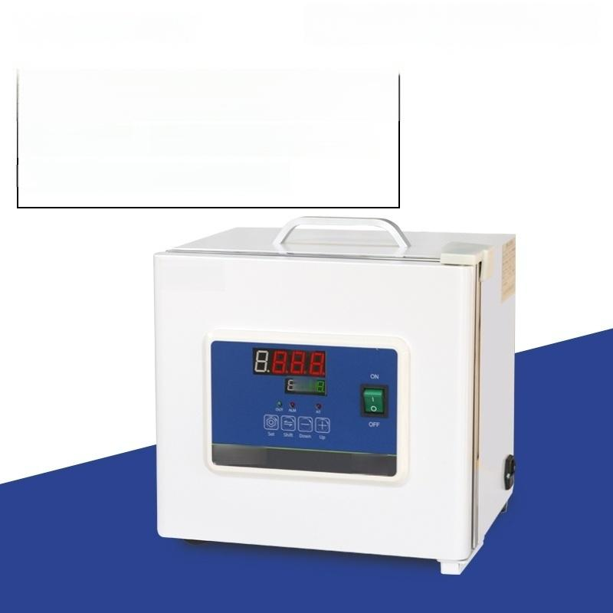
Portable Incubator
BXP-6 Model
_{i} ^{r}_{:1} ^{Chamber} 180x230x160mm
In
n
e
S
z
e
Temperature Control Range:RT+5~45℃
LICHEN
B8.
UCHEN
金▲

Slide 20
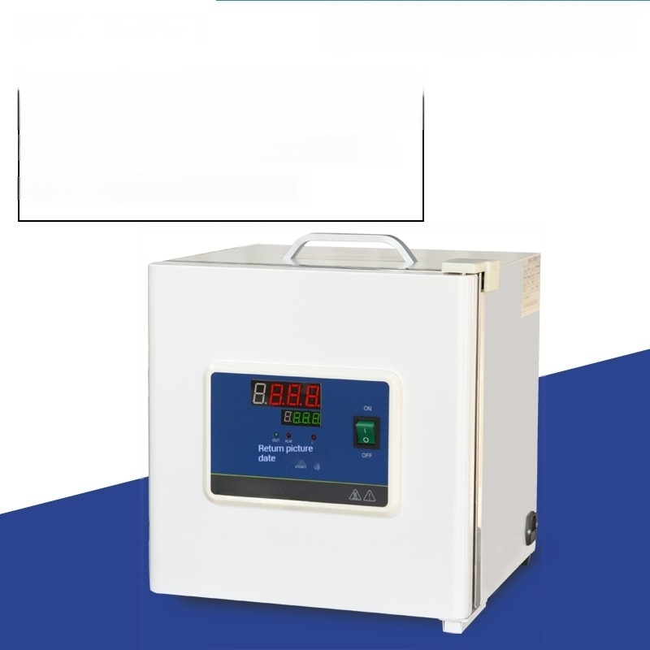
Portable incubator
BXP-16 Model
Inner liner size:250x250x250mm
Temperature control range:RT+5~45℃

