Slide 1
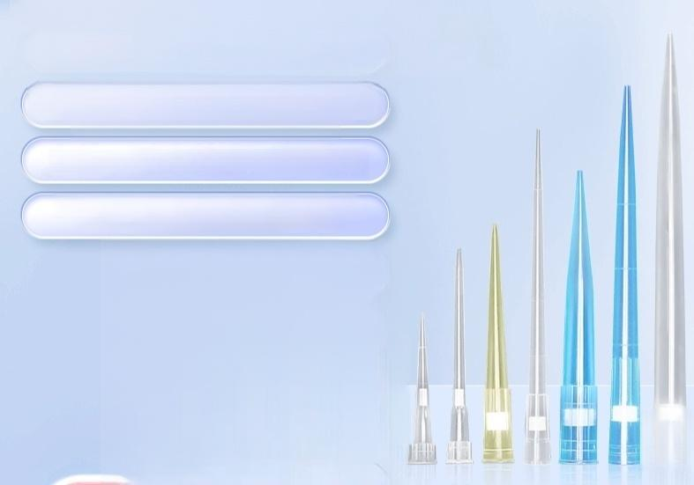
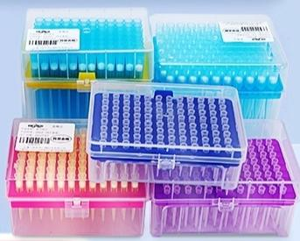

Pipette tips /gun tips
Standard version /filter version
/extended filter version
Universal for major brands like Dalong and Eppendorf
Can be sterilized at high temperature,acid
and alkali resistant

Slide 2
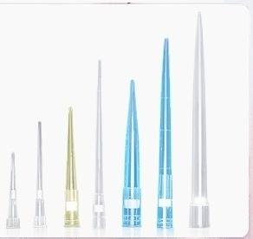
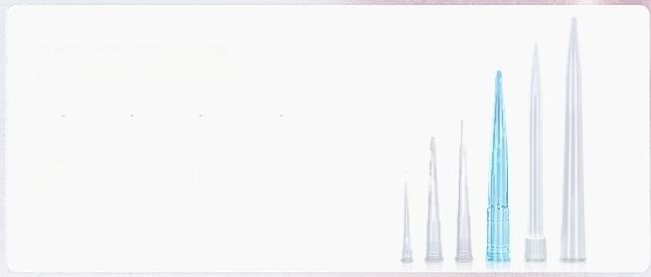
Filter element/
Non-filter element
Multiple specifications available for
one-stop purchase
The suction head uses high-quality polypropylene(PP)material,
with qood transparency,sturdy and durable,not easy to deform
Filter element suction head
10μl 200μl 1ml 5ml
Extended version:10ul 200ul 1ml
Prevents cross-contamination of samples
■ Non-filter element suction head
10μl 200μl 300μl 1000μl 5ml 10ml
Wide measurement range
Suitable for basic daily use

Slide 3
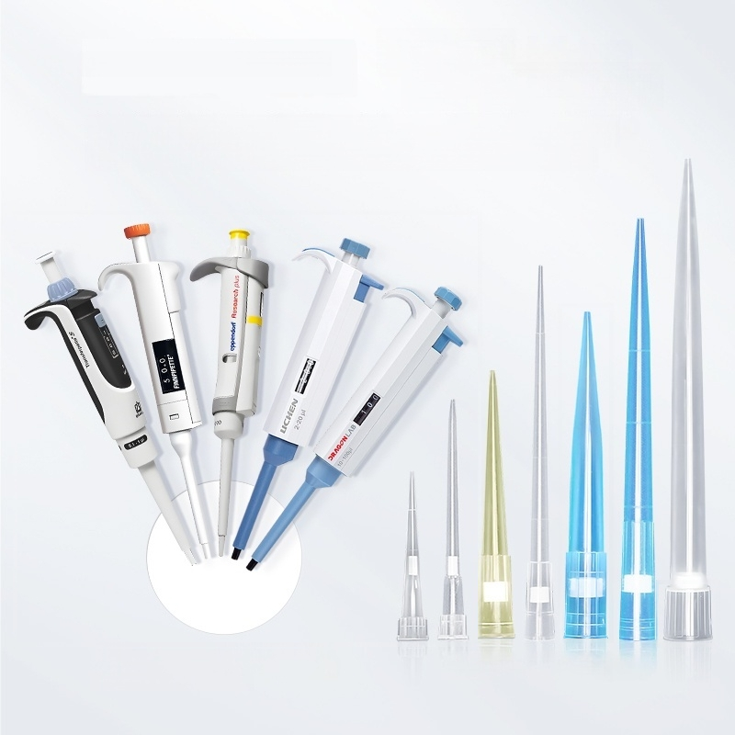
「Strong
adaptability
Multi-brand universal
」
Eppendorf,Thermo Fisher,Pland,Gilson,Finland Becton,Finland Rebl Darlong,Lichen,Baoyude
^{Can} ^{be} ^{compatible} ^{with} ^{multiple} _{·10ul~5ml} _{optional}
mainstream pipettes

Slide 4
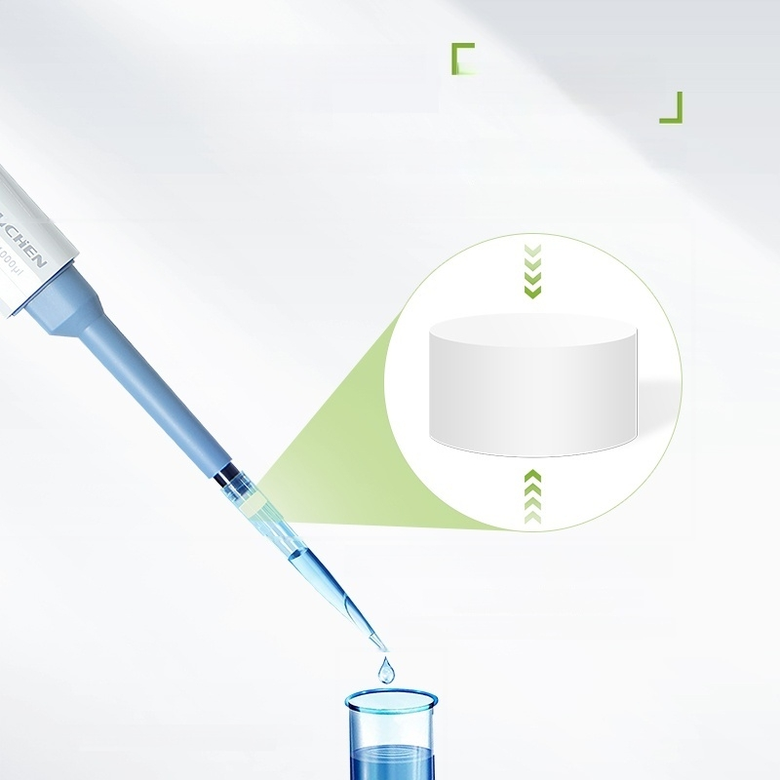
Minimal residual adsorption
High
precision
【Smooth inner wall】effectively prevents liquid residue
Enhances experimental accuracy
·High-quality filter membrane
Prevents aerosol contamination
Cross-contamination between pipettes or samples
Note:The illustration shows a filter tip

Slide 5


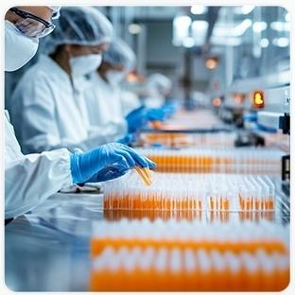
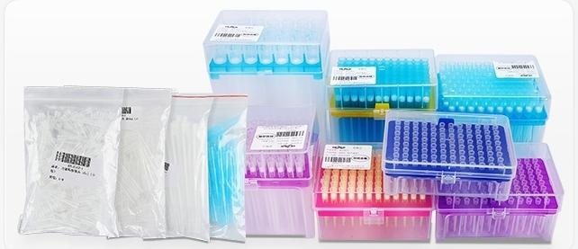
「Sterilization
treatment
Suitable for high temperature and high pressure
Each box of filter head has been sterilized with ethylene oxide

Slide 6



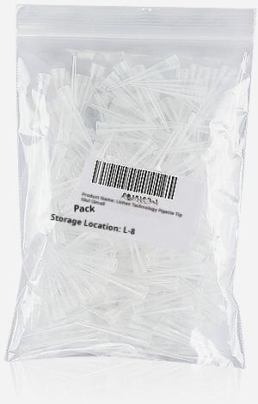


全国 包邮
LICHEN LICHEN
10μl
Suction Head
Length(mm): | 31.5 | Aperture(mm): | 3.3
Specifications (pieces/bag): | 1000 | Packaging: | Bags
[Non-filter |Bagged]10ul(1000 pieces/pack)

Slide 7
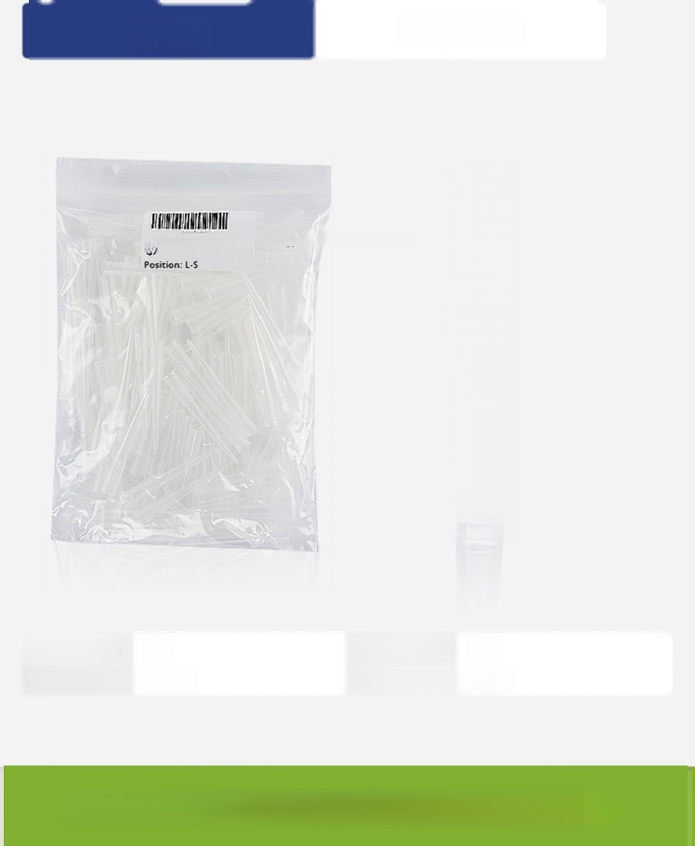

200μl | Suction Head
Product Name:LIZHAN Technology Limited Head 2001 (Small
Length(mm): | 50 | Aperture(mm): | 5.5
Specifications (pieces/bag): | 1000 | Packaging: | Bags
[Non-filter element |Bagged]200ul(1000 pcs /pack)

Slide 8
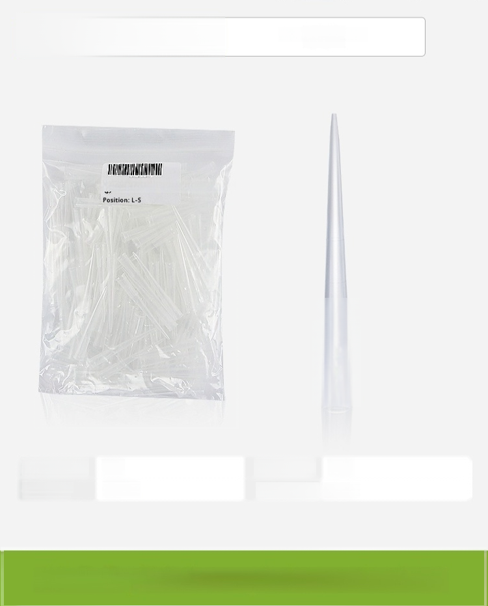

300μl ^{Suction} ^{Head}
Product Name:LIZHAN Technology Limited Head 2001(Small
Length(mm): | 52 | Aperture(mm): | 5.3
Specifications (pieces/bag): | 1000 | Packaging: | Bags
[Non-filter element |Bagged]300ul(1000 pieces/large package)

Slide 9


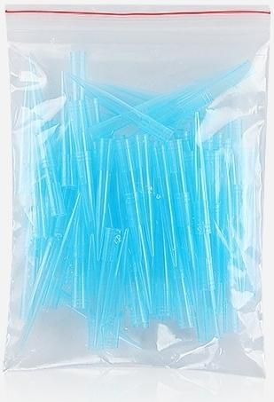

1000μl | Suction Head
Length(mm): | 71 | Hole diameter (mm): | 7.5
Specifications (pieces/bag): | 500 | Packaging | Bags
[Non-filter element |Bagged]1000ul(500 pieces per pack)

Slide 10
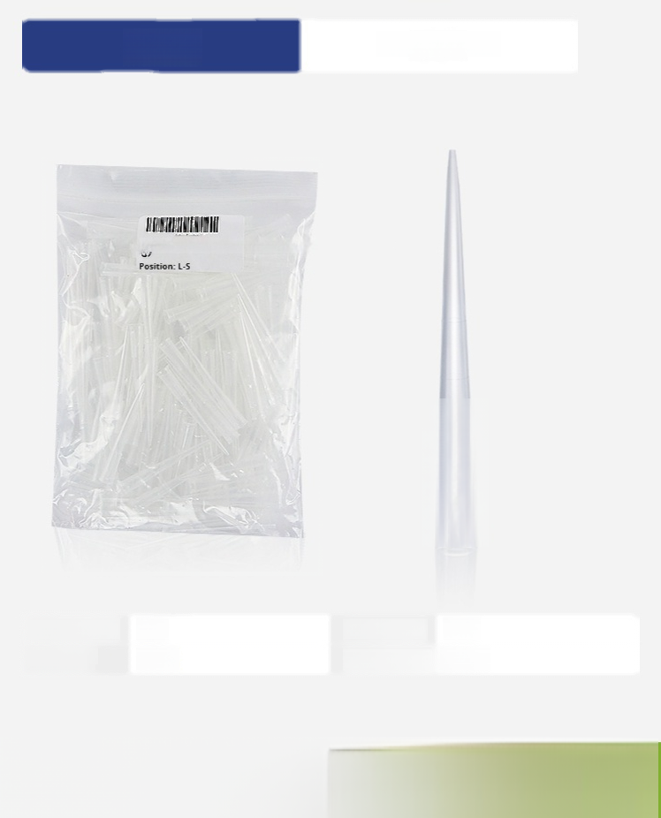


300μl | Suction Head
Product Name:LIZHAN Technology Limited Head 2001(Small
Length(mm): | 52 | Aperture(mm): | 5.3
Specifications (pieces/bag): | 200 | Packaging | Bags
[Non-filter element|Bagged]300ul (200 pieces per small package)

Slide 11
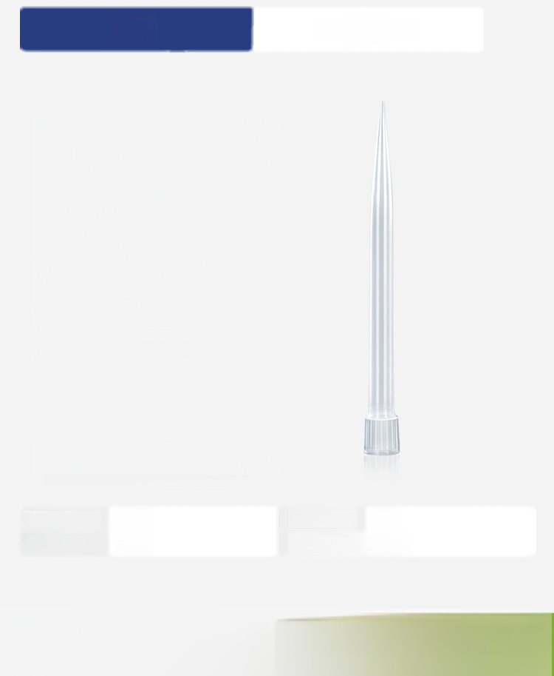
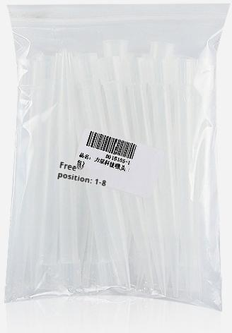
5ml | Suction Head
Length(mm): | 146 | Aperture(mm): | 13
Specifications (pieces/bag): | 300 | Packaging: | Bags
[Non-filter element |Bagged]5ml(300 pieces per bag)

Slide 12
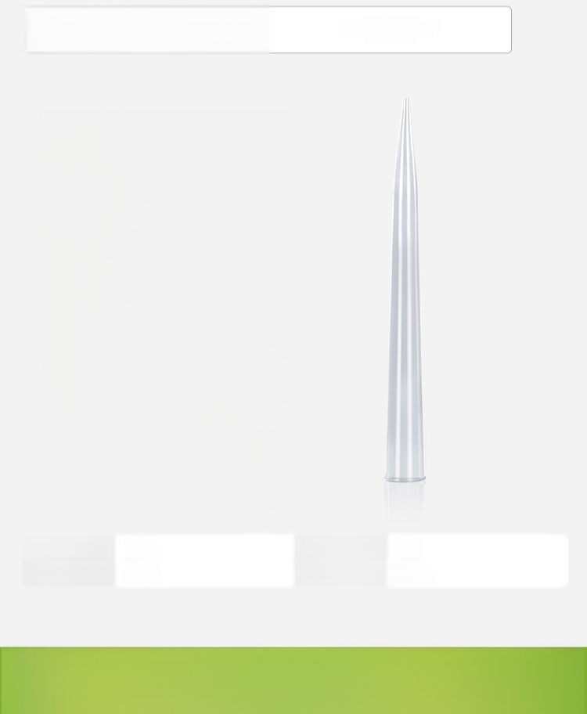
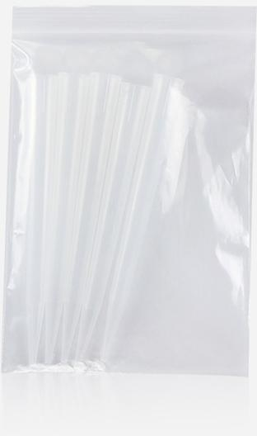

10ml
Suction Head
Length(mm): | 160 | Aperture(mm): | 15
Specifications (pieces/bag): | 100 | Packaging: | Bags
[Non-filter element|Bagged]10ml(100 pieces per pack)

Slide 13

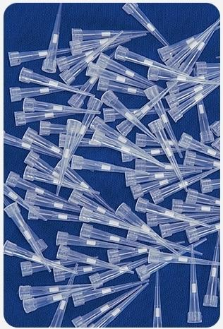


10μl | Filter element suction head
Length(mm): | 32 | Hole diameter (mm): | 5
Specification (pieces/pack): | 1000 | Packaging | Bags
【Filter element |bagged]10ul(1000 pieces/pack)

Slide 14

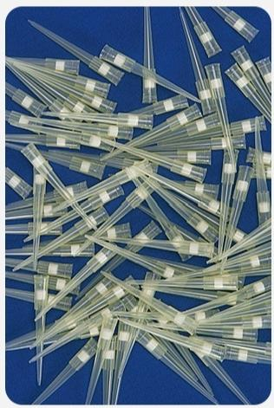


200μl
Filter Tip
Length(mm): | 50 | Aperture(mm): | 5.5
Specification (pieces/bag): | 1000 | Packaging | Bags
Filter cartridge |Bagged |200ul(1000 pieces per pack)

Slide 15
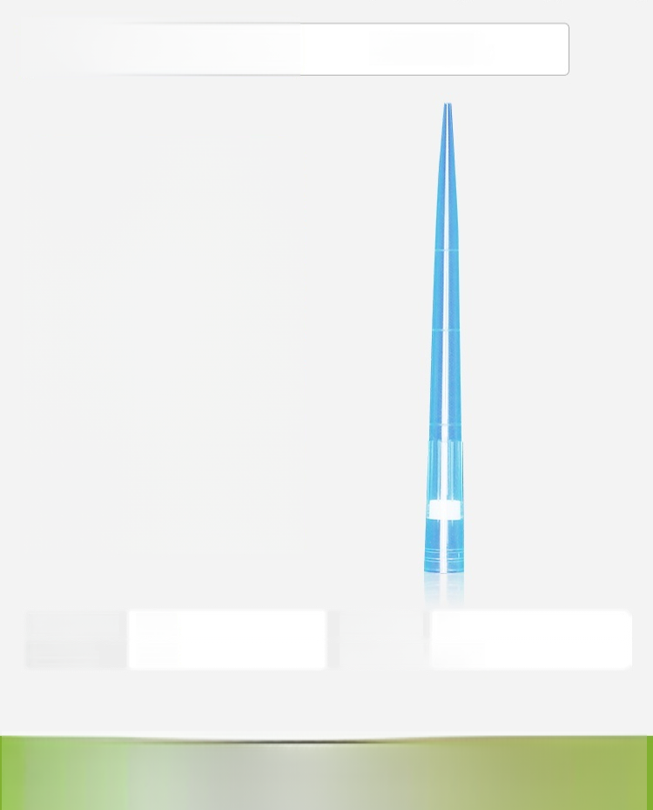
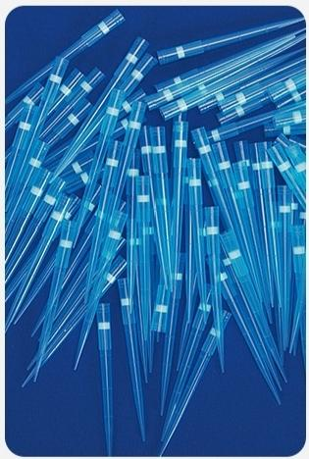

1ml extended version Filter Tip
Length(mm): | 101 | Aperture(mm): | 8
Specification (pieces/pack): | 500 | Packaging: | Bags
Filter cartridge |Extended type,bagged |1ml(500 pieces per pack)

Slide 16
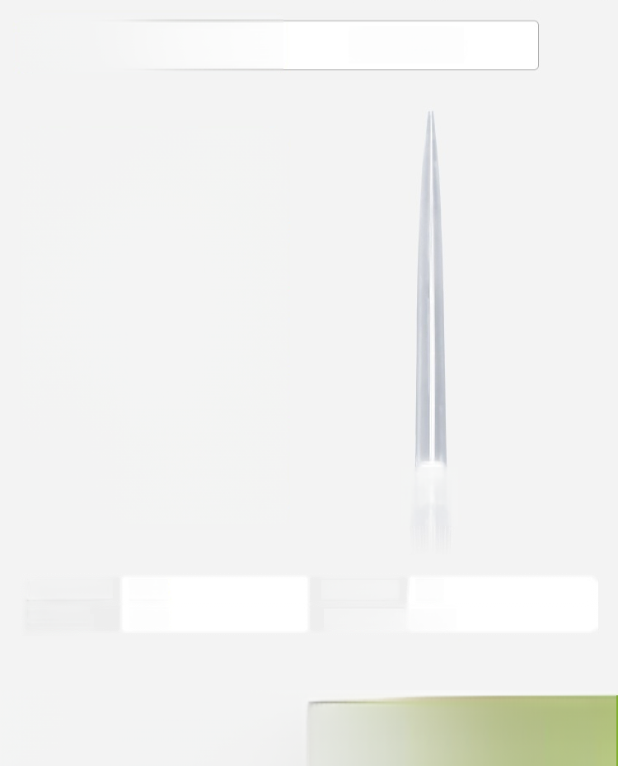
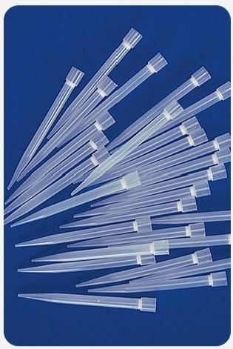


5ml Filter Tip
Length(mm): | 145 | Aperture(mm): | 13
Specification (pieces/pack): | 150 | Packaging: | Bags
Filter cartridge |Bagged|5ml(150 pieces per pack)

Slide 17
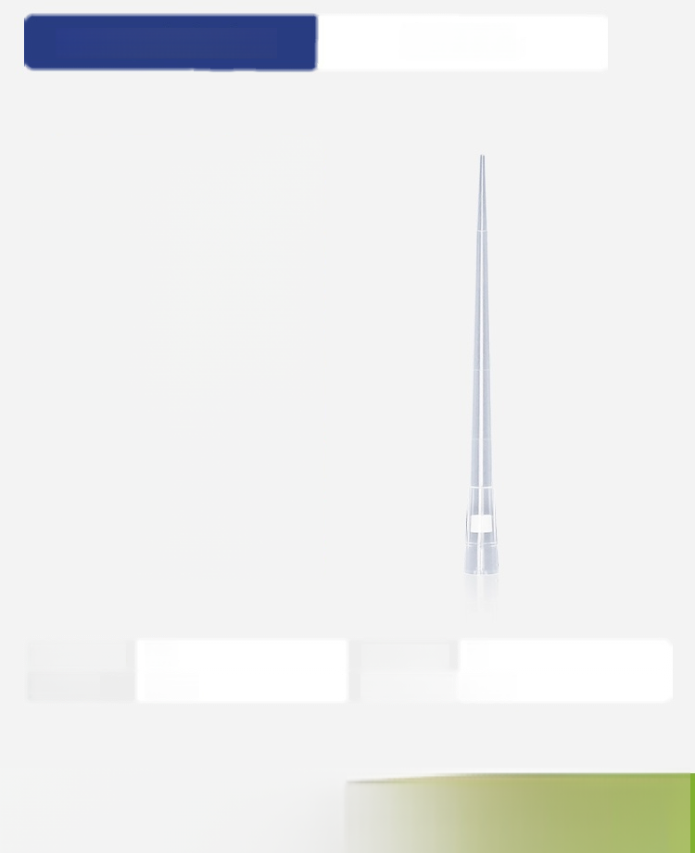
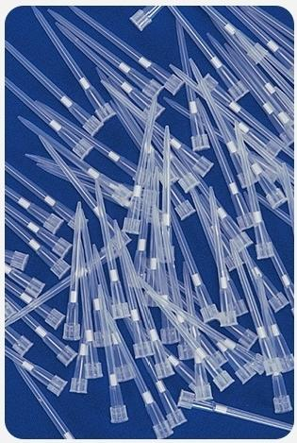

10ul Extended Version | Filter Tip
Length(MM): | 49 | Aperture(mm): | 5
Specification (pieces/bag): | 1000 | Packaging | Bags
【Filter element |Extended version,bagged]10uL(1000 pieces/pack)

Slide 18
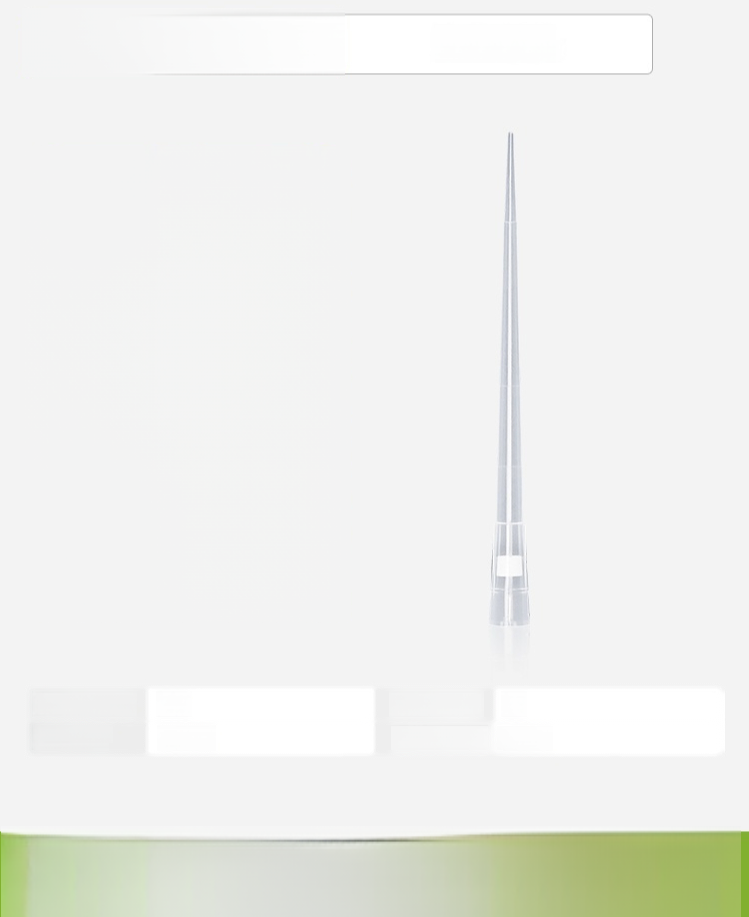
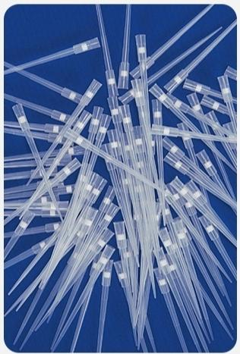

200ul Extended Version
Filter Tip
Length(mm): | 90 | Aperture(mm): | 6
Specifications (pieces/bag): | 1000 | Packaging | Bags
Filter cartridge |Extended version,bagged |200ul(1000 pieces per pack)

Slide 19
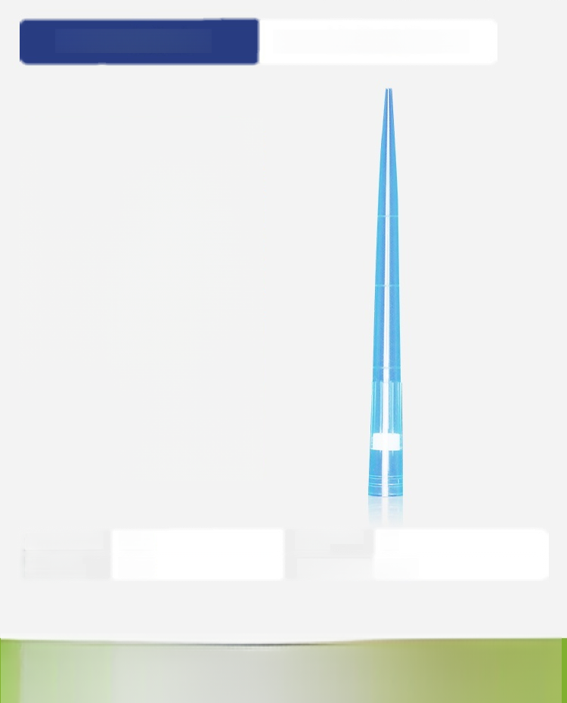
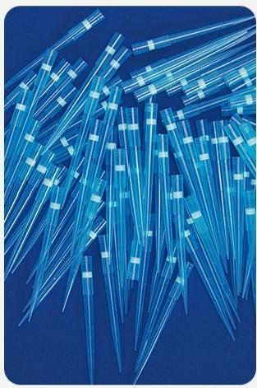

1ml extended version | Filter Cartridge Suction Head
Length(mm): | 101 | Hole Diameter (mm): | 8
Specification (pieces/pack): | 500 | Packaging: | Bags
Filter cartridge |Extended type,bagged |1ml(500 pieces per pack)

Slide 20
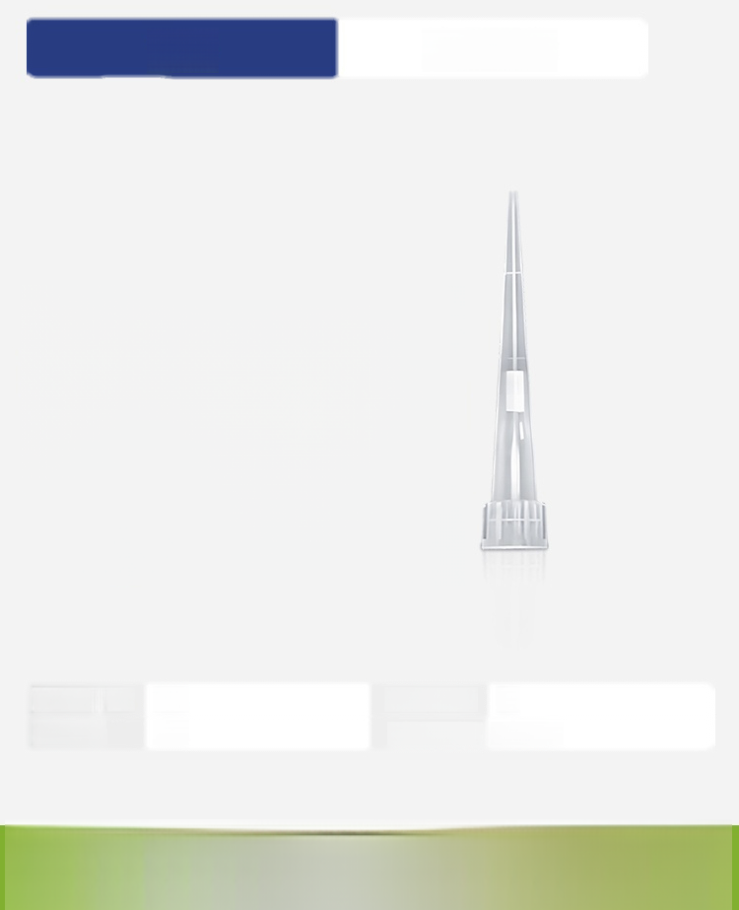
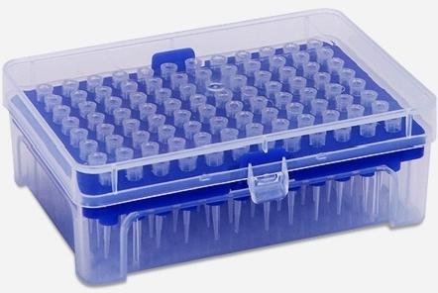
10μl | Filter Tip
Length(mm): | 32 | Aperture(mm): | 5
Specification (pieces/box): | 96 | Packaging: | Boxed set
Filter Cartridge |Boxed |10ul(96 pieces/box)

Slide 21
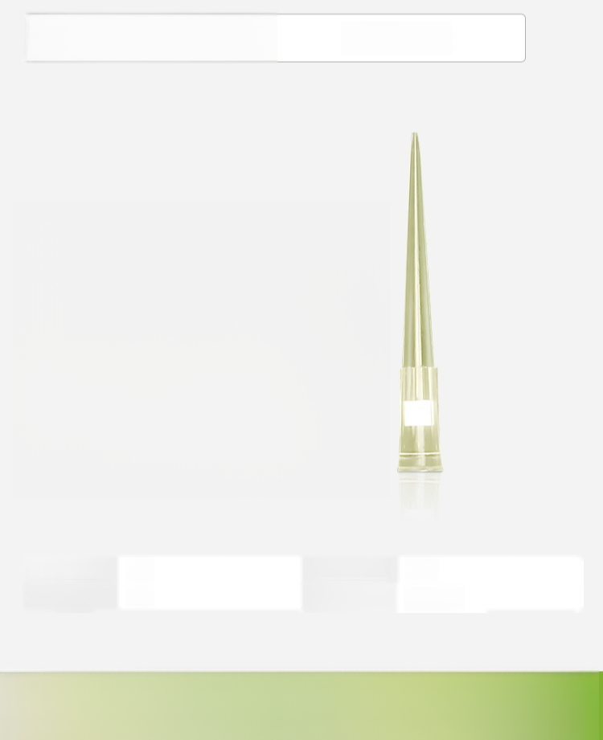
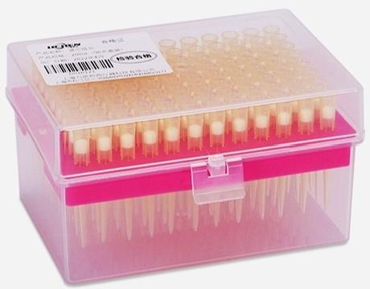

200μl Filter Tip
Length(mm): | 50 | Aperture(mm): | 5.5
Specifications (pieces/box): | 96 | Packaging: | Boxed set
Filter Cartridge |Boxed |200μL(96 pieces/box)

Slide 22
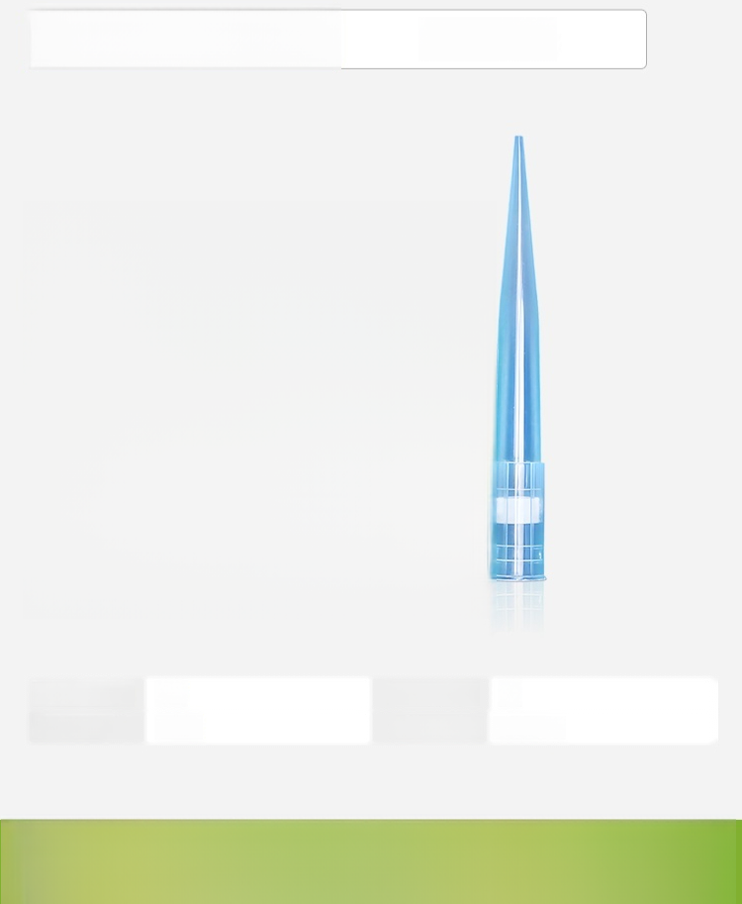
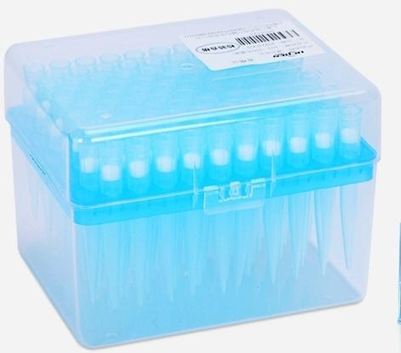

_{1ml} Filter Tip
Length(MM): | 71 | Aperture(mm): | 8
Specifications (pieces/box): | 100 | Packaging: | Boxed set
Filter Cartridge |Boxed |1ml(100 pieces/box)

Slide 23
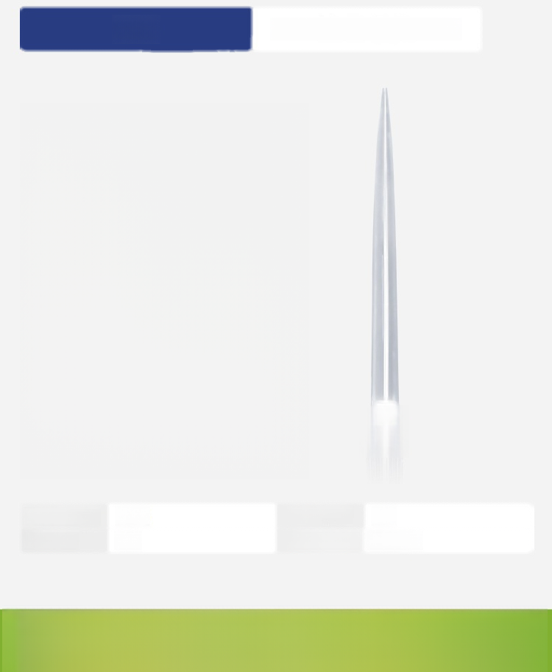
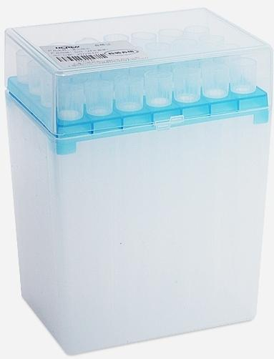


5ml | Filter Cartridge Suction Head
Length(mm): | 145 | Hole Diameter (mm): | 13
Specification (pieces/box): | 28 | Packaging: | Boxed set
【Filter Cartridge |Boxed]5ml(28 pieces/box)

Slide 24

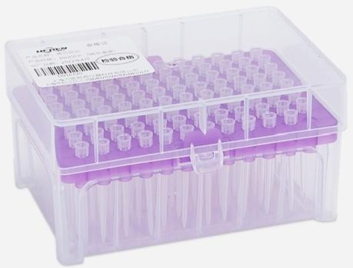

10ul Extended Version | Filter Tip
Length(mm): | 49 | Aperture(mm): | 5
Specifications (pieces/box): | 96 | Packaging: | Boxed set
【Filter |Extended version,boxed】10ul (96 pieces/box)

Slide 25
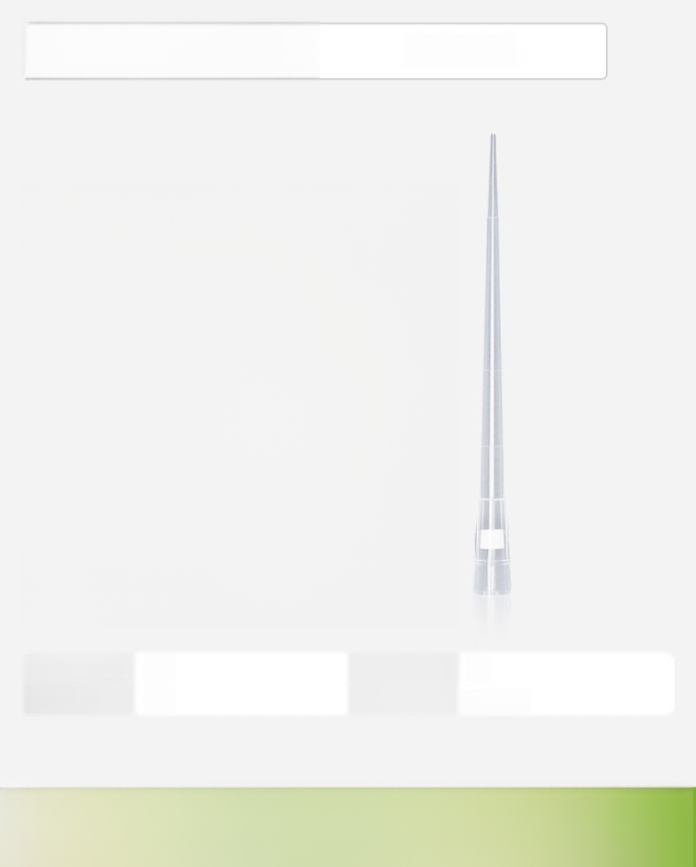
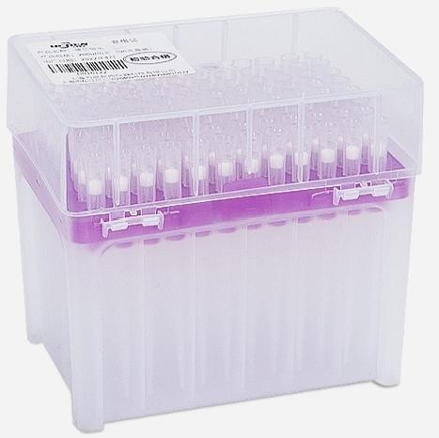

200ul Extended Version
Filter Tip
Length(mm): | 90 | Aperture(mm): | 6
Specification (pieces/box): | 96 | Packaging: | Boxed set
【Filter Element |Extended Version,Boxed]200ul(96 pieces/box)

Slide 26
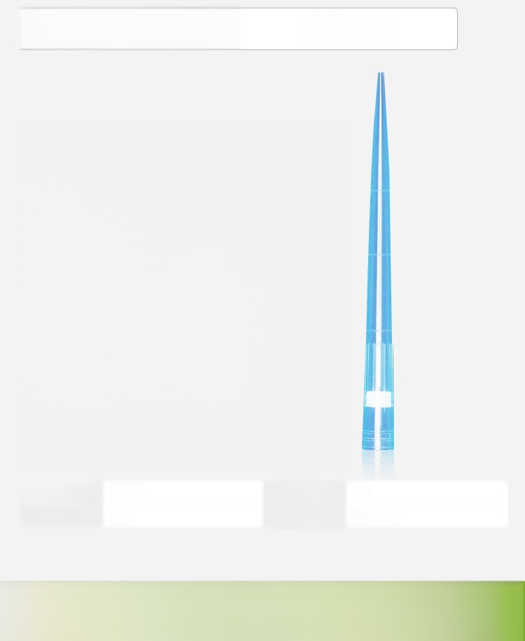
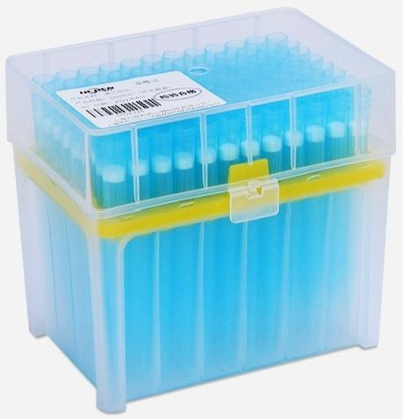

1ml extended version
Filter Tip
Length(mm): | 101 | Aperture(mm): | 8
Specifications (pieces/box): | 96 | Packaging: | Boxed set
Filter cartridge |Extended length,boxed |1ml(96 pieces/box)

Slide 27
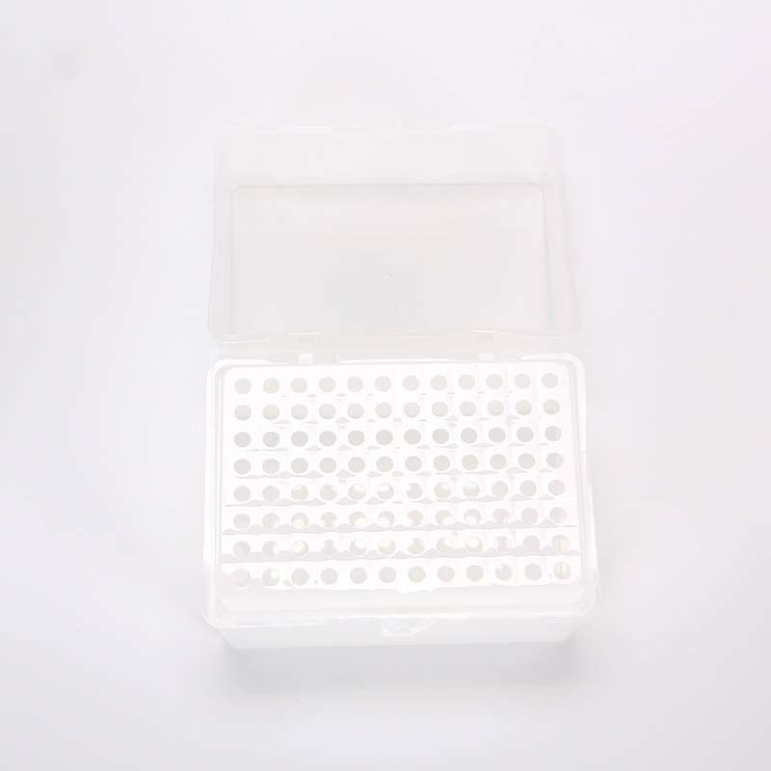
200ul

Slide 28
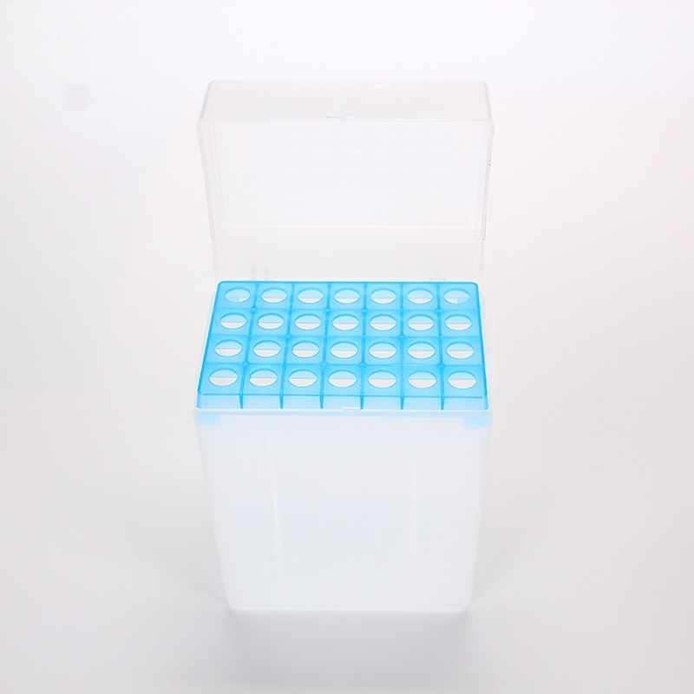
5ml

Slide 29
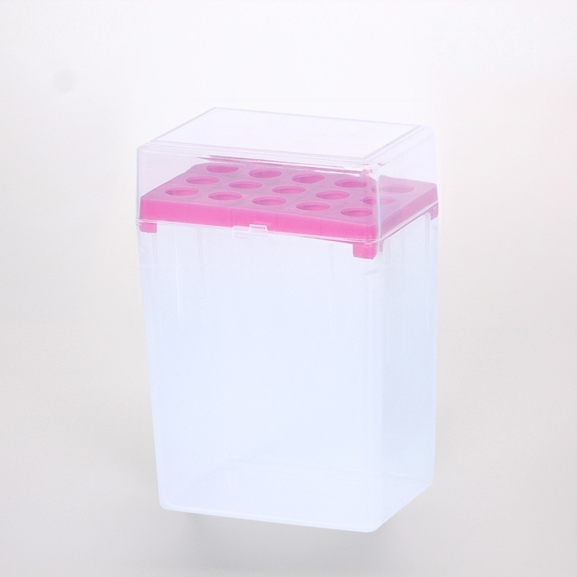
10ml

Slide 30


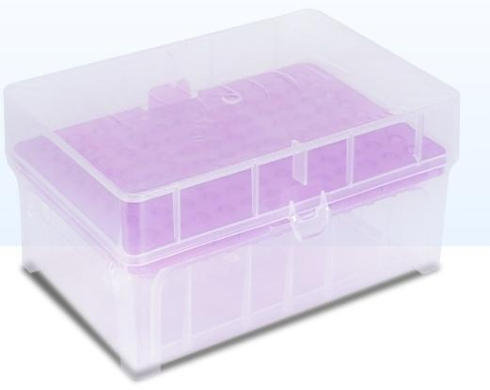
Suction Tip Box
10u Extended 96 Wells
Well Diameter(mm):5
Material:PP
Product size(mm):
125×86×66 Net Weight:0.076

Slide 31


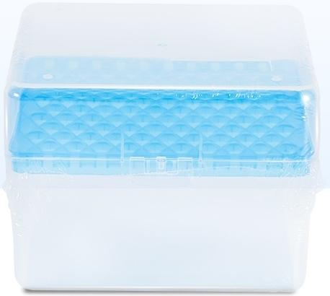
Suction Tip Box
1ml 100 holes
Hole diameter(mm):8
Material:PP
Product size(mm): 130×105×97
Net weight:0.105

